Slide 1
The Book of Genesis
Textual Study: Introduction
Notes:
Genesis is, naturally, the kick off of a new OT track of classes at EH. If this goes well you can use other upcoming OT classes to broaden your knowledge of the OT and that can be very beneficial to you. Genesis is a big book – it is 50 chapters and very dense so we’re running this class over 2 segments, so hopefully we’ve got a commitment from you to hang in with us for the next 3 months. It should be enlightening…

Slide 2
Class Schedule, (Segment 1)
Session | Topic | Reading | Date
Lesson 1 – Grant | Introduction |  | Sun, April 16
Lesson 2 – Grant | Creation | Gen 1:1-2:3 | Wed, April 19
Lesson 3 - Sam | Adam & Eve | Gen 2:4-4:26 | Sun, April 23
Lesson 4 - Sam | Adam & Eve – Descendants | Gen 2:4-4:26 | Wed, April 26
Lesson 5 - Danny | Science, History & Genesis |  | Sun, April 30
Lesson 6 – Grant | Key Figure: Adam |  | Wed, May 3
Lesson 7 – Grant | Noah | Gen 5:1–9:29 | Sun, May 7
Lesson 8 – Grant | Noah | Gen 5:1–9:29 | Wed, May 10
Lesson 9 - Sam | After the Flood | Gen 10:1-11:26 | Sun, May 14
Lesson 10 - Sam | Review |  | Wed, May 17
Lesson 11 – Grant, Danny | Aspects of Patriarchal Life |  | Sun, May 21
Lesson 12 – Sam | Abraham | Gen 11:27-25:12 | Wed, May 24
Lesson 13 - Sam | Abraham | Gen 11:27-25:12 | Sun, May28
Notes:
Note that we’re approaching this as a textual study, meaning that our focus will mainly stay on the features of the book which God inspired. For that reason it will be important that you read the book. There is lesson material, but that should only help focus your reading. I think you should have plenty of time for reading. Since we won’t have a lot of time to read the text aloud in class, having the text read means that you’ll be able to follow any discussion we have and be able to easily understand anything we talk about from up here.
Note that we’ve broken this down by section/topic rather than by date. We didn’t’ want to commit to strict sections of the text which are large and deal with the same basic characters. So for instance we’ve allowed 2 classes to cover Noah and the Flood, or 5 classes to cover Abraham. Lesson material should reflect that setup. It won’t be lesson 1,2,3, etc. The material you get will cover the entire section and can be done at your own pace.
We have interjected here a number of ‘topical’ classes. Danny Haynes will be presenting a single class at the beginning covering the issues of how Genesis relates to science and history. The point of the class is more of a textual study of Genesis, but we recognize that those are important issues and worth addressing so Danny has agreed to give us an overview of some of those evidences. We also have a class once we start the section on the patriarchs that I hope will be a historical look at the life of the patriarchs, and explain the world in which they lived. That should be really interesting and help our study through the last ¾ of the book. There are two classes that will focus on the characters of Adam and Abraham, and I think specifically will look at what the New Testament writers have to say about them. That should broaden our understanding of the significance of them for understanding who we are as Christians today. And then we have a couple of review periods in there as well.

Slide 3
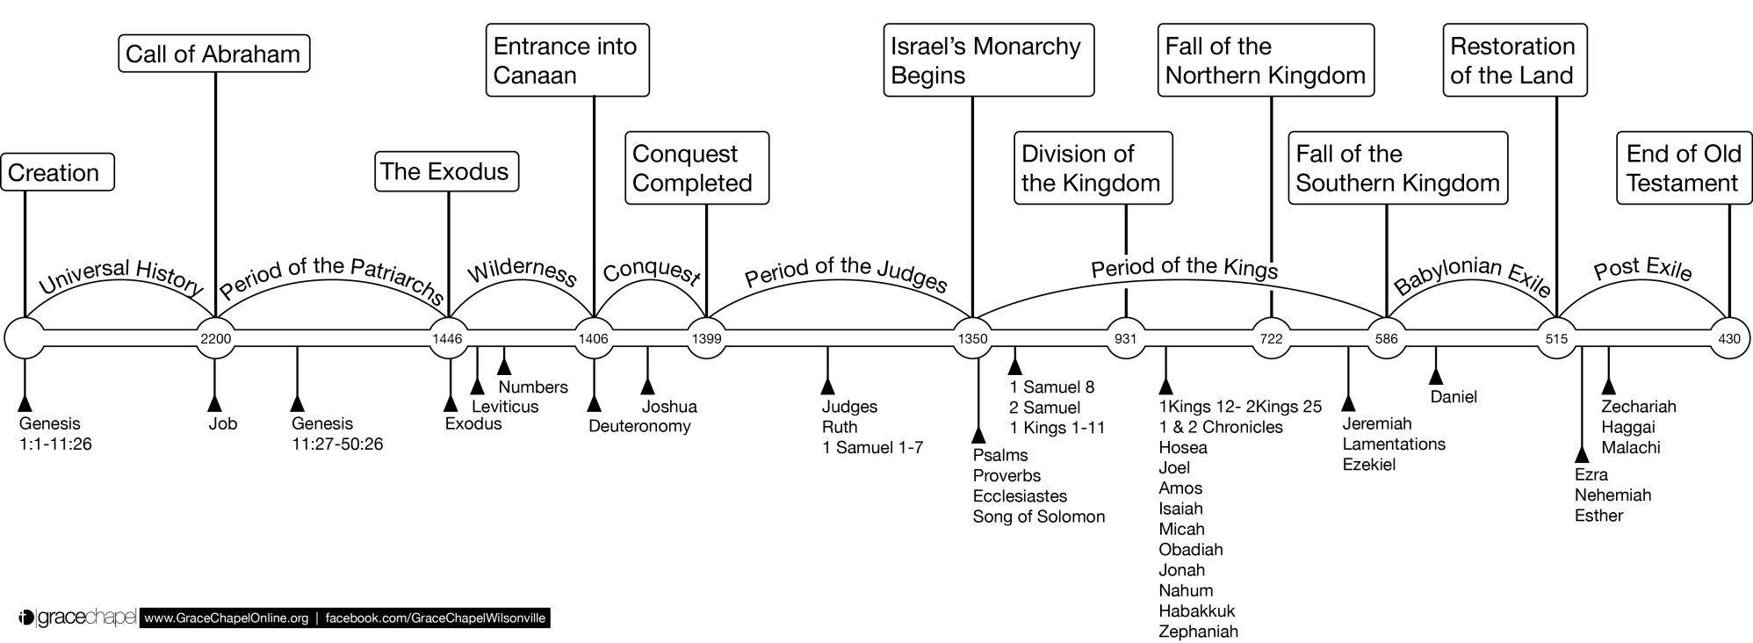
Old Testament Timeline

Slide 4
Canon & Title
First Book of the ‘Torah’ – Hebrew for ‘Law, Instruction’
(with Exodus, Leviticus, Numbers, Deuteronomy)
‘Pentateuch’ – Greek for ‘Five-Part Book’
Genesis – ‘the origin, source, or beginning of a thing’
From the Greek genesis – ‘generations’
LXX 2:4: Biblos geneseōs – ‘the book of the generations’
Hebrew – bereshit/bə·rê·šîṯ – ‘In the beginning’
The first word of the Hebrew text of the book
Notes:
The place to start talking about Genesis is at the beginning – of the bible, that is. Genesis is not just the first book of the Bible, it is also the first of the 5-book set of the OT known as the Torah, which is the Hebrew word for ‘Law’ or ‘instruction.’ These were kind of the backbone of Jewish history and divine instruction. This ‘Pentateuch, or ‘Five-Part Book’ in Greek, established the ancestral, national, social, legal and moral identity of Israel. Genesis is the first of that set.
The books title reflects some interesting things about the content of this text. In English, the book is known as Genesis, a word which generally refers to the origin, source or beginning of a thing. We have a general understanding of that meaning, but the word itself comes from Greek.
In the LXX, the Greek translations of the OT, the book uses the root word in a phrase in 2:4 – BIB-los gen-NES-say-os – ‘the book of the generations.’ That’s an important phrase through Genesis as we’ll say, and it actually the basis for the books title. That phrase refers to the fact that what we have in genesis is a record of the people and events of various generations of people. Thus the story is a retrospective of ancient ancestry.
Finally, in the original Hebrew in which the book was written, the title is ‘be-ray-SHEET,’ which it itself the very first word in the text, and means ‘In the beginning…’ Like the English title this suggests that the entire story of Genesis represents the beginning of God’s dealings in the world.

Slide 5
Purpose
Genesis is a book of origins
The Universe
Human Beings
The Ancestors of Israel
Why do we study ‘beginnings?’
“The ‘era of origins’ has a special authority – its formative events set the rules and conditions for the future by establishing the sacred”
IDENTITY
Notes:
So…Genesis is a book of origins – of the universe and humanity, but also of the ancestors of Israel – about 4/5 of the book is devoted to the lives of Abraham, Isaac and Jacob as the forefathers of God’s chosen people.
And that leads to this question, which is probably the most important that we’ll discuss this morning…[[Why study beginnings?]]
[Hendel quote} – beginnings define for us what is sacred – in this case what God has deemed to be sacred.
Origin stories provide a bedrock for meaning in our lives. They orientate us to the world and explain for us in an indispensable way how the world works. As a result, we tend to see and interpret everything we encounter through the lens of what a thing was from its beginning, and we draw our motivations from that.
- Example: superheroes thrive on origin stories.
So why is studying Genesis important? I would suggest it is largely about identity
The stories of Genesis tell us who we are. Beginnings establish a pattern upon which even today we find meaning and significance. They provide for us the terms upon which our lives matter. One of the things that we want to impress as we study this book is that these aren’t just neat moral examples and interesting history, they are explanations of how we came to be among God’s people. They are ‘our’ stories and history because they are the beginning of us.
So a relevant question to ask as we go through this class is ‘Who are we, in light of the overall story being told in this book? One of the things we’ll hope to do as we go through this book is to show the capacity of the narrative to answer that even for us today. Typically that happens by taking stock of the larger over-arching plot of the book, but some of that will be drawn out from the text itself and some of it will rely upon what the New Testament says about these figures and stories.
So, for instance – if I were to ask you ‘What is one thing you learn from the story of Adam and Eve in the Garden of Eden?,’ you would not be wrong in answering “Why snakes don’t have feet.” But of course that isn’t really the point. But I think equally not to the point of the story would be the response, ‘that people shouldn’t disobey God.’ Again, not wrong, but not to the point. The question is, what does that story tell us about us? Well, it tells us about our place as a human beings before the creator God and what the eternal punishment of humans is before the God in whose image they were made when they disobey.”
Another example, this time with an interesting twist - The (non) sacrifice of Isaac explains why animal sacrifice is preferable to human sacrifice to those Jews under the Mosaic Law – but what is tells us Christians is that God’s covenant promises to Abraham are maintained through his act of faithfulness, a trait which is central to our identity in Christ, because we Abraham’s heirs, see Galatians 3-4.

Slide 6
Content & Structure
Genesis tells the story of God and his people.
From Creation
Through ‘the Fall’
Reclaimed through the Call of Abra(ha)m
To displacement in Egypt
Conflict: Will human beings aid or thwart the purpose of God for his creation?
1-11 Early History
‘The Fall’
12-50 Patriarchal History
The Call of Abra(ha)m
The Flood
Dispersion of the Nations
Designation of Jacob as ‘Israel’
Displacement in Egypt / Joseph
Creation
Notes:
Turning back to the content of the book itself, Genesis is a large-scale/epic narrative. It tells a story – one which follows the relationship between the Creator God and his creation, most specifically with human beings, and even more specifically with the ancestors of Israel. And what is at stake in that story is the question of whether humans will aid or thrwart / help or hurt God’s purpose for creation. That is the basic conflict in this book.
The story is essentially told in two parts. The first 11 chapters (roughly) tell us about what might be called Early or Primordial history, meaning events which occur at the very beginning of the universe. The chapters contain the narratives of creation of the world, and then the widespread introduction of sin into the world, weather that be in Eden, or leading up to the flood, or in the dispersion of the nations at Babel. Then with chapter 12 you have the major turning point, not only of the book itself, but as we’ll see, of the history of God’s entire plan of salvation – the call and promises to Abraham. And the rest of the narrative of Genesis all the way through the rest of the book is focused on the history of Abraham and his children as the subject of God’s call and promises to see if/how those will be fulfilled.

Slide 7
Content & Structure
“These are the generations of…”
2:4
Heavens & Earth
5:1
6:9
Noah
10:1
11:10
Noah’s Sons
Shem
Adam
11:27
Terah
25:12
25:19
Isaac
36:1
37:2
Jacob (Israel)
Ishamel
Esau(Edom)
Notes:
Structure is important as well because it tells something about the intentions of the author, and Genesis has one of the most clearly defined structures of any book of the Bible. The various stories and episodes within Genesis are organized around 10 different ‘accounts’ or ‘generations.’ In each of the verses listed you have the phrase ‘elleh toledot’ in Hebrew, which is usually translated as “These are the generations of…” This phrase introduces a genealogy and or a narrative in the name of person referenced which progresses the story along from one phase to another.
[[Do you see anything here that interests you or surprises you?]] [[What does this tell you about the author’s intentions?]]
These formulaic introductions are frequently followed by genealogies – [[what is the purpose of recording a genealogy in a book like Genesis?]]
Note that the first 5 of these occur in the Primordial History section of 1-11, while the last 5 occur in the larger section of the book which deals with the patriarchs of Israel. (11:27, which is right at the end of chapter 11, is the ACTUAL transition point from Primordial History to Patriarchal History)

Slide 8
Composition & Authorship
Smaller stories/episodes
From different sources
Written/Oral traditions
God/Elohim LORD/YHWH
Repeated stories (creation, covenant w/ Abraham, etc.)
Edited/compiled into a single, seamless narrative
Notes:
Within the overall structure of the book, the bulk of the narrative is made up of smaller stories and episodes which exemplify the ‘main characters’ and retell the main events in their lives. But – you know – Genesis was written well after all of the events of Genesis occurred – so who wrote these down? How did this come together?
Biblical/literary scholars (even conservative) acknowledge that the narrative of Genesis shows evidence of being an edited composition of smaller narratives from multiple different sources. There are a few reasons for reading the book this way, and a couple of them are things that you might find on your own as you read:
You might catch that throughout Genesis, God is sometimes known as ‘God,’ the Hebrew El or Elohim, but sometimes he is known as ‘the LORD,’ which designates the Hebrew YHWH. And the interesting thing is that these designations go back and forth throughout the narrative with no explanation. This might indicate multiple sources of the flood story which have now been combined together to form the flood story. And I think the point on this is that author can do this because of the reverence for YHWH, the God of Israel.
EX. Gen 6:1-2 – God // 6:3-8 – LORD // 6:9-22 – God // 7:1-5 – LORD // 7:16 – God // 7:17 – LORD // 8:1 – God // 8 – 20 LORD
You also might be reading along and thought, ‘haven’t I read something about this before?’ Well perhaps yes. Genesis also occasionally includes repeated stories, or multiple accounts of the same or similar events. Again the value of this is in being able to capture multiple traditions and stories from which to draw, and still being able to incorporate them into the single story of God’s people.
EX. There appear to be two tellings of God’s covenant with Abraham, one in chapter 15 and another in chapter 17. Both accounts are rooted in the same covenant promises to Abra(ha)m, but tell different aspects of those covenant ceremonies – in 15 its about sacrificial ritual and in 17 its about the act of circumcision. Other examples include the creation stories in Genesis 1 & 2 and Jacob being renamed as Israel in 32 & 35.
So, what we think of as the ‘writing’ of Genesis probably involved translation, editing and ordering of these traditions into a single cohesive narrative/document.
Now, there are some challenges with understanding Genesis this way, and those challenges become apparent when we take this idea of how the book was composed and apply that to the question of authorship…
Who wrote Genesis? Everyone knows that Genesis, along with the rest of the Torah/Pentateuch was written by Moses. These book are after all known as the ‘The Law/Books of Moses.’

Slide 9
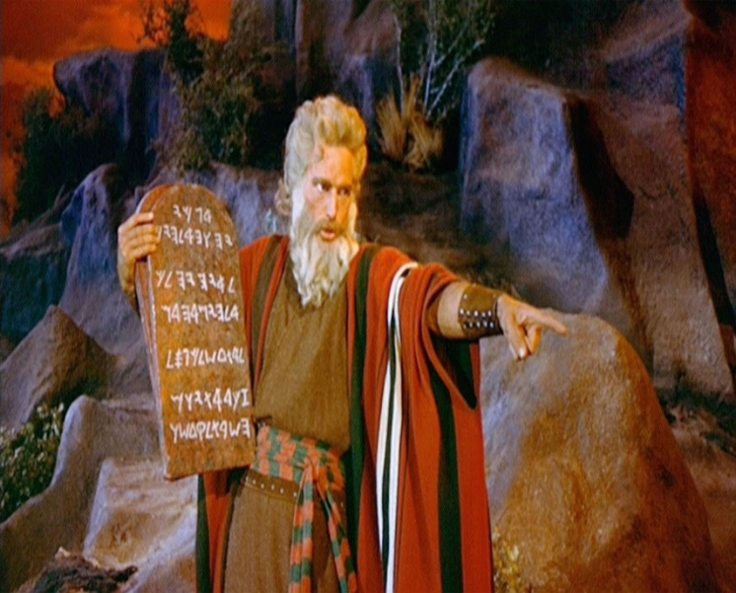
Composition & Authorship
The Pentateuch is anonymous
Numerous references throughout the OT that Moses wrote down the law of the Israelites at Sinai
Long-standing Jewish and biblical tradition held that Moses’ writing of the law extended to all books of the Torah
Upheld by Jesus and the Gospel writers
And beginning with Moses and with all the prophets, [Jesus] explained to them the things concerning Himself in all the Scriptures.“ (Lk 24:27)
Notes:
Who wrote Genesis? Everyone knows that Genesis, along with the rest of the Torah/Pentateuch was written by Moses. These book are after all known as the ‘The Law/Books of Moses.’ But we should point out as a matter of fact that those writing themselves do not have an attributed author.
However, authorship has never been in doubt within Jewish and biblical tradition. Starting with Sinai and running throughout the books of Exodus, Leviticus, Numbers and Deuteronomy, there is frequent witness to the laws and records which God Moses would write down for the Hebrew people and priests to be regulated by. Further, those references extend into the rest of the Old Testament where there are numerous references to Israelite law as the ‘the Law of Moses.’ And that association is even made explicit in non-biblical Jewish sources, like Josephus and the later Jewish Rabbis, who explicitly held that Moses has authored the five books of the Torah. (Josephus CAp 1:37-43; TB Baba Batra 14b-15a)
Jesus and the Gospel writers affirm this traditional view over and over again in the New Testament, referring to the law and the scripture as that which was written by Moses. Indeed by that time, this view was so ingrained that Jesus could say [Luke 24 citation], where for Moses he is referring metonymically to the five books of the Torah.
So again, from a biblical perspective the composer/author of Genesis is not in doubt – it is Moses.

Slide 10
Composition & Authorship
Many scholars and literary critics have suggested over the last two centuries that the method of composition suggests that Moses could not have authored the Torah
Documentary Hypothesis – JEPD
Reasons for Mosaic Authorship
Attribution from Joshua to Jesus
Moses as leader and scribe for the people
Translation from Egyptian
Thematic unity of the narrative
Notes:
However, if you read any kind of critical commentary or introduction to the Pentateuch you’ll find that for a long while now, Mosaic authorship has been denied by a number of people trying to reconcile the method of composition of the book to the notion of a single, ancient author like Moses. The most dominant position to take up this line of thinking is called the Documentary Hypothesis which posits that Genesis has no true author, but it merely the combination of four separate and distinct traditional sources which have different interests and theologies and which developed over the long history of the Jewish people until they were brought together in the Torah some time in the 400-500s BC, during and after the time of the return from Babylonian exile. Extreme versions of this theory go so far as to deny any historical basis for the stories in Genesis, suggesting that even Abraham and the other Israelite patriarchs are just fictional characters, fabricated to justify certain religious beliefs of the day.
However, there are good reasons to suggest that Moses could have been, and was, the primary contributor to the composition of the Torah and Genesis in particular: Besides the traditional attribution to Moses which we have seen went from Joshua to the New Testament, Moses certainly was qualified to write the book, as he appears to have taken on a scribal role regarding Israel’s law (some have denied that developed forms of writing even existed in Moses’ day, but those have been debunked). Translation of some of the traditions from Egyptian dialect into Hebrew would have been within Moses’ abilities having grown up in the court of Pharaoh. Perhaps most telling is the clear thematic unity in the narrative, by which we primarily mean the theology of promise, to which we’ll turn in a moment.
Two additional points to make: 1) This text does have occasional references to what seem like anachronistic peoples, such as the ‘Chaldeans,’ ‘Philistines,’ the kings of the Edomites, all of which by all accounts did not exist during the Patriarchal Age. Or there are a few references to places or events which are recognized “to this day.” These are likely later textual emendations from another writer to explain or update the geography described. These do not have any bearing on the overall question of authorship.
2) Despite the fact that JEPD was the dominant view for over 2 centuries, further research into the writing and writing styles of that day/time and a renewed appreciation for the unity of the narrative have caused that theory – at least in its formal expressions – to fall out of favor with many. So even academia is starting to lose confidence in the results of the source-critical analysis.

Slide 11
Geography
Notes:
The first 11 chapters take place almost exclusively in the area of present-day ME/Iran – known in the text as the ‘East,’ which is a reference to its geographical position vis a vis the land of Promise. This location is the home of the ancient Babylonian Empire as well.
The story of Genesis is highlighted by an important geographical move from the ‘East’ to the land which God calls Abraham to – the land of promise. Abraham is called to make the journey around the ‘Fertile Crescent’ and into the land known as Palestine. Thus the call of God was about many promises to Abraham, but those were symbolized and designated by a physical move of location. Where he goes and the nature of his travels is very important to the fabric of the story.
Further, the conclusion of the story in Genesis leaves the reader a little puzzled. The story doesn’t have a traditional happy ending where everyone lives happily ever after. The story ends with God’s people not in the land of promise, but in a third location – that of Egypt. This represents a kind of cliffhanger ending – will God’s people make it back to the land promised to their forebears?

Slide 12
Themes & Theology
God as Creator
The unifying theme of the Patriarchal History is divine promise.
Sovereign
Faithfulness
Marked by Covenant
Notes:
It should help if we talk about some of the major themes and ideas of the book. These first two really have to do with the identify of God (earlier we spoke about the capacity of Genesis to reveal things about our identity, but what Genesis really does is reveal to us who God is. And the first thing God is is the creator of the universe, including humans. This makes God the authoritative figure over all things which occur on the Earth, including the lesser gods of other tribal people.
The primary theme in Genesis is that of divine promise. The major recurring plot point, and the event which really drives the story forward, is God’s call to Abraham and his descendants through a series of promises which affect the standing of all people before God. There are three features of God’s promises which are of special significance. 1) God’s promises are sovereign – they are autonomous, based solely on God’s will and election of Abraham and his family and not based upon any previous qualifications of Abraham. The choice to call Abraham is God’s and God’s alone. 2) God’s covenant promises will be met with recurring faithfulness to all of Abraham’s descendants. This is true despite the fact that the book ends without these promises being fulfilled – in fact being far from fulfilled. The story doesn’t tell how God will be faithful, only that he will be. 3) God commemorates his promises with a covenant meant to formalize the agreement and bind both parties (God and Abraham) to each other (though we have spoken of Abraham, these ideas apply to Noah as well)
[So, God is creator, sovereign, covenant-related, and faithful]

Slide 13
Themes & Theology
God’s people as keepers of creation
Abraham and descendants as ‘tricksters’
Reversals/The Younger over the Older
Name Meanings
Ancestry
Land
Notes:
Counter to the nature and character of God, God’s people are difficult to peg in this book because they do everything so poorly, for the most part. The primary function of human beings in Genesis, from Adam forwards is a keeper’s of God’s creation. We’ll talk about this more on Wednesday in relation to the idea of being in God’s image.
One other thing that I see over and over again in Genesis is that God’s people – especially Abraham and his descendants – are ‘tricksters.’ That’s a term I pulled from a commentary I read. But while some times that implies a level of deceit that we might see as negative or even sinful, some times this activity turns out positively for those people and even advances God’s overall purposes. For example, the story of how Abraham escapes from Pharaoh by lying about Sarah, how Jacob deceives Isaac to receive the blessing, or how Jacob’s sons defend the honor of their sister Dinah.
This is going to be a challenge as we read through this book in places, because there are times that God’s people behave in ways that we find objectionable, and we will want to say “That’s wrong – they shouldn’t have done that” – and we wouldn’t be wrong to do so…but we should also note that in those cases, there is little in the text which explicitly calls those actions out as sinful. And really, those actions are presented positively.
Now, I want to be clear – that is not to say that Genesis is endorsing sin, or even a principal that ‘the ends justify the means.’ I think the lesson in those cases is to underscore the character of God already noted – especially that God’s call is sovereign, and that he is faithful to his covenant promises. “The individual lives of the promise bearers cannot abort those promises. God will be no means scrap his chosen family, their moral inadequacies notwithstanding.”
Regardless, it is not the primary purpose of the writing of Genesis to present its characters as moral exemplars, whether positively or negatively.
And another note on this – the New Testament reflection on the Patriarchs (e.g. Acts 7, Romans 9, Hebrews 11) is entirely positive, suggesting that the examples these figures set are not defined by our judgement of character. Nevertheless, you can see this kind of behavior repeatedly in the story.
Four other features of the book are of great importance: 1) There are frequent reversals in this book, especially as it relates to the younger succeeding over the older – the most prominent example of which is Jacob’s receipt of the divine blessing over Esau. 2) People and place names frequently have some kind of meaning attached to them which explains their origin or importance. This suggests that names are themselves somewhat sacred. 3) The repeated genealogies in the book indicate a strong sense of the importance of family lineage and ancestry. This is heightened by the promises of God through a particular familial line. 4) The possession and maintenance of land is a primary indicator of God’s blessing. From creation where God is given dominion over the earth, to the prominence of the land promised to Abraham by God, the Earth itself is a symbol of mans’ status before God. Victor Hamilton has noted that chapters 1-11 (which are about the rise of sin) are about people who have land, but are losing it, whereas 12-50 (which about salvation) is about people who don’t have land but on their way toward it.

