Slide 1
The Book of Genesis
Text: 1:1-2:3

Slide 2
Overview of Chapters 1-11
Establishes the theme that God (Elohim) and his creation are bound together is a distinct way.
Characterized by God’s gracious act of creation and human’s rebellion and degradation
Consists of Three Parts
Creation Account/Hymn: 1:1-2:3
Adam Cycle (Creation): 2:4-5:32
Noah Cycle (Recreation): 6-11
1-11 Early History
‘The Fall’
The Flood
Dispersion of the Nations
Creation
ADAM
NOAH
Notes:
Before we jump directly into the text of chapter 1, I want to quickly give us some overview of what to expect in the first 11 chapters. The first thing to note, and we’ll emphasize this both now and later, is that these 11 chapters set the table for not only the story of the patriarchs, but really the entire biblical story of God’s acts of salvation by establishing two things: 1) That God and creation are bound together in a special and distinct way. That is, they have an intimate relationship with one another, (this is a theme that will become apparent in tonight’s class) but 2) That God’s act of grace in creating the world is met by rebellion and degradation from the creature, specifically, humanity.
These themes are explicated across two major storyline cycles. The first is that of Adam, who is the subject of God’s initial creation, is given the right of God to rule over the Earth, but through whom sin enters the world which causes a spiral of evil events which force God to effectively hit the reset button on creation through the character of Noah. Much the same, Noah is the inheritor of God’s now re-created world, and yet through his sin, the world continues to devolve into beings who do not honor God as God, causing humans to fail in their intended role as the keepers of creation. Both cycles include genealogies which progress the stories from one age to the next. Think of the genealogies in these chapters as ‘bridges’ which connect one set of stories to another.
So, the first 11 chapters really consist of three parts – the Adam cycle starts with his creation in ch. 2, Noah and ‘recreation’ starts in ch. 5. But our subject today is the first part, and that is chapter 1 through 2:3, which stands as an opening, stand-alone account of God’s creation of the universe. The language of this account is so high and so honorific of God that many have recognized here the potential for use as formal praise to God – thus this is sometimes referred to as a Creation Hymn.

Slide 3
The Creator & His Creation
Premise:
“In the beginning, God created the heavens and the earth…”
“…God saw everything that he had made, and indeed, it was very good.”
Method:
“Then God said, ‘Let there be light’; And there was light.”
Atheism
Pantheism
GOD
WORLD
Polytheism
Deism
Dualism
Notes:
Genesis chapter 1 is perhaps as rich of biblical text as we have. There are few other sections of scripture which are more insightful, descriptive, beautiful, and inspiring as this one. There is so much here in which we can and should find meaning and significance, but as much as anything, and as much as any other scripture, Genesis 1 tells us about who God is. So what I want to make sure we don’t miss in this chapter is a foundation for understanding God himself. This takes us into the realm of theology, but if there was ever a place from which to do theology its Genesis 1.
I will say that although there is going to be some technical terminology on the screen here, that the point is not so much that we know the terms as that we know the concepts that stand behind them. Far from being something high and heady and speculative, speech about God himself is actually something that is ingrained to us and a fundamental part of everything we do as people of faith, if we would just take the time to recognize it. It is not ‘high in heaven’ or ‘across the sea’ that we need someone to go get it for us – it is near to us, in our mouths and in our hearts for us to observe.
[[So as you read through the text, what are some of the characteristics of God that you see?]] [Question 1 on the WS]
There are clear inferences we could make about God here – God exists, he is ‘pre-existant’/eternal, he exists as a person, maybe even in multiple consubstantial hypostases…? – and those are fine as far as they go. But what those attempt to describe is the internal being of God, whereas what the account of Genesis 1 is about is what God did.
And what God did was create. There may be no more important statements about God in all of the Bible than “In the beginning, God created the heavens and the earth,” & “God saw everything that he had made, and indeed, it was very good.”
What these two statements together say is that God and God’s creation are bound together in an intimate and distinct way. 1) First, that the meaning and purpose of creation is defined by God – and God alone! – but God is not defined by his creation. God is eternal, the creation is not. The world depends upon God, but God does not depend upon the world. He is under no compulsion to create, but he does so. That means that the act of creation itself is matter of God’s gracious choice to cause something other than himself to exist. 2) Second that his creation is valued positively – God calls it ‘good.’ It is something that is worthy of God’s attention and action because God deems it so. Now, what we might recognize here is that this is the idea upon which all of our faith is built. Think about that – by pronouncing his creation good, it means that God has invested himself in its welfare, he will seek to maintain it, or even provide salvation if needed. One theologian states that God’s relationship for creation is “the presupposition for everything that follows in the Bible. It is the deepest premise from which Good News is possible.” And as the premise of God’s Good News, this is not a claim which can be fully explained or analyzed. This claim is not open to scientific inquiry because it is a value judgment made by the divine. This is simply a statement which we believe, affirm and confess.
Just as telling as God’s act of creation is the method that he uses. The chapter uses the verb to create 3 times and to make 5 times, but those actions are done through speech 14 times. This is a sign of power and authority, wherein God states what the creation will be, and the creation in effect ‘obeys’ that command. Thus, creation appears as what God originally calls it to be. Among a couple of the things I read in preparation were a comparison of this creation account to various other creation accounts you might find in other ancient cultures. And one of the predominant themes you find in some of these other accounts is that, in one way or another, the world is created out of the being or the body of a divinity. So for instance, in another ANE creation story from Babylon, the Heaven and Earth are created by their god out of the divided body of a conquered deity, or in another story, the world comes about because the god vomits it into existence. Now besides, these being obviously mythological and false, the difference here is that in Genesis 1, light, the expanse of the sky, the dry land, etc are created solely by God’s word. They don’t come from out of God – rather they are entities which are, as Romans 4 puts it, “Called into Being.”
Here is what all of this means in particular – that affirming and confessing that God is, and that he is a rewarder of those who seek him, there are certain things which we would deny.
We would obviously deny that God does not exist,
but we would also deny that God is just one among many other Gods – it is God and God alone who creates.
Similarly, we would deny the pre-existence of some competing evil force or being to counter God’s goodness.
Given what we noted about God’s method of creation through speech, we would deny that God and the world are essentially the same – that God is everything and everything is God. Such a conception of the world is called Pantheism.
Given what we noted about God’s pronouncement upon creation as ‘good,’ we would also deny that God just turns the creation loose, abandoning it to its own fate, because it is an accident, or carelessly made.

Slide 4
The Creator & His Creation
Premise:
“In the beginning, God created the heavens and the earth…”
“…God saw everything that he had made, and indeed, it was very good.”
Method:
“Then God said, ‘Let there be light’; And there was light.”
Atheism
Pantheism
GOD
WORLD
Polytheism
Deism
Dualism
Monotheism
Notes:
Rather what you have is an important relationship wherein God and the creation maintain their distinctiveness from one another, but also their closeness to one another. Such a relationship allows God to maintain his ever-present authority over his creation, AND permits the creation the freedom to respond to the will of God. This is Creational Monotheism, a theology which values both God’s role in creation and his pronounced judgment that his creation is indeed good.
This is important because most, if not all religious worldviews deal in one or another of these categories, and it is important to see the distinctions between the Judeo-Christian conception of God as opposed to the others. Even in the account of God’s making of the world, who God is becomes known.

Slide 5
1:1-2
‘In the beginning, God created the heavens and the earth…’
‘Formless and void’
‘Darkness over the face of the deep’
‘The Spirit of God hovered over the waters’
SOMETHING FROM NOTHING
ORDER FROM CHAOS
Notes:
Two ways of understanding ‘created the heavens and the earth.’ Either an initial act of creation OR a summary statement for all of ch. 1
Gap Theory – H&E are created, then a gap where the creation becomes F&V, and then god (re)creates out of that
Day/Age Theory – non-literal 24-hour days allow for time for creation
Understanding of tohu wabohu – formless wasteland, without substance >> chaos (Is 45:18-19), unformed, unfilled
Understanding of darkness over the face of the deep – primordial waters/sea from which God created the world (2 Peter 3:5-6)
Understanding of the spirit/wind/breath of God hovering over the waters – an active wind? A restrictive/confrontational act? An act of formation? (Deut. 32)
The purpose of this verse is not for us to speculates about times and processes – what the world was or wasn’t. The point is to set up the idea that from out of this primordial state, God brings about abundant life upon a good Earth. From nothingness he brings something, and from chaos he brings order. I think that as the account carries on, we see other hints that the value of creation lies in this principle of order and symmetry and structure.

Slide 6
1:3-25
Day 1
Light
Day 2
Expanse
Day 3
Earth
Vegetation
Day 4
Luminaries
Day 5
Fish/Birds
Day 6
Animals
Humans
Notes:
One of those hints is in the sequence in which God creates.
Genesis describes 8 separate acts of creation over 6 days with Days 3 & 6 containing two distinct creative actions on each day
Days 1-3 are foundations, creating fundamental aspects of the earthly environment
Days 4-6 are the counterparts to days 1-3 in populating and governing that creation

Slide 7
1:3-25
The symmetrical structure of each creative act
“God said, ‘Let there be…’”
“And it was so.”
“God saw that it was good.”
“And there was evening and morning.”
How is God’s creation ‘Good’?
In the progression of creative actions, we continue to see God create by bringing order and form to the world.
Notes:
Notice that the language of the text itself actually suggests the level of structure to God’s creative activity. Most of these 8 activities contain repeated statements and phrases which suggest that there is a structure inherent within the creation.
This suggests that there is value in the symmetry of God’s method, but also in the results. This is one of those hints which suggest that one of the things we appreciate about creation is its order – not only in its aesthetic, but in its repeated functions. For example, one of the best things in the world is that the sun always comes up in the east and always goes down in the west – there is repetition and predictability in that which reflect the method of God’s activity, and which in turn are described with these structured refrains.
Perhaps that gives us new insight into this question of how the creation is ‘Good.’ How would you say, whether from this text, or from your own experience, that this world was made as ‘good?’ I think the aesthetic is in view, but at least as important as that is the fact that the world is one in which human beings can easily and rightfully exist and rule.

Slide 8
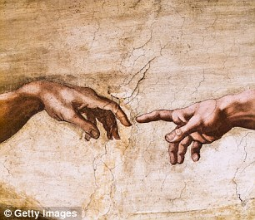
1:26-31
The entire narrative leads up to the creation of mankind, and celebrates them as the honored climax of God’s creation.
Created in God’s image
God speaks directly to humans
Given dominion over the Earth
Who is ‘Us’?
Other gods?
Angelic Host?
Earth?
“God created humankind in his image”
What does this mean?
Elohim?
Himself?
Trinity?
Notes:
On the sixth day the creation account culminates in the creation of human beings in verse 26. Humans are said to be made in God’s image. Of all creatures, God speaks to them and gives them rule and dominion over the earth and all that is in it.
But before we get into what it means to be made in God’s image, one thing that can easily throw us is the reference to ‘Us’ & ‘Our’ in v. 26. What does this mean that God would speak in a plural? Here are some options proposed by interpreters over the years – other gods / the angelic host/ the earth itself / the Hebrew term for God Elohim is actually in a plural form, so some have suggested the God is referring to this fact here (though this isn’t entirely accurate – this isn’t a good option) / a way of referring to Himself / later Christian interpreters have seen here a reference to the three-person Godhead, a reference to the Son and the Spirit. I don’t’ know which of these options is correct, and I don’t think anyone else does really. Whatever you prefer, there is no explicit reference in the text. I will say, that from the perspective of later Christian understanding of the Son being the one through whom creation occurred does, the text certainly does allow for the trinitarian interpretation.
So what does it mean that God created man in his image?
conscience? - a soul? - original righteousness? - capacity for reason? - capacity for fellowship with God? - emotion/love?
I think one thing that is overlooked is the surrounding context about the dominion given to humans…

Slide 9
1:26-31
Man is given rule over the earth
“Be fruitful and multiply and fill the earth”
“Have dominion over [all living creatures]”
Representatives of God upon the Earth
Freedom and Authority
To consume, but not to exploit
Humanity is ordained as male and female
Sexuality is inherent in the creature, and is therefore good
Sexual function allows for the blessing of procreation
Sexual function is part of the creation, but not the creator
Notes:
…I think at least a part of what it means to be made in God’s image is to have dominion over the earth. Notice how that is the instruction to man in the context of the statement about being in God’s image. Man is told to Be fruitful and multiply to fill the earth, and to have dominion over the creatures of the world which God created. What this means is that God is effectively appointing human beings in his role as the ruler of the world. This means that humans have a level of freedom and authority in the world, just as God does as the creator. He has bestowed upon human beings his image which carries along with it his authority. And finally, God gives human beings the right to ‘subdue’ the earth – that is to consume it (every plant is free for food) but not to exploit it (that becomes clear later when the sin of humanity results in the corruption of the earth).
One thing to note that I think DOESN’T belong to the category of made in his image is the differentiation in sex within the species. God ordains mankind to be male and female. This means that sexuality is inherent and is good. Specifically, it facilitates the blessing of procreation which God had instructed for humanity. But we should be clear that while humans are two – God remains as One, neither male nor female.

Slide 10
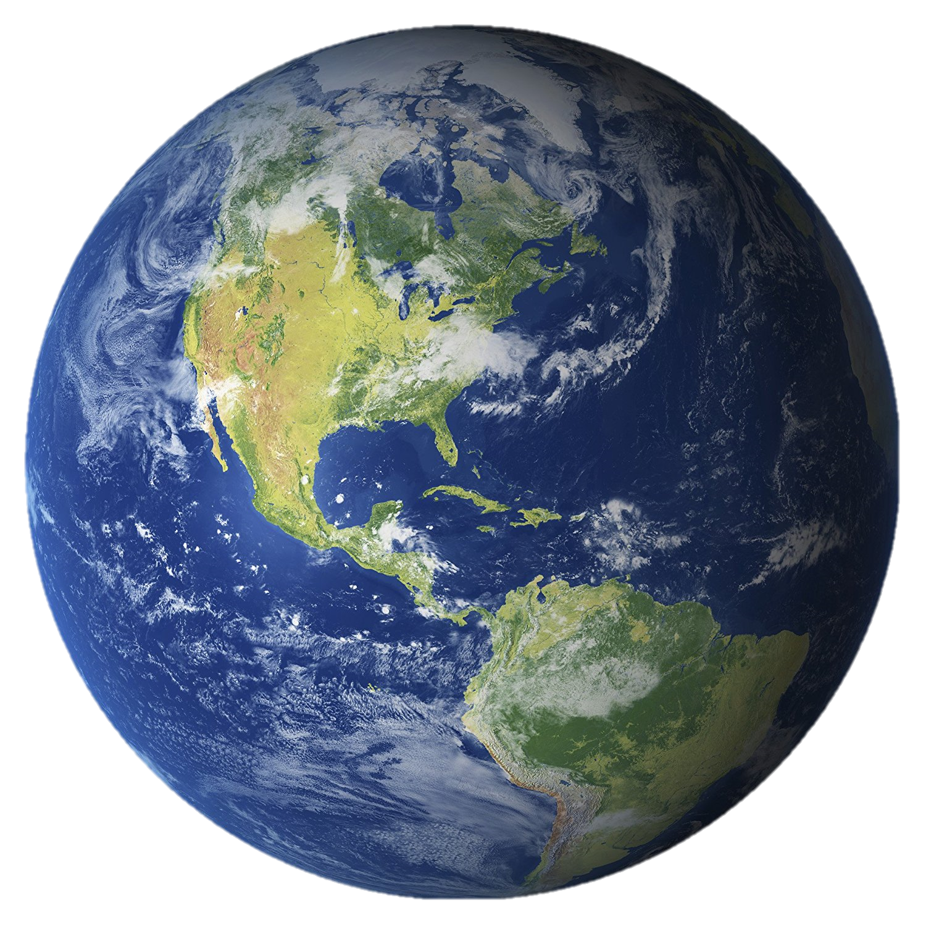
2:1-3
The creation account in chapter 1 carries over into the beginning of chapter 2.
³¹The completion of the work on the sixth day was ‘very good.’ ^{2:1}Thus, the heavens and the earth were finished...
God’s rest is not because of exhaustion, but because of peace and contentment with his work
The Sabbath is hallowed – the first sacred thing
Notes:
-Its important to realize that the account of chapter 1 carries over into chapter 2, and that the final three verses are the conclusion to the start of the creation in 1:1-2.
-God’s rest is because of the peace and contentment from the ‘goodness’ of what he had made.
-The Sabbath is the first thing that God hallows in creation – it commemorates God’s rest, and will later serve as a sign of the covenant with Israel.

