Slide 1
The Book of Genesis
Sin & The Flood
Notes:
With tonight’s class we return back to the text of Genesis after about a 1 week detour. With tonight’s class, and the class on Wednesday, we’re going to be taking a look primarily at the story of Noah and the great flood – but part of what I want to suggest as we go through these chapters is that Noah and the flood itself are actually incidental to the larger story which is being told here – which is about the sin of mankind and determinations that God makes in light of that and in response to it. Once again, these stories will tell us about who we are only inasmuch as they tell us about who God is.

Slide 2
Overview of Chapters 1-11
Establishes the theme that God (Elohim) and his creation are bound together is a distinct way.
Characterized by God’s gracious act of creation and human’s rebellion and degradation
Consists of Three Parts
Creation Account/Hymn: 1:1-2:3
Adam Cycle (Creation): 2:4-5:32
Noah Cycle (Recreation): 6-11
1-11 Early History
‘The Fall’
The Flood
Dispersion of the Nations
Creation
ADAM
NOAH
Notes:
To understand the story of the flood you have to understand the context into which it arises. I want to start by putting this slide up again which I used a couple of weeks ago which shows us the overview of the first 11 chapters of Genesis and the two major story cycles within that section. As we said, both of these sections have two distinct themes or lessons: 1) That God and creation are connected to each other and 2) that God’s act of creation is met by human rebellion. We’ve seen that already through the creation and fall, and through Cain’s murder of Abel.
What I want to do in the first part of this class is walk through the end of chapter 4 and genealogy of Cain through chapter 6 and run up to the flood and note the ways in which this rebellion plays itself out. So that starts at the end of chapter 4.

Slide 3
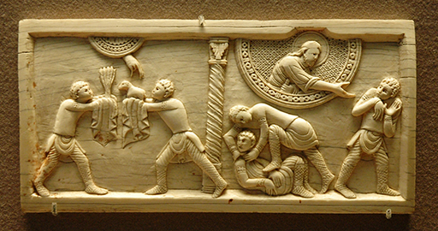
The Lines of Cain and Seth
The Line of Cain
The beginnings of civilization (cities, culture, technology, etc.)
Lamech’s pride
The Line of Seth
Devotion to YHWH
Enoch taken by God
‘Relief’ from Noah
Notes:
We think of Cain as being paired with Abel because of the story of his murder in chapter 4, but actually Genesis places a larger emphasis on the pair of Cain and Seth, specifically about their two divergent lines of descendants. You can see that since at the conclusion of the Cain genealogy in ch. 4, it is followed by a statement about the birth of Seth. That isn’t just a historical detail, it’s a statement which then sets up the ‘book of the generations’ of chapter 5 which is Adam’s line through Seth.
[[What do you notice about the things that Cain’s descendants are involved in?]]1) If you read through this, you find Cain’s people are no longer workers of the ground as Adam and Cain had been, but are involved in more things which in a way designate the rise of civilization in the world – you have people building cities, making music, forging metals, etc. So you have this rise of urbanization, technology, etc. all of which are in their own way the creation of man apart from that which God originally designated them. I would not want to press this point too far, but it does seem to me that this line represents the idea of human venture and ingenuity. Here, humanity is creating without reference to God. 2) The genealogy is highlighted by the figure of Lamech. For one, Lamech is polygamous, having two wives – although the text doesn’t explicitly condemn that here, but more important is the speech or song he gives in v. 23-24. [[How do you read the speech of Lamech?]], the basic idea behind this is a kind of prideful taunt – that Lamech in his sin has become greater than Cain! Lamech claims to have killed a man, and possibly a young man or boy as well (the reference to young man may be an expansion on the man in the first line, or could be a separate ‘victim’), and as a result proclaims that retribution for his act is even more dangerous than that promised to Cain. Lamech has essentially twisted the grace of God to protect Cain into a justification to kill! And inasmuch as this is the final word in the genealogy, it seems pretty clear that this statement becomes in effect the ‘legacy’ of the line of Cain.
The introduction of Seth in v. 25 is interesting for a couple of reasons. 1) He is clearly meant to replace Abel – Eve says as much in her naming of him – thus setting him up as an opposite to Cain. 2) That difference is highlighted by the final statement in the chapter “At that time people began to call upon the name of the LORD.” This is a fascinating statement. For one, this doesn’t mean that this was the first time people began to recognize God in general. What is means is that people began to recognize the creator God Elohim by a personal name, being YHWH. Now this is somewhat confusion because in Exodus when God introduces himself to Moses in the burning bush as ‘I AM who I AM,’ there is an indication there that this name YHWH is only then being revealed, but this indicates that YHWH was always known. I don’t think there is too much of an issue with that here. Moses may be ascribing the terms back onto the primitive humans, or the revelation to Moses may be the recovery of a lost name of God. In any case, what is being claimed here is that Seth’s descendants begin to confess YHWH as Elohim. I think this draws a good contrast between the descendants of Cain, whose focus again seems to be cultural and technological – for Seth’s descendants the focus is theological and religious – an understanding and devotion to God.
This is further manifested by the descendants of Seth who include people of very, very long ages and many children – again these aren’t likely just interesting facts, they are likely indicative of an extended life and fertility due to their righteousness before God. (I had not thought of this, but it was pointed out to me that by doing the math on the ages here, Noah would have been the first one born after the death of Adam, and that Methuselah and others of this line would have died in the flood.) The oldest man in the Bible, Methuselah lives to be nearly 1,000 years old. His father is the famous and mysterious Enoch, who ‘walked with God’ and thus was taken by God rather than experience death (that comment there is so mysterious and open-ended…later Jewish writers had a field day with Enoch as an apocalyptic/prophetic figure in tune with angels and other gods and such…). And of course the line of Seth leads us up to Noah.
The statement the father Lamech (not Cain’s Lamech, this is apparently a different person w/ the same name) makes in naming his son Noah is interesting. [[How do you suppose that Noah brings ‘relief’?]] It isn’t clear exactly clear now Noah will bring ‘relief’ from work and pain. If anything, that ‘relief’ comes in the form of death and destruction. Further it is not clear how that ‘relief’ comes out of the ground which the LORD cursed. Perhaps this is a reference to the waters of deep breaking forth at the start of the flood. It may be that this statement is prophetic in its capacity to speak of the salvation offered to men through the work in which Noah participates.

Slide 4
6:1-4 and the ‘Sons of God’
Notes:
[[What in the world is going on here?]]

Slide 5
6:1-4 and the ‘Sons of God’
‘Sons of God’
Angels?
Great Earthly Rulers?
‘Nephilim’
Lit. ‘Fallen Ones’
Giants? (Numbers 13:33)
The sin of ‘intermarriage’
God’s provision:
He will remove his Spirit
Life is restricted to 120 years
Introduction to the flood story
Notes:
One of the others passages which tries to speak to the further fallen state of the world is 6:1-4. This passage here ranks at or near the top of the list of the most strange, mysterious and frankly, uninterpretable passages in scripture. I had you write down your questions about this passage. I included just as a kind of exercise to help us formulate things we don’t really understand. [[What questions did you have about this section?]] I think there are four main questions here:
Who are the ‘Sons of God?’
Who are the ‘Nephilim’ and how are they related to the ‘sons of God?’
Why does verse 3 interject into the middle of the discussion of the ‘sons of God?’
What is the meaning of God’s judgement in limiting man’s days to 120 years?
I’ll answer these with the following. 1) Who are the ‘sons of God?’ No clue – a popular opinion in Jewish tradition is that these represent some kind of semi-divine beings, perhaps angels who intermarry with and bear children with them, leading to the presence of these mighty men of renown upon the earth. There are couple of other possibilities, none of which are assured. 2) The other group here, which may or may not be associated with the ‘sons of God’ and their offspring with human women, are called the Nephilim. That term literally means ‘fallen ones,’ which may again refer to some kind of disgraced angelic being. These ‘Nephilim’ are often associated with a larger/ giant race of beings who came to live in the land of Canaan – In Numbers 13, when the 12 spies of Israel report back their findings to the people they say that “The land…is a land that devours its inhabitants, and all the people that we saw in it are of a great height. And there we saw the Nephilim…and we seemed to ourselves like grasshoppers and so we seemed to them.” 3) The interjection in verse 3 appears to indicate that God saw this ‘intermarriage’ as offensive. It is interesting that God’s response is against mankind – this may indicate that the ‘sons of God’ are in fact human (??). Further, that it has to do with his being ‘flesh’ – not what man does but who he is as a fallible being. 4) Finally, the provision is to remove his Spirit from them – which undoes the act of God’s breath in 2:7. This removal is apparently to restrict man’s life to 120 years. [[What does this mean?]] This is a bit confusing – does this mean that all of those really high ages go away now? Well, even after the flood you have people living longer than 120 years. I tend to think that this is not making age limits for individuals, but is a statement which anticipates God’s judgment upon all humans. What God is saying here is that man will be around for 120 more years, and then the race will be judged.
If that is accurate then it provides perhaps the best answer for why this text is here – it is an introduction into the idea of the worldwide wickedness which brings about God’s judgment in the flood.

Slide 6
The Wickedness of Man
‘Great in the earth’
‘Every scheme in man’s imagination was nothing but evil perpetually’
Corrupted earth
Filled with violence
Notes:
What is really striking about the state of the world as described in chapter 6 is just how extensive evil had become by the time of Noah. Notice these phrases from the text:
v. 5 - “The LORD saw that the wickedness of man was great in the earth” & “Every intention of the thoughts of his heart was only evil continually”
v. 12 – “all flesh had corrupted their way on the earth” & “…filled with violence”
Notice how frequently, especially in v. 11 & 12 you have this implicit tie between the violence of mankind and its effect upon ‘the earth.’ I think you have here the complete failure of God’s people to be God’s image in the world and to be the keepers of creation. They are ruining God’s good world through their harm of their fellow man.

Slide 7
The Response of God
“the Lord was sorry he had made man…”
Heb. Root naḥ̣am, to console oneself, regret, repent(!)
“…it grieved him to his heart.”
Cf. 3:16,17 & 5:29 – related to pain, toil, hardship
MORAL JUDGE
CAPACITY FOR CHANGE
(in judgment or grace)
Notes:
With the utter sinfulness of degradation of God’s creation as a set up, I want to now focus on what I think is the main plot device in chapters 6 through 9, which is God’s decision to change course regarding the world and ‘re-create’ the world through the great flood. And what I want to suggest here is that the flood itself is actually somewhat incidental to this story. Rather, this story is about a decisive change in God’s mind and heart which allows for a new beginning to mankind.
And we see this right off the bat in verses 6-7: “And the LORD was sorry that he had made humankind on the earth, and it grieved him to his heart. So the Lord said, ‘I will blot out from the earth the human beings I have created – people together with animals and creeping things and birds of the air, for I am sorry that I have made them.’” This is a fascinating statement, one that penetrates right into the inner thoughts of God. For the first time we begin to see God as a personal being who is impacted by man’s behavior, almost vulnerable to it.
Two important textual notes here which support that:
The word here translated in my translation as ‘sorry’ is from the Hebrew root ‘naham’ (NHM), a term that usually means regret, and can even be translated as ‘repent.’ In fact nearly ¾ of the times that root is used in the NT it is used with God as the subject – so here we have the idea of God’s ‘repentance’ of making mankind!
The word for ‘grieved’ here is the same used of the ‘pain’ inflicted upon Eve and Adam in their punishments by God in response to their sin in the garden. It is also the same word as the ‘toil of our hands’ spoken of by Lamech in 5:29. Here you have God’s pain matching that which Adam and Eve and their descendants experience as a result of their sin
Those are a couple of clues to the deep pathos of God that we find here which is the basis upon which the flood serves as judgment. A few lessons that I think we can learn from this:
God as moral judge – God is not amoral. He doesn’t sit back and watch man act with no repercussions. Nor is he capricious, inflicting judgment upon a whim whenever he feels like it. He has a standard of right and wrong / good and evil, and will act upon that and himself be affected by it. God does not act in judgment here because he is acting against the creature in anger – in fact the text doesn’t say that God is angry, it says he is sorry/grieved. It might be a misinterpretation were we to read this text with a harsh tone in God’s voice. Rather, God is acting against a creature which has on the whole refused to recognize him and his purpose for the world, and the ways of right and wrong which embody that. The result is an uncompromising resolution on God’s part to act against the state of the world which ungodly humanity has brought about. Because man’s heart was inclined toward evil, God’s heart was full of grief.
That God has the capacity for change – many would suggest that God is immutable, unchanging – and while in some contexts that description might be apt, I think we see here that in an absolute sense, God does have not only the capacity for change, but the freedom to exercise it. When God uses that in judgement as he does here, that is a warning, but in the greater scheme of things this also means that God can be gracious. Thus, God is free to judge the world by reversing course and blotting out the whole creation from the face of the earth, and to be gracious, in this case through his recognition of the righteousness of Noah.

Slide 8
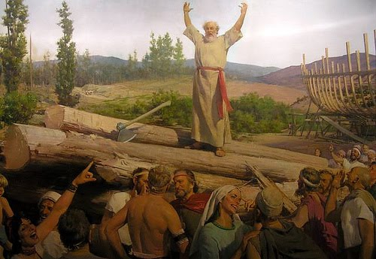
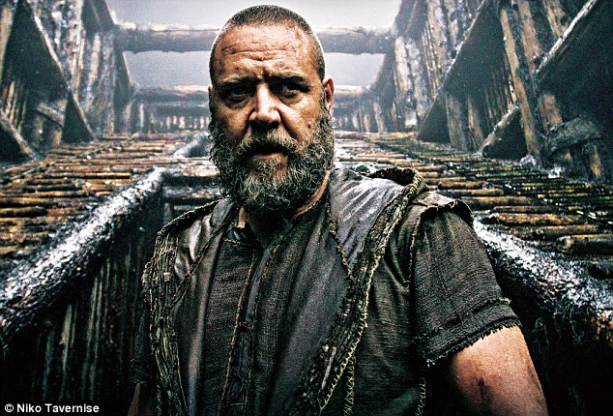
Noah
What do we know about Noah?
Favorable before God
Righteous, blameless, walked w/ God
He…did all that God commanded him (6:22)
Noah did all that the LORD commanded him (7:5)
…as God had commanded Noah (7:9)
Notes:
Let’s talk about Noah for a minute, because in many respects, he too is somewhat incidental in the telling of this story.
[[What do we know about Noah?]] besides his ancestry/family…
Noah found favor in the sight of the LORD, v. 8
Noah was a righteous man, blameless in his generation, walked with God, v. 9 (10 words in Hebrew)
We don’t really know exactly what this means – by what means was Noah favorable and righteous in God’s eyes? Does this mean he was the only one who was morally upright? Or that he was hanging on to the last vestiges of the religion which confessed YHWH as God? The text is not explicit in this regard, though we can assume these are likely meanings.
But beyond that we don’t really know anything about him. Now, you might say, what else is there to know that’s more important than being righteous before God – but consider this:
Noah doesn’t speak for the entirety of the Flood narrative. Noah’s first words quoted in the bible are in chapter 9 in his curse of his son Ham.
We’re not actually told about Noah building the ark, or gathering the animals or prepare the food, or even agreeing to the covenant God speaks of. All of those things are presented in the form of instructions by God to Noah, the conclusion of which are the simple statements that Noah did what God commanded him.
It may be that the point of this is to hold up Noah as a model of righteousness as simple, uncompromising obedience to God’s command. I think that is emphasized by the details of the instruction God gives about the dimensions of the flood, provision for the pairs of animals, etc. As the sole redeemable man in the world, Noah prepares for God’s judgment by doing just as he says.
It is interesting that there seems to be a tradition that Noah attempted to preach to the people of his day to themselves repent. You find in artists renderings like this one…but the text doesn’t state that, or even hint at it. It is pretty clear from the text that God’s verdict against the world is final and his intention is that all will perish besides Noah’s family, and that they’re just along for the ride…

Slide 9
The Flood
Time
Begins in Noah’s 600th year, 2nd month, 17th day.
The flooding lasts 7-10 months
Noah leaves the ark after more than a year aboard
Purpose
Judgment/Destruction
Salvation/Recreation
Notes:
…a very long ride.
The story of the flood has a lot of important details in it, many of which have to do with time and dates. Consider:
Noah enters the ark in his 600th year
The flood begins 7 days later 600th year, 2nd month, 17 day
Rain falls for 40 days and nights
Water continued on the earth for 150 days
On the 7th month, 17th day the ark comes to rest
Takes 3 months for the waters to recede
40 days to send the raven, another 7 for the dove, another 7 for the dove again
Water is fully dried from the earth on the 1st month, 1st day of Noah’s 601st year
Noah leaves the ark in the 2nd month, 27th day
In total Noah and his family are in the ark for a little over a year
The purpose of this flood is two-fold 1) To judge all flesh and destroy the earth (6:13,17), but 2) to allow for the salvation of humanity through Noah, and to effectively re-create the earth which was the subject of God’s original purpose (6:18-19)

Slide 10
The Flood
Water
The Deep bursts forth
Rain from the heavens
Swelled to cover the mountains by 15 cubits (20-25 feet)
Leaves only Noah and his family, and the animals in the ark, alive
Notes:
[[How does the flood come about?]]
One of the reasons why I think God is affecting a kind of ‘recreation through this act is because of the description of the waters here. Remember, we saw that in the beginning the earth was formless and void, and subsisted in the chaotic watery deep, and that God created order from that on the 2nd day by creating the expanse which separated the waters from each other, creating the waters below from the sky above. Here in the story of the flood you have a return to that state before God eventually causes the waters to recede.
The flood begins with the waters of the deep breaking forth
Then the rain falls on the earth 40 days
That water covers the earth, rising far above the tallest mountains so that the entire earth is nothing but a watery mass
In 8:1, when the flood waters stop, it is because “God made a wind to blow over the earth, and the waters subsided; the fountains of the deep and the windows of the heavens were closed…” This also hearkens back to 1:2 and God’s spirit, or wind, hovering over the face of the waters.
The result is of full and total annihilation – all human beings perished, and all creatures were erased from the face of the earth. For 150 days, he and his family are the only ones living in the world.

Slide 11
The Flood Recedes
‘God Remembered Noah’

