Slide 1
The Book of Genesis
Abraham
Notes:
With this class we return to the text of Genesis and into the middle of the Abraham narrative. Today we’re going to cover chapters 18,19,20, three chapters which contain a number of important episodes in the life of Abraham, and which contain some interesting connections between them.
In these chapters, we learn about Abraham’s hospitality to his visitors, Sarah’s laughter at the promise to her of a son, Abraham’s negotiation with God over the fate of Sodom, Lot’s rescue from the destruction of Sodom, the incestuous origin of his descendants, and then a second episode of Sarah offered up to a king as Abraham’s sister. So there is a lot of content to cover in these chapters. As always, we not only learn from these stories about Abraham, but ultimately about God.

Slide 2
Chapter 18
18:1-15
18:16-33
Abraham as gracious host
Value of hospitality
Abraham stands as server
Recipient of Promise
Sound of Sarah’s laugh
“Is anything too hard for the Lord?”
Abraham as bold inquisitor
Value of justice
Abraham stands as counsel
Arbitrator for Sodom
Sound of Sodom’s groans
Shall he who judges all the earth give right judgment?”
Notes:
Diving into chapter 18, I want to suggest the two stories here, on one hand of the three visitors to Abraham’s tent, and on the other Abraham’s negotiation with God, are juxtaposed pretty well here. Consider the following:
Abraham takes on two very different roles in these stories. Among his three visitors, he serves as a gracious host; whereas standing before God, he is very bold in questioning God about what is right justice.
Thus the traditional Hebrew values of both hospitality and justice are espoused in these stories, respectively.
In both of these stories, Abraham takes a standing posture at an important point
On one hand Abraham is the recipient of a promise from God, whereas on the other he is arbitrator for the fate of Sodom.
The actions in these stories turn on a sound – the promise of God is challenged by Sarah’s laughter at the prospect of bearing a child. The intentions of God are sparked by the groans or outcry that he hears from Sodom
And perhaps most importantly, a key question at the center of the episode serves as the heart of the story for both theological reflection and practical lessons.

Slide 3
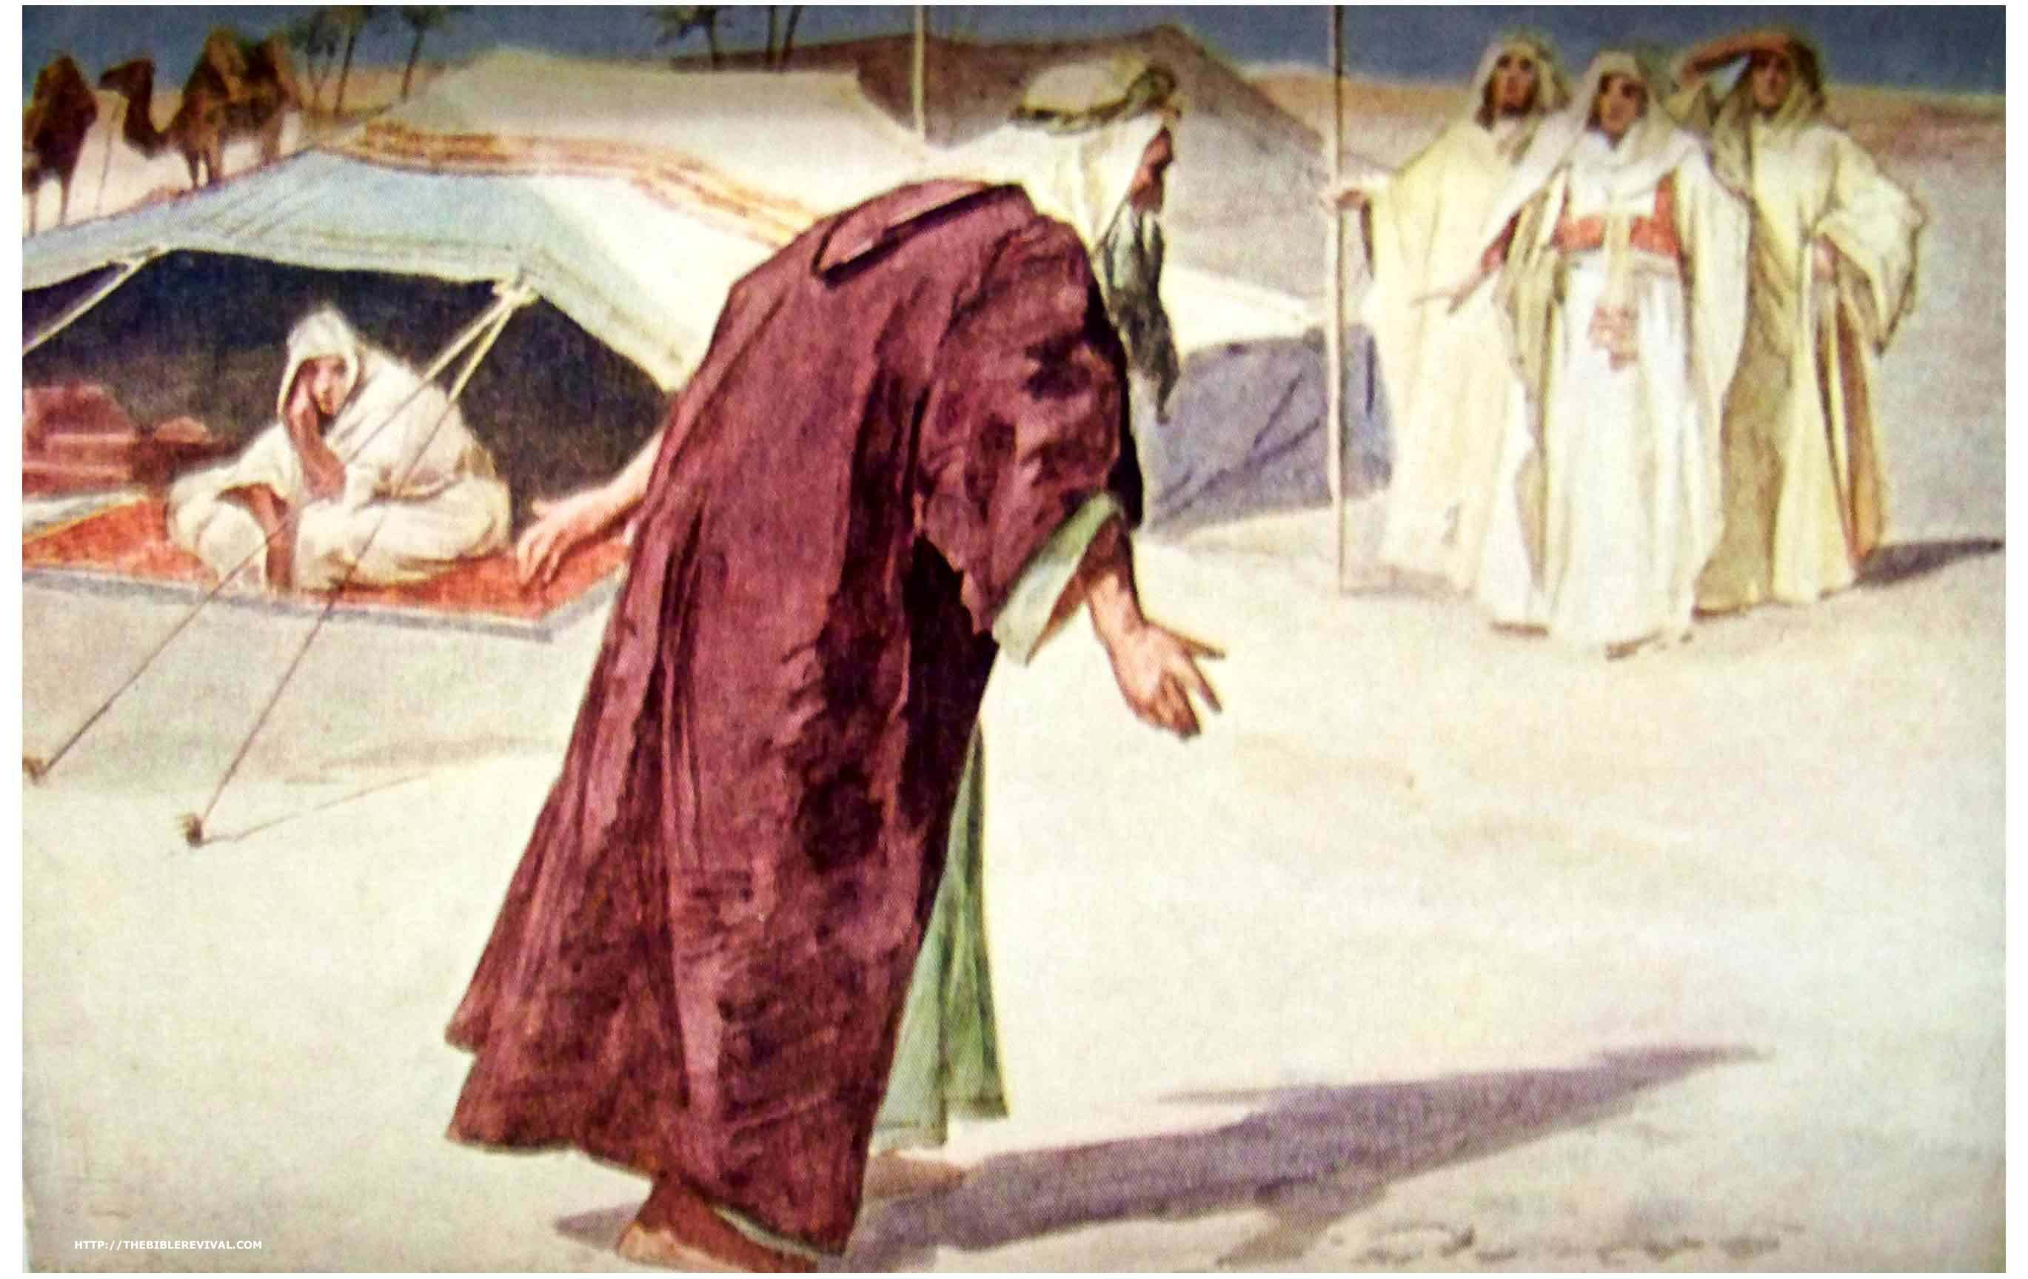
Abraham The Host
Three Men Appear to Abraham
Heb. uses singular & plural pronouns
Revealed to the reader (not yet Abraham!) as YHWH and his messengers
As Host, Abraham is responsible
for the needs of his guests
Water/Food
Rest
Service
Notes:
Chapter 18 opens with an introduction that is important to set up the stories of both chapters 18-19. Now, we haven’t highlighted this, but Mamre, or Hebron, is one of the places where Abraham settles in his various journey’s up down through the promised land, the area of Palestine. But while he is settled there, we are told that the LORD, YHWH, appeared to Abraham. Now where previously we have seen God call out to Abraham, or come to him in a vision, here we have God appear as three men. (It should be noted that older Christian interpreters – in late antiquity and especially in medieval times – saw in this story a preview of God as The Trinity.) As we go through the story, it becomes clear that Abraham identifies one of these three as the ‘leader’ of the group, and Abraham has conversation with him as YHWH himself, as we are told. Thus, you might notice there is a back-and-forth here of both singular and plural pronouns – sometimes referring to the three men, sometimes to the one. And it is interesting here that we, the readers are given the hint on this from the beginning, but Abraham is unaware of the identity of the men.
In the ancient Near Eastern world, and especially among the nomadic herders and merchants, hospitality was an important virtue. The host is not only responsible for the reception of guests, but attending to their needs. [[What acts of hospitality does Abraham show here?]] Thus, here we see Abraham bowing to the men in welcome, and offering rest and refreshment to the men, calling for water, and employing Sarah and other servants to prepare food for his guests. And Abraham then serves the men and stands attending to them while they eat. The hospitality shown by Abraham here is thorough and effusive.

Slide 4
Promise of a Son
Here is the most explicit form of the promise to Abraham of a son
Made to his face by YHWH
V. 10 likely means that God will cause Sarah to have a son
The problem of Barrenness
This has been the theme of Sarah’s role in the story since chapter 11
In age, she is past the capability to have children
She laughs with incredulity and suspicion
Is anything too hard for the LORD?
Notes:
Quickly thereafter, we have the men ask about Sarah, and then one of them – the LORD YHWH we are told – speaks to Abraham with the recurrence of the promise for a son. [[What is different about this promise from previous ones God has made to Abraham?]] This is, I think, the most explicit version of this promise given to Abraham – for one it is made in person! For another, the timing of the birth is given – which is not only a prediction, but also an indication that conception is act of God. For that reason, we are told in v. 11 that both Abraham and Sarah are very old, and that it was beyond Sarah’s ability to have children. The statement that ‘The way of women had ceased to be with Sarah’ is a way of saying what today is known as menopause.
This story is probably the most stark in presenting the problem of Sarah’s barrenness. We known this about Sarah since we were introduced to her in chapter 11, and really, this has been almost all that we have known about Sarah so far, that she is incapable of having children. So when she hears this man, this stranger, make this statement, her reaction of laughter is somewhat appropriate. This statement is outright ridiculous. (It does seem from this episode, that Sarah may not have been told about previous promises like this.) So when she laughs, it is at the absurdity of the idea. After all, she laughs to herself, unable to imagine the possibility of such a ‘pleasure’ – as she puts it.
But a private reaction gets exposed – where Sarah overhears the promise of a son, now the LORD knows her response and calls her on it. (The LORD seems to know, both without indication, Sarah’s name and thoughts.) And then 14 presents the question which is the lesson of the story – “Is anything too hard for the LORD?” This question shifts Abraham & Sarah’s sight from their own aged and forsaken situation, to the limitless power and resources of God. It is not in the ability of mankind, but in the promise of God that these impossible things come to be possibilities. Notice, then that Sarah’s disbelief doesn’t abort the promise – YHWH repeats the promise, stating that it will take place at ‘the appointed time.’
[[What do you make of the end of this conversation?]] This ends kind of abruptly – Sarah defensively denies laughing, but YHWH makes clear that he heard it for certain. By ending on this note, it indicates that this is a defining moment in the story of Sarah. It will be no accident that the son who is here promised is named ‘Isaac,’ which means ‘laughter.’ Thus this looks ahead to chapter 21 when Isaac is finally born.

Slide 5
Abraham the Intercessor
The inner dialogue of YHWH
Abraham is to be a blessing and observe righteousness
Thus he deserves to know God’s intentions for Sodom
V. 20-1 announces those intentions to Abraham
Abraham stands before YHWH
To argue over divine justice
To negotiate with God on behalf of Sodom for the sake of the innocent
Shall not he who judges all the earth
give right judgment?
Notes:
From Abraham’s tent, the men get up to go to Sodom, and are accompanied by Abraham. The exact location of Sodom & Gomorrah is unknown, but given the clues we have from Genesis, it is assumed to be somewhere just to the south of the Dead Sea, thus this a journey to the southeast.
Here we are given an account of God’s internal thoughts. There are a number of similarities between the stories of God’s destruction of Sodom and that of the flood, and this is one of them, as in both places we have God presented as a self-reflective person. What God muses here is about whether to tell Abraham why he is going to Sodom. And he does decide to do so, but the reasons we have here are of interest:
God remembers the specific promise made to Abraham that stem from chapter 12 – namely that Abraham is to be the father of a great nation, and one in whom all the other nations or peoples of the earth will be blessed. Here we’re going to have Abraham be directly involved in deciding the fate – blessing or curse – of a people that are not his own, nor does Abraham have any natural stake in their survival. And yet because Abraham is the one in whom all will be blessed, then yes Abraham does deserve to know God’s intentions.
Secondly, God identifies Abraham as the one he has ‘chosen’ – that is the word rendered in the ESV at the beginning of v. 19. Literally the Hebrew word there is yād̲a, ‘to know.’ This word ‘know’ has a broad range of meaning in Hebrew. There is ample evidence from the OT, as well as other places, that the term is used as a shorthand for covenant recognition – thus for God to ‘know’ Abraham here means to identify him as legitimate covenant partner.
Thirdly, the reason for this choice God says, is so that Abraham will teach his family about ‘righteousness and justice,’ here called ‘the way of the LORD.’ Inasmuch as these are values held by God, Abraham is the one through whom these will be practiced and observed in the world.
And finally, to wrap it up, that this would fulfill God’s will through Abraham. In the end, God’s covenant choice to bless the world through the righteousness of Abraham’s family is a matter of the promises and purposes of God.
As a result of God’s own consideration, he speaks out in verse 20, informing Abraham of what he is doing. God is moved by outcry, the load groans of the city. Now this term, the Hebrew ṣᵉāqâ, typically refers to a cry of an oppressed people – this is the word use of Abel’s blood in Gen 4, as well as the Hebrew people in Egypt before Moses leads them out. It might be difficult to reconcile that with the full destruction of the city and what appears to be a lack of righteousness anywhere, the city is presented as fully evil. But YHWH announces his plan to go investigate and find out just how wicked the city has become. It is not exactly clear what the sin of Sodom is – but we will see, it involves, or results in, sexual perversion and violence toward strangers. Ezekiel tells us in 16:49 “Behold, this was the guilt of your sister Sodom: she and her daughters had price, excess of food, and prosperous ease, but did not aid the poor and needy.” It seems from this – and here is the connection to the previous story – that Sodom has become a completely inhospitable place. We’ll see some more indications of that as we get into that story.
In light of this, the two other men travel down to Sodom, but then, the text says, Abraham stood before YHWH. What is interesting is that somewhere along the line in this chapter Abraham understands who he’s actually speaking with. It may have been back in his tent with the promise of his son, but perhaps it is most clear in this action. Abraham humbly approaches YHWH, but boldly challenges his intended actions. The conversations here is fascinating. Here you have Abraham negotiating with God over the number of righteous people it will take for God to save the city and not destroy it. Abraham is ultimately able to talk God down from 50 to just 10 as a minimum for which God will spare Sodom. There is some question as to why Abraham stops at 10 (why not go down to 5? Or 1?), but the point is sufficiently made at that point. But what is the point?
The truly interesting thing here is not the numbers, or even the negotiation, but instead the grounds on which Abraham feels compelled to negotiate with God in the first place. Abraham does not appeal to Sodom’s moral quality – he doesn’t argue that its not a sinful place, and that God should go easy on them. Rather,see Abraham’s question is v. 23 – “Will you indeed sweep away the righteous with the wicked?” Abraham is calling on God to exercise mercy. The negotiations are just a way of Abraham drawing out the logical conclusion of a God who may be defined not in his punishment of wickedness, but in his salvation of the innocent. Here Abraham, the one through whom the world will do justice , seems to challenge God on God’s own standard of justice! “Far be it from you,” Abraham says, “to do such a thing, to put the righteous to death with the wicked…Shall not he who judges all the earth give right judgment?”
Imagine being Abraham, standing before a person who is not only the God of the Universe, but your covenant God, and saying this! The phrase “Far be it from you to do such a thing,” which Abraham says twice, is perhaps more strong than is rendered in English, literally is implies that for God to act in an unjust way would be abominable. Now, Abraham does not say this in doubt of God’s justice ( I don’t think), but rather in his ultimate confidence that God will do what is just. I would contrast this conversation with the conversation between Even and the serpent in the garden. That was also a conversation about God, one that resulted in the implication that God was self-serving in his restriction upon humanity. A perversion of God’s character led to sin. Here Abraham has a conversation about God – with God himself – to the implication that God will do what is within his character to be right and just.

Slide 6
Lot the Host
Two messengers meet Lot at the Sodom Gate
Indicates Lot’s place within the city
Lot is insistent in his hospitality
He performs all the functions of a host
Lot is accosted by the townsmen looking for the men
Their intention is sexual perversion and violence
Lot defends his guests by offering his daughters
They reject Lot’s offer, referring to him as gēr, alien
He is rescued by the two men
Notes:
The other two men, companions of YHWH, reach Sodom later that evening (one commentary pointed out that this indicates the divine being of these men – a journey from Hebron to the south end of the Dead Sea in one afternoon on foot is nearly impossible). There they find Lot at the city gate. You’ve probably heard this before, but the city gate of any town like this was the place where leaders and officials would come to do adjudicate business or meet for official purposes. It is somewhat strange that Lot would be here at the gate, especially because later on the men of the city call him a gûr, a transient or alien. Why would such a person be at the gate?
Well, I’m going to read into the text here a little bit, but I have a theory about this…a) the men do not come in the day when the city officials would be present, but in the evening. B) Lot is there on official business, but at his post as the town watchman for the night. C) In a place that had a disregard for outsiders and those in need, it might make more sense that they assigned this post to one whom they already saw as an outsider. D) Lot, knowing the reputation of the townsfolk, offers hospitality to these men in a measure to keep them from the harm that may come to them in the city square – thus his insistence that they stay with him.
Lot offers his guests service just as Abraham did [[How would you compare the hospitality of Lot with Abraham?]]
The trouble Lot hoped to avoid for his guests finds him, as all the men of the city come out to surround the house…they want to ‘know’ these men. Here is the far end of the spectrum of this word ‘know.’ On one hand it can mean covenant relationship, but on the other it is a euphemism for sexual encounter, and here not only homosexual, but assaultive behavior. This is a proposal of violence. Lot’s response to the men is at one moment commendable, and in the next deeply troubling. He calls on the men to stop their behavior, but then as an compromise offers his own daughters up to them. Here is where Lot’s commitment to the protection of his guests leads to a hasty and offensive proposition. Fortunately, for all involved, these two men quickly reach out and rescue Lot from the angry mob and blind them to end the threat.

Slide 7
Destruction of Sodom & Gomorrah
The intention to destroy the city is made clear
Lot cannot save his son-in-laws
And has to be pulled out of the city himself
Sulfur & Fire rain from the sky
All inhabitants and vegetation are destroyed
Lot’s wife is struck for her return look upon the city
Notes:
The men warn Lot about the impending destruction of the city – the outcry has become too great! YHWH has sent them to destroy it. It appears that not even 10 could be found to save it. Nonetheless Lot and his family are permitted to escape the city – because, in v. 16, the Lord was being merciful to him. Unfortunately, Lot is not able to convince his sons-in-law to leave with them.
The following morning, the two messengers get Lot’s family up with haste to leave the city. The text says that Lot lingered / took his time. It is not clear why, but the result is that the men have to grab him a second time, and force him outside the city.
God rains down sulfur and fire in an incredible display of destruction. The disaster is often described by naturalists as the result of an earthquake. However, its clear that this is the result of the action of YHWH. Two things happen here: 1) the men warn Lot’s family to not look back at the city, and yet Lot’s wife, who has not really been present in this story – does so, and is turned to a pillar of salt. 2) We’ve already seen the hospitality of Lot, I think we see here also a version of his negotiation to escape to the nearby village of Zoar rather than to the hills.

Slide 8
Destruction of Sodom & Gomorrah
Abraham overlooks the destruction of the city
Lot’s rescue is the result of God’s remembrance of Abraham
Not Lot’s own righteousness
Lot’s daughters bear sons by him
This turns the tables on his offer of them for sexual purposes
Notes:
Interestingly, the story of Sodom & Gomorrah ends where it began, with Abraham overlooking the place. In the same place where he stood before YHWH, he sees the smoldering destruction of the city. Even the though the city has been destroyed, I think we see the results of that conversation here – when God destroyed S&G, God remembered Abraham (another echo of the Noah story), and resultantly Lot was saved for his sake.
A minor narrative here at the end of this section relates the origin of Israel’s neighbors Moab and Ammon. Previously Lot’s daughters had been offered up for the sexual appetite of the Sodomites. Now that seems to come back upon Lot. In the end, he becomes a rather pathetic figure. Ironically, while living in a cave (as far away from a city dwelling as you can get) his daughters take advantage of him in order to preserve their lines. The result is the nations of Moab and Ammon.

Slide 9
Abraham in Gerar
Similar to Abraham in Egypt in ch. 12
Abraham offers Sarah to Abimelech as his sister
This was apparently a standard practice for the couple
Abimelech is presented as full innocent
God keeps him from sinning
He rebukes Abraham for bringing guilt upon his people
Abraham is still God’s chosen ‘prophet’
Abraham is able to pray for restored fertility to Gerar
Sarah is restored to Abraham, who is given gifts and choice of land
Notes:
The story of Abraham in Gerar is obviously similar to the one in Egypt from chapter 12. Many believe it to be a duplicate account through a separate tradition. Although this quotation from one scholar is insightful…”Critical scholars reckon a story a duplicate of 12:10ff, ultimately on the ground that a man does not repeat a lapse of this kind. But it is easier to be consistent in theory than under the fear of death.”
We do have an indication here that Abraham and Sarah had this as an established practice when they entered a new place. The question raised in ch. 12 is still relevant here – why does Abraham do this? It is ironic that he says that he believed there to be no fear of God in the place. There is something duplicitous about his demand for justice for the innocent in Sodom, and his assumption of guilt upon the people of Gerar.
In fact in this story, the innocent party is clearly King Abimelech. Upon taking Sarah as his wife, God comes to warn Abimelech, and Abimelech is the one who questions God in a question similar to the one Abraham offered YHWH before Sodom. “Lord, would you kill an innocent people?”
God acknowledges, and even assists in, Abimelech's innocence, and yet again, this story does not turn out poorly for Abraham. Despite the rebuke he receives, Gerer cannot be restored without the intercessory prayer of Abraham. 1) Here Abraham is referred to as ‘prophet.’ This is the first use of this prominent OT term. Here Abraham fulfills this role through intercessory prayer. 2) In doing this he restores fertility to the women of Gerar. After the fact, we are told that the taking of Sarah affected this among the women. The irony here is that Abraham the prophet can, through prayer, cause fertility of the foreigner, but not his own wife.
Two implications of this story: 1) God’s people do not have a monopoly on divine revelation. 2) All peoples, not just the patriarchs, are obligated to the moral standard’s of God.

