Slide 1
The Gospel of Matthew

Slide 2
Class Goals
To better understand the life of Jesus…
To equip one another to imitate Matthew…
To spotlight bold teachings of Jesus…
To avoid the pitfalls of hypocrisy…
To increase confidence in the Scriptures…

Slide 3
When Reading Matthew 8-10, What Wonderful Ideas Stand Out To You?
Notes:
The great variety of problems Jesus heals: from demons, to bleeding, to blind and mute…
Statements about great faith and little faith. The apostles had little faith.
9:1. His own city. Raised in Nazareth but he was at home in Capernaum with Peter and Andrew.
Faith is Invisible: But we can “See” it time and time again.
Salvation is Invisible: But we can ”see” it in Matthew and the paralytic.
9:8 – The response of the crowd: awestruck and glorifying God.

Slide 4
Notes:
Likely near Capernaum.
Matt 4:18-22 is near Peters house…in capernaum.
Mark 1:21-28 records the same time period… emphasizing this is the occasion people recognized he was teaching with authority…and He’s in Capernaum.
Mark 1:29-37 records the following day…and they are still in Capernaum.

Slide 5
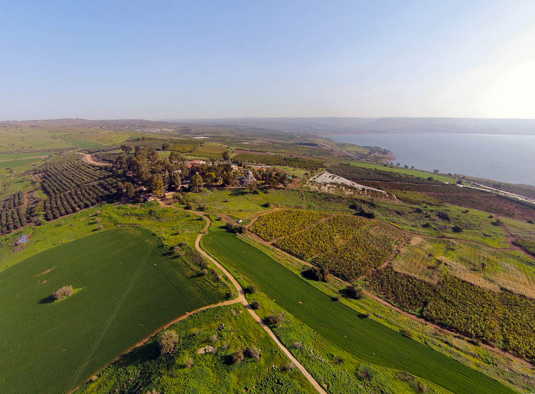
And when He came down from the mountain
Mount of Beatitudes (aerial view from the southwest)
8:1
Notes:
See the next slide for identifying labels showing the relationship between the traditional Mount of Beatitudes and Jesus’s destination of Capernaum (verse 5).
ws011415247

Slide 6
And when He came down from the mountain
Capernaum
Chapel
Mount of Beatitudes (aerial view from the southwest)
8:1
Notes:
This slide shows the relationship between the traditional Mount of Beatitudes and Jesus’s destination of Capernaum (verse 5).
ws011415247

Slide 7
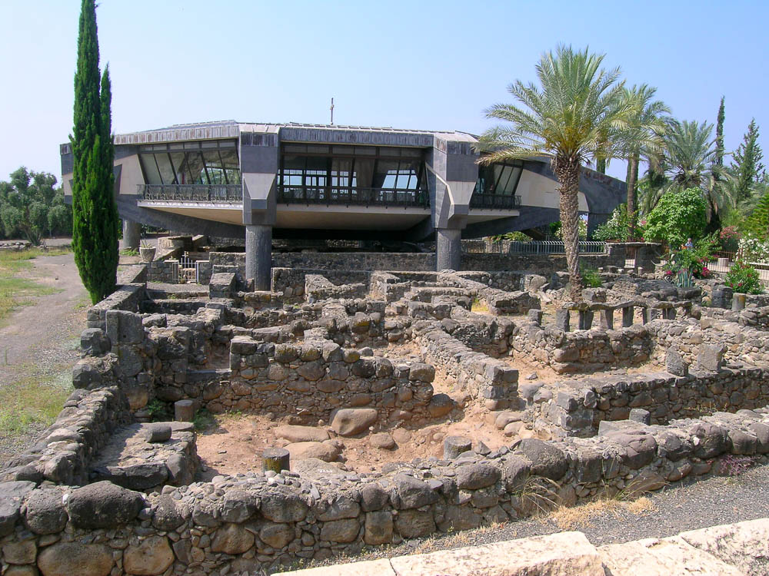
And when He had entered Capernaum . . .
Basalt houses in Capernaum with Peter’s house (from the north)
8:5
Notes:
The Capernaum of Jesus’s day consisted largely of houses and public structures built of basalt stone, as seen in the foreground. The ruins of the traditional house of Peter are located beneath the modern Roman Catholic chapel.
tb052604018

Slide 8
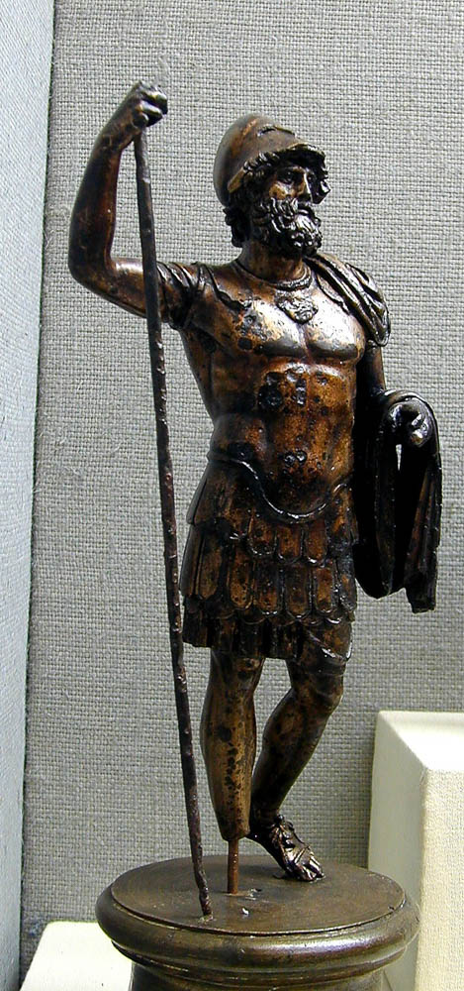
And when He had entered Capernaum, a centurion approached Him
Roman soldier in bronze
8:5
Notes:
This bronze statue is on display in the Bergama Museum (near biblical Pergamum in modern Turkey). It may date to the second century AD. A removable box has been added to the figure on the right to avoid causing offense or surprise.
tb010901882

Slide 9
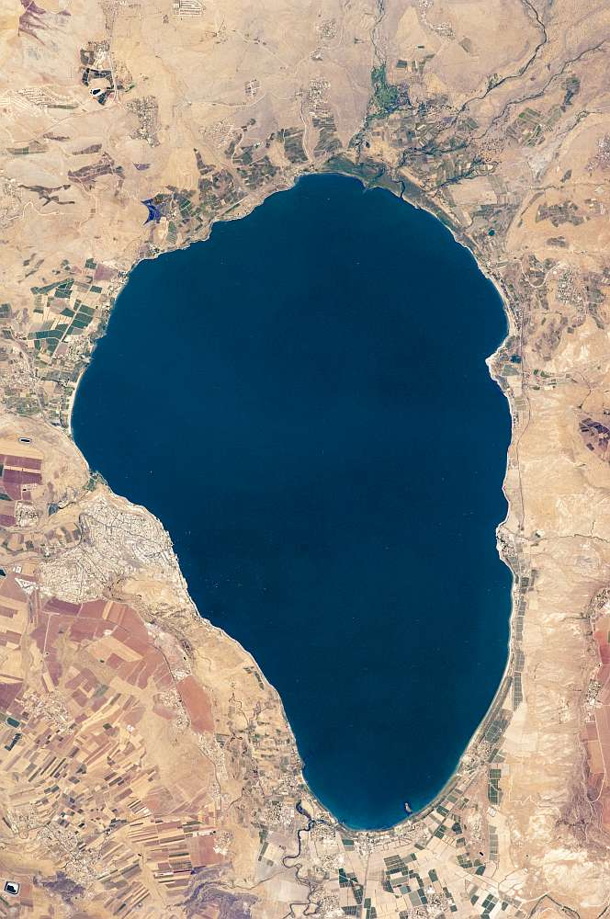
Jesus . . . gave orders to go over to the other side
Capernaum
Gadara harbor
Sea of Galilee from space
8:18
Notes:
This arrow shows the approximate route taken by Jesus and the disciples across the Sea of Galilee.
This image was taken by Expedition Crew 20 from the International Space Station and is provided by NASA’s Earth Observatory. Source: http://earthobservatory.nasa.gov/IOTD/view.php?id=40147
nasa40147

Slide 10
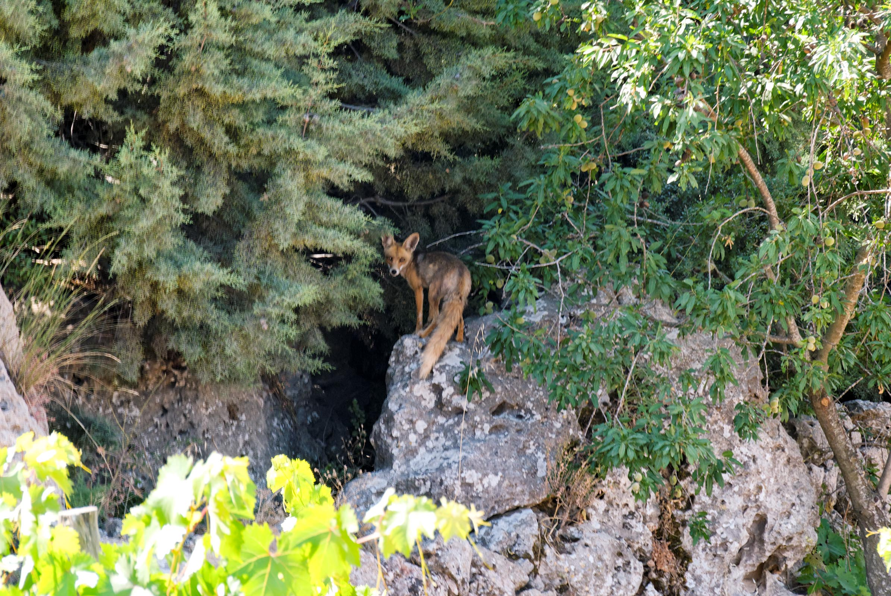
Foxes have holes
Fox near Bethlehem
8:20
Notes:
Because foxes have holes, they are very difficult to photograph.
cd09053004

Slide 11
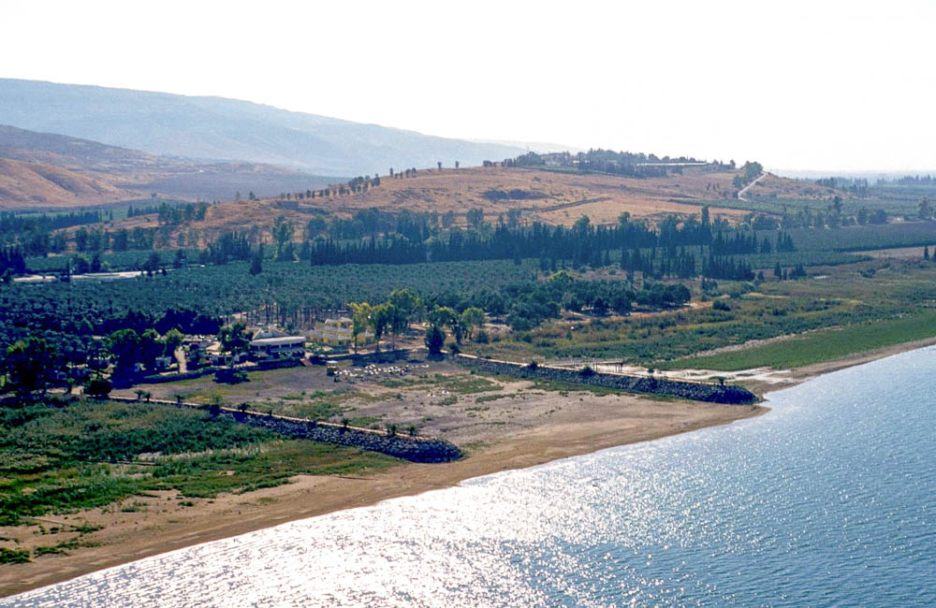
And, behold, the whole herd rushed down the steep slope into the sea
Steep slope
Tell Samra
Gadara harbor
Area of Gadara harbor (aerial view from the northwest)
8:32
Notes:
This aerial photograph shows the “region of the Gadarenes” and the likely region where the pigs ran into the lake and were drowned. The city of Gadara had a harbor along the shore, remains of which have been discovered in recent years. An archaeological survey discovered Roman-period tombs near Tell Samra as well as a Byzantine chapel at the site. One can speculate that this church commemorated the site of a miracle in Jesus’s ministry, but this cannot be proved given the poor state of the chapel’s preservation. The pigs may have been grazing on the steep slope behind Tell Samra. In this reconstruction, the pigs ran down the slope and across the plain before plunging into the lake.
tbs117020011

Slide 12
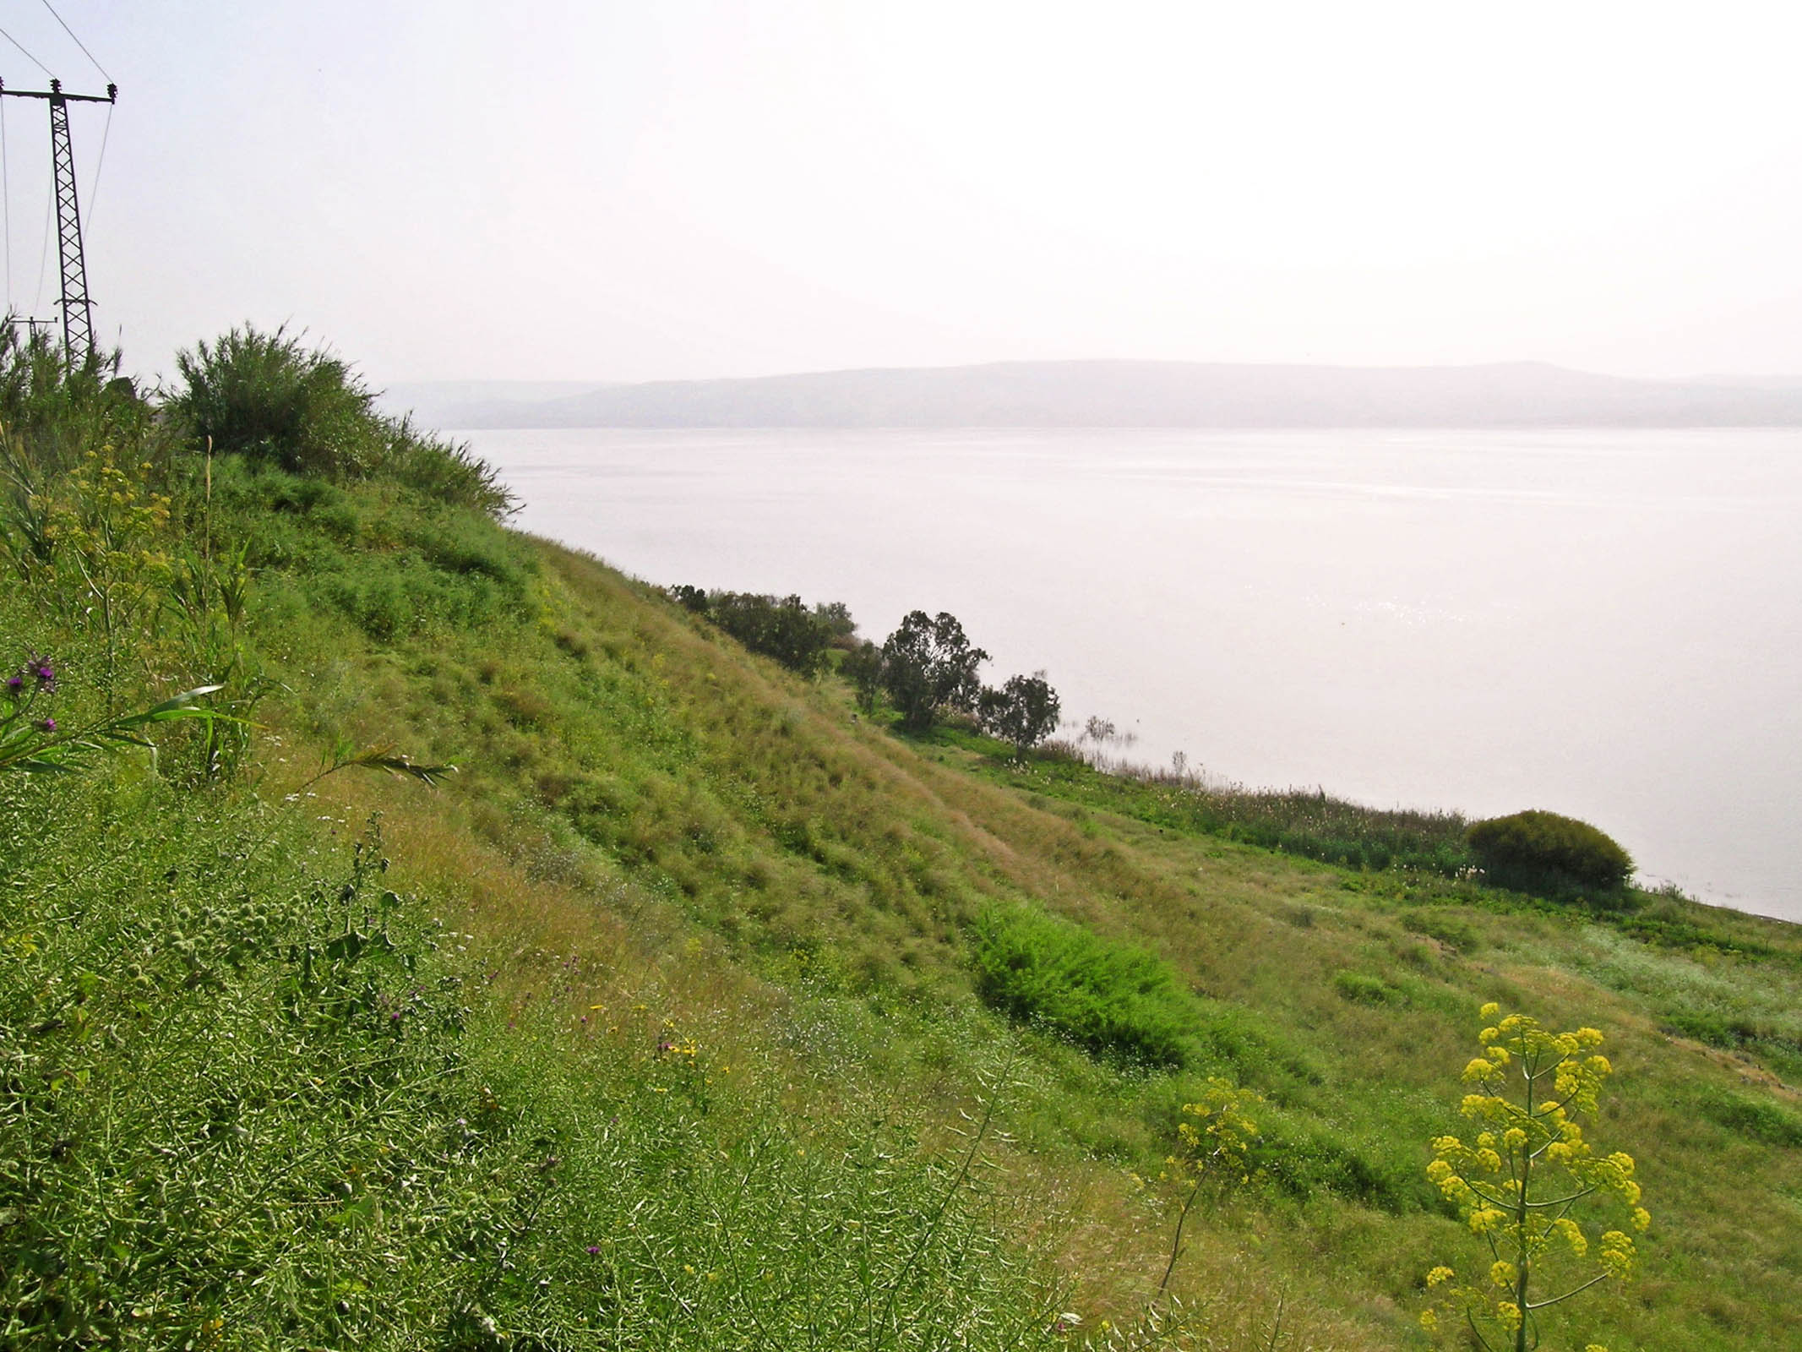
And, behold, the whole herd rushed down the steep slope into the sea
Steep slope at Kursi (traditional site of event)
8:32
Notes:
This photograph shows the steep slope near Kursi, a location which follows the Majority Text reading of “the land of the Gergesenes” and assumes that Gergesa existed nearby. This photo is included for those who prefer this site, but the previous photographs illustrate the reading of the earlier Greek texts: “the land of the Gadarenes.”
tb032804322

Slide 13
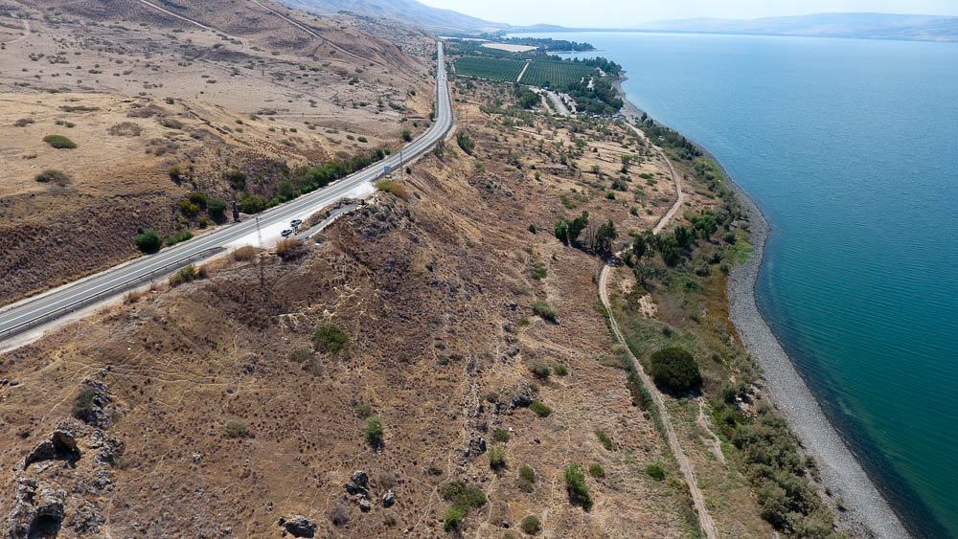
And, behold, the whole herd rushed down the steep slope into the sea
Kursi slope (aerial view from the north)
8:32
Notes:
This photograph shows an aerial view of the slope shown in the previous slide.
ws092816466

Slide 14
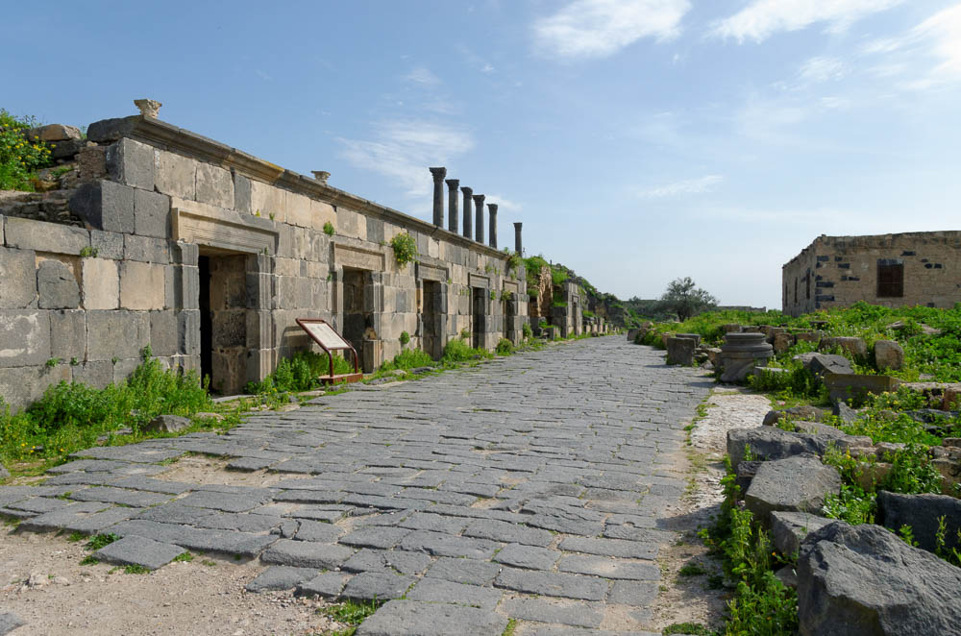
And the herdsmen fled, and went into the city, and told everything
The Cardo of Gadara with shops
8:33
Notes:
The “cardo” was the main north-south street in a Roman city.
tb030915741

Slide 15
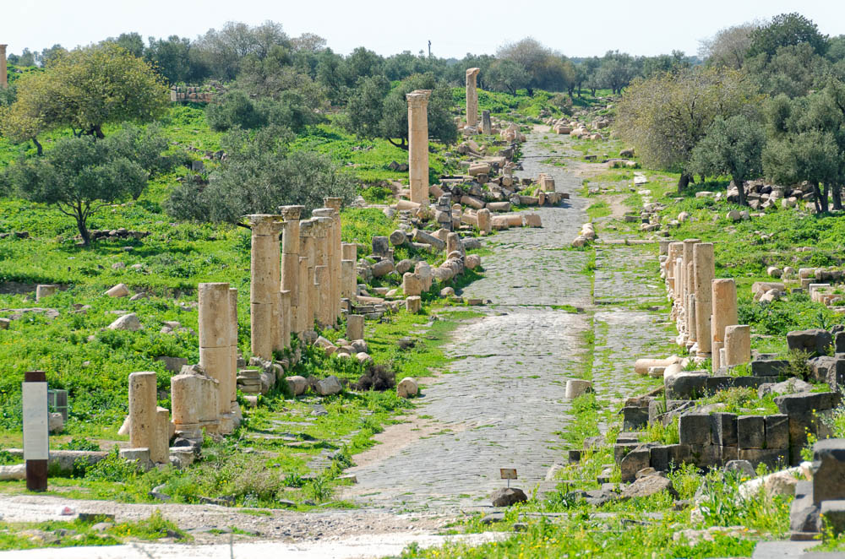
And the herdsmen fled, and went into the city, and told everything
The Decumanus Maximus of Gadara (from the east)
8:33
Notes:
The Decumanus runs east to west through the city. It was the main street in town, much longer than the Cardo Maximus.
tb030915681

Slide 16
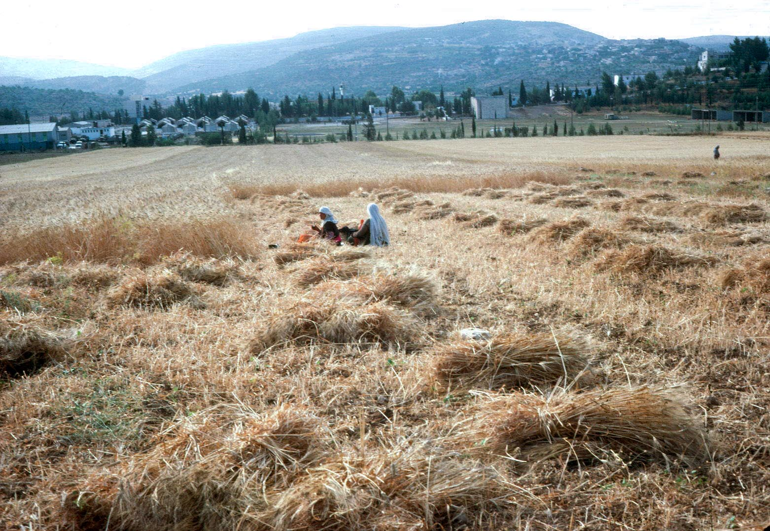
The harvest indeed is plentiful, but the laborers are few
Harvesting in Makhaneh Valley south of Shechem
9:37
Notes:
In some parts of the land of Israel, farmers continue to do all of their work by hand, just as their fathers and forefathers have always done. This photograph was taken by David Dorsey in the 1970s.
dad240102

Slide 17
Miracles in Matthew 8-10
1st Set of Miracles & Teaching
Healing the Leper (8:3), Centurion’s Servant (8:13), Peter’s M-in-Law (8:15), Many (8:16)
Will We Follow Him Anywhere & Right Away?
2nd Set of Miracles & Teaching
Calm The Sea (8:26), Demons (8:32), Paralysis(9:6)
Do We Understand The Mission He Is On?
3rd Set of Miracles & Teaching
Woman Touching Cloak(9:22), Little Girl Raised (9:24), Blind (9:30), Mute (9:33), Every Sickness (9:35)
Am I Working In His Harvest?
Notes:
QUESTION #1. #2. #3.
I just LOVE that people are following Him after seeing just 1 or a few miracles! We sit here and read chapter after chapter and we waiver. But they change everything: BC THIS IS REAL! And the Blind men are following him – after “seeing” zero miracles!! (9:30)
Importance of Miracles & Teaching Together…
** Miracles will draw crowds and curiosity, but what Jesus most wanted to produce was repentance and deep-rooted faith.

Slide 18
Faith That Pleases Jesus: Matt. 8-10
Leper: Humility (8:3)
C. Servant: Authority (8:13)
P. M-in-Law: Service (8:15)
Many: With a Word (8:16)
The Sea: Courage (8:26)
Demons: Rejection (8:32)
Paralysis: Forgiveness (9:6)
Woman: Seeking (9:22)
Little Girl: Life Giving (9:24)
Blind: Gives Sight (9:30)
Mute: Amazed (9:33)
Every Sickness: Teacher (9:35)
Notes:
Let’s look at the qualities of Faith Matthew is recording and teaching us about. The faith that Pleases the Lord.
Amazed: Also for some: simply unbelievable. They retreat to their small view of the world – instead of embrace the AWESOME GOD before them.

Slide 19
Considering Matthew 1-10, What Do We Know About Jesus?
Notes:
Is Matthew doing His job? Convincing us that this is a man who is worth following? Convincing us that this is the Messiah spoken of in the OT? Convincing us that He is the SON of GOD who provides eternal life? He’s certainly on the right track!
Jesus is humble. He’s not doing this for attention.
Jesus is merciful and compassionate. Healing the hurting.
Jesus is honest. Telling the apostles what to expect.

Slide 20
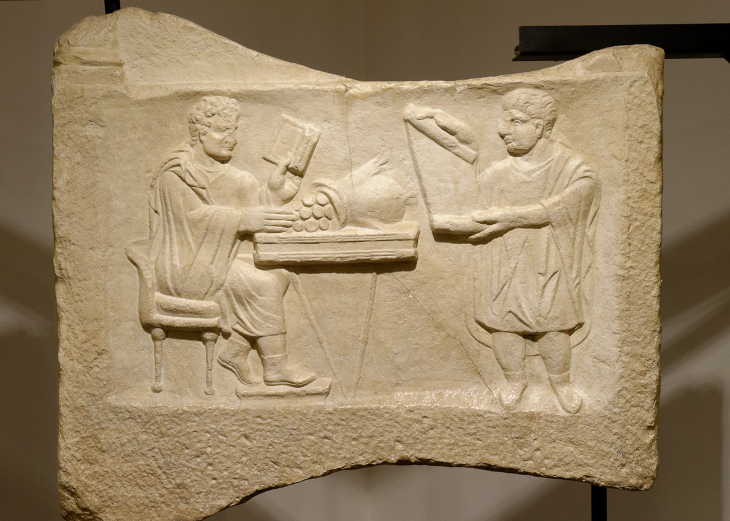
He saw a man called Matthew sitting at the tax office
Money changer and servant counting daily income, 3rd century AD
9:9
Notes:
This copy of a funerary stele relief was discovered in Pannonia, Hungary. Today it is on display in the Eretz Israel Museum in Tel Aviv.
tb031114406

Slide 21
Imitating Matthew
Where was Matthew when Jesus called Him?
Pause: Remember where you were when you decided to follow Jesus.
Once Matthew begins following Jesus, what is the first thing he does? (vs. 10)
Read Matthew 10:1-7. What has created such great faith in these men that they would do whatever Jesus asked of them?
Notes:
Pause & Remember: Just imagine Matthew writing these lines in his gospel. Realizing that HIS STORY was incomplete until it intersected with Jesus. This day became a cross-roads for Matthew…and oh how far he’s come from the days of sitting at that tax collecting booth.
In that booth – Matthew was closer to the world. An outcast and desipsed by the Pharisees. A man with many spiritually sick friends – whose home is now filled with God Himself! And Jesus, Immanuel, is there to heal them.

Slide 22
Bold Teachings In 8-10
8:10 – This Included The Apostles!
8:21-22 – The Highest Priority Goes To Jesus
9:6 – Jesus is the Son of Man (Dan. 7:13)
9:13 – God Is Looking For Acts of Love
9:17 – Jesus Answers Sometimes Reveal Our Completely Wrong Approach To The Topic.
Notes:
Son of Man – God would not bless a liar with the power to perform miracles. Jesus is telling the truth about His authority.
This self-description seems to be Jesus way of expanding the Jews understanding of the Messiah. Jesus is saying that He is a Messiah with a broader mission than simply a jewish earthly kingdom. He has come for all people of every nation.

Slide 23
Bold Teaching In 8-10
10:9-15 – Take The Message & Keep Going.
10:16-23 – Expect Persection & Hatred.

Slide 24
Responding To Rejection
Remember Who Is Being Rejected (10:24-25)
1 Samuel 8:7
Speak Out Despite Our Fears (10:26-28)
Speak Out Knowing God Cares (10:29-30)
Speak Out Thinking of the Future (10:32-33)
Expect Even Family Division (10:34-36)
Only The Son of God Can Offer… (10:37-42)
Notes:
God has made our hearts to dislike rejection…Because HE dislikes rejection.

Slide 25
The Gospel of Matthew

