Slide 1
The Gospel of Matthew

Slide 2
Matthew 13: Kingdom Parables
God’s Reign In The Hearts of Men.
Each Parable Helps Us See How A Spiritual Kingdom Is Different From An Earthly One.
Conquer People vs. Preach to People
Weed Out Disloyal vs. Delay Judgment
Military Might vs. Strength for Shelter
Visible Force vs. Invisible Influence
Wealthy Nation vs. Wealthy Citizens
Born A Citizen vs. Must Be Sought Out
Judgment Now vs. Judgment for Eternity
Notes:
Notice the similarities:

Slide 3
Consider The Connections
Hearts & Plants
Plants & Examine What Grows
Growth & Change
Change & Hidden
Hidden & Value
Value & Someone Seeking
God Is Seeking & Will Judge Hearts
Notes:
Ask you to consider how the parables are connected.
1 and 2 both explain why everyone doesn’t follow Jesus … sometimes people reject God & sometimes Satan attacks God’s field.
3 and 4 both deal with growth… Growth That Looks Impressive, But Is Also Hard To See
5 and 6 both deal with value… Value That Is Hidden & Must Be Sought Out
7 deals with judgment.
1-6 reveals man’s responses to God.
7 – God’s response to man.

Slide 4
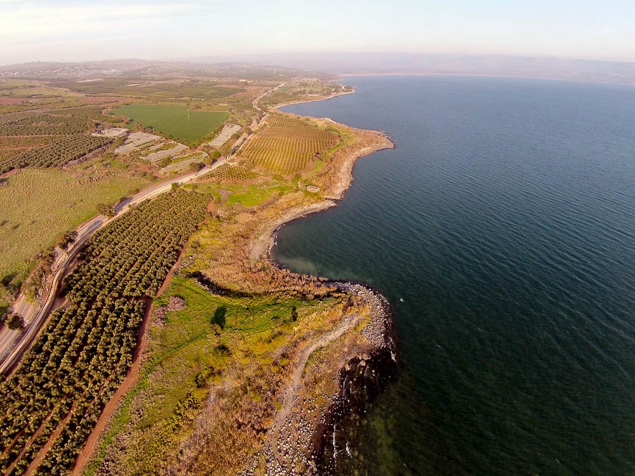
He entered into a boat, and sat; and all the crowd stood on the beach
The “Cove of the Sower” (aerial view from the southwest)
13:2
Notes:
The “Cove of the Sower” is located 1 mile (1.6 km) southwest of Capernaum. See the next slide for identifying labels.
ws011315204

Slide 5
He entered into a boat, and sat; and all the crowd stood on the beach
Capernaum
Sea of Galilee
“Cove of the Sower”
The “Cove of the Sower” (aerial view from the southwest)
13:2
Notes:
The “Cove of the Sower” is located 1 mile (1.6 km) southwest of Capernaum.
ws011315204

Slide 6
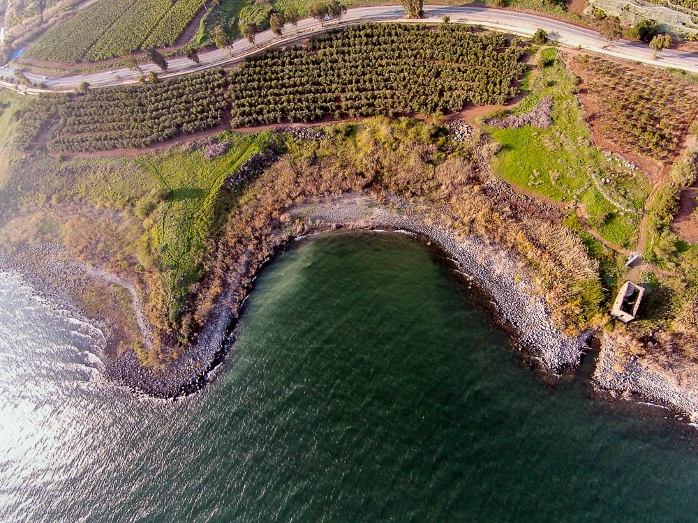
He entered into a boat, and sat; and all the crowd stood on the beach
“Cove of the Sower” (aerial view from the south)
13:2
Notes:
The Cove of the Sower is shaped like a natural amphitheater.
ws011315214

Slide 7
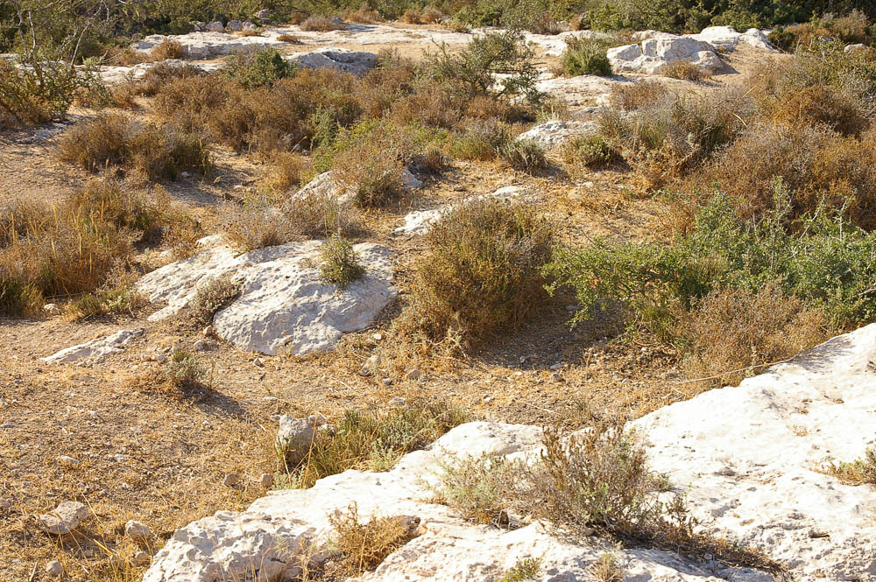
And the one that was sown upon the rocky places
Rocky ground near the ancient Philistine city of Gath
13:20
Notes:
The above illustration gives a good example of the rocky and thorny soil that the ancient farmer had to contend with.
adr08072470311

Slide 8
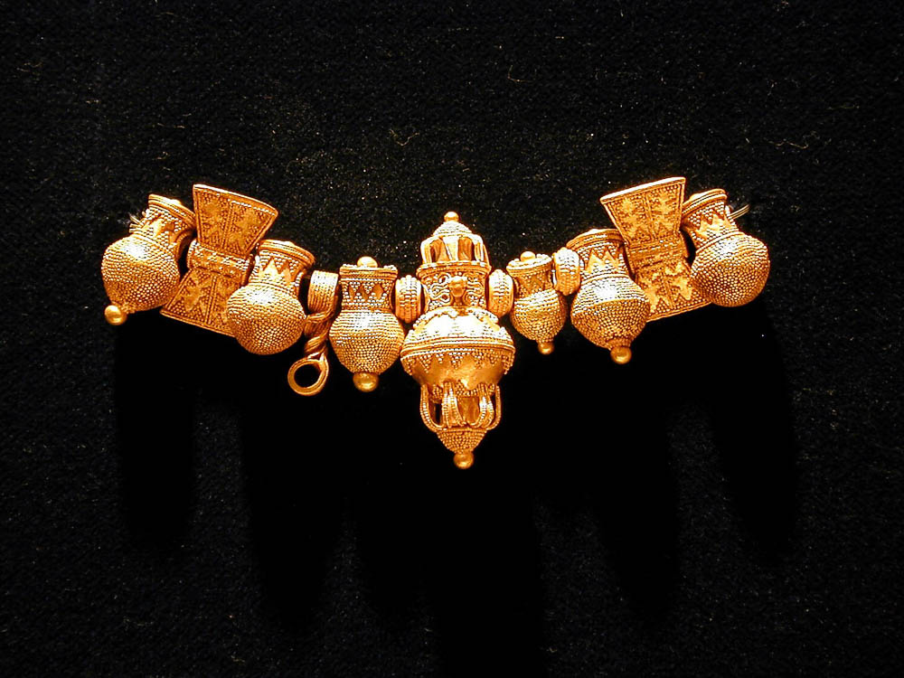
The deceitfulness of riches chokes the word
Gold necklace from Sindos, 500 BC
13:22
Notes:
This necklace is on display at the Thessalonica Archaeological Museum.
tb011301128

Slide 9
1. The Sower
We must see the importance of accepting the Words of Jesus, guarding against spiritual threats, and becoming fruitful.
Application: Be The Good Soil
Notes:
If we spend 3 minutes overviewing each parable we will still have 20 minutes.
>. Notice how very PERSONAL each of these parables are… they aren’t about some massive world power – they are about each, individual person, and the relationship we have with God.

Slide 10
2. The Tares
Sets our Expectations. For all the work Jesus puts into correcting hypocrisy, we are reminded that we will still encounter (if not be surrounded) by self-righteous people.
Application: Don’t Judge Too Quickly

Slide 11
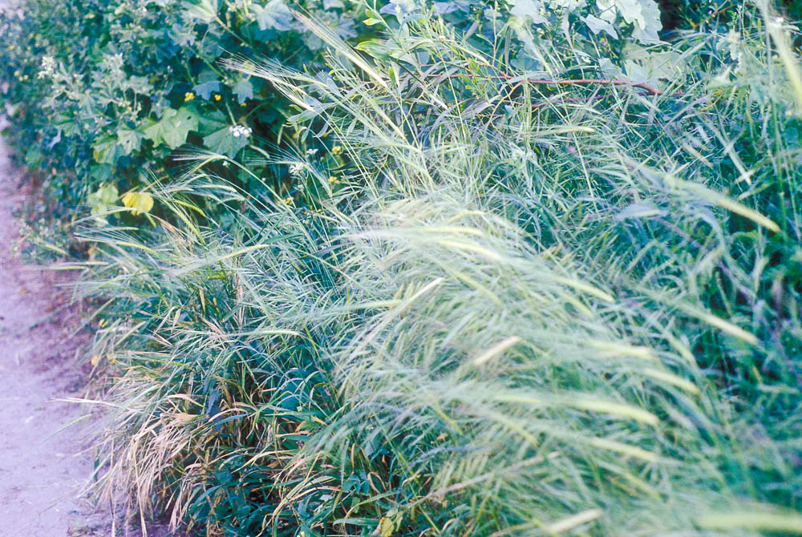
His enemy came, and sowed tares also among the wheat
Mixed wheat and tares at En Gev (growing)
13:25
Notes:
gs030193158

Slide 12
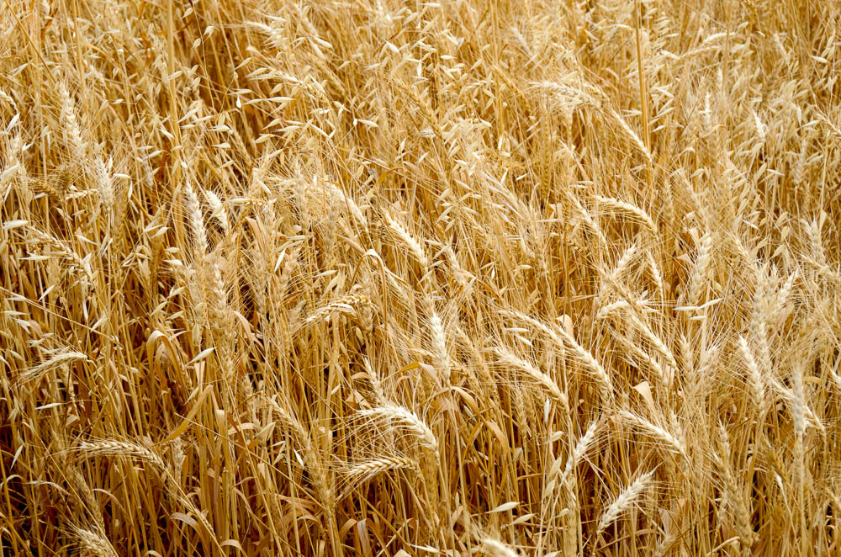
His enemy came, and sowed tares also among the wheat
Wheat and tares near Mount Gerizim
13:25
Notes:
tb052916397

Slide 13
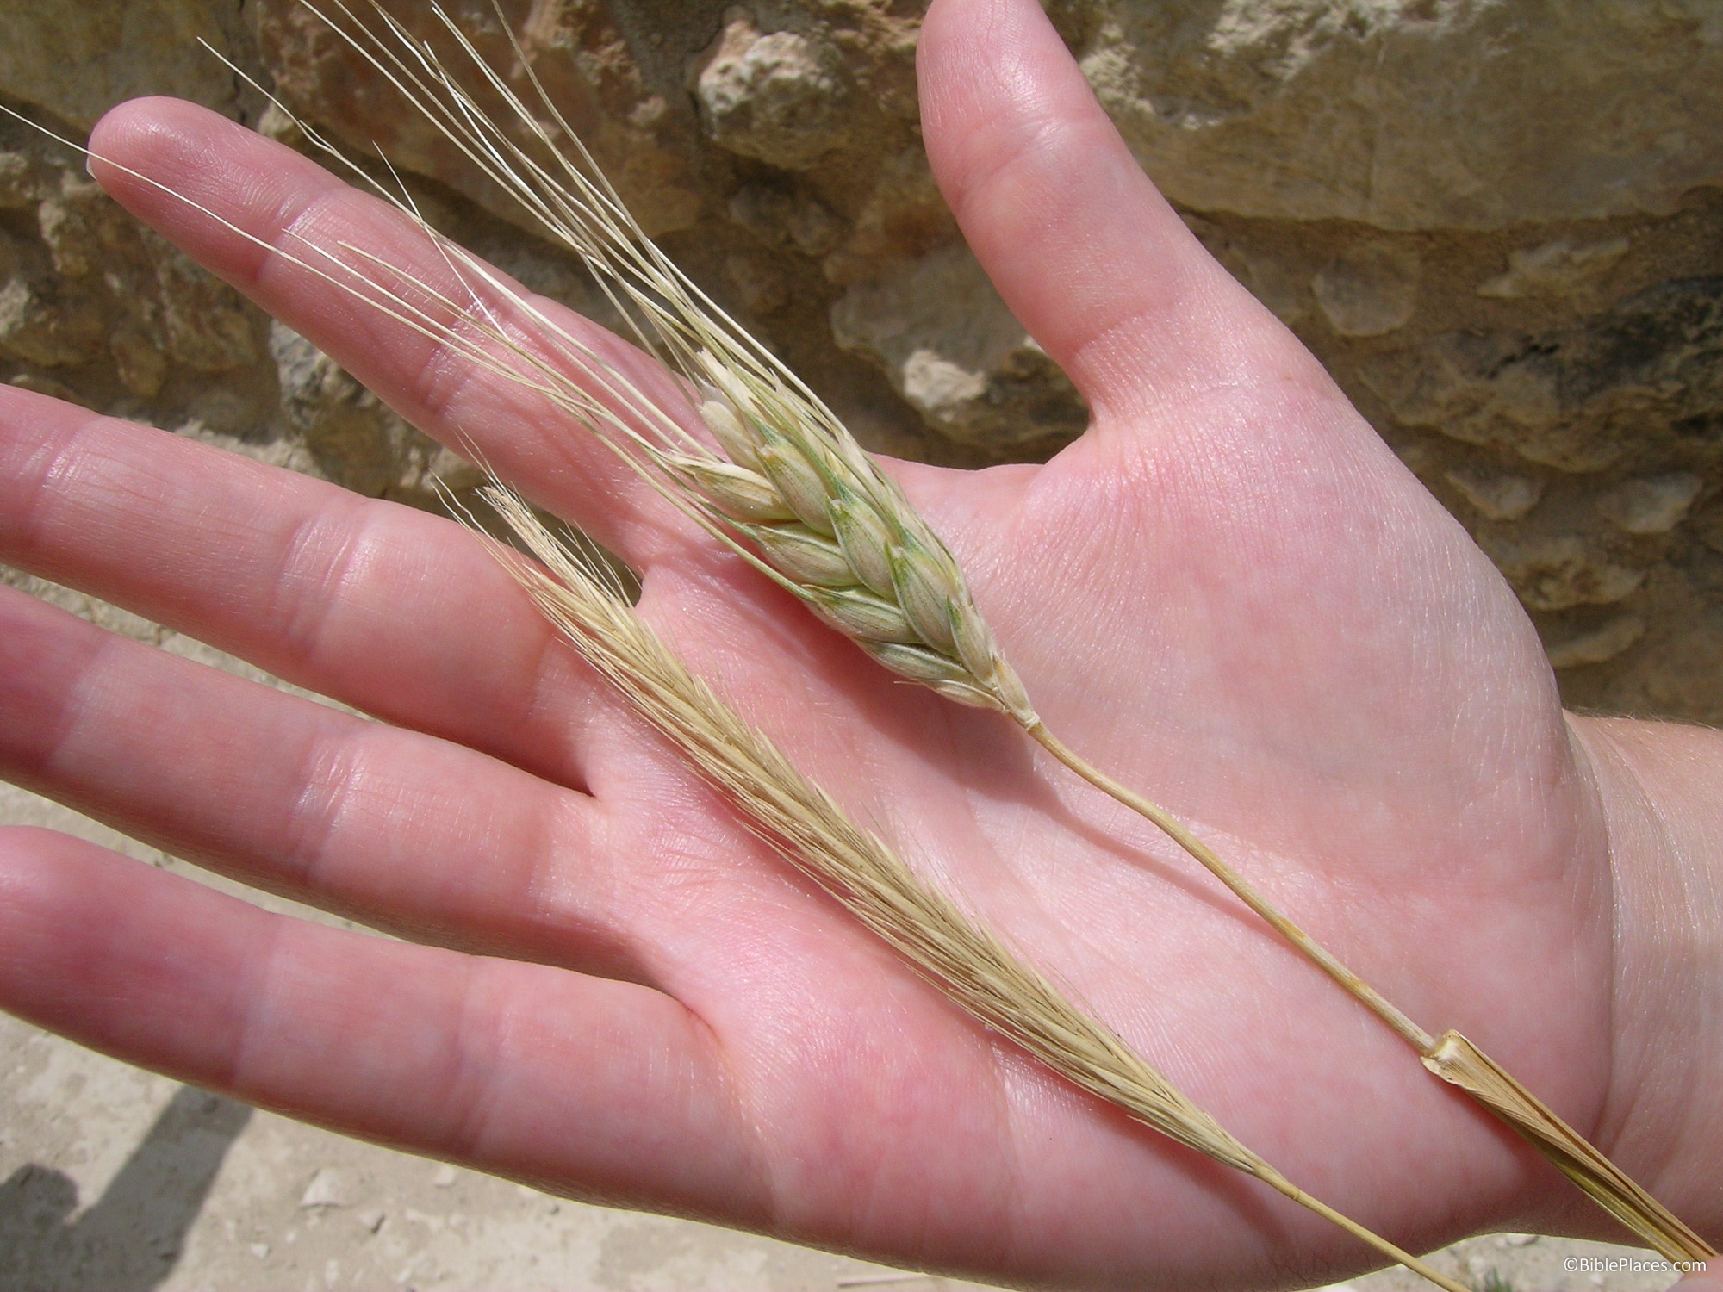
His enemy came, and sowed tares also among the wheat
Wheat and tare (mature)
13:25
Notes:
tb052704126

Slide 14
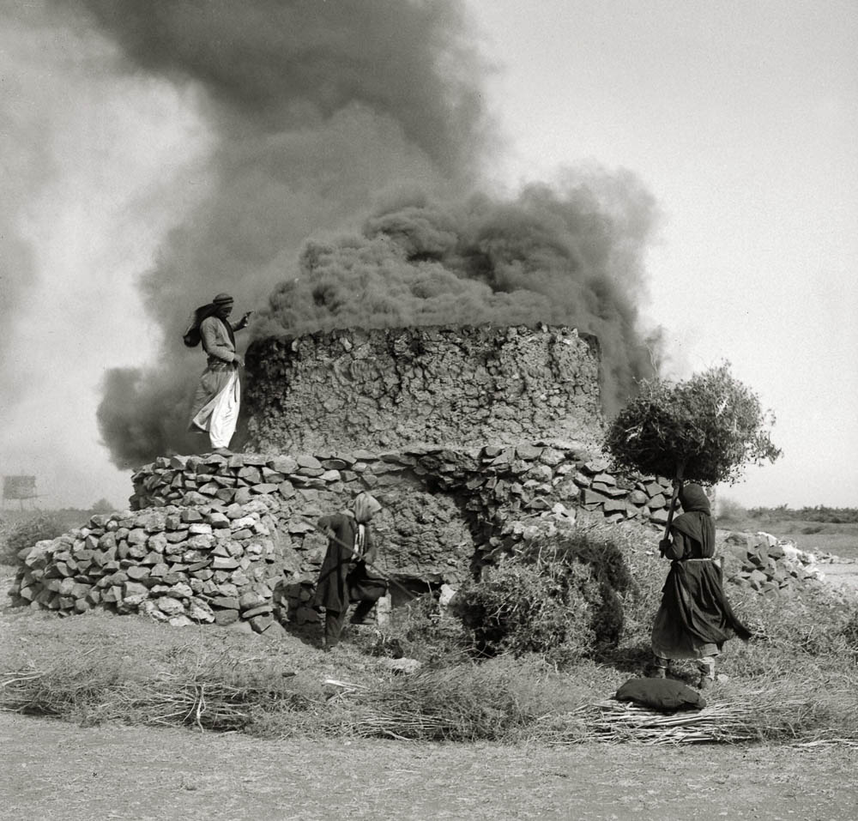
First gather up the tares and bind them in bundles to burn them
Burning thorns in a lime kiln in Homs
13:30
Notes:
This American Colony photograph was taken in Homs, Syria, in the early 1900s.
mat02208

Slide 15
3. The Mustard Seed
The Kingdom of Heaven will have a small, humble beginning, but result in a great salvation.
Application: Take refuge in Jesus.

Slide 16
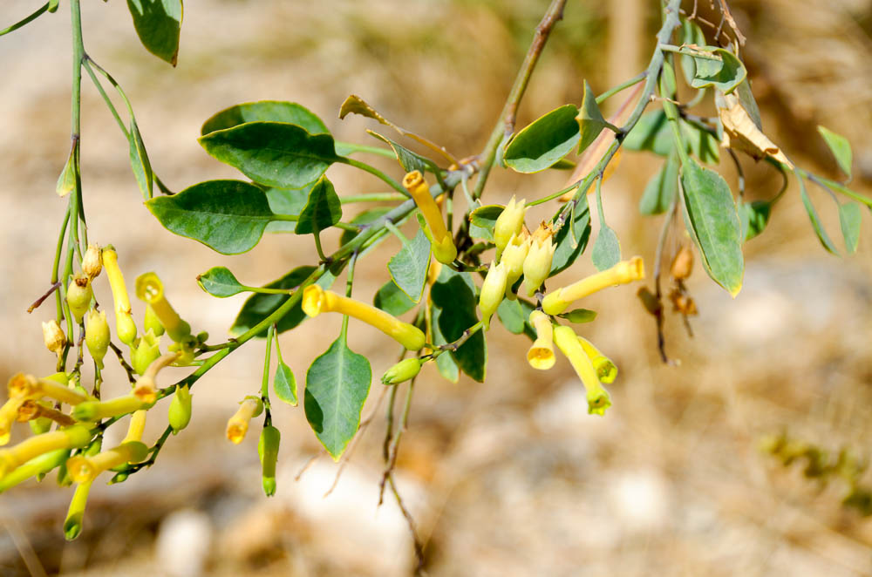
The kingdom of heaven is like a grain of mustard seed . . .
Mustard plant near Good Samaritan Inn
13:31
Notes:
tb053116582

Slide 17
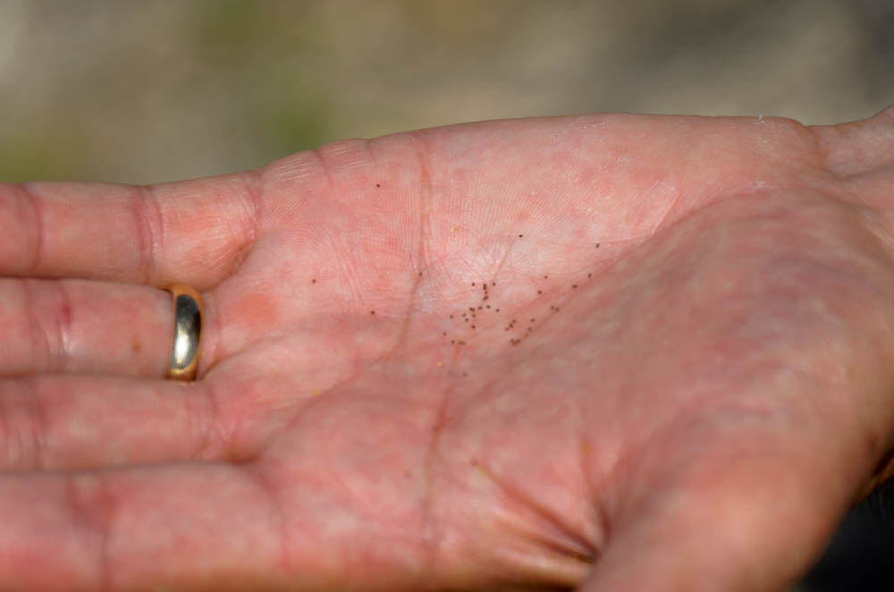
The kingdom of heaven is like a grain of mustard seed . . .
Mustard seeds in hand
13:31
Notes:
tb053116573

Slide 18
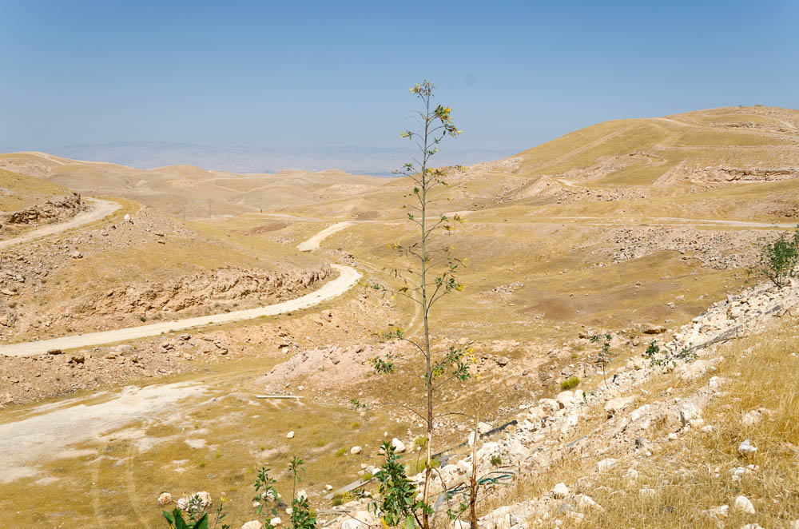
But when it is grown, it is greater than the garden plants and becomes a tree
Mustard plant near Good Samaritan Inn
13:32
Notes:
tb053116592

Slide 19
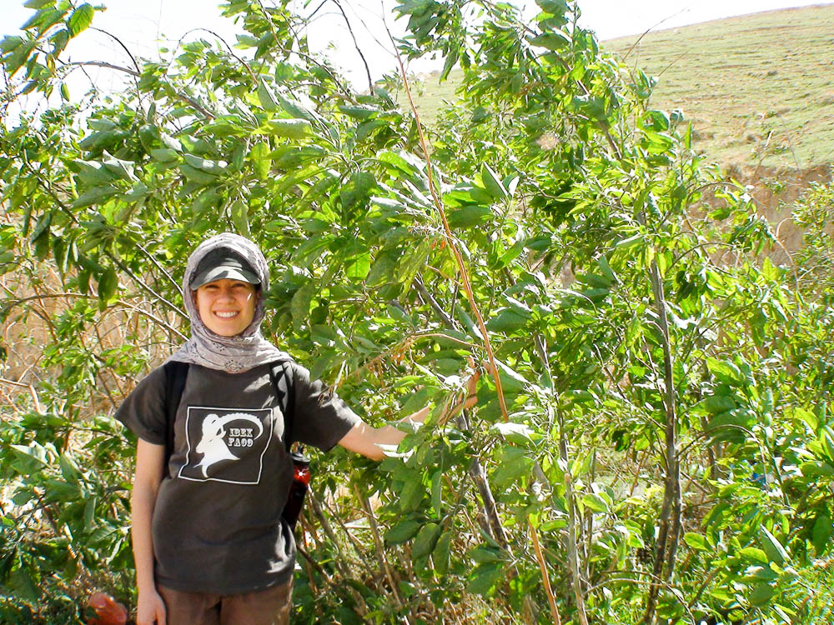
But when it is grown, it is greater than the garden plants and becomes a tree
Mustard plant
13:32
Notes:
ws022611001

Slide 20
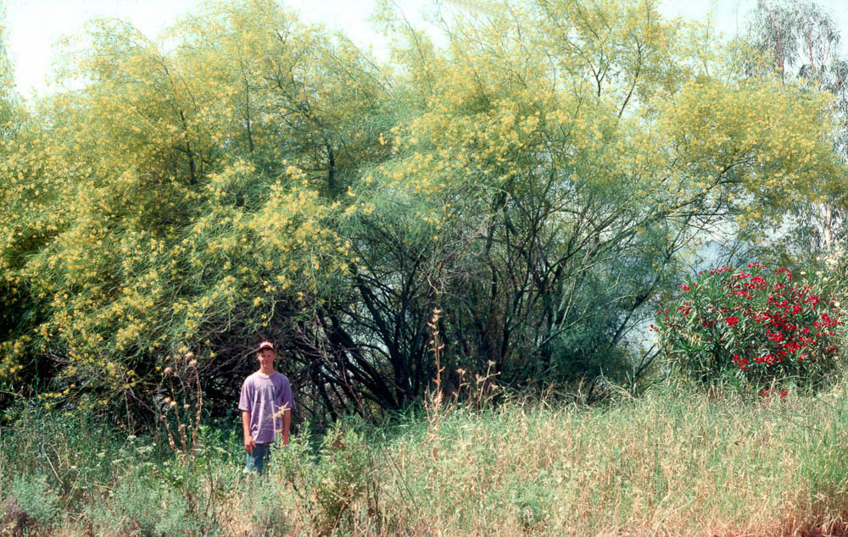
But when it is grown, it is greater than the garden plants and becomes a tree
Mustard plant
13:32
Notes:
dad2888

Slide 21
4. The Leaven
The Kingdom of Heaven grows and spreads impacting everything it touches, but this happens internally where it is harder to see.
Application: Focus on Internal Growth and External Growth Will Follow.

Slide 22
5. The Hidden Treasure
The Kingdom of Heaven is so valuable, that once we see it for what it really contains the only reasonable response is life-changing joy.
Application: Leave behind any necessary to be with the Lord.

Slide 23
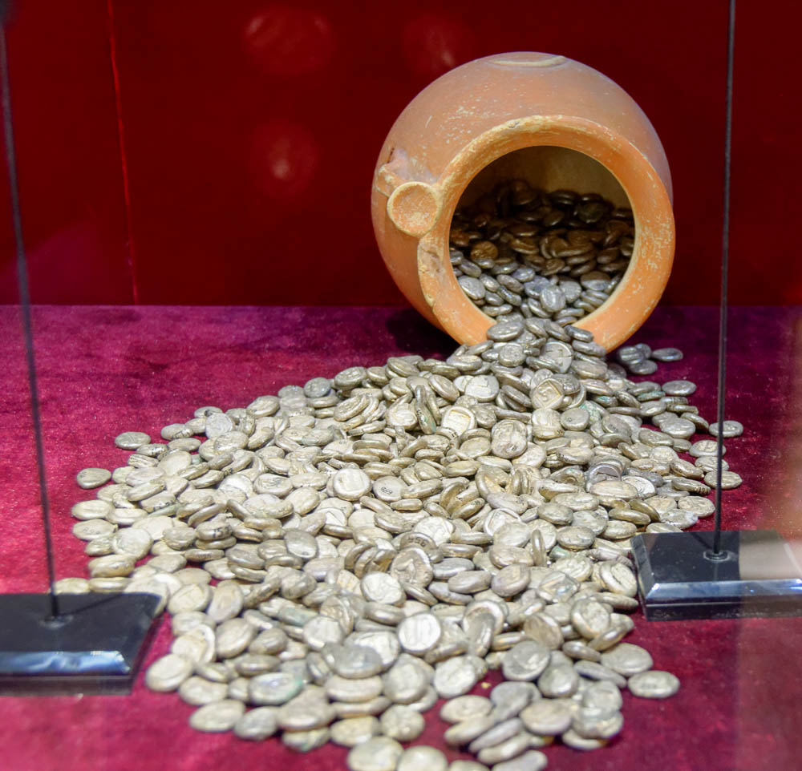
The kingdom of heaven is like a treasure hidden in a field
Coin treasure from southern Turkey
13:44
Notes:
This display was photographed in the Antalya Museum.
tb123016964

Slide 24
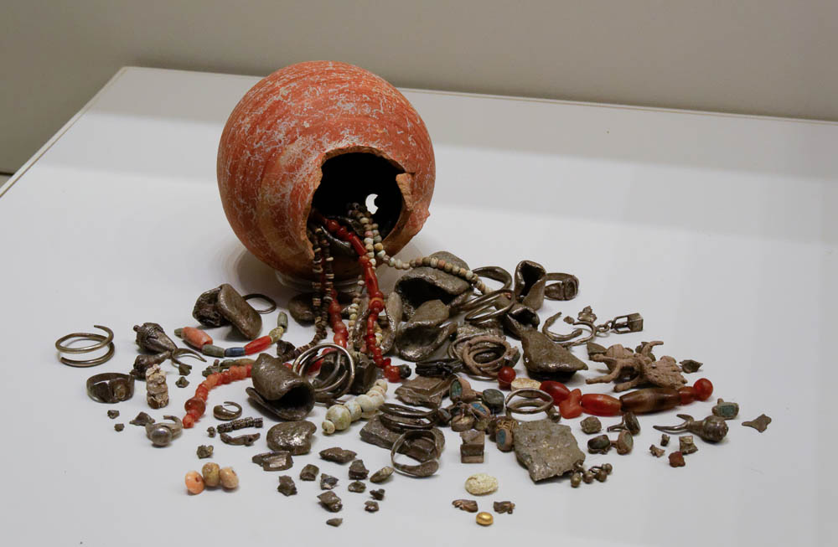
The kingdom of heaven is like a treasure hidden in a field
Treasure hoard from Ekron, 7th century BC
13:44
Notes:
This display was photographed in the Israel Museum.
tb032014405

Slide 25
6. The Pearl of Great Price
We must look for the Kingdom of Heaven carefully. There are many other imitators, but only one true kingdom of God. Seek until you find Him.
Application: Don’t settle for substitutes.

Slide 26
7. The Dragnet
The Kingdom of Heaven will be made up of every kind of people possible, and God will judge who is truly His child.
Application: Live to please the true Judge.

Slide 27
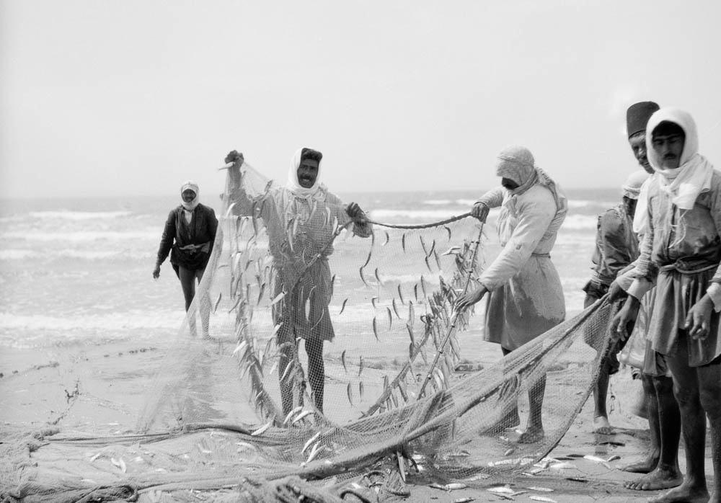
When it was filled, they drew up on the beach
Fishermen removing fish from a net near Haifa
13:48
Notes:
This American Colony photograph was taken between 1920 and 1933.
mat15379

Slide 28
The King
Sower: Reigns in the Heart By His Word
Tares: Is Good & Patient
Mustard: Offers Rest & Security
Leaven: Works Providentially
Hidden Treasure: Provides Riches of Grace
Pearl: Can Be & Will Be Found
Dragnet: Perfect Judge

Slide 29
The Kingdom
Sower: Spreads In Hearts All Over The World, But Will Be Rejected By Many
Tares: Is Under Attack From Evil Imposters
Mustard: Starts Small & Possesses An Unexpected Type of Glory
Leaven: Hard To See
Hidden Treasure: Source of Life-Changing Joy!
Pearl: Worthy of Every Sacrifice
Dragnet: Pulls In All Types, But Will Be Sorted.

Slide 30
Kingdom Citizens
Sower: Fruitful
Tares: Hard To Recognize True from False
Mustard: Growing Faith
Leaven: Spreading Influence
Hidden Treasure: Recognize Amazing Value
Pearl: Seekers
Dragnet: Sorted & Judged for Eternity

Slide 31
The Gospel of Matthew

Slide 32
Matthew 11: John & Jesus
Jesus Responds To John’s Question
Vs. 1-11
Jesus Explains John’s Role In The Kingdom
Vs. 12-19
Jesus Rebukes The Faithlessness in Galilee.
Vs. 20-30
Notes:
There’s a part of me that really want to pause and talk about the Kingdom of Heaven here…but next class is Ch 13 where we will focus almost entirely on the kingdom. So we are going to come back to this verse on Wednesday night. We just have so much in these chapters.
WORKBOOK QUESTIONS:

Slide 33
The Pharisees…
Condemn The Innocent (12:1-14)
But Jesus Is The Servant Who Brings Hope To The Gentiles (12:15-21)
Misjudge & Reject The Spirit (12:22-24)
But Jesus Honors The Spirit (12:25-32)
Jesus Calls For Integrity, Not Hypocrisy (12:33-37)
Ask For A Sign (12:38)
But Jesus Foretells The Sign of Jonah & Holds Them Accountable For The Numerous Signs Already Performed.
Notes:
Overview before we look at 1-14

Slide 34
Matthew 12: The Sabbath
You Are Judging Too Quickly, Without Proper Understanding, and Without Mercy.
They are condemning the Innocent. (vs. 7)
They allow rescuing livestock, but not a few heads of grain. Why is that? They need to slow down and think about it.
Slow Down & Remember: Even Though What David Did Was Unlawful, People Commonly Judged Him Mercifully.
Slow Down & Remember: Some Acts of Service May Appear To Be Work But Are Not A Violation of The Law.
Notes:
Because it is compassionate. Because it is an act of mercy, not an act driven by business profit.
Because they are not rejecting or resisting God’s commands.
Because they can distinguish between work for profit and an act of sympathy. Just as we can distinguish picking up a snack, vs harvesting 100 acres of land.
Then, You’ll See These Men Have Not Violated The Sabbath.

Slide 35
Matthew 12: The Sabbath
Two Things Jesus Is NOT Teaching:
When to Break God’s Law. Jesus Declares That The Apostles Were Not Breaking The Law In The First Place.
Relieving Hunger & Suffering Are More Important Than Observing The Sabbath. Jesus Never Taught Like That.
Three Things Jesus IS TEACHING:
How To Better Understand God’s Law About The Sabbath.
Jesus Declares It Is LAWFUL To Do Good On The Sabbath.
Jesus Calls On Us To Avoid Hypocrisy By Measuring Others with Greater Mercy.
Notes:
HE IS TEACHING: God Desires Mercy!!! Jesus Declares That Improved Understanding of What God Desires Will Help Us Understand The Law of the Sabbath Better.
Application Is NOT: Break God’s Law When Its Hard or Seems “Best” To Us.
Application IS: Jesus is the authority. God’s laws direct us to do good. Beware of judging others quickly (especially in hypocrisy).

Slide 36
The Pharisees…
Condemn The Innocent (12:1-14)
But Jesus Is The Servant Who Brings Hope To The Gentiles (12:15-21)
Misjudge & Reject The Spirit (12:22-24)
But Jesus Honors The Spirit (12:25-32)
Jesus Calls For Integrity, Not Hypocrisy (12:33-37)
Ask For A Sign (12:38)
But Jesus Foretells The Sign of Jonah & Holds Them Accountable For The Numerous Signs Already Performed.
Notes:
Honors the Spirit:: vs. 28 is HUGELY IMPORTANT!
** Unforgivable sin. >> To permanently conclude. Remebmer, Paul rejected Jesus but came around later. This is not a matter of doubting – This is a matter or rejecting.

Slide 37
Sins Against The Spirit
Let Us Welcome, Not Resist (Acts 7:57)
Let Us Promote, Not Quench (1 Thess. 5:19)
Let Us Please, Not Grieve (Eph. 4:30)
Let Us Respect, Not Insult (Heb. 10:26-31)
Let Us Honor, Not Blaspheme (Matt. 12:31)
Notes:
The Example: The Pharisees
Matthew 12:31-32
The Meaning: Permanently concluding that the work of the Holy Spirit is of Satan, and therefore rejecting the gospel as un-confirmed and un-true.
More specific than rejecting the gospel.
More conclusive than critically considering the validity of Biblical evidence. (1 Timothy 1:12-16)
The Application: If we completely reject the work of the Holy Spirit we have rejected Jesus’ works and words and can thus never develop a saving faith. (Hebrews 6:4-6)
Blaspheme in its most general sense is speaking evil against God. (Blaspheming Jesus = Luke 22:65) Three Ideas to understand.
1. Continued and obstinate rejection of the gospel, therefore cutting yourself off from forgiveness. (I think this is partially correct in describing the sin as an on-going obstinate rejection, but I believe Jesus is talking about more than just rejecting the Gospel here. Rejecting the gospel is horrible and will result in being lost…but I wouldn’t say that is all this passage is talking about.)
2. Attributing to Satan the miracles which Christ performed. (I think this is closer because it fits the actions which prompted Jesus to give this teaching in the first place. Certainly this is a rejection not just of the gospel but a rejection of Christ Himself and of the Holy Spirit’s power working through Christ…but in its most general, unqualified sense this would mean anyone who ever believes Jesus miracles to be invalid is beyond forgiveness, and I think Paul himself is proof that this is not the case. Many people will deliberate long and hard about the validity of Jesus miracles and may initially reach the wrong conclusions just as Paul had, yet later find forgiveness.)
3. Seems to best fit the context and best explain why this sin is unforgiveable: Permanently concluding that the work of the Holy Spirit, is actually the work of Satan, and therefore rejecting the gospel as un-confirmed and un-true.
The FACT is that there is only ONE GOD, and if you reject God the Father, God the Son, or God the Spirit - you have rejected God. To use very plain and simple terms - Faith is a package deal. (1Jo 2:23 Whoever denies the Son does not have the Father; the one who confesses the Son has the Father also.) You can’t accept one and reject the other.
If you reject the Holy Spirit’s work, you are rejecting Jesus, and the Father as well.
There are many who have this conclusion at one time or another. But those who are seeking the truth can be led back based on the evidence. But if we abandon the evidence, all hope of forming true faith a gone.

Slide 38
Exposing & Avoiding Hypocrisy
11:6 – Do Not Take Offense At Jesus. Yes, He Surprises & Challenges Us, So Learn From Him.
11:19 – Do Not Exaggerate, Classify & Then Dismiss The Life of Jesus.
He’s just like all the others…
He’s no model, after all He…
11:23 – Do Not Put Your Hope In Your Proximity To Godly People. Be Godly.
12:33-37 – Have Good Roots & Good Fruits
What Is in My Heart & What comes out of my mouth?

Slide 39
Behold…the Family of God
We Must Be Disciples of Jesus, The Servant.
We Must Realize He Fulfills The Prophecies.
We Must Appreciate & Honor The Spirit.
We Must Live With Integrity In Speech & Acts.
We Must Respond To His Miracles.
We Must Respond To His Crucifixion.
We Must Do The Will of God the Father.

Slide 40
The Gospel of Matthew

