Slide 1
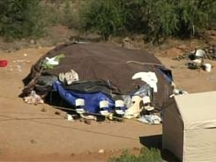

Slide 2
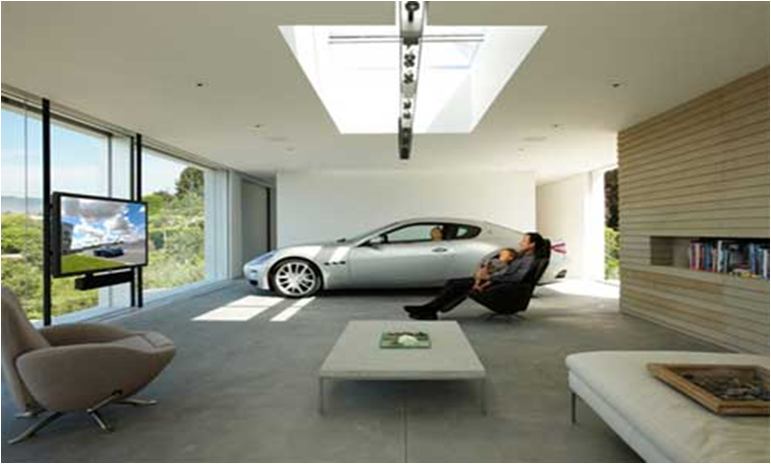
Have I Been Told the Truth?
Messages which challenge today’s conventional thinking about…
Prosperity
When the Good Life Isn’t Good Enough

Slide 3
Ecclesiastes and the “man on top of the world”
Ecclesiastes 1:3
What profit has a man from all his labor In which he toils under the sun?
Ecclesiastes 1:12-13
I, the Preacher, was king over Israel in Jerusalem. And I set my heart to seek and search out by wisdom concerning all that is done under heaven; this burdensome task God has given to the sons of man, by which they may be exercised.

Slide 4
Ecclesiastes and the “man on top of the world”
Ecclesiastes 2:1-6
I said in my heart, "Come now, I will test you with mirth; therefore enjoy pleasure"; but surely, this also was vanity. I said of laughter — "Madness!"; and of mirth, "What does it accomplish?“ I searched in my heart how to gratify my flesh with wine, while guiding my heart with wisdom, and how to lay hold on folly, till I might see what was good for the sons of men to do under heaven all the days of their lives.
I made my works great, I built myself houses, and planted myself vineyards. I made myself gardens and orchards, and I planted all kinds of fruit trees in them. I made myself water pools from which to water the growing trees of the grove.

Slide 5
Ecclesiastes and the “man on top of the world”
Ecclesiastes 2:7-11
I acquired male and female servants, and had servants born in my house. Yes, I had greater possessions of herds and flocks than all who were in Jerusalem before me. I also gathered for myself silver and gold and the special treasures of kings and of the provinces. I acquired male and female singers, the delights of the sons of men, and musical instruments of all kinds.
For my heart rejoiced in all my labor;
And this was my reward from all my labor.
Then I looked on all the works that my hands had done
And on the labor in which I had toiled;
And indeed all was vanity and grasping for the wind.
There was no profit under the sun.

Slide 6
Ecclesiastes and the “man on top of the world”
Vanity (vapor, empty)
No profit
Grasping for the wind
Our experience – Is this familiar?
Prosperity…things…experiences

Slide 7
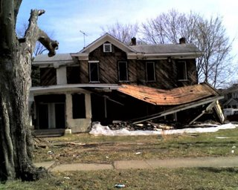
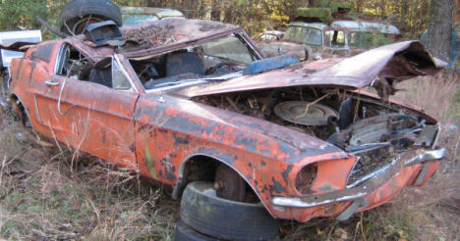

Slide 8
Ecclesiastes and the “man on top of the world”
Vanity (vapor, empty)
No profit
Grasping for the wind
Our experience – Is this familiar?
Prosperity…things…experiences

Slide 9
When the good life isn’t good enough
Don’t depend on material things for happiness and fulfillment

Slide 10
When the good life isn’t good enough
Don’t trust in material things

Slide 11
When the good life isn’t good enough
Beware of the “I need more things, I need different things, and I need new things” cycle
Ecclesiastes 5:10
He who loves money will not be satisfied with money, nor he who loves wealth with his income; this also is vanity.
Ecclesiastes 6:9
Better is the sight of the eyes than the wandering of the appetite: this also is vanity and a striving after wind
(English Standard Version)

Slide 12
When the good life isn’t good enough
See through the cravings for material things that complicate and burden our lives
Ecclesiastes 4:6
Better a handful with quietness Than both hands full, together with toil and grasping for the wind.
Ecclesiastes 5:11-12
When goods increase, They increase who eat them; So what profit have the owners Except to see them with their eyes? The sleep of a laboring man is sweet, Whether he eats little or much; But the abundance of the rich will not permit him to sleep.

Slide 13
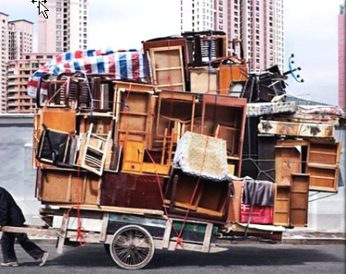

Slide 14
When the good life isn’t good enough
Enjoy life now with what you have
Ecclesiastes 2:24
Nothing is better for a man than that he should eat and drink, and that his soul should enjoy good in his labor. This also, I saw, was from the hand of God.

Slide 15
When the good life isn’t good enough
Enjoy life now with what you have
Ecclesiastes 9:7-10
Go, eat your bread with joy,
And drink your wine with a merry heart;
For God has already accepted your works.
Let your garments always be white,
And let your head lack no oil.
Live joyfully with the wife whom you love all the days of your vain life which He has given you under the sun, all your days of vanity; for that is your portion in life, and in the labor which you perform under the sun. Whatever your hand finds to do, do it with your might; for there is no work or device or knowledge or wisdom in the grave where you are going.

Slide 16
When the good life isn’t good enough
Invest in spiritual, eternal treasure
Luke 12:15, 20-21
And He said to them, "Take heed and beware of covetousness, for one's life does not consist in the abundance of the things he possesses."
But God said to him, 'Fool! This night your soul will be required of you; then whose will those things be which you have provided?'
"So is he who lays up treasure for himself, and is not rich toward God."

Slide 17
When the good life isn’t good enough
Invest in spiritual, eternal treasure
Matthew 6:19-21
"Do not lay up for yourselves treasures on earth, where moth and rust destroy and where thieves break in and steal; but lay up for yourselves treasures in heaven, where neither moth nor rust destroys and where thieves do not break in and steal. For where your treasure is, there your heart will be also.

Slide 18
When the good life isn’t good enough
Invest in spiritual, eternal treasure
I Corinthians 15:58
Therefore, my beloved brothers, be steadfast, immovable, always abounding in the work of the Lord, knowing that in the Lord your labor is not in vain. (ESV)

Slide 19
Have I Been Told the Truth?
Messages which challenge today’s conventional thinking about…
Prosperity
When the Good Life Isn’t Good Enough

