Slide 1
The Gospel of Matthew

Slide 2
Overview of Chapters 14-17
Ch. 14: Feeding the 5,000 & Walking on Water
Ch. 15: Doctrines of Men & Feeding 4,000
Ch. 16: Warning of Leaven & Confessing Christ
Ch. 17: Transfiguration & Temple Tax
Notes:
In ch 13, Jesus’ Kingdom parables explained that not everyone would accept His teachings.
This section records BOTH faith & opposition.
TRANSITION:
The “masks” of hypocrisy worn by the Pharisees are called out….and they are a reminder for us to follow God with integrity and sincerity.

Slide 3
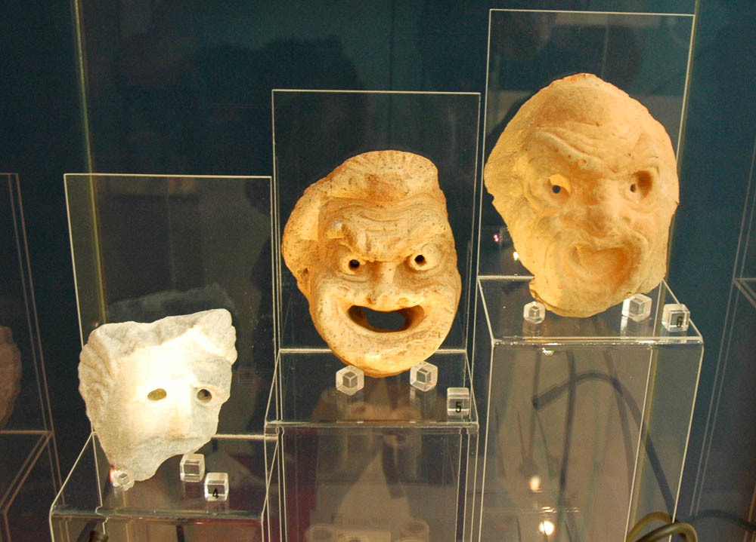
You hypocrites!
Theater masks from Malta
15:7
Notes:
The Greek word for “hypocrite” originally referred to an actor, who pretended to be someone else than himself. These masks are on display in the Domus Romana Museum in Rabat, Malta.
tb112005640

Slide 4
Emphasis of 14-17: Jesus Is The Christ
His Great Public Miracles Verify It.
14:14, 15:32
His Wisdom with the Law Verifies It.
15:3-9
His Apostle’s Faith Verifies It.
16:16
His Glory Before Moses & Elijah Verifies It.
17:3
His Father’s Declaration Verifies It.
17:5

Slide 5
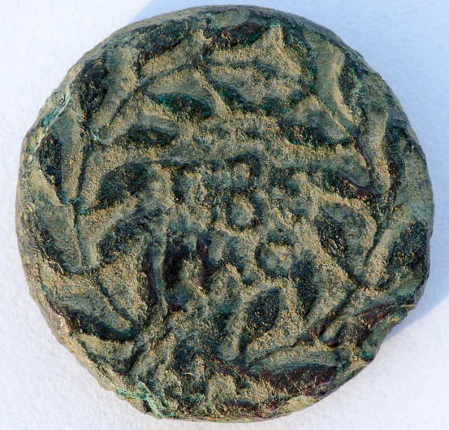
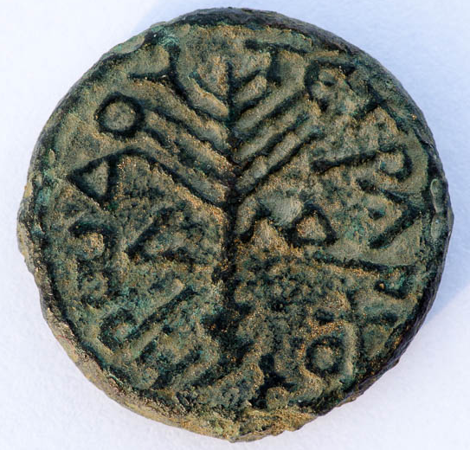
At that time Herod the tetrarch heard the report concerning Jesus
Bronze coin of Herod Antipas, AD 30/31, from the Tiberias mint
14:1
Notes:
Inscription: A coin of Herod the Tetrarch. *Great reminder that it’s not just Jesus visiting all of these places…but the people of the Bible are verified too!
The obverse of this coin contains the text ΤΙΒΕΡΙΑϹ (“Tiberias”) within a wreath. The reverse depicts an upright palm branch surrounded by the inscription ΗΡωΔΟΥ ΤΕΤΡΑΡΧΟΥ (“[a coin of] Herod the tetrarch”). The reverse also contains the date L (“year”) ΛΔ (34 = AD 30/31). This coin is in the Jared James Clark Collection.
Obverse (left): tb0713158746; reverse (right): tb0713158738

Slide 6
John the Baptist & Feeding The 5,000
What do we learn about John’s character?
Two Big Lessons
Speaking the Truth About Unlawful Marriages.
The Danger of Lust, Pride, & Foolish Vows.
Two Big Miracles
Feeding The 5,000
Jesus & Peter Walk On The Water
Notes:
His Courage & His Death
Feeding the 5,000 – Notice that Jesus prays for this meal. Prayer is mentioned often by Matthew – We need to imiate this about Jesus!
we can TRUST JESUS, with everything we have! Give Him our All.
Peter: Get’s a taste of walking by Faith. What do we learn about walking by faith: Walking by Faith is: Going where Jesus calls us to come. Going where we can’t go alone. Going, but only as far as we keep our eyes fixed on HIM. Depending on Him when we are sinking!
TRANSITION: These 2 miracles are well remembered…. Photos….

Slide 7
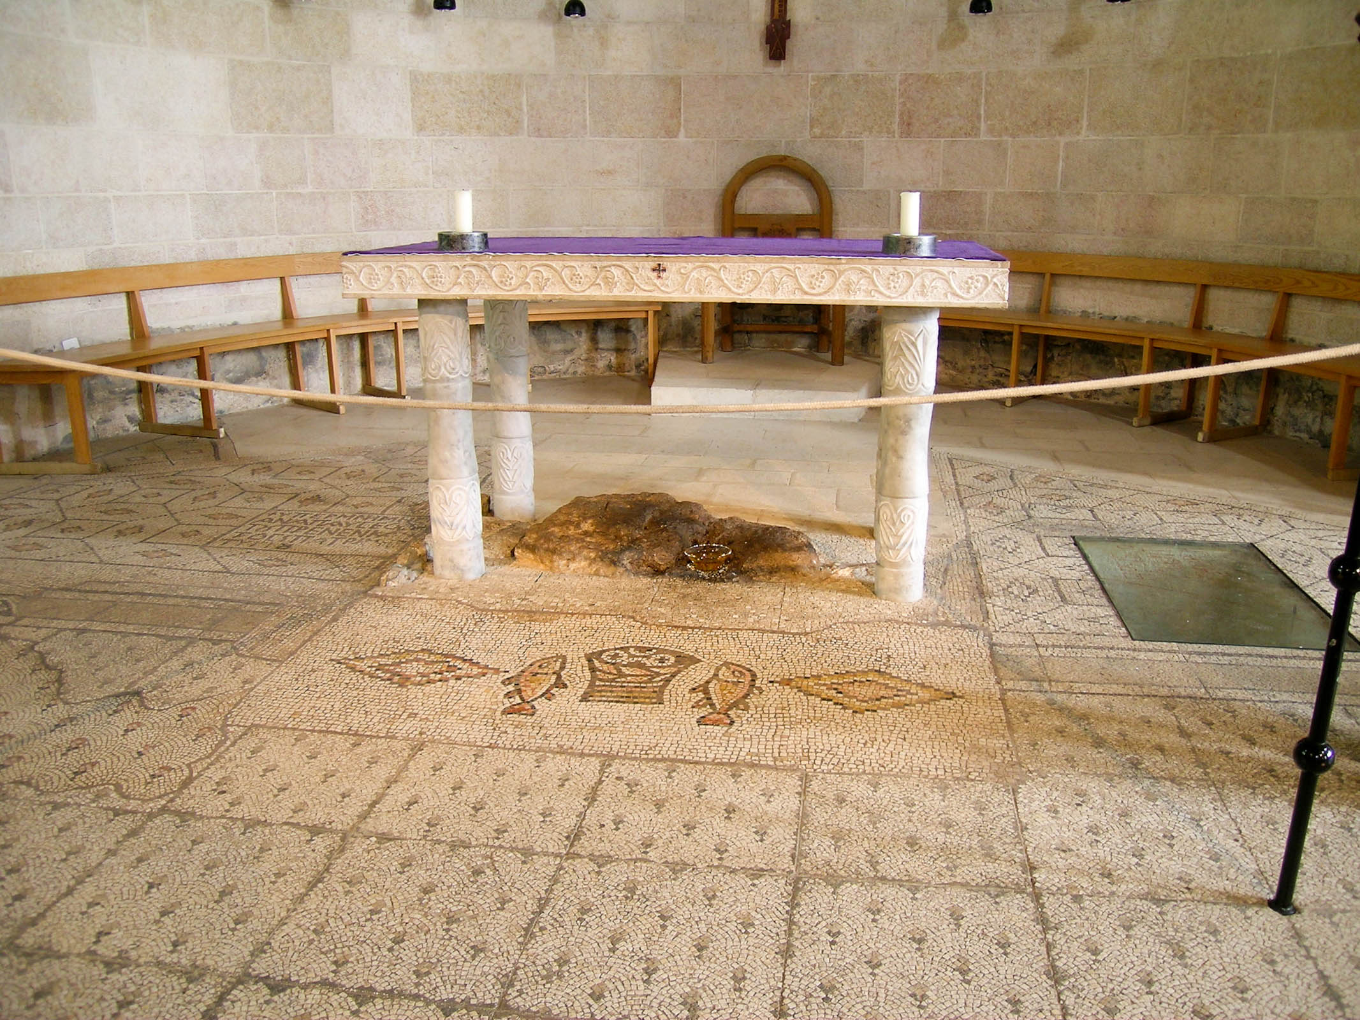
And they said to Him, We have only five loaves here and two fishes
Mosaic of fish and loaves from Tabgha
14:17
Notes:
The Church of Multiplication of Loaves and Fishes at Tabgha (ancient Heptapegon) commemorates this miracle, but it is based on the incorrect identification of Tabgha with Bethsaida. Nonetheless, the ancient depiction of the loaves and fish provide a valuable, historic illustration of the event.
tb032804310

Slide 8
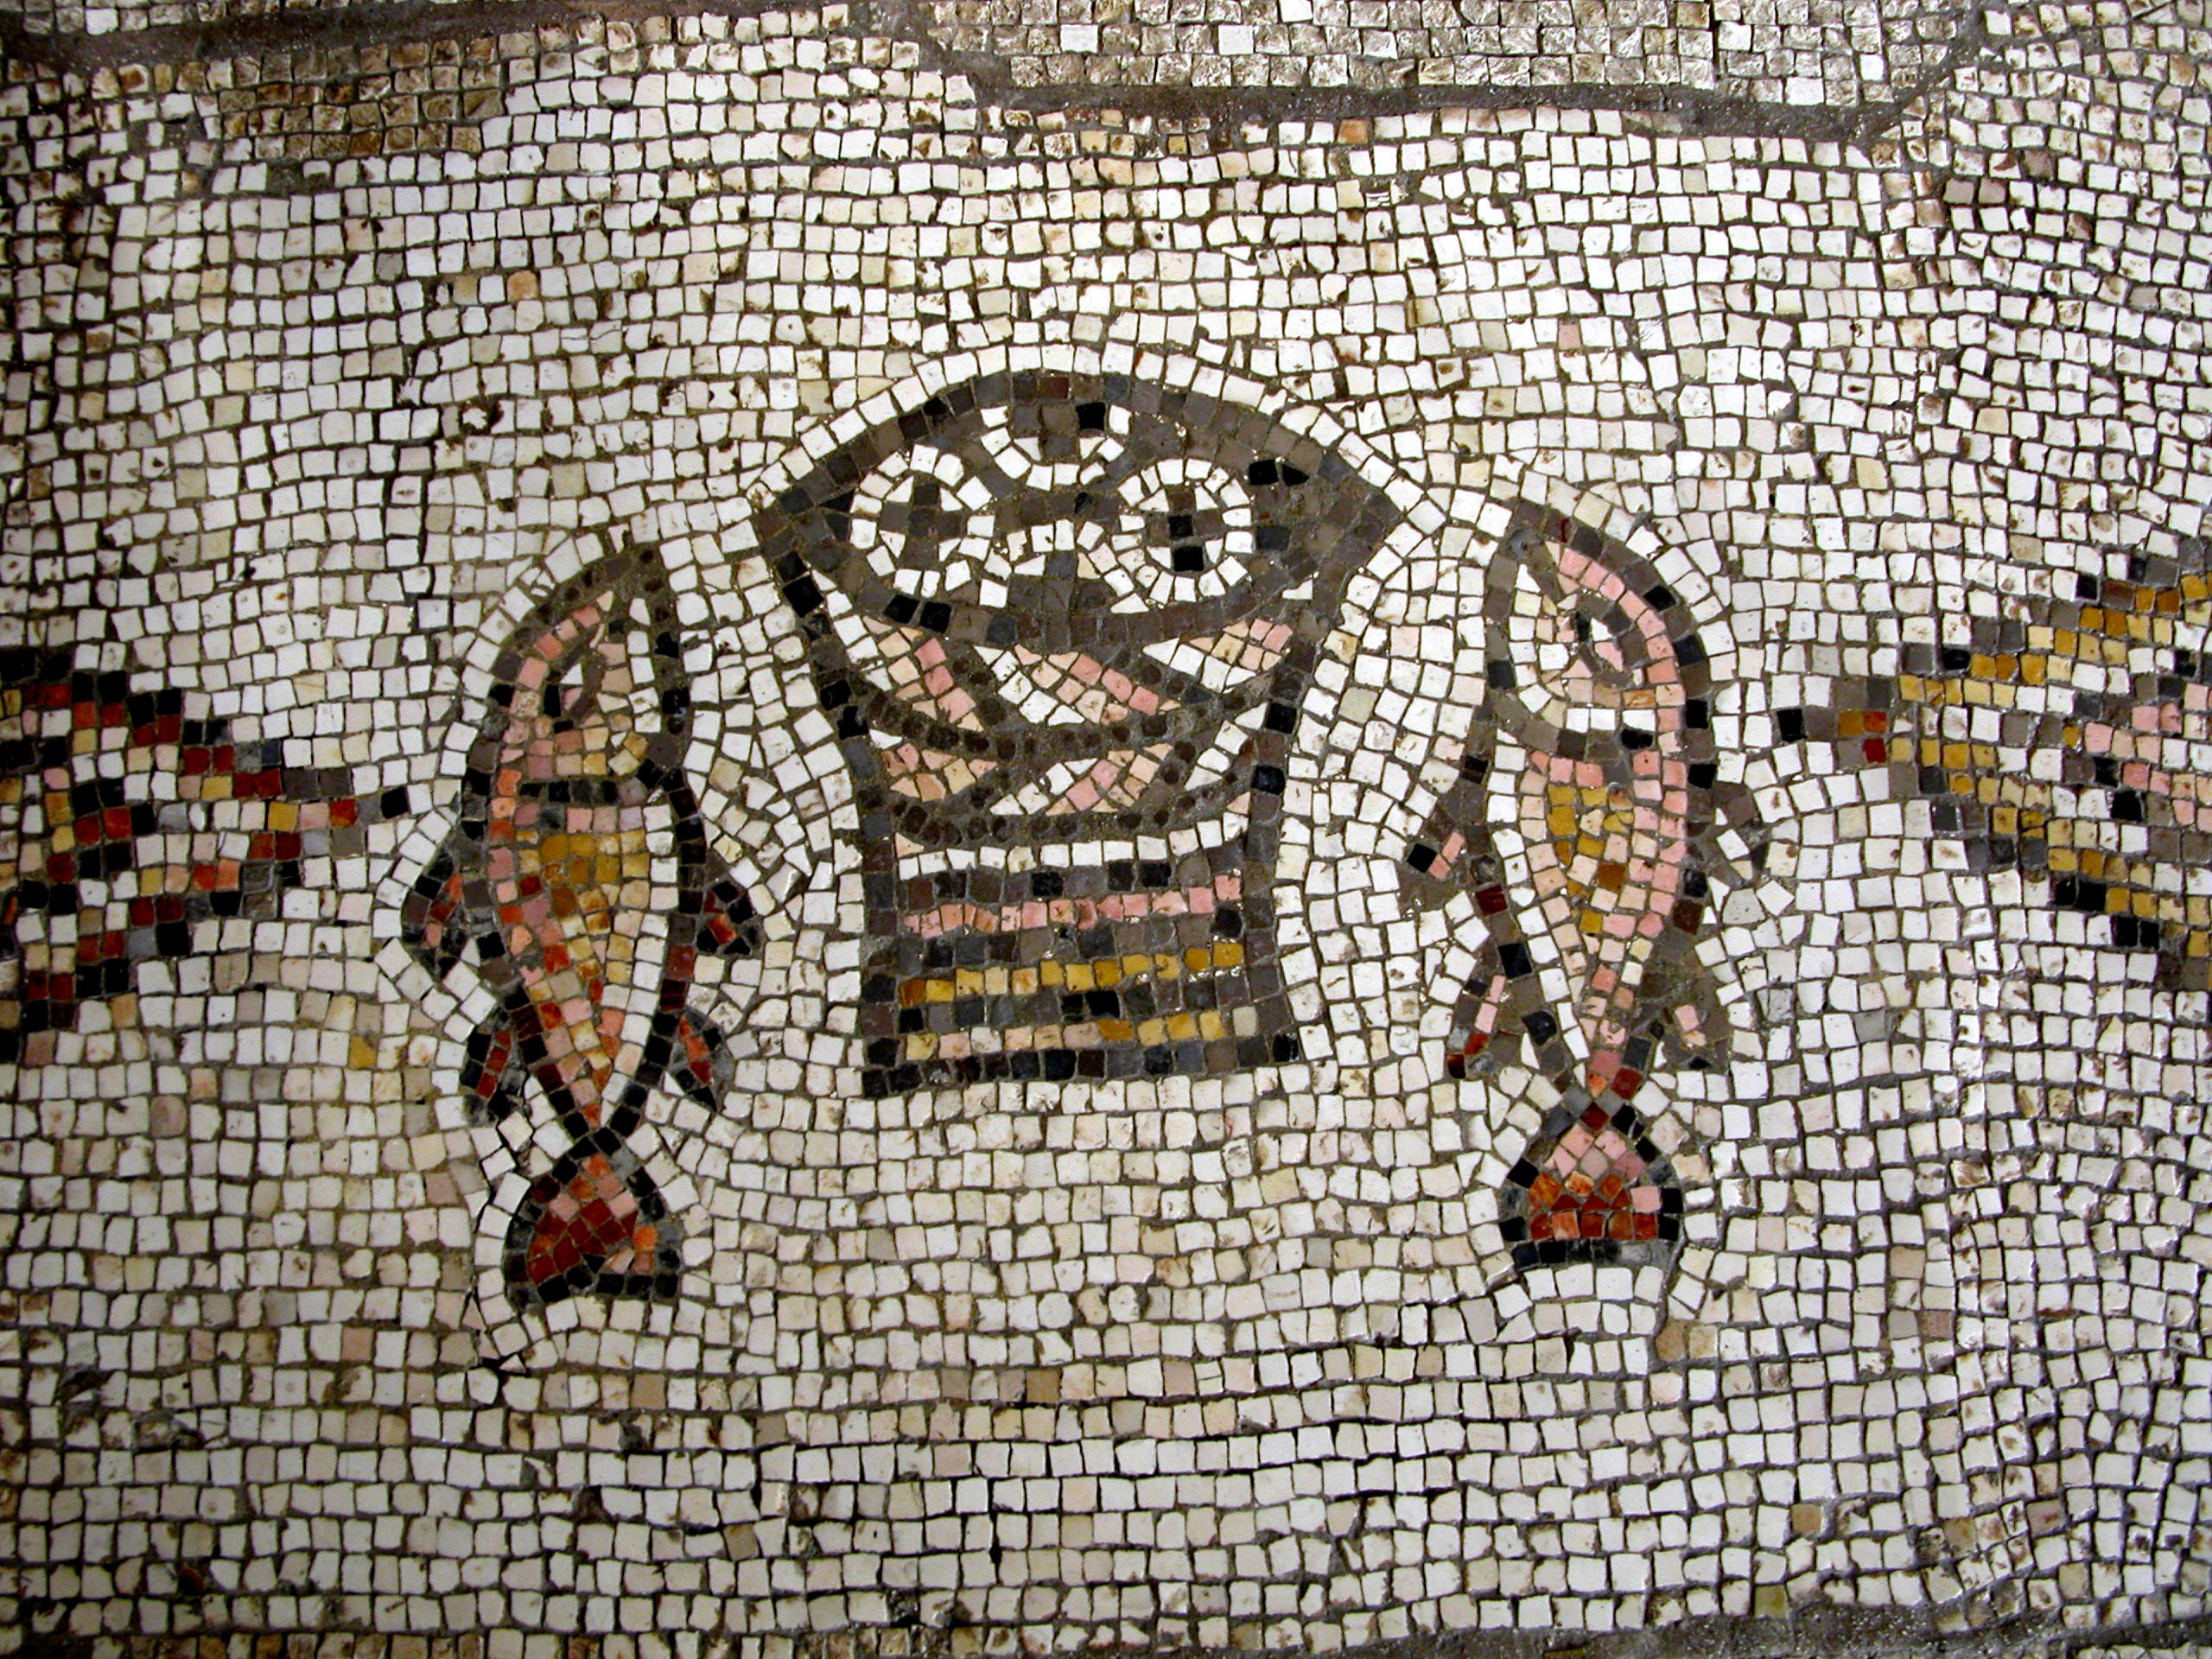
And they said to Him, We have only five loaves here and two fishes
Mosaic of fish and loaves from Tabgha
14:17
Notes:
This is a close-up of the mosaic shown in the previous photo.
tb102702024

Slide 9
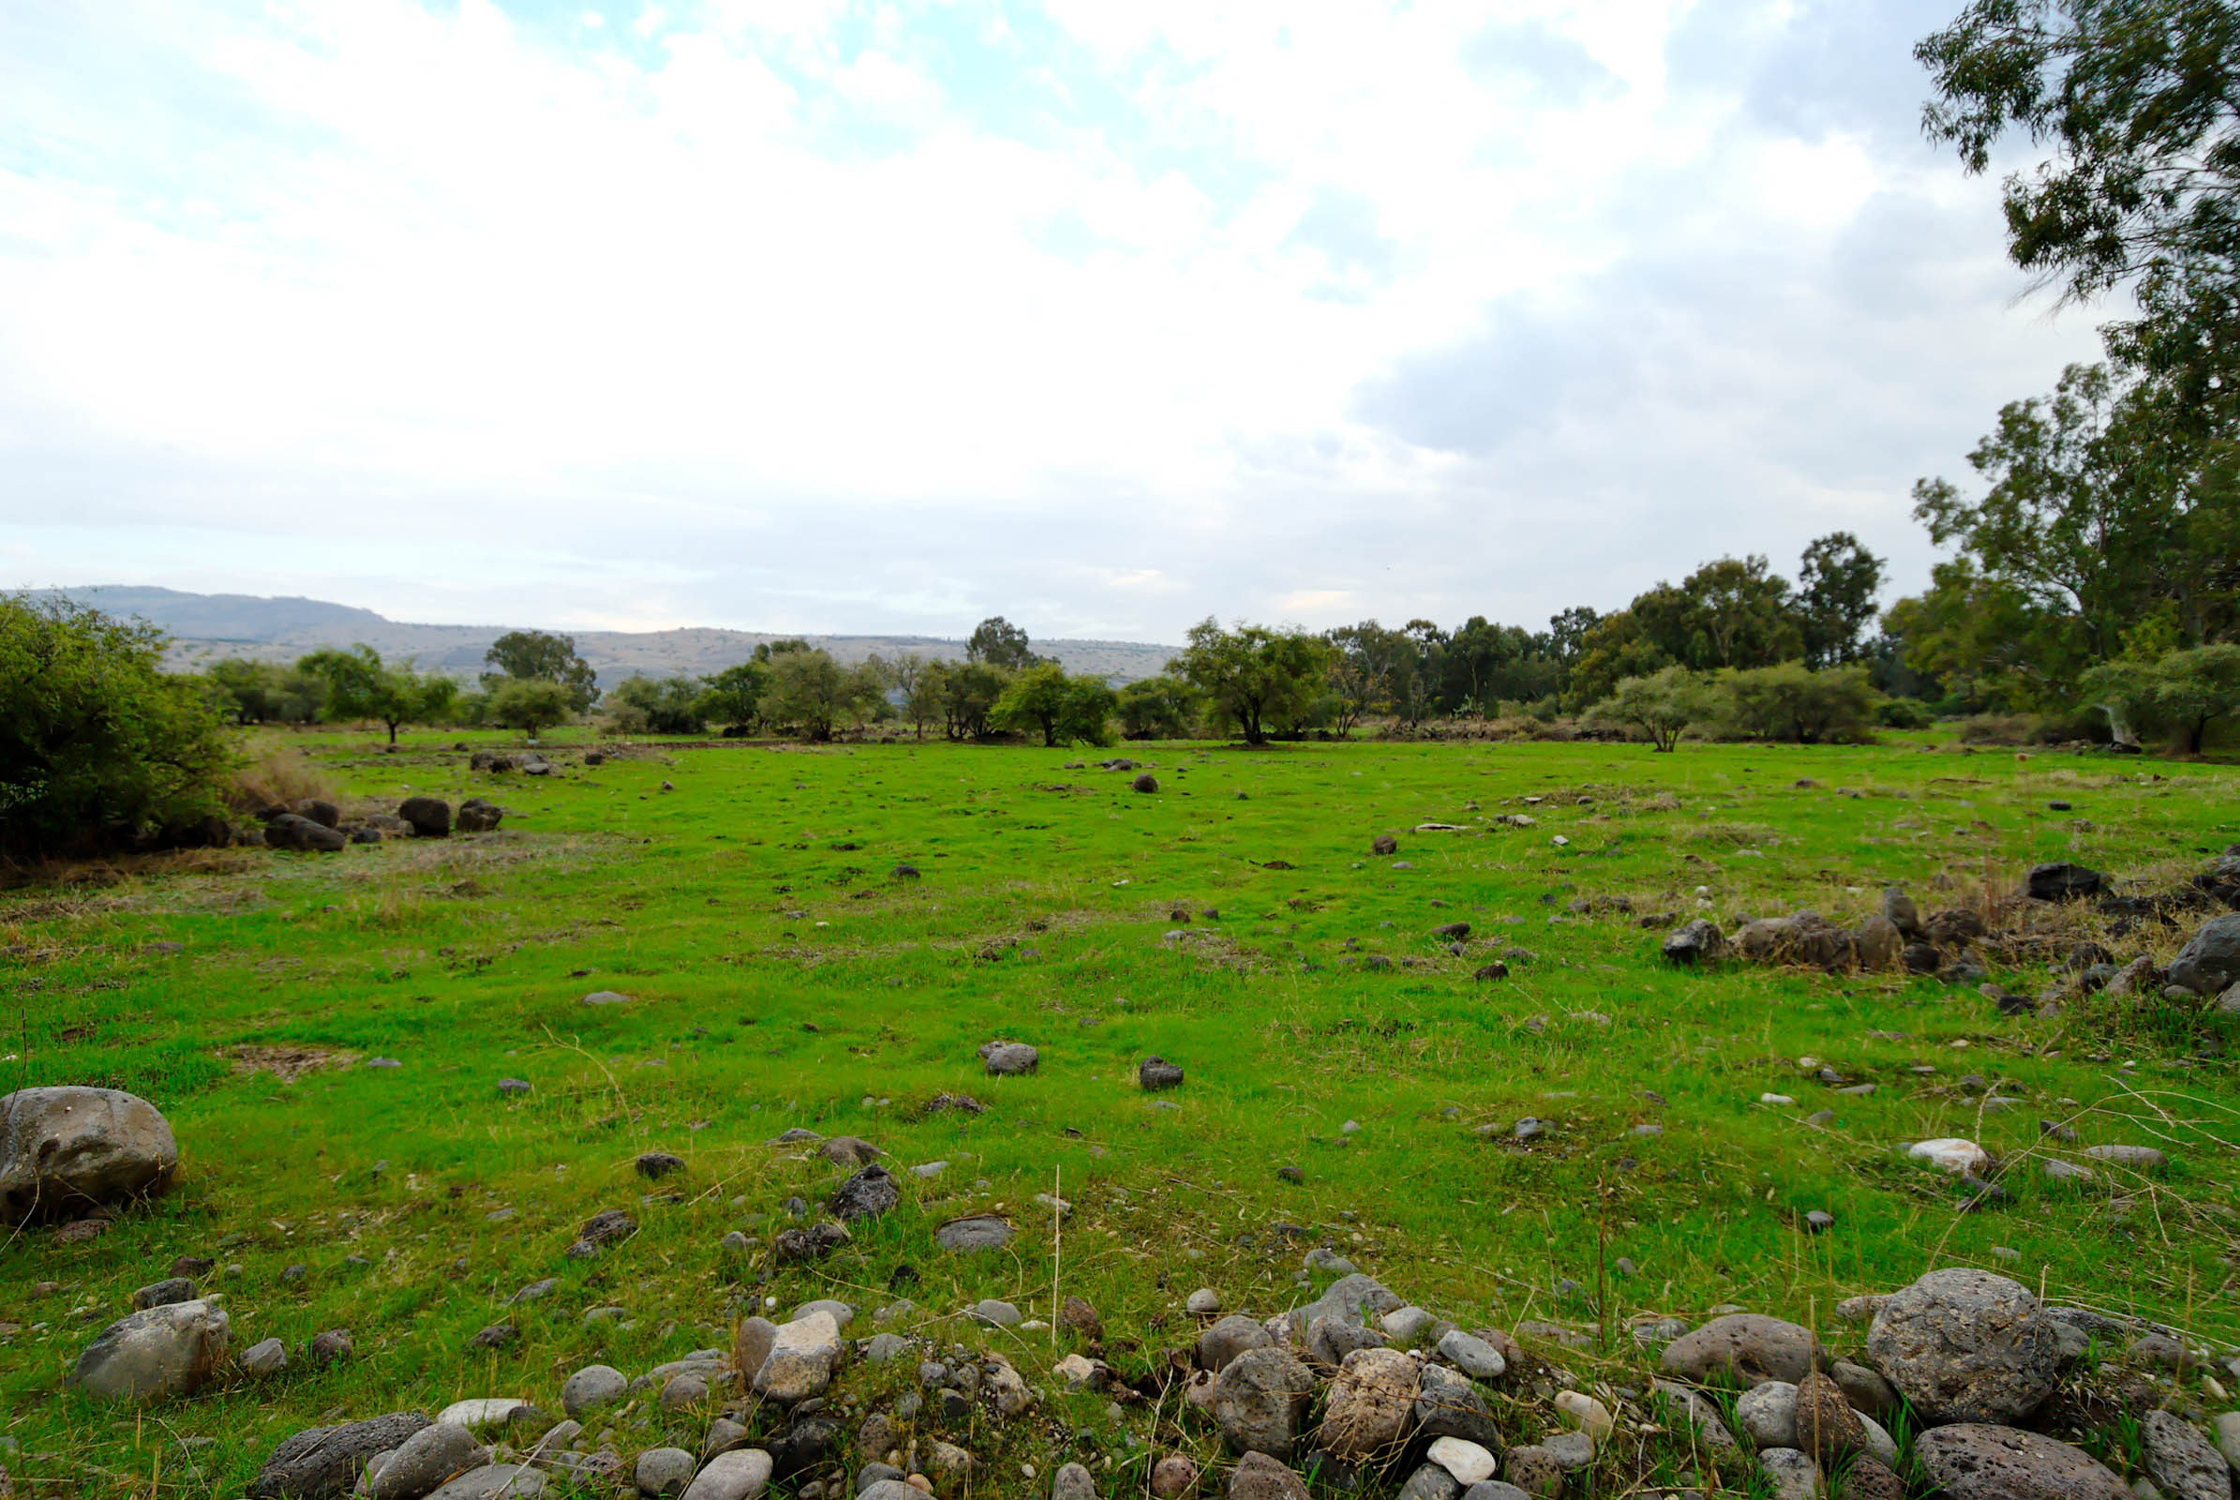
And He commanded the crowds to sit down on the grass
Plain of Bethsaida with green grass
14:19
Notes:
Mark 6:39 adds the detail that the grass was green. This may not be the same area as the miracle, but it gives a good visual representation and it is likely not far from the place where the crowds sat down to eat.
tb110206630

Slide 10
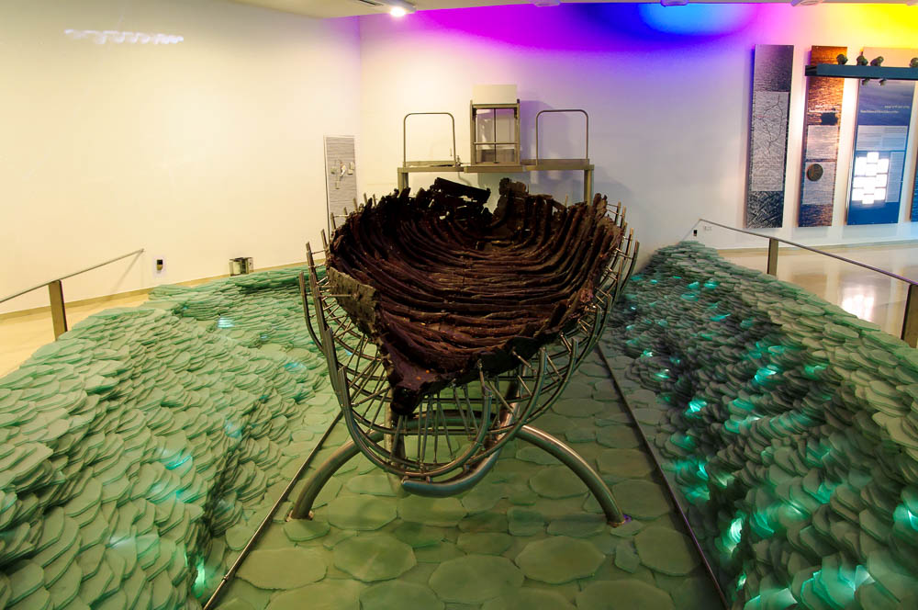
And immediately He made the disciples get into the boat
First-century AD boat excavated in the Sea of Galilee
14:22
Notes:
This boat was excavated about 600 meters south of Kibbutz Nof Ginosar. It is now on display at the Yigal Alon Museum at the kibbutz.
adr1305051109

Slide 11
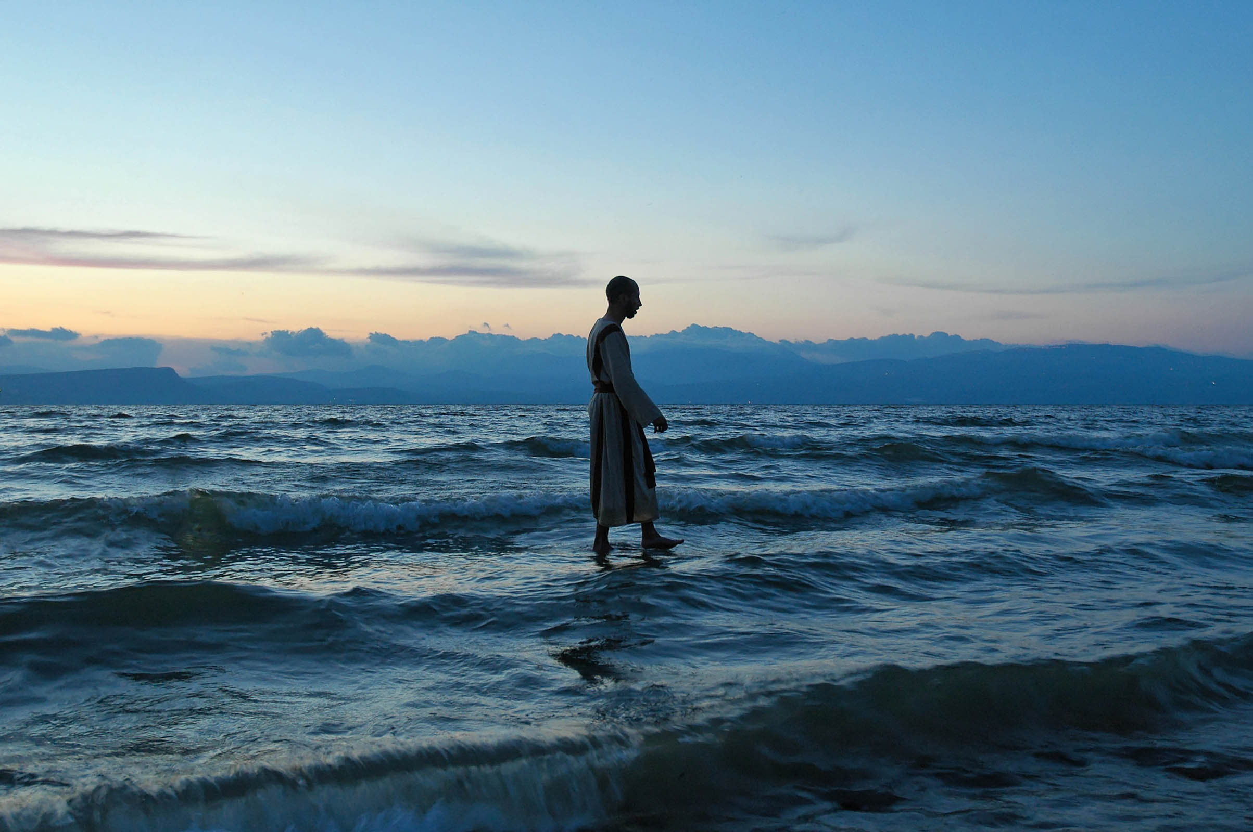
And in the fourth watch of the night He came to them, walking on the sea
Dramatization of Jesus walking on the Sea of Galilee
14:25
Notes:
This scene was recreated with one of our students one evening while staying at the En Gev Holiday Resort. The effect was accomplished without the assistance of Photoshop.
tb040606161

Slide 12
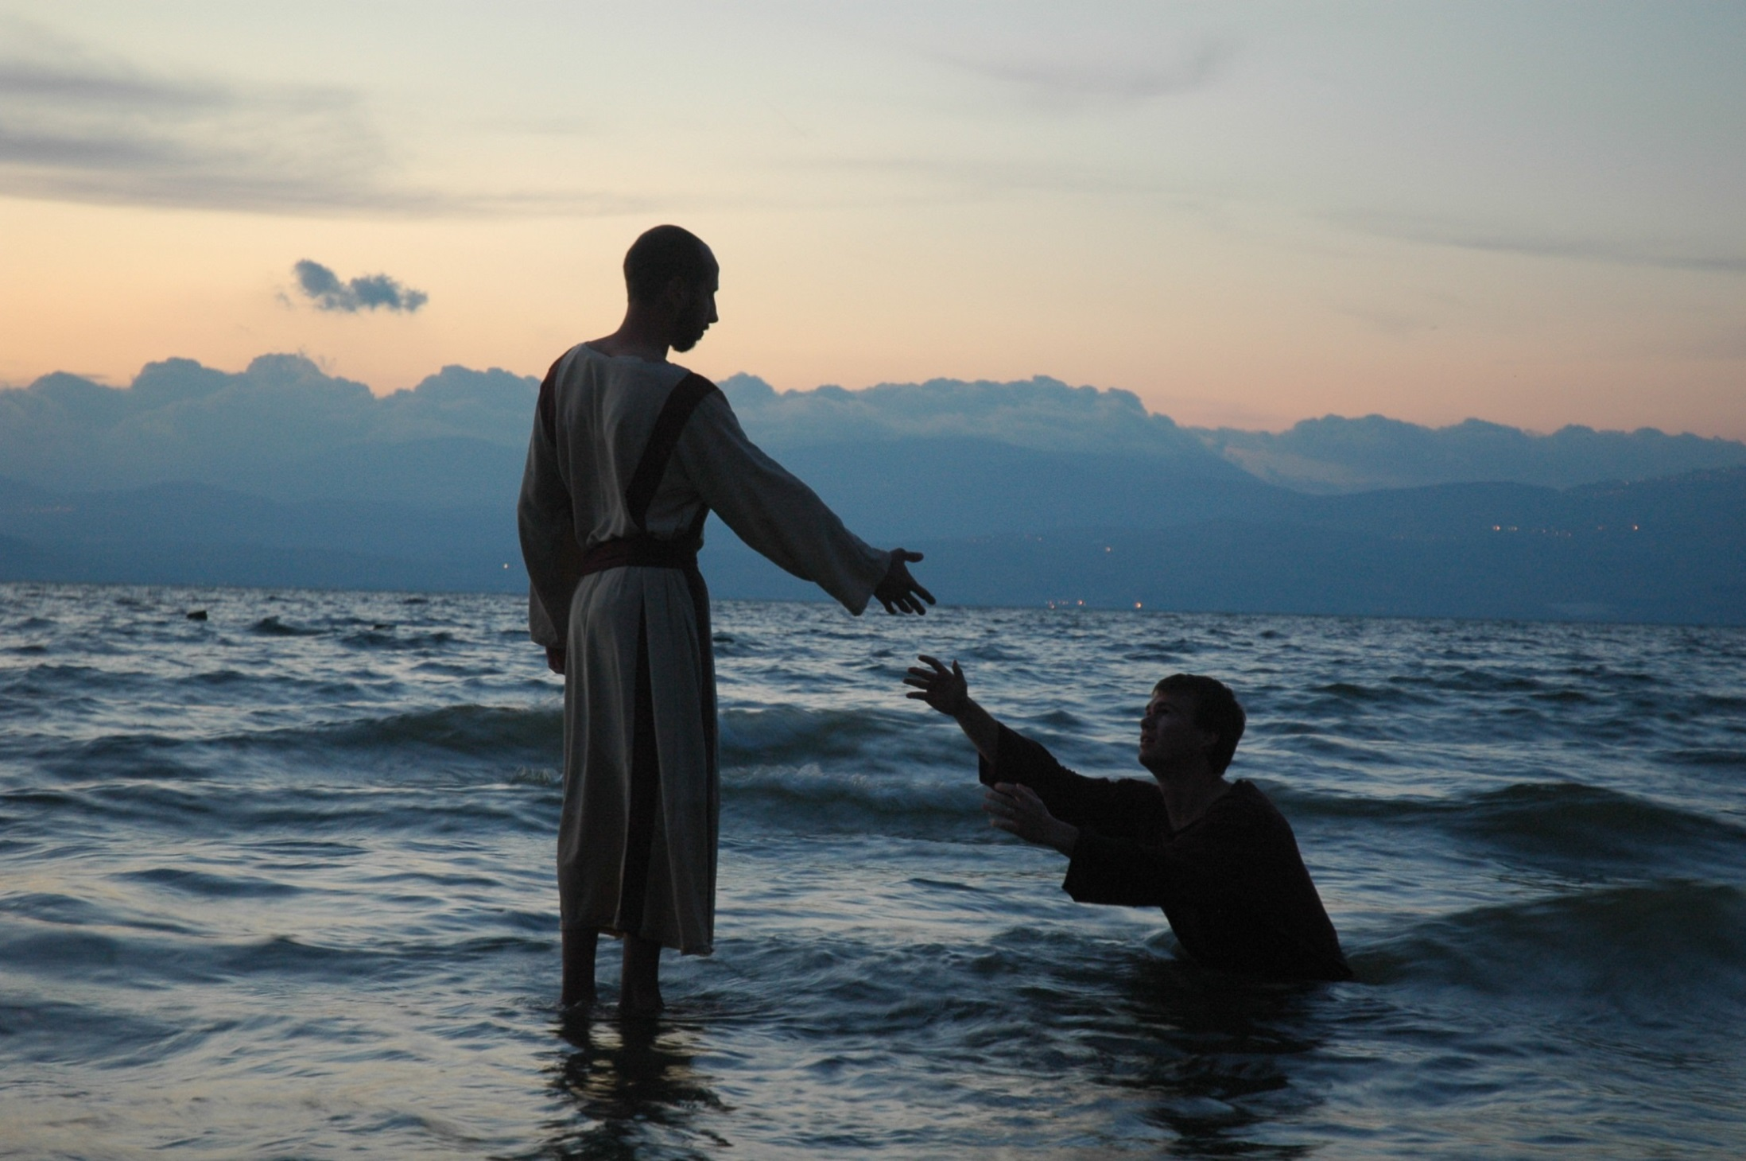
And immediately Jesus extended His hand and took hold of him
Dramatization of Jesus and Peter walking on the Sea of Galilee
14:31
Notes:
tb040606187

Slide 13
“A Wonderful Savior Is Jesus My Lord”
How Wonderful To Keep God’s Word Instead of The Doctrines & Traditions of Men.
How Wonderful To Have A Clean Heart, Not Just Clean Hands.
How Wonderful To See Great Love & Faith In Godly Mothers.
How Wonderful To Hear of Jesus’ Miracles.
Notes:
Ch 15.
What commandments do people set aside for the sake of their traditions today?
- Tradition of Sprikiling vs. Command of Immersion.
- Tradition of

Slide 14
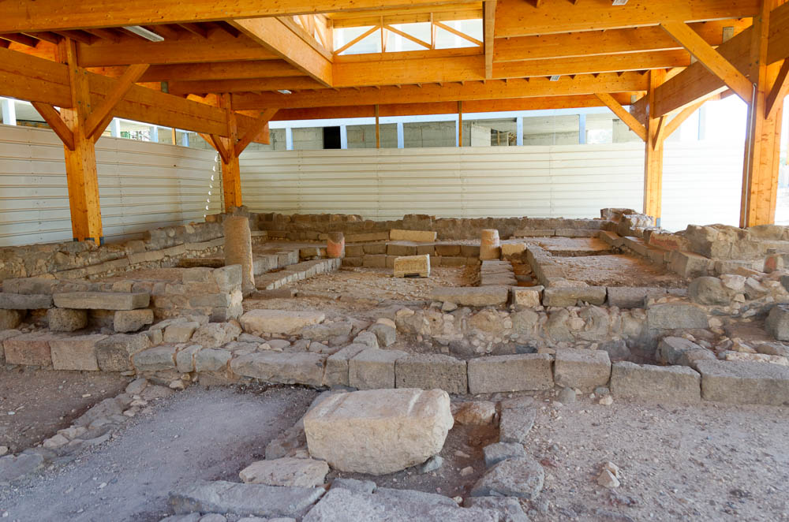
And He . . . got into the boat, and went to the region of Magadan
Magdala synagogue (from the west)
15:39
Notes:
Magdala…. Appian Media has an excellent video touring this city for free online.
Recent excavations have discovered ruins from the first-century village of Magdala, including this synagogue.
tb053116422

Slide 15
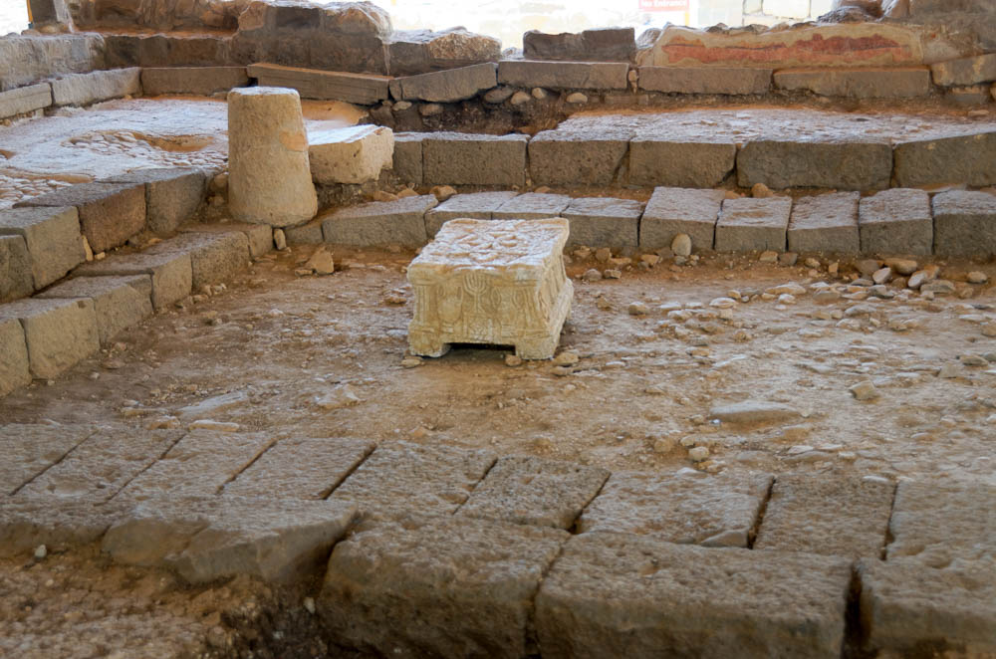
And He . . . got into the boat, and went to the region of Magadan
Magdala synagogue with ornamented table (from the north)
15:39
Notes:
tb053116431

Slide 16
Jesus Asks Us To…
Observe What Is Already Provided, Not Simply Ask For More.
Think About Spiritual Concerns, Not Simply Physical Concerns.
Jesus Is Going To Build His Church…
16:13

Slide 17
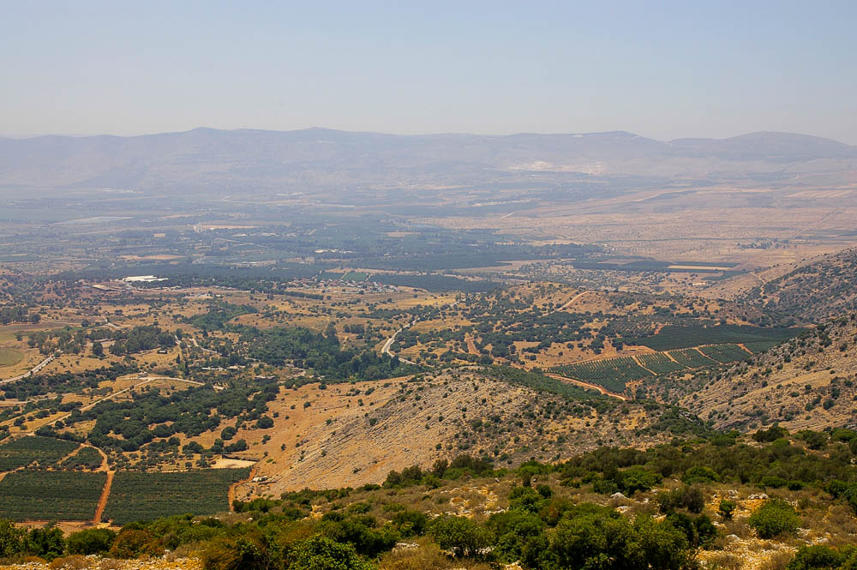
Now when Jesus came into the district of Caesarea Philippi . . .
Caesarea Philippi
Area of Caesarea Philippi (from the northeast)
16:13
Notes:
Matthew writes that Jesus came into the region of Caesarea Philippi, and it is likely that Jesus did not enter the city. Caesarea Philippi is located at the bottom of the ridge in the center of the photo.
adr0807088541

Slide 18
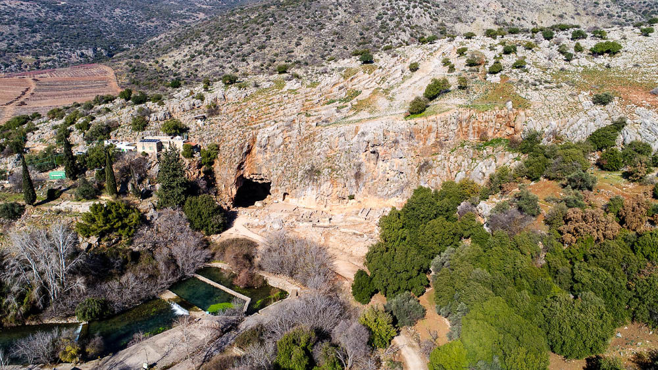
On this rock I will build My church, and the gates of Hades will not prevail against it
Caesarea Philippi cave and temples area (aerial view from the south)
16:18
Notes:
Significance: Around Ceasarea Philippi there were many buildings – ones that were wonderful to behold – built upon the rocks.
JESUS is going to out-shine and out-do these human structures. He is going to build on THE ROCK and He will draw people to Himself!
ws012317100

Slide 19
Christ, the Son of the Living God
Peter’s Confession
Jesus Will Build His Church
Jesus Will Suffer & Die
Jesus Will Save Our Souls

Slide 20
The Transfiguration
“We were eyewitnesses of His majesty…”
2 Peter 1:16
The Son of God: By Association
The Son of God: By Glorification
The Son of God: By Declaration
The Son of God: By Inspiration
The One Above All Others, Would Soon Die For All Others.
Notes:
CONFIRMS THAT JESUS IS THE SON of GOD: *Can you see that THIS IS JUST A TASTE of the Glory He had in eternity & that He will return with!
** Also shows us our weaknesses: they fell asleep, they spoke in ignorance, the were terrified.

Slide 21
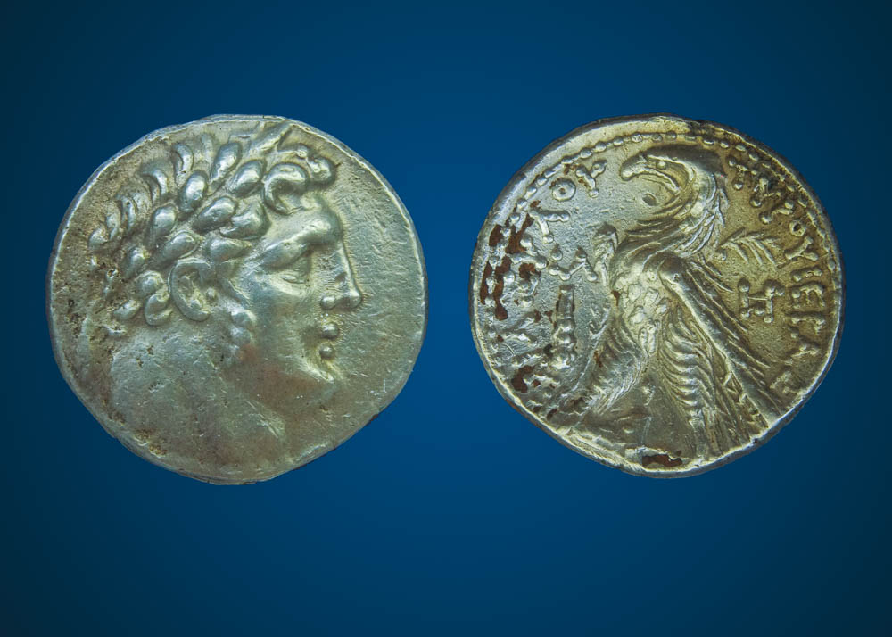
And when you have opened its mouth, you will find a stater
Silver stater (tetradrachm, shekel) with Baal Melkart and eagle, from Tyre, 97–96 BC
17:27
Notes:
The Tyrian shekel was the coin used to pay the temple tax. This coin (obverse and reverse sides) is part of the Trinity Evangelical Divinity School Biblical Coin Collection. For more information on the Tyrian shekel, see Steven Rudd’s guide at http://www.bible.ca/coins/Jesus-coins-of-the-bible-Phoenician-Tyre-Tyrian-Shekel-official-sancturary-Temple-tax-Peters-fish-money-changers-Judas-30-silver-pieces.htm
adr1410019877

Slide 22
The Gospel of Matthew

