Slide 1
1 Samuel
“The LORD Doe s Not See As Man Sees” (16:7)

Slide 2
The Bookends of 1-2 Samuel
Hannah’s Prayer and David’s Song
Hannah’s Prayer (1 Samuel 2:1-10) | David’s Song (2 Samuel 22:1-51)
“My horn is exalted in the LORD. I smile at my enemies, because I rejoice in Your salvation.” (v.1) | “My shield and the horn of my salvation … so shall I be saved from my enemies.” (v. 3-4)
“No one is holy like the LORD, for there is none besides You, nor is there any rock like our God.” (v.2) | “The Lord is my rock…” (v.2) “For who is God, except the LORD? And who is a rock, except our God?” (v. 32) Also see v.47.
The LORD can reverse the normal course of things to accomplish His purpose, V.4-8 | “by You I can run against a troop…I can leap over a wall … my arms can bend a bow of bronze…”; “You have kept me as the head of nations.” (vv.30,35,44)
“He will guard the feet of His saints …” (chasyid, v.9) | “With the merciful you will show Yourself merciful…” (chasyid, v.26)
“…but the wicked shall be silent in darkness.” (v.9) | See judgment in vv.10-12. “For You are my lamp, O LORD; The LORD shall enlighten my darkness.” (v.29)
“From heaven He will thunder against them” (adversaries, v.10) | “The LORD thundered from heaven…” (against adversaries, v.14)
“He will give strength to His king, And exalt the horn of His anointed.” (v.10) | “He is the tower of salvation to His king, and shows mercy to His anointed” (v.51)

Slide 3
Chapter 3 – A Prophet in Israel
“The word of the LORD was rare in those days.” (3:1) Why might this be?
Why might God have not corrected Samuel’s misunderstanding when He called Samuel?
Was the first message that God gave Samuel an easy one? How did Samuel handle it? And Eli?
How did all Israel know that the LORD had appeared again in Shiloh?

Slide 4
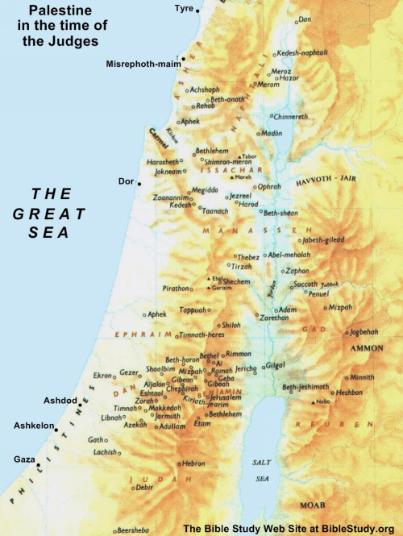
Chapter 4
V.1-2, Israel was defeated. Why would God do this?
V.3-5, How did Israel respond?
  What would cause them to respond this way?
V.6-9, How did Philistines respond?
V.10-11, What happened?
What do the accounts of Eli and Ichabod tell us about how the capture of the ark was viewed?
What lessons do you learn?

Slide 5
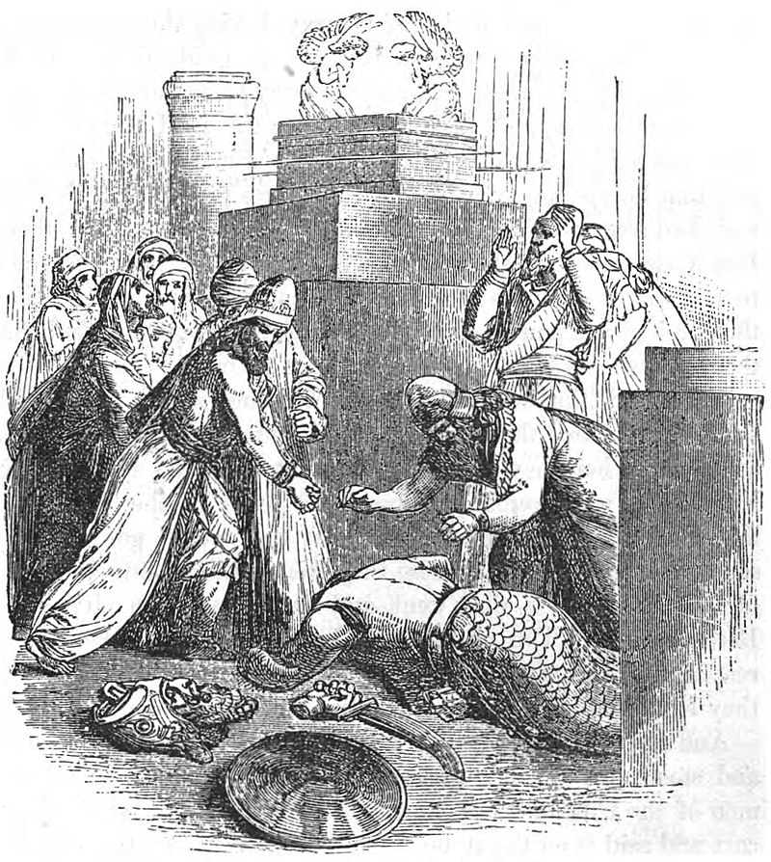
Chapter 5

Slide 6
Chapter 6
Philistine “priests” and “diviners”:
  Include an offering – gold tumors and rats!
  “Give glory to the God of Israel”
  “Why then do you harden your hearts as the Egyptians…?”
V.7-12,16, what would the Philistines think when the ark returned?
V.13-15,19-21, what would the Israelites think when the ark returned? What did they do wrong?

Slide 7
7:3-12, What has happened in Israel?

Slide 8
7:3-12, What has happened in Israel?
Chapter 4
Chapter 7
Israel “struck down”
  (Hebrew nagaph)
  By Philistines, v.2, 3, 10
Manipulation
  “Let it save”, v.3
Philistines hear, v.6
Result: Ichabod, v.21
Philistines “struck down”
  (Hebrew nagaph)
  By Israel, v.10
Repentance
  “Let him deliver/save”, v.3, 8
Philistines hear, v.7
Result: Ebenezer, v.12
D. R. Davis, 1 Samuel, p.75
Note 1 Samuel 7:10 – “But the LORD thundered with a loud thunder upon the Philistines that day, and so confused them that they were overcome before Israel.” See Hannah’s prayer, 2:10

Slide 9
The LORD Does Whatever Is Good To Him
(cf. 1 Samuel 3:18)
What God did | “God wouldn’t do that…” | What we learn
Closed the womb of Hannah (1:5-6) | “Talk no more so very proudly; Let no arrogance come from your mouth, for the LORD is the God of knowledge, and by Him actions are weighed.” (2:3) Knowledge Power Holiness/Goodness | God hears prayers of faithful; He raises needed leaders
Did not remove the sons of Eli immediately (2:12-36) |  | God wants His people to clearly see right and wrong
Promised to punish the very old Eli (2:27 – 3:18) |  | God says that faith without works is dead (James 2:17)
Did not speak very often to the people (3:1) |  | God chooses when/how to speak and confirms His words
Did not immediately identify himself to Samuel (3:2-10) |  | God gives time to learn and understand
Gave the child Samuel a hard message (3:11-18) |  | God trains his servants by setting a high expectation
Allowed Israel to be defeated and the ark taken (4:1-11) |  | God will suffer “shame” if it wakes people up to who He is

