Slide 1
1 Samuel
“The LORD Does Not See As Man Sees” (16:7)

Slide 2
What are some of the lessons you’ve learned so far?
1 Samuel 1-12

Slide 3
The LORD closed Hannah’s womb (1:5-6)
The LORD remembered Hannah (answered her prayer,1:19)
The LORD desired to kill Hophni and Phinehas (2:24)
The LORD gave a prophecy of specific judgment to Eli’s family (2:27-36)
The LORD spoke to and through Samuel starting even from boyhood (3:1-21)
Chapters 4-7
Directly stated - Hand of the LORD was against cities of Philistines (5:6,9,11); He struck the men of Beth Shemesh for looking into the ark (6:19); He answered Samuel’s prayer and thundered against the Philistines (7:9-10); His hand was against the Philistines the days of Samuel (7:13)
Implied – He caused the Israelites to be defeated in battle (4:2,10); He caused Dagon to fall before the ark (5:3-4); He caused the cows to pull the cart with the ark to Israel (6:7-14)
Chapters 8-12
Directly stated – Spoke to Samuel about the request for a king (8:1-22); Identified Saul to Samuel (9:17); Sent Spirit upon Saul (10:10); Found Saul among the equipment (10:22); Sent Spirit upon Saul again for battle (11:6); Brought thunder and rain as a sign (12:18).
Implied – Somehow led Saul to Samuel (9:16); Gave Samuel signs to give to Saul (10:1-8)

Slide 4
1 Samuel 12:12-15, 24-25 (NKJV)
¹² And when you saw that Nahash king of the Ammonites came against you, you said to me, ‘No, but a king shall reign over us,’ when the Lord your God was your king.
¹³ “Now therefore, here is the king whom you have chosen and whom you have desired. And take note, the Lord has set a king over you.
¹⁴ If you fear the Lord and serve Him and obey His voice, and do not rebel against the commandment of the Lord, then both you and the king who reigns over you will continue following the Lord your God.
¹⁵ However, if you do not obey the voice of the Lord, but rebel against the commandment of the Lord, then the hand of the Lord will be against you, as it was against your fathers …..
²⁴ Only fear the Lord, and serve Him in truth with all your heart; for consider what great things He has done for you.
²⁵ But if you still do wickedly, you shall be swept away, both you and your king.

Slide 5
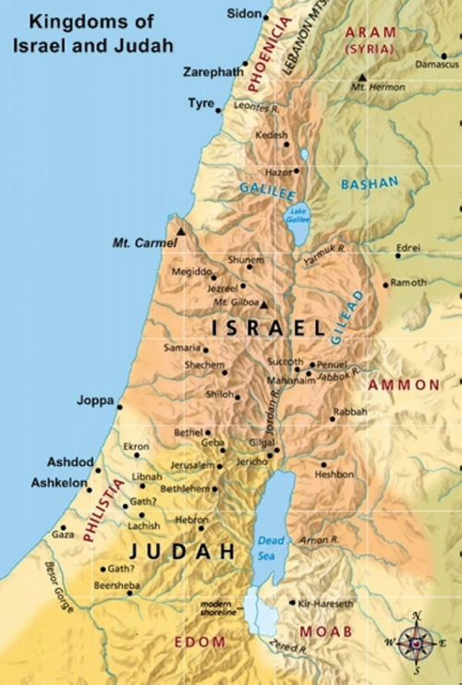
13:1-15
“You shall go down before me to Gilgal; and surely I will come down to you to offer burnt offerings and make sacrifices of peace offerings. Seven days you shall wait, till I come to you and show you what you should do.” (10:8)
The Philistines Attack!
“Then he waited seven days, according to the time set by Samuel. But Samuel did not come to Gilgal, and the people were scattered from him.” (13:8)

Slide 6
Why did he do it?
“Let us bring the ark of the covenant of the LORD from Shiloh to us, that when it comes among us it may save us from the hand of our enemies.” (4:3)
“Make us a king … that we also may be like all the nations, and that our king may judge us and go out before us and fight our battles.” (8:4,20)
“… Saul said, ‘When I saw that the people were scattered from me, and that you did not come within the days appointed, and that the Philistines gathered together at Michmash, then I said, ‘The Philistines will now come down on me at Gilgal, and I have not made supplication to the LORD.’ Therefore I felt compelled, and offered a burnt offering.” (13:11-12)
“So Saul said, ‘Bring A burnt offering and peace offerings here to me.’ And he offered the burnt offering.” (13:9)

Slide 7
Was he justified in doing it?
“And Samuel said to Saul, ‘You have done foolishly. You have not kept the commandment of the LORD your God, which He commanded you. For now the LORD would have established your kingdom over Israel forever. But now your kingdom shall not continue. The LORD has sought for Himself a man after His own heart, and the LORD has commanded him to be commander over His people, because you have not kept what the LORD commanded you.” (13:13-14)
“So Saul said, ‘Bring A burnt offering and peace offerings here to me.’ And he offered the burnt offering.” (13:9)

Slide 8
1 Samuel 16:7 (NKJV)
But the Lord said to Samuel:
“Do not look at his appearance
or his physical stature,
because I have refused him.
For the LORD does not see as man sees;
For man looks at the outward appearance,
But the LORD looks at the heart.”

Slide 9
Applications?

Slide 10
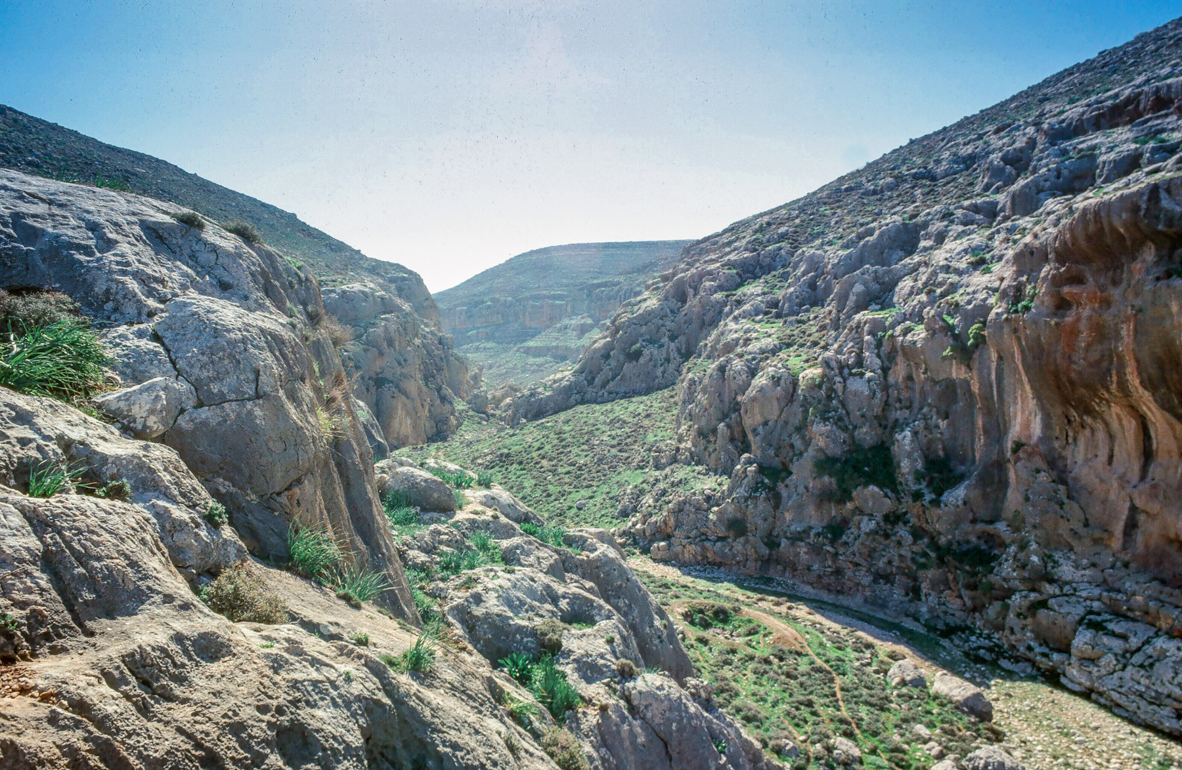
14:1-23
Jonathan
Action, faith (trust), courage
“It may be that the LORD will work for us. For nothing restrains the LORD from saving by many or by few.” (v.6)
“for the LORD has delivered them into the hand of Israel.” (v.12)
Saul
Inaction, doubt?, fear?
“Bring the ark of God here” (v.18) Was the ark of God needed? [note: the LXX says “ephod”]
(when the noise increased) – “so Saul said to the priest, ‘Withdraw your hand.’ (v.19, cf. Deut. 20:3-5?)

Slide 11
Saul’s Oath
“Cursed is the man who eats any food until evening, before I have taken vengeance on my enemies.” (v.24)
Why might Saul do this? What does this say about his faith?
What negative consequences resulted? (v.27-28, v.31-33)
What lessons do we learn?
Sin in the camp?
What is the significance of v.35? But is Saul really seeking God? (v.36)
What “sin” does Saul find? And how does he intend to respond?
What do the people do in return?
What lessons do we learn?

Slide 12
Saul (1 Samuel 13-14)
Presumptuous sacrifices to seek divine favor
A rash oath to avoid food to motivate greater fervor
Zeal to prosecute his laws in the name of God

Slide 13
Saul (1 Samuel 13-14) | Colossians 2:23
Presumptuous sacrifices to seek divine favor | “self-imposed religion”
A rash oath to avoid food to motivate greater fervor | “neglect of the body”
Zeal to prosecute his laws in the name of God | “false humility”

