Slide 1
1 Samuel
“The LORD Does Not See As Man Sees” (16:7)

Slide 2
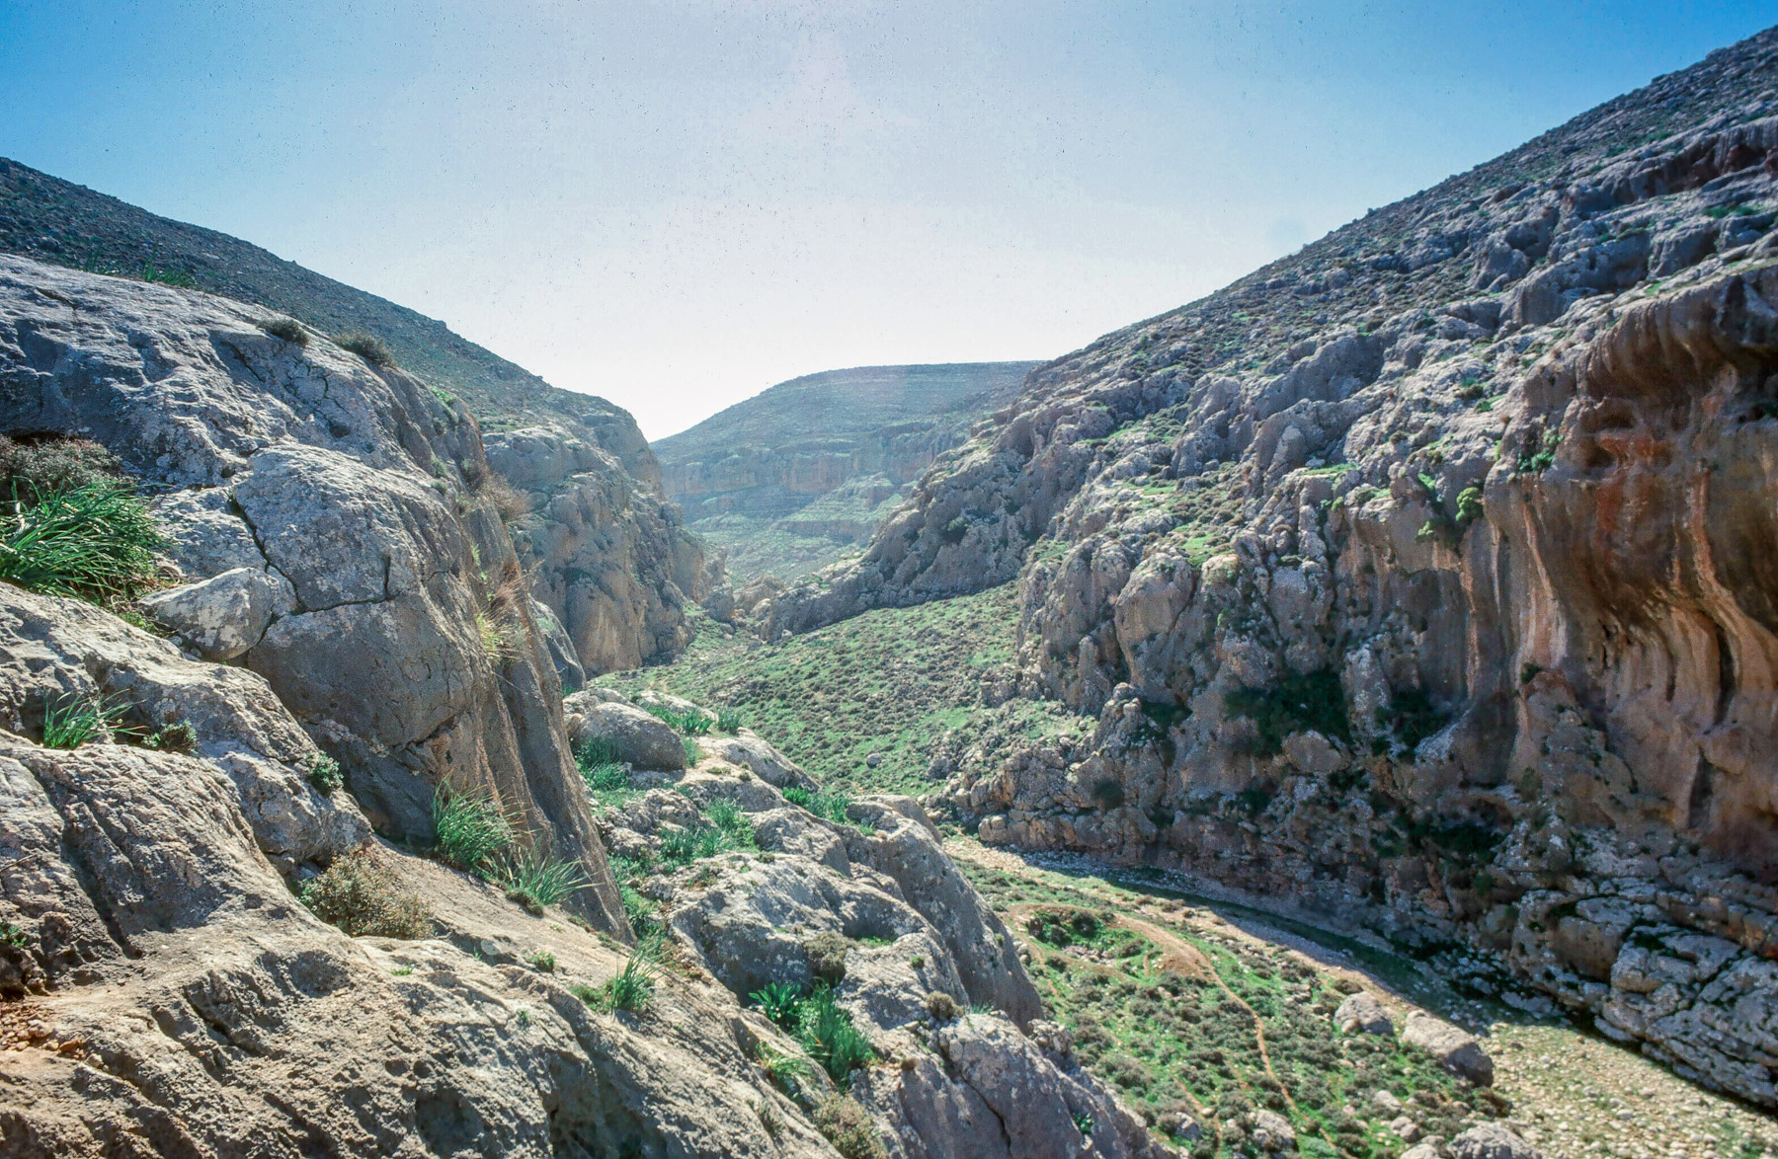
14:1-23
Jonathan
Action, faith (trust), courage
“It may be that the LORD will work for us. For nothing restrains the LORD from saving by many or by few.” (v.6)
“for the LORD has delivered them into the hand of Israel.” (v.12)
Saul
Inaction, doubt?, fear?
“Bring the ark of God here” (v.18) Was the ark of God needed? [note: the LXX says “ephod”]
(when the noise increased) – “so Saul said to the priest, ‘Withdraw your hand.’ (v.19, cf. Deut. 20:3-5?)

Slide 3
Saul’s Oath
“Cursed is the man who eats any food until evening, before I have taken vengeance on my enemies.” (v.24)
Why might Saul do this?
What negative consequences resulted? (v.27-28, v.31-33)
What lessons do we learn?
Sin in the camp?
What “sin” does Saul find? And how does he intend to respond?
What do the people do in return?
What lessons do we learn?

Slide 4
Saul (1 Samuel 13-14)
Presumptuous sacrifices to seek divine favor
A rash oath to avoid food to motivate greater fervor
Zeal to prosecute his laws in the name of God

Slide 5
Saul (1 Samuel 13-14) | Colossians 2:23
Presumptuous sacrifices to seek divine favor | “self-imposed religion”
A rash oath to avoid food to motivate greater fervor | “neglect of the body”
Zeal to prosecute his laws in the name of God | “false humility”

Slide 6
Did Saul obey God? 1 Samuel 15:4-9
Yes?
No?
He gathered together over 200,000 men to fight, V.4.
He attacked the Amelekites from Havilah all the way to Shur, so you would need a lot of men; it was a very large attack, V.7
Of those people that he attacked, he utterly destroyed all the people with the edge of the sword, V.8
He kept the king Agag alive, V.8
He kept the best of the sheep, the oxen, the fatlings, the lambs, all the good animals alive, V.9
We will find evidence later in the book of 1 Samuel (e.g., ch. 30) that Saul stopped and did not destroy all of the Amelekites.
“Now the word of the LORD came to Samuel, saying, ‘I greatly regret that I have set up Saul as king, for he has turned back from following me, and has not performed my commandments…” (v.10-11)

Slide 7
1 Samuel 15:22-23 (NKJV)
“Has the LORD as great delight in burnt offerings and sacrifices, as in obeying the voice of the LORD?
Behold, to obey is better than sacrifice, and to heed than the fat of rams.
For rebellion is as the sin of witchcraft, and stubbornness is as iniquity and idolatry.
Because you have rejected the word of the LORD, He also has rejected you from being king.”

Slide 8
How would you describe Saul’s excuses?
What was the result?

