Slide 1
1 Samuel
“The LORD Does Not See As Man Sees” (16:7)

Slide 2
1 Samuel 22:1-5
¹ David therefore departed thence, and escaped to the cave Adullam: and when his brethren and all his father's house heard it, they went down thither to him.
² And every one that was in distress, and every one that was in debt, and every one that was discontented, gathered themselves unto him; and he became a captain over them: and there were with him about four hundred men.
³ And David went thence to Mizpeh of Moab: and he said unto the king of Moab, Let my father and my mother, I pray thee, come forth, and be with you, till I know what God will do for me.
⁴ And he brought them before the king of Moab: and they dwelt with him all the while that David was in the hold.
⁵ And the prophet Gad said unto David, Abide not in the hold; depart, and get thee into the land of Judah. Then David departed, and came into the forest of Hareth.

Slide 3
1 Samuel 22:6-23
Saul murders the priests of nob

Slide 4
Who has God’s help?
David
Saul
Inquires of the LORD (twice!) about whether to attack the Philistines. The LORD says to go. (v.1-6)
Inquires whether the men of Keilah would give him up to Saul. The LORD says they would. David leaves. (v.9-13)
Jonathan finds David and encourages him. (v.15-18)
David has gone out ahead (v.25)
Says, ‘God has delivered him (David) into my hand…” (v.7-8)
God did not deliver David into his hand; Saul cannot find David (v.14-15)
The Ziphites offer to deliver David to him. Saul says, ‘Blessed are you of the LORD…’ (v.19-24)
A messenger comes to direct him elsewhere, right as Saul was about to capture David (v.26-29)

Slide 5
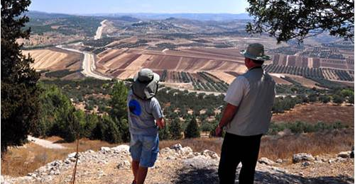
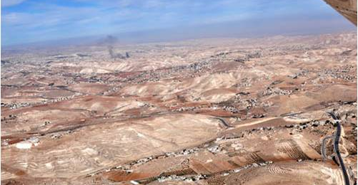
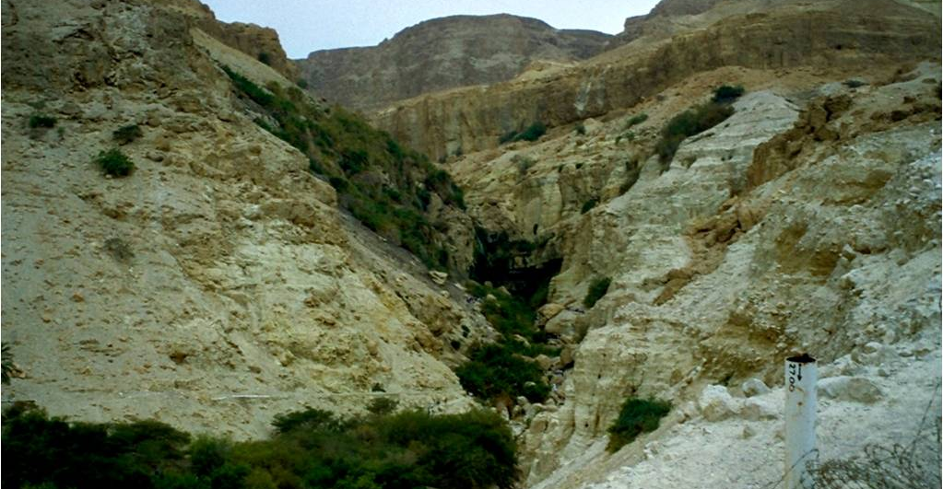
On The Run
Cave of Adullam
Ziph, Maon, etc.
En Gedi
22:1
23:14,24-25
23:29

Slide 6
Wise/Fool
Chapter 24
Chapter 25
Chapter 26
Saul seeks revenge.
David shows mercy.
Saul turns back.
David seeks revenge.
Abigail sparks mercy.
David turns back.
Saul seeks revenge.
David shows mercy.
Saul turns back?

