Slide 1
Please turn off or silence all cell phones and PDAs before the worship service begins

Slide 2
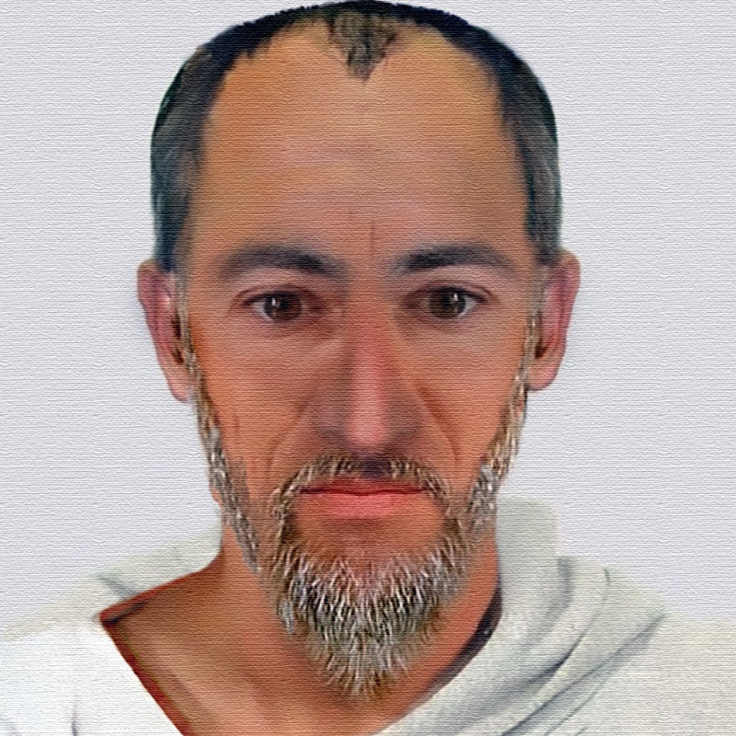
Scripture Reading
Final Instructions
1 Corinthians 16:1-24
Pew Bible – pg 776
Notes:
12/31/2017
1 Cor. 16:1-24
776

Slide 3
Song #500
O Thou Fount of Every Blessing
Sing Chorus at the end of verses 2 & 4 Only

Slide 4
1 - O Thou Fount of Every Blessing
500
1.
O Thou Fount of every blessing,
Tune my heart to sing Thy grace;
Streams of mercy, never ceasing,
Call for songs of loudest praise;
Teach me ever to adore Thee;
May I still Thy goodness prove,
While the hope of endless glory
Fills my heart with joy and love.
Words: Robert Robinson
Music: Wyeth’s Repository of Sacred Music
© 2001 The Paperless Hymnal™

Slide 5
1 - O Thou Fount of Every Blessing
500
© 2001 The Paperless Hymnal™

Slide 6
2 - O Thou Fount of Every Blessing
500
2.
Here I raise my Ebenezer:
Hither by Thy help I've come;
And I hope by Thy good pleasure
Safely to arrive at home;
Jesus sought me when a stranger,
Wandering from the fold of God;
He to rescue me from danger
Interposed His precious blood.
Words: Robert Robinson
Music: Wyeth’s Repository of Sacred Music
© 2001 The Paperless Hymnal™

Slide 7
2 - O Thou Fount of Every Blessing
500
© 2001 The Paperless Hymnal™

Slide 8
3 - O Thou Fount of Every Blessing
500
3.
O to grace how great a debtor
Daily I'm constrained to be!
Let Thy good-ness like a fetter
Bind my wandering heart to Thee;
Never let me wander from Thee,
Never leave the God I love;
Here's my heart, O take and seal it,
Seal it for Thy courts above.
Words: Robert Robinson
Music: Wyeth’s Repository of Sacred Music
© 2001 The Paperless Hymnal™

Slide 9
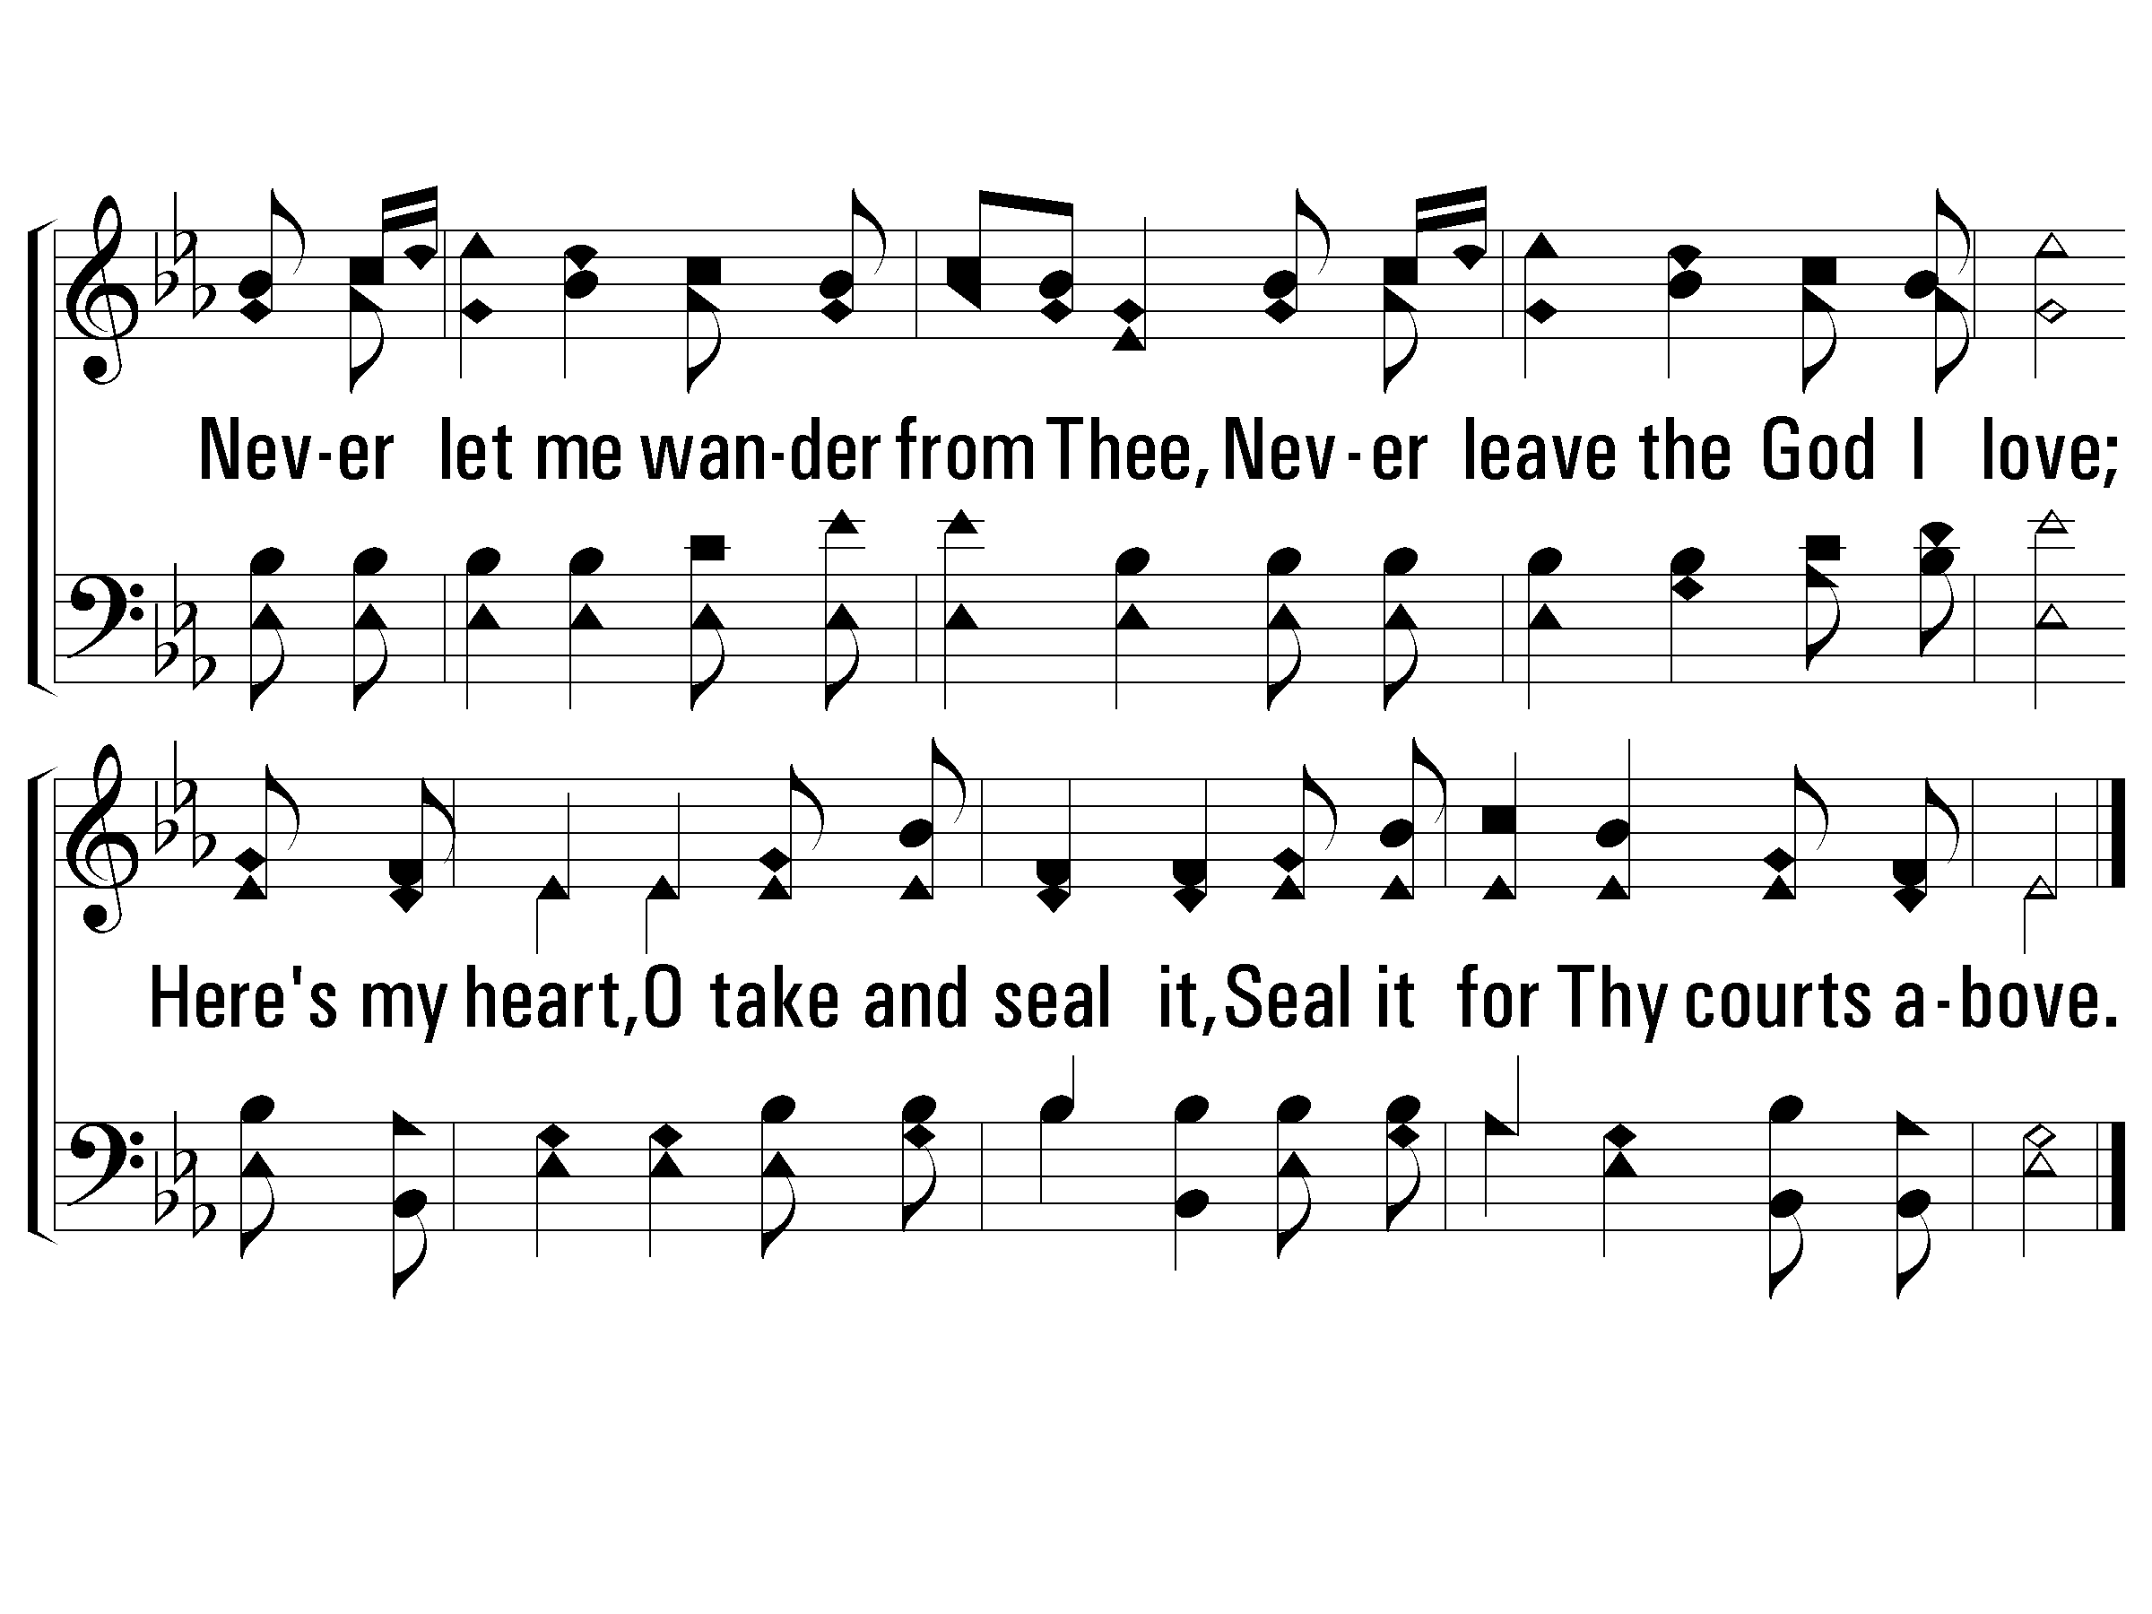
3 - O Thou Fount of Every Blessing
500
© 2001 The Paperless Hymnal™

Slide 10
Order of Service
Song: ‘Higher Ground’
Pressing On to the Goal
Prayer
Song: ‘We are Called to be God’s People’
New Creation
Prayer
Song: ‘In His Time’
A Living Hope
Prayer

Slide 11
Song #234
Higher Ground
Sing Chorus at the end of verses 2 & 4 Only

Slide 12
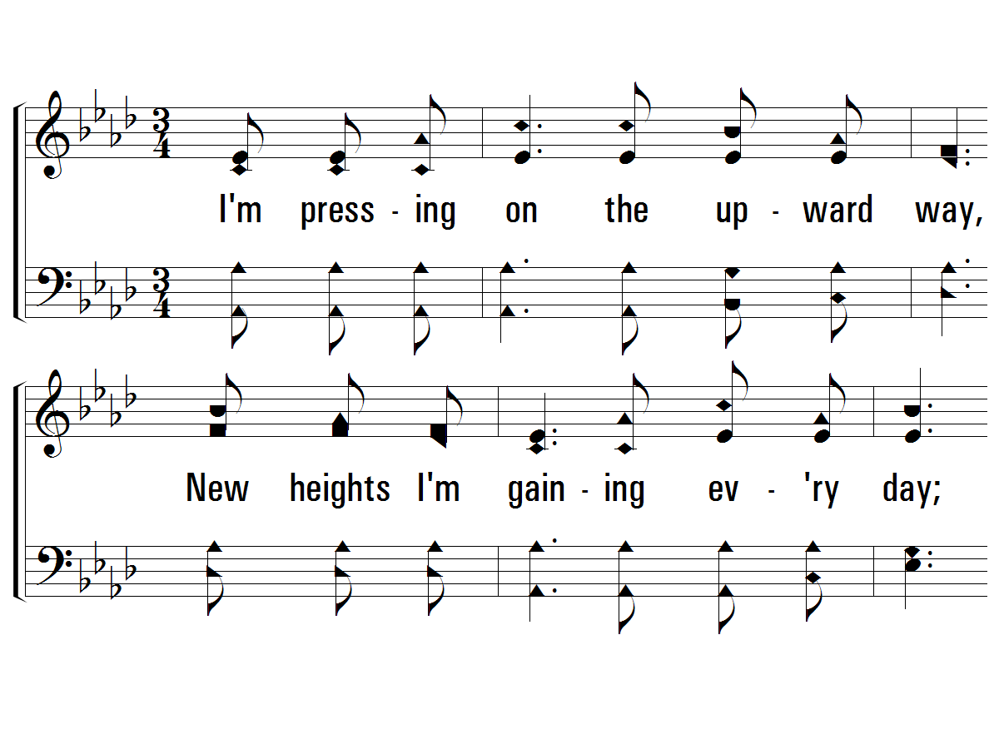
1 - Higher Ground
234
1.
I'm pressing on the upward way,
New heights I'm gaining every day;
Still praying as I onward bound,
"Lord, plant my feet on higher ground."
Words by: Johnson Oatman
Music by: Charles H. Gabriel
© 2001 The Paperless Hymnal™

Slide 13
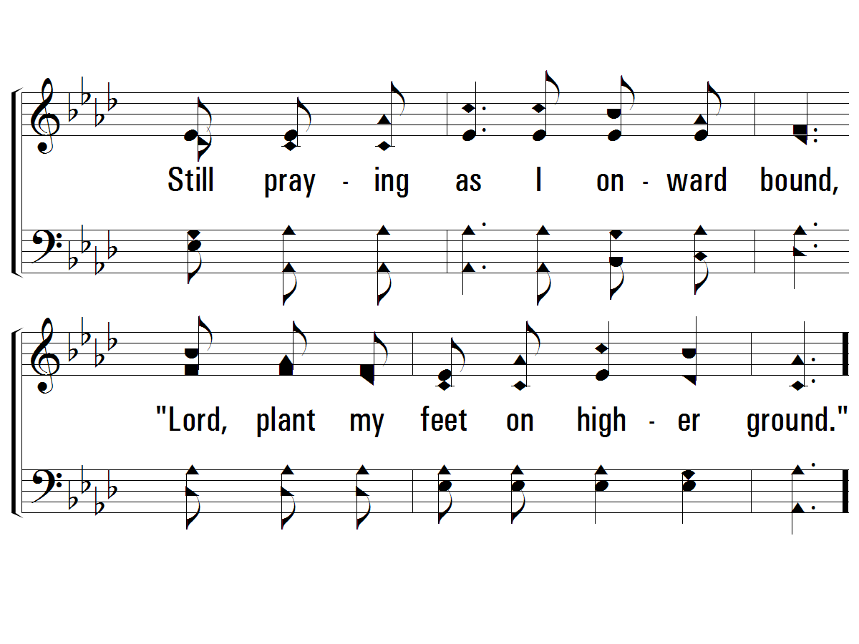
1 - Higher Ground
234
© 2001 The Paperless Hymnal™

Slide 14
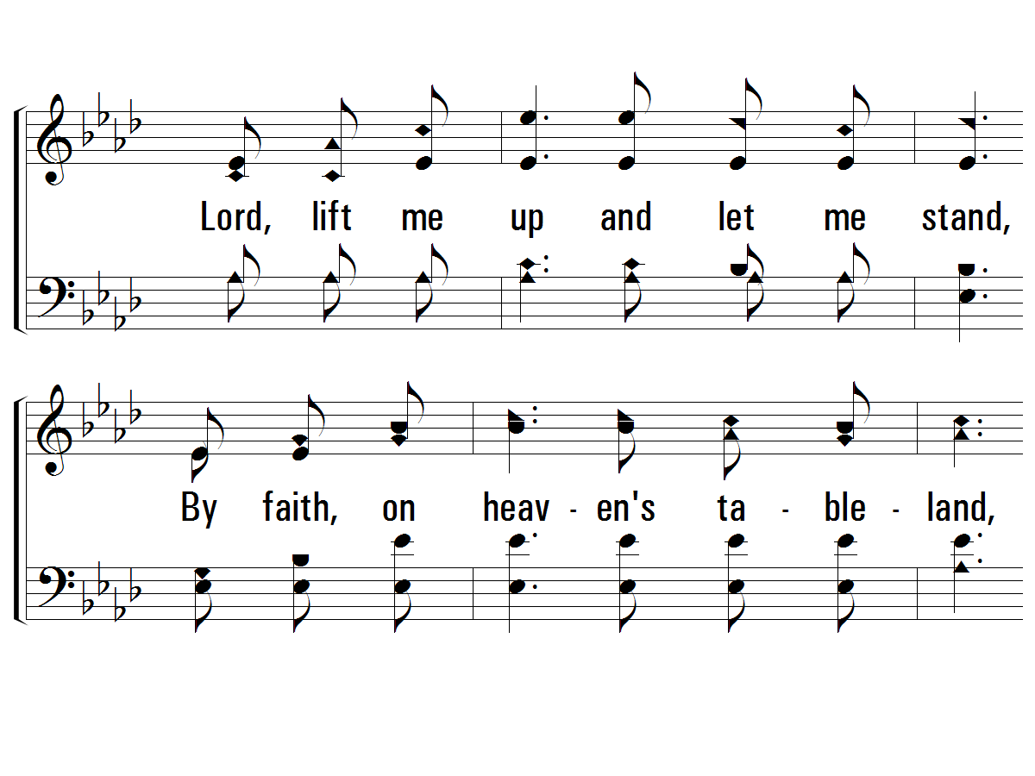
c - Higher Ground
234
Lord, lift me up and let me stand,
By faith, on heaven's tableland,
A higher plane than I have found;
Lord, plant my feet on higher ground.
© 2001 The Paperless Hymnal™

Slide 15
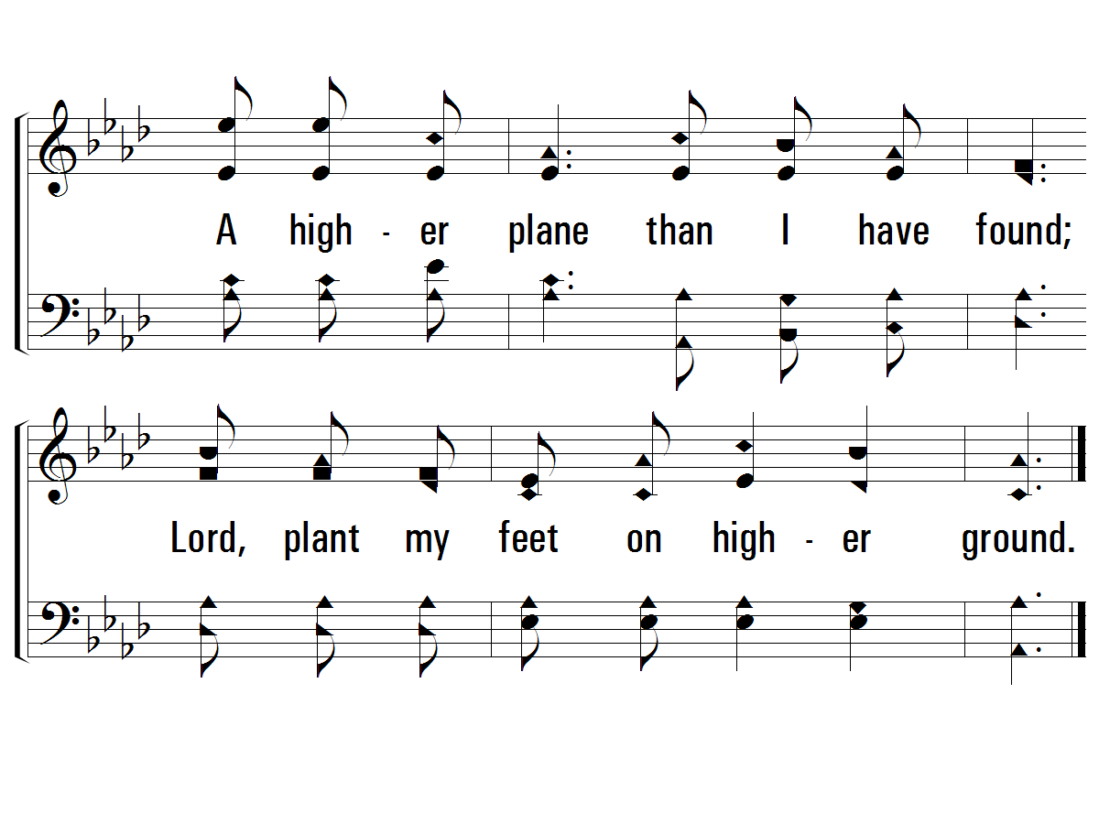
c - Higher Ground
234
© 2001 The Paperless Hymnal™

Slide 16
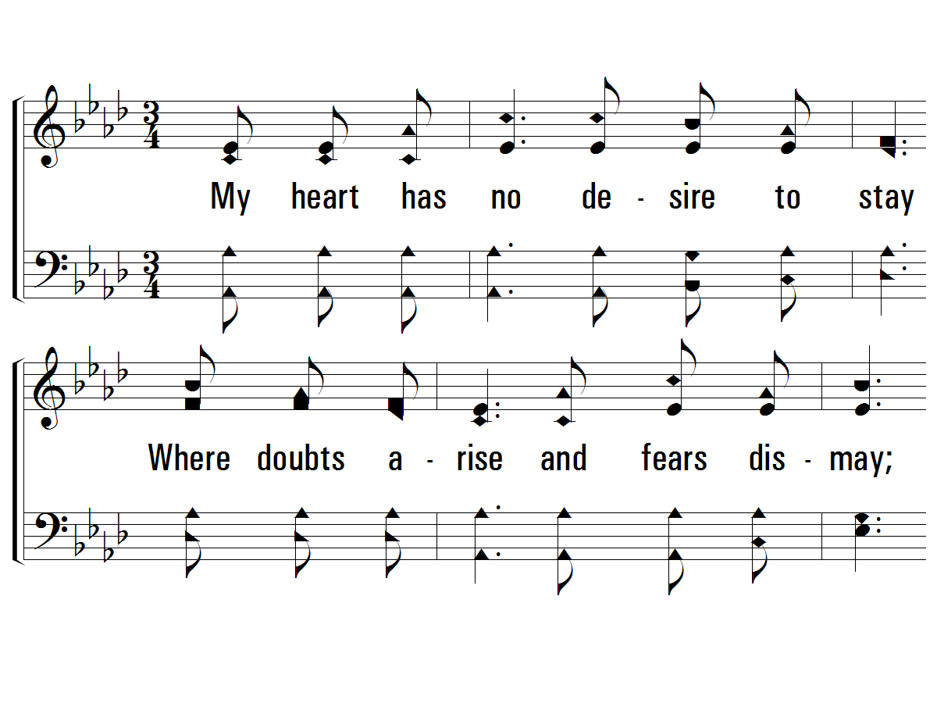
2 - Higher Ground
234
2.
My heart has no desire to stay
Where doubts arise and fears dismay;
Though some may dwell where these abound,
My prayer, my aim is higher ground.
Words by: Johnson Oatman
Music by: Charles H. Gabriel
© 2001 The Paperless Hymnal™

Slide 17
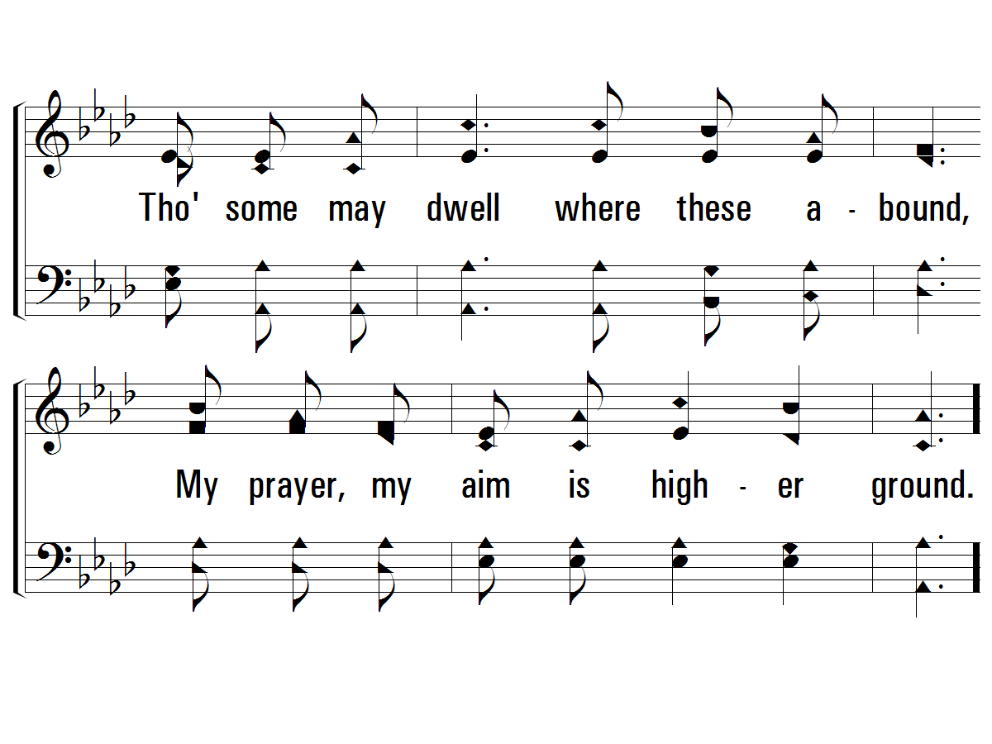
2 - Higher Ground
234
© 2001 The Paperless Hymnal™

Slide 18
c - Higher Ground
234
Lord, lift me up and let me stand,
By faith, on heaven's tableland,
A higher plane than I have found;
Lord, plant my feet on higher ground.
© 2001 The Paperless Hymnal™

Slide 19
c - Higher Ground
234
© 2001 The Paperless Hymnal™

Slide 20
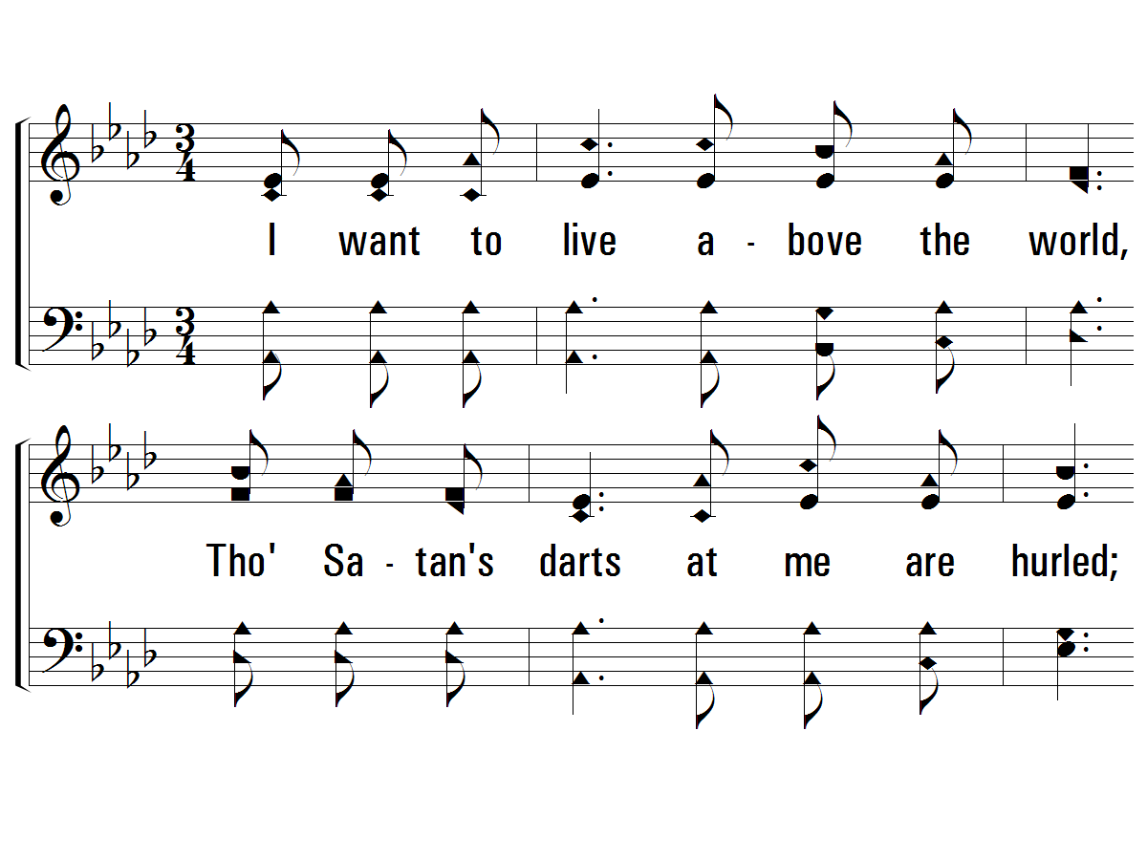
3 - Higher Ground
234
3.
I want to live above the world,
Though Satan's darts at me are hurled;
For faith has caught the joyful sound,
The song of saints on higher ground.
Words by: Johnson Oatman
Music by: Charles H. Gabriel
© 2001 The Paperless Hymnal™

Slide 21
3 - Higher Ground
234
© 2001 The Paperless Hymnal™

Slide 22
c - Higher Ground
234
Lord, lift me up and let me stand,
By faith, on heaven's tableland,
A higher plane than I have found;
Lord, plant my feet on higher ground.
© 2001 The Paperless Hymnal™

Slide 23
c - Higher Ground
234
© 2001 The Paperless Hymnal™

Slide 24
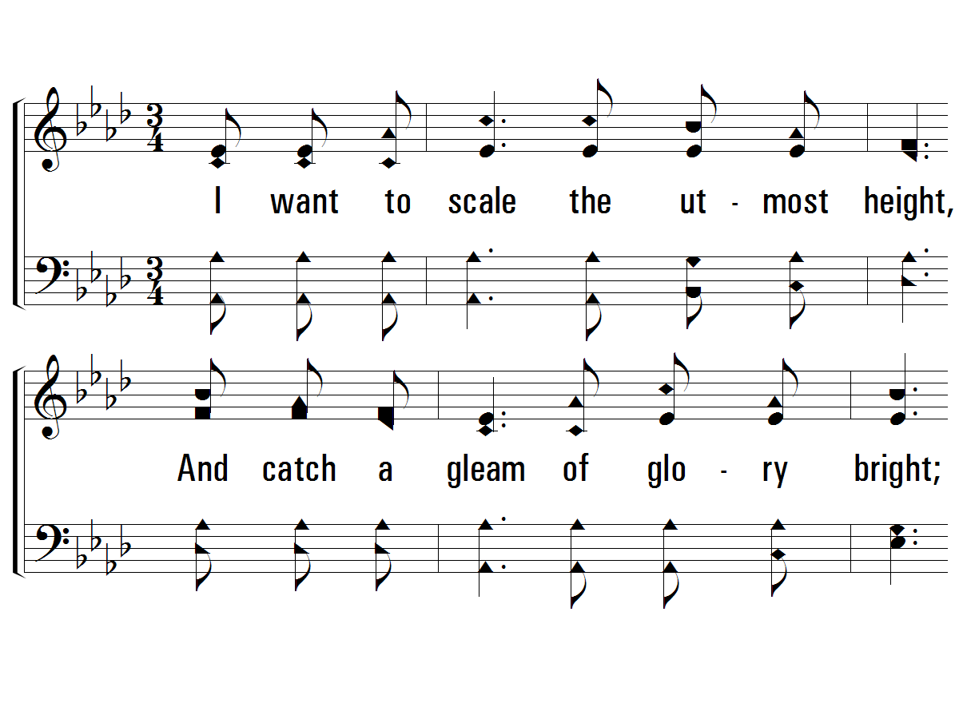
4 - Higher Ground
234
4.
I want to scale the utmost height,
And catch a gleam of glory bright;
But still I'll pray till heaven I've found,
"Lord, lead me on to higher ground."
Words by: Johnson Oatman
Music by: Charles H. Gabriel
© 2001 The Paperless Hymnal™

Slide 25
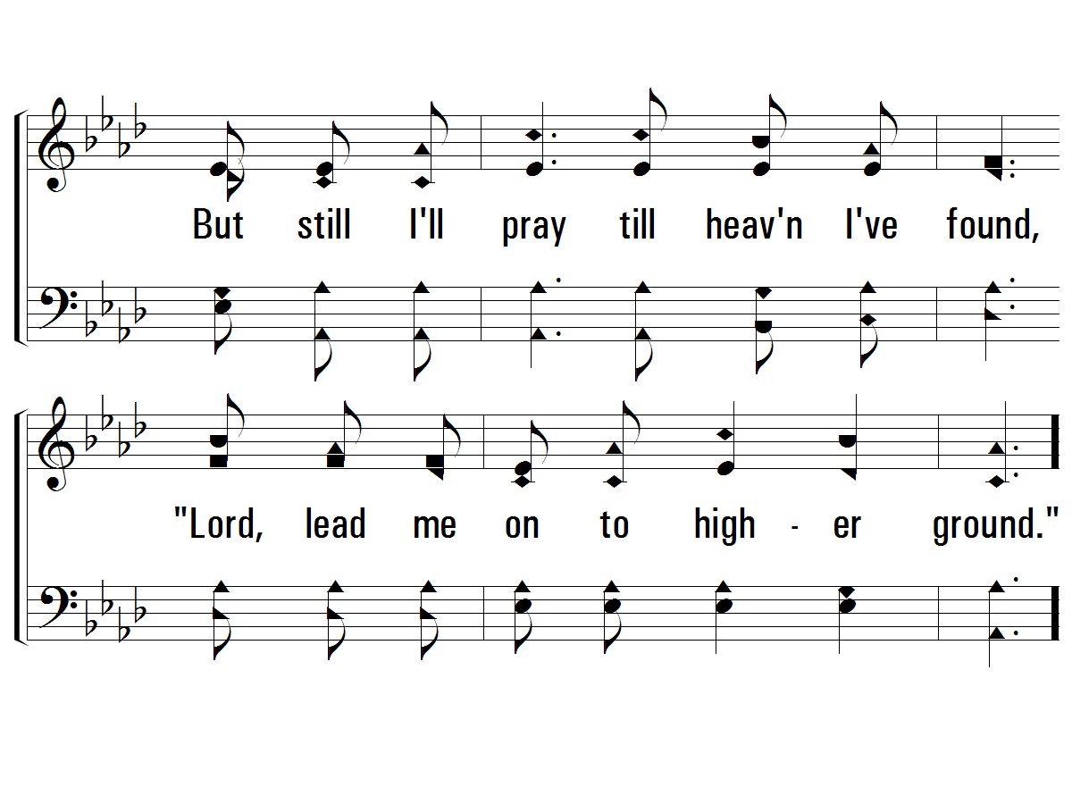
4 - Higher Ground
234
© 2001 The Paperless Hymnal™

Slide 26
c - Higher Ground
234
Lord, lift me up and let me stand,
By faith, on heaven's tableland,
A higher plane than I have found;
Lord, plant my feet on higher ground.
© 2001 The Paperless Hymnal™

Slide 27
c - Higher Ground
234
© 2001 The Paperless Hymnal™

Slide 28
Pressing On to the Goal
Sing Chorus at the end of verses 2 & 4 Only

Slide 29
Song #706
We Are Called to be God’s People
Sing Chorus at the end of verses 2 & 4 Only

Slide 30
1 - We Are Called to Be God’s People
706
1.
We are called to be God's people,
Showing by our lives His grace.
One in heart and one in spirit,
Sign of hope for all the race.
Let us show how He has changed us,
And remade us as His own,
Let us share our life together
As we shall around His throne.
Words: Thomas A. Jackson / Music: Franz J. Haydn
Words Copyright © 1973, Ren. 2001 by Broadman Press (SESAC) (adm. by LifeWay Worship)
All rights reserved. Used by permission.
© 2010 The Paperless Hymnal®

Slide 31
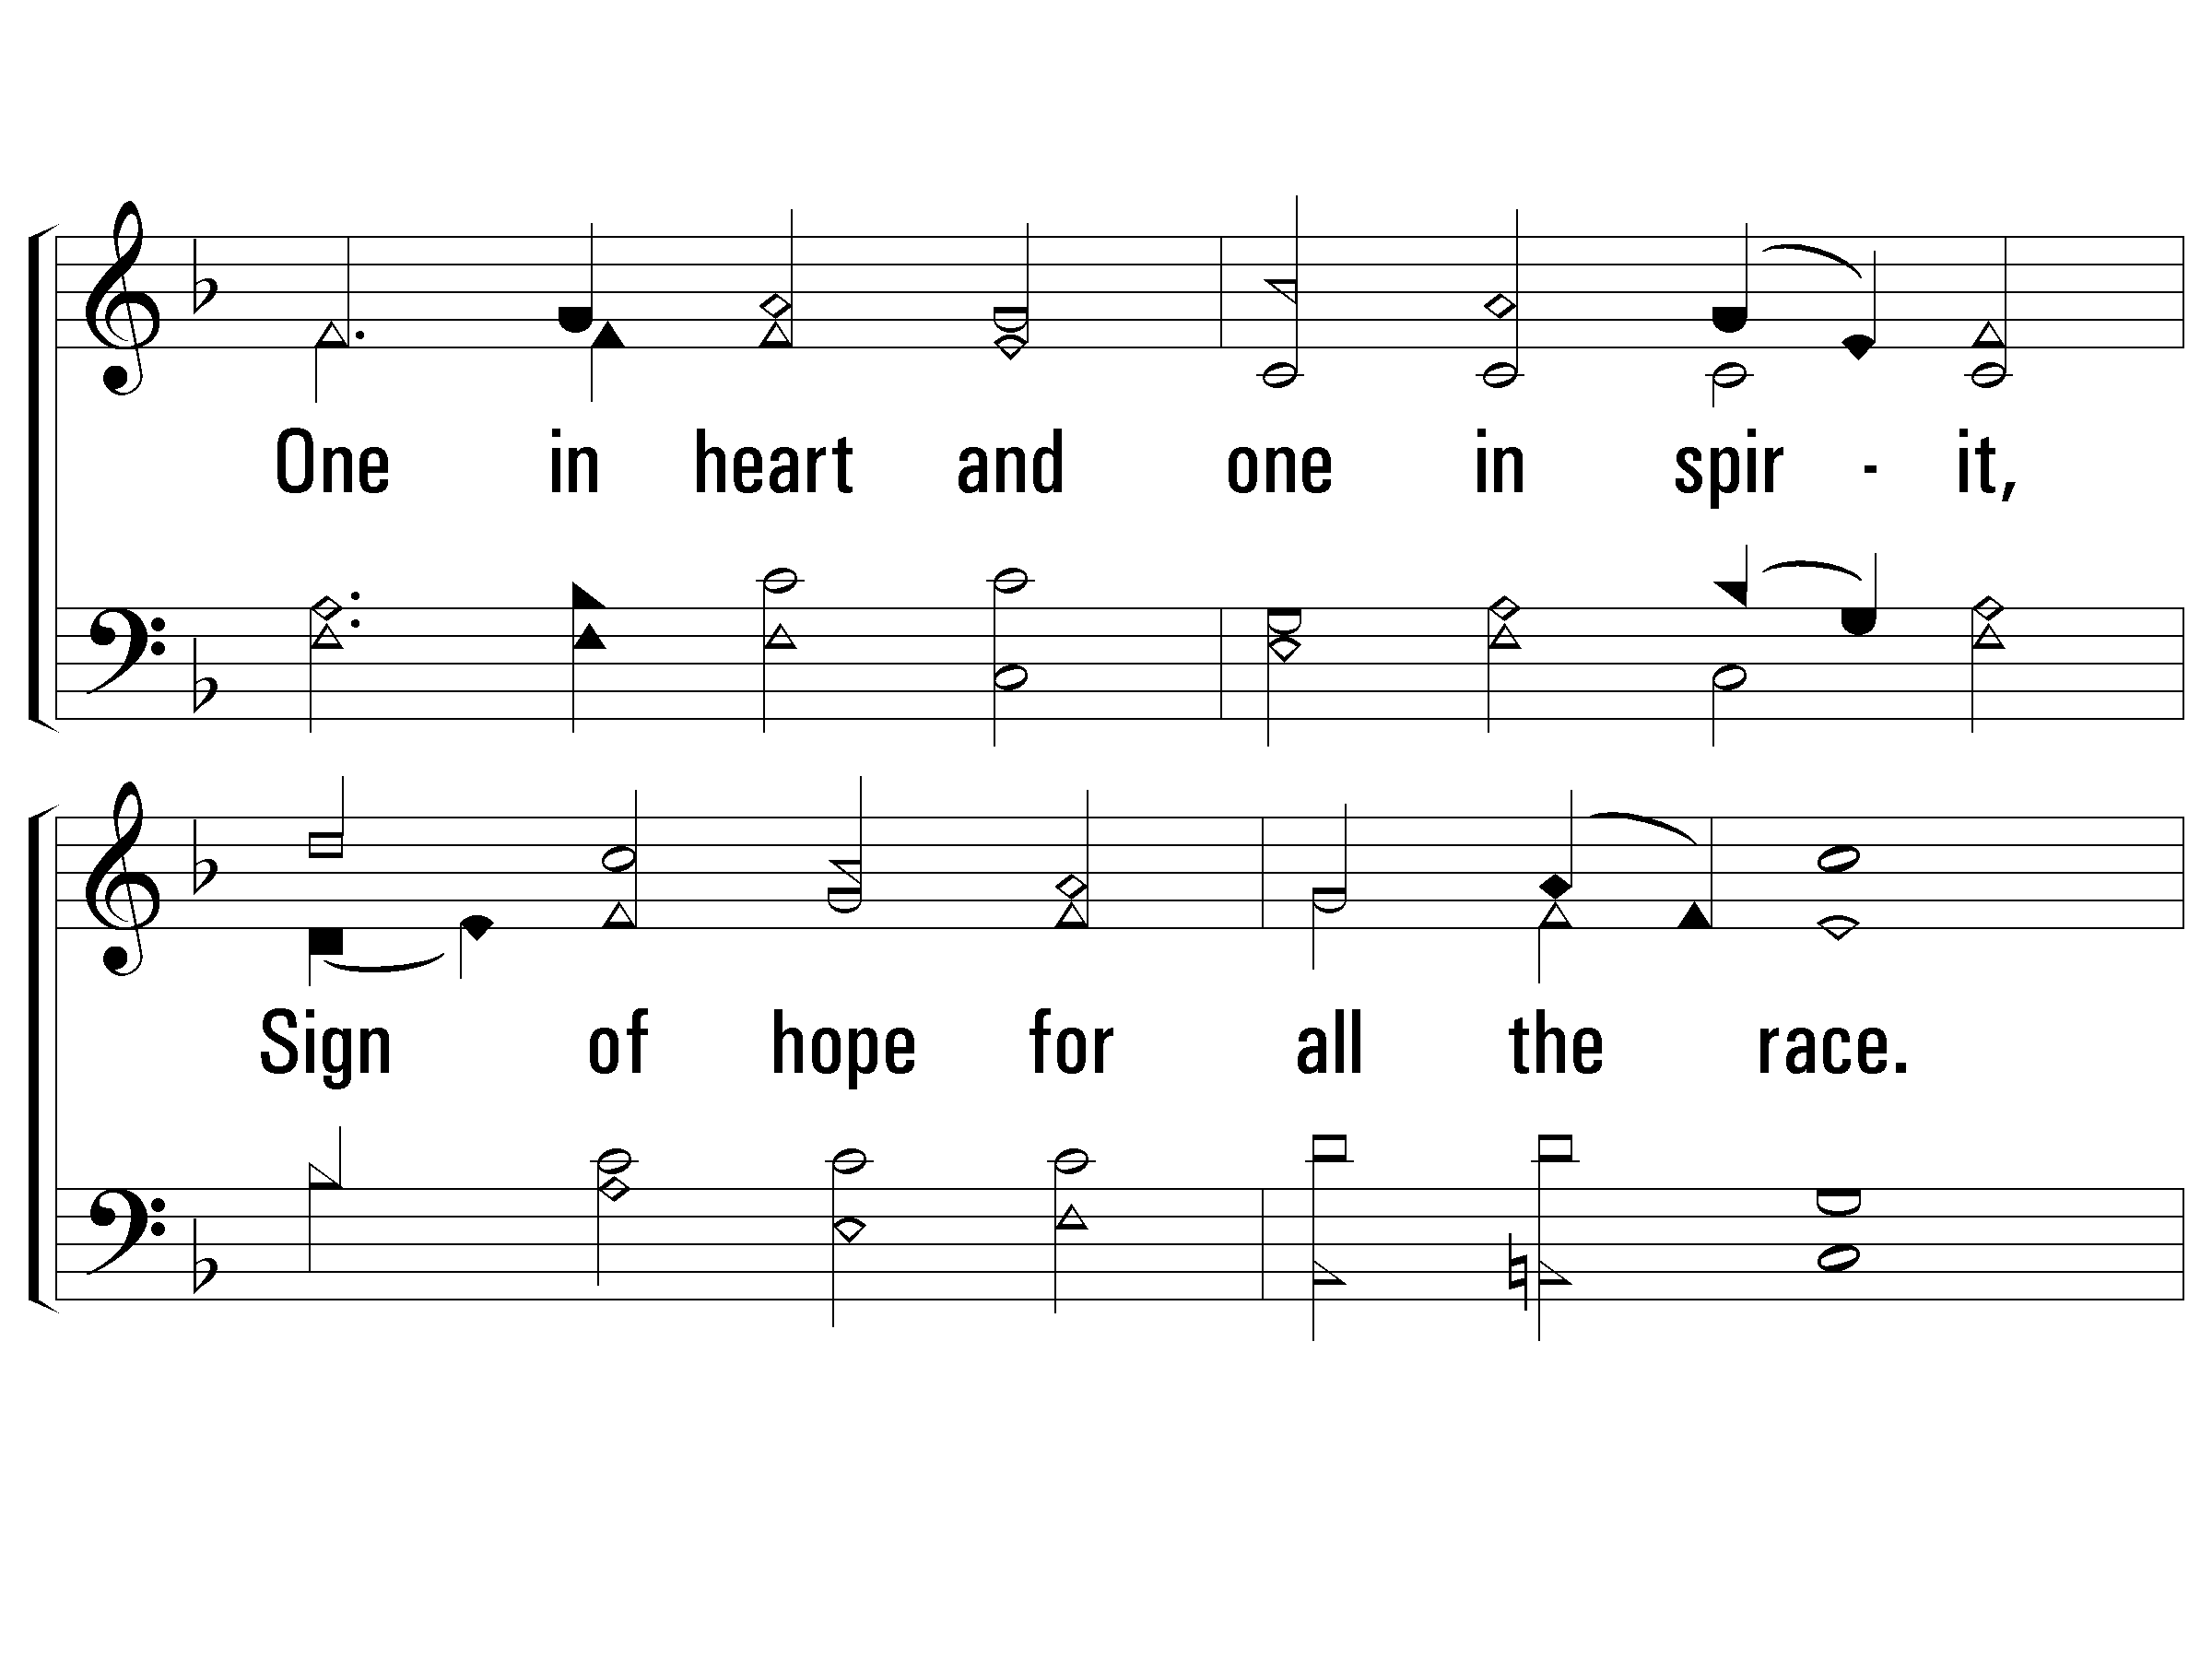
1 - We Are Called to Be God’s People
706
© 2010 The Paperless Hymnal®

Slide 32
1 - We Are Called to Be God’s People
706
© 2010 The Paperless Hymnal®

Slide 33
1 - We Are Called to Be God’s People
706
© 2010 The Paperless Hymnal®

Slide 34
2 - We Are Called to Be God’s People
706
2.
We are called to be God's servants,
Working in His world today;
Taking His own task upon us,
All His sacred words obey.
Let us rise, then, to His summons,
Dedicate to Him our all,
That we may be faithful servants,
Quick to answer now His call.
Words: Thomas A. Jackson / Music: Franz J. Haydn
Words Copyright © 1973, Ren. 2001 by Broadman Press (SESAC) (adm. by LifeWay Worship)
All rights reserved. Used by permission.
© 2010 The Paperless Hymnal®

Slide 35
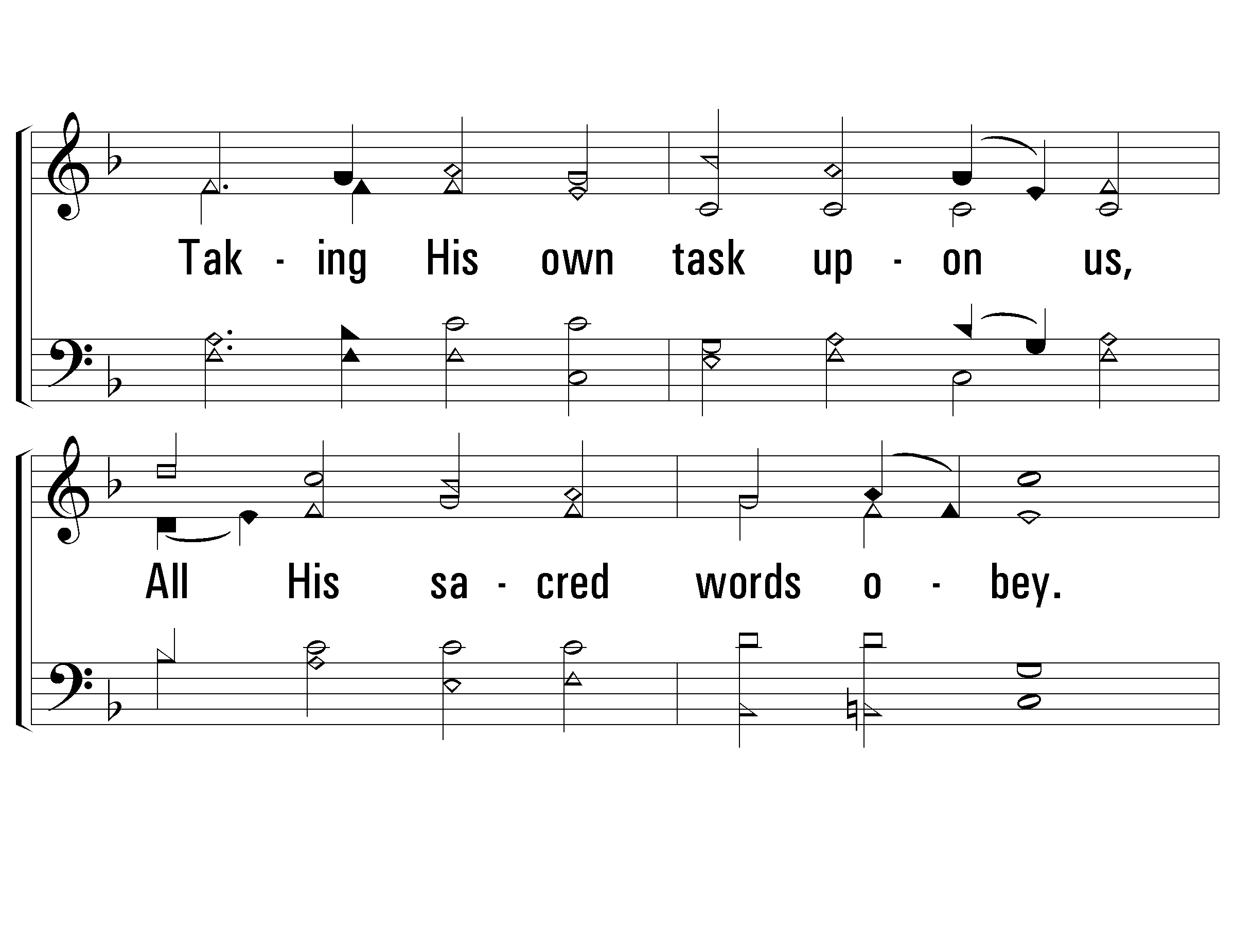
2 - We Are Called to Be God’s People
706
© 2010 The Paperless Hymnal®

Slide 36
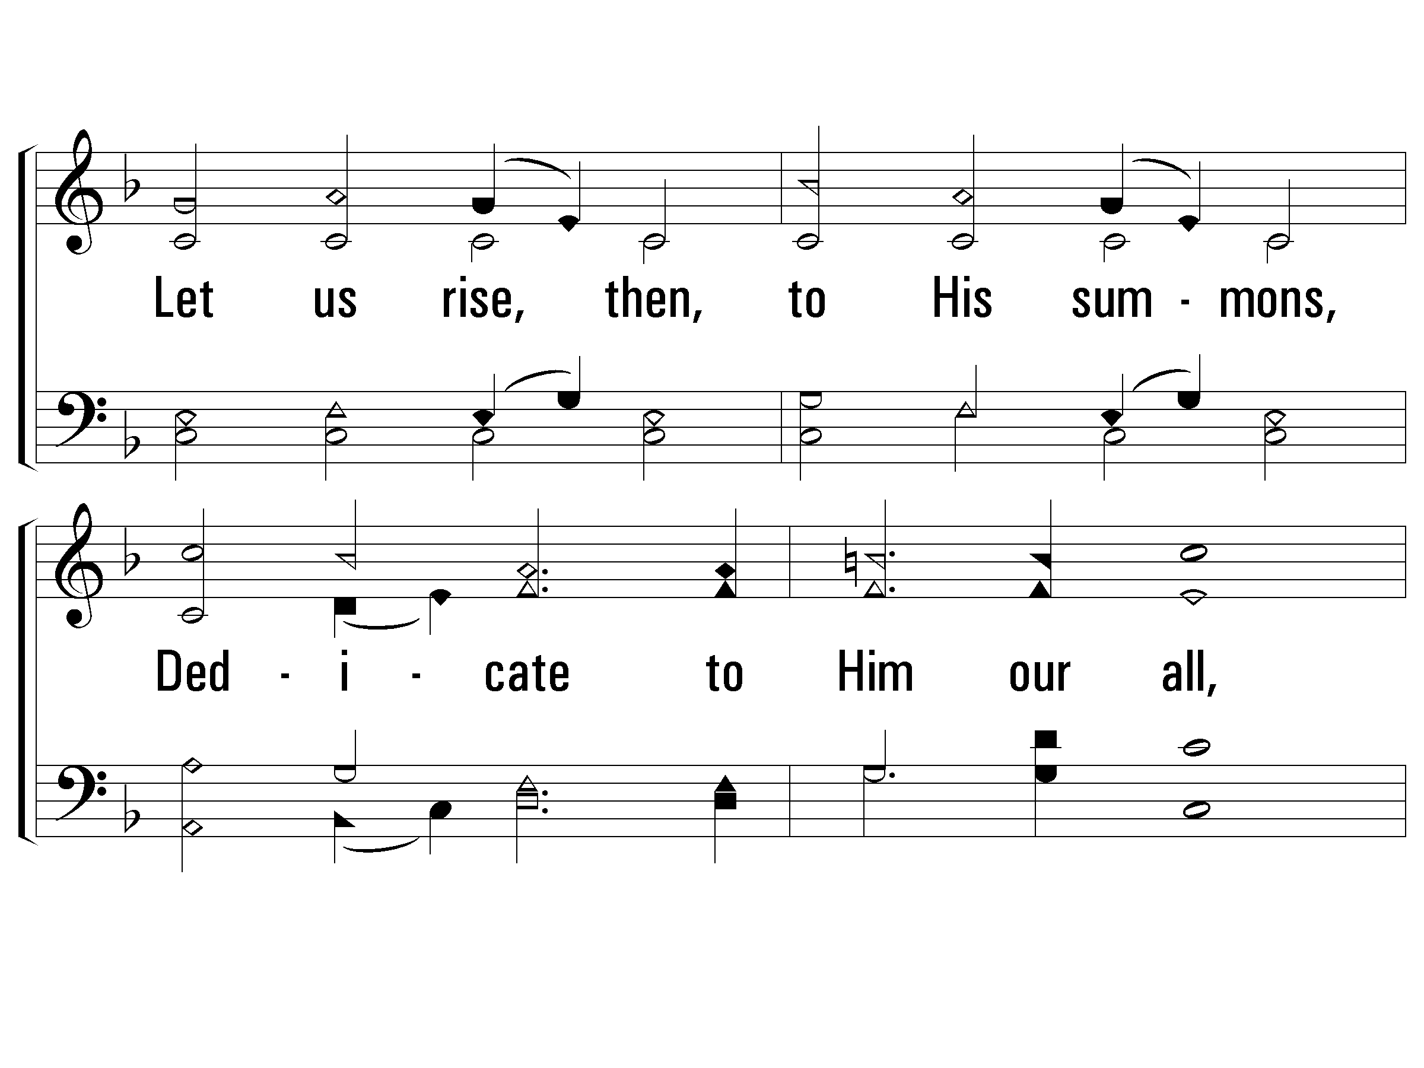
2 - We Are Called to Be God’s People
706
© 2010 The Paperless Hymnal®

Slide 37
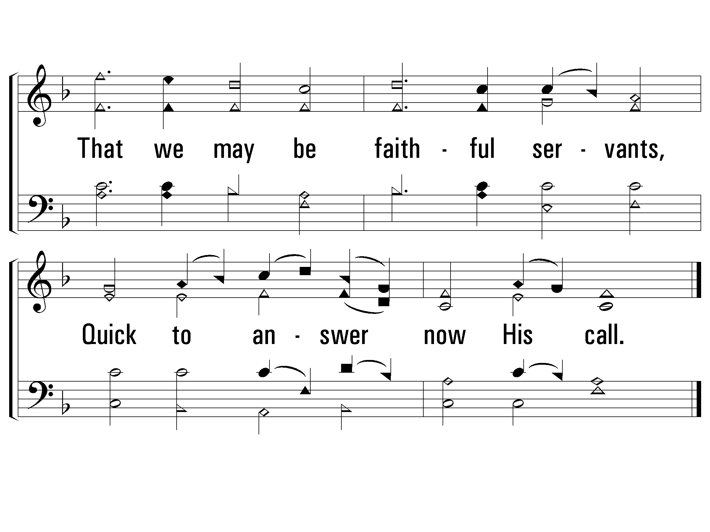
2 - We Are Called to Be God’s People
706
© 2010 The Paperless Hymnal®

Slide 38
3 - We Are Called to Be God’s People
706
3.
We are called to be God's prophets,
Spokesmen for the truth and right;
Standing firm for godly justice,
Bringing evil into light.
Let us seek the courage needed,
Our high calling to fulfill,
That mankind may know the blessing
Of the doing of God's will.
Words: Thomas A. Jackson / Music: Franz J. Haydn
Words Copyright © 1973, Ren. 2001 by Broadman Press (SESAC) (adm. by LifeWay Worship)
All rights reserved. Used by permission.
© 2010 The Paperless Hymnal®

Slide 39
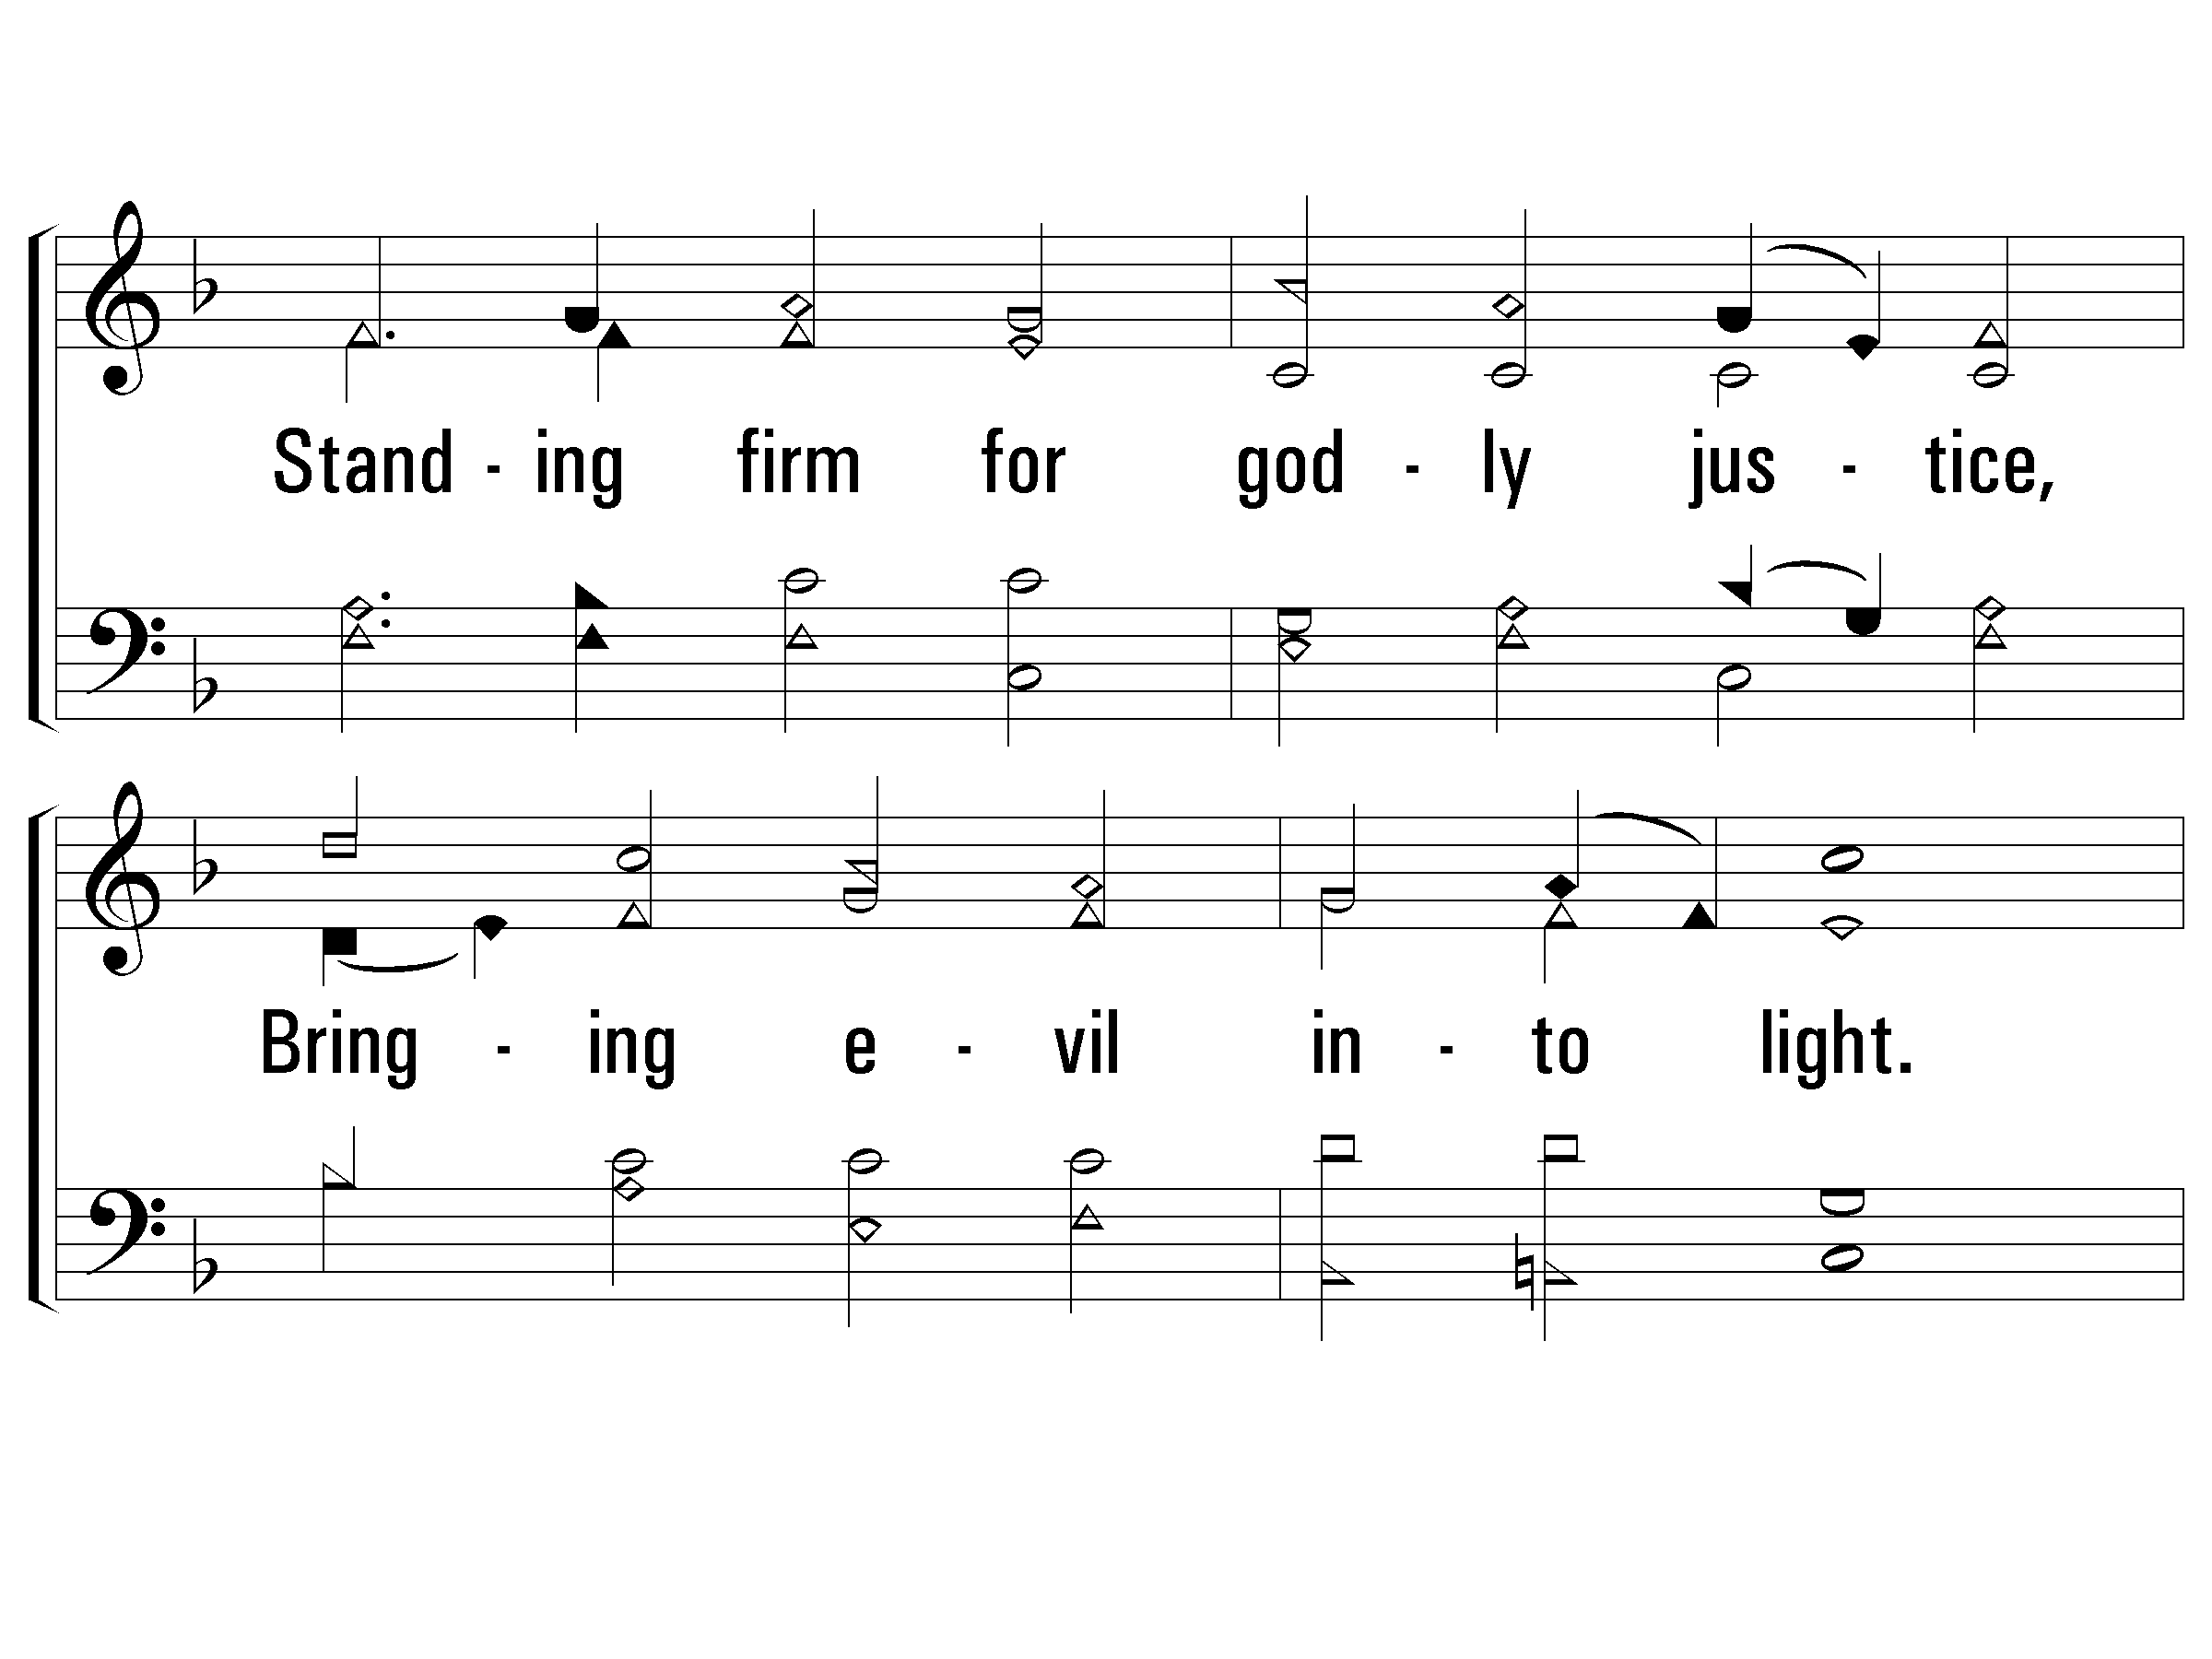
3 - We Are Called to Be God’s People
706
© 2010 The Paperless Hymnal®

Slide 40
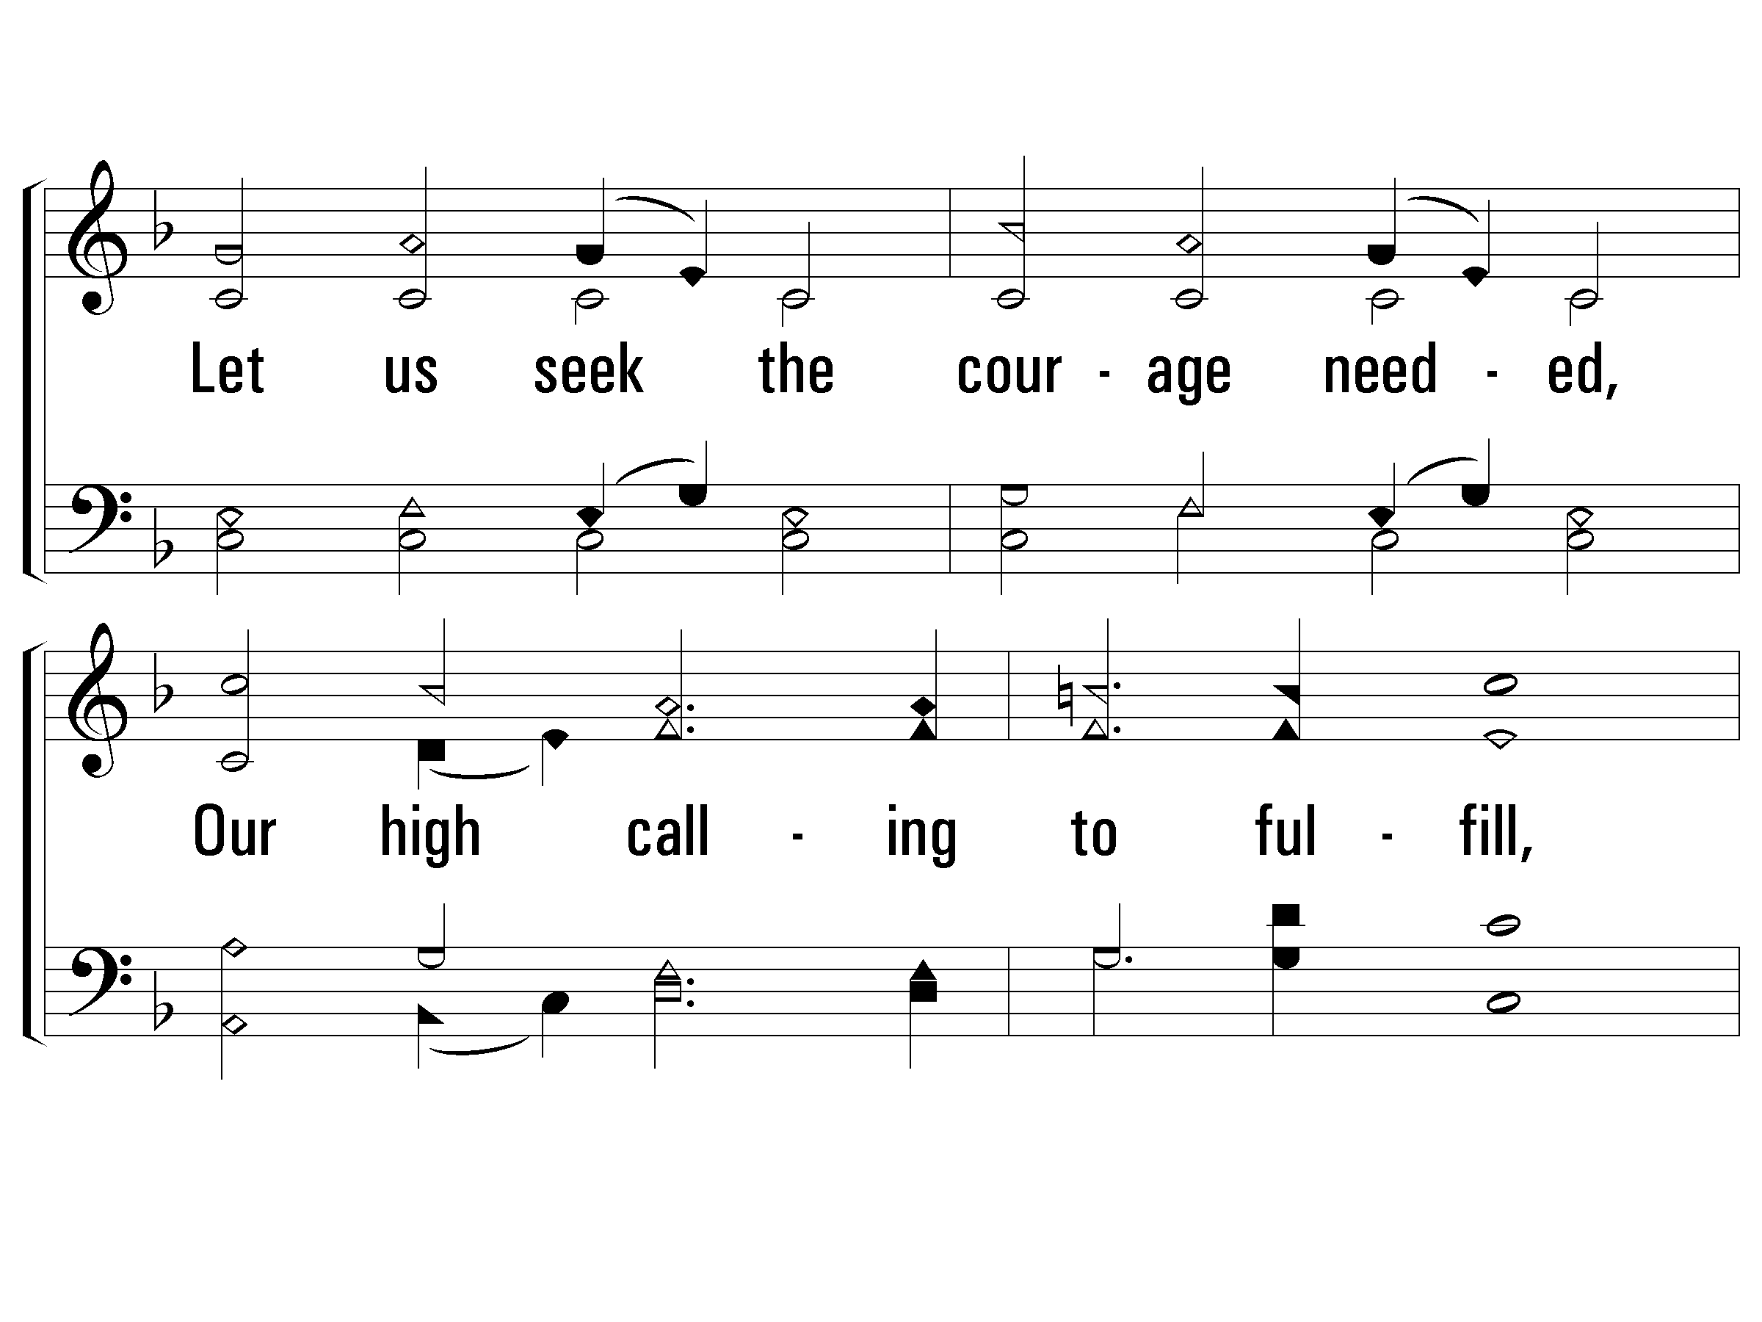
3 - We Are Called to Be God’s People
706
© 2010 The Paperless Hymnal®

Slide 41
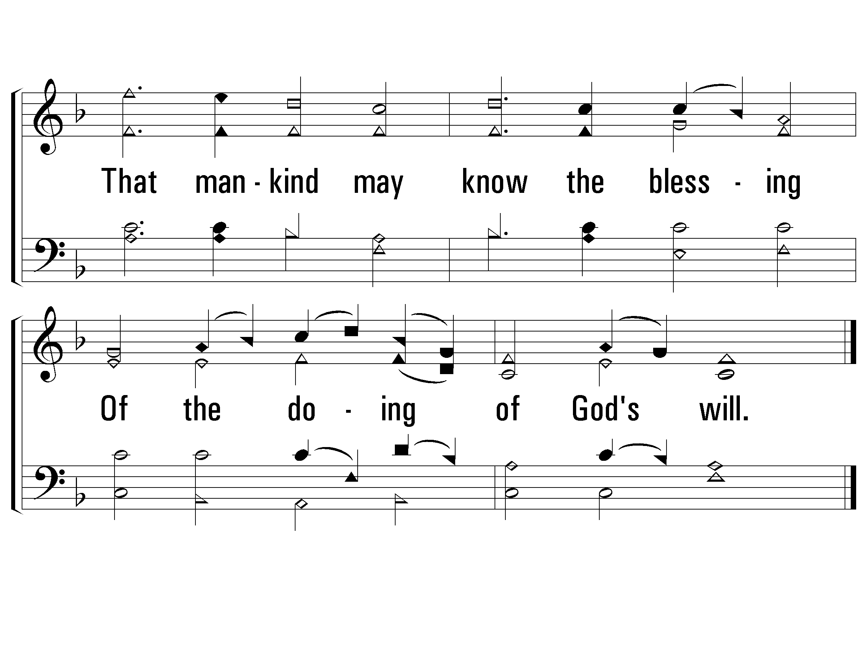
3 - We Are Called to Be God’s People
706
© 2010 The Paperless Hymnal®

Slide 42
New Creation
Sing Chorus at the end of verses 2 & 4 Only

Slide 43
Song #871
In His Time
Sing Chorus at the end of verses 2 & 4 Only

Slide 44
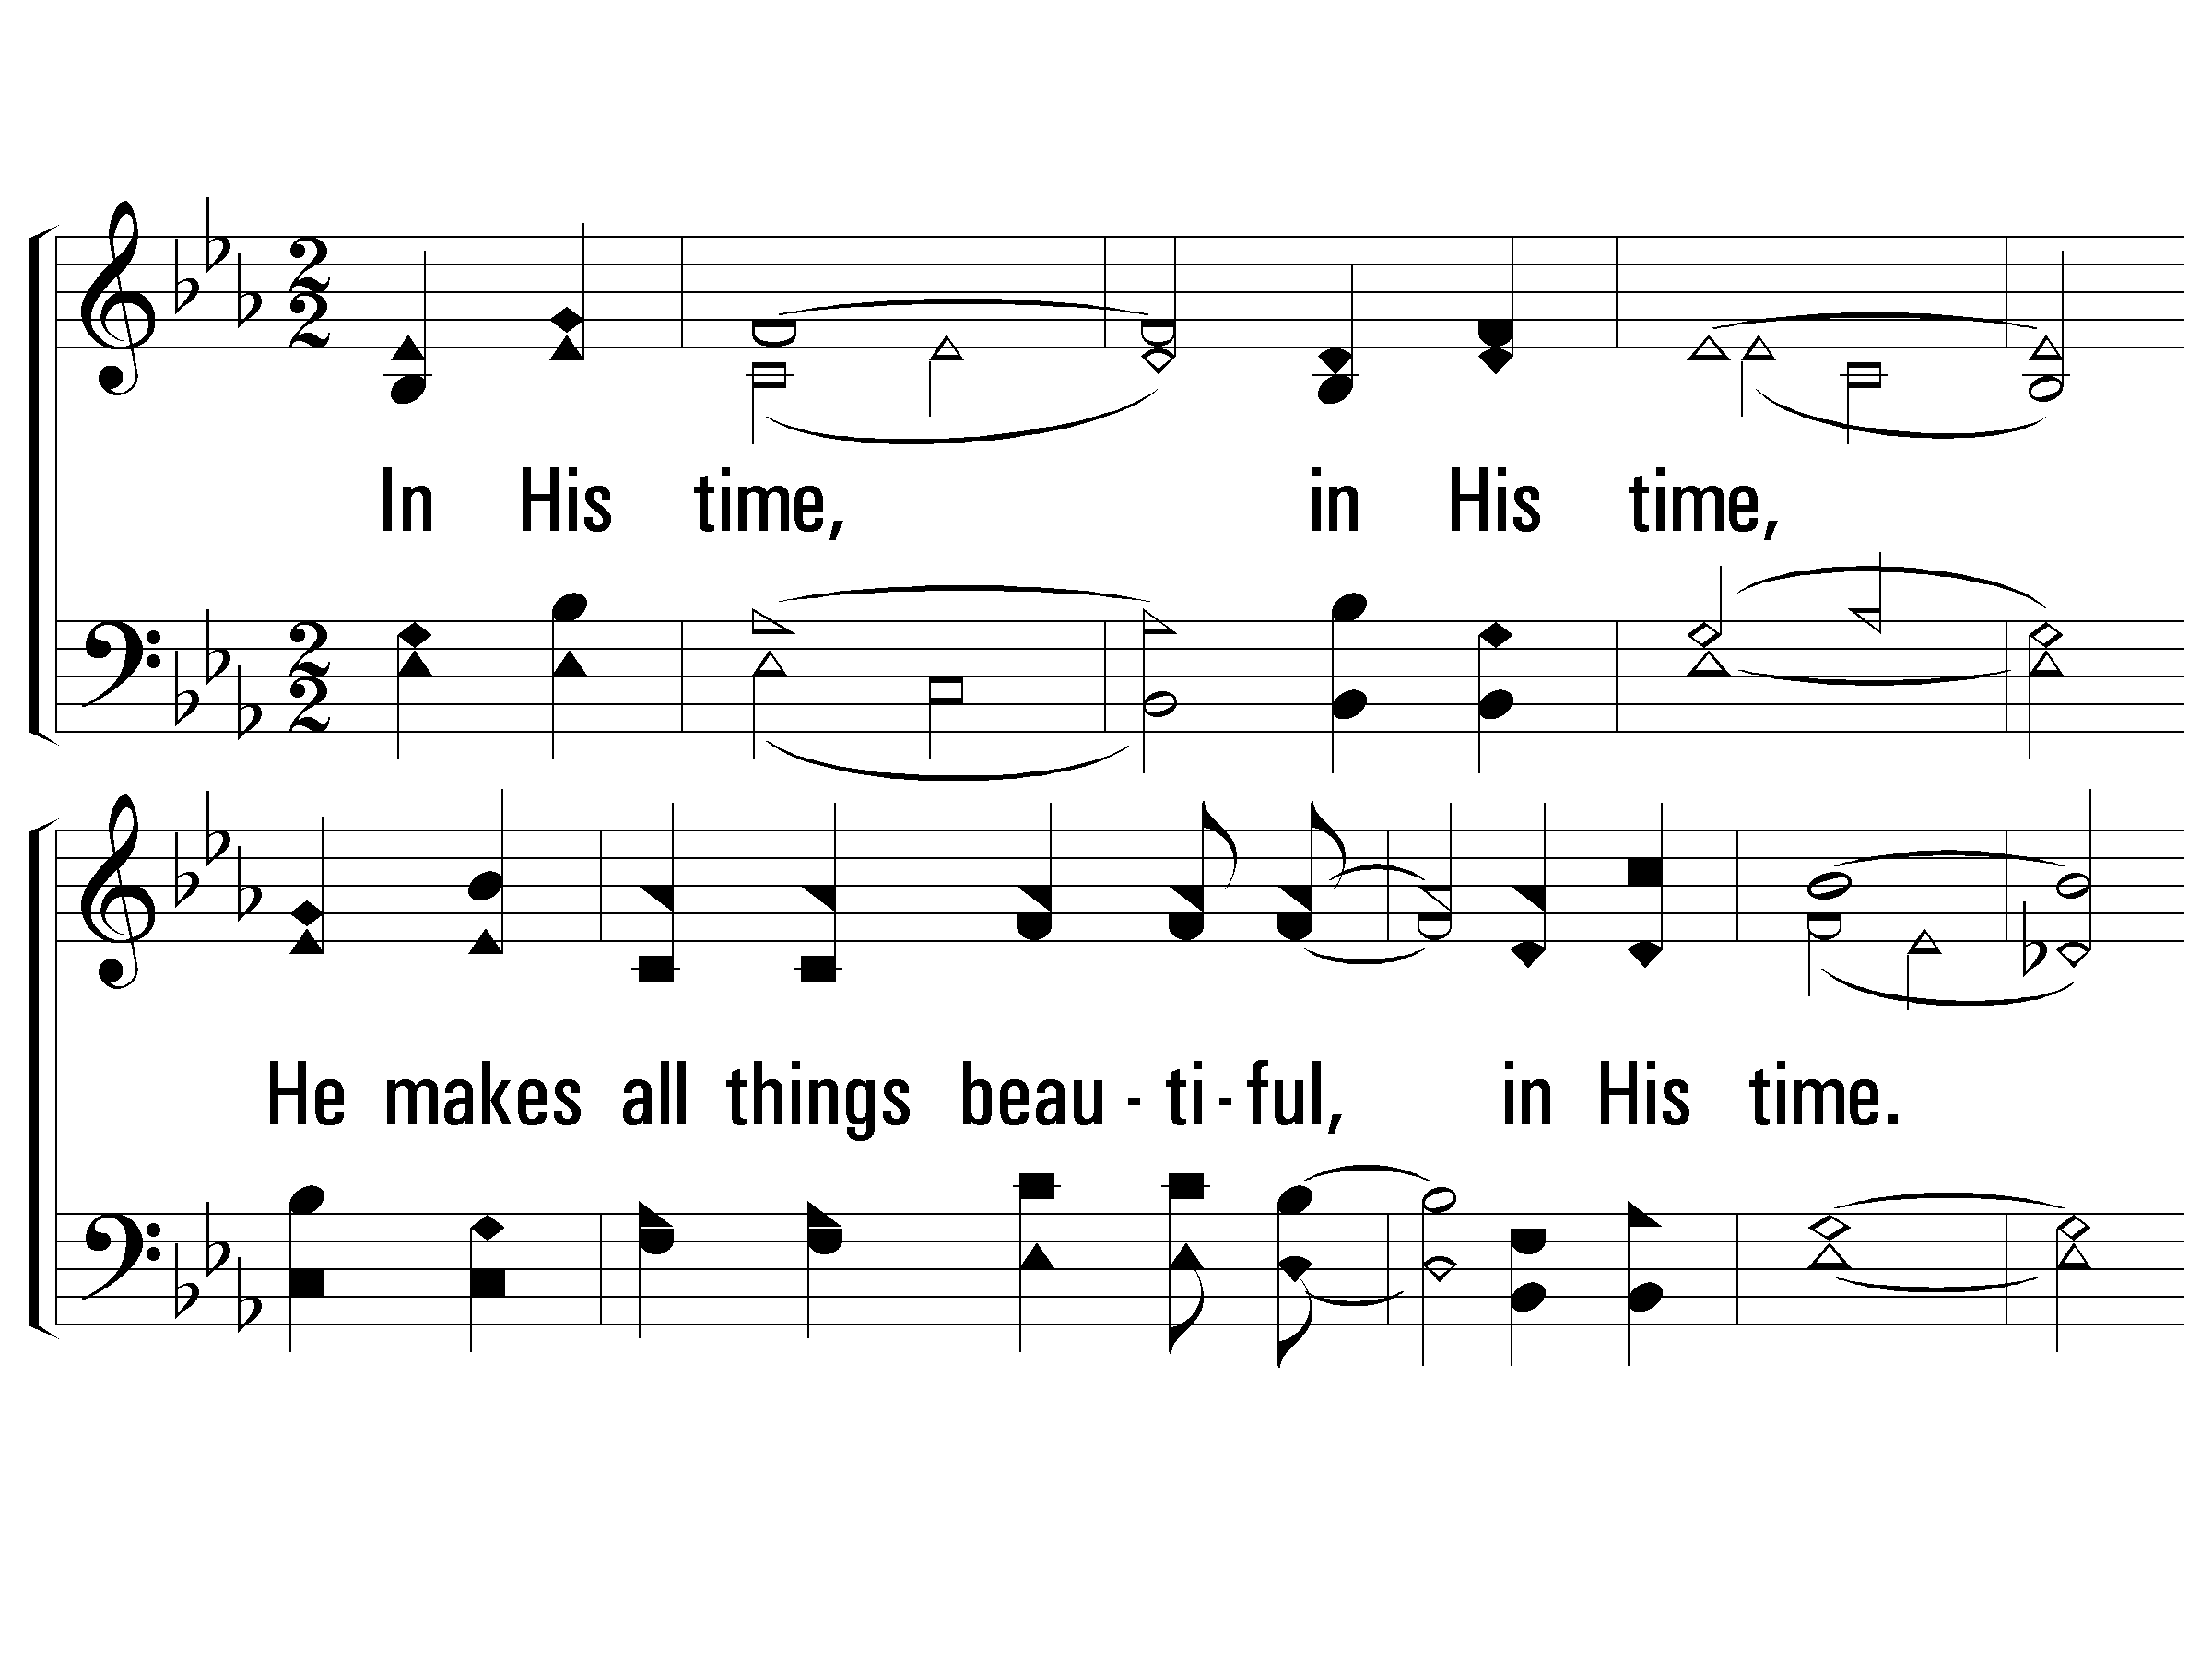
1 – In His Time
871
1.
In His time, in His time,
He makes all things beautiful, in His time.
Lord, please show me every day,
as You're teaching me Your way,
That You do just what You say, in Your time.
Words & Music: Dianne Ball
Copyright © 1978 by CCCM Music (Adm. by Maranatha! Music c/o The Copyright Company)
Maranatha! Music (Adm. by The Copyright Company, Nashville, TN)
All Rights Reserved. International Copyright Secured. Used By Permission.
© 2002 The Paperless Hymnal™

Slide 45
1 – In His Time
871
© 2002 The Paperless Hymnal™

Slide 46
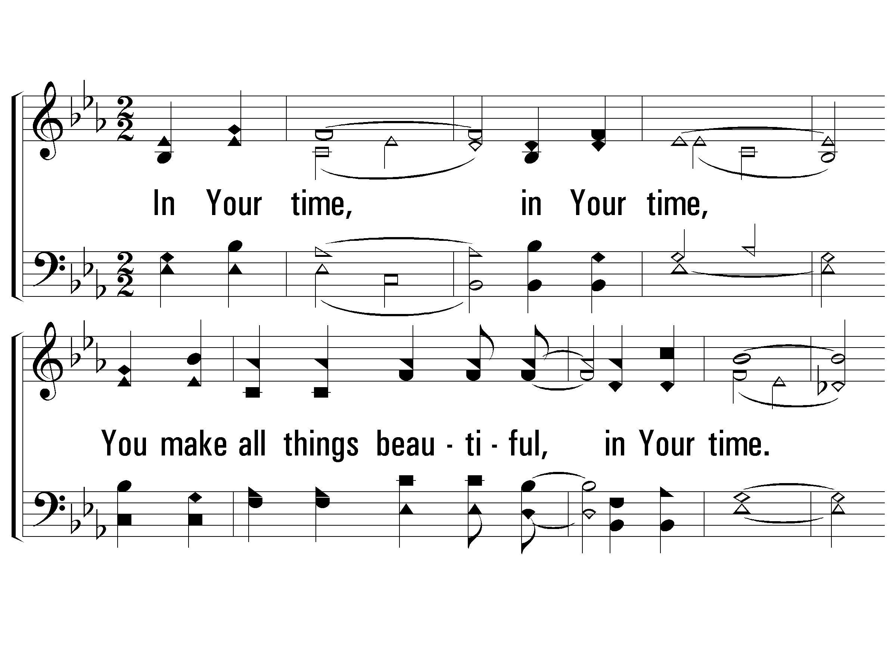
2 – In His Time
871
2.
In Your time, in Your time,
You make all things beautiful, in Your time.
Lord my life to You I bring,
may each song I have to sing,
be to You a lovely thing, in Your time.
Words & Music: Dianne Ball
Copyright © 1978 by CCCM Music (Adm. by Maranatha! Music c/o The Copyright Company)
Maranatha! Music (Adm. by The Copyright Company, Nashville, TN)
All Rights Reserved. International Copyright Secured. Used By Permission.
© 2002 The Paperless Hymnal™

Slide 47
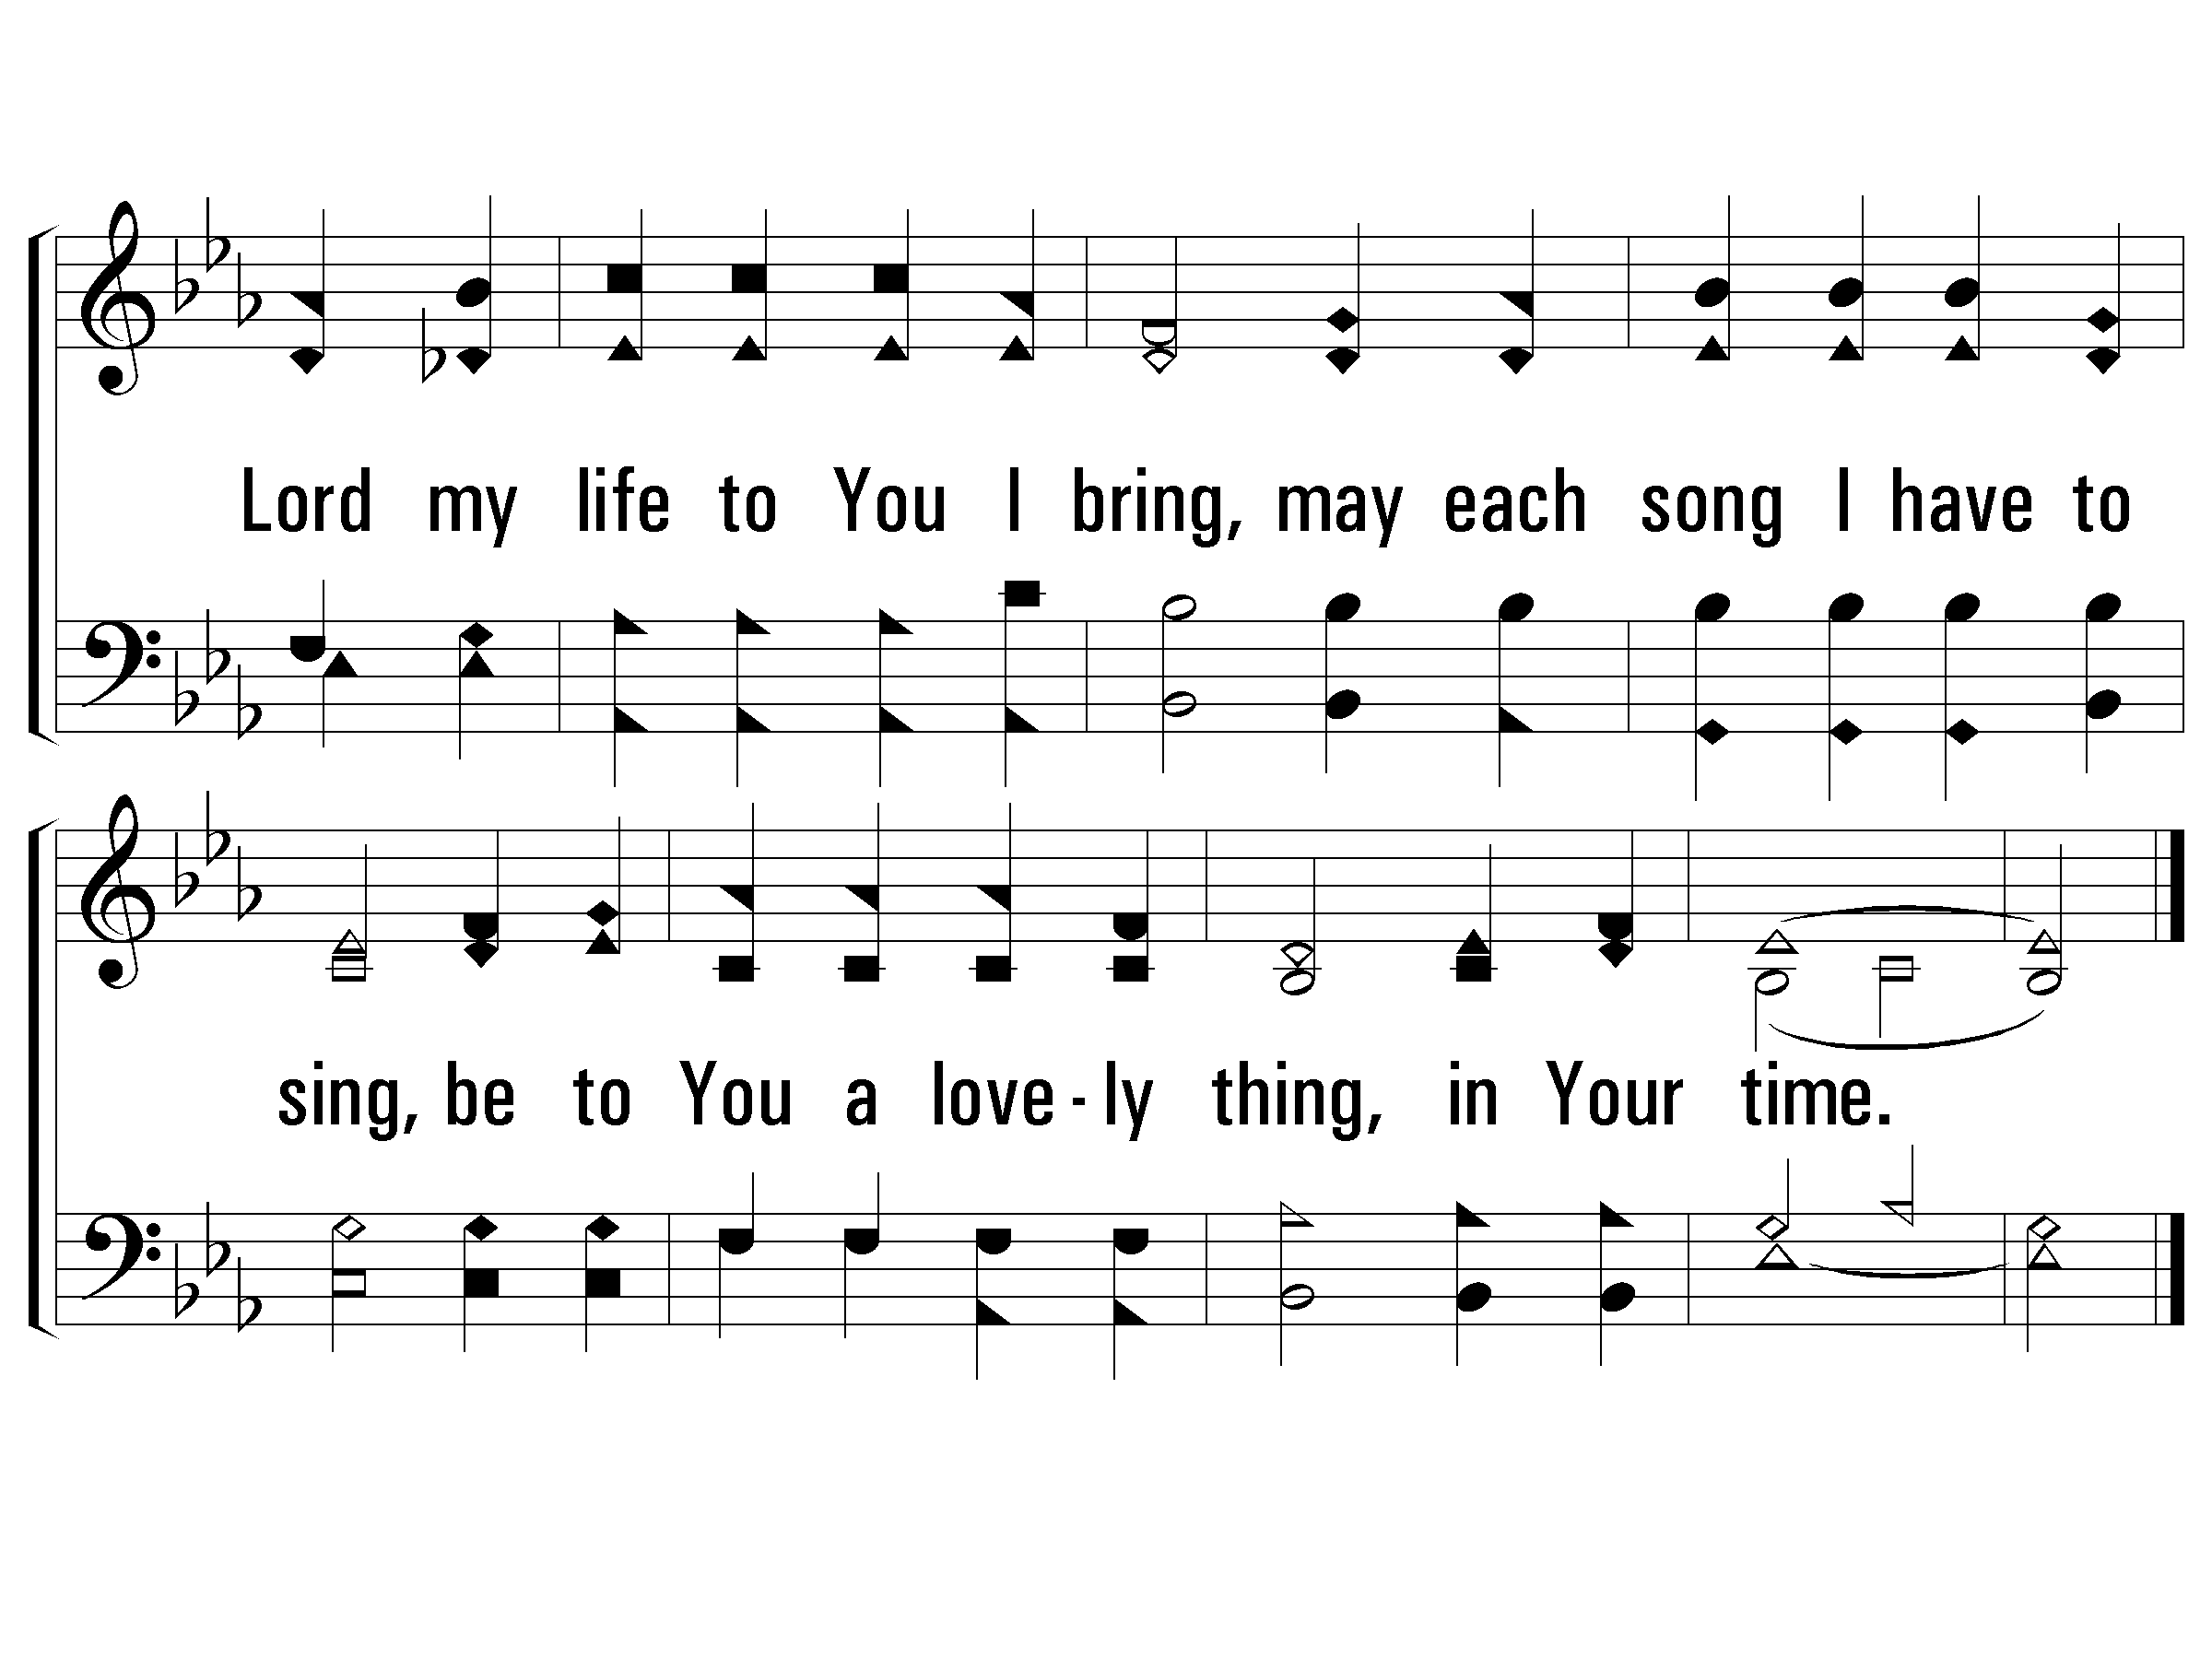
2 – In His Time
871
© 2002 The Paperless Hymnal™

Slide 48
A Living Hope
Sing Chorus at the end of verses 2 & 4 Only

Slide 49
Invitation Song #634
The Great Physician
Sing Chorus at the end of verses 2 & 4 Only

Slide 50
1 – The Great Physician
634
1.
The great Physician now is near,
The sympathizing Jesus;
He speaks the drooping heart to cheer:
O hear the voice of Jesus.
Words: William Hunter
Music: John H. Stockton
© 2005 The Paperless Hymnal™

Slide 51
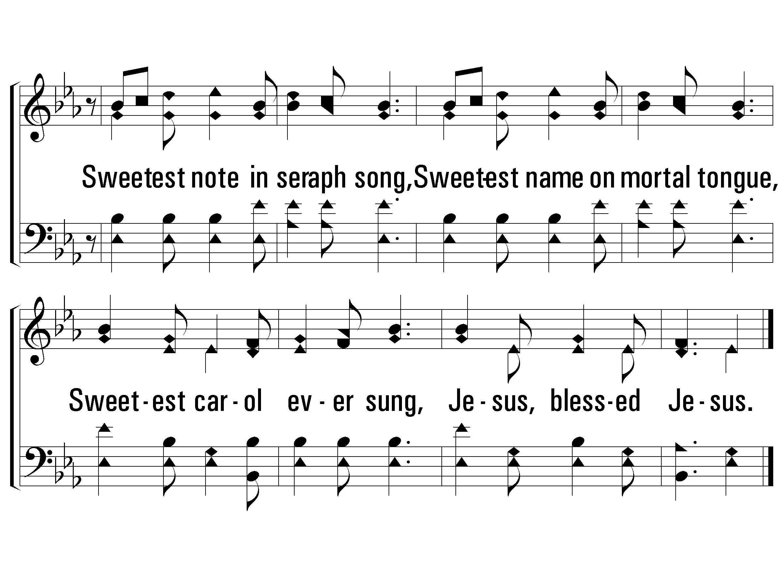
c – The Great Physician
634
Sweetest note in seraph song,
Sweetest name on mortal tongue,
Sweetest carol ever sung,
Jesus, blessed Jesus.
© 2005 The Paperless Hymnal™

Slide 52
2 – The Great Physician
634
2.
All glory to the dying Lamb!
I now believe in Jesus;
I love the blessed Savior's name,
I love the name of Jesus.
Words: William Hunter
Music: John H. Stockton
© 2005 The Paperless Hymnal™

Slide 53
c – The Great Physician
634
Sweetest note in seraph song,
Sweetest name on mortal tongue,
Sweetest carol ever sung,
Jesus, blessed Jesus.
© 2005 The Paperless Hymnal™

Slide 54
3 – The Great Physician
634
3.
His name dispels my guilt and fear,
No other name but Jesus;
O how my soul delights to hear
The charming name of Jesus.
Words: William Hunter
Music: John H. Stockton
© 2005 The Paperless Hymnal™

Slide 55
c – The Great Physician
634
Sweetest note in seraph song,
Sweetest name on mortal tongue,
Sweetest carol ever sung,
Jesus, blessed Jesus.
© 2005 The Paperless Hymnal™

Slide 56
4 – The Great Physician
634
4.
And when to that bright world above,
We rise to see our Jesus,
We'll sing around the throne of love
His name, the name of Jesus.
Words: William Hunter
Music: John H. Stockton
© 2005 The Paperless Hymnal™

Slide 57
c – The Great Physician
634
Sweetest note in seraph song,
Sweetest name on mortal tongue,
Sweetest carol ever sung,
Jesus, blessed Jesus.
© 2005 The Paperless Hymnal™

Slide 58
Sing Chorus at the end of verses 2 & 4 Only

