Slide 1
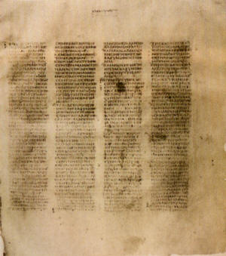
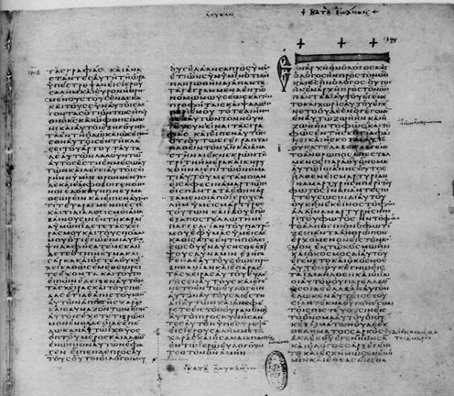
HOW WE GOT the Bible
A class on Bible origin, transmission and reliability
January 2018
Lesson 2
How the Bible Builds Our Faith

Slide 2
Class Objectives
Show the importance of the Bible to our faith & that it is reliable.
Demonstrate that we can be confident that we have God’s inspired word today.
Understand the difference in modern versions of English Bible
Be able to answer questions about the origin of the Bible

Slide 3
From Last Time…
How God Reveals Himself
Authority of Jesus to Command
Inspiration of the writers
What is Scripture?

Slide 4
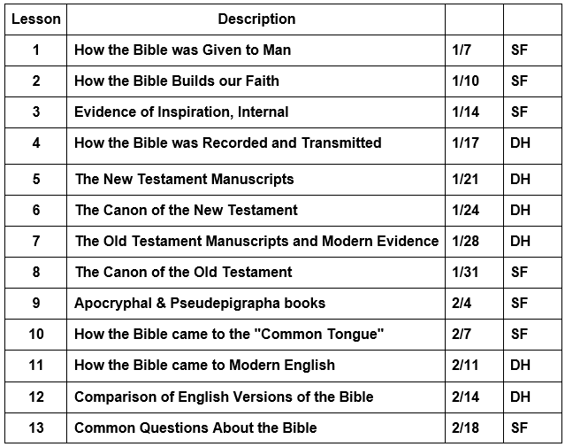
Course Content

Slide 5
How the Bible Builds Our Faith
The Fact of the Resurrection
The Permanence of the Scripture

Slide 6
Of First Importance
For I delivered to you first of all that which I also received: that Christ died for our sins according to the Scriptures, and that He was buried, and that He rose again the third day according to the Scriptures, and that He was seen by Cephas, then by the twelve. After that He was seen by over five hundred brethren at once, of whom the greater part remain to the present, but some have fallen asleep. After that He was seen by James, then by all the apostles. Then last of all He was seen by me also, as by one born out of due time.
(1Co 15:3-8)
Now if Christ is preached that He has been raised from the dead, how do some among you say that there is no resurrection of the dead? But if there is no resurrection of the dead, then Christ is not risen. And if Christ is not risen, then our preaching is empty and your faith is also empty. Yes, and we are found false witnesses of God, because we have testified of God that He raised up Christ, whom He did not raise up—if in fact the dead do not rise. For if the dead do not rise, then Christ is not risen. And if Christ is not risen, your faith is futile; you are still in your sins! Then also those who have fallen asleep in Christ have perished. If in this life only we have hope in Christ, we are of all men the most pitiable.
But now Christ is risen from the dead, and has become the firstfruits of those who have fallen asleep. For since by man came death, by Man also came the resurrection of the dead. For as in Adam all die, even so in Christ all shall be made alive. (1Co 15:12-22)

Slide 7
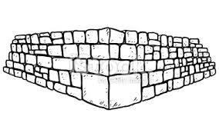
The Foundation of Christ
1 Cor 3:10-11
What is the foundation?
Who is the builder in this verse?
Eph 2:19-22
What is the expanded view of the foundation?
What can be built on this foundation?
Acts 4:10-12
How critical is this foundation?
According to the grace of God which was given to me, as a wise master builder I have laid the foundation, and another builds on it. But let each one take heed how he builds on it. For no other foundation can anyone lay than that which is laid, which is Jesus Christ. (1Co 3:10-11)
Now, therefore, you are no longer strangers and foreigners, but fellow citizens with the saints and members of the household of God, having been built on the foundation of the apostles and prophets, Jesus Christ Himself being the chief cornerstone, in whom the whole building, being fitted together, grows into a holy temple in the Lord, in whom you also are being built together for a dwelling place of God in the Spirit. (Eph 2:19-22)
let it be known to you all, and to all the people of Israel, that by the name of Jesus Christ of Nazareth, whom you crucified, whom God raised from the dead, by Him this man stands here before you whole. This is the 'STONE WHICH WAS REJECTED BY YOU BUILDERS, WHICH HAS BECOME THE CHIEF CORNERSTONE.' Nor is there salvation in any other, for there is no other name under heaven given among men by which we must be saved.“ (Act 4:10-12)

Slide 8
Other Building Materials
1 Cor 3:12-14
How do we build on this foundation? Why does the quality of material vary?
2 Thess 2:15
Is there a place for traditions of man and non-inspired teaching?
Mark 7:6-9
What is the risk of traditions of Man?
Now if anyone builds on this foundation with gold, silver, precious stones, wood, hay, straw, each one's work will become clear; for the Day will declare it, because it will be revealed by fire; and the fire will test each one's work, of what sort it is. If anyone's work which he has built on it endures, he will receive a reward. (1Co 3:12-14)
Therefore, brethren, stand fast and hold the traditions which you were taught, whether by word or our epistle.
(2Th 2:15)
He answered and said to them, "Well did Isaiah prophesy of you hypocrites, as it is written: 'THIS PEOPLE HONORS ME WITH THEIR LIPS, BUT THEIR HEART IS FAR FROM ME. AND IN VAIN THEY WORSHIP ME, TEACHING AS DOCTRINES THE COMMANDMENTS OF MEN.' For laying aside the commandment of God, you hold the tradition of men— the washing of pitchers and cups, and many other such things you do." He said to them, "All too well you reject the commandment of God, that you may keep your tradition. (Mar 7:6-9)
We will return to this idea when we discuss the non-inspired writings, and other aids

Slide 9
The Permanence of God’s Word

Slide 10
The Preservation of God’s Word
Psalms 12:6-7
Isaiah 40:8
Mark 13:31
Matt 5:18-19
Will God preserve His word?
For how long?
The words of the LORD are pure words, Like silver tried in a furnace of earth, Purified seven times. You shall keep them, O LORD, You shall preserve them from this generation forever. (Psa 12:6-7)
The grass withers, the flower fades, But the word of our God stands forever." (Isa 40:8)
Heaven and earth will pass away, but My words will by no means pass away. (Mar 13:31)
For assuredly, I say to you, till heaven and earth pass away, one jot or one tittle will by no means pass from the law till all is fulfilled. (Mat 5:18)

Slide 11
We Are Judged by God’s Word
John 12:48
John 5:39-40, 45-47
Will we be judged by God’s Word?
Would God allow us to be judged by a Word that was corrupted?
Can we depend on God’s promise to preserve His Word?
He who rejects Me, and does not receive My words, has that which judges him— the word that I have spoken will judge him in the last day. (Joh 12:48)
You search the Scriptures, for in them you think you have eternal life; and these are they which testify of Me. But you are not willing to come to Me that you may have life. (Joh 5:39-40)
Do not think that I shall accuse you to the Father; there is one who accuses you—Moses, in whom you trust. For if you believed Moses, you would believe Me; for he wrote about Me. But if you do not believe his writings, how will you believe My words?" (Joh 5:45-47)

Slide 12
Changing God’s Word

Slide 13
Adding or Subtracting
Deut 4:1-2
Deut 12:32
Prov 30:5-6
1 Cor 4:6
Jude 1:3
Rev 22:18-19
Does God address adding or removing from His Word?
Is He consistent?
Has the faith been “once for all” delivered to the saints?
What does this mean?
"Now, O Israel, listen to the statutes and the judgments which I teach you to observe, that you may live, and go in and possess the land which the LORD God of your fathers is giving you. You shall not add to the word which I command you, nor take from it, that you may keep the commandments of the LORD your God which I command you. (Deu 4:1-2)
"Whatever I command you, be careful to observe it; you shall not add to it nor take away from it. (Deu 12:32)
Every word of God is pure; He is a shield to those who put their trust in Him. Do not add to His words, Lest He rebuke you, and you be found a liar. (Pro 30:5-6)
Now these things, brethren, I have figuratively transferred to myself and Apollos for your sakes, that you may learn in us not to think beyond what is written, that none of you may be puffed up on behalf of one against the other. (1Co 4:6)
Beloved, while I was very diligent to write to you concerning our common salvation, I found it necessary to write to you exhorting you to contend earnestly for the faith which was once for all delivered to the saints. (Jud 1:3)
For I testify to everyone who hears the words of the prophecy of this book: If anyone adds to these things, God will add to him the plagues that are written in this book; and if anyone takes away from the words of the book of this prophecy, God shall take away his part from the Book of Life, from the holy city, and from the things which are written in this book. (Rev 22:18-19)

Slide 14
Satan’s Attempts to Corrupt It
Gen 3:1-4
Matt 4:5-7
Has Satan tried to change the Word of God?
Has he tried to present less than the whole Word of God in order to deceive?
What does this say about reading the context of scripture for full understanding?
Now the serpent was more cunning than any beast of the field which the LORD God had made. And he said to the woman, "Has God indeed said, 'You shall not eat of every tree of the garden'?" And the woman said to the serpent, "We may eat the fruit of the trees of the garden; but of the fruit of the tree which is in the midst of the garden, God has said, 'You shall not eat it, nor shall you touch it, lest you die.' " Then the serpent said to the woman, "You will not surely die. (Gen 3:1-4)
Then the devil took Him up into the holy city, set Him on the pinnacle of the temple, and said to Him, "If You are the Son of God, throw Yourself down. For it is written: 'HE SHALL GIVE HIS ANGELS CHARGE OVER YOU,' and, IN THEIR HANDS THEY SHALL BEAR YOU UP, LEST YOU DASH YOUR FOOT AGAINST A STONE.' " Jesus said to him, "It is written again, 'YOU SHALL NOT TEMPT THE LORD YOUR GOD.' " (Mat 4:5-7)

Slide 15
Fate of False Teachers
Acts 20:29-30
2 Tim 4:3-4
Were men teaching false doctrine in the time of the Apostles?
Gal 1:8-9
2 Pet 3:15-16
What is the fate of one who preaches a different gospel than the one Paul preached?
What is the fate of one who “twists” scripture?
For I know this, that after my departure savage wolves will come in among you, not sparing the flock. Also from among yourselves men will rise up, speaking perverse things, to draw away the disciples after themselves. (Act 20:29-30)
For the time will come when they will not endure sound doctrine, but according to their own desires, because they have itching ears, they will heap up for themselves teachers; and they will turn their ears away from the truth, and be turned aside to fables. (2Ti 4:3-4)
But even if we, or an angel from heaven, preach any other gospel to you than what we have preached to you, let him be accursed. As we have said before, so now I say again, if anyone preaches any other gospel to you than what you have received, let him be accursed. (Gal 1:8-9)
and consider that the longsuffering of our Lord is salvation—as also our beloved brother Paul, according to the wisdom given to him, has written to you, as also in all his epistles, speaking in them of these things, in which are some things hard to understand, which untaught and unstable people twist to their own destruction, as they do also the rest of the Scriptures. (2Pe 3:15-16)

Slide 16
Summary
The Resurrection proves Jesus’ authority is given from God
If Jesus is Christ, we can trust Him to save us
The inerrancy and permanence of the Bible confirm its claim to be the Word of God
If the Bible is from God, we can trust the facts revealed (Origins, Purpose, etc)
If God “breathed” scripture, we must obey His commands and believe His promises
We must not add or subtract from God’s Word
Satan will try to change the Word of God
He will fail in the face of God’s promise to preserve it
We must be diligent for his attempts

