Slide 1
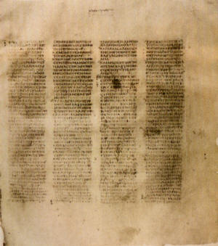
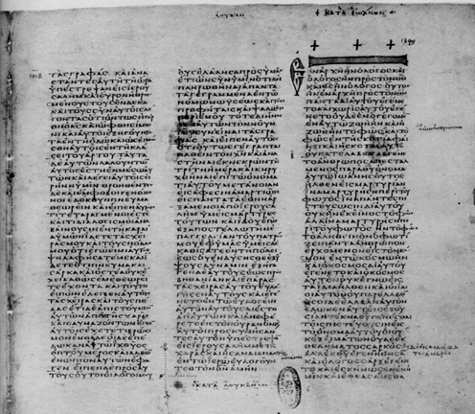
HOW WE GOT the Bible
A class on Bible origin, transmission and reliability
January 2018
Lesson 13
Answering the Questions

Slide 2
1 Peter 3:15 - 16
15 But sanctify the Lord God in your hearts, and always be ready to give a defense to everyone who asks you a reason for the hope that is in you, with meekness and fear;
16 having a good conscience, that when they defame you as evildoers, those who revile your good conduct in Christ may be ashamed.
(NKJV)

Slide 3
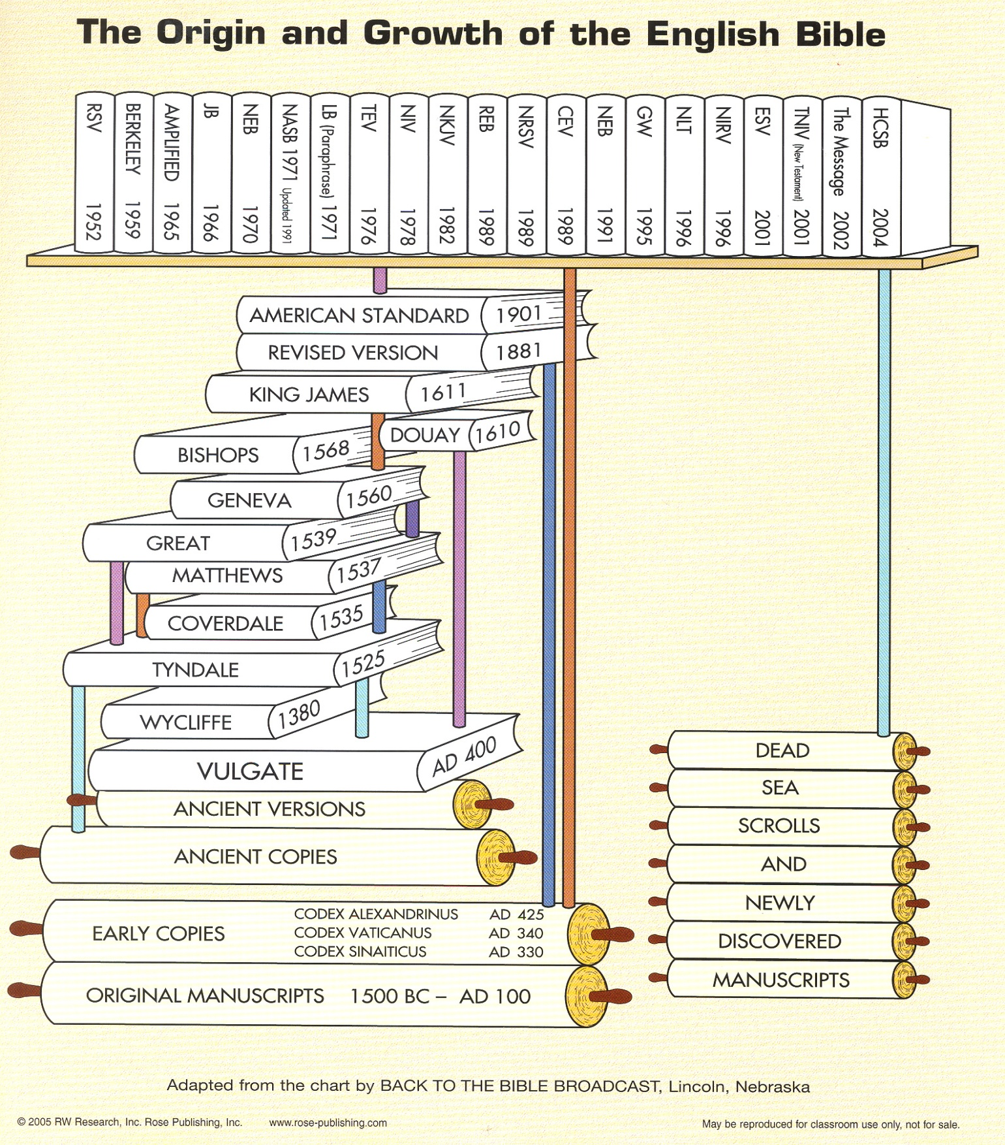
Origin & Growth of English Bible
Lessons 12
Lessons 11
Lessons 1 to 10

Slide 4



Lesson 13 Answering Questions about the Bible

Slide 5

Doesn't the Bible have a lot of mistakes?

Slide 6
How can 200000 errors be reliable?
You may hear of thousands of variants or errors, this is based on counting the same error in each of the 5,000 manuscripts
Only 40 lines (400 words) of the 20,000 lines are in question. We can be sure that the New Testament is 99.5% pure.
The Iliad (oldest and highest number of manuscripts) by contrast has 5% corrupted text.

Slide 7
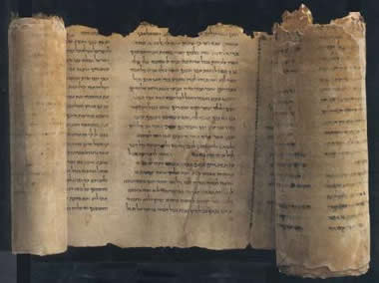
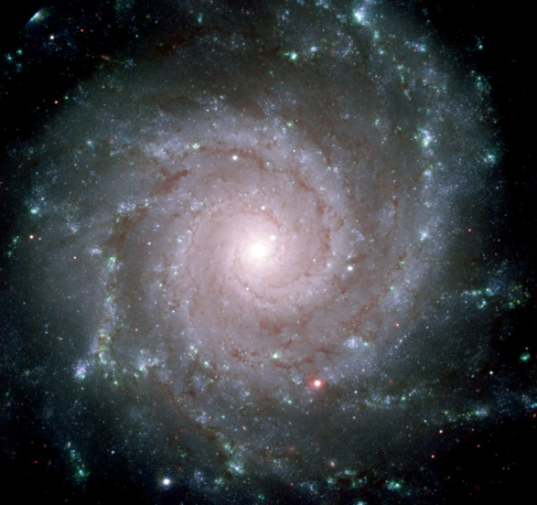
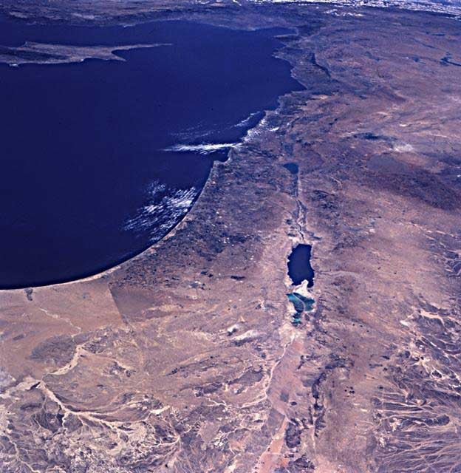
Some Brief Considerations of Evidence
1) The Bible: A Collection of Books Written …
Over a 1,500 year span
Over 40 generations
By more than 40 authors, from every walk of life - including kings, peasants, philosophers, fishermen, poets, statesmen, scholars, etc.
  Moses, a political leader, trained in the universities of Egypt.
  Peter, a fisherman
  Amos, a herdsman
  Joshua, a military general

Slide 8
The Bible: A Collection of Books Written…
  Nehemiah, a cupbearer
  Daniel, a prime minister
  Luke, a doctor
  Solomon, a king
  Matthew, a tax collector
  Paul, a rabbi
In different places:
  Moses in the wilderness
  Jeremiah in a dungeon
  Daniel on a hillside and in a palace

Slide 9
The Bible: A Collection of Books Written…
On three continents: Europe, Asia and Africa
In three different languages:
  Hebrew, the language of the OT
  Aramaic, the “common language” of the near east until the time of Alexander the Great
  Greek, the NT language (the international language at the time of Christ)
Its subject matter includes hundreds of contro-versial topics. Yet, the biblical authors spoke with harmony and continuity … there is one unfolding story: “God’s redemption of man.”

Slide 10
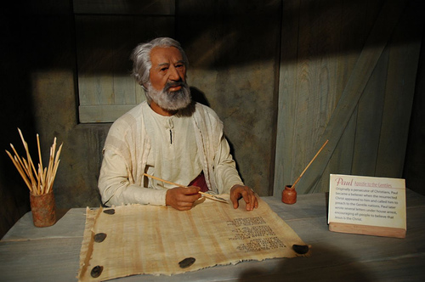
Do we have the Original Books?
Autograph Text

Slide 11
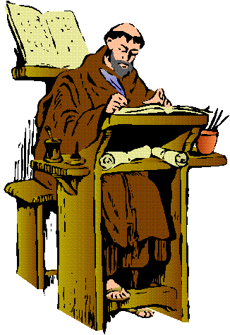
No, we have copies – so does God use miraculous powers to keep copiers from making errors

Slide 12
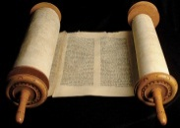
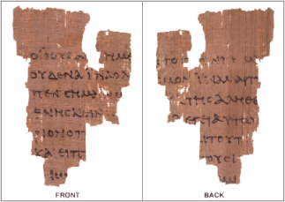




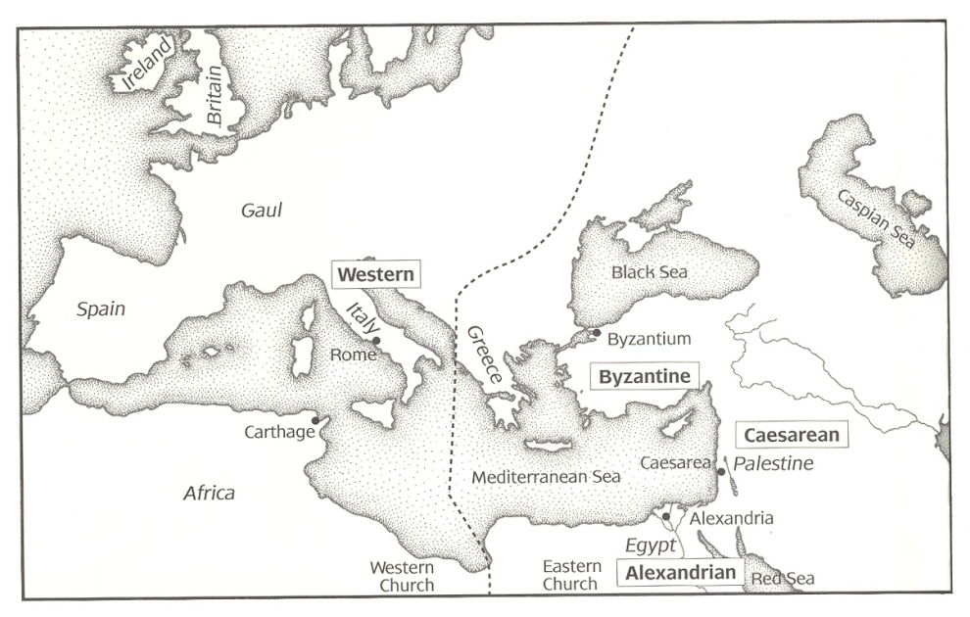
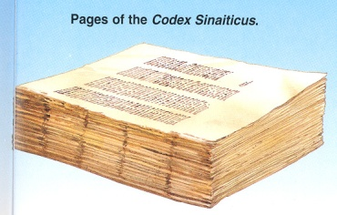
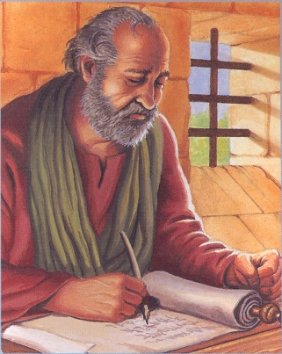
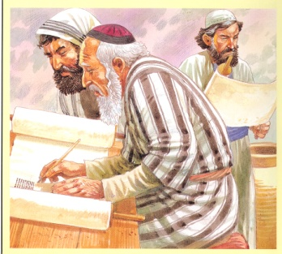
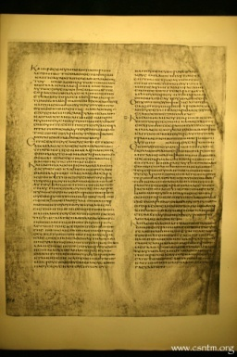
From Autograph to Manuscripts
Original Gospel, Epistles and Revelation written on Papyrus & Lost
Fragments of
Papyri
Codex Vaticanus
Copies collected at Bible Centers and Copied
Copies made & circulated
Codex Alexandrinus

Slide 13
Five Important Greek Codex Bibles
The form of writing is used to date ancient documents - for example, the following MSS are all uncials:
Codex (A) Alexandrinus - 5th century
Codex (B) Vaticanus - 4th century
Codex (C) of Ephraem - 5th century
a palimpsest
Codex (D) Bezae - 5th or 6th century (most questionable)
Codex (a) Sinaiticus - 4th century

Slide 14
What Bible version should I use?
I'm confused about all the different versions.

Slide 15
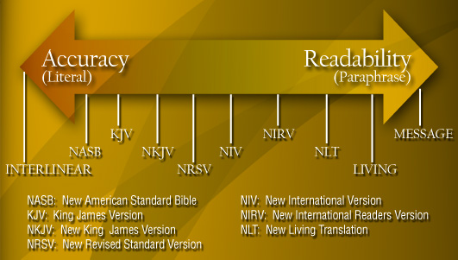
Form Driven
versions
ESV
Meaning Driven versions
ESV: English Standard Version

Slide 16
Comparing Translations
Scoring System
Best to Pick Verses you know or verses that represent three different type of verses
Luke 20:22 - Literal - This verse was chosen because it demands an almost word-for-word translation with little room for experimentation or imagination
Acts 27:14 - Expressive - Paul uses language at this point which is very flexible, permitting the translator to be inventive with vocabulary and creative with interpretation.
Mark 11:16 - Interpretative - contains an irresistible enticement to be interpretatively and theologically adventurous.

Slide 17
Word count according to Translation Discipline
Test Passages
1 Matthew - Style is rigid and diminishes imaginative interpretation
Philippians 1 - Style is expressive and encourages imaginative interpretation
3 John 1 - Style is compressed and forces imaginative interpretation
The literal King James experienced
20.6% increase in English words to render its underlying Greek text
Allowed 88.9% of its Greek text to pass through translation
Paraphrased Living Bible incurred
54.3% increase in the number of words.
Greek text permitted was only 35.1%.

Slide 18
Is the Bible really relevant to my life?

Slide 19
It is Possible that there is Supernatural
The Universe had Supernatural Origins
The Universe had a Intelligent, Personal Origin
There is a Purpose for the Creation
It is Likely There is a Moral Law
Miracles & Revelation are Possible
Divine Revelation is Possible
Divine Revelation or Bible would be Accurate
Accurate Account of Jesus’ Life
Bible is Inspired
Based on Bible Testimony Jesus is the Son of God
Teachings of the Bible are Truth
Teachings of Jesus are Truth

Slide 20
Mind of God is Revealed
Job 32:8 (ESV) ⁸ But it is the spirit in man, the breath of the Almighty, that makes him understand.
2 Timothy 3:16 - 17 (ESV) 16All Scripture is breathed out by God and profitable for teaching, for reproof, for correction, and for training in righteousness, 17that the man of God£ may be competent, equipped for every good work.

Slide 21
1 Corinthians 2:9 - 13 (ESV) ⁹But, as it is written,
“What no eye has seen, nor ear heard,
nor the heart of man imagined,
what God has prepared for those who love him”—
¹⁰these things God has revealed to us through the Spirit. For the Spirit searches everything, even the depths of God.
¹¹For who knows a person’s thoughts except the spirit of that person, which is in him? So also no one comprehends the thoughts of God except the Spirit of God. ¹²Now we have received not the spirit of the world, but the Spirit who is from God, that we might understand the things freely given us by God. ¹³And we impart this in words not taught by human wisdom but taught by the Spirit, interpreting spiritual truths to those who are spiritual.
Lesson 1

Slide 22
What about the Lost Books of the Bible?

Slide 23
Old Testament Apocrypha
(or simply: Apocrypha)
Apocrypha: means hidden, or at times, non-canonical
Catholic Bible includes all but I & II Esdras and Tobit
LXX includes all but II Esdras
The Apocrypha fall into the following four general categories:
  Historic
  Prophetic
  Ethical
  Legendary

Slide 24
Pseudepigrapha
(soo’ de-pig’ re-fe)
1. Certain writings other than the canonical books and the Apocrypha professing to be Biblical in character.
2. Gk, of pseudepígraphos falsely inscribed, bearing a false title. From PSEUD (a person of fatuously intellectual, artistic or social pretentions) + EPIGRAPH (an inscription, esp. on a building, statue or the like).
í Pretentious inscriptions..
Random House Webster’s College Dictionary - ISBN 0-679-41420-7

Slide 25
How did the Bible come into being?

Slide 26





From Autograph to Manuscripts
Original Gospel, Epistles and Revelation written on Papyrus & Lost
Fragments of
Papyri
Codex Vaticanus
Copies collected at Bible Centers and Copied
Lesson 2
Copies made & circulated
Codex Alexandrinus

Slide 27
History of Old Testament Manuscript Transmission.
The Old Testament or Hebrew Bible was produced from 1450 BC to 425 BC
After the conquest of Persia, by Alexander the Great 330 BC, Alexandria Egypt, became a major center for Biblical manuscript transmission. From Alexandria, the Septuagint would be created for Greek speaking Jews.
The inter-testamental transmission involved individual scrolls. They were made of leather or papyrus. The standard size was 10 inches by 30 feet. Long enough to accommodate the text of Isaiah

Slide 28
How is the Bible different today from when it was written?

Slide 29
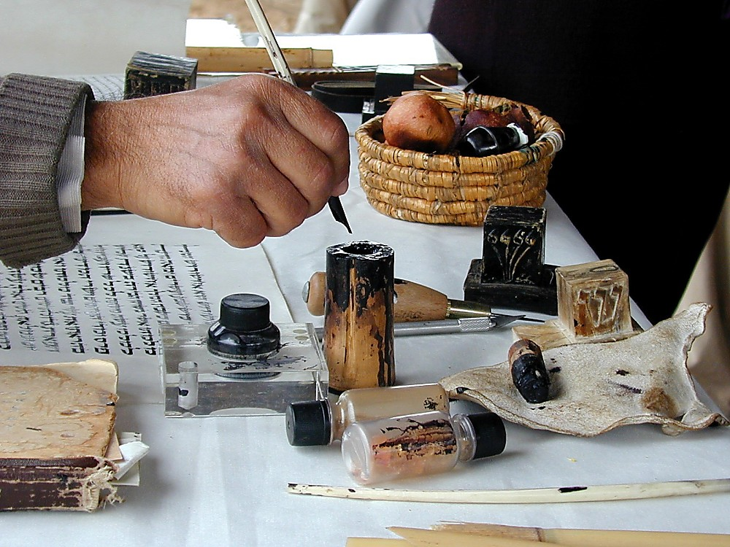
Quill and ink well
Quill and ink well
Notes:
Jeremiah 36:18 (NIV) “‘Yes,’ Baruch replied, ‘he dictated all these words to me, and I wrote them in ink on the scroll.’”

Slide 30
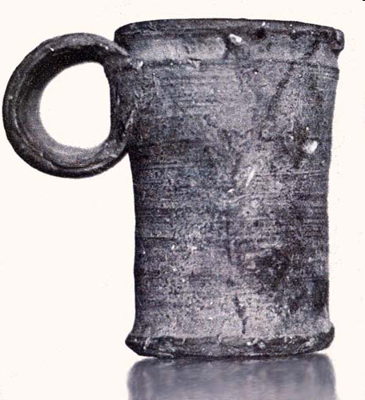
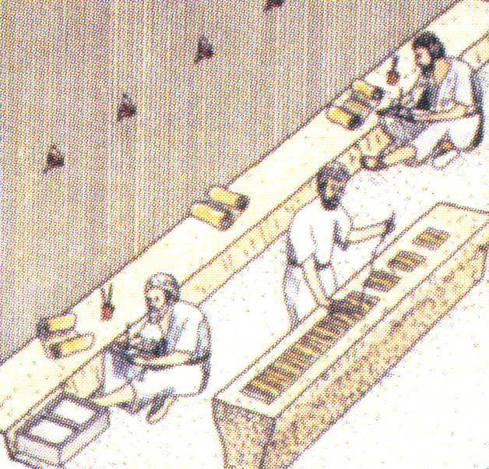
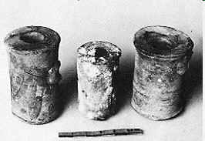
Dead Sea Scroll Ink Wells
Notes:
The Essene’s choice of ink was also fortunate. Most of the scrolls are written in a carbon ink made from soot or lampblack. Gum arable, a liquid adhesive, was added to stabilize the carbon ink. Lampblack is an inert and very durable substance. Unlike most modern inks which fade and even disappear after a few decades, the ink on the Dead Sea Scrolls has remained dark and legible for more than twenty centuries. Editor, H. S. (2004; 2004). BAR 07:04 (July/Aug 1981). Biblical Archaeology Society.
Not all of the Dead Sea Scrolls were written with this ink, however. For example, the scroll known as the Genesis Apocryphon was written in an iron gall ink which includes gallotannic acid. Over the ages the acidity of this ink ate away the parchment. As a result, this scroll came to us in a much more deteriorated condition than the scrolls written in carbon ink, and the task of deciphering the Genesis Apocryphon was correspondingly more formidable.Aside from the parchment and the ink, the single most important factor accounting for the extraordinary preservation of the scrolls is the climatic condition of the caves in which they were stored. The air there is extremely dry, the temperature is stable within very narrow limits, and there is almost no air flow within the caves. When the scrolls were placed in the caves, they dehydrated gradually and soon reached a state of almost perfect equilibrium with the environment which surrounded and protected them. Moreover, the same climatic conditions which favored the preservation of the scrolls prevented the growth of harmful bacteria which might otherwise have caused them to decompose.Editor, H. S. (2004; 2004). BAR 07:04 (July/Aug 1981). Biblical Archaeology Society.
Reuven and Edith Hecht MuseumDried ink discovered inside this Qumran inkwell may prove important for future research, especially if the ink matches that on any Dead Sea Scrolls. Solomon H. Steckoll, working on behalf of the Antiquities Department of Jordan, discovered this unbroken inkwell at Qumran in the 1960s. The inkwell measures about 2 inches (5.5 cm) tall and 1.5 inches (3.9 cm) in diameter.Editor, H. S. (2004; 2004). BAR 20:05 (Sep/Oct 1994). Biblical Archaeology Society.

Slide 31
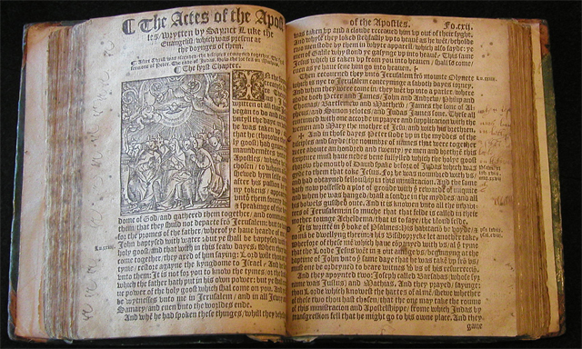
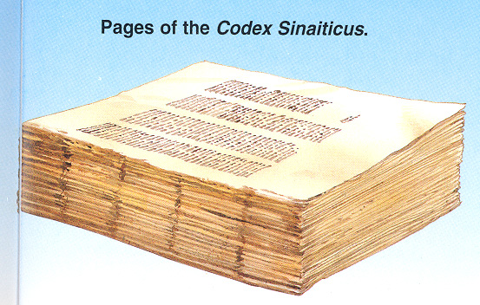
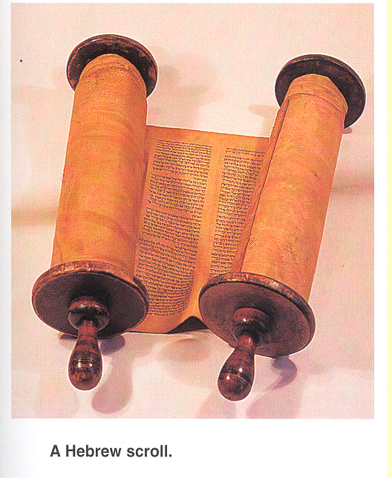
From Scroll to Printed Bible

Slide 32
I thought common people could not read and write in the time of Jesus and the Apostles?

Slide 33
Over 5000 Greek Manuscripts
Codex –Manuscripts are almost complete bibles bound as books and will contain most of the Old and New Testament.
Palimpsest – manuscripts that have been scraped again or the ink washed off in order to reuse the parchment.
Papyri - usually incomplete portions of the New Testament written on papyrus that have been unearthed from the sands of Egypt
Early Church Fathers – It has been estimated that the whole New Testament can be reconstructed from references from the Early Church Fathers in the second and third centuries.
Lectionary - eastern churches used the same passage of scripture or liturgy on a certain Sunday or ecclesiastical holiday each year, these repeatedly used scriptures or lections were housed in a specially constructed book called a Lectionary.

Slide 34
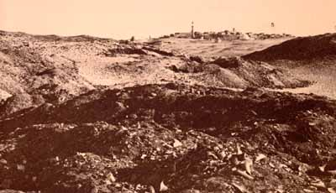
Priceless rubbish
The rubbish mounds of Oxyrhynchus
Notes:
The town dumps of ancient Oxyrhynchus remained intact right up to the late nineteenth century. They didn’t look exciting, just a series of mounds covered with drifting sand. But they offered ideal conditions for preservation. In this part of Egypt it never rains; perishables which are above the reach of ground water will survive. In the dumps was something which the famous sites of classical Greece and Italy could not preserve: papyrus, the ancient equivalent of paper.

Slide 35
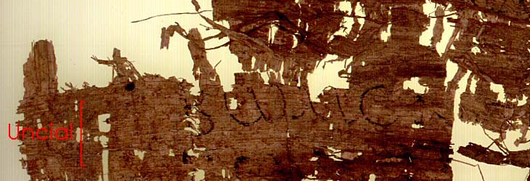
Scribes Practicing Various Styles: Late second or third century AD
The second line is in a similar style, but larger.
Notes:
One of the ancient scribes of Oxyrhynchus in the process of demonstrating his talents. The same line is written in various styles. A fictitious pseudo-epic line is used for copying practice because it contains every letter of the alphabet. (Similar lines are discussed by Clement of Alexandria, Strom. v 8.46-9; see also D. Hagedorn, ZPE 2 (1968) 65-9, to whose examples may be added P.Köln IV no. 175). The first line is written in cramped, tall upright letters of the ‘chancery’ type. The second line is in a similar style, but larger. The third attempt is the same pseudo-epic line in large, round uncial letters, decorated with serifs, of a much more archaic type.
The Oxyrhynchus Papyri vol. XXXI no. 2604
© E.E.S. In preparation for publication

Slide 36
How can you prove that the Bible is inspired and what we have today is truly God’s word?

Slide 37
These fulfilled prophecies established three important truths
The existence of God
The deity of Jesus Christ
The inspiration of the OT Scriptures

Slide 38



Bible Authority Established
Creation, Flood, Redemption Story, Moses, Moral Laws, Miracles, Nature of Man, Purpose of Man, Nature of God, Christ & Holy Spirit, Requirements for Worship, Personality of Jesus, Coming Judgment, Heaven, Hell, Angels, Demons, & Satan
Bible would be Accurate
Based on Bible Testimony Jesus is Son of God
Teachings of
Jesus are True
Accurate Account of Jesus’ Life
A Step of Faith not
A Leap of Faith
Bible can be Understood
Bible is Inspired
Bible is Accurate
Bible is Reliable
If Bible Revelation of Creator then
Divine Revelation Possible
& Accurate So Purpose is Known
Starting Point for
How We Got the Bible
class
Creation
has a purpose
Likely a Moral Law
Miracles &
Revelations
Universe had an Intelligent, Personal Origin
Possible that Universe had Supernatural Origin
It is Possible that there is Supernatural Force
Based on material from mmb, jr Establishing Bible Authority Class - 10/30/2002

Slide 39
“But the word of the LORD endures forever." Now this is the word which by the gospel was preached to you.
(NKJV)
I Peter 1:25

Slide 40
Did God speak in English?

Slide 41
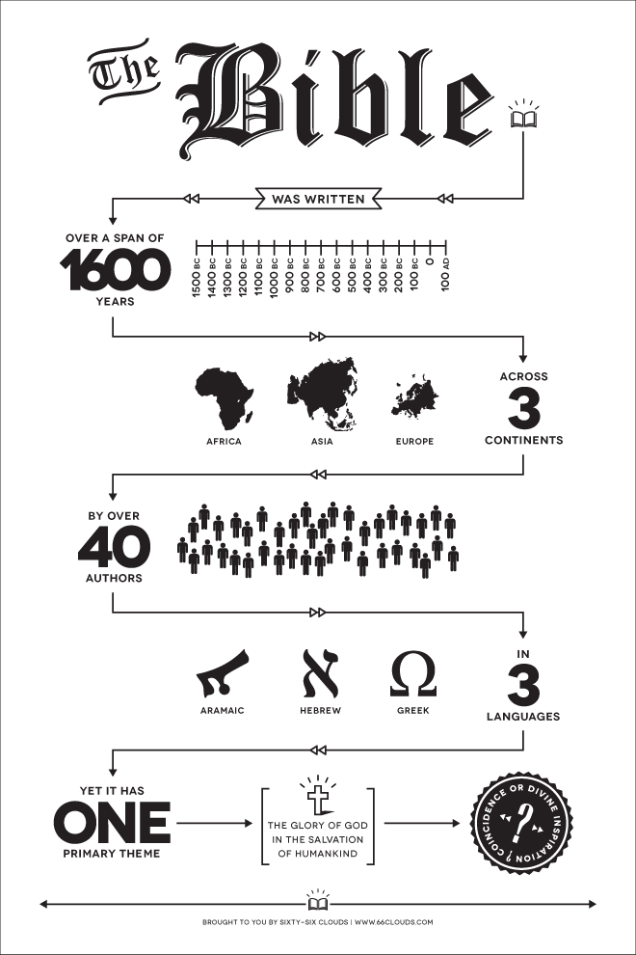
Uniqueness of God’s Word
Unique
  being the only one
  being without a like or equal
  unusual
Consistent
  marked by harmony, regularity, or steady continuity : free from variation or contradiction
  marked by agreement : compatible
  showing steady conformity to character, profession, belief, or custom

Slide 42
Origin & Growth of English Bible
Greek, Hebrew, Aramaic

Slide 43
Since we can not understand the Bible, don’t you think I can believe it my way and you believe it your way?

Slide 44
1 Corinthians 2:9 - 13 (ESV) ⁹But, as it is written,
“What no eye has seen, nor ear heard,
nor the heart of man imagined,
what God has prepared for those who love him”—
¹⁰these things God has revealed to us through the Spirit. For the Spirit searches everything, even the depths of God.
¹¹For who knows a person’s thoughts except the spirit of that person, which is in him? So also no one comprehends the thoughts of God except the Spirit of God. ¹²Now we have received not the spirit of the world, but the Spirit who is from God, that we might understand the things freely given us by God. ¹³And we impart this in words not taught by human wisdom but taught by the Spirit, interpreting spiritual truths to those who are spiritual.

Slide 45
Mind of God is Revealed
Job 32:8 (ESV) ⁸ But it is the spirit in man, the breath of the Almighty, that makes him understand.
2 Timothy 3:16 - 17 (ESV) 16All Scripture is breathed out by God and profitable for teaching, for reproof, for correction, and for training in righteousness, 17that the man of God£ may be competent, equipped for every good work.

Slide 46
How do you respond to someone who believed that the Bible was written by men who were very religious, but wrote what they remembered hearing taught by the prophets, Christ, and the apostles without inspiration?

Slide 47
It is Possible that there is Supernatural
The Universe had Supernatural Origins
The Universe had a Intelligent, Personal Origin
There is a Purpose for the Creation
It is Likely There is a Moral Law
Miracles & Revelation are Possible
Divine Revelation is Possible
Divine Revelation or Bible would be Accurate
Accurate Account of Jesus’ Life
Bible is Inspired
Based on Bible Testimony Jesus is the Son of God
Teachings of the Bible are Truth
Teachings of Jesus are Truth

Slide 48
Why are so many of the passages in the Gospel the same?

Slide 49
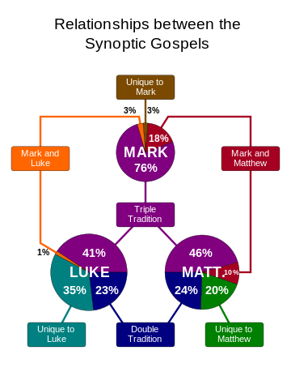
Synoptic
Gospels share because speaking of same events

Slide 50
Intentional Scribal errors.
Variant readings purposefully inserted by the scribe.
Scribe wants only to “correct” what appears to be an error in the text.
If scribe found a statement of Jesus in one Gospel similar to a statement in another, he might modify one to make it in perfect agreement with the other.
Matthew 11:19 (ESV) ¹⁹ The Son of Man came eating and drinking, and they say, ‘Look at him! A glutton and a drunkard, a friend of tax collectors and sinners!’ Yet wisdom is justified by her deeds.”
Matthew 11:19 (NIV) ¹⁹ The Son of Man came eating and drinking, and they say, 'Here is a glutton and a drunkard, a friend of tax collectors and "sinners."' But wisdom is proved right by her actions."
Matthew 11:19 (NKJV) ¹⁹ The Son of Man came eating and drinking, and they say, 'Look, a glutton and a winebibber, a friend of tax collectors and sinners!' But wisdom is justified by her children."
Chap 8 – How We Got the Bible
Notes:
This may explain a variant found in two verses of Matthew and Luke. The King James Version of Matthew 11: 19 reads, “But wisdom is justified of her children,” an exact parallel of Luke 7: 25. However, the more recent translations of Matthew have “works” instead of “children” in agreement with our earliest manuscript authorities. We surmise that at some early date “works” was changed to “children” by a copyist to bring the phrase in harmony with Luke’s Gospel. Thus we are practically certain that originally the two records of Jesus’ sayings were not the same. This, to be sure, is what one frequently finds in the Gospels, for in quoting Jesus, the Gospel writers often do not give his words verbatim.
Lightfoot, Neil R.. How We Got the Bible (pp. 90-91). Baker Publishing Group. Kindle Edition.

Slide 51
Intentional Scribal errors.
If scribe found a statement of Jesus in one Gospel similar to a statement in another, he might modify one to make it in perfect agreement with the other.
Matthew 11:19 (ESV) ¹⁹ The Son of Man came eating and drinking, and they say, ‘Look at him! A glutton and a drunkard, a friend of tax collectors and sinners!’ Yet wisdom is justified by her deeds.”
Matthew 11:19 (NIV) ¹⁹ The Son of Man came eating and drinking, and they say, 'Here is a glutton and a drunkard, a friend of tax collectors and "sinners."' But wisdom is proved right by her actions."
Matthew 11:19 (KJV) ¹⁹ The Son of man came eating and drinking, and they say, Behold a man gluttonous, and a winebibber, a friend of publicans and sinners. But wisdom is justified of her children.
Luke 7:35 (NIV) ³⁵ But wisdom is proved right by all her children."
Luke 7:35 (KJV) ³⁵ But wisdom is justified of all her children.
Chap 8 – How We Got the Bible
Notes:
This may explain a variant found in two verses of Matthew and Luke. The King James Version of Matthew 11: 19 reads, “But wisdom is justified of her children,” an exact parallel of Luke 7: 25. However, the more recent translations of Matthew have “works” instead of “children” in agreement with our earliest manuscript authorities. We surmise that at some early date “works” was changed to “children” by a copyist to bring the phrase in harmony with Luke’s Gospel. Thus we are practically certain that originally the two records of Jesus’ sayings were not the same. This, to be sure, is what one frequently finds in the Gospels, for in quoting Jesus, the Gospel writers often do not give his words verbatim.
Lightfoot, Neil R.. How We Got the Bible (pp. 90-91). Baker Publishing Group. Kindle Edition.

