Slide 1
Syllabus
Introduction 4/15
Paul’s Service as an Example 4/18
Paul’s “Charges” to Timothy 4/22
Personal Admonition: Purity 4/25
Personal Admonition: Development 4/29
Special Meeting Wednesday May 2nd
Roles in the Church: Men & Women 5/6
Roles in the Church: Old & Young 5/9
Roles in the Church: Elders and Deacons 5/13
Lessons to Servants and Rich 5/16
Living in a World of Sinners 5/20
Dealing with Sinful Men in the church 5/23
Responsibility for Good Works 5/27
Review 5/30

Slide 2
Timothy & Titus: Lesson 4
Personal Admonition: Purity
Texts
I Tim 6:11-16,20,21
II Tim 1:3-14; 2:22
Titus 2:11-14; 3:1-8

Slide 3
Personal Admonition: Purity
Class Objectives
Facts to remember:
1. What Timothy was to flee
2. What Timothy was to pursue
3. Two things Timothy was not to be ashamed of

Slide 4
Personal Admonition: Purity
I Timothy 4:12
Let no one look down on your youthfulness, but rather in speech, conduct, love, faith and purity, show yourself an example of those who believe
Purity (hagneia) – Sinlessness of life (Strongs) morally clean, without blemish. Purity for the Christian is keeping our hearts, minds and bodies holy, without moral blemish or stain for the purposes of God

Slide 5
Personal Admonition: Purity
I Timothy 6:11-16; 20-21
But flee from these things, you man of God
Notes:
.

Slide 6
“flee these things”
I Timothy 6:1-10
³ If anyone advocates a different doctrine and does not agree with sound words, those of our Lord Jesus Christ, and with the doctrine conforming to godliness, ⁴ he is conceited (proud NKJV) and understands nothing; but he has a morbid interest in controversial questions and disputes about words, out of which arise envy, strife, abusive language, evil suspicions, ⁵ and constant friction between men of depraved mind and deprived of the truth, who suppose that godliness is a means of gain. ⁶ But godliness actually is a means of great gain when accompanied by contentment. ⁷ For we have brought nothing into the world, so we cannot take anything out of it either. ⁸ If we have food and covering, with these we shall be content. ⁹ But those who want to get rich fall into temptation and a snare and many foolish and harmful desires which plunge men into ruin and destruction. ¹⁰ For the love of money is a root of all sorts of evil, and some by longing for it have wandered away from the faith and pierced themselves with many griefs.
Are there more temptations to immoral pleasures among the rich?
Would the temptation to Timothy have been greater if their were rich members of the church?
Motive = Pride
Rich in Ephesus? (Acts 19)
Wealthy Christians? Vs 17

Slide 7
“Flee These Things” (I Tim 6:11)
(In Context) What Timothy was to Flee
Harmful
Lusts…
Desire to be Rich
Pride, Obsession with Disputes
Lust of the Flesh
Lust of the Eyes
Pride of Life
I John 2:16

Slide 8
Personal Admonition: Purity
I Timothy 6:11-16; 20-21
But flee from these things, you man of God, and pursue righteousness, godliness, faith, love, perseverance and gentleness. ¹² Fight the good fight of faith; take hold of the eternal life to which you were called, and you made the good confession in the presence of many witnesses. ¹³ I charge you in the presence of God, who gives life to all things, and of Christ Jesus, who testified the good confession before Pontius Pilate, ¹⁴ that you keep the commandment without stain or reproach until the appearing of our Lord Jesus Christ, ¹⁵ which He will bring about at the proper time—He who is the blessed and only Sovereign, the King of kings and Lord of lords, ¹⁶ who alone possesses immortality and dwells in unapproachable light, whom no man has seen or can see. To Him be honor and eternal dominion! Amen.
²⁰ O Timothy, guard what has been entrusted to you, avoiding worldly and empty chatter and the opposing arguments of what is falsely called “knowledge”— ²¹ which some have professed and thus gone astray from the faith
to seek after eagerly, earnestly endeavor to acquire:

Slide 9
Pursue:
Righteousness (dikaiosunē) “is the character or quality of being right or just” (Vine). This involves our actions or conduct in relation to God and man. What is right must always be determined by God’s standard
Godliness (eusebeia) is respect and reverence toward things that pertain to God , Vines: “piety…characterized by a God-ward attitude; does what is well-pleasing to Him” God-centered living: All decisions & actions informed by an accountability to God & desire to please Him.
Faith (pistis) “fidelity, faithfulness, and is the virtue of the man who, through all the chances and the changes of life, down even to the gates of death, is loyal to God” (Barclay)
Godliness & Faith - Minds focused on what God wants instead of my desires (lust of flesh). God-directed thought.
Righteousness - Opposite of running toward harmful desires (lust of flesh) is running toward righteousness. God-directed behavior.

Slide 10
Pursue:
Love (agape) which is love at its highest possible level. Agapē never fails in the face of duty. While personal affection may be absent in the action of such toward another, still it does what is right.
Patience (hypomonē) means “steadfastness, constancy, endurance”
Gentleness (praupathia) (meekness - KJV)- strength under control
Pride and disputing has to do with my relationship with other people. God-like care for others may mean I am willing to be “wrong” in an argument. And I will be patient with others and my manner will be gentle in every way.

Slide 11
Flee These Things (I Tim 6)
(In Context) What Timothy was to Flee
Harmful
Lusts…
Desire to be Rich
Pride, Obsession with Disputes
Lust of the Flesh
Lust of the Eyes
Pride of Life
What Timothy was to Pursue
Righteousness
Godliness, Faith
Love, Patience, Gentleness
God-Directed Behavior
God-Directed Thought
God-like Care for Others

Slide 12
Personal Admonition: Purity
I Timothy 6:11-16; 20-21
But flee from these things, you man of God, and pursue righteousness, godliness, faith, love, perseverance and gentleness. ¹² Fight the good fight of faith; take hold of the eternal life to which you were called, and you made the good confession in the presence of many witnesses. ¹³ I charge you in the presence of God, who gives life to all things, and of Christ Jesus, who testified the good confession before Pontius Pilate, ¹⁴ that you keep the commandment without stain or reproach until the appearing of our Lord Jesus Christ, ¹⁵ which He will bring about at the proper time—He who is the blessed and only Sovereign, the King of kings and Lord of lords, ¹⁶ who alone possesses immortality and dwells in unapproachable light, whom no man has seen or can see. To Him be honor and eternal dominion! Amen.
²⁰ O Timothy, guard what has been entrusted to you, avoiding worldly and empty chatter and the opposing arguments of what is falsely called “knowledge”— ²¹ which some have professed and thus gone astray from the faith
Heb. 10:23 - Let us hold fast the confession of our hope without wavering, for He who promised is faithful;
Challenge to keep fighting in the great spiritual struggle.
Where is the focus of this fight?
What is the goal of the struggle?
When? cf Romans 10:10; Acts 8:37

Slide 13
Personal Admonition: Purity
He is tied to Jesus by making the confession that he is King, Christ & Son of God. Be like Jesus - Courage despite the consequences (among rich & influential) - live consistent with that confession.
I Timothy 6:11-16; 20-21
But flee from these things, you man of God, and pursue righteousness, godliness, faith, love, perseverance and gentleness. ¹² Fight the good fight of faith; take hold of the eternal life to which you were called, and you made the good confession in the presence of many witnesses. ¹³ I charge you in the presence of God, who gives life to all things, and of Christ Jesus, who testified the good confession before Pontius Pilate, ¹⁴ that you keep the commandment without stain or reproach until the appearing of our Lord Jesus Christ, ¹⁵ which He will bring about at the proper time—He who is the blessed and only Sovereign, the King of kings and Lord of lords, ¹⁶ who alone possesses immortality and dwells in unapproachable light, whom no man has seen or can see. To Him be honor and eternal dominion! Amen.
²⁰ O Timothy, guard what has been entrusted to you, avoiding worldly and empty chatter and the opposing arguments of what is falsely called “knowledge”— ²¹ which some have professed and thus gone astray from the faith
What is it and how does it relate to the context?
cf John 18:33-37 19:6
“keep” - to watch over, preserve
“without stain” - refers to any deviation from the gospel in its purity.
“reproach” - cannot be reprehended, not open to censure

Slide 14
Personal Admonition: Purity
I Timothy 6:11-16; 20-21
But flee from these things, you man of God, and pursue righteousness, godliness, faith, love, perseverance and gentleness. ¹² Fight the good fight of faith; take hold of the eternal life to which you were called, and you made the good confession in the presence of many witnesses. ¹³ I charge you in the presence of God, who gives life to all things, and of Christ Jesus, who testified the good confession before Pontius Pilate, ¹⁴ that you keep the commandment without stain or reproach until the appearing of our Lord Jesus Christ, ¹⁵ which He will bring about at the proper time—He who is the blessed and only Sovereign, the King of kings and Lord of lords, ¹⁶ who alone possesses immortality and dwells in unapproachable light, whom no man has seen or can see. To Him be honor and eternal dominion! Amen.
²⁰ O Timothy, guard what has been entrusted to you, avoiding worldly and empty chatter and the opposing arguments of what is falsely called “knowledge”— ²¹ which some have professed and thus gone astray from the faith
Synthesize popular modern philosophies or new innovative ideas with bible teaching = academic pursuit appealing to intellectual community (pride of life) May be a connection to the rich (Intellectualism)

Slide 15
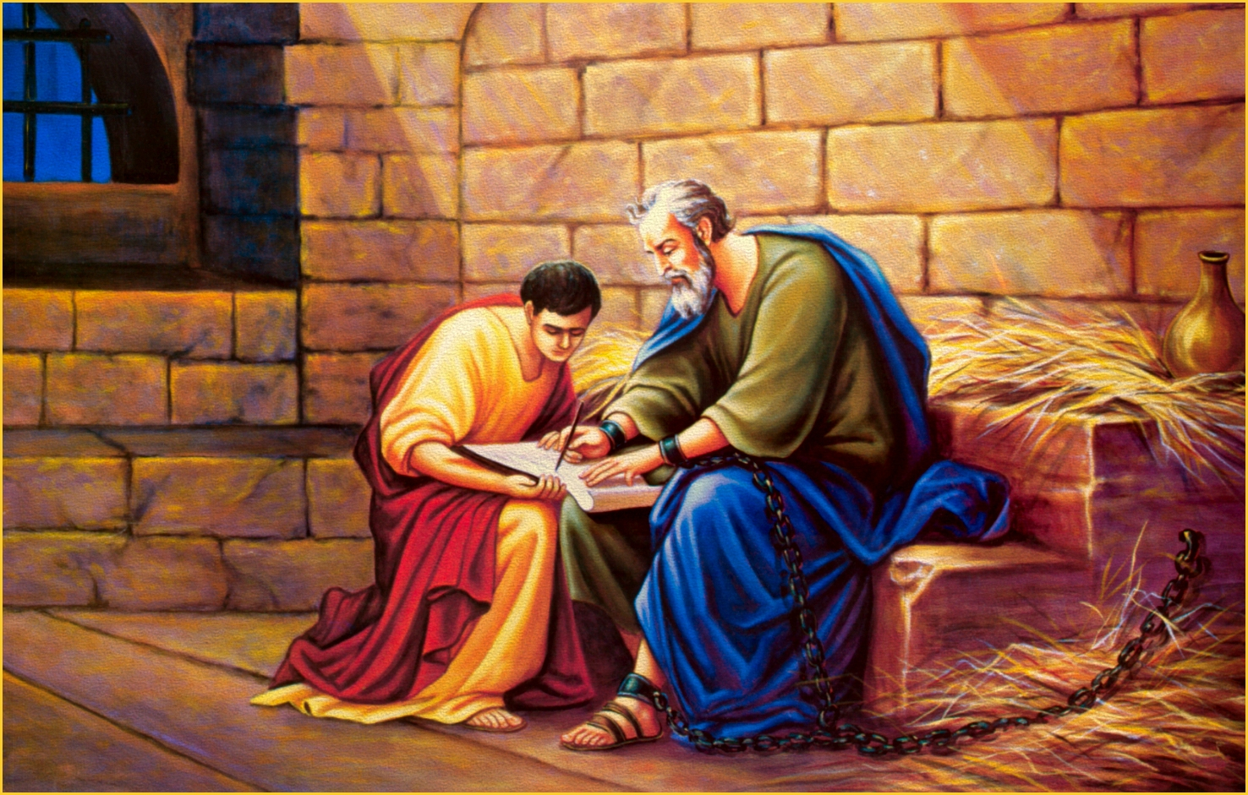
What in Paul & Timothy’s lives have changed between 1st and 2nd Timothy?
All in Asia turned away from me, among whom are Phygelus and Hermogenes
“all forsook me”
Demas, having loved this present world, has deserted me
Alexander the coppersmith did me much harm
Hymenaeus and Philetus gone astray

Slide 16
II Timothy 1:3-14; 2:22
³ I thank God, whom I serve with a clear conscience the way my forefathers did, as I constantly remember you in my prayers night and day, ⁴ longing to see you, even as I recall your tears, so that I may be filled with joy. ⁵ For I am mindful of the sincere faith within you, which first dwelt in your grandmother Lois and your mother Eunice, and I am sure that it is in you as well. ⁶ For this reason I remind you to kindle afresh (stir up –NKJV) the gift of God which is in you through the laying on of my hands. ⁷ For God has not given us a spirit of timidity (fear NKJV), but of power and love and discipline. ⁸ Therefore do not be ashamed of the testimony of our Lord or of me His prisoner, but join with me in suffering for the gospel according to the power of God, ⁹ who has saved us and called us with a holy calling, not according to our works, but according to His own purpose and grace which was granted us in Christ Jesus from all eternity
Why would shame be a possibility?

Slide 17
II Timothy 1:3-14; 2:22
¹⁰ but now has been revealed by the appearing of our Savior Christ Jesus, who abolished death and brought life and immortality to light through the gospel, ¹¹ for which I was appointed a preacher and an apostle and a teacher. ¹² For this reason I also suffer these things, but I am not ashamed; for I know whom I have believed and I am convinced that He is able to guard what I have entrusted to Him until that day. ¹³ Retain the standard of sound words which you have heard from me, in the faith and love which are in Christ Jesus. ¹⁴ Guard, through the Holy Spirit who dwells in us, the treasure which has been entrusted to you
^{2:22} Now flee from youthful lusts and pursue righteousness, faith, love and peace, with those who call on the Lord from a pure heart.
cf. 1 Tim. 1:3, 10; 6:3; 2 Tim. 4:3; Tit. 1:9, 13; 2:1, 2, 8
It matters what we believe and teach!
1st letter perhaps focused on a young man in a wealthy city among church members who may be influential, being tempted by lusts. Perhaps a theme of fear, shame and discouragement in the 2nd letter.

Slide 18
II Timothy 1:3-14; 2:22
³ I thank God, whom I serve with a clear conscience the way my forefathers did, as I constantly remember you in my prayers night and day, ⁴ longing to see you, even as I recall your tears, so that I may be filled with joy. ⁵ For I am mindful of the sincere faith within you, which first dwelt in your grandmother Lois and your mother Eunice, and I am sure that it is in you as well. ⁶ For this reason I remind you to kindle afresh the gift of God which is in you through the laying on of my hands. ⁷ For God has not given us a spirit of timidity (fear – NKJV), but of power and love and discipline (sound mind - NKJV) ⁸ Therefore do not be ashamed of the testimony of our Lord or of me His prisoner, but join with me in suffering for the gospel according to the power of God, ⁹ who has saved us and called us with a holy calling, not according to our works, but according to His own purpose and grace which was granted us in Christ Jesus from all eternity
What is the antidote to fear?
What is the antidote to fear?
Proper view of priorities and the job at hand.
As I pursue love I may suffer as a result of preaching but fear is not produced because I am motivated by sacrificial love.

Slide 19
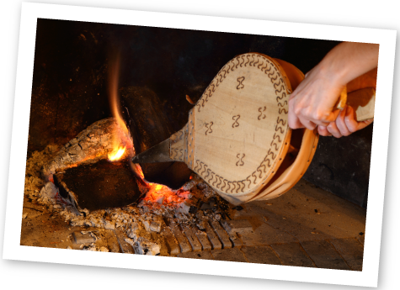
II Timothy 1:3-14; 2:22
What should Timothy be doing as an antidote to fear, discouragement and shame in the text?
³ I thank God, whom I serve with a clear conscience the way my forefathers did, as I constantly remember you in my prayers night and day, ⁴ longing to see you, even as I recall your tears, so that I may be filled with joy. ⁵ For I am mindful of the sincere faith within you, which first dwelt in your grandmother Lois and your mother Eunice, and I am sure that it is in you as well. ⁶ For this reason I remind you to kindle afresh (stir up –NKJV) the gift of God which is in you through the laying on of my hands. ⁷ For God has not given us a spirit of timidity, but of power and love and discipline. ⁸ Therefore do not be ashamed of the testimony of our Lord or of me His prisoner, but join with me in suffering for the gospel according to the power of God, ⁹ who has saved us and called us with a holy calling, not according to our works, but according to His own purpose and grace which was granted us in Christ Jesus from all eternity
Be active doing what he/we should in service to God. Stir up your gift! Be absorbed in doing what is right.

Slide 20
II Timothy 1:3-14; 2:22
¹⁰ but now has been revealed by the appearing of our Savior Christ Jesus, who abolished death and brought life and immortality to light through the gospel, ¹¹ for which I was appointed a preacher and an apostle and a teacher. ¹² For this reason I also suffer these things, but I am not ashamed; for I know whom I have believed and I am convinced that He is able to guard what I have entrusted to Him until that day. ¹³ Retain the standard of sound words which you have heard from me, in the faith and love which are in Christ Jesus. ¹⁴ Guard, through the Holy Spirit who dwells in us, the treasure which has been entrusted to you
^{2:22} Now flee from youthful lusts and pursue righteousness, faith, love and peace, with those who call on the Lord from a pure heart.
The “gift”, or charge, or faith that was in his mother, grandmother and him

Slide 21
Personal Admonition: Purity
Titus 2:11-14
¹¹ For the grace of God has appeared, bringing salvation to all men, ¹² instructing us to deny ungodliness and worldly desires and to live sensibly, righteously and godly in the present age, ¹³ looking for the blessed hope and the appearing of the glory of our great God and Savior, Christ Jesus, ¹⁴ who gave Himself for us to redeem us from every lawless deed, and to purify for Himself a people for His own possession, zealous for good deeds.

Slide 22
Personal Admonition: Purity
Titus 3:1-8
Remind them to be subject to rulers, to authorities, to be obedient, to be ready for every good deed, ² to malign no one, to be peaceable, gentle, showing every consideration for all men. ³ For we also once were foolish ourselves, disobedient, deceived, enslaved to various lusts and pleasures, spending our life in malice and envy, hateful, hating one another. ⁴ But when the kindness of God our Savior and His love for mankind appeared, ⁵ He saved us, not on the basis of deeds which we have done in righteousness, but according to His mercy, by the washing of regeneration and renewing by the Holy Spirit, ⁶ whom He poured out upon us richly through Jesus Christ our Savior, ⁷ so that being justified by His grace we would be made heirs according to the hope of eternal life. ⁸ This is a trustworthy statement; and concerning these things I want you to speak confidently, so that those who have believed God will be careful to engage in good deeds. These things are good and profitable for men.

Slide 23
Personal Admonition: Purity – “Flee These Things” (I Tim 6)
(In Context) What Timothy was to Flee
Harmful
Lusts…
Desire to be Rich
Pride, Obsession with Disputes
Lust of the Flesh
Lust of the Eyes
Pride of Life
What Timothy was to Pursue
Righteousness
Godliness, Faith
Love, Patience, Gentleness
God-Directed Behavior
God-Directed Thought
God-like Care for Others

Slide 24
Personal Admonition: Purity - Fear & Shame (II Tim 1)
Warnings
Stir up the Gift of God (v 6)
Do not have a Spirit of Fear (v 7)
Do not be ashamed of the Lord’s Testimony (v 8)
Do not be ashamed of Paul (v 8)
Hold Fast the Pattern of Sound Words (v 13)
Keep (by the Holy Spirit) the Good thing Committed to you (v 14)
The Antidote for Fear: “A Spirit of…”
Sound Mind
(Discipline)
Power
Love
Lesson 5 -Personal Admonition: Development
Backed, & Protected by Power
Not Concerned for Self (Ready to Suffer)
Stir-up Gifts & zealous for Activities

Slide 25
Personal Admonition: Purity
Class Objectives
Facts to remember:
1. What Timothy was to flee
2. What Timothy was to pursue
3. Two things Timothy was not to be ashamed of

