Slide 1
Jonah Overview

Slide 2
Minor Prophets Background

Slide 3
Why Study the Minor Prophets?
Time of Jonah |  | Time of Today
Deeply trenched in idol worship (golden calves & Baal) | g | Deeply trenched in materialism “idolatry” (cars, houses, stuff)
Corrupt leadership (Kings & Priest) | g | Corrupt leadership (Gov/society?, others who claim to teach truth)
Some prosperity (Assyrian alliances) | g | MUCH prosperity (alliances with the world)
Lack of knowledge and true worship of God | g | Lack of knowledge and true worship of God
Engaged in moral decay (Adultery, murder, thievery, lying, deceit, drunkenness) | g | Engaged in moral decay (Adultery, murder, thievery, lying, deceit, drunkenness, … immodesty, immorality, tolerance of sin )

Slide 4
General Themes Within the Prophets
Holiness of God
Sovereignty of God
Immutability of God (unchanging)
God’s attitude toward sin
Repentance & Righteousness
True Worship

Slide 5
The purpose of the prophets was threefold
1
2
3
To warn the nations of the coming judgment.
To explain why the judgment had come upon them.
To give assurance, at least to a remnant, of a hope that lay beyond the judgment.
Notes:
1. The purpose of the prophets was threefold:
a. To warn the nations of the coming judgment.
b. To explain why the judgment had come upon them.
To give assurance, at least to a remnant, of a hope that lay beyond the judgment.

Slide 6
The Role of the Prophets
They are Spokesmen for God, serving as “forthtellers,” speaking what God put in their mouth.
They are Preachers of the Covenant, relating their message to God’s previous promises to the nation of Israel. These covenants were made with or through Abraham, Moses, and David
They are historians, or Interpreters of the Israelites’ History. With out their interpretation God’s people would not know why an event was occurring.

Slide 7
How are the Prophets Classified
The minor prophets are not lesser; they just wrote less material
Category
Earlier Prophets | Joshua, Judges, 1-2 Samuel, 1-2 Kings
Later Prophets - Major | Isaiah Jeremiah Ezekiel Daniel
Later Prophets – Minor | The Book of the Twelve Obadiah Joel Jonah Amos Micah Hosea Nahum Zephaniah Habakkuk Haggai Zechariah Malachi

Slide 8
Minor Prophets by Size
Books | Chapters | Verses | Words
Zechariah | 14 | 211 | 6,444
Hosea | 14 | 197 | 5,175
Amos | 9 | 146 | 4,217
Micah | 7 | 105 | 3,153
Joel | 3 | 73 | 2,034
Malachi | 4 | 55 | 1,782
Zephaniah | 3 | 53 | 1,617
Habakkuk | 3 | 56 | 1,476
Jonah | 4 | 48 | 1,321
Nahum | 3 | 47 | 1,285
Haggai | 2 | 38 | 1,131
Obadiah | 1 | 21 | 670

Slide 9
Predictive Elements in Minor Prophets
Book | Distinct Predictions | Predictive Verses | % Predictive | Messianic | Focus Prediction
Hosea | 28 | 111 | 56% | 4 vv. | Destruction of Samaria
Joel | 25 | 50 | 68% | 1 v. | Day of Yahweh
Amos | 26 | 85 | 58% |  | Destruction of Samaria
Obadiah | 10 | 17 | 81% |  | Edom Cut Off
Jonah | 4 | 5 | 10% |  | Overthrow of Nineveh
Micah | 40 | 73 | 70% | 7 vv. | Fall of Jerusalem
Nahum | 2 | 35 | 74% |  | Fall of Nineveh
Habakkuk | 4 | 23 | 47% | 4 vv. | Judgment on the Chaldeans
Zephaniah | 20 | 47 | 89% |  | Judgement on Judah
Haggai | 7 | 15 | 39% | 6 vv. | The Great Shaking
Zechariah | 78 | 144 | 69% | 21 vv. | Temple to be Rebuilt
Malachi | 19 | 31 | 56% | 2 vv. | Coming of Messengers of Yahweh
 | 263 | 636 | 61% Avg. | 45 vv.

Slide 10
Personal Background of the Minor Prophets
Only five of authors reveal the names of their fathers:
Jonah = Amittai, Hosea = Beeri, Joel = Pethuel, Zephaniah = Cushi, Zechariah = Berechiah
Four of the minor prophets are mentioned in the Old Testament:
Jonah (2 Kings 14)
Micah (Jeremiah 26)
Haggai
Zechariah
The hometowns of four of the prophets are known:
Micah (Moresheth-gath in the Shephelah, the rolling hills of Judah southwest of Jerusalem)
Jonah (Gath-hepher, on Zebulun’s borders a couple of miles from Nazareth)
Amos (Tekoa, near Bethlehem near Judean wilderness)
Nahum (Elkosh, exact location unknown but possibly near Galilee)

Slide 11
Prophets Within Major Periods
Divided Kingdom |  | Captivity |  | Return from Captivity
Obadiah Joel Jonah Amos Micah Hosea |  | Nahum Habakkuk Zephaniah |  | Haggai Zechariah Malachi

Slide 12
Assyrian Empire and Nineveh

Slide 13
Assyrian Kings during Jonah
 | 800 | 790 | 780 | 770 | 760 | 750 | 740 | 730
Israel
Judah
Assyria
Three Assyrian kings ruled at the time of Jeroboam II
Adad-nirari III (810 – 783 BC)
He moved the nation towards monotheism, potentially due to Jonah’s message
Shalmaneser IV (783 – 773 BC)
Ashurdan III (773–755 BC)
Serious plagues to Assyria in 765 BC and 759 BC
Nineveh was one of the main epicenters of the Assyrian empire, but the empire did not reach it’s full prominence until around the reign of Sennacherib
Using historical data points, Jonah’s mission was probably between 780 – 755 BC
Jeho.
Jeroboam II
Jonah
Pekah
Menahem
Amaziah
Uzziah
Jotham
Adad-nirari III
S. IV
Ashurdan III
Ashur-nirari V
Tiglath-Pileser III

Slide 14
Wickedness of Assyria
Idolatry and Pride
(Isa 10:5-19, Isa 36:16,17)
Oppression, Inhumane Warfare
(2 Kings 15:29, 2 Kings 17:6, Isa 36:16,17)
For he [the king of Assyria] says: “By the strength of my hand I have done it, and by my wisdom, for I have understanding; I remove the boundaries of peoples, and plunder their treasures; like a bull I bring down those who sit on thrones. (Isa 10:13)
In the ninth year of Hoshea, the king of Assyria captured Samaria, and he carried the Israelites away to Assyria and placed them in Halah, and on the Habor, the river of Gozan, and in the cities of the Medes. (2Ki 17:6)
Assyria was under the condemnation of God!
“Arise, go to Nineveh, that great city, and call out against it, for their evil has come up before me.” (Jon 1:2)

Slide 15
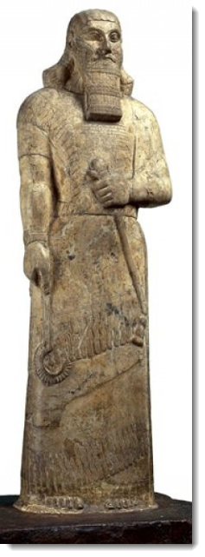
Wickedness of Assyira
Citation from Ashur-nasirpal II (king of Assyria from 883 to 859 BC)
Example of:
Ruthlessness of Assyrians
Cruel Oppression
Inhumane warfare
Lust for possessions
Pride
I stormed the mountain peaks and took them. In the midst of the mighty mountains I slaughtered them; with their blood I dyed the mountain red like wool. With the rest of them I darkened the gullies and precipices of the mountains. I carried off their spoil and their possessions. The heads of their warriors I cut off, and I formed them into a pillar over against their city; their young men and their maidens I burned in the fire! … I built a pillar over against the city gates, and I flayed all the chief men who had revolted, and I covered the pillar with their skins; some I walled up within the pillar, some I impaled upon the pillar on stakes, and others I bound to stakes round about the pillar.
Statue of King Ashurnasirpal II

Slide 16
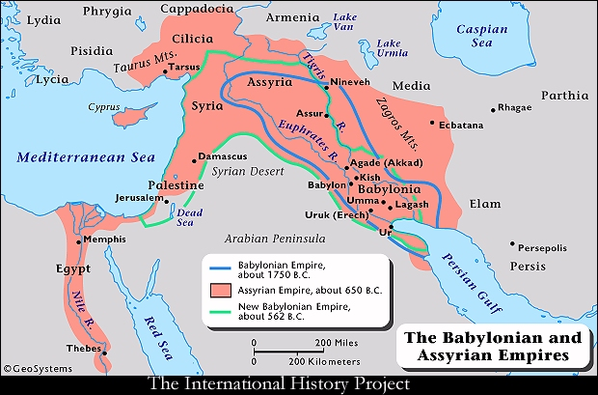
Assyrian Empire Expansion
Note: Jeroboam II ruled from 793-753 BC (II Kings 14:23-29)

Slide 17
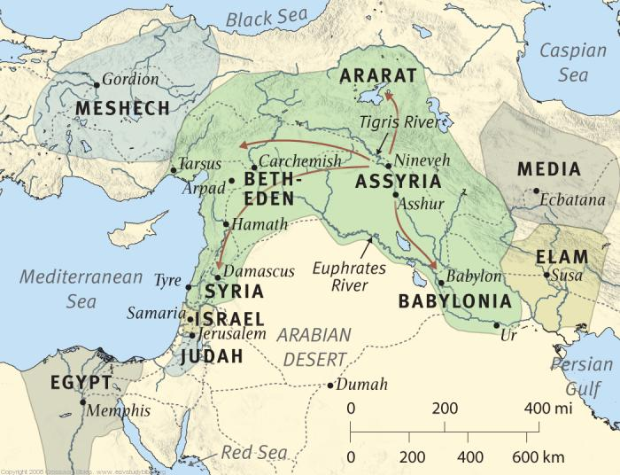
Assyria’s Expansion and Dominance

Slide 18
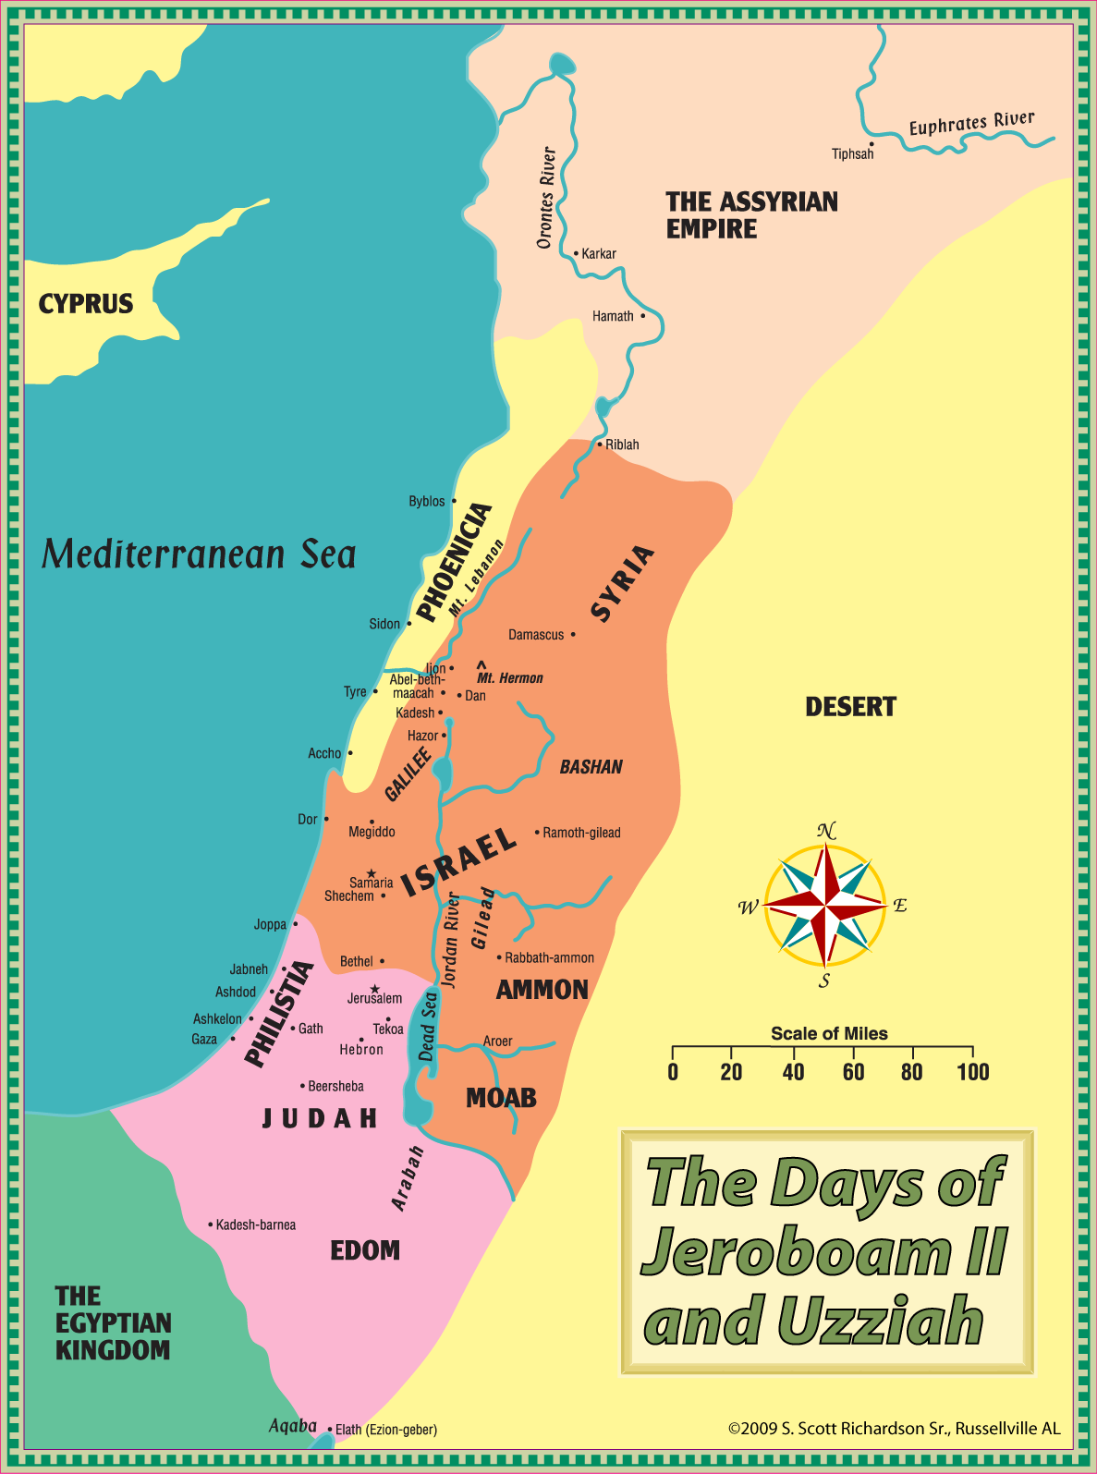
Assyria’s Dominance During Jeroboam II

Slide 19
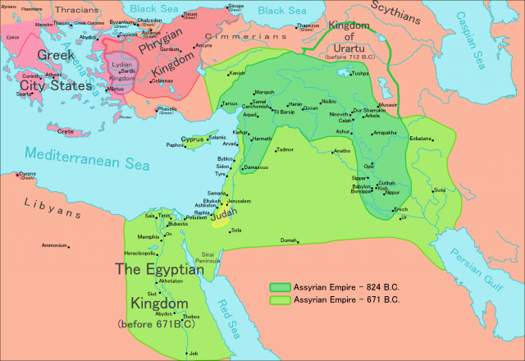
Assyria’s Rapid Expansion
Assyria Expands Rapidly from 9th Century to 7th Century BC
Note: Jeroboam II ruled from 793-753 BC (II Kings 14:23-29)

Slide 20
Timeline, Kings of Israel and Judah

Slide 21
Minor Prophets by Time Period
Minor Prophet | Date (est) | Note
Obadiah | 845 | Period: Ninth / Eighth Centuries Prior to the great rise of the Assyrian Empire Sometimes known as the Pre-Assyrian Prophets
Joel | 835
Jonah | 755
Amos | 752 | Period: Eighth Century Assyrian armies beginning to dominate in the ancient Near East
Micah | 735
Hosea | 725
Nahum | 650 | Period: Seventh Century Period of Assyrian Empire faded rapidly and was eclipsed by Babylon
Zephaniah | 630
Habakkuk | 609
Haggai | 520 | Period: Fifth / Sixth Centuries After the exile when Judea was a province of the Persian Empire
Zechariah | 480
Malachi | 432

Slide 22
Genealogy of Kings of Israel & Judah

Slide 23
United Kingdom
Divided Kingdom
Return from
Captivity
Captivity
931 BC
721 BC
536 BC
Israel into captivity
Israel
Cyrus’ decree
Saul-David-Solomon
Assyria
Medo-Persia
Babylon
612 BC
Assyria falls
Judah
586 BC
539 BC
Jerusalem falls
Babylon falls
Judah into captivity:
605 BC
Hosea (750-725)
Joel ?
Amos (760-750)
Obadiah ?
Jonah (780)
Micah (735-700)
Isaiah (740-690)
Nahum (635-612)
Habakkuk (612-606)
Zephaniah (630-625)
Jeremiah (627-586)
Daniel (605-534)
Ezekiel 592-570)
Haggai (520)
Zechariah (520-518)
Malachi (445-432)
Prophets?

Slide 25
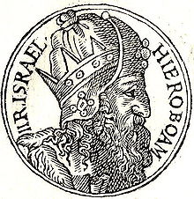
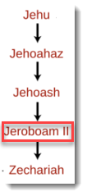
Jeroboam II
The king who reigned in during the prophecies of Jonah, Amos, and Hosea
14th King of Israel who ruled 41 years in the Jehu Dynasty around 793-753 BC (II Kings 14:23-29)
He restored prosperity and territory to a weak nation, but continued the religious practices of Jeroboam I and met condemnation.
He restored the boundaries of David’s empire, reaching even into Syria.
(2 Kings 14:25) He restored the border of Israel from Lebo-hamath as far as the Sea of the Arabah, according to the word of the Lord, the God of Israel, which he spoke by his servant Jonah the son of Amittai, the prophet, who was from Gath-hepher.
He did “what was evil in the sight of the Lord”
(2 Kings 14:24) And he did what was evil in the sight of the Lord. He did not depart from all the sins of Jeroboam the son of Nebat, which he made Israel to sin.
But the Lord saved his people by the hand of Jeroboam II because of his promise and his covenant faithfulness!
(2 Kings 14:26-27) For the Lord saw that the affliction of Israel was very bitter, for there was none left, bond or free, and there was none to help Israel. But the Lord had not said that he would blot out the name of Israel from under heaven, so he saved them by the hand of Jeroboam the son of Joash.
Blotting out was closely associated with destruction; (Deut 9:14) 14 Let me alone, that I may destroy them and blot out their name from under heaven.

Slide 26
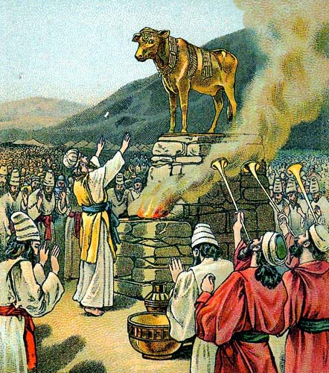
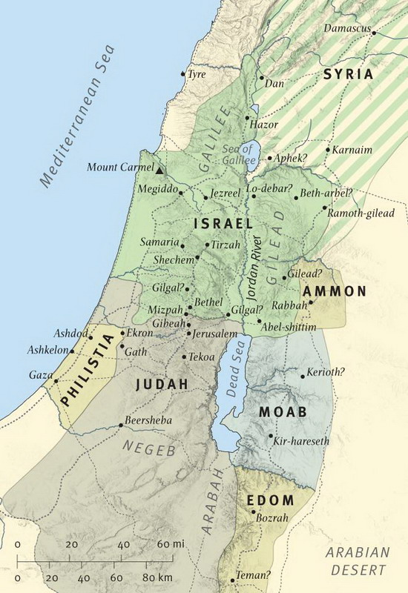
Sins of Jeroboam I
Jeroboam II did evil in the sight of the Lord as he continued in the sins of Jeroboam I
Jeroboam I was the first king of the Northern Kingdom Israel about 926-909 B.C.
Jeroboam led the 10 tribes to revolt against the house of David and he was then crowned as king.
He built temples in Dan and Bethel with golden calves for false worship.
Built shrines on high places and appointed priests from all sorts of people, even though they were not Levites
1 Kings chapters 12 and 14 outlines the sin of Jeroboam his idolatry:
1Ki 12:28-29 ESV So the king (Jeroboam) took counsel and made two calves of gold. And he said to the people, “You have gone up to Jerusalem long enough. Behold your gods, O Israel, who brought you up out of the land of Egypt.” (29) And he set one in Bethel, and the other he put in Dan.
1Ki 14:9 ESV (9) but you have done evil above all who were before you and have gone and made for yourself other gods and metal images, provoking me to anger, and have cast me behind your back

Slide 27
Jonah Background

Slide 28
What Makes Jonah Unique?
Narrative form
Unusual story of a prophet who was initially disobedient
Jonah preaches in a foreign nation
Often, prophets did not leave their nation to a foreign land – another example is Elisha who went to Damascus of Syria
Very little prediction
Only 1 verse is a prediction about the fall of Nineveh
3 days and 3 nights in the great fish is foreshadowing of Christ in the tomb

Slide 29
Jonah is Historical
This book is historical rather than didactic fiction; it is not a parable
Jonah was a historical character in the bible (2 Kings 14)
Nineveh was a real city, notorious for moral depravity
Joppa and Tarshish are historical cities
Jesus referenced Jonah in the fish as a historical event and in the same context referenced other events regarded as historical

Slide 30
Key Lessons in Jonah
Our preaching should never be discriminatory based on prejudice; rather, we should preach to all men as commanded
Mark 16:15 “… preach the gospel to all creation”
We should not question the wisdom, purpose, and guidance from God
Psa 147:5 ”Great is our Lord, and abundant in power; his understanding is beyond measure.”
Disobedience may seem tempting (flee to Tarshish) but God knows what’s best for us and others (salvation)
(Pro 3:5) Trust in the LORD with all your heart, and do not lean on your own understanding.
God’s love and mercy are great in magnitude and extend univerally to the ends of the earth
(Psa 86:15) But you, O Lord, are a God merciful and gracious, slow to anger and abounding in steadfast love and faithfulness.
Our appreciation of God should not be dependent on the physical comforts that he provides for us (the plant)
Rejoice always, pray without ceasing, give thanks in all circumstances; for this is the will of God in Christ Jesus for you.(1Th 5:16-18)
God expects obedience, and he loves those who he chastens
Heb 12:6-11 ESV For the Lord disciplines the one he loves, and chastises every son whom he receives.

Slide 31
Themes within Jonah
While there are many lessons in Jonah, here are three key themes throughout the book
Book of Jonah
God’s Mercy and Love Extend Universally to All
God Expects Obedience and Repentance
God’s is Sovereign over all nations and earth’s creation

Slide 32
Themes within Jonah
While there are many lessons in Jonah, here are three key themes throughout the book
Themes within Jonah Chapter 1
God’s Mercy and Love Extend Universally to All
The Lord is merciful on the sailors and saves them from the storm even though they just pagans in the eyes Jonah, similar to the Ninevites
The Lord is merciful on Jonah as he delivers him from the storm and his disobedience through the great fish
The Lord is merciful on the Ninevites, relenting from the disaster because of the humility and submission of the Ninevites

Slide 33
Themes within Jonah
While there are many lessons in Jonah, here are three key themes throughout the book
Themes within Jonah Chapter 1
God Expects Obedience and Repentance
The Lord saves the Sailors as they submitted to him: they cried out to God, feared the Lord exceedingly, offered a sacrifice, and made vows
The Lord disciplined Jonah to obedience and delivered him through the great fish, allowing him opportunity for obedience
The Lord relented from disaster on the Ninevites after they submitted to God, fasting in sackcloth

Slide 34
Themes within Jonah
While there are many lessons in Jonah, here are three key themes throughout the book
Themes within Jonah Chapter 1
God’s is Sovereign over all nations and earth’s creation
The Lord’s power over the earths creation is clearly seen throughout Jonah: power over the storm, the fish, the plant, the worm
The Lord is Lord of not just the Hebrews, but of all people including the pagan sailors and the Ninevites
The Lord has the power to overthrow nations, bring destruction on evil nations, or use them for his will

Slide 35
Jonah the Man
Name
The name Jonah means Dove
Home
He lived in Gath-hepher which was near Nazareth
Family
Jonah was the son of Amittai, but nothing more is known about his family
Timing,
King
He prophesied in Israel during the time of Jeroboam II (793-753 B.C.)
He helped Jeroboam II in his military campaigns to recover the territories which Israel had lost to the Arameans.
(2 Kings 14:25) He restored the border of Israel from Lebo-hamath as far as the Sea of the Arabah, according to the word of the Lord, the God of Israel, which he spoke by his servant Jonah the son of Amittai, the prophet, who was from Gath-hepher

Slide 36
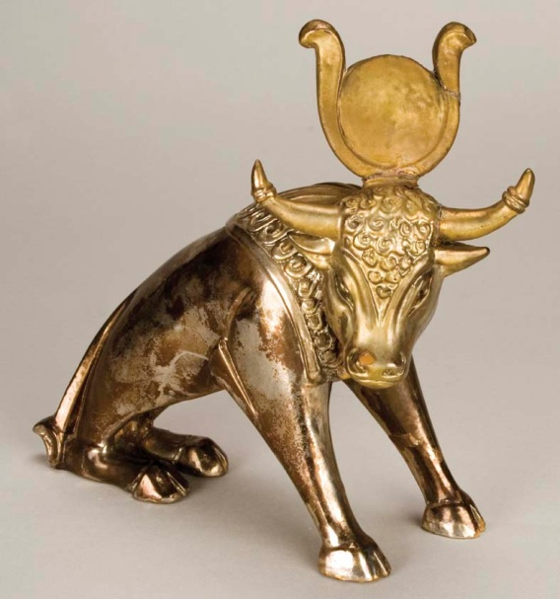
Social & Moral Climate of Israel
Time of Jonah
Deeply trenched in idol worship (golden calves & Baal)
Corrupt leadership (Kings & Priest)
Some prosperity (Expansion)
Lack of knowledge and true worship of God
Engaged in moral decay (Adultery, murder, thievery, lying, deceit, drunkenness)

Slide 37
Jonah Chapter 1
JONAH FLEES FROM THE LORD

Slide 38
Goals of this Class
Gain a greater understanding of God’s nature and what He expects of us:
Love & Compassion Mercy (not giving us what we deserve) Grace (giving us what we don’t deserve) Longsuffering (patience when we fail) Perfect Justice Discipline
Be willing to change our behavior when considering the themes found in the prophets:
Sovereignty of God – we should submit to God Immutability of God (Unchanging) God’s attitude toward sin (God hates sin) God’s perfect Justice Expects Repentance & Righteousness Expects True Worship

Slide 39
Why Study the Minor Prophets?
Time of Jonah |  | Time of Today
Deeply trenched in idol worship (golden calves & Baal) | g | Deeply trenched in materialism “idolatry” (cars, houses, stuff)
Corrupt leadership (Kings & Priest) | g | Corrupt leadership (Gov/society?, others who claim to teach truth)
Some prosperity (Assyrian alliances) | g | MUCH prosperity (alliances with the world)
Lack of knowledge and true worship of God | g | Lack of knowledge and true worship of God
Engaged in moral decay (Adultery, murder, thievery, lying, deceit, drunkenness) | g | Engaged in moral decay (Adultery, murder, thievery, lying, deceit, drunkenness, … immodesty, immorality, tolerance of sin )

Slide 41
Corruption During Jonah
Religious Corruption | Political Corruption
Israel had become like a harlot as she went to the idols (Hosea 2:12-13)
The people were ignorant of God (Hosea 4:6, 5:4)
Political Conniving, Anarchy, Rebellion, Treachery, Murder, Alliances
They believed they were worshipping God, but were honoring the Baalim
Calf worship introduced by Jeroboam I
Baal worship stressed by Ahab/Jezebel
The people had become entangled in many sins: Swearing, Breaking faith, Murder, Stealing, Adultery, Deceit, Lying, Drunkenness, Business Corruption
Upon death of Jeroboam, his son Zechariah reigned only 12 months
Shallum, who murdered Zechariah, replaced him (II Kings 15) and reigned 1 month
Menahem, who murdered Shallum, ruled for 10 years
Pekahiah, Menahem’s son, succeeded him and was killed by Pekah
Pekah was killed by Hoshea, who became the last king of Israel
(Hos 4:6 ESV) My people are destroyed for lack of knowledge; because you have rejected knowledge, I reject you from being a priest to me. And since you have forgotten the law of your God, I also will forget your children.

Slide 42
The Role of the Prophets
They are Spokesmen for God, serving as “forthtellers,” speaking what God put in their mouth.
They are Preachers of the Covenant, relating their message to God’s previous promises to the nation of Israel. These covenants were made with or through Abraham, Moses, and David
They are historians, or Interpreters of the Israelites’ History. With out their interpretation God’s people would not know why an event was occurring.

Slide 43
The purpose of the prophets was threefold
1
2
3
To warn the nations of the coming judgment.
To explain why the judgment had come upon them.
To give assurance, at least to a remnant, of a hope that lay beyond the judgment.
Notes:
1. The purpose of the prophets was threefold:
a. To warn the nations of the coming judgment.
b. To explain why the judgment had come upon them.
To give assurance, at least to a remnant, of a hope that lay beyond the judgment.

Slide 44
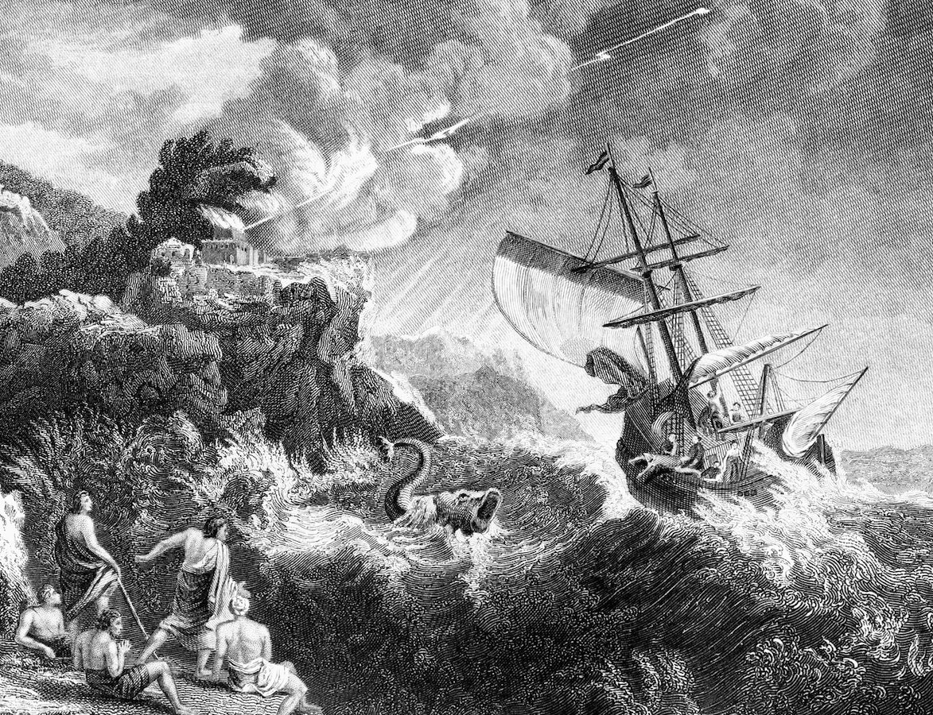
Outline of Jonah
I. Jonah Rejects God’s Call (1:1-2:10)
II. Jonah Fulfills God’s Call (3:1-4:11)

Slide 45
Outline of Jonah
I. Jonah Rejects God’s Call (1:1-2:10)
A. Introduction: Yahweh’s Command and Jonah’s Disobedience (1:1-3)
B. Episode 1-A: Jonah and the Sailors (1:4-16)
C. Episode 2-A: Jonah and Yahweh in the Great Fish (2:1-11)
II. Jonah Fulfills God’s Call (3:1-4:11)
A. Introduction: Yahweh’s Command and Jonah’s Obedience (3:1-4)
B. Episode 1-B: Jonah and the Ninevites (3:5-10)
C. Episode 2-B: Jonah and Yahweh in Nineveh (4:1-11)

Slide 46
Jonah Structure (View 1)
Jonah can be thought of as a two part narrative
The Structure of Jonah
Chapters 1 & 2 | Chapters 3 & 4
“The Savings of a Sinner” Disobedience (1:1-3) Discipline (1:4-16) Deliverance (1:17) Declaration (2:1-9) Discharge (2:10) | “The Savings of a City” Jonah and Nineveh Jonah and the Lord

Slide 47
Jonah Structure (View 2)
Jonah can be thought of as a seven episode story with multiple parallels
Seven Episodes in Jonah
Key question in italics
 |  |  | (7) Jonah’s lesson about compassion (4:5-11) “Should not I pity Nineveh…?”
 |  | (3) Jonah’s grateful prayer (1:17-2:10) How does Jonah respond to God’s grace towards him? | (6) Jonah’s angry prayer (4:1-4) How does Jonah respond to God’s grace towards others?
 | (2) Jonah and the pagan sailors (1:4-16) How responsive are the pagan sailors? | (5) Jonah and the pagan Ninevites (3:3b-10) How responsive are the pagan Ninevites?
(1) Jonah’s commissioning and flight (1:1-3) What will happen to Jonah? | (4) Jonah’s recommissioning and compliance (3:1-3a) What will happen to the Ninevites?

Slide 48
Seven Episodes of Jonah
The story of Jonah can be viewed of as seven distinct “episodes”
(1) Jonah’s commissioning and flight (1:1-3)
What will happen to Jonah?
Today’s Lesson
(2) Jonah and the pagan sailors (1:4-16)
How responsive are the pagan sailors?
(3) Jonah’s grateful prayer (1:17-2:10)
How does Jonah respond to God’s grace towards him?
(4) Jonah’s recommissioning and compliance (3:1-3a)
What will happen to the Ninevites?
(5) Jonah and the pagan Ninevites (3:3b-10)
How responsive are the pagan Ninevites?
(6) Jonah’s angry prayer (4:1-4)
How does Jonah respond to God’s grace towards others?
(7) Jonah’s lesson about compassion (4:5-11)
“Should not I pity Nineveh…?”

Slide 49
Jonah’s Character
When the sun rose, God appointed a scorching east wind, … And he asked that he might die and said, “It is better for me to die than to live.” Jon 4:8
But Jonah rose to flee to Tarshish from the presence of the Lord. (Jon 1:3)
Therefore now, O Lord, please take my life from me, for it is better for me to die than to live.” (Jon 4:3)
Disobedient
Self Willed / Stubborn
Complainer
But I with the voice of thanksgiving will sacrifice to you; what I have vowed I will pay. Salvation belongs to the Lord!” (Jon 2:9)
But it displeased Jonah exceedingly, and he was angry. (Jon 4:1)
JONAH’S CHARACTER
Devoted
Angry
Obedient
Unsympathetic, Narrow
Servant of God
That is why I made haste to flee to Tarshish; for I knew that you are a gracious God and merciful, slow to anger and abounding in steadfast love, and relenting from disaster. (Jon 4:2b)
Jonah began to go into the city, going a day's journey. And he called out, “Yet forty days, and Nineveh shall be overthrown!” (Jon 3:4)

Slide 50
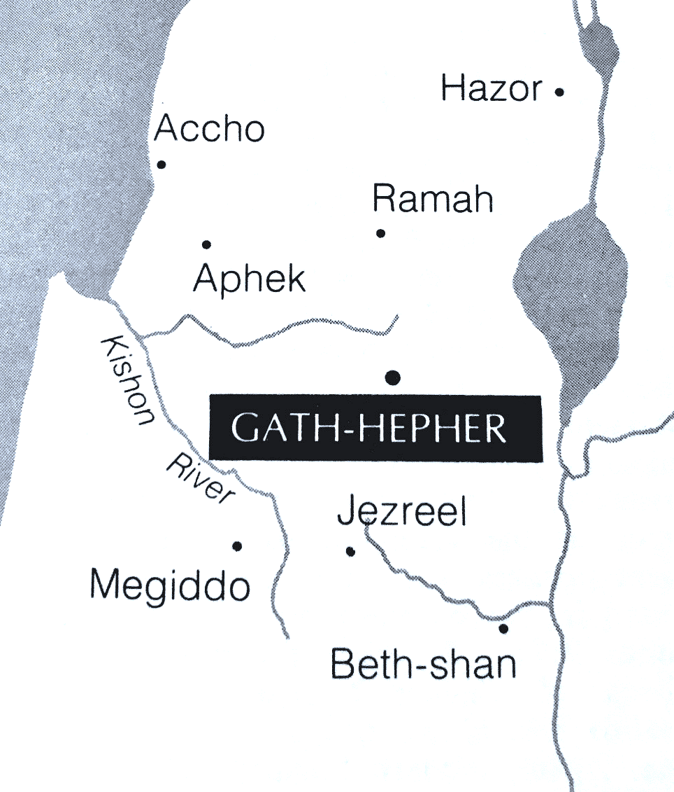
Jonah was from Gath-Hepher
Place-name meaning “winepress on the watering hole.”
A city on the eastern border of Zebulun’s tribal allotment (Josh. 19:13).
It is located at modern el-Meshed or nearby Khirbet ez-Zurra, three miles northeast of Nazareth.

Slide 51
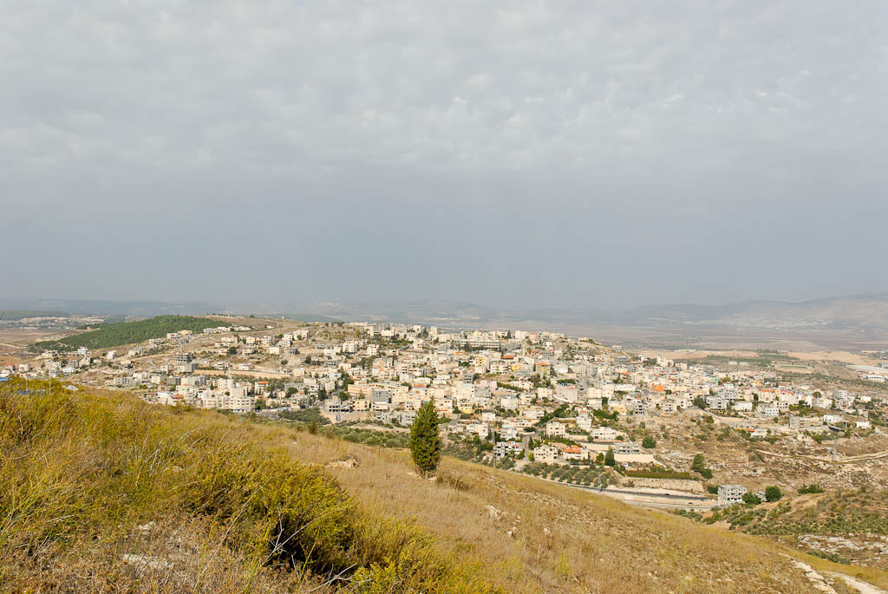
Gath Hepher from east
Notes:
tb110106368

Slide 52
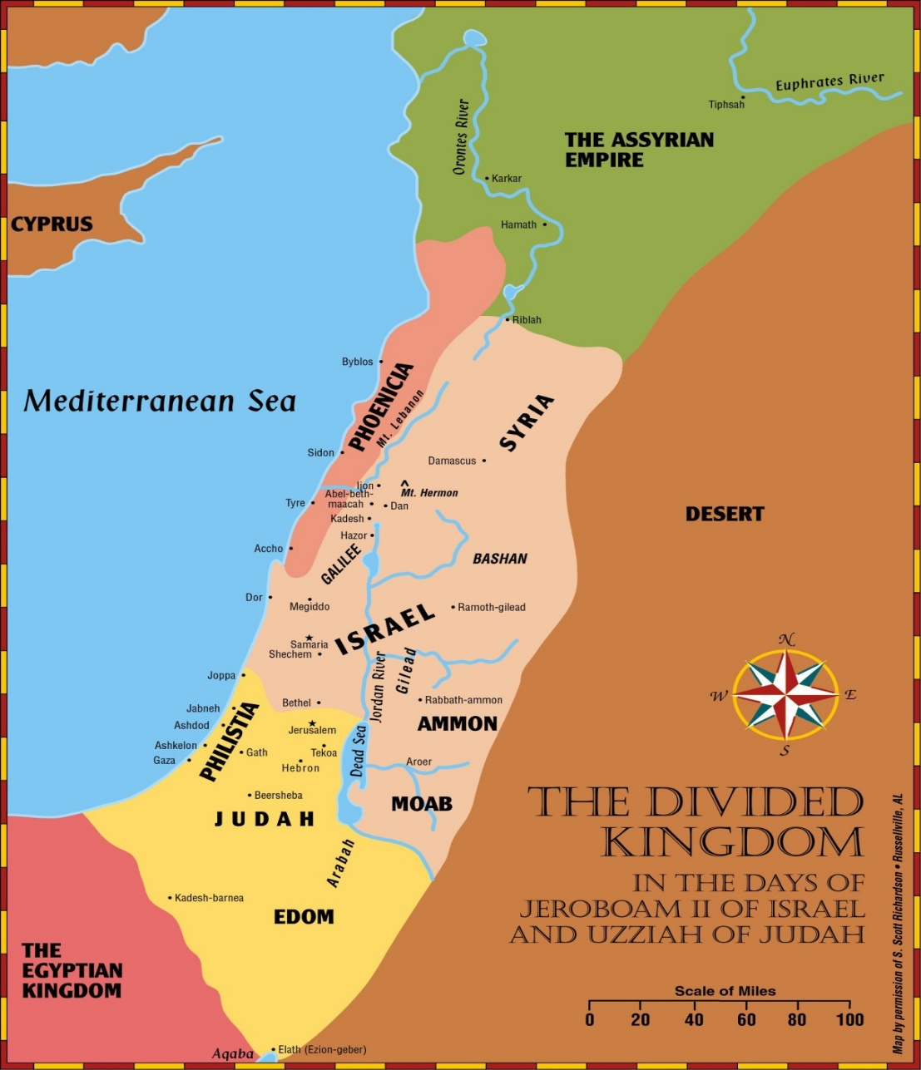
Jonah’s Work Prior to His Calling
2 Kings 14:23 - 26 (NKJV)
²⁵ He restored the territory of Israel from the entrance of Hamath to the Sea of the Arabah,
according to the word of the Lord God of Israel,
which He had spoken through His servant Jonah the son of Amittai, the prophet who was from Gath Hepher.
²⁶For the Lord saw that the affliction of Israel was very bitter; and whether bond or free, there was no helper for Israel.

Slide 53
Jonah’s Mission
He was called away from his ministry of national recovery (2 Kings 14) to deliver judgement on some of the most ruthless people history had ever known
Normally when prophets spoke against other nations, it was from their own soil rather than as a missionary in a foreign land (e.g. Jonah to Nineveh, Elisha to Damascus in 2 Kings 8)
Some were reluctant to bear the burden of the prophetic call (Moses, Elijah, Jeremiah) however Jonah went beyond hesitation and fled
Was it fear of success or failure that drove Jonah away? It was fear of success. He did not want a heathen nation to be saved from the wrath of God. (Jonah 4:2)
God Commands Jonah
“Now the word of the LORD came unto Jonah the son of Amittai, saying, Arise, go to Nineveh, that great city, and cry against it; for their wickedness is come up before me.” (Jon 1:1-2)
“Then the word of the Lord came to Jonah the second time, saying, “Arise, go to Nineveh, that great city, and call out against it the message that I tell you.”
(Jon 3:1-2)

Slide 54
Jonah’s Flight to Tarshish
Location of Tarshish is unknown, but many believe that it is what is today Spain
It was a Phoenician outpost
Joppa was Israel’s only semi-adequate port

Slide 55
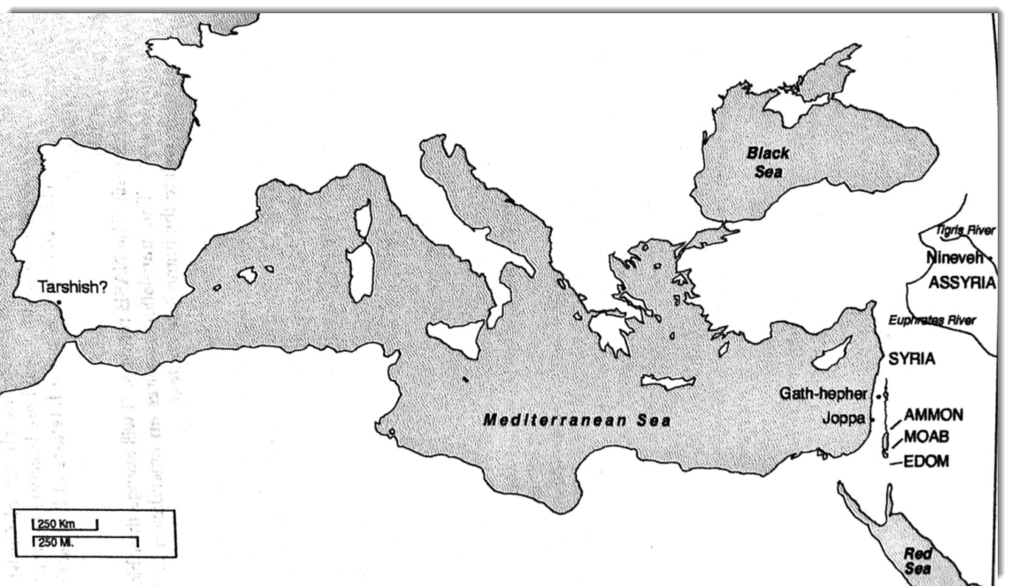
Jonah Map
Historical cities of Tarshish, Joppa, Gath-Hepher, Nineveh

Slide 56
Jonah in the Fish vs. Jesus
Jonah was initially disobedient (sin)
Jonah in the fish 3 days and 3 nights
Jonah was delivered from the storm (and his sin)
Christ died on the cross for our sins
He was in the grave for 3 days and 3 nights
Christ raised from the dead = our salvation from sin
(Mat 12:40 ESV) For just as Jonah was three days and three nights in the belly of the great fish, so will the Son of Man be three days and three nights in the heart of the earth.

Slide 57
Jonah in the Fish vs. Jesus
Jonah fled because he did not want the mercy of God to be made available to heathen nations yet his mission ultimately led to the Mercy of God on the Sailors, who feared the Lord
Jonah’s sin caused the storm and his ‘burial’ in the fish, foreshadowing the greater Jonah; it was our sin that caused the storm in our lives, and Christ’s burial offers a calm from the storm to those who believe through atonement for sin
Christ ultimately brings salvation to all “heathen” nations
Repentance based on the simple message of Jonah was a forerunner of the repentance required of all nations based on the message from Jesus
Christ was the greater Jonah who fulfilled prophecy, and if the Ninevites repent at the simple message of Jonah, we too should be willing to repent based on the many signs of Jesus

Slide 58
Jesus Points to the Sign of Jonah
^{Matthew 12}
³⁸Then some of the scribes and Pharisees answered, saying, “Teacher, we want to see a sign from You.”
³⁹But He answered and said to them, “An evil and adulterous generation seeks after a sign, and no sign will be given to it except the sign of the prophet Jonah.
⁴⁰For as Jonah was three days and three nights in the belly of the great fish, so will the Son of Man be three days and three nights in the heart of the earth.
⁴¹The men of Nineveh will rise up in the judgment with this generation and condemn it, because they repented at the preaching of Jonah; and indeed a greater than Jonah is here.
⁴²The queen of the South will rise up in the judgment with this generation and condemn it, for she came from the ends of the earth to hear the wisdom of Solomon; and indeed a greater than Solomon is here.
Why Jesus referenced the story of Jonah:
The Ninevites repented at the preaching of Jonah alone, and yet the scribes and Pharisees wanted a sign greater than Jesus, who fulfilled prophecy
The prophets foretold the future and pointed to the greater Jonah (Jesus)
Jonah was in the fish for three days and three nights which foreshadowed Jesus in the earth for three days and three nights
Jesus claims that he is greater than the temple (Matt. 12:6), the prophet Jonah (v. 41), and the wise king Solomon.

Slide 59
Jonah in the Fish vs. Our Salvation
Jonah was initially disobedient
Delivered from his sin through the great fish
Jonah was delivered from the storm
We were living in sin
Delivered from our sin through baptism
We were delivered from sin
(Rom 3:23 ESV) for all have sinned and fall short of the glory of God,
(Rom 6:7 ESV) For one who has died has been set free from sin.
(Rom 6:4 ESV) We were buried therefore with him by baptism into death, in order that, just as Christ was raised from the dead by the glory of the Father, we too might walk in newness of life.

Slide 60
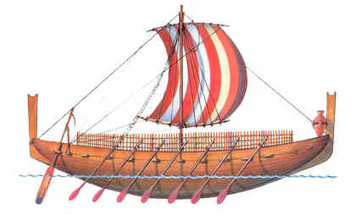
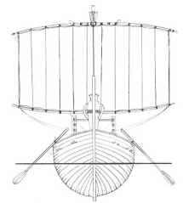
Jonah on the Ship
Phoenician round ships traveled the Mediterranean and beyond. To the left is a Phoenician trade ship of about 1500 BC and is an example of the type of ship Jonah may have taken to Tarshish.
Nevertheless, the men rowed hard to get back to dry land, but they could not, for the sea grew more and more tempestuous against them.
(Jon 1:13)
But Jonah rose to flee to Tarshish from the presence of the LORD. He went down to Joppa and found a ship going to Tarshish. So he paid the fare and went down into it, to go with them to Tarshish, away from the presence of the LORD.
(Jon 1:3)

Slide 61
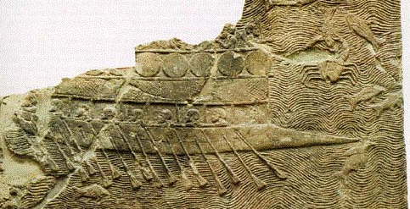
Phoenician Ship From 800 BCE Stone Relief Sculpture

Slide 62
Lengths Jonah Took to Flee
Willing to disobey the LORD
Willing to travel a great distance to Joppa, and an even greater distance to Tarshish
60 miles – Distance from Gath-hepher to Joppa
2,000+ miles – Distance to Tarshish
Willing to pay an expensive fare to travel to Tarshish
Willing to risk his life at sea with the sailors

Slide 63
Jonah Chapter 1:1-6
JONAH FLEES THE PRESENCE OF THE LORD (1) Now the word of the LORD came to Jonah the son of Amittai, saying, (2) “Arise, go to Nineveh, that great city, and call out against it, for their evil has come up before me.” (3) But Jonah rose to flee to Tarshish from the presence of the LORD. He went down to Joppa and found a ship going to Tarshish. So he paid the fare and went down into it, to go with them to Tarshish, away from the presence of the LORD. (4) But the LORD hurled a great wind upon the sea, and there was a mighty tempest on the sea, so that the ship threatened to break up. | (5) Then the mariners were afraid, and each cried out to his god. And they hurled the cargo that was in the ship into the sea to lighten it for them. But Jonah had gone down into the inner part of the ship and had lain down and was fast asleep. (6) So the captain came and said to him, “What do you mean, you sleeper? Arise, call out to your god! Perhaps the god will give a thought to us, that we may not perish.”

Slide 64
Jonah Chapter 1:7-17
JONAH IS THROWN INTO THE SEA (7) And they said to one another, “Come, let us cast lots, that we may know on whose account this evil has come upon us.” So they cast lots, and the lot fell on Jonah. (8) Then they said to him, “Tell us on whose account this evil has come upon us. What is your occupation? And where do you come from? What is your country? And of what people are you?” (9) And he said to them, “I am a Hebrew, and I fear the LORD, the God of heaven, who made the sea and the dry land.” (10) Then the men were exceedingly afraid and said to him, “What is this that you have done!” For the men knew that he was fleeing from the presence of the LORD, because he had told them. (11) Then they said to him, “What shall we do to you, that the sea may quiet down for us?” For the sea grew more and more tempestuous. | (12) He said to them, “Pick me up and hurl me into the sea; then the sea will quiet down for you, for I know it is because of me that this great tempest has come upon you.” (13) Nevertheless, the men rowed hard to get back to dry land, but they could not, for the sea grew more and more tempestuous against them. (14) Therefore they called out to the LORD, “O LORD, let us not perish for this man's life, and lay not on us innocent blood, for you, O LORD, have done as it pleased you.” (15) So they picked up Jonah and hurled him into the sea, and the sea ceased from its raging. (16) Then the men feared the LORD exceedingly, and they offered a sacrifice to the LORD and made vows A GREAT FISH SWALLOWS JONAH (17) And the LORD appointed a great fish to swallow up Jonah. And Jonah was in the belly of the fish three days and three nights.

Slide 65
Jonah Ch1 Class Exercise
Break into groups of 2-5 and answer the questions below:
What actions and steps did the sailors take? | Compare and contrast Jonah vs. the Sailors | What lessons can we learn from this chapter? | Where do you see the themes in this chapter?
 |  |  | God’s mercy/love God’s Sovereignty God’s expectation of repentance/obedience
We will gather back together to discuss in around 10 minutes

Slide 66
Steps Taken by the Sailors
Feared the storm and cried out to his god
Threw cargo into the sea to lighten load
Told Jonah to wake and call on his God
Cast lots to determine Jonah caused the trouble
Interrogated Jonah, asked him what they should do
Rowed hard to return to the land
Cried out to LORD to not charge them
Cast Jonah overboard
Feared LORD exceedingly, offered sacrifice, and took vows
Pagan deity
Strong's Concordance, 3068
Yhvh: the proper name of the God of Israel
Short Definition: LORD

Slide 67
Progressive Salvation of Sailors
The sailors prayed to their “gods” to deliver them from the storm
In what was either an act of repentance or an act of suicide, Jonah offered to sacrifice himself in compassion for the sailors
The men feared Jonah’s God, acknowledged that the LORD caused the storm, and showed compassion on Jonah by trying to row to land
The men called out to the LORD and asked for forgiveness for throwing Jonah overboard
The sailors threw Jonah overboard and were saved from the storm
The sailors then feared the LORD and offered sacrifices and made vows to the LORD.
The very thing that Jonah did not want to happen in Nineveh was happened on the ship
Pagan Fear of the LORD Salvation

Slide 68
Contrast of Sailors vs Jonah in Ch 1
Sailors |  | Jonah
Called out to their gods during the storm (1:5)
Slept through the storm (1:5)
Took responsibility by attempting to lighten the ship (1:5)
Took no responsibility until the lot fell on himself (1:7), but then offered himself as a sacrifice (1:12)
Feared the LORD and took action by offering sacrifices (1:16)
Says he feared God, but actions up to this point do not reflect his fear (1:9)
Humbly sought truth and salvation through God (1:14)
Fled from the presence of God (1:3)
What does Jonah do right in these passages?

Slide 69
Key Lessons in Jonah
Our preaching should never be discriminatory based on prejudice; rather, we should preach to all men as commanded
Mark 16:15 “… preach the gospel to all creation”
We should not question the wisdom, purpose, and guidance from God
Psa 147:5 ”Great is our Lord, and abundant in power; his understanding is beyond measure.”
Disobedience may seem tempting (flee to Tarshish) but God knows what’s best for us and others (salvation)
(Pro 3:5) Trust in the LORD with all your heart, and do not lean on your own understanding.
God’s love and mercy are great in magnitude and extend universally to the ends of the earth
(Psa 86:15) But you, O Lord, are a God merciful and gracious, slow to anger and abounding in steadfast love and faithfulness.
Our appreciation of God should not be dependent on our circumstances (Jonah’s deliverance through the great fish)
Rejoice always, pray without ceasing, give thanks in all circumstances; for this is the will of God in Christ Jesus for you.(1Th 5:16-18)
God expects obedience, and he loves those who he chastens
Heb 12:6-11 ESV For the Lord disciplines the one he loves, and chastises every son whom he receives.

Slide 70
Themes within Jonah
While there are many lessons in Jonah, here are three key themes throughout the book
Book of Jonah
God’s Mercy and Love Extend Universally to All
God Expects Obedience and Repentance
God’s is Sovereign over all nations and earth’s creation

Slide 71
Themes within Jonah
While there are many lessons in Jonah, here are three key themes throughout the book
Themes within Jonah Chapter 1
God’s Mercy and Love Extend Universally to All
The Lord is merciful on the sailors and saves them from the storm even though they are pagans in the eyes Jonah, similar to the Ninevites
(Jon 1:15) So they picked up Jonah and hurled him into the sea, and the sea ceased from its raging.
(Jon 1:16) Then the men feared the LORD exceedingly, and they offered a sacrifice to the LORD and made vows.
The Lord is merciful on Jonah and saves him from the storm through the great fish
(Jon 1:17 ESV) And the LORD appointed a great fish to swallow up Jonah. And Jonah was in the belly of the fish three days and three nights.

Slide 72
Themes within Jonah
While there are many lessons in Jonah, here are three key themes throughout the book
Themes within Jonah Chapter 1
God Expects Obedience and Repentance
Jonah fled the Lord (1:3), but God did not let him escape the mission to Nineveh; rather the Lord expected Jonah to repent of his sin and obey the original command
Jonah says to the sailors that he fears the Lord, but the Lord expects this fear to lead Jonah (and us) to repentance and obedience
(Jon 1:9) And he said to them, “I am a Hebrew, and I fear the LORD, the God of heaven, who made the sea and the dry land.”
The sailors fear the Lord at the end of Chapter 1, but their fear extends to their actions as they offered a sacrifice to the Lord and made Vows
(Jon 1:16) Then the men feared the LORD exceedingly, and they offered a sacrifice to the LORD and made vows.

Slide 73
Themes within Jonah
While there are many lessons in Jonah, here are three key themes throughout the book
Themes within Jonah Chapter 1
God’s is Sovereign over all nations and earth’s creation
Jonah acknowledges that God made the land and the dry sea
Jon 1:9(9) And he said to them, “I am a Hebrew, and I fear the LORD, the God of heaven, who made the sea and the dry land.”
The Lord sent a great storm upon the sea to bring the sailors and Jonah to repentance
(Jon 1:4) But the LORD hurled a great wind upon the sea, and there was a mighty tempest on the sea, so that the ship threatened to break up.
The Lord calms the storm after Jonah is thrown into the sea
(Jon 1:15) So they picked up Jonah and hurled him into the sea, and the sea ceased from its raging.
The Lord appoints a great fish to swallow up Jonah
(Jon 1:17) And the LORD appointed a great fish to swallow up Jonah. And Jonah was in the belly of the fish three days and three nights.

Slide 74
Reluctant Servants of God
Jeremiah
Jeremiah was reluctant because he thought he was perhaps too young for God’s calling
God provided comfort to Jeremiah and promised to deliver him and put the words in his mouth to give him confidence
(Jer 1:6 ESV) Then I said, “Ah, Lord GOD! Behold, I do not know how to speak, for I am only a youth.”
Moses
Moses had little confidence in his speaking and persuasion ability
The Lord gives Moses powerful signs such as the staff to serpent. The Lord was patient with him and makes promises to Moses and allowed him to bring Aaron along as the speaker
(Exo 4:10 ESV) But Moses said to the LORD, “Oh, my Lord, I am not eloquent, either in the past or since you have spoken to your servant, but I am slow of speech and of tongue.”

Slide 75
Reluctant Servants of God
Isaiah
Isaiah felt that he was unworthy to accept God’s calling and he was surrounded by unworthy people
The Lord provided comfort to him saying, “your guilt is taken away, and your sin atoned for.”
Isa 6:5 ESV And I said: “Woe is me! For I am lost; for I am a man of unclean lips, and I dwell in the midst of a people of unclean lips; for my eyes have seen the King, the LORD of hosts!”
Gideon
Gideon was fearful about his abilities to fight the Midianites
God was patient with Gideon as he provided multiple signs for Gideon including the fire from the rock and the dew on the fleece
Jdg 6:14-15 ESV And the LORD turned to him and said, “Go in this might of yours and save Israel from the hand of Midian; do not I send you?” (15) And he said to him, “Please, Lord, how can I save Israel? Behold, my clan is the weakest in Manasseh, and I am the least in my father's house.”

Slide 76
Reluctant Servants of God
Jonah’s was reluctant because he knew God would be merciful on the Ninevites
Jonah
There is no indication that Jonah was reluctant because he was not confident in his abilities to delivery the message
Jonah was reluctant because he knew God was merciful and didn’t want to see his mercy extended to the Ninevites
God addressed this by first accomplishing his will (sending the message to the Ninevites) and then teaching Jonah a lesson in Chapter 4
(Jon 4:2b ESV) That is why I made haste to flee to Tarshish; for I knew that you are a gracious God and merciful, slow to anger and abounding in steadfast love, and relenting from disaster.

Slide 77
Do We Flee the Call of God?
Jonah fled far away from God’s call; do we sometimes flee from the call as well?
The Call of God
Disobedience
Jonah was called to preach against the Evil in Nineveh
(Jon 1:2) “Arise, go to Nineveh, that great city, and call out against it, for their evil has come up before me.”
Jonah’s fled the call and the Lord
(Jon 1:3a) “But Jonah rose to flee to Tarshish from the presence of the LORD”
He fled because he knew God is merciful
Jonah
Our call as Christians:
Spread the Gospel (Matthew 28:19-20)
Give to the church as we have been blessed (2 Corinthians 9:7)
Contribute good works (James 2:26)
Have “Marks of the True Christian” (Romans 12:9-12) … Love, show honor, be fervent, rejoice in hope, contribute, show hospitality, bless others, live in harmony …
Our flight from the call?:
?
Us

Slide 78
Miracles within Jonah
All acts of God in Jonah should not be considered “miracles”
Miracle: An effect or deed in the physical world that surpasses all known human and natural powers and is therefore ascribed to supernatural intervention
Miracle
Not a miracle
Jonah’s life preserved in the fish for 3 days and 3 nights
The fish consuming Jonah
The growth of the vine overnight
The growth of the vine
The storm on the sea
The ceasing of the storm
The Ninevites repentance

Slide 79
Jonah and the Great Fish
“Men have been looking so hard at the great fish that they have failed to see the great God” – G Campbell Morgan
(Jon 1:17) And the LORD appointed a great fish to swallow up Jonah. And Jonah was in the belly of the fish three days and three nights.
We do not know what type of “fish” Jonah was swallowed by, but we definitely know there are sea creatures that have the capability of swallowing an entire human being.

Slide 80
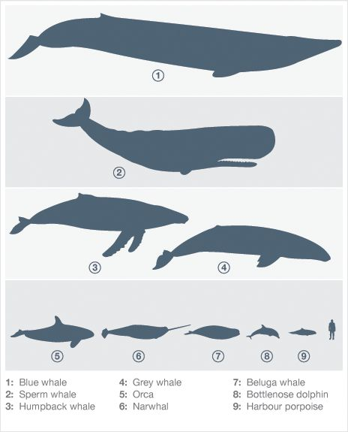
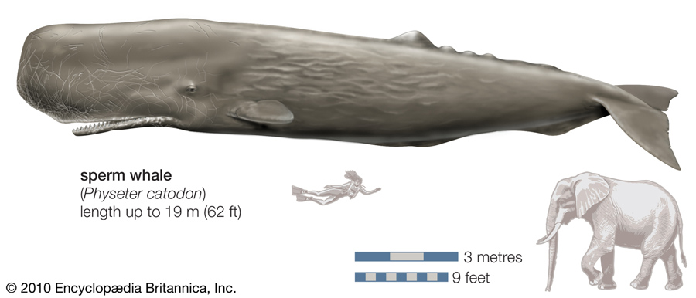
Jonah and the Great Fish
“Men have been looking so hard at the great fish that they have failed to see the great God” – G Campbell Morgan
(Jon 1:17) And the LORD appointed a great fish to swallow up Jonah. And Jonah was in the belly of the fish three days and three nights.
We do not know what type of “fish” Jonah was swallowed by, but we definitely know there are sea creatures that have the capability of swallowing an entire human being.

Slide 81
Theme: God’s Mercy
God was merciful on … | A | Act of Mercy
The Mariners Why? The men feared God Therefore they called out to the Lord, “O Lord, let us not perish for this man's life, and lay not on us innocent blood, for you, O Lord, have done as it pleased you.” (Jon 1:14) “Then the men feared the Lord exceedingly, and they offered a sacrifice to the Lord and made vows.” (Jon 1:16) | g | God exercised his power over nature to calm the sea So they picked up Jonah and hurled him into the sea, and the sea ceased from its raging. (Jon 1:15)
Jonah Why? Jonah recognizes and praises God “But I with the voice of thanksgiving will sacrifice to you; what I have vowed I will pay. Salvation belongs to the Lord!” (Jon 2:9) | g | The Lord exercised his power over nature to save Jonah from the fish. And the Lord spoke to the fish, and it vomited Jonah out upon the dry land. (Jon 2:10)
Nineveh Why? Because they were humbled and repented “The word reached the king of Nineveh, and he arose from his throne, removed his robe, covered himself with sackcloth, and sat in ashes.” (Jon 3:6) “Let everyone turn from his evil way and from the violence that is in his hands.” (Jon 3:8b) | g | The Lord relented of the disaster preached by Jonah “When God saw what they did, how they turned from their evil way, God relented of the disaster that he had said he would do to them, and he did not do it.” (Jon 3:10)

Slide 82
We Serve a Merciful God
We serve a merciful, graceful, and loving God – who are we to judge his mercy?
Laborers in the Vineyard Parable (Mat 20:1-16) | Jonah's Anger and the Lord’s Mercy (Jon 4:1-11)
Master of a house hires laborers throughout the day. At the end of the day, he pays them all the same wage, but those who labored all day rec’d the same amount as those who labored for only part of the day. Those who came first grumbled and complained because those who came to work later rec’d the same amount. (8) And when evening came, the owner of the vineyard said to his foreman, ‘Call the laborers and pay them their wages, beginning with the last, up to the first.’ (9) And when those hired about the eleventh hour came, each of them received a denarius. (10) Now when those hired first came, they thought they would receive more, but each of them also received a denarius. (11) And on receiving it they grumbled at the master of the house, (12) saying, ‘These last worked only one hour, and you have made them equal to us who have borne the burden of the day and the scorching heat.’ (13) But he replied to one of them, ‘Friend, I am doing you no wrong. Did you not agree with me for a denarius? (14) Take what belongs to you and go. I choose to give to this last worker as I give to you. (15) Am I not allowed to do what I choose with what belongs to me? Or do you begrudge my generosity?’ (16) So the last will be first, and the first last.” | Jonah was angry because God was merciful on Nineveh. He fled the mission because he knew God’s mercy. Jonah accepted God’s mercy on him, but was unwilling to accept God’s mercy on others. God, the creator of all things, has the right to be merciful on whoever he wills. (1) But it displeased Jonah exceedingly, and he was angry. (2) And he prayed to the LORD and said, “O LORD, is not this what I said when I was yet in my country? That is why I made haste to flee to Tarshish; for I knew that you are a gracious God and merciful, slow to anger and abounding in steadfast love, and relenting from disaster. … (6) Now the LORD God appointed a plant and made it come up over Jonah, that it might be a shade over his head, to save him from his discomfort. So Jonah was exceedingly glad because of the plant. (7) But when dawn came up the next day, God appointed a worm that attacked the plant, so that it withered. … (9) But God said to Jonah, “Do you do well to be angry for the plant?” And he said, “Yes, I do well to be angry, angry enough to die.” (10) And the LORD said, “You pity the plant, for which you did not labor, nor did you make it grow, which came into being in a night and perished in a night. (11) And should not I pity Nineveh, that great city, in which there are more than 120,000 persons who do not know their right hand from their left, and also much cattle?”

Slide 83
Themes within Jonah
While there are many lessons in Jonah, here are three key themes throughout the book
Themes within Jonah Chapter 1
God’s Mercy and Love Extend Universally to All
The Lord is merciful on the sailors and saves them from the storm even though they just pagans in the eyes Jonah, similar to the Ninevites
The Lord is merciful on Jonah as he delivers him from the storm and his disobedience through the great fish
The Lord is merciful on the Ninevites, relenting from the disaster because of the humility and submission of the Ninevites

Slide 84
Themes within Jonah
While there are many lessons in Jonah, here are three key themes throughout the book
Themes within Jonah Chapter 1
God Expects Obedience and Repentance
The Lord saves the Sailors as they submitted to him: they cried out to God, feared the Lord exceedingly, offered a sacrifice, and made vows
The Lord disciplined Jonah to obedience and delivered him through the great fish, allowing him opportunity for obedience
The Lord relented from disaster on the Ninevites after they submitted to God, fasting in sackcloth

Slide 85
Themes within Jonah
While there are many lessons in Jonah, here are three key themes throughout the book
Themes within Jonah Chapter 1
God’s is Sovereign over all nations and earth’s creation
The Lord’s power over the earths creation is clearly seen throughout Jonah: power over the storm, the fish, the plant, the worm
The Lord is Lord of not just the Hebrews, but of all people including the pagan sailors and the Ninevites
The Lord has the power to overthrow nations, bring destruction on evil nations, or use them for his will

Slide 86
Israel’s King in the Time of Jonah
Jeroboam II
Was an evil King of Israel
He restored the border of Israel according to the word of the Lord through Jonah
Powerful king of Israel in the dynasty of Jehu about 793-753 B.C.
He managed to restore prosperity and territory to a weak nation but continued the religious practices of Jeroboam I and thus met condemnation from the biblical writers.
Jeroboam basically restored the boundaries of David’s empire, reaching even into Syria.
Jonah, Amos, and Hosea prophesied during his reign.
(1) Now the word of the LORD came to Jonah the son of Amittai, saying,
(Jon 1:1)
(23) In the fifteenth year of Amaziah the son of Joash, king of Judah, Jeroboam the son of Joash, king of Israel, began to reign in Samaria, and he reigned forty-one years.
(24) And he did what was evil in the sight of the LORD. He did not depart from all the sins of Jeroboam the son of Nebat, which he made Israel to sin.
(25) He restored the border of Israel from Lebo-hamath as far as the Sea of the Arabah, according to the word of the LORD, the God of Israel, which he spoke by his servant Jonah the son of Amittai, the prophet, who was from Gath-hepher.
(26) For the LORD saw that the affliction of Israel was very bitter, for there was none left, bond or free, and there was none to help Israel.
(2Ki 14:23-26)

Slide 87
Jonah Chapter 4
JONAH'S ANGER AND THE LORD'S COMPASSION

Slide 88
Seven Episodes of Jonah
The story of Jonah can be viewed of as seven distinct “episodes”
(1) Jonah’s commissioning and flight (1:1-3)
What will happen to Jonah?
(2) Jonah and the pagan sailors (1:4-16)
How responsive are the pagal sailors?
(3) Jonah’s grateful prayer (1:17-2:10)
How does Jonah respond to God’s grace towards him?
(4) Jonah’s recommissioning and compliance (3:1-3a)
What will happen to the Ninevites?
(5) Jonah and the pagan Ninevites (3:3b-10)
How responsive are the pagan Ninevites?
(6) Jonah’s angry prayer (4:1-4)
How does Jonah respond to God’s grace towards others?
Today’s Lesson
(7) Jonah’s lesson about compassion (4:5-11)
“Should not I pity Nineveh…?”

Slide 89
Summary up to Jonah Chapter 4
Chapter 1
God commands Jonah to call out the evil against Nineveh
Jonah flees on a ship to Tarshish
God sends a great storm upon the sea and the sailors cry out to their gods
The sailors discover that Jonah is the cause of the storm because he is fleeing from God
Jonah tells the sailors that the solution is to throw him into the sea
The sailors throw Jonah into the sea as a last resort, and the sea calmed
The men feared the Lord exceedingly and offered a sacrifice and made vows
God appointed a great fish to swallow Jonah, and he was in the fish for 3 days and 3 nights

Slide 90
Summary up to Jonah Chapter 4
Chapter 2
Jonah prays a poetic prayer to the Lord, thanking him for delivering him from the storm and from drowning in the sea
Jonah promises a sacrifice to the Lord, offers a vow, and praises the Lord
Chapter 3
Chapters 3-4 parallel chapters 1-2
The Lord commands Jonah again to deliver the message from Nineveh
The Ninevites (similar to the sailors) repent, call out to God, fear the Lord, and make sacrifices
Chapter 4
The Lord teaches Jonah of his mercy and compassion
The Lord appoints a plant and a worm to deliver Jonah from his selfish ways; previously he had appointed the great fish to deliver Jonah physically

Slide 91
Jonah: The Worst Preacher in History?

Slide 92
Miracles within Jonah
All acts of God in Jonah should not be considered “miracles”
Miracle: An effect or deed in the physical world that surpasses all known human and natural powers and is therefore ascribed to supernatural intervention
Miracle
Not a miracle
Jonah’s life preserved in the fish for 3 days and 3 nights
The fish consuming Jonah
The growth of the vine overnight
The growth of the vine
The storm on the sea
The ceasing of the storm
The Ninevites repentance

Slide 93
Why Did Jonah Flee?
(Jon 4:2-3) And he prayed to the LORD and said, “O LORD, is not this what I said when I was yet in my country? That is why I made haste to flee to Tarshish; for I knew that you are a gracious God and merciful, slow to anger and abounding in steadfast love, and relenting from disaster. Therefore now, O LORD, please take my life from me, for it is better for me to die than to live.”
(Jon 4:4 ESV)
And the LORD said, “Do you do well to be angry?”
(Jon 4:4 NASB)
The LORD said, "Do you have good reason to be angry?"
(Jon 4:4 NIV)
But the LORD replied, "Is it right for you to be angry?"

Slide 94
God’s Lesson on Compassion
Jon 4:10-11 ESV
(10) And the LORD said, “You pity the plant, for which you did not labor, nor did you make it grow, which came into being in a night and perished in a night.
(11) And should not I pity Nineveh, that great city, in which there are more than 120,000 persons who do not know their right hand from their left, and also much cattle?”
chus: to pity, look upon with compassion
NKJV: You have had pity on the plant
NIV: You have been concerned about this plant
NASB: You had compassion on the plant

Slide 95
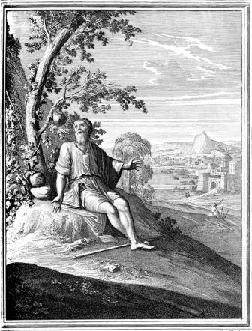
The Lord’s Compassion
The Lord teaches Jonah a lesson on compassion to delivery him from his sin
The Lord had compassion on the sailors
The sailors truly feared God, offered a sacrifice, and made vows
The Lord had compassion on the Jonah
Jonah repented of his sin, promised a sacrifice and a vow
The Lord had compassion on the Ninevites
The Ninevites repented of their sin, feared God, and made sacrifices
Yet Jonah did not have compassion for the Sailors or the Ninevites - Jonah only had compassion for a plant in this story
He did not labor for the plant, nor did he make it grow; the plant came into being in a night and perished in a night
Jonah praised the Lord in his prayer for delivering him from the storm, yet he was not willing to accept God’s compassion and mercy on those who needed salvation just as much as Jonah needed it

Slide 96
Jonah Chapter 4:1-11
JONAH’S ANGER AND THE LORD’S COMPASSION (1) But it displeased Jonah exceedingly, and he was angry. (2) And he prayed to the LORD and said, “O LORD, is not this what I said when I was yet in my country? That is why I made haste to flee to Tarshish; for I knew that you are a gracious God and merciful, slow to anger and abounding in steadfast love, and relenting from disaster. (3) Therefore now, O LORD, please take my life from me, for it is better for me to die than to live.” (4) And the LORD said, “Do you do well to be angry?” (5) Jonah went out of the city and sat to the east of the city and made a booth for himself there. He sat under it in the shade, till he should see what would become of the city. (6) Now the LORD God appointed a plant and made it come up over Jonah, that it might be a shade over his head, to save him from his discomfort. So Jonah was exceedingly glad because of the plant. | (7) But when dawn came up the next day, God appointed a worm that attacked the plant, so that it withered. (8) When the sun rose, God appointed a scorching east wind, and the sun beat down on the head of Jonah so that he was faint. And he asked that he might die and said, “It is better for me to die than to live.” (9) But God said to Jonah, “Do you do well to be angry for the plant?” And he said, “Yes, I do well to be angry, angry enough to die.” (10) And the LORD said, “You pity the plant, for which you did not labor, nor did you make it grow, which came into being in a night and perished in a night. (11) And should not I pity Nineveh, that great city, in which there are more than 120,000 persons who do not know their right hand from their left, and also much cattle?”

Slide 97
Themes within Jonah
While there are many lessons in Jonah, here are three key themes throughout the book
Book of Jonah
God’s Mercy and Love Extend Universally to All
God Expects Obedience and Repentance
God’s is Sovereign over all nations and earth’s creation

Slide 98
Class Exercise
Break into groups of 2-5 and answer the questions below:
What lesson(s) was God teaching Jonah (and us)? | What lessons can we learn from this chapter? | Where do you see the the themes in this chapter?
 |  | God’s mercy/love God’s Sovereignty God’s expectation of repentance/obedience
We will gather back together to discuss in 5-10 minutes

Slide 99
Themes within Jonah
While there are many lessons in Jonah, here are three key themes throughout the book
Themes within Jonah Chapter 4
God’s Mercy and Love Extend Universally to All
God relented from his destruction on Nineveh and saved many people and cattle
(Jon 4:11) And should not I pity Nineveh, that great city, in which there are more than 120,000 persons who do not know their right hand from their left, and also much cattle?”
Jonah did not want to preach in Nineveh because he knew that because God is merciful, and would allow repentance and salvation from destruction
(Jon 4:2b) That is why I made haste to flee to Tarshish; for I knew that you are a gracious God and merciful, slow to anger and abounding in steadfast love, and relenting from disaster.
God was merciful on Jonah and provided shade for his comfort
(Jon 4:6a) Now the LORD God appointed a plant and made it come up over Jonah, that it might be a shade over his head, to save him from his discomfort.

Slide 100
Themes within Jonah
While there are many lessons in Jonah, here are three key themes throughout the book
Themes within Jonah Chapter 4
God Expects Obedience and Repentance
Nineveh was saved because they repented from their sin – God hates sin, but is patient and loving towards us with the expectation that there will be repentance sin
(Jon 4:11) And should not I pity Nineveh, that great city, in which there are more than 120,000 persons who do not know their right hand from their left, and also much cattle?”
God teaches Jonah a lesson about mercy, expecting him to repent of his selfish ways
(Jon 4:10) And the LORD said, “You pity the plant, for which you did not labor, nor did you make it grow, which came into being in a night and perished in a night.

Slide 101
Themes within Jonah
While there are many lessons in Jonah, here are three key themes throughout the book
Themes within Jonah Chapter 4
God’s is Sovereign over all nations and earth’s creation
God “appointed a plant” to grow and provide shade for Jonah, but also God “appointed a worm” to kill the same plant to teach Jonah a lesson
(Jon 4:7) But when dawn came up the next day, God appointed a worm that attacked the plant, so that it withered.
God appointed a scorching east wind on Jonah as part of his lesson
(Jon 4:8) When the sun rose, God appointed a scorching east wind, and the sun beat down on the head of Jonah so that he was faint. And he asked that he might die and said, “It is better for me to die than to live.”

Slide 102
God Chastens Who He Loves
Heb 12:3-17
(5) And have you forgotten the exhortation that addresses you as sons? “My son, do not regard lightly the discipline of the Lord, nor be weary when reproved by him.
(6) For the Lord disciplines the one he loves, and chastises every son whom he receives.”
(7) It is for discipline that you have to endure. God is treating you as sons. For what son is there whom his father does not discipline?
(8) If you are left without discipline, in which all have participated, then you are illegitimate children and not sons.
(9) Besides this, we have had earthly fathers who disciplined us and we respected them. Shall we not much more be subject to the Father of spirits and live?
(10) For they disciplined us for a short time as it seemed best to them, but he disciplines us for our good, that we may share his holiness.
(11) For the moment all discipline seems painful rather than pleasant, but later it yields the peaceful fruit of righteousness to those who have been trained by it.
(Pro 3:11-12)
(11) My son, do not despise the LORD's discipline or be weary of his reproof,
(12) for the LORD reproves him whom he loves, as a father the son in whom he delights.
(Tit 2:11-12)
(11) For the grace of God has appeared, bringing salvation for all people,
(12) training us to renounce ungodliness and worldly passions, and to live self-controlled, upright, and godly lives in the present age,
(1Co 11:32)
But when we are judged by the Lord, we are disciplined so that we may not be condemned along with the world.

Slide 103
Patterns of Jonah’s Mercy & Grace
When was Jonah Grateful and Merciful?
When was Jonah Ungrateful and Unmerciful?
Jonah was grateful for the plant and “exceedingly glad” (4:6)
Jonah was so angry that God relented from disaster on Nineveh, that he wanted to die (4:3)
Jonah pitied the plant that died that provided him with shade (4:9)
Jonah did not want God’s message of repentance and mercy to be taken to Nineveh (1:3, 4:2)
Jonah showed mercy on the sailors by offering to sacrifice his life, but perhaps saw this as a way out of the mission because he would rather die than delivery the message to Nineveh (1:12, 4:3)
Jonah was grateful when he was saved from the fish (2:2), but his prayer compared himself to pagans with their worthless idols (2:8); in his prayer he promised a sacrifice (2:9), but only after God chastened him

Slide 104
Patterns of God’s Mercy & Grace
Patterns both within the Book of Jonah as well as throughout the Bible
God’s Mercy and Grace Throughout the Book of Jonah
God was merciful on the sailors as he saved them from the storm
God was merciful on the Jonah, as he was saved from drowning in the sea
God was merciful on the Ninevites as he relented from destroying them for their evil
God’s Mercy and Grace Today Through Jesus
(Mic 7:18 ESV) Who is a God like you, pardoning iniquity and passing over transgression for the remnant of his inheritance? He does not retain his anger forever, because he delights in steadfast love.
(Rom 3:23-25 ESV) for all have sinned and fall short of the glory of God, (24) and are justified by his grace as a gift, through the redemption that is in Christ Jesus, (25) whom God put forward as a propitiation by his blood, to be received by faith. This was to show God's righteousness, because in his divine forbearance he had passed over former sins.

Slide 105
Micah 4:1 – 5:15
HOPE AND REDEMPTION

Slide 106
Micah Chapter 4:1-13
THE MOUNTAIN OF THE LORD (1) It shall come to pass in the latter days that the mountain of the house of the LORD shall be established as the highest of the mountains, and it shall be lifted up above the hills; and peoples shall flow to it, (2) and many nations shall come, and say: “Come, let us go up to the mountain of the LORD, to the house of the God of Jacob, that he may teach us his ways and that we may walk in his paths.” For out of Zion shall go forth the law, and the word of the LORD from Jerusalem. (3) He shall judge between many peoples, and shall decide disputes for strong nations far away; and they shall beat their swords into plowshares, and their spears into pruning hooks; nation shall not lift up sword against nation, neither shall they learn war anymore; (4) but they shall sit every man under his vine and under his fig tree, and no one shall make them afraid, for the mouth of the LORD of hosts has spoken. (5) For all the peoples walk each in the name of its god, but we will walk in the name of the LORD our God forever and ever. | THE LORD SHALL RESCUE ZION (6) In that day, declares the LORD, I will assemble the lame and gather those who have been driven away and those whom I have afflicted; (7) and the lame I will make the remnant, and those who were cast off, a strong nation; and the LORD will reign over them in Mount Zion from this time forth and forevermore. (8) And you, O tower of the flock, hill of the daughter of Zion, to you shall it come, the former dominion shall come, kingship for the daughter of Jerusalem. (9) Now why do you cry aloud? Is there no king in you? Has your counselor perished, that pain seized you like a woman in labor? (10) Writhe and groan, O daughter of Zion, like a woman in labor, for now you shall go out from the city and dwell in the open country; you shall go to Babylon. There you shall be rescued; there the LORD will redeem you from the hand of your enemies. (11) Now many nations are assembled against you, saying, “Let her be defiled, and let our eyes gaze upon Zion.” (12) But they do not know the thoughts of the LORD; they do not understand his plan, that he has gathered them as sheaves to the threshing floor.(13) Arise and thresh, O daughter of Zion, for I will make your horn iron, and I will make your hoofs bronze; you shall beat in pieces many peoples; and shall devote their gain to the LORD, their wealth to the Lord of the whole earth.

Slide 107
Micah Chapter 5:1-15
THE RULER TO BE BORN IN BETHLEHEM (1) Now muster your troops, O daughter of troops; siege is laid against us; with a rod they strike the judge of Israel on the cheek. (2) But you, O Bethlehem Ephrathah, who are too little to be among the clans of Judah, from you shall come forth for me one who is to be ruler in Israel, whose coming forth is from of old, from ancient days. (3) Therefore he shall give them up until the time when she who is in labor has given birth; then the rest of his brothers shall return to the people of Israel. (4) And he shall stand and shepherd his flock in the strength of the LORD, in the majesty of the name of the LORD his God. And they shall dwell secure, for now he shall be great to the ends of the earth. (5) And he shall be their peace. When the Assyrian comes into our land and treads in our palaces, then we will raise against him seven shepherds and eight princes of men; (6) they shall shepherd the land of Assyria with the sword, and the land of Nimrod at its entrances; and he shall deliver us from the Assyrian when he comes into our land and treads within our border. | A REMNANT SHALL BE DELIVERED (7) Then the remnant of Jacob shall be in the midst of many peoples like dew from the LORD, like showers on the grass, which delay not for a man nor wait for the children of man. (8) And the remnant of Jacob shall be among the nations, in the midst of many peoples, like a lion among the beasts of the forest, like a young lion among the flocks of sheep, which, when it goes through, treads down and tears in pieces, and there is none to deliver. (9) Your hand shall be lifted up over your adversaries, and all your enemies shall be cut off. (10) And in that day, declares the LORD, I will cut off your horses from among you and will destroy your chariots; (11) and I will cut off the cities of your land and throw down all your strongholds; (12) and I will cut off sorceries from your hand, and you shall have no more tellers of fortunes; (13) and I will cut off your carved images and your pillars from among you, and you shall bow down no more to the work of your hands; (14) and I will root out your Asherah images from among you and destroy your cities. (15) And in anger and wrath I will execute vengeance on the nations that did not obey.

Slide 108
Micah 6:1 – 7:7
GOD’S CASE AGAINST ISRAEL

Slide 109
Micah the Man
Name
Meaning is “Who is like Yahweh?”
Home
He was of Moresheth (1:1)
Family
Timing,
King
Micah prophesied during the reigns of the Judean kings Jotham (750–735 B.C.), Ahaz (735–715), and Hezekiah (715–687)
(Mic 1:1) The word of the LORD that came to Micah of Moresheth in the days of Jotham, Ahaz, and Hezekiah, kings of Judah, which he saw concerning Samaria and Jerusalem.

Slide 110
Micah the Message
the message from God was the imminent devastation of Judah (3:5-12)

Slide 111
Devotion to God
God Wanted True Devotion Then |  | God Wants True Devotion Today
God does not only want his people to offer sacrifices and offerings at the temple – he wants obedience that into daily life! The people believed that religion only required sacrifices and offerings. No relationship was acknowledged between their activity in the temple and their activity in daily life. Micah argued that God is not just interested in the physical act of making a sacrifice but is concerned with obedience that extends into daily life. (Mic 6:8) He has told you, O man, what is good; and what does the LORD require of you but to do justice, and to love kindness, and to walk humbly with your God? |  | Today, God also does not want followers who only attend church, but wants obedience and devotion of his followers every day!

Slide 112
Sins of the People
rich as devising ways in which to cheat the poor out of their land (2:1-5)
People were evicted from their homes and had their possessions stolen. Those who committed such crimes were fellow Israelites (2:6-11)
The marketplace was full of deception and injustice (6:9-16)
The rulers of the country, who had the responsibility of upholding justice, did the opposite (3:1-4)
Although the people worshiped other gods, they did not quit believing in and worshiping the God of Judah but combined this worship with devotion to the other deities (5:10-15)

Slide 113
Themes within Micah
While there are many lessons in Micah, here are three key themes throughout the book
Book of Micah
God’s Mercy and Love Extend Universally to All
God Expects Obedience and Repentance
God’s is Sovereign over all nations and earth’s creation

Slide 114
Micah Chapter 6:1-8
THE INDICTMENT OF THE LORD (1) Hear what the LORD says: Arise, plead your case before the mountains, and let the hills hear your voice. (2) Hear, you mountains, the indictment of the LORD, and you enduring foundations of the earth, for the LORD has an indictment against his people, and he will contend with Israel. (3) “O my people, what have I done to you? How have I wearied you? Answer me! (4) For I brought you up from the land of Egypt and redeemed you from the house of slavery, and I sent before you Moses, Aaron, and Miriam. (5) O my people, remember what Balak king of Moab devised, and what Balaam the son of Beor answered him, and what happened from Shittim to Gilgal, that you may know the righteous acts of the LORD.” | WHAT DOES THE LORD REQUIRE (6) “With what shall I come before the LORD, and bow myself before God on high? Shall I come before him with burnt offerings, with calves a year old? (7) Will the LORD be pleased with thousands of rams, with ten thousands of rivers of oil? Shall I give my firstborn for my transgression, the fruit of my body for the sin of my soul?” (8) He has told you, O man, what is good; and what does the LORD require of you but to do justice, and to love kindness, and to walk humbly with your God?

Slide 115
Micah Chapter 6:9 – 7:7
DESTRUCTION OF THE WICKED (9) The voice of the LORD cries to the city— and it is sound wisdom to fear your name: “Hear of the rod and of him who appointed it! (10) Can I forget any longer the treasures of wickedness in the house of the wicked, and the scant measure that is accursed? (11) Shall I acquit the man with wicked scales and with a bag of deceitful weights? (12) Your rich men are full of violence; your inhabitants speak lies, and their tongue is deceitful in their mouth. (13) Therefore I strike you with a grievous blow, making you desolate because of your sins. (14) You shall eat, but not be satisfied, and there shall be hunger within you; you shall put away, but not preserve, and what you preserve I will give to the sword. (15) You shall sow, but not reap; you shall tread olives, but not anoint yourselves with oil; you shall tread grapes, but not drink wine. (16) For you have kept the statutes of Omri, and all the works of the house of Ahab; and you have walked in their counsels, that I may make you a desolation, and your inhabitants a hissing; so you shall bear the scorn of my people.” | WAIT FOR THE GOD OF SALVATION (1) Woe is me! For I have become as when the summer fruit has been gathered, as when the grapes have been gleaned: there is no cluster to eat, no first-ripe fig that my soul desires. (2) The godly has perished from the earth, and there is no one upright among mankind; they all lie in wait for blood, and each hunts the other with a net. (3) Their hands are on what is evil, to do it well; the prince and the judge ask for a bribe, and the great man utters the evil desire of his soul; thus they weave it together. (4) The best of them is like a brier, the most upright of them a thorn hedge. The day of your watchmen, of your punishment, has come; now their confusion is at hand. (5) Put no trust in a neighbor; have no confidence in a friend; guard the doors of your mouth from her who lies in your arms; (6) for the son treats the father with contempt, the daughter rises up against her mother, the daughter-in-law against her mother-in-law; a man's enemies are the men of his own house. (7) But as for me, I will look to the LORD; I will wait for the God of my salvation; my God will hear me.

Slide 116
Micah 7:8-20
THE FINAL RESTORATION OF ISRAEL

Slide 117
Micah Chapter 7:8-20
WAIT FOR THE GOD OF SALVATION (8) Rejoice not over me, O my enemy; when I fall, I shall rise; when I sit in darkness, the LORD will be a light to me.(9) I will bear the indignation of the LORD because I have sinned against him, until he pleads my cause and executes judgment for me. He will bring me out to the light; I shall look upon his vindication.(10) Then my enemy will see, and shame will cover her who said to me, “Where is the LORD your God?” My eyes will look upon her; now she will be trampled down like the mire of the streets.(11) A day for the building of your walls! In that day the boundary shall be far extended.(12) In that day they will come to you, from Assyria and the cities of Egypt, and from Egypt to the River, from sea to sea and from mountain to mountain.(13) But the earth will be desolate because of its inhabitants, for the fruit of their deeds. (14) Shepherd your people with your staff, the flock of your inheritance, who dwell alone in a forest in the midst of a garden land; let them graze in Bashan and Gilead as in the days of old. | (15) As in the days when you came out of the land of Egypt, I will show them marvelous things.(16) The nations shall see and be ashamed of all their might; they shall lay their hands on their mouths; their ears shall be deaf;(17) they shall lick the dust like a serpent, like the crawling things of the earth; they shall come trembling out of their strongholds; they shall turn in dread to the LORD our God, and they shall be in fear of you. GOD’S STEADFAST LOVE AND COMPASSION (18) Who is a God like you, pardoning iniquity and passing over transgression for the remnant of his inheritance? He does not retain his anger forever, because he delights in steadfast love.(19) He will again have compassion on us; he will tread our iniquities underfoot. You will cast all our sins into the depths of the sea.(20) You will show faithfulness to Jacob and steadfast love to Abraham, as you have sworn to our fathers from the days of old.

Slide 120
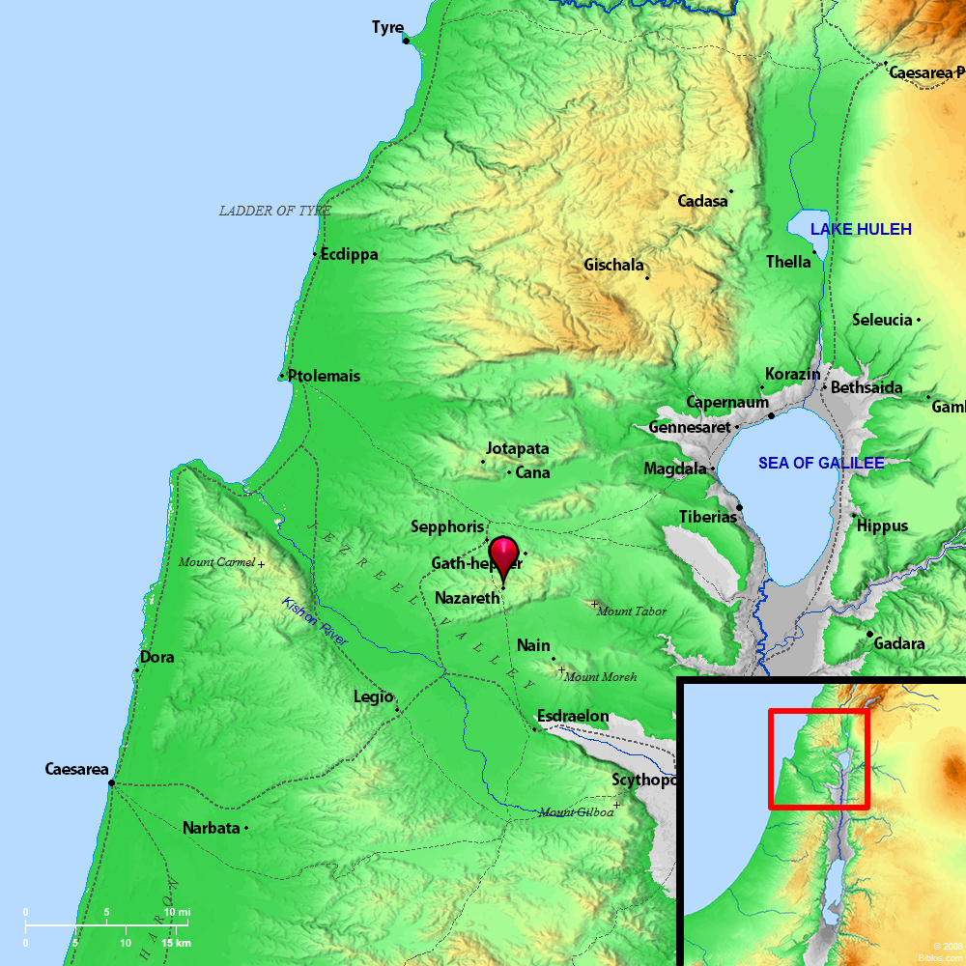
Geography
Gath-hepher

Slide 121
Appendix

Slide 122
Major Periods of the Old Testamant

Slide 123
United Kingdom
Divided Kingdom
Return from
Captivity
Captivity
931 BC
721 BC
536 BC
Israel into captivity
Israel
Cyrus’ decree
Saul-David-Solomon
Assyria
Medo-Persia
Babylon
612 BC
Assyria falls
Judah
586 BC
539 BC
Jerusalem falls
Babylon falls
Judah into captivity:
605 BC
Hosea (750-725)
Joel ?
Amos (760-750)
Obadiah ?
Jonah (780)
Micah (735-700)
Isaiah (740-690)
Nahum (635-612)
Habakkuk (612-606)
Zephaniah (630-625)
Jeremiah (627-586)
Daniel (605-534)
Ezekiel 592-570)
Haggai 520)
Zechariah (520-518)
Malachi (445-432)
Prophets?

Slide 124
Divided Kingdom Timeline (930 BC)
 | 930 | 920 | 910 | 900 | 890 | 880 | 870 | 860 | 850 | 840 | 830 | 820 | 810 | 800 | 790 | 780 | 770 | 760 | 750 | 740 | 730 | 720 | 710 | 700 | 690
Israel
Judah
Jeroboam
Baasha
Omri
Ahab
Joram
Jehu
Jehoahaz
Jehoash
Jeroboam II
Jonah
Rehoboam
Asa
Jehoshaphat
Jehoram
Ath.
Joash
Amaziah
Uzziah
Jotham
Ahaz
Hezekiah
Obadiah
Divided Kingdom (931)
Israel is led into captivity (721)

Slide 125
Jonah – 820-804 BC – spoke to the Assyrians
Micah – 749-722 BC – spoke to the northern kingdom
722 BC – Northern Kingdom of Israel destroyed by the Assyrians
605, 597, 586 BC – Jerusalem is attacked in three waves and ultimately destroyed by the Babylonians
Obadiah – 585 BC – spoke to the Edomites
539 BC – Babylon is conquered by Cyrus, Jews allowed to return to Jerusalem
931 BC – The kingdom divides after the death of Solomon
721 BC – Israel is led into captivity
605 BC – Judah into captivity

Slide 126
Jonah Chapter 2
JONAH’S PRAYER INSIDE THE FISH

Slide 127
Seven Episodes of Jonah
The story of Jonah can be viewed of as seven distinct “episodes”
(1) Jonah’s commissioning and flight (1:1-3)
What will happen to Jonah?
(2) Jonah and the pagan sailors (1:4-16)
How responsive are the pagal sailors?
Today’s Lesson
(3) Jonah’s grateful prayer (1:17-2:10)
How does Jonah respond to God’s grace towards him?
(4) Jonah’s recommissioning and compliance (3:1-3a)
What will happen to the Ninevites?
(5) Jonah and the pagan Ninevites (3:3b-10)
How responsive are the pagan Ninevites?
(6) Jonah’s angry prayer (4:1-4)
How does Jonah respond to God’s grace towards others?
(7) Jonah’s lesson about compassion (4:5-11)
“Should not I pity Nineveh…?”

Slide 128
Jonah Chapter 2:1-10
JONAH’S PRAYER (1) Then Jonah prayed to the LORD his God from the belly of the fish, (2) saying, “I called out to the LORD, out of my distress, and he answered me; out of the belly of Sheol I cried, and you heard my voice. (3) For you cast me into the deep, into the heart of the seas, and the flood surrounded me; all your waves and your billows passed over me. (4) Then I said, ‘I am driven away from your sight; yet I shall again look upon your holy temple.’ (5) The waters closed in over me to take my life; the deep surrounded me; weeds were wrapped about my head | (6) at the roots of the mountains. I went down to the land whose bars closed upon me forever; yet you brought up my life from the pit, O LORD my God. (7) When my life was fainting away, I remembered the LORD, and my prayer came to you, into your holy temple. (8) Those who pay regard to vain idols forsake their hope of steadfast love. (9) But I with the voice of thanksgiving will sacrifice to you; what I have vowed I will pay. Salvation belongs to the LORD!” (10) And the LORD spoke to the fish, and it vomited Jonah out upon the dry land.

Slide 129
Themes within Jonah
While there are many lessons in Jonah, here are three key themes throughout the book
Book of Jonah
God’s Mercy and Love Extend Universally to All
God Expects Obedience and Repentance
God’s is Sovereign over all nations and earth’s creation

Slide 130
Themes within Jonah
While there are many lessons in Jonah, here are three key themes throughout the book
Themes within Jonah Chapter 2
God’s Mercy and Love Extend Universally to All
Despite Jonah fleeing from his duty, God is willing to forgive Jonah and let him have a second try; God listens to Jonah as he prays
(Jon 2:2) saying, “I called out to the LORD, out of my distress, and he answered me; out of the belly of Sheol I cried, and you heard my voice.

Slide 131
Themes within Jonah
While there are many lessons in Jonah, here are three key themes throughout the book
Themes within Jonah Chapter 2
God Expects Obedience and Repentance
God throws Jonah into the sea as a consequence to his sin, but God is ultimately seeking to drive Jonah to repentance because God chastens those who he loves
(Jon 2:3) For you cast me into the deep, into the heart of the seas, and the flood surrounded me; all your waves and your billows passed over me.
The Lord does not allow for man to mix idolatry with devotion to God
(Jon 2:8) Those who pay regard to vain idols forsake their hope of steadfast love.

Slide 132
Themes within Jonah
While there are many lessons in Jonah, here are three key themes throughout the book
Themes within Jonah Chapter 2
God’s is Sovereign over all nations and earth’s creation
God has power over all of earth’s creation and commands not only the fish to swallow Jonah, but also for the fish to spit him onto the land
(Jon 2:10) And the LORD spoke to the fish, and it vomited Jonah out upon the dry land.

Slide 133
Jonah Cries from the Belly of She’ol
What did Jonah mean when he said he cried out from Sheol?
Jon 2:1-2
(1) Then Jonah prayed to the LORD his God from the belly of the fish, (2) saying, “I called out to the LORD, out of my distress, and he answered me; out of the belly of Sheol I cried, and you heard my voice.
The Lord saved Jonah from a dark place both physically and
spiritually when he was near death
It was a word that indicated a serious engagement with the reality of death, mortality, and the way one’s life impacted one’s destiny
It is often visualized as beneath the earth, similar to a grave (Amo 9:2)
The word Sheol was primarily used in poetic contexts (e.g. Pslams, prophecy, wisdom) and translations of Sheol include the grave or the pit
Sheol is the place of the dead, and it is a word often associated with the death of the unrighteous, unfaithful, immoral, and ungodly (Ps. 49:14), (Prov. 5:5), (Isa. 5:14)
In Sheol there is no praise of Yahweh (Pss. 6:5; 115:17) indicating that it is not the abode of the righteous. It is a place of pain and distress (Ps. 116:3), of weakness (Isa. 14:10), helplessness (Ps. 88:4), hopelessness (Isa. 38:10), and destruction (Isa. 38:17).

Slide 134
The Power of God Presented
Power of God | Verses
God’s omnipotence by his acts of creation
God’s control over the forces of nature
God’s supremacy over the nations
God’s omnipresence is implied
God’s omniscience is indicated
He knows the thoughts of men

Slide 135
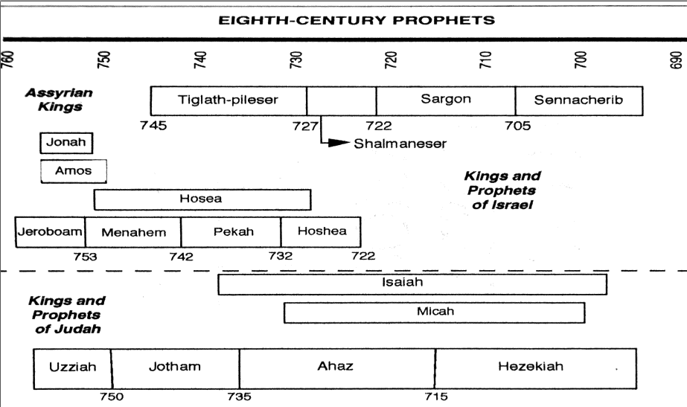

Slide 136
Old Testament Timeline

Slide 137
Key Passages
…
…

