Slide 1
Jeremiah – 40 years of prophecy
Lesson 4: Consequences of rejecting god’s covenant

Slide 2
Class Objectives
Give examples of how God moves in the Nations and in Time to accomplish His will
See Jeremiah as a real person in history, and how God developed his faith
See how idolatry betrays our relationship with God
See God’s mercy displayed, even in judgement
Lesson 4: Consequences of Rejecting God’s Covenant

Slide 3
Outline of Jeremiah
Part I: Chapter 1
Part II: Chapter 2-20
Part III: Chapters 21-39
Part IV: Chapters 40-45
Part V: Chapters 46-51
Historical Appendix: Chapter 52
Jeremiah’s call
Speeches and Prophecies during rule of Josiah
Prophecies of Specific Events during rule of Jehoiakim & Zedekiah
Judah After the Fall of Jerusalem
The Lord’s Word Against Foreign Nations
The Fall of Jerusalem
Lesson 4: Consequences of Rejecting God’s Covenant
Notes:
Part I: Chapter 1 Jeremiah’s call
Part II: Chapter 2-20 Speeches and Prophecies Concerning Judah & Jerusalem Primarily During the Time of Josiah, (641-610 B.C.)
Part III: Chapters 21-39 Prophecies of Specific Events during the Time of
Jehoiakim (608-597) and Zedekiah, (597-586),
1: Woe to Zedekiah, Chs. 21-24
2: In the Fourth Year of Jehoiakim, Chs. 25-26
3: In the Fourth Year of Zedekiah, Chs. 27-29
4: The Book of God’s Consolation, Chs. 30-33
5: Under the Reign of Zedekiah, Ch. 34
6: Under the Reign of Jehoiakim, Chs. 35-36
7: Under Zedekiah, Chs. 37-39
Part IV: Chapters 40-45 Jeremiah’s Ministry to Judah After the Fall of
Jerusalem,
Part V: Chapters 46-51 The Lord’s Word Against Foreign Nations,
Historical Appendix: Chapter 52 The Fall of Jerusalem

Slide 4
Dating of Jeremiah’s Prophecies
645
KINGS
Of
JUDAH
640
EVENTS
635
Josiah begins reforms
630
1-6
Josiah purges idolatry
625
Jeremiah Called
JOSIAH
11-13
Book of Law found
620
18-20
615
22:1-23
Nineveh falls
JEHOAHAZ
610
25
26
35
36:1-8
45:1-49:33
7-10
36:9-32
First Deportation, Daniel & Ezekiel taken
JEHOIAKIM
605
JEHOIACHIN
600
14-17
23-24
29-31
49:34-39
595
Second Deportation
ZEDEKIAH
22:24-30
50-51
590
21
27-28
GEDALIAH
585
32-34
37
38-44
Destruction of Jerusalem, Final Deportation
580
575
570
565
52
560
Jehoiachin released & fed at kings table

Slide 5
Sermon’s/Speeches of Jeremiah
Where is the Lord? Judah forsakes God (Jer. 2:1 – 3:5)
Return to Me! Without Repentance there is no Salvation (Jer. 3:6 – 6:30)
The Temple of the Lord! Be not deceived with False Religion (Jer. 7-10)
Cursed is the Man! The Broken Covenant (Jer. 11-13)
Lesson 4: Consequences of Rejecting God’s Covenant

Slide 6
A summary of Jeremiah…
Jeremiah’s Call… Chapter 1
Jeremiah’s Confusion… Chapter 4,5
Jeremiah’s Cry… Chapter 8,9
Jeremiah’s Compassion… Chapter 10
Jeremiah’s Consent… Chapter 11:5
Jeremiah’s Crisis… Chapter 11:18f
Jeremiah’s Complaint… Chapter 12
Lesson 4: Consequences of rejecting God’s Covenant

Slide 7
The Covenant sermon… chapter 11
Jer 11:1-5 The word that came to Jeremiah from the LORD, saying, ² "Hear the words of this covenant, and speak to the men of Judah and to the inhabitants of Jerusalem; ³ and say to them, 'Thus says the LORD God of Israel: "Cursed is the man who does not obey the words of this covenant ⁴ which I commanded your fathers in the day I brought them out of the land of Egypt, from the iron furnace, saying, 'Obey My voice, and do according to all that I command you; so shall you be My people, and I will be your God,' ⁵ that I may establish the oath which I have sworn to your fathers, to give them 'a land flowing with milk and honey,' as it is this day." ' " And I answered and said, "So be it, LORD."
2Ch 34:8 In the eighteenth year of his reign, when he had purged the land and the temple
2Ch 34:15 Then Hilkiah answered and said to Shaphan the scribe, "I have found the Book of the Law in the house of the LORD
2Ch 34:18,19 Then Shaphan the scribe told the king, saying, "Hilkiah the priest has given me a book." And Shaphan read it before the king. Thus it happened, when the king heard the words of the Law, that he tore his clothes.
Lesson 4: Consequences of Rejecting God’s Covenant

Slide 8
The Covenant sermon… chapter 11
Why did Josiah tear his clothes at the hearing of the Book of the Law?
Exo 20:1-6 And God spoke all these words, saying:
"I am the LORD your God, who brought you out of the land of Egypt, out of the house of bondage.
"You shall have no other gods before Me.
"You shall not make for yourself a carved image—any likeness of anything that is in heaven above, or that is in the earth beneath, or that is in the water under the earth;
you shall not bow down to them nor serve them. For I, the LORD your God, am a jealous God, visiting the iniquity of the fathers upon the children to the third and fourth generations of those who hate Me,
but showing mercy to thousands, to those who love Me and keep My commandments.
Jer 11:6-15 Then the LORD said to me, "Proclaim all these words in the cities of Judah and in the streets of Jerusalem, saying: 'Hear the words of this covenant and do them:
Vs.8 Yet they did not obey or incline their ear, but everyone followed the dictates of his evil heart; therefore I will bring upon them all the words of this covenant, which I commanded them to do, but which they have not done.' "
Vs.7 For I earnestly exhorted your fathers in the day I brought them up out of the land of Egypt, until this day, rising early and exhorting, saying, "Obey My voice."
Lesson 4: Consequences of Rejecting God’s Covenant

Slide 9
The Covenant sermon… chapter 11
Why did Josiah tear his clothes at the hearing of the Book of the Law?
A conspiracy has been found among the men of Judah and among the inhabitants of Jerusalem
Vs.10 They have turned back to the iniquities of their forefathers who refused to hear My words, and they have gone after other gods to serve them; the house of Israel and the house of Judah have broken My covenant which I made with their fathers."
Vs.13 For according to the number of your cities were your gods, O Judah; and according to the number of the streets of Jerusalem you have set up altars to that shameful thing, altars to burn incense to Baal.
Vs.14 "So do not pray for this people, or lift up a cry or prayer for them; for I will not hear them in the time that they cry out to Me because of their trouble.
Lesson 4: Consequences of Rejecting God’s Covenant

Slide 10
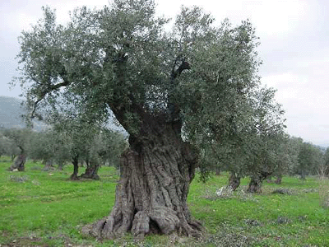
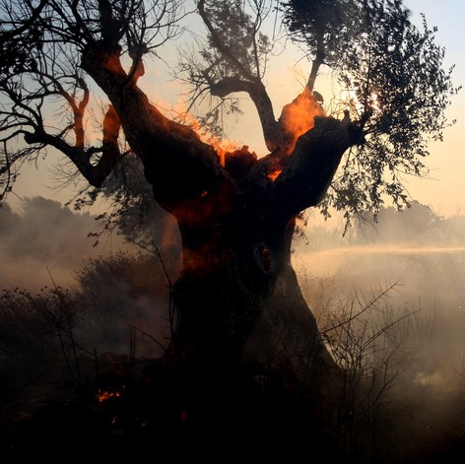
The Covenant sermon… chapter 11
Why did Josiah tear his clothes at the hearing of the Book of the Law?
Jer 11:16 The LORD called your name, Green Olive Tree, Lovely and of Good Fruit. With the noise of a great tumult He has kindled fire on it, And its branches are broken.
Jer 11:15 "What has My beloved to do in My house, Having done lewd deeds with many? And the holy flesh has passed from you. When you do evil, then you rejoice.
Lesson 4: Consequences of Rejecting God’s Covenant

Slide 11
The Covenant sermon… chapter 11
Threads of Jeremiah
Jer 11:1-5 The word that came to Jeremiah from the LORD, saying, ² "Hear the words of this covenant, and speak to the men of Judah and to the inhabitants of Jerusalem; ³ and say to them, 'Thus says the LORD God of Israel: "Cursed is the man who does not obey the words of this covenant ⁴ which I commanded your fathers in the day I brought them out of the land of Egypt, from the iron furnace, saying, 'Obey My voice, and do according to all that I command you; so shall you be My people, and I will be your God,' ⁵ that I may establish the oath which I have sworn to your fathers, to give them 'a land flowing with milk and honey,' as it is this day." ' " And I answered and said, "So be it, LORD."
“Covenant”
Jer_11:6 …"Proclaim all these words in the cities of Judah and in the streets of Jerusalem, saying: 'Hear the words of this covenant and do them.
Jer_22:9 Then they will answer, 'Because they have forsaken the covenant of the LORD their God, and worshiped other gods and served them.' "
Jer_31:31 "Behold, the days are coming, says the LORD, when I will make a new covenant with the house of Israel and with the house of Judah—
Jer_50:5 They shall ask the way to Zion, With their faces toward it, saying, 'Come and let us join ourselves to the LORD In a perpetual covenant That will not be forgotten.'
Lesson 4: Consequences of Rejecting God’s Covenant

Slide 12
The Covenant sermon… chapter 11
Threads of Jeremiah
Jer 11:1-5 The word that came to Jeremiah from the LORD, saying, ² "Hear the words of this covenant, and speak to the men of Judah and to the inhabitants of Jerusalem; ³ and say to them, 'Thus says the LORD God of Israel: "Cursed is the man who does not obey the words of this covenant ⁴ which I commanded your fathers in the day I brought them out of the land of Egypt, from the iron furnace, saying, 'Obey My voice, and do according to all that I command you; so shall you be My people, and I will be your God,' ⁵ that I may establish the oath which I have sworn to your fathers, to give them 'a land flowing with milk and honey,' as it is this day." ' " And I answered and said, "So be it, LORD."
“Obedience”
What was God’s intention for their obedience?
7:23 But this is what I commanded them, saying, 'Obey My voice, and I will be your God, and you shall be My people.
11:7 For I earnestly exhorted your fathers in the day I brought them up out of the land of Egypt, until this day, rising early and exhorting, saying, "Obey My voice."
26:13 Now therefore, amend your ways and your doings, and obey the voice of the LORD your God
38:20 But Jeremiah said, "They shall not deliver you. Please, obey the voice of the LORD which I speak to you. So it shall be well with you
Lesson 4: Consequences of Rejecting God’s Covenant

Slide 13
The Covenant sermon… chapter 11
Threads of Jeremiah
Jer 11:1-5 The word that came to Jeremiah from the LORD, saying, ² "Hear the words of this covenant, and speak to the men of Judah and to the inhabitants of Jerusalem; ³ and say to them, 'Thus says the LORD God of Israel: "Cursed is the man who does not obey the words of this covenant ⁴ which I commanded your fathers in the day I brought them out of the land of Egypt, from the iron furnace, saying, 'Obey My voice, and do according to all that I command you; so shall you be My people, and I will be your God,' ⁵ that I may establish the oath which I have sworn to your fathers, to give them 'a land flowing with milk and honey,' as it is this day." ' " And I answered and said, "So be it, LORD."
“Obedience”
What was God’s intention for their obedience?
7:23 But this is what I commanded them, saying, 'Obey My voice, and I will be your God, and you shall be My people.
11:7 For I earnestly exhorted your fathers in the day I brought them up out of the land of Egypt, until this day, rising early and exhorting, saying, "Obey My voice."
26:13 Now therefore, amend your ways and your doings, and obey the voice of the LORD your God
38:20 But Jeremiah said, "They shall not deliver you. Please, obey the voice of the LORD which I speak to you. So it shall be well with you
Lesson 4: Consequences of Rejecting God’s Covenant

Slide 14
The Covenant sermon… chapter 11
Threads of Jeremiah
Jer 11:1-5 The word that came to Jeremiah from the LORD, saying, ² "Hear the words of this covenant, and speak to the men of Judah and to the inhabitants of Jerusalem; ³ and say to them, 'Thus says the LORD God of Israel: "Cursed is the man who does not obey the words of this covenant ⁴ which I commanded your fathers in the day I brought them out of the land of Egypt, from the iron furnace, saying, 'Obey My voice, and do according to all that I command you; so shall you be My people, and I will be your God,' ⁵ that I may establish the oath which I have sworn to your fathers, to give them 'a land flowing with milk and honey,' as it is this day." ' " And I answered and said, "So be it, LORD."
“God’s Sovereignty in Salvation”
2:6 Neither did they say, 'Where is the LORD, Who brought us up out of the land of Egypt
7:22 For I did not speak to your fathers, or command them in the day that I brought them out of the land of Egypt, concerning burnt offerings or sacrifices.
7:25 Since the day that your fathers came out of the land of Egypt until this day, I have even sent to you all My servants the prophets, daily rising up early and sending them
34:13 "Thus says the LORD, the God of Israel: 'I made a covenant with your fathers in the day that I brought them out of the land of Egypt, out of the house of bondage, saying,
Lesson 4: Consequences of Rejecting God’s Covenant

Slide 15
A snapshot of Jeremiah…
Jeremiah’s Consent…
Jer. 11:5 that I may establish the oath which I have sworn to your fathers, to give them 'a land flowing with milk and honey,' as it is this day." ' " And I answered and said, "So be it, LORD."
Lesson 4: Consequences of rejecting God’s Covenant

Slide 16
A snapshot of Jeremiah…
Jeremiah’s Crisis…
Jer 11:18-20 Now the LORD gave me knowledge of it, and I know it; for You showed me their doings. ¹⁹ But I was like a docile lamb brought to the slaughter; and I did not know that they had devised schemes against me, saying, "Let us destroy the tree with its fruit, and let us cut him off from the land of the living, that his name may be remembered no more." ²⁰ But, O LORD of hosts, You who judge righteously, Testing the mind and the heart, Let me see Your vengeance on them, For to You I have revealed my cause.
Lesson 4: Consequences of rejecting God’s Covenant

Slide 17
A snapshot of Jeremiah…
Jeremiah’s Crisis…
The Lord’s Answer…
Jer 11:21-23 "Therefore thus says the LORD concerning the men of Anathoth who seek your life, saying, 'Do not prophesy in the name of the LORD, lest you die by our hand'— ²² therefore thus says the LORD of hosts: 'Behold, I will punish them:
The young men shall die by the sword
their sons and their daughters shall die by famine
there shall be no remnant of them
I will bring catastrophe on the men of Anathoth
Lesson 4: Consequences of rejecting God’s Covenant

Slide 18
A snapshot of Jeremiah…
Jeremiah’s Complaint…
Jer 12:1-4 Righteous are You, O LORD, when I plead with You; Yet let me talk with You about Your judgments. Why does the way of the wicked prosper? Why are those happy who deal so treacherously? ² You have planted them, yes, they have taken root; They grow, yes, they bear fruit. You are near in their mouth But far from their mind. ³ But You, O LORD, know me; You have seen me, And You have tested my heart toward You. Pull them out like sheep for the slaughter, And prepare them for the day of slaughter. ⁴ How long will the land mourn, And the herbs of every field wither? The beasts and birds are consumed, For the wickedness of those who dwell there, Because they said, "He will not see our final end."
Lesson 4: Consequences of rejecting God’s Covenant

Slide 19
A snapshot of Jeremiah…
Jeremiah’s Complaint…
Jeremiah’s praise:
Righteous are You, O LORD, when I plead with You; Yet let me talk with You about Your judgments.
Jeremiah’s problem:
Why does the way of the wicked prosper? Why are those happy who deal so treacherously?
You have planted them, yes, they have taken root; They grow, yes, they bear fruit. You are near in their mouth But far from their mind.
But You, O LORD, know me; You have seen me, And You have tested my heart toward You.
Lesson 4: Consequences of rejecting God’s Covenant

Slide 20
A snapshot of Jeremiah…
Jeremiah’s Complaint…
Prayer of Imprecation
Jeremiah’s petition:
Pull them out like sheep for the slaughter, And prepare them for the day of slaughter.
How long will the land mourn, And the herbs of every field wither?
The beasts and birds are consumed, For the wickedness of those who dwell there
Because they said, "He will not see our final end."
“You have seen me…”
Opposite of Jeremiah’s claim
God is not all Sovereign
Lesson 4: Consequences of rejecting God’s Covenant

Slide 21
A snapshot of Jeremiah…
Jeremiah’s Complaint…
The Lord’s Answer…
Jer 12:5 "If you have run with the footmen, and they have wearied you, Then how can you contend with horses? And if in the land of peace, In which you trusted, they wearied you, Then how will you do in the floodplain of the Jordan?
Jer 12:6 For even your brothers, the house of your father, Even they have dealt treacherously with you; Yes, they have called a multitude after you. Do not believe them, Even though they speak smooth words to you.
God sees everything!!!
Lesson 4: Consequences of rejecting God’s Covenant

Slide 22
A snapshot of Jeremiah…
Jeremiah’s Complaint…
The Lord’s Answer…
Vs. 7 "I have forsaken My house, I have left My heritage; I have given the dearly beloved of My soul into the hand of her enemies.
Vs. 8 My heritage is to Me like a lion in the forest; It cries out against Me; Therefore I have hated it.
Vs. 9 My heritage is to Me like a speckled vulture; The vultures all around are against her…
Vs. 10 "Many rulers have destroyed My vineyard, They have trodden My portion underfoot; They have made My pleasant portion a desolate wilderness.
Vs.11 They have made it desolate; Desolate, it mourns to Me; The whole land is made desolate, because no one takes it to heart.
Vs. 12 …For the sword of the LORD shall devour from one end of the land to the other end of the land
Vs. 13 They have sown wheat but reaped thorns… But be ashamed of your harvest Because of the fierce anger of the LORD."
Lesson 4: Consequences of rejecting God’s Covenant

Slide 23
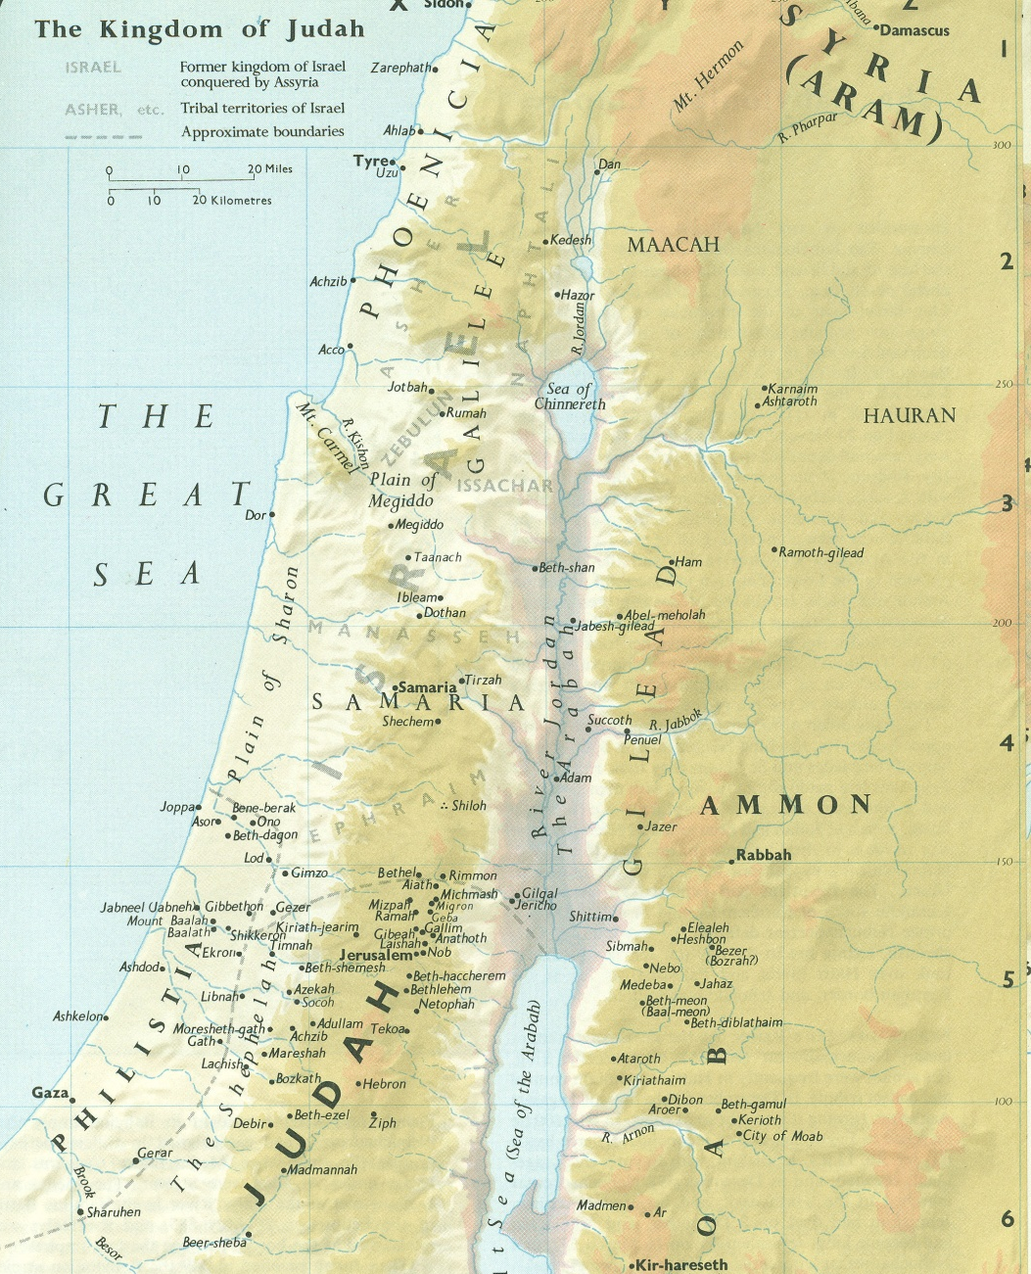
Symbol of the Linen Cloth
Jer 13:4 "Take the loincloth that you have bought, which is around your waist, and arise, go to the Euphrates and hide it there in a cleft of the rock."
Jer 13:5 So I went and hid it by the Euphrates, as the LORD commanded me.
Jer 13:6 And after many days the LORD said to me, "Arise, go to the Euphrates, and take from there the loincloth that I commanded you to hide there."
About 700 mile round trip
Jer 13:7 Then I went to the Euphrates and dug, and I took the sash from the place where I had hidden it; and there was the sash, ruined. It was profitable for nothing.
Lesson 4: Consequences of Rejecting God’s Covenant

Slide 24
Symbol of the Linen Cloth
Why this symbolic lesson?
Vs.9 I will ruin the pride of Judah and the great pride of Jerusalem.
Vs.10 …who refuse to hear My words, who follow the dictates of their hearts, and walk after other gods to serve them and worship them, shall be just like this sash which is profitable for nothing.
Vs.11 For as the sash clings to the waist of a man, so I have caused the whole house of Israel and the whole house of Judah to cling to Me,' says the LORD, 'that they may become My people, for renown, for praise, and for glory; but they would not hear.'
About 700 mile round trip
Humility or Humiliation
Lesson 4: Consequences of Rejecting God’s Covenant

Slide 25
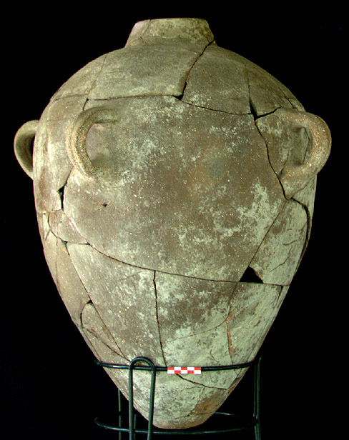
Symbol of jars of wine
Jer 13:12 "Therefore you shall speak to them this word: 'Thus says the LORD God of Israel: "Every bottle shall be filled with wine." ' "And they will say to you, 'Do we not certainly know that every bottle will be filled with wine?'
Jer 13:13 "Then you shall say to them, 'Thus says the LORD: "Behold, I will fill all the inhabitants of this land—even the kings who sit on David's throne, the priests, the prophets, and all the inhabitants of Jerusalem—with drunkenness!
Jer 13:14 And I will dash them one against another, even the fathers and the sons together," says the LORD. "I will not pity nor spare nor have mercy, but will destroy them." ' "
Lesson 4: Consequences of Rejecting God’s Covenant

Slide 26
The state of humiliation - chapter 13
Filled with the drunkenness of God’s wrath! 12-14
Stumbling in Darkness 15-17
15 Hear and give ear: Do not be proud, For the LORD has spoken.
16 Give glory to the LORD your God before He causes darkness, And before your feet stumble
The Throne will Cease! 18-19
18 Say to the king and to the queen mother, "Humble yourselves; Sit down, For your rule shall collapse, the crown of your glory."
The Violence of Prostitution 20-27
22 And if you say in your heart, "Why have these things come upon me?" For the greatness of your iniquity Your skirts have been uncovered, Your heels made bare.
26 Therefore I will uncover your skirts over your face, That your shame may appear.
27 I have seen your adulteries And your lustful neighings, The lewdness of your harlotry, Your abominations on the hills in the fields. Woe to you, O Jerusalem! Will you still not be made clean?"

Slide 27
Thank you

