Slide 1
Patience Special Classes, Sunday Evening July 29
Patience When Enduring
Patience In Our Relationships
Patience When Hoping
When hardships come and seem to stay much longer than welcome, our patience is tested. This class will study what the Bible teaches about long-suffering, to help students who feel overwhelmed or hurt.
When patience is required, it is often because we are disappointed with the choices or actions of someone around us. This class will study what the Bible teaches about extending patience to those we love and those who may be pushing our buttons! It will help students who want to respond with greater patience to the people in their lives.
When it seems good things are on the horizon, but they just can't get here soon enough, our patience is tested. This class will study what the Bible teaches about working and waiting with contentment to help students who feel like they are stuck spinning their wheels.

Slide 2
Is there a good thing that you are hoping for and you’re struggling to accept the timing?
PRE-CLASS QUESTION

Slide 3
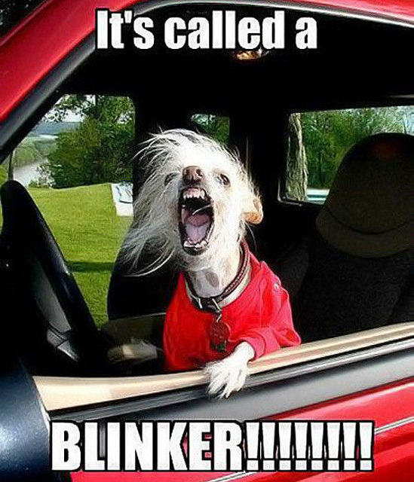
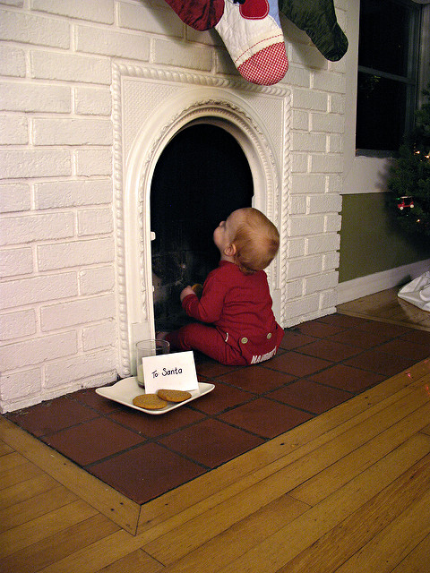

Slide 4
“4 Tips to Help You Be a More Patient Person”, Inc.com, Rhett Power, 10/24/2017 “5 Tricks To Becoming a More Patient Person”, Huffpost.com, Lindsay Holmes, 9/19/2014 “Those Who Make It As Writers Tend To Have One Big Thing In Common: Patience”, laurensapela.com
Wisdom of the World
“Think about it for a minute. We all want instant gratification and want things without waiting … I think that has lead to a life where we have very little patience. Maybe it is time we slow down and practice a little patience. Here are four ways to be the patient person you never thought you could be.” (Inc. article)
Make Yourself Wait
Relax and Take Deep Breaths
Embrace the Uncomfortable (“Creative Adaptability”)
Colossians 2:20-23
1 Timothy 4:8, 6:6
Just addresses symptoms; doesn’t address the root issue…
What is the root issue?

Slide 5
“In the morning sow your seed, and in the evening do not withhold your hand; For you do not know which will prosper, either this or that, or whether both alike will be good.” (Ecclesiastes 11:6)
YOU DON’T HAVE control

Slide 6
“Be anxious for nothing, but in everything by prayer and supplication, with thanksgiving, let your requests be made known to God; and the peace of God, which surpasses all understanding, will guard your hearts and minds through Christ Jesus.”
(Philippians 4:6-7)
“Wait on the LORD;
Be of good courage,
and He shall strengthen your heart;
Wait, I say, on the LORD!”
(Psalm 27:14)

Slide 7
But you knew that already.
SO WHAT IS IT THEN ABOUT THIS SOLUTION THAT WE STRUGGLE WITH?

Slide 8
What’s the struggle?
The promises to Abraham (Genesis 12ff)
Is it not obvious that He means it? (15:2-6)
Do you assume you need to take a suboptimal approach? (16:1-5)
Do you question whether He can really do it? (17:17-18; 18:11-14)
Are you not sure He is really on your side? (22:1ff; 29-30, 37&39)
Are you afraid he’ll not give you what you really wanted? (23:1)
Are you really walking with Him in the first place? (24:1-14, 21, 26-27)
What is your orientation to this earthly life? (Hebrews 11:13-16)

Slide 9
“Be anxious for nothing, but in everything by prayer and supplication, with thanksgiving, let your requests be made known to God; and the peace of God, which surpasses all understanding, will guard your hearts and minds through Christ Jesus.”
(Philippians 4:6-7)
“Wait on the LORD;
Be of good courage,
and He shall strengthen your heart;
Wait, I say, on the LORD!”
(Psalm 27:14)

Slide 10
“Be anxious for nothing, but in everything by prayer and supplication, with thanksgiving, let your requests be made known to God; and the peace of God, which surpasses all understanding, will guard your hearts and minds through Christ Jesus.”
(Philippians 4:6-7)
“Wait on the LORD;
Be of good courage,
and He shall strengthen your heart;
Wait, I say, on the LORD!”
(Psalm 27:14)

Slide 11
“Be anxious for nothing, but in everything by prayer and supplication, with thanksgiving, let your requests be made known to God; and the peace of God, which surpasses all understanding, will guard your hearts and minds through Christ Jesus.”
(Philippians 4:6-7)
“Wait on the LORD;
Be of good courage,
and He shall strengthen your heart;
Wait, I say, on the LORD!”
(Psalm 27:14)

Slide 12
“Be anxious for nothing, but in everything by prayer and supplication, with thanksgiving, let your requests be made known to God; and the peace of God, which surpasses all understanding, will guard your hearts and minds through Christ Jesus.”
(Philippians 4:6-7)
“Wait on the LORD;
Be of good courage,
and He shall strengthen your heart;
Wait, I say, on the LORD!”
(Psalm 27:14)

Slide 13
“Be anxious for nothing, but in everything by prayer and supplication, with thanksgiving, let your requests be made known to God; and the peace of God, which surpasses all understanding, will guard your hearts and minds through Christ Jesus.”
(Philippians 4:6-7)
“Wait on the LORD;
Be of good courage,
and He shall strengthen your heart;
Wait, I say, on the LORD!”
(Psalm 27:14)

Slide 14
Is your focus on the future causing you to miss the present?
Patience in hoping

