Slide 1
Jeremiah – 40 years of prophecy
Lesson 11: After the Fall

Slide 2
Class Objectives
Give examples of how God moves in the Nations and in Time to accomplish His will
See Jeremiah as a real person in history, and how God developed his faith
See how idolatry betrays our relationship with God
See God’s mercy displayed, even in judgement

Slide 3
Outline of Jeremiah
Part I: Chapter 1
Part II: Chapter 2-20
Part III: Chapters 21-39
Part IV: Chapters 40-45
Part V: Chapters 46-51
Historical Appendix: Chapter 52
Jeremiah’s call
Speeches and Prophecies during rule of Josiah
Prophecies of Specific Events during rule of Jehoiakim & Zedekiah
Judah After the Fall of Jerusalem
The Lord’s Word Against Foreign Nations
The Fall of Jerusalem
Notes:
Part I: Chapter 1 Jeremiah’s call
Part II: Chapter 2-20 Speeches and Prophecies Concerning Judah & Jerusalem Primarily During the Time of Josiah, (641-610 B.C.)
Part III: Chapters 21-39 Prophecies of Specific Events during the Time of
Jehoiakim (608-597) and Zedekiah, (597-586),
1: Woe to Zedekiah, Chs. 21-24
2: In the Fourth Year of Jehoiakim, Chs. 25-26
3: In the Fourth Year of Zedekiah, Chs. 27-29
4: The Book of God’s Consolation, Chs. 30-33
5: Under the Reign of Zedekiah, Ch. 34
6: Under the Reign of Jehoiakim, Chs. 35-36
7: Under Zedekiah, Chs. 37-39
Part IV: Chapters 40-45 Jeremiah’s Ministry to Judah After the Fall of
Jerusalem,
Part V: Chapters 46-51 The Lord’s Word Against Foreign Nations,
Historical Appendix: Chapter 52 The Fall of Jerusalem

Slide 4
Dating of Jeremiah’s Prophecies
645
KINGS
Of
JUDAH
640
EVENTS
635
Josiah begins reforms
630
1-6
Josiah purges idolatry
625
Jeremiah Called
JOSIAH
11-13
Book of Law found
620
18-20
615
7-10
22:1-23
Nineveh falls
JEHOAHAZ
610
25
26
35
36:1-8
45:1-49:33
605
36:9-32
First Deportation, Daniel & Ezekiel taken
JEHOIAKIM
JEHOIACHIN
600
14-17
23-24
29-31
49:34-39
595
Second Deportation
ZEDEKIAH
22:24-30
50-51
590
21
27-28
GEDALIAH
585
32-34
37
38-44
Destruction of Jerusalem, Final Deportation
580
575
570
565
52
560
Jehoiachin released & fed at kings table

Slide 5
Prophets in Judah
Prophets
Daniel
606 to 536 BC
Habakkuk
Ezekiel
Jeremiah
Captives
Captives
592 to 570 BC
627
-
586
Zephaniah
Nahum
st
nd
1
2
Judah Falls
630
620
610
600
590
580
Josiah
Jehoiakim
Zedekiah
After the Fall of Israel
Jehoahaz
Jehoiachin
Kings

Slide 6
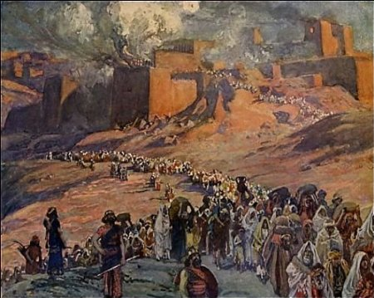
After the Fall – Jeremiah and Gedaliah
Jeremiah leaves Jerusalem (40:1-6)
Bound with chains with the captives, Released by Nebuzaradan at Ramah
Nebuzaradan recognized this doom was from the Lord God, because of sin
Jeremiah allowed to go to Babylon or wherever he chooses
Recommended to go to Gedeliah (son of Ahikim, son of Shaphan)
Gave him food and a gift and let him go
Gedaliah is Named Governor by Nebuchadnezzar (40:7-12)
Captains of the armies came to him at Mizpah
He swore to serve them and represent them to the King of Babylon
Commanded them to gather wine, oil, and summer fruits and live in the cities
Jews returned from the surrounding lands when they heard the news

Slide 7
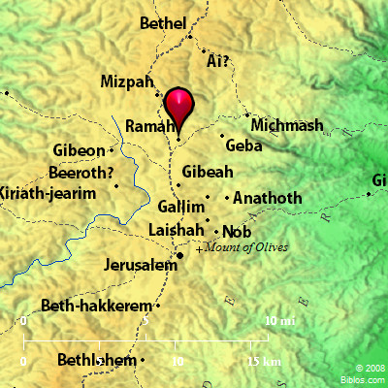
Assassination of Gedaliah
The Plot Uncovered (40:13-16)
Ishmael sent by King of Ammon to kill Gedaliah
Ishmael was a Captain of the armies and a maybe also a friend
Johanan and the captains warn Gedaliah of Ishmael’s plan
Gedaliah dismisses the warning, rebukes Johanan
The Plot Performed (41:1-18)
Ishmael brings men and betrays Gedaliah during a meal
Kills the Jews with him, some Chaldeans, and even some visiting pilgrims
Captures the rest of the people of Mizpah and flees to Ammon
Pursued by Johanan and the captains of armies
Confronted at Gibeon, Ishmael flees to Ammon
The people are rescued and carried to Bethlehem

Slide 8
Questions
Why do you think Nabuzaradan released Jeremiah? What choice and recommendation did he give?
What might have motivated the Captains to return to Gedaliah?
What was their fear after Gedaliah was killed? Was that fear well founded?
Why did the people go to Bethlehem? Where were they actually planning to go?

Slide 9
What to do next?
The People ask Jeremiah to consult the Lord (42:1-6)
People: “Pray for us to the Lord your God”
Jeremiah: “I will pray to the Lord your God...”
Jeremiah: “I will keep nothing back from you”
People: “… we will obey the voice of the Lord…”
The word of the Lord came after 10 days (42:7)
Jeremiah knew they would not obey it (42:19-22)
“Know certainly that I have admonished you this day”
You are hypocrites in your hearts when you asked me to pray to the Lord
You have not obeyed the voice of the Lord your God or anything which he has sent by me
You shall die by sword, pestilence, and famine

Slide 10
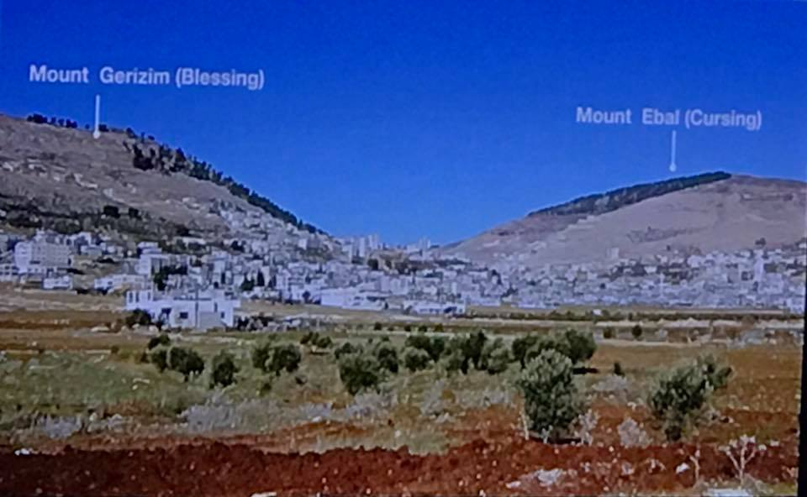
The Response from Jehovah
If you remain in the land (42:9-18)
I will build you up and not pull you down
I will relent concerning the disaster I have brought upon you
Do not be afraid of the king of Babylon, for I will deliver you from his hand
I will show you mercy, and cause you to return to your own land
If you disobey the voice of the Lord, and do not dwell in the land
If you go to Egypt to avoid war or hunger
The sword and the famine you feared will overtake you there, there you shall die
You will die by sword, famine, and pestilence
None of them shall remain or escape the disaster God will bring on them
You shall be an oath, astonishment, curse, and a reproach
You shall see this place no more

Slide 11
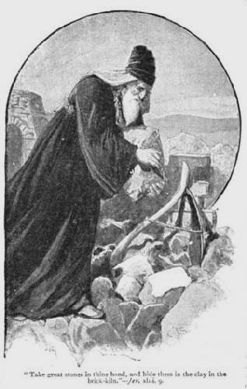
The people respond
Response of the “proud men” of Judah (43:1-7)
“You speak falsely! The Lord God has not sent you”
“Baruch has set you against us”
“You are plotting with the Chaldeans”
Off to Egypt…
Jeremiah’s Symbols of stones (43:8-13)
Placed stones in the Brick Courtyard at Tahpanes
Do this in the sight of the men of Judah
Nebuchadnezzar will set his throne above these stones
He will strike the land of Egypt
He will set fire to the house of the gods of Egypt

Slide 12
Questions
Why did the people ask Jeremiah to seek the Lord? Did they really want direction or confirmation?
Did Jeremiah see their true motives? How do you know?
Do we seek the Lord in similar ways today?
Did the people accept the words of this well-proven Prophet? Would they have reason to doubt him?

Slide 13
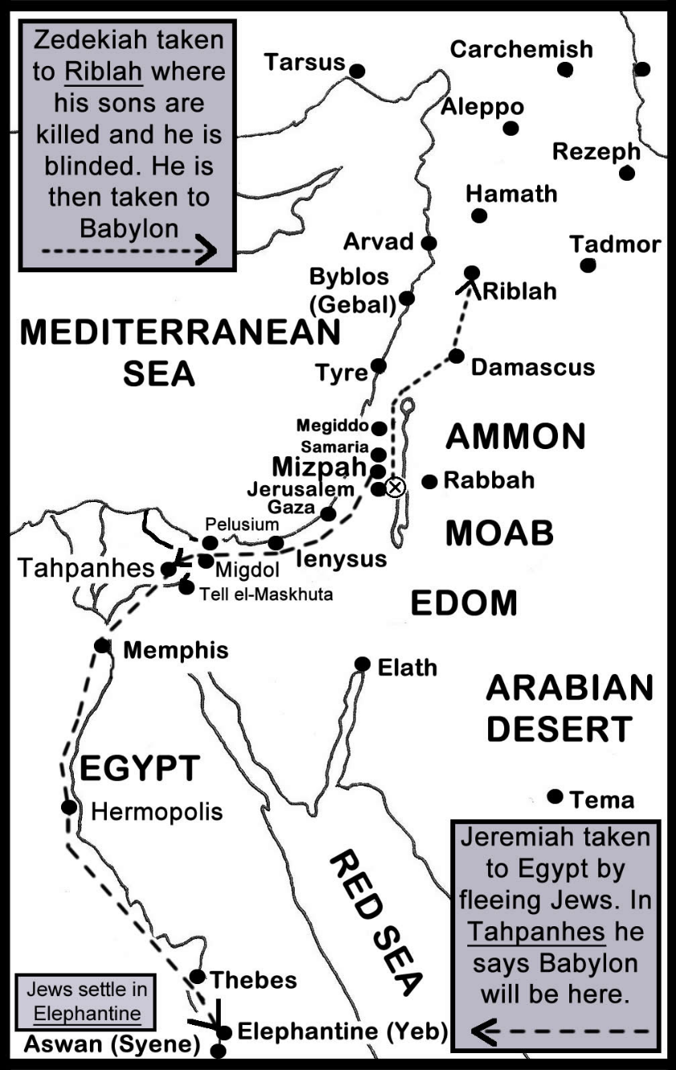
Warning to Jews in Egypt
The charges against them (44:1-14)
You have seen the calamity God brought on Jerusalem and Judah
They burned incense and served other gods
I sent them warnings by the prophets, but they refused
They did not listen, so they were punished
Why do you do this great evil too? Will there be no remnant left?
You will be punished as they were, and shall all die
The people respond (44:15-19)
We will not listen, but will continue to do as we have said
We were blessed when we worshipped idols, and cursed when we stopped
We will continue to serve the idols

Slide 14
Conclusion of the matter
The Judgement of God (44:20-25)
Because you burned incense and worshipped other gods, God’s wrath has come
This is why Jerusalem and Judah are in desolation today
You have spoken with your mouth and fulfilled with your hands
Therefore, (44:26-28)
God’s name will no longer be named in Egypt
God will watch over you for adversity and not for good
All will be consumed by sword and famine except for a small number who escape
A sign (44:29-30)
Pharoah Hophra will be given to his enemies, those who seek his life

Slide 15
To Baruch…
In the fourth year of Jehoiakim (45:1-5)
After he burns the scroll of prophecy
Do not complain about your sorrows
What I have built up shall be pulled down
Do not seek great things in a time of adversity
Yet your life is given as your prize

Slide 16
Questions
What lessons should the Jews in Egypt have been able to see?
What was their reaction to the word of the Lord? Do we see this reaction today?
What was the promise from God in response to this?
Would He still leave a remnant? Where?
What do we see of “good figs” or “bad figs” in this story?

Slide 17
Thank you

