Slide 1
Lesson 10
Jeremiah &
the sons of Josiah

Slide 2
Kings of United & Divided Kingdom
United
Kingdom
Divided Kingdom
Judah Alone
Early Kings – Israel
Dynasty 1&2
Omri
Dynasty 3
Jehu
Dynasty 4
Confusing
Dynasties
Hezekiah
Hezekiah
(728-686)
Manasseh
Amon
1
Jereboam
Nadab
3
Omri
Ahab
(874-853)
Ahaziah
Jehoram
4
Jehu
(841-814)
Jehoahaz
Jehoash
Jereboam II
(793-753)
Zechariah
Shallum
Menahem
Pekaiah
Pekah
Hosea
(732-722)
5
Saul
(1050-1010)
David
(1010-970)
Solomon
(970-930)
2
Baasha
Elah
Josiah &
Sons
Zimri ~ 885
Tibni
Josiah
(640-609)
Jehoahaz
Jehoiakim
Jehoiachin
Zedekiah
(597-586)
Early Kings – Judah
Dynasty 1&2
Omri
Dynasty 3
Jehu
Dynasty 4
Confusing
Dynasties
Rehoboam
Abijam
Asa
(930-870)
Jehosphat
(873-848)
Jehoram
Ahaziah
Athaliah
Joash
Amaziah
Azariah/Uzziah
(790-739)
Jotham
Ahaz
Hezekiah
Judah Return
Zerubbabel (538-515)
Ezra (458-456)
Nehemiah (444-432)

Slide 3
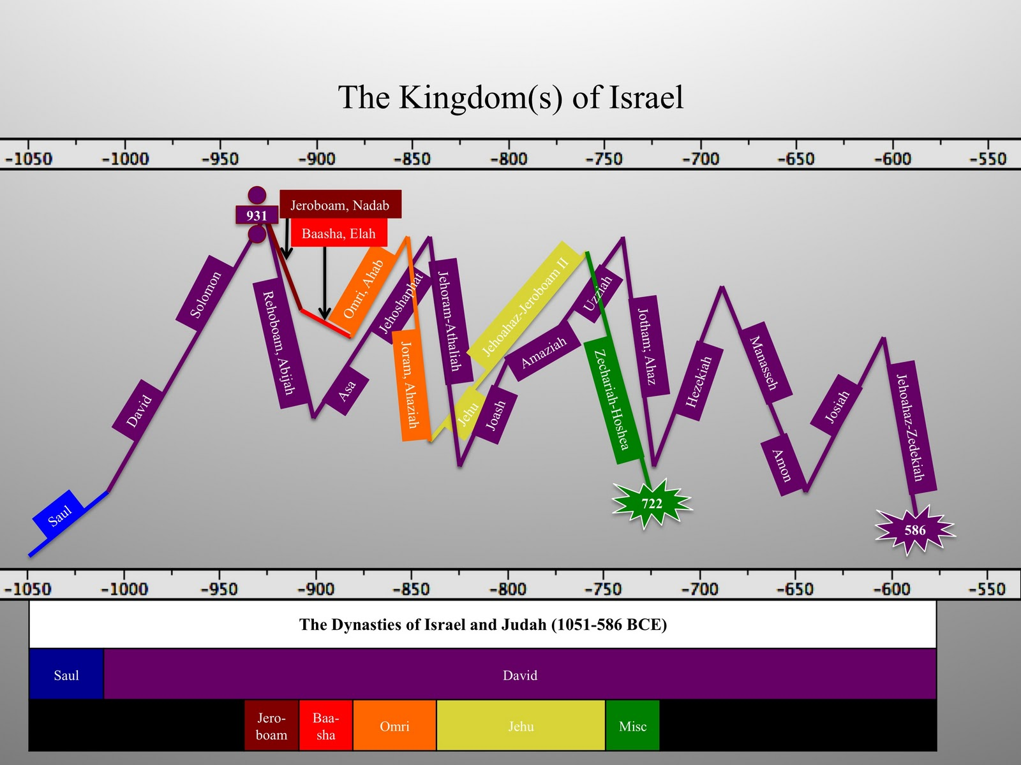

Slide 4
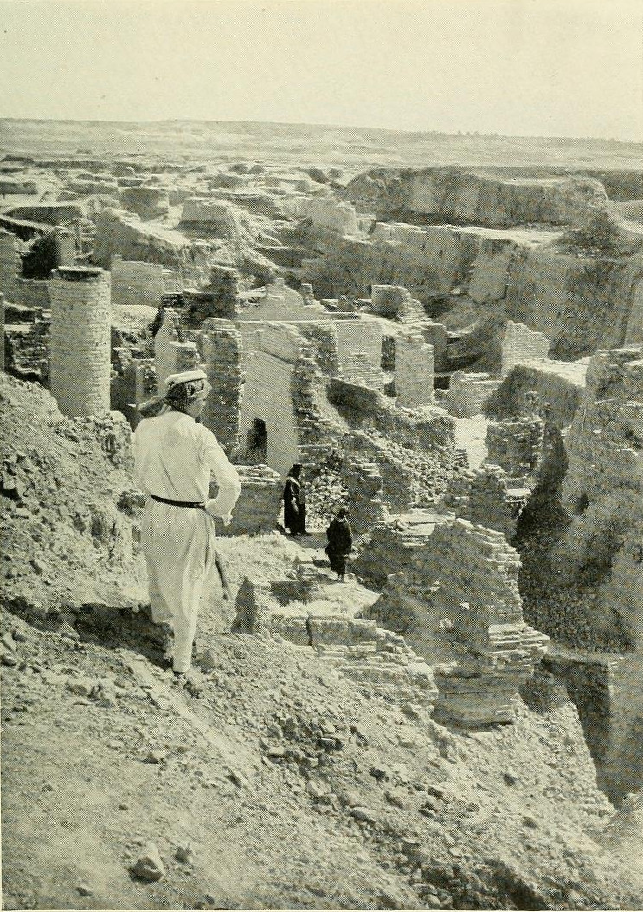
Return from Captivity
Can this be rebuilt?
Why did Jehovah let this happen?
What about a king?
What about the temple?
What do I do to keep this from happening again?

Slide 5
The Role of the Prophets
They are Spokesmen for God, serving as “forthtellers,” speaking what God put in their mouth.
They are Preachers of the Covenant, relating their message to God’s previous promises to the nation of Israel. These covenants were made with or through Abraham, Moses, and David
They are historians, or Interpreters of the Israelites’ History. With out their interpretation God’s people would not know why an event was occurring.

Slide 6
God’s Test for a Prophet
Deuteronomy 18:18-22(ESV)
¹⁸I will raise up for them a prophet like you from among their brothers.
And I will put my words in his mouth, and he shall speak to them
all that I command him.
¹⁹And whoever will not listen to my words that he shall speak in my name, I myself will require it of him.
²⁰But the prophet who presumes to speak a word in my name that I have not commanded him to speak, or who speaks in the name of other gods, that same prophet shall die.’
²¹And if you say in your heart, ‘How may we know the word that the Lord has not spoken?’—
²² when a prophet speaks in the name of the Lord, if the word does not come to pass or come true, that is a word that the Lord has not spoken; the prophet has spoken it presumptuously. You need not be afraid of him.

Slide 7
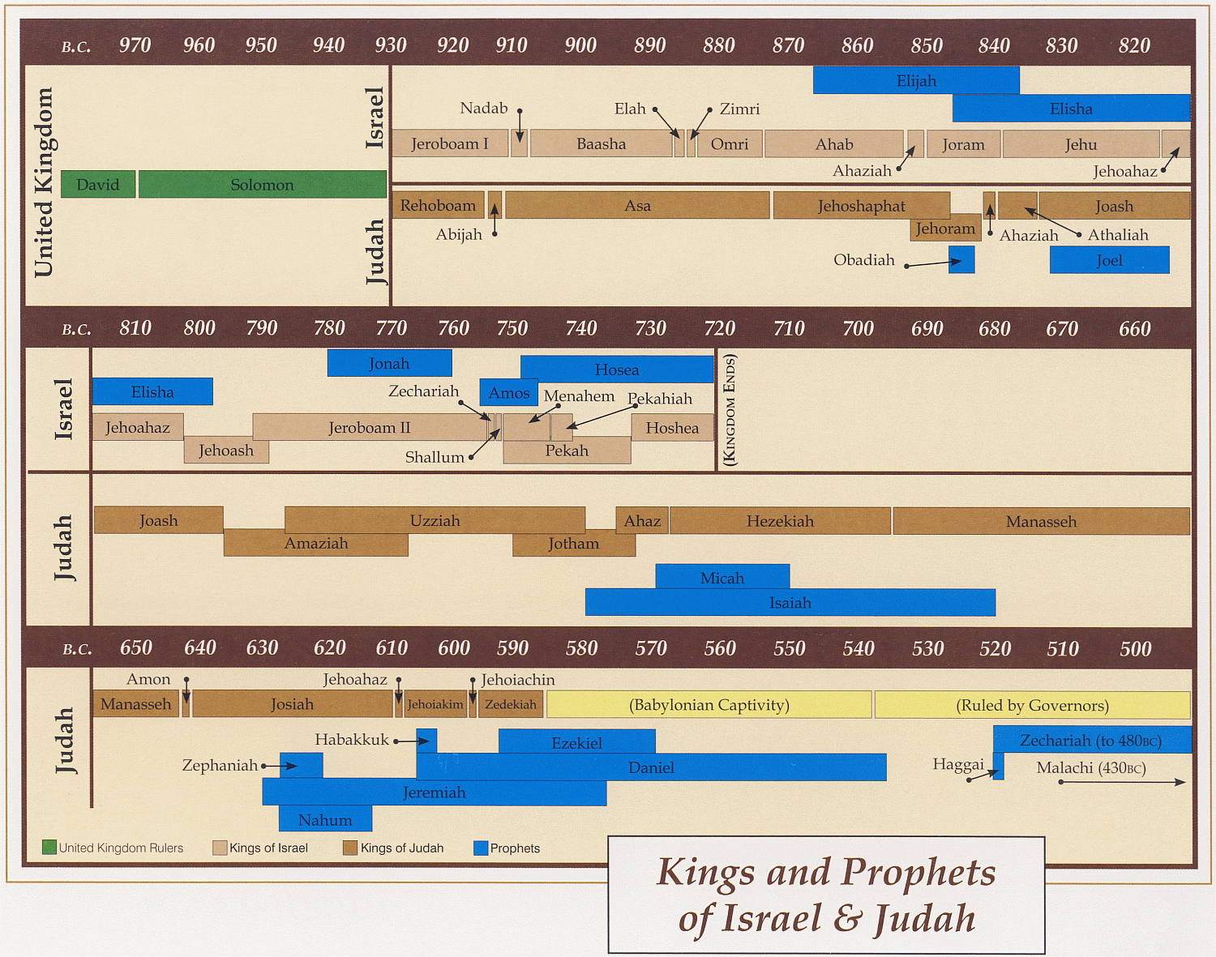
Ahijah
Jehu
Man of God
Micaiah
Man of God
Syria
Shemaiah
Azariah
Hanani
Assyria
Babylon/Persia

Slide 8
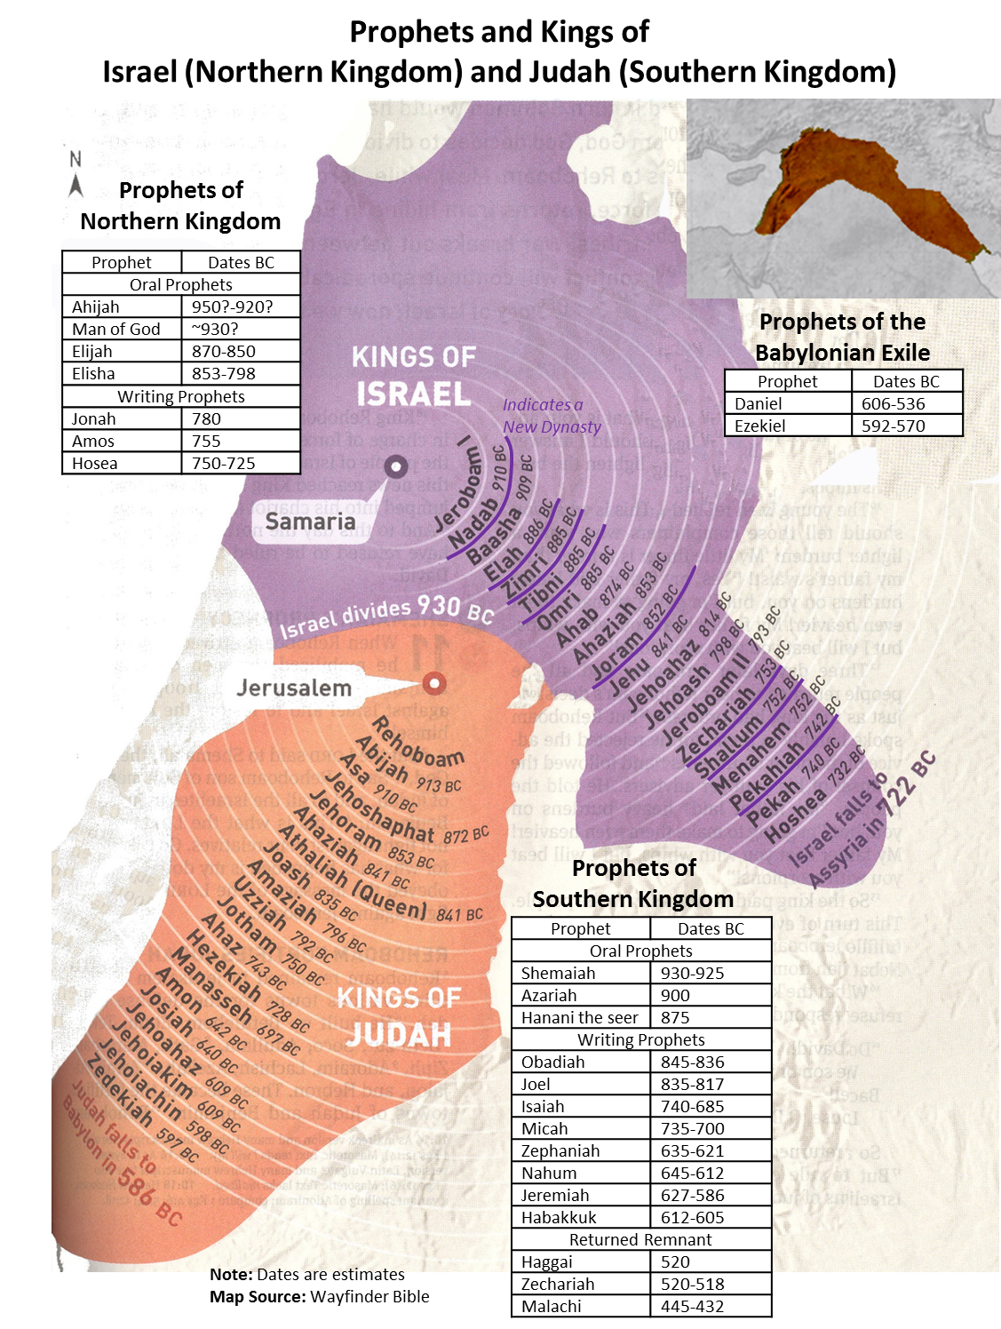

Slide 9

Time Line – Judah Alone
Josiah born
730 BC
710 BC
690 BC
670 BC
650 BC
630 BC
610 BC
590 BC
570 BC
648 BC Manasseh
taken
prisoner?
~Josiah born
627 BC Jeremiah begins his prophecies
722 BC Fall of Samaria
622 BC Book of the Law found
Josiah begins reforms
588 BC Nebuchadnezzar begins final siege
715 BC Hezekiah Life extended 15 yrs
586 BC Jerusalem Falls-Exile
697 BC Manasseh becomes king
640 BC Josiah
becomes king
597 BC Nebuchadnezzar besieges Jerusalem & takes Jehoiachin captive
701 BC Sennacherib invades Judah
(14th yrs after Hezekiah’s
life extended?)
642 BC Amon
becomes king
605 BC Nebuchadnezzar invades Judah
& takes captives (Daniel)
728 BC Hezekiah king (3rd yr Hoshea)
609 BC Pharaoh Neco kills Josiah in battle
& puts Jehoakim on throne
730 BC
710 BC
690 BC
670 BC
650 BC
630 BC
610 BC
590 BC
570 BC

Slide 10
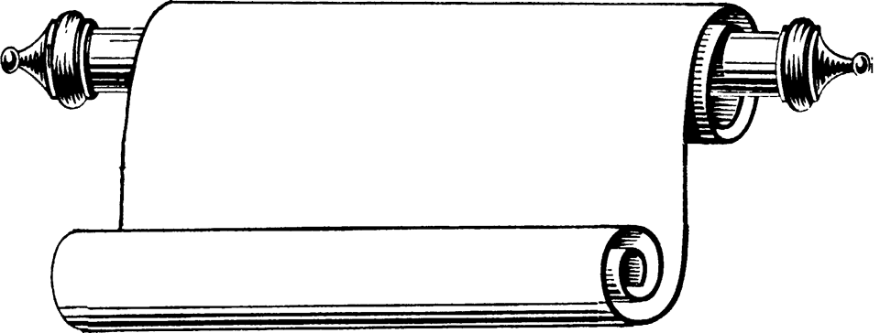
Edomites invaded Judah just as Judah was being ransacked - prophesies Edom's downfall
The
Judges
OBADIAH
845 Edom
JOEL
Judah see severe locust plague as a coming
Day of the LORD
830
Told to preach in Nineveh resulted in his being swallowed by a fish & city repenting
Kings & Prophets
JONAH
780 Nineveh
Israel, repent of injustice and idolatry or else go into exile
AMOS
Divided Kingdom
Israel & Judah
755
HOSEA
His life with adulterous wife like God & Israel
750-725
MICAH
Judah, repent of injustice and idolatry or else go into exile
735-700
ISAIAH
Isaiah 1-6 Reason for God’s Actions &
Isaiah’s Call
Isaiah 7-35 Immediate threat & Judgments
Isaiah 36-39 Historical account of siege
Isaiah 40-66 Cyrus, Future Threats & Hopes
740-690

Slide 11
Kings & Prophets
NAHUM
Divided Kingdom
Judah Alone
& Fall of Judah
The prophet predicts the fall of Nineveh
630-612 Nineveh
ZEPHANIAH
Prophet emphasizes the need for the people of Judah to turn away from idolatry
630-625
HABAKKUK
"Why do the wicked and cruel Babylonians go unpunished?" Prophet finds his answer in God's goodness and wisdom
612-606
Jer 1-20 Sermons & prophecies during Josiah
Jer 21-39 Prophecies of Specific Events
Jer 40-45 Sermons after fall of Israel
Jer 46-51 God’s Judgment on Foreign Nations
Jer 52 Fall of Jerusalem
JEREMIAH
627-586
LAMENTATIONS
Jeremiah cries from the depths of his heart over the destruction of Jerusalem
586

Slide 12
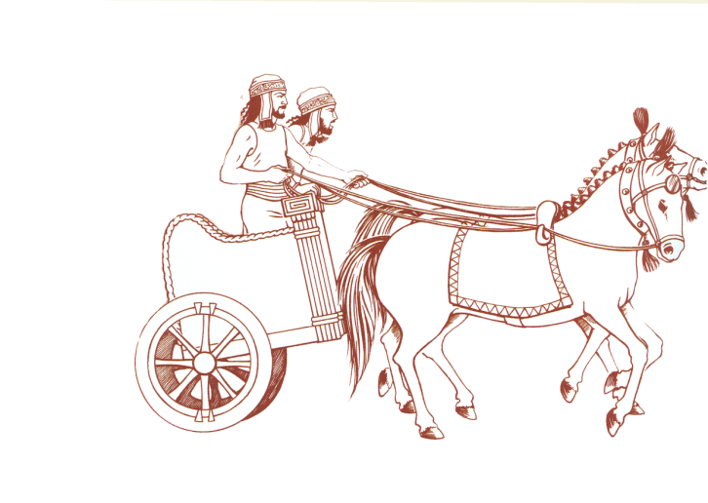
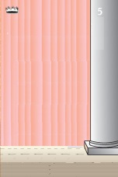

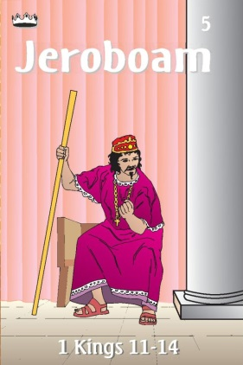

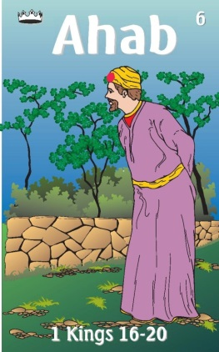
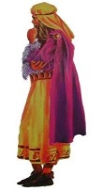
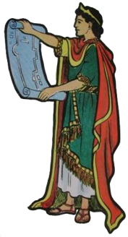

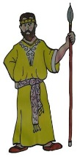
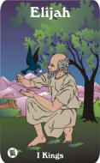
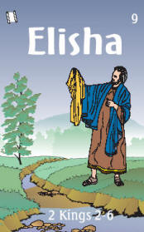

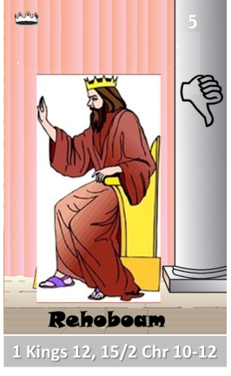
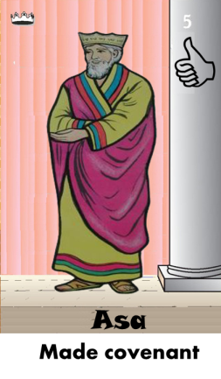
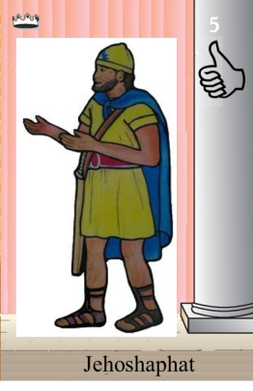
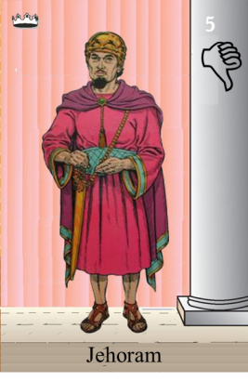
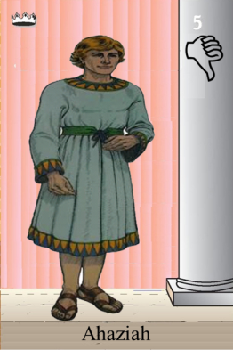
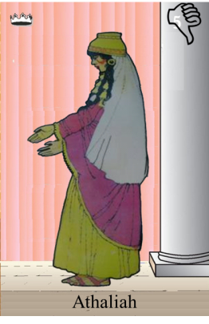
Ahaziah
Jehoram
Killed by Jehu
Baasha
Jehu
Ahijah
Man of God
Rocks for
Mizpah & Geba
Early Kings
Omri Kings
Jehu Kings
Brings in Syria
Obadiah - 830
Killed by Jehu
Shemaiah
Azariah
Hanani the Seer

Slide 13

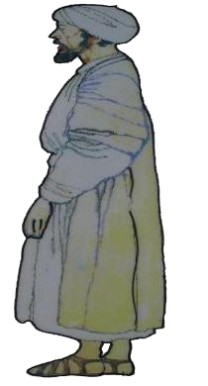

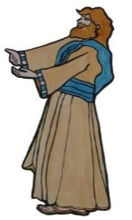
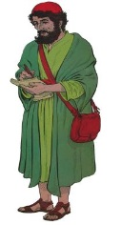
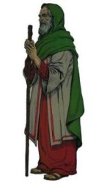
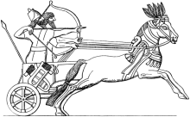

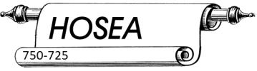

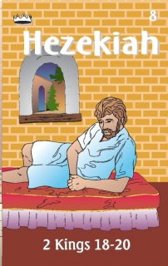

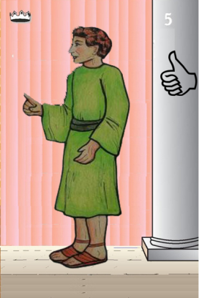
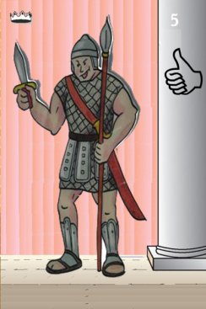
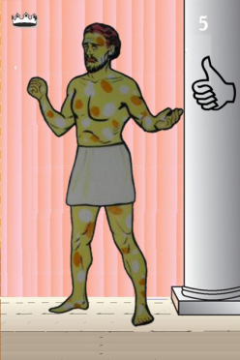
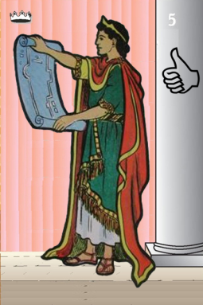
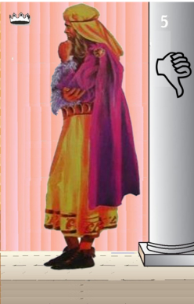
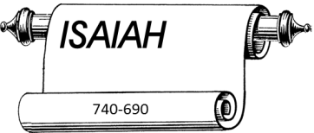
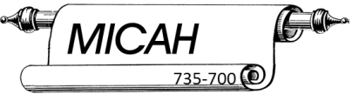
Jehu
841-814
Jehoahaz
Jehoash
Elisha &
the Arrows
Jeroboam II
Zechariah
Tiglath-pileser III
(745–727 b.c.)
793-753
Jehu Kings
Confusing
Brings in Assyria
Joash
Amaziah
Uzziah
Jotham
Ahaz
Jehoiada Made covenant

Slide 14
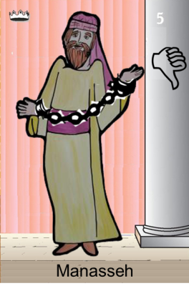
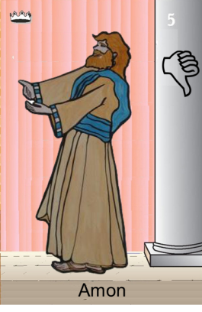
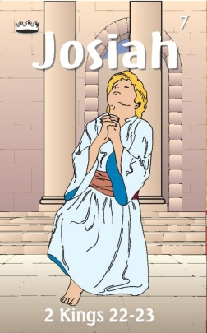
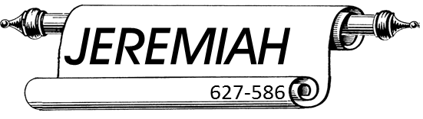
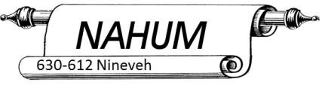
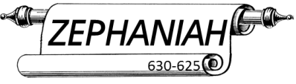
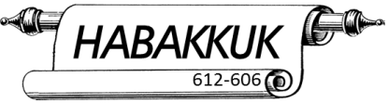
Confusing
Judah Alone
Tiglath-pileser III
(745–727 b.c.)
Shallum 752
Menahem 752-742
Pekahiah 742-740
Pekah(752) 740-732
Hoshea 732-722
697-642
640-609
Made covenant
Uzziah
Jotham
Ahaz

Slide 15
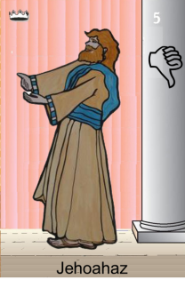

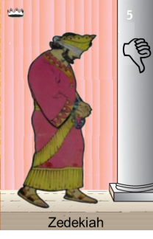
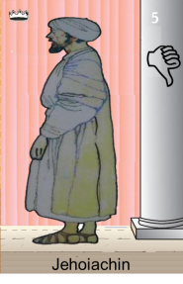
Confusing
Judah Alone
Tiglath-pileser III
(745–727 b.c.)
697-642
640-609
Shallum 752
Menahem 752-742
Pekahiah 742-740
Pekah(752) 740-732
Hoshea 732-722
Made covenant
609
609-597
Egypt
597-586
Babylon
Uzziah
Jotham
Ahaz
597
Babylon

Slide 16
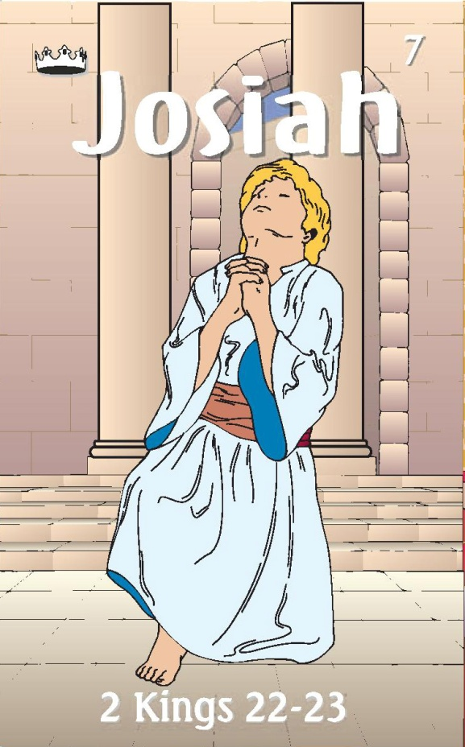
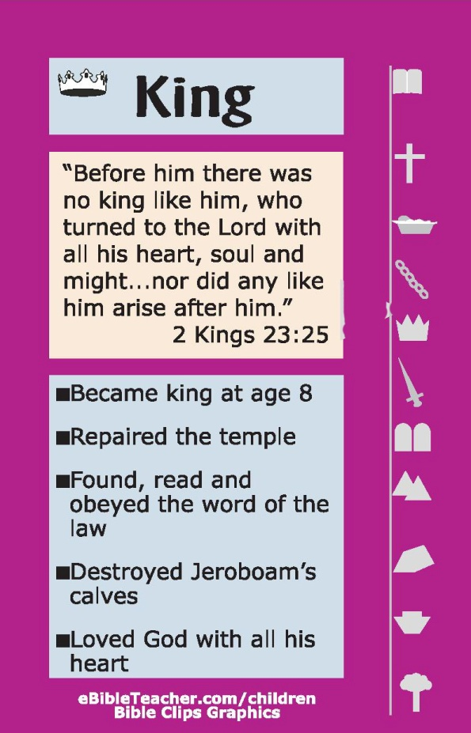

#16 Josiah Card
Kings of Assyria
Ashurbanipal
668–627
Assur-etil-ilani
626-607
640-609
Prophets
Jeremiah (J)
Zephaniah (J)
Habakkuk (J)
Nahum (Nineveh)
Made covenant
JOSIAH & SONS

Slide 17
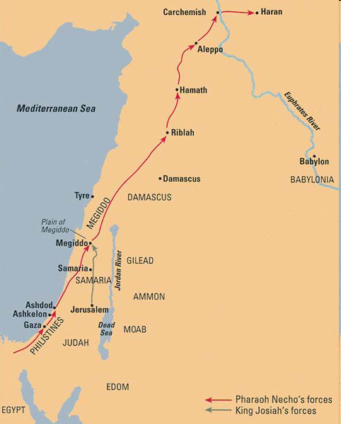
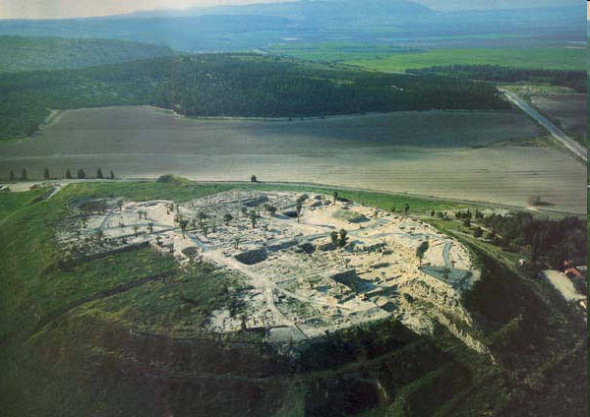
2 Chronicles 35:20 - 23 ²⁰After all this, when Josiah had prepared the temple, Necho king of Egypt came up to fight at Carchemish by the Euphrates; and Josiah went out against him.

Slide 18
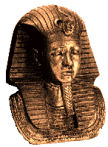
Death of Josiah
2 Kings 23:29 - 30 (NKJV) ²⁹In his days Pharaoh Necho king of Egypt went to the aid of the king of Assyria, to the River Euphrates; and King Josiah went against him. And Pharaoh Necho killed him at Megiddo when he confronted him. ³⁰Then his servants moved his body in a chariot from Megiddo, brought him to Jerusalem, and buried him in his own tomb. And the people of the land took Jehoahaz the son of Josiah, anointed him, and made him king in his father’s place.

Slide 19





Josiah’s Family
640-609
Age 8
Zebudah
Hamutal
Hamutal
609-597
Age 25
609 (3 mon)
Age 23
597-586
Age 21
Nehushta
597
Age 8/18
Zerubbabel
Governor on Return
Shealtiel

Slide 20

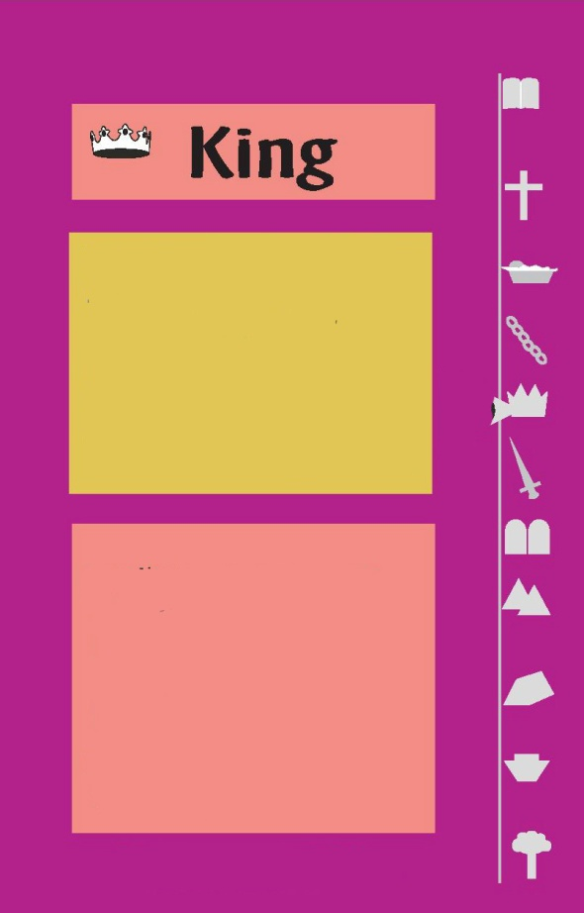


#17 Jehoahaz Card
Kings of Babylon
Nabopolassar-
625-604 BC
did what was evil in the sight of the Lord, according to all that his fathers had done.
609
Prophets
chosen by people
Reigned 3 months
Deposed by pharaoh Neco
Died in Egypt
Jeremiah (J)
Habakkuk (J)
Jehoahaz
JOSIAH & SONS

Slide 21
Jeremiah 22 The Fates-Jehoahaz’s Fate
2 Kings 23
³³And Pharaoh Neco put him in bonds at Riblah in the land of Hamath, that he might not reign in Jerusalem, and laid on the land a tribute of a hundred talents of silver and a talent of gold.
³⁴And Pharaoh Neco made Eliakim the son of Josiah king in the place of Josiah his father, and changed his name to Jehoiakim.
But he took Jehoahaz away, and he came to Egypt and died there.
Jeremiah 22:11 - 12 (ESV) ¹¹For thus says the Lord concerning Shallum the son of Josiah, king of Judah, who reigned instead of Josiah his father, and who went away from this place: “He shall return here no more, ¹²but in the place where they have carried him captive, there shall he die, and he shall never see this land again.”

Slide 22
#18 Jehoiakim Card
Kings of Babylon
Nabopolassar
625-604
Nebuchadrezzar II
604-568
did what was evil in the sight of the Lord, according to all that his fathers had done
609 -597
made king by pharaoh Neco
Served Nebuchadnezzar
3 years then rebelled
Jerusalem falls in 597 – Daniel and Ezekiel
Prophets
Jeremiah (J)
Jehoiakim
JOSIAH & SONS

Slide 23
Jehoahaz & Jehoiakim
Caught between Egypt & Babylon
2 Kings 23:31 - 35 (ESV) ³¹Jehoahaz was twenty-three years old when he began to reign, and he reigned three months in Jerusalem. … ³²And he did what was evil in the sight of the Lord, according to all that his fathers had done.
³³And Pharaoh Neco put him in bonds at Riblah in the land of Hamath, that he might not reign in Jerusalem, and laid on the land a tribute of a hundred talents of silver and a talent of gold.
³⁴And Pharaoh Neco made Eliakim the son of Josiah king in the place of Josiah his father, and changed his name to Jehoiakim.
But he took Jehoahaz away, and he came to Egypt and died there.
³⁵And Jehoiakim gave the silver and the gold to Pharaoh, but he taxed the land to give the money according to the command of Pharaoh…

Slide 24
Jehoiakim’s Palace of Injustice
Jeremiah 22:13 - 17 (ESV)
¹³ “Woe to him who builds his house by unrighteousness, and his upper rooms by injustice,
who makes his neighbor serve him for nothing and does not give him his wages,
¹⁴ who says, ‘I will build myself a great house with spacious upper rooms,’ who cuts out windows for it, paneling it with cedar and painting it with vermilion.
¹⁵ Do you think you are a king because you compete in cedar?
Did not your father eat and drink and do justice & righteousness?
Then it was well with him. ¹⁶ He judged the cause of the poor and needy; then it was well. Is not this to know me? declares the Lord.
¹⁷ But you have eyes and heart only for your dishonest gain, for shedding innocent blood, and for practicing oppression and violence.”

Slide 25

Days of Jehoiakim
Jeremiah 26:20-21(ESV)
²⁰There was another man who prophesied in the name of the Lord, Uriah the son of Shemaiah from Kiriath-jearim. He prophesied against this city and against this land in words like those of Jeremiah.
²¹And when King Jehoiakim, with all his warriors and all the officials, heard his words, the king sought to put him to death. But when Uriah heard of it, he was afraid and fled and escaped to Egypt.
Jeremiah 26:22-23(ESV)
²²Then King Jehoiakim sent to Egypt certain men, Elnathan the son of Achbor and others with him,
²³and they took Uriah from Egypt and brought him to King Jehoiakim, who struck him down with the sword and dumped his dead body into the burial place of the common people.

Slide 26
Days of Jehoiakim
Jeremiah 26:16-19(ESV)
¹⁶Then the officials and all the people said to the priests and the prophets, “This man does not deserve the sentence of death, for he has spoken to us in the name of the Lord our God.”
¹⁷And certain of the elders of the land arose and spoke to all the assembled people, saying,
¹⁸“Micah of Moresheth prophesied in the days of Hezekiah king of Judah, and said to all the people of Judah:
‘Thus says the Lord of hosts,
“‘Zion shall be plowed as a field;
Jerusalem shall become a heap of ruins,
and the mountain of the house a wooded height.’
¹⁹Did Hezekiah king of Judah and all Judah put him to death? Did he not fear the Lord and entreat the favor of the Lord, and did not the Lord relent of the disaster that he had pronounced against them? But we are about to bring great disaster upon ourselves.”

Slide 27

Response of Jehoakim
Jeremiah 36
²¹So the king sent Jehudi to bring the scroll, and he took it from Elishama the scribe’s chamber. And Jehudi read it in the hearing of the king and in the hearing of all the princes who stood beside the king.
²²Now the king was sitting in the winter house in the ninth month, with a fire burning on the hearth before him.
²³And it happened, when Jehudi had read three or four columns, that the king cut it with the scribe’s knife and cast it into the fire that was on the hearth, until all the scroll was consumed in the fire that was on the hearth.
²⁴Yet they were not afraid, nor did they tear their garments, the king nor any of his servants who heard all these words

Slide 28
Jehoiakim
Caught between Egypt & Babylon
2 Kings 24:2 - 7 (ESV) ²And the Lord sent against him … and sent them against Judah to destroy it, according to the word of the Lord that he spoke by his servants the prophets.
³Surely this came upon Judah at the command of the Lord, to remove them out of his sight, for the sins of Manasseh, according to all that he had done, ⁴and also for the innocent blood that he had shed. For he filled Jerusalem with innocent blood, and the Lord would not pardon.
⁶So Jehoiakim slept with his fathers, and Jehoiachin his son reigned in his place. ⁷And the king of Egypt did not come again out of his land, for the king of Babylon had taken all that belonged to the king of Egypt from the Brook of Egypt to the river Euphrates.

Slide 29
Jehoiakim’s Uncertain Demise
2 Kings 24:6 (ESV) ⁶So Jehoiakim slept with his fathers, and Jehoiachin his son reigned in his place.
2 Chronicles 36:6 - 7 (ESV) ⁶Against him came up Nebuchadnezzar king of Babylon and bound him in chains to take him to Babylon. ⁷Nebuchadnezzar also carried part of the vessels of the house of the Lord to Babylon and put them in his palace in Babylon.
Jeremiah 22:18 - 19 (ESV) ¹⁸Therefore thus says the Lord concerning Jehoiakim the son of Josiah, king of Judah:
“They shall not lament for him, saying,
‘Ah, my brother!’ or ‘Ah, sister!’
They shall not lament for him, saying,
‘Ah, lord!’ or ‘Ah, his majesty!’
¹⁹ With the burial of a donkey he shall be buried,
dragged and dumped beyond the gates of Jerusalem.”

Slide 30

Keeping Captivities Straight
Daniel 1:1(ESV)
¹In the third year of the reign of Jehoiakim king of Judah, Nebuchadnezzar king of Babylon came to Jerusalem and besieged it.
Jehoiakim
Jeremiah 52:28-30(ESV)
²⁸This is the number of the people whom Nebuchadnezzar carried away captive: in the seventh year, 3,023 Judeans;
²⁹in the eighteenth year of Nebuchadnezzar he carried away captive from Jerusalem 832 persons;
³⁰in the twenty-third year of Nebuchadnezzar, Nebuzaradan the captain of the guard carried away captive of the Judeans 745 persons; all the persons were 4,600.
Jehoiachin
Zedekiah

Slide 31
#19 Jehoiachin Card
Kings of Babylon
Nebuchadrezzar II
604-568
he reigned three months and ten days in Jerusalem.
He did what was evil in the sight of the Lord.
597
gave himself up and his family
captive of Nebuchadnezzar
Son of Jehoiakim
After 37 years in prison allowed to dine with king
Prophets
Jeremiah (J)
Jehoiachin
JOSIAH & SONS

Slide 32

Jeremiah 22 – Fate of Josiah’s Sons - Jehoiachin
Jeremiah 22:24-27(ESV)
²⁴“As I live, declares the Lord, though Coniah the son of Jehoiakim, king of Judah, were the signet ring on my right hand, yet I would tear you off
²⁵and give you into the hand of those who seek your life, into the hand of those of whom you are afraid, even into the hand of Nebuchadnezzar king of Babylon and into the hand of the Chaldeans.
²⁶I will hurl you and the mother who bore you into another country, where you were not born, and there you shall die.
²⁷But to the land to which they will long to return, there they shall not return.”
Jeremiah 22:30(ESV)
³⁰ Thus says the Lord:
“Write this man down as childless,
a man who shall not succeed in his days,
for none of his offspring shall succeed
in sitting on the throne of David
and ruling again in Judah.”

Slide 33

Arm Chair Critics & Jeremiah
Jeremiah 52:31-34(ESV)
³¹And in the thirty-seventh year of the exile of Jehoiachin king of Judah, in the twelfth month, on the twenty-fifth day of the month, Evil-merodach king of Babylon, in the year that he became king, lifted up the head of Jehoiachin king of Judah and brought him out of prison.
³²And he spoke kindly to him, and gave him a seat above the seats of the kings who were with him in Babylon.
³³So Jehoiachin put off his prison garments. And every day of his life he dined regularly at the king’s table,
³⁴and for his allowance, a regular allowance was given him by the king according to his daily need, until the day of his death as long as he lived.

Slide 34

Arm Chair Critics & Jeremiah
Clay tablet listing rations for King Jehoiachin
32 pts (of sesame oil) for Jehoiachin king of Judah
5 pts (of sesame oil) for [the 5] sons of the king of Judah
8 pts (of sesame oil) for 8 men of Judah
About the age of 56 he was released from prison (561/560 BC) & treated well by King – this tablet dates to around 595 – 570 BC
Discovered in an Underground Building close to the Ishtar Gate

Slide 35

#20 Zedekiah Card
Kings of Babylon
Nebuchadrezzar II
604-568
did what was evil in the sight of the Lord his God. He did not humble himself before Jeremiah the prophet, stiffened his neck and hardened his heart against turning to the Lord
597 - 586
made king by Nebuchadnezzar
rebelled
Jerusalem falls in 586
Saw sons killed before being blinded
Prophets
Jeremiah (J)
Zedekiah
JOSIAH & SONS

Slide 36

Fate of Zedekiah
Jeremiah 39:5-7(ESV)
⁵But the army of the Chaldeans pursued them and overtook Zedekiah in the plains of Jericho. And when they had taken him, they brought him up to Nebuchadnezzar king of Babylon, at Riblah, in the land of Hamath; and he passed sentence on him.
⁶The king of Babylon slaughtered the sons of Zedekiah at Riblah before his eyes, and the king of Babylon slaughtered all the nobles of Judah.
⁷He put out the eyes of Zedekiah and bound him in chains to take him to Babylon.

Slide 37
Kings of Judah Before Fall of Israel
Basic Info
King
Good /Bad King
Age
Years of Rule
Buried Where
Cause of Death
Rehoboam
Did Evil
17
Natural
41
City of David
Abijah
Not Loyal
3
City of David
Natural
Asa
41
Own tomb City of David
Diseased Feet
Did Right
Jehoshaphat
City of David
Natural
Doing right
35
25
Jehoram
Ways of
Israel
No Fire
No Kings Tomb
Lord – intestines came out
32
8
Ahaziah
Ways of
Ahab
Killed by Jehu
22
1
City of David
Athaliah (usurper)
Doing
Wickedly
Killed by Captains of 100
7

Slide 38
Kings of Judah Before Fall of Israel
Basic Info
King
Good /Bad King
Age
Years of Rule
Buried Where
Cause of Death
Joash
Did right
instructed
7
40
City of David
No King’s Tomb
Killed by Servants
Amaziah
Did right
Not Loyal
Killed by Servants
25
29
City of David
With Fathers
Uzziah
Did right
Eyes of Lord
Died a Leper
16
52
Burial Field
Jotham
Did right
Eyes of Lord
Natural
25
16
City of David
With Fathers
Ahaz
Did not do right
Eyes of Lord
20
16
Not in tombs of the kings
Natural
Hezekiah
Did right-David
None like him
Natural
25
29
Upper Part
Of Tomb
Manasseh
Did not do right
Worse than Nations
Natural
12
55
Garden of his House

Slide 39
Kings of Judah Before Fall of Israel
Basic Info
King
Good /Bad King
Age
Years of Rule
Buried Where
Cause of Death
Manasseh
Did not do right
Worse than Nations
Natural
12
55
Garden of his House
Amon
Did evil as his father did
Killed by Servants
22
2
Garden of his House
Josiah
Did right-
walked like David
Killed in Battle
8
31
Own Tomb
Jehoahaz
Did evil as
his fathers did
Prisoner
Natural
23
3 months
Egypt
Jehoiakim
Did evil as
his fathers did
25
Dumped
with a donkey
Natural?
11
Jehoiachin
Did evil as
his fathers did
18/8
3 months
Natural
Captive
Babylon
Zedekiah
Did evil as
Jehoiakim did
Natural
Prisoner
21
11
Babylon

Slide 40
Daniel
Jeremiah
Ezekiel
Jeremiah

Slide 41

JEREMIAH
Remaining Faithful
Obedience
Captivity
Return
New Covenant
Disobedience
Sword
Pestilence
Famine

Slide 42



Jeremiah 2:11-13(ESV)
Has a nation changed its gods,
even though they are no gods?
But my people have changed their glory
for that which does not profit.
Be appalled, O heavens, at this;
be shocked, be utterly desolate,
declares the Lord,
for my people have committed two evils: they have forsaken me,
the fountain of living waters,
and hewed out cisterns for themselves, broken cisterns that can hold no water.

Slide 43




Jeremiah
4 Destroyers
Jeremiah 15:3-4(ESV)
³I will appoint over them four kinds of destroyers, declares the Lord:
the sword to kill,
the dogs to tear,
and the birds of the air
and the beasts of the earth to devour and destroy.
⁴And I will make them a horror to all the kingdoms of the earth because of what Manasseh the son of Hezekiah, king of Judah, did in Jerusalem.

Slide 44

Jeremiah 19:10-12(ESV)
¹⁰“Then you shall break the flask in the sight of the men who go with you,
¹¹and shall say to them, ‘Thus says the Lord of hosts: So will I break this people and this city, as one breaks a potter’s vessel, so that it can never be mended. Men shall bury in Topheth because there will be no place else to bury.
¹²Thus will I do to this place, declares the Lord, and to its inhabitants, making this city like Topheth.

Slide 45


Jeremiah’s Good & Bad Figs
- Jer 24
…Like these good figs, so I will regard as good the exiles from Judah, whom I have sent away from this place to the land of the Chaldeans. ⁶I will set my eyes on them for good, and I will bring them back to this land. I will build them up, and not tear them down; I will plant them, and not uproot them.
³And the Lord said to me, “What do you see, Jeremiah?” I said, “Figs, the good figs very good, and the bad figs very bad, so bad that they cannot be eaten.”

Slide 46
Jeremiah’s Good & Bad Figs
- Jer 24
…Like the bad figs that are so bad they cannot be eaten, so will I treat Zedekiah the king of Judah, his officials, the remnant of Jerusalem who remain in this land, and those who dwell in the land of Egypt. ⁹I will make them a horror to all the kingdoms of the earth, to be a reproach, a byword, a taunt, and a curse in all the places where I shall drive them. ¹⁰And I will send sword, famine, and pestilence upon them, until they shall be utterly destroyed from the land that I gave to them and their fathers.”
³And the Lord said to me, “What do you see, Jeremiah?” I said, “Figs, the good figs very good, and the bad figs very bad, so bad that they cannot be eaten.”

Slide 47


Comparing the Message
Hananiah - False Prophet
Lord of hosts says I have broken the yoke (28:2)
In 2 years I will bring back the vessels of House of the Lord (28:3)
Lord will bring back Jehoiachin (28:4)
Lord will return the exiles (28:4)
Jeremiah – True Prophet
Hananiah - False Prophet
Breaks Jeremiah’s yoke and says in 2 years yoke of Nebuchadnezzer will be broken – dies within a year
Amen – may the Lord do so (28:6)
True prophets preach sword, famine, pestilence (28:8)
False prophets preach peace (28:9)
Which event happens is the true prophet (28:9)
Hananiah has replaced wooden yoke for a iron yoke (28:13)
Jeremiah - True Prophet
Walks away

Slide 48

Zedekiah's fear and Jeremiah's advice - Jer 38
¹⁴Then Zedekiah the king sent and had Jeremiah the prophet brought to him at the third entrance of the house of the Lord. And the king said to Jeremiah, “I will ask you something. Hide nothing from me.”
¹⁶So Zedekiah the king swore secretly to Jeremiah, saying, “As the Lord lives, who made our very souls, I will not put you to death, nor will I give you into the hand of these men who seek your life.”
¹⁵Jeremiah said to Zedekiah, “If I declare it to you, will you not surely put me to death? And if I give you advice, you will not listen to me.”
¹⁷Then Jeremiah said to Zedekiah, “Thus says the Lord, the God of hosts, the God of Israel: ‘If you surely surrender to the king of Babylon’s princes, then your soul shall live; this city shall not be burned with fire, and you and your house shall live.
¹⁸But if you do not surrender to the king of Babylon’s princes, then this city shall be given into the hand of the Chaldeans; they shall burn it with fire, and you shall not escape from their hand.’”

Slide 49

Zedekiah's fear and Jeremiah's advice - Jer 38
¹⁹And Zedekiah the king said to Jeremiah, “I am afraid of the Jews who have defected to the Chaldeans, lest they deliver me into their hand, and they abuse me.”
²⁰But Jeremiah said,
“They shall not deliver you. Please, obey the voice of the Lord which I speak to you. So it shall be well with you, and your soul shall live.
²¹But if you refuse to surrender, this is the word that the Lord has shown me:
²²‘Now behold, all the women who are left in the king of Judah’s house shall be surrendered to the king of Babylon’s princes, and those women shall say:
“Your close friends have set upon you
And prevailed against you;
Your feet have sunk in the mire,
And they have turned away again.”
²³‘So they shall surrender all your wives and children to the Chaldeans. You shall not escape from their hand, but shall be taken by the hand of the king of Babylon. And you shall cause this city to be burned with fire.’”
The meaning is that, after urging the weak-minded Zedekiah on to a conflict with the Chaldeans, they have left him involved in hopeless difficulties.

