Slide 1
Lesson 11
Daniel Ezekiel &
the Kings

Slide 2
1445-1405 BC
Wilderness
Wanderings
931-722 BC
Divided
Kingdom
605-538 BC
Babylonian
Captivity
444 BC - ~4 BC
The Silent Years
(Intertestamental)
30-90 AD
The Church
NT Era
2166-1859 BC
Patriarchs
1300-1050 BC
Judges
Slavery in Egypt
1859-1445 BC
Conquest
of Canaan
1405-1300 BC
United
Kingdom
1050-931 BC
Life of
Christ
4 BC – 30 AD
United
Kingdom
1050-931 BC
Judah
Alone
722-605 BC
Return
From Exile
538-444 BC
722 BC
586 BC
Temple/City Destroyed
Northern Kingdom:
ISRAEL
597 BC
Ezekiel
605 BC
Daniel
Saul
David
Solomon
Southern Kingdom:
JUDAH
931 BC
Based on Graphics from Marc Hinds & David Maxson
Notes:
With animation

Slide 3
Kings of United & Divided Kingdom
United
Kingdom
Divided Kingdom
Judah Alone
Early Kings – Israel
Dynasty 1&2
Omri
Dynasty 3
Jehu
Dynasty 4
Confusing
Dynasties
Hezekiah
Hezekiah
(728-686)
Manasseh
Amon
1
Jereboam
Nadab
3
Omri
Ahab
(874-853)
Ahaziah
Jehoram
4
Jehu
(841-814)
Jehoahaz
Jehoash
Jereboam II
(793-753)
Zechariah
Shallum
Menahem
Pekaiah
Pekah
Hosea
(732-722)
5
Saul
(1050-1010)
David
(1010-970)
Solomon
(970-930)
2
Baasha
Elah
Josiah &
Sons
Zimri ~ 885
Tibni
Josiah
(640-609)
Jehoahaz
Jehoiakim
Jehoiachin
Zedekiah
(597-586)
Early Kings – Judah
Dynasty 1&2
Omri
Dynasty 3
Jehu
Dynasty 4
Confusing
Dynasties
Rehoboam
Abijam
Asa
(930-870)
Jehosphat
(873-848)
Jehoram
Ahaziah
Athaliah
Joash
Amaziah
Azariah/Uzziah
(790-739)
Jotham
Ahaz
Hezekiah
Judah Return
Zerubbabel (538-515)
Ezra (458-456)
Nehemiah (444-432)

Slide 4
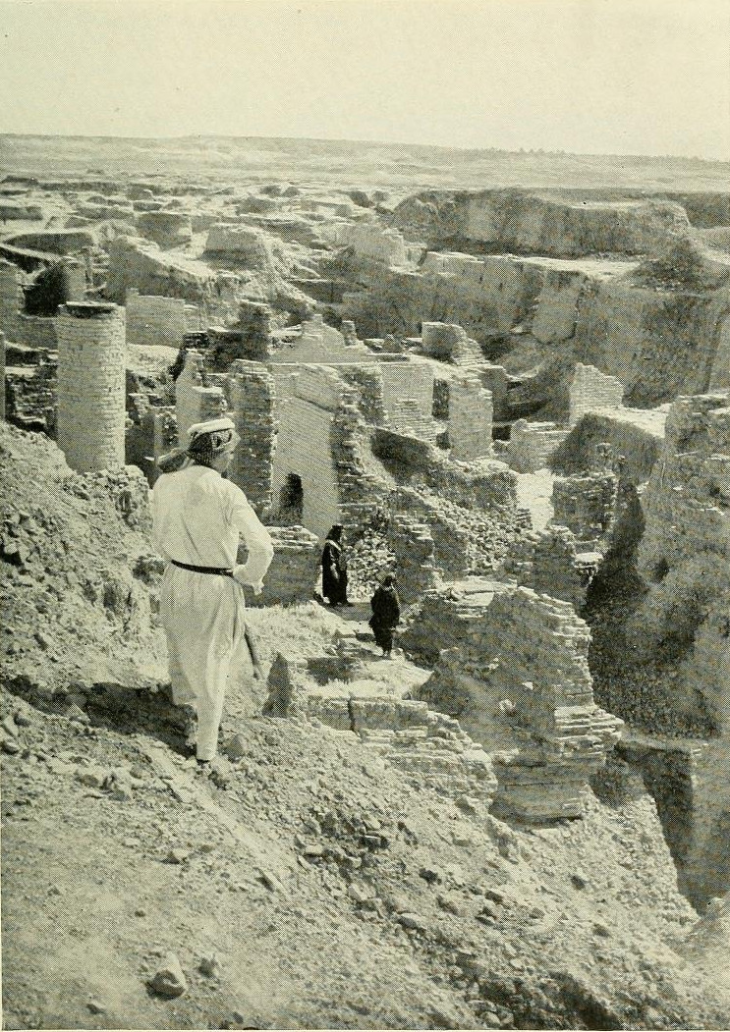
Return from Captivity
Can this be rebuilt?
Why did Jehovah let this happen?
What about a king?
What about the temple?
What do I do to keep this from happening again?

Slide 5
Ahijah
Jehu
Man of God
Micaiah
Man of God
Syria
Shemaiah
Azariah
Hanani
Assyria
Babylon/Persia

Slide 6
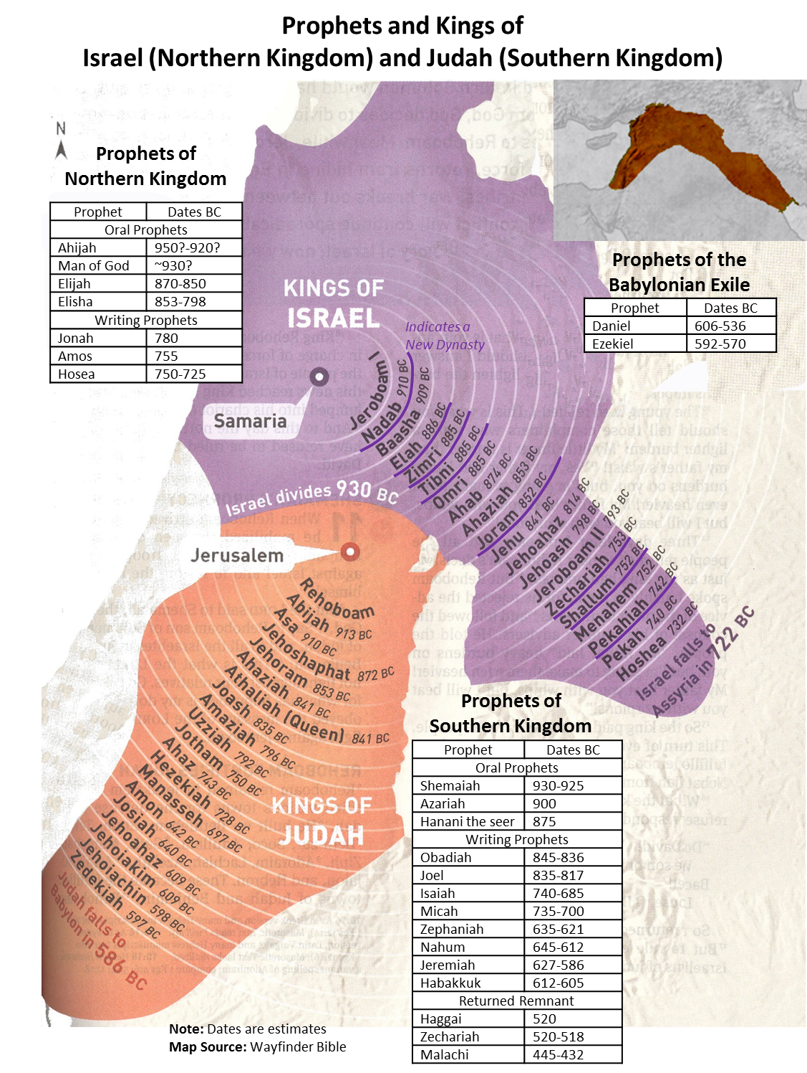

Slide 7
Edomites invaded Judah just as Judah was being ransacked - prophesies Edom's downfall
The
Judges
OBADIAH
845 Edom
JOEL
Judah see severe locust plague as a coming
Day of the LORD
830
Told to preach in Nineveh resulted in his being swallowed by a fish & city repenting
Kings & Prophets
JONAH
780 Nineveh
Israel, repent of injustice and idolatry or else go into exile
AMOS
Divided Kingdom
Israel & Judah
755
HOSEA
His life with adulterous wife like God & Israel
750-725
MICAH
Judah, repent of injustice and idolatry or else go into exile
735-700
ISAIAH
Isaiah 1-6 Reason for God’s Actions &
Isaiah’s Call
Isaiah 7-35 Immediate threat & Judgments
Isaiah 36-39 Historical account of siege
Isaiah 40-66 Cyrus, Future Threats & Hopes
740-690

Slide 8
Kings & Prophets
NAHUM
Divided Kingdom
Judah Alone
& Fall of Judah
The prophet predicts the fall of Nineveh
630-612 Nineveh
ZEPHANIAH
Prophet emphasizes the need for the people of Judah to turn away from idolatry
630-625
HABAKKUK
"Why do the wicked and cruel Babylonians go unpunished?" Prophet finds his answer in God's goodness and wisdom
612-606
Jer 1-20 Sermons & prophecies during Josiah
Jer 21-39 Prophecies of Specific Events
Jer 40-45 Sermons after fall of Israel
Jer 46-51 God’s Judgment on Foreign Nations
Jer 52 Fall of Jerusalem
JEREMIAH
627-586
LAMENTATIONS
Jeremiah cries from the depths of his heart over the destruction of Jerusalem
586

Slide 9
Kings & Prophets
Divided Kingdom
Judah Alone
& Fall of Judah
Babylonian Captivity
2 Chron 29-32 Hezekiah observes passover
2 Chron 33 Manasseh & Amon
2 Chron 34-35 Josiah – cleanses the land
2 Chron 36 Jehoahaz, Jehoiakim, Jehoiachin
& Zedekiah & Fall of Jerusalem
God Rules
DANIEL
Daniel 1-6 Daniel & Friends at Babylonian
Court
Daniel 7-12 The Visions of Daniel
NAHUM
The prophet predicts the fall of Nineveh
EZEKIEL
Ezekiel 1-3 Inaugural Vision
Ezekiel 4-24 Judgment on Jerusalem & Judah
Ezekiel 25-32 Oracles against Foreign Nations
Ezekiel 33-39 After the Fall of Jerusalem
Ezekiel 40-48 Vision of Restoration
ZEPHANIAH
Prophet emphasizes the need for the people of Judah to turn away from idolatry
Edomites invaded Judah just as Judah was being ransacked - prophesies Edom's downfall
OBADIAH
"Why do the wicked and cruel Babylonians go unpunished?" Prophet finds his answer in God's goodness and wisdom
HABAKKUK
Settle in for 70 years

Slide 10
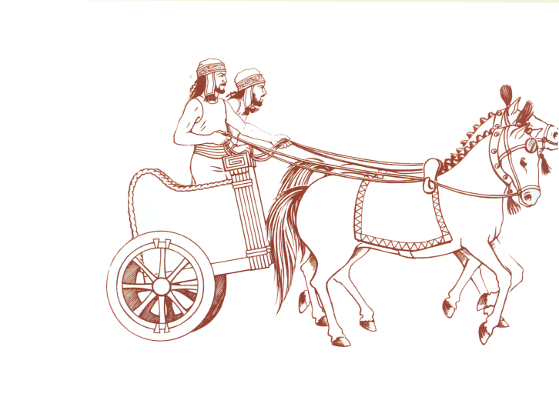
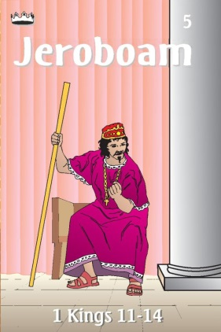
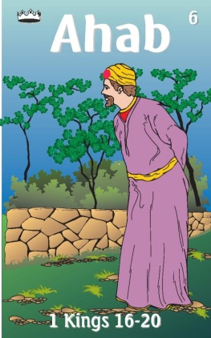
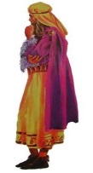
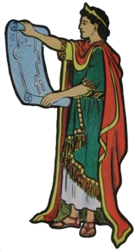
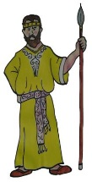
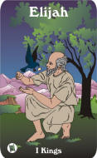
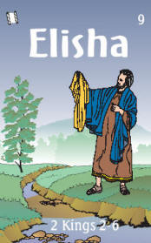
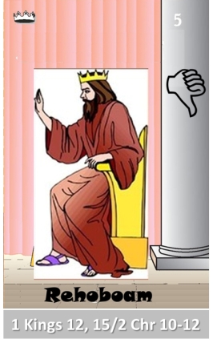
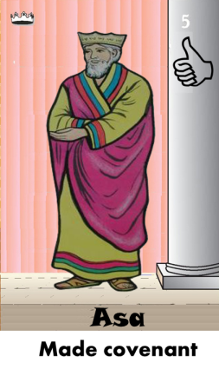
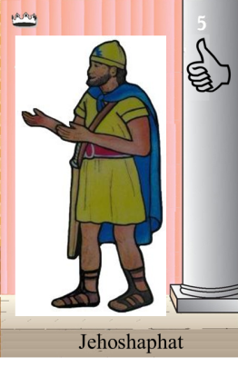
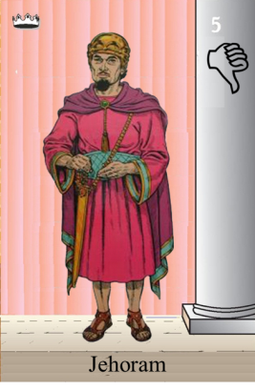
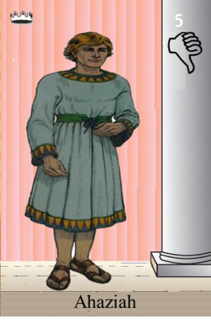
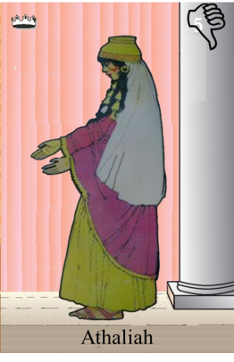
Ahaziah
Jehoram
Killed by Jehu
Baasha
Jehu
Ahijah
Man of God
Rocks for
Mizpah & Geba
Early Kings
Omri Kings
Jehu Kings
Brings in Syria
Obadiah - 830
Killed by Jehu
Shemaiah
Azariah
Hanani the Seer

Slide 11
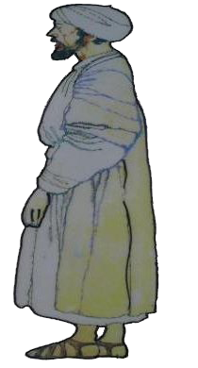
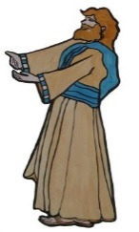
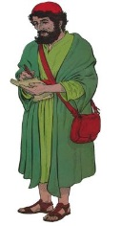
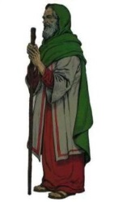
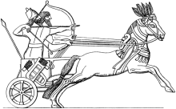
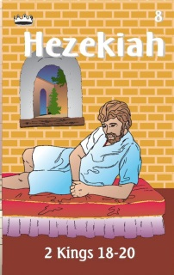
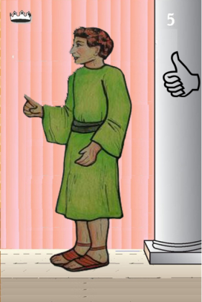
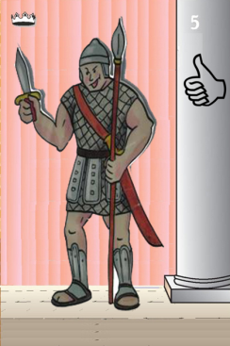
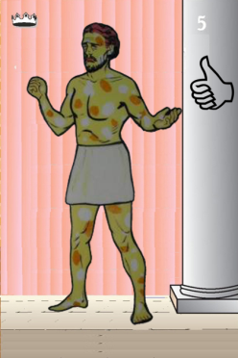
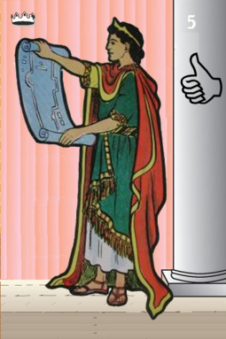
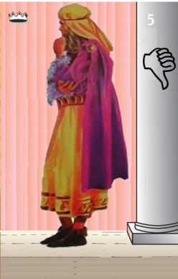
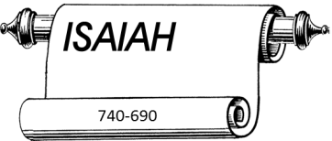
Jehu
841-814
Jehoahaz
Jehoash
Elisha &
the Arrows
Jeroboam II
Zechariah
Tiglath-pileser III
(745–727 b.c.)
793-753
Jehu Kings
Confusing
Brings in Assyria
Joash
Amaziah
Uzziah
Jotham
Ahaz
Jehoiada Made covenant

Slide 12
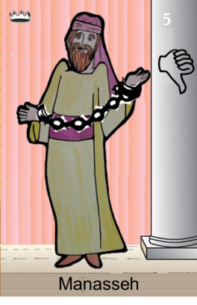
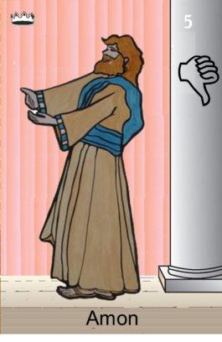
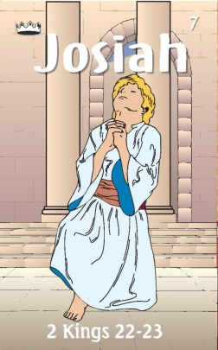
Confusing
Judah Alone
Tiglath-pileser III
(745–727 b.c.)
Shallum 752
Menahem 752-742
Pekahiah 742-740
Pekah(752) 740-732
Hoshea 732-722
697-642
640-609
Made covenant
Uzziah
Jotham
Ahaz

Slide 13
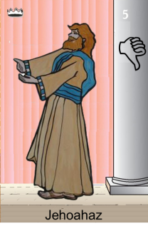
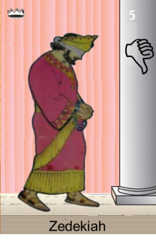
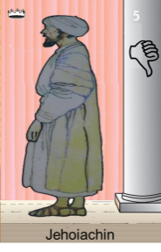
Confusing
Judah Alone
Tiglath-pileser III
(745–727 b.c.)
697-642
640-609
Shallum 752
Menahem 752-742
Pekahiah 742-740
Pekah(752) 740-732
Hoshea 732-722
Made covenant
609
609-597
Egypt
597-586
Babylon
Uzziah
Jotham
Ahaz
597
Babylon

Slide 14
Confusing
Judah Alone
Tiglath-pileser III
(745–727 b.c.)
697-642
640-609
Shallum 752
Menahem 752-742
Pekahiah 742-740
Pekah(752) 740-732
Hoshea 732-722
Made covenant
609
609-597
Egypt
597-586
Babylon
Uzziah
Jotham
Ahaz
597
Babylon

Slide 15
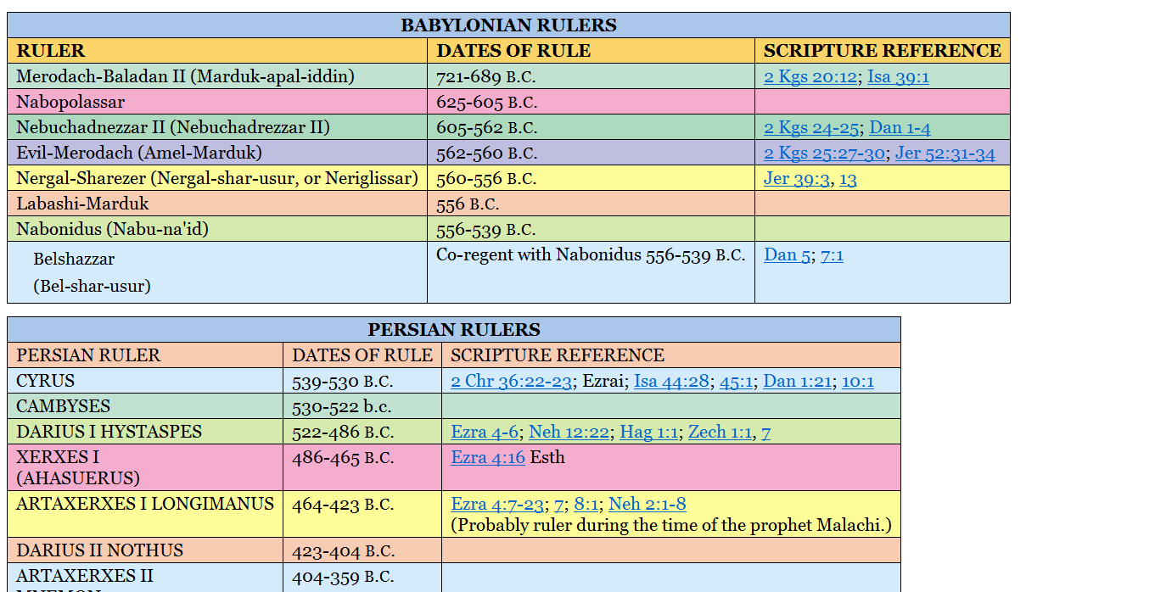
605-538 BC
Return From Exile
Babylonian Captivity
697-642
640-609
Jotham

Slide 16
The Role of the Prophets
They are Spokesmen for God, serving as “forthtellers,” speaking what God put in their mouth.
They are Preachers of the Covenant, relating their message to God’s previous promises to the nation of Israel. These covenants were made with or through Abraham, Moses, and David
They are historians, or Interpreters of the Israelites’ History. With out their interpretation God’s people would not know why an event was occurring.

Slide 17
God’s Test for a Prophet
Deuteronomy 18:18-22(ESV) ¹⁸I will raise up for them a prophet like you from among their brothers.
And I will put my words in his mouth, and he shall speak to them
all that I command him.
¹⁹And whoever will not listen to my words that he shall speak in my name, I myself will require it of him.
²⁰But the prophet who presumes to speak a word in my name that I have not commanded him to speak, or who speaks in the name of other gods, that same prophet shall die.’
²¹And if you say in your heart, ‘How may we know the word that the Lord has not spoken?’—
²² when a prophet speaks in the name of the Lord, if the word does not come to pass or come true, that is a word that the Lord has not spoken; the prophet has spoken it presumptuously. You need not be afraid of him.

Slide 18
Outline - Ezekiel
Part I: Call of Ezekiel (1:1–3:27)
Part II: Judgment of Judah & Jerusalem (4-24)
• Jews false hope, fueled by words of false prophets.
• God’s punishment due to their worship of idols.
• The exiles must repent and turn back to God.
• Destruction is imminent and certain.
Part III: Judgment of Gentile Nations (25-32)
• The rejoicing at Judah’s destruction by nations would be turned to sorrow with their destruction.
• God rules in the affairs of all nations,
Part IV: Restoration of Israel (33-48)
• Judah & Israel brought back to land as one nation.
• God will save his righteous remnant and fulfill his promise of the Messiah.
• We are given a symbolic view of the temple/worship and land of the future.

Slide 19
Key Expressions in the Book of Ezekiel
“The word of the Lord came to me saying” Used 49 times
A claim to direct inspiration of the Holy Spirit for the things written. & used frequently in Jeremiah
2. “Thus says the Lord God” Used 64 times
Affirmation his message was the truth from God in contrast to false prophets telling people what their wished
3. “Son of Man” Used 93 times
• Often with “The word of the Lord came to me saying”.
4. “Ye shall know that I AM THE LORD” Used 63 times
Pivotal idea in the message of Ezekiel - God is in control and all will know
God’s sovereign power will be shown among all nations in all the following cases:
→ When Jerusalem is destroyed and people are taken captive to Babylon
→ When judgment comes upon the Gentile nations in the land
→ When God restores his people to their land
→ When God saves his righteous remnant to bring about the promise to Abraham.
5. “I the Lord have spoken it” Used 12 times
Refers back to the power of God’s spoken word in the creation of the world. Shows that God, who is unbound by time/space, could speak about events in human history years into the future as if they had already happened

Slide 21
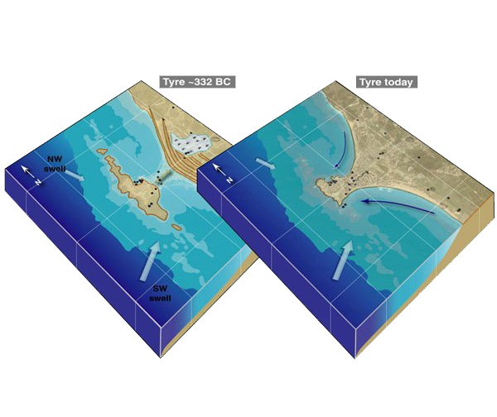
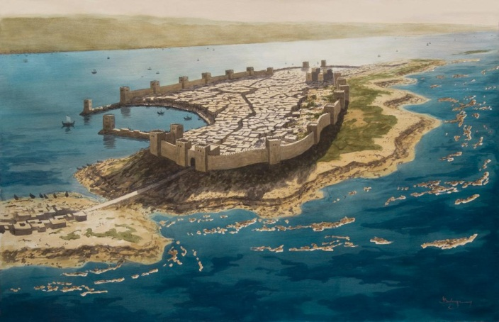
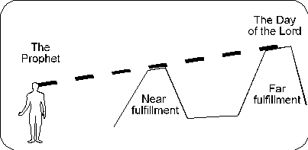
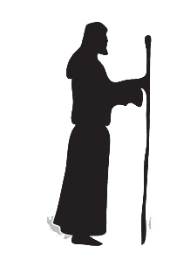
Prophecy Against Tyre-Ezekiel 26
~587/586 BC
Lifetime of Prophet
~585 to 572 BC
Long
Range
Prophecies
??
Medium
Range
Prophecies
Messianic
Short
Term
Today
Tomorrow
~322BC
Short Term Prophecies - ~585-572 BC 13yr siege of island
⁷“For thus says the Lord God: Behold, I will bring against Tyre from the north Nebuchadnezzar king of Babylon, king of kings, with horses and chariots, and with horsemen and a host of many soldiers.
Long-Range Prophecies
– Alexander the Great 322 BC
⁴They shall destroy the walls of Tyre and break down her towers, and I will scrape her soil from her and make her a bare rock. ¹²They will plunder your riches and loot your merchandise. They will break down your walls and destroy your pleasant houses. Your stones and timber and soil they will cast into the midst of the waters.

Slide 22
Keeping Captivities Straight
Daniel 1:1(ESV) ¹In the third year of the reign of Jehoiakim king of Judah, Nebuchadnezzar king of Babylon came to Jerusalem and besieged it.
Jehoiakim
Jeremiah 52:28-30(ESV) ²⁸This is the number of the people whom Nebuchadnezzar carried away captive: in the seventh year, 3,023 Judeans; ²⁹in the eighteenth year of Nebuchadnezzar he carried away captive from Jerusalem 832 persons; ³⁰in the twenty-third year of Nebuchadnezzar, Nebuzaradan the captain of the guard carried away captive of the Judeans 745 persons; all the persons were 4,600.
Jehoiachin
Zedekiah

Slide 23
RETURN OF THE
PEOPLE
Proclamation of Cyrus – Ezra 1
Return to Land Ezra - 2:1
TEMPLE ALTAR
Jeshua the priest and Zerubbabel - Ezra 3:2
TEMPLE
Haggai , Zechariah Zerubbabel & Darius the Persian- Ezra 5-6
LAW
Ezra Sent - Ezra 7
WALLS
Nehemiah Sent - Nehemiah
KING
Daniel 2, 7, 9-12

Slide 24
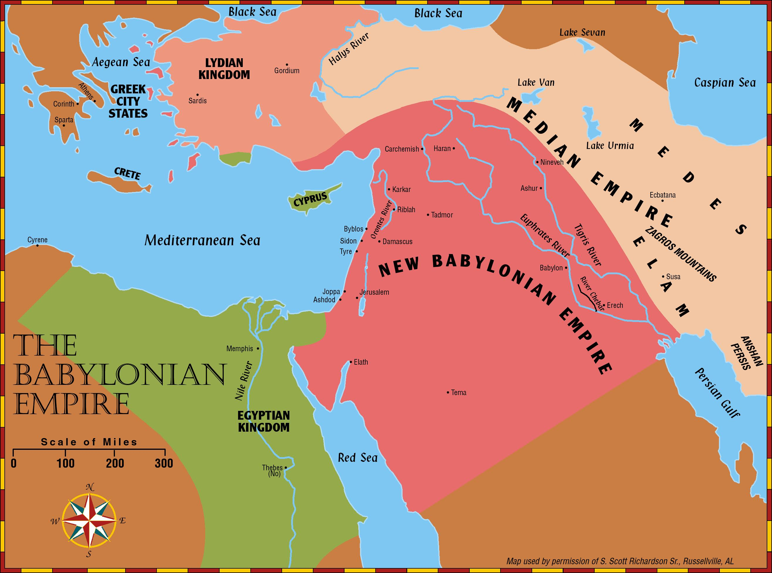
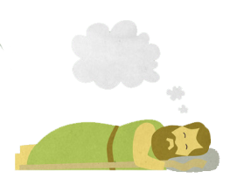
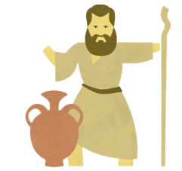
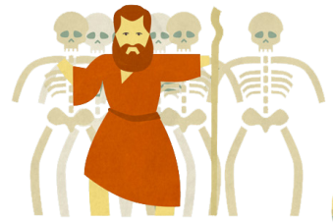
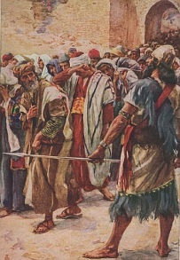
Daniel
Rulers
Jeremiah
Bad Figs
Ezekiel
Good Figs

Slide 25
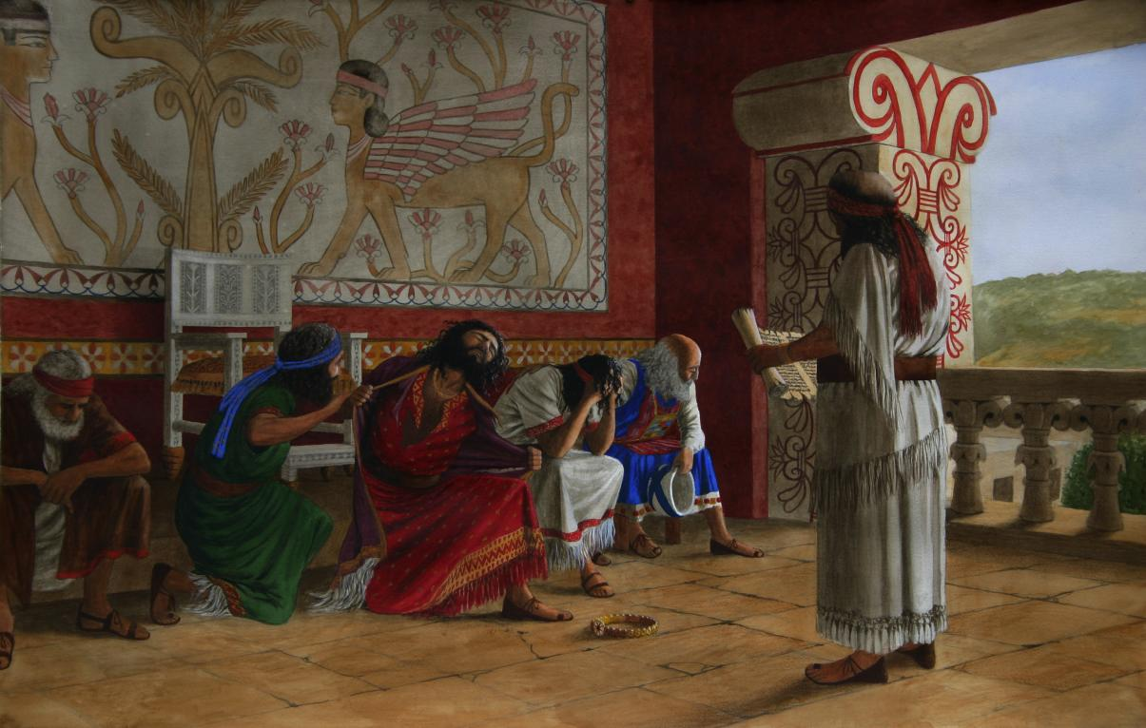
Book of Law Found – 2yrs before Daniel

Slide 26
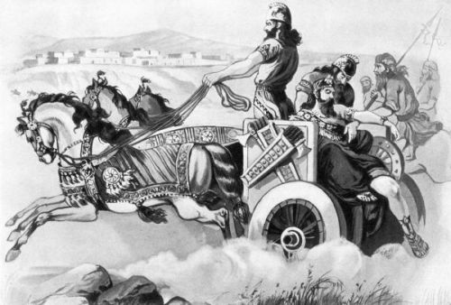
609 BC Death of Josiah - Daniel 11 yrs old
2 Chronicles 35:22-23(NKJV) ²²Nevertheless Josiah would not turn his face from him, but disguised himself so that he might fight with him, and did not heed the words of Necho from the mouth of God. So he came to fight in the Valley of Megiddo. ²³And the archers shot King Josiah; and the king said to his servants, “Take me away, for I am severely wounded.”

Slide 27
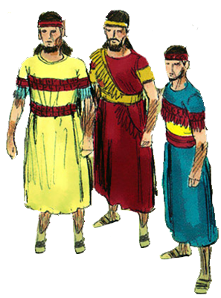
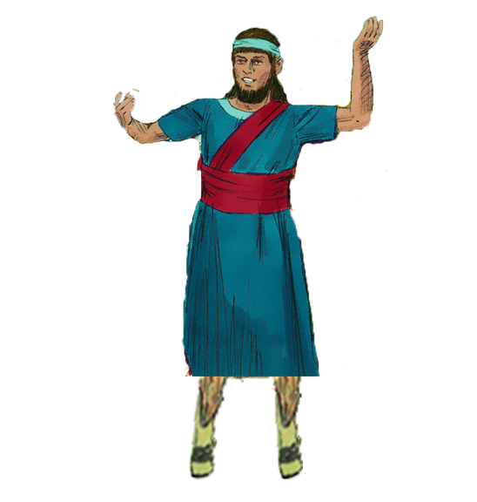
4 Hebrew Youth in Babylon – 605 BC Daniel 15 yrs old
Hananiah^{H}
“The Lord is gracious”
Daniel^{H}
“God is my Judge”
Shadrach^{B}
“Command of Aku”
Belteshazzar^{B}
“May Balak protect”
Mishael^{H}
“Who is what God is”
Meshach^{B}
“Who is what Aku is”
Azariah^{H}
“The Lord has helped”
Abenego^{B}
“Servant of Nebo”
Daniel was taken captive to Babylon in 605 BC.
He had excelled as a servant of God and as a Ruler.
He was given information about future world events.

Slide 28
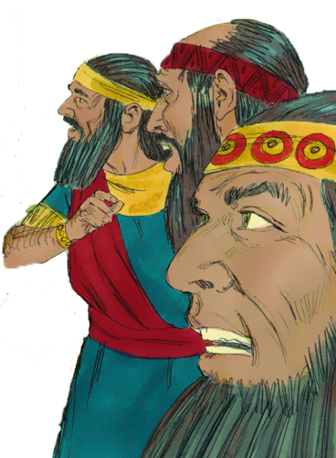
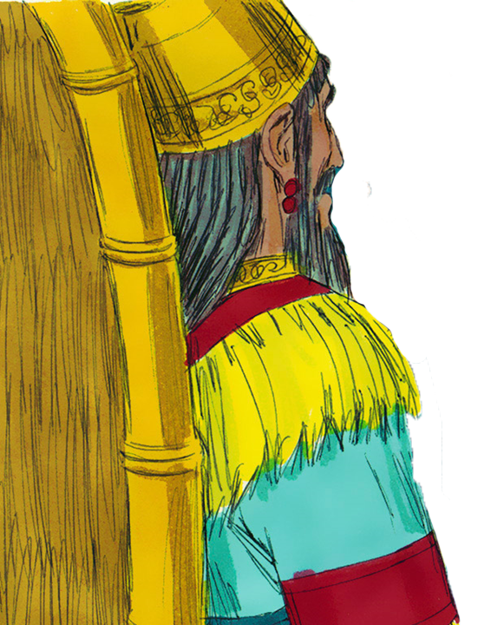
Daniel 2 – Metallic Man Vision 602 BC -Daniel 18 yrs
²⁷Daniel answered in the presence of the king, and said,
“The secret which the king has demanded, the wise men, the astrologers, the magicians, and the soothsayers cannot declare to the king. ²⁸But there is a God in heaven who reveals secrets, and He has made known to King Nebuchadnezzar what will be in the latter days. Your dream, and the visions of your head upon your bed, were these: ²⁹As for you, O king, thoughts came to your mind while on your
bed, about what would come to pass after this; and He who
reveals secrets has made known to you what will be. ³⁰But as for me, this secret has not been revealed to me
because I have more wisdom than anyone living, but for our
sakes who make known the interpretation to the king, and
that you may know the thoughts of your heart.

Slide 29
Background
Daniel was taken captive to Babylon in 605 BC.
He had excelled as a servant of God and as a Ruler.
He was given information about future world events.
Jerusalem was destroyed in 586 BC.
The people were scattered (Nation was non-existent).
Daniel 9 occurs in the 1st year of Darius: 539 BC.
Babylon had just fallen.
It had been about 66 years since the captivity began.
Cyrus was rising to power.
Daniel was in his 80’s.

Slide 30
Jerusalem Destroyed – 586 BC Daniel 34 yrs old

Slide 31
Madness of Nebucahdnessar Daniel 4 ~ 565 BC? Daniel 55 yrs old

Slide 32
Writing on the Wall – 539 BC Daniel 81 yrs old

Slide 33
Theme of Daniel
And He changes the times and the seasons; He removes kings and raises up kings; He gives wisdom to the wise And knowledge to those who have understanding. (Dan 2:21)
In order that the living may know That the Most High rules in the kingdom of men, Gives it to whomever He will, And sets over it the lowest of men.’ (Dan 4:17)
And you have lifted yourself up against the Lord of heaven. They have brought the vessels of His house before you, and you and your lords, your wives and your concubines, have drunk wine from them. And you have praised the gods of silver and gold, bronze and iron, wood and stone, which do not see or hear or know; and the God who holds your breath in His hand and owns all your ways, you have not glorified. (Dan 5:23)

Slide 34
Precursor Prophecies
Leviticus 26
Deuteronomy 28
II Kings 20:16 Isaiah 39:7
Isaiah 44:23 – 45:1
Jeremiah 25
Jeremiah 29
(see Matt 24:15)
Desolation, scattering
Foreign King (far away)
Babylon to take sons away
‘Cyrus’ to allow a return
Babylon punished in 70 yrs
People to return in 70 yrs
“… spoken of by Daniel…”

Slide 35
God’s Prophets
Leviticus 26
Deuteronomy 28
~800 yrs
605-586 BC
Matthew 24
Daniel
600 yrs
1400 BC
Isaiah 39, 44
100+ yrs
30/70 AD
701 BC
Jeremiah 25, 29
70+ yrs
536 BC

Slide 36
Overview
Captive
But obey
Food God’s Laws
Hebrew
Taken
Into
Captivity
Hebrew
Daniel 10:14(NKJV) ¹⁴Now I have come to make you understand what will happen to your people in the latter days, for the vision refers to many days yet to come.”
Chapter 1
Aramaic
Interprets
Nebuchadnezzar’s
Dream
God Controls Rise & Fall of Kingdoms
Chapter 2
Chapter 3
Fiery
Furnace
Pray to God not Objects
Interprets
Nebuchadnezzar’s
Dream
God Humbles Powerful Dynasty building Kings
Chapter 8
Chapter 4
Ram &
Goat
Chapter 5
Interprets
Writing on
The Wall
God Humbles Vain Spoiled Bad Kings
MENE, MENE,
TEKEL, UPHASSIN
Chapter 9
Prays for Return
& 70 Weeks
Return from Exile
538 BC
Chapter 6
Lion’s
Den
Pray to God not Kings
Chapter
10-12
Chapter 7
God Controls Rise & Fall of Kingdoms
Israel’s
Future
Beast from Sea

Slide 37
Characters from Daniel
Four Hebrew Men in Babylon
Ch 1-2,4-12
Daniel^{H}
“God is my Judge”
Belteshazzar^{B}
“May Balak protect”
Ch 1,3
Shadrach^{B}
“Command of Aku”
Hananiah^{H}
“The Lord is gracious”
Ch 1,3
Meshach^{B}
“Who is what Aku is”
Mishael^{H}
“Who is what God is”
Ch 1,3
Abenego^{B}
“Servant of Nebo”
Azariah^{H}
“The Lord has helped”
Two Kings of Babylon
Ch 1-4
Nebuchadnezzar
“Nebo, protect the crown”
Ch 5,7,8
Belshazzar
“Bel protect the king”
Two Kings of Medo-Persian
Ch 1,6,10
Cyrus the Persian
“Throne”
Ch 5-6,9,11
Darius the Mede – governor of Babylon
“Preserver”

Slide 38
Nebuchadnezzar’s Dream Daniel 2
Babylonian
605-539 BC
Medo
-Persian
539-331 BC
70 yrs
Greek
331-168/63 BC
300 yrs
Roman
168/63 BC
-476 AD
500 yrs
Notes:
Animated

Slide 39
Nebuchadnezzar
“you are the head of gold”
Babylon
“and yet a third kingdom of bronze, which shall rule over all the earth” Greek 331-168/63 BC
604-568 BC
And there shall be a fourth kingdom, strong as iron …feet and toes, partly of potter’s clay and partly of iron Roman 168/63 BC– 476 AD
“Another kingdom inferior to you shall arise after you” Persia 539-331 BC
604-536 BC
Daniel 2
in the days of those kings the God of heaven will set up a kingdom that shall never be destroyed
4BC-30/33 AD

Slide 40
Nebuchadnezzar’s Dream Daniel 2
Daniel 2:34-35(NKJV) ³⁴You watched while a stone was cut out without hands, which struck the image on its feet of iron and clay, and broke them in pieces. ³⁵Then the iron, the clay, the bronze, the silver, and the gold were crushed together, and became like chaff from the summer threshing floors; the wind carried them away so that no trace of them was found.
And the stone that struck the image became
a great mountain and filled the whole earth.
Daniel 2:44-45(NKJV) ⁴⁴And in the days of these kings the God of heaven will set up a kingdom which shall never be destroyed; and the kingdom shall not be left to other people; it shall break in pieces and consume all these kingdoms, and it shall stand forever.
Notes:
Animated

Slide 41
Setting Up an Eternal Kingdom
Daniel 2:44(NKJV) ⁴⁴And in the days of these kings the God of heaven will set up a kingdom which shall never be destroyed; and the kingdom shall not be left to other people; it shall break in pieces and consume all these kingdoms, and it shall stand forever.
Mark 1:14-15(NKJV) ¹⁴Now after John was put in prison, Jesus came to Galilee, preaching the gospel £of the kingdom of God, ¹⁵and saying, “The time is fulfilled, and the kingdom of God is at hand. Repent, and believe in the gospel.”
Mark 9:1(NKJV) ¹And He said to them, “Assuredly, I say to you that there are some standing here who will not taste death till they see the kingdom of God present with power.”

Slide 42
Daniel’s Prayer What 3 things Daniel asked from God?
Daniel 9:17(NKJV) ¹⁷Now therefore, our God, hear the prayer of Your servant, and his supplications, and for the Lord’s sake cause Your face to shine on Your sanctuary, which is desolate.
Daniel 9:19(NKJV) ¹⁹O Lord, hear! O Lord, forgive! O Lord, listen and act! Do not delay for Your own sake, my God, for Your city and Your people are called by Your name.”
Daniel 9:18(NKJV) ¹⁸O my God, incline Your ear and hear; open Your eyes and see our desolations, and the city which is called by Your name; for we do not present our supplications before You because of our righteous deeds, but because of Your great mercies.

Slide 43
Three Returns
rebuilt

Slide 44
Promise of Return after Seventy Years Captivity
Jeremiah 25:11-12(ESV) ¹¹This whole land shall become a ruin and a waste, and these nations shall serve the king of Babylon seventy years. ¹²Then after seventy years are completed, I will punish the king of Babylon and that nation, the land of the Chaldeans, for their iniquity, declares the Lord, making the land an everlasting waste.
Jeremiah 29:10-14(ESV) – Letter to Exiles in Babylon ¹⁰“For thus says the Lord: When seventy years are completed for Babylon, I will visit you, and I will fulfill to you my promise and bring you back to this place. ¹¹For I know the plans I have for you, declares the Lord, plans for wholeness and not for evil, to give you a future and a hope.
~70 years
609 BC
Necho
70 years
586 BC
Jerusalem
Temple
Destroyed
539 BC
Cyrus Conquers Babylon
520 BC
Haggai-rebuild Temple
605 BC
1st Captives
597 BC
2nd Captives
522 BC
Darius becomes emperor
538 BC Edict Go Home
537 BC Rebuild altar & foundation
516 BC
Temple finish

Slide 45
Daniel 9:1-2 (ESV) ¹ In the first year of Darius the son of Ahasuerus, by descent a Mede, who was made king over the realm of the Chaldeans— ² in the first year of his reign, I, Daniel, perceived in the books the number of years that, according to the word of the LORD to Jeremiah the prophet, must pass before the end of the desolations of Jerusalem, namely, seventy years.

Slide 46
Prayer Answered
Daniel 9:20-21(NKJV) ²⁰Now while I was speaking, praying, and confessing my sin and the sin of my people Israel, and presenting my supplication before the Lord my God for the holy mountain of my God, ²¹yes, while I was speaking in prayer, the man Gabriel, whom I had seen in the vision at the beginning, being caused to fly swiftly, reached me about the time of the evening offering.
²² He made me understand, speaking with me and saying,
“O Daniel, I have now come out to give you insight and understanding. ²³ At the beginning of your pleas for mercy a word went out, and I have come to tell it to you, for you are greatly loved. Therefore consider the word and understand the vision.

Slide 47
341
5th Syrian War 202-195 BC – 11:15-17
400+ Years of Silence
Chapter 11
Antiochus III & Seleucus IV 187- 175 BC – 11:18-20
Alexander the Great 336-323 BC – 11:3-4
Seleucus Nicator I 311-280 BC – 11:5
3rd Syrian War 246-241 BC – 11:7-9
Battle of Raphia 217 BC – 11:10-14
Daniel
Xerxes I invades Greece 480 BC
Antiochus IV Epiphanes 175-164 BC – 11:21-35
Roman Empire Augustus –4 BC/14 AD 11:45
536 BC
56 yrs
200 yrs
256
319
532/550 yrs
296
361
372

Slide 48
Matthew 2:7-12(ESV) ¹Now after Jesus was born in Bethlehem of Judea in the days of Herod the king, behold, wise men£ from the east came to Jerusalem, ²saying, “Where is he who has been born king of the Jews? For we saw his star when it rose and have come to worship him.”

Slide 49
Angel’s Final Message
Daniel 12:4(NKJV) ⁴“But you, Daniel, shut up the words, and seal the book until the time of the end; many shall run to and fro, and knowledge shall increase.”

