Slide 1
Lesson 12
Return from Exile

Slide 2
Kings of United & Divided Kingdom
United
Kingdom
Divided Kingdom
Judah Alone
Early Kings – Israel
Dynasty 1&2
Omri
Dynasty 3
Jehu
Dynasty 4
Confusing
Dynasties
Hezekiah
Hezekiah
(728-686)
Manasseh
Amon
1
Jereboam
Nadab
3
Omri
Ahab
(874-853)
Ahaziah
Jehoram
4
Jehu
(841-814)
Jehoahaz
Jehoash
Jereboam II
(793-753)
Zechariah
Shallum
Menahem
Pekaiah
Pekah
Hosea
(732-722)
5
Saul
(1050-1010)
David
(1010-970)
Solomon
(970-930)
2
Baasha
Elah
Josiah &
Sons
Zimri ~ 885
Tibni
Josiah
(640-609)
Jehoahaz
Jehoiakim
Jehoiachin
Zedekiah
(597-586)
Early Kings – Judah
Dynasty 1&2
Omri
Dynasty 3
Jehu
Dynasty 4
Confusing
Dynasties
Rehoboam
Abijam
Asa
(930-870)
Jehosphat
(873-848)
Jehoram
Ahaziah
Athaliah
Joash
Amaziah
Azariah/Uzziah
(790-739)
Jotham
Ahaz
Hezekiah
Judah Return
Zerubbabel (538-515)
Ezra (458-456)
Nehemiah (444-432)

Slide 3
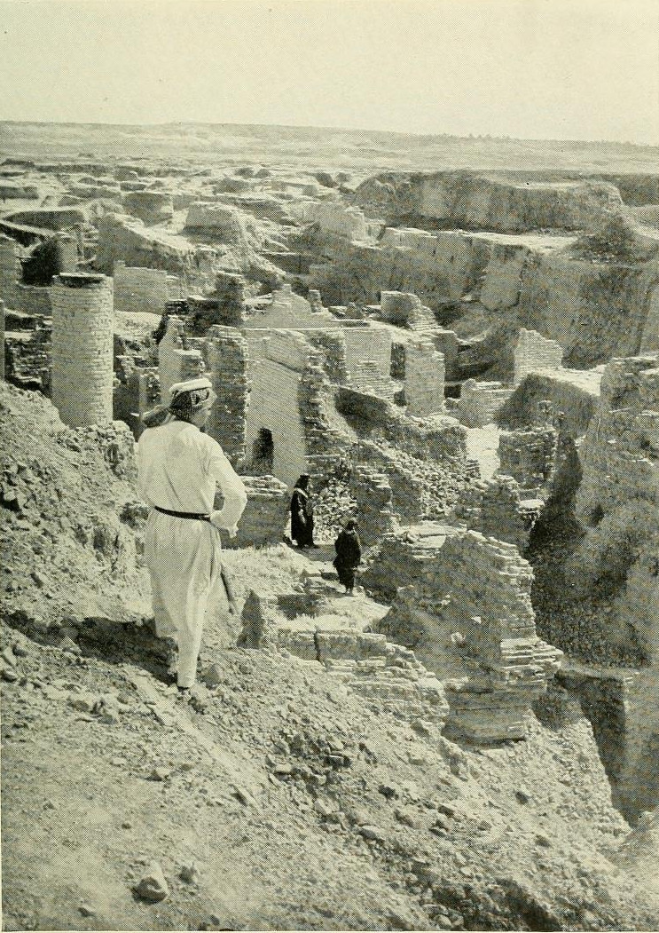
Return from Captivity
Can this be rebuilt?
Why did Jehovah let this happen?
What about a king?
What about the temple?
What do I do to keep this from happening again?

Slide 4
RETURN OF THE
PEOPLE
Proclamation of Cyrus – Ezra 1
Return to Land Ezra - 2:1
TEMPLE ALTAR
Jeshua the priest and Zerubbabel - Ezra 3:2
TEMPLE
Haggai , Zechariah Zerubbabel & Darius the Persian- Ezra 5-6
LAW
Ezra Sent - Ezra 7
WALLS
Nehemiah Sent - Nehemiah
KING
Daniel 2, 7, 9-12

Slide 5
Ahijah
Jehu
Man of God
Micaiah
Man of God
Syria
Shemaiah
Azariah
Hanani
Assyria
Babylon/Persia

Slide 6
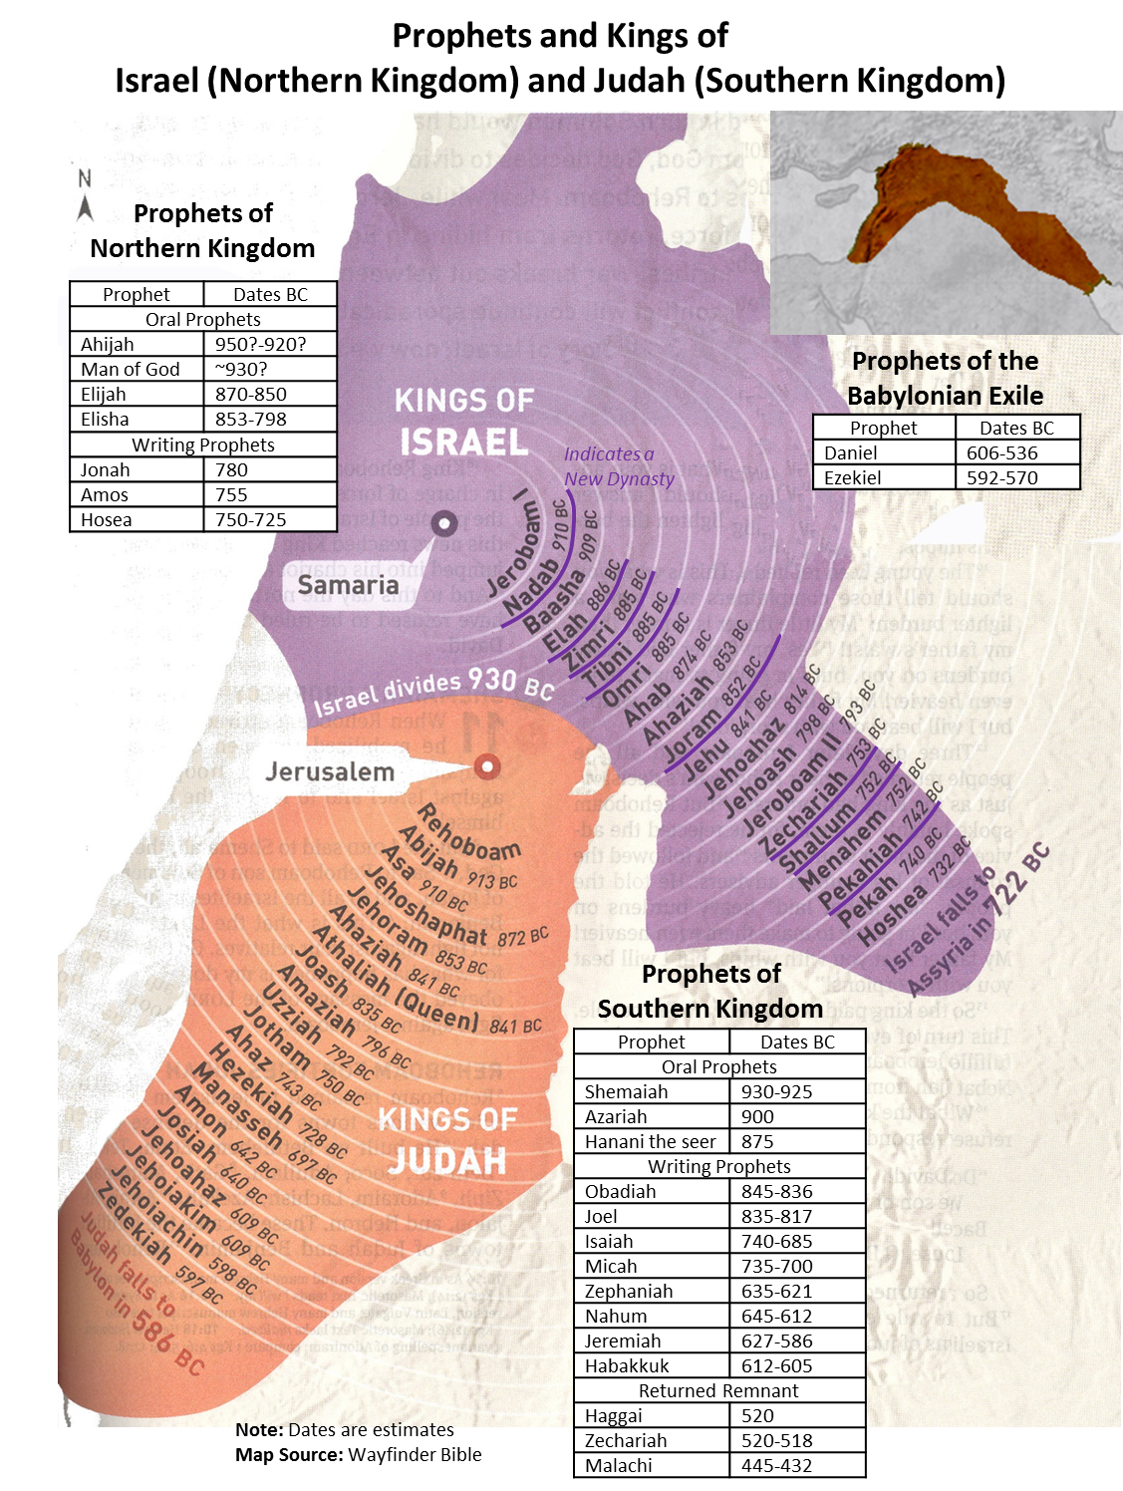

Slide 7
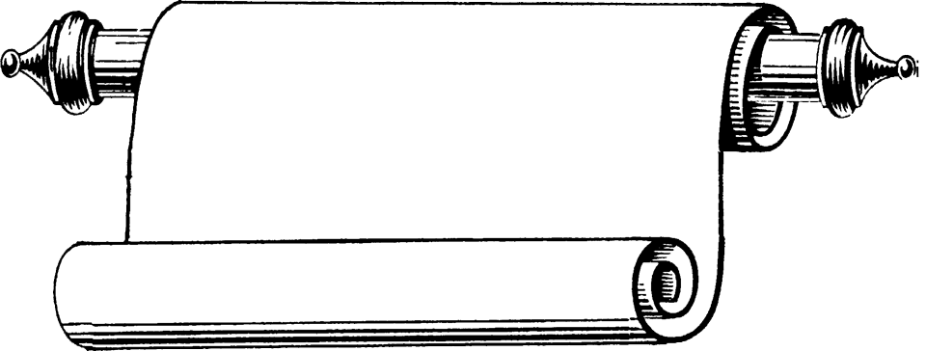
Edomites invaded Judah just as Judah was being ransacked - prophesies Edom's downfall
The
Judges
OBADIAH
845 Edom
JOEL
Judah see severe locust plague as a coming
Day of the LORD
830
Told to preach in Nineveh resulted in his being swallowed by a fish & city repenting
Kings & Prophets
JONAH
780 Nineveh
Israel, repent of injustice and idolatry or else go into exile
AMOS
Divided Kingdom
Israel & Judah
755
HOSEA
His life with adulterous wife like God & Israel
750-725
MICAH
Judah, repent of injustice and idolatry or else go into exile
735-700
ISAIAH
Isaiah 1-6 Reason for God’s Actions &
Isaiah’s Call
Isaiah 7-35 Immediate threat & Judgments
Isaiah 36-39 Historical account of siege
Isaiah 40-66 Cyrus, Future Threats & Hopes
740-690

Slide 8
Kings & Prophets
NAHUM
Divided Kingdom
Judah Alone
& Fall of Judah
The prophet predicts the fall of Nineveh
630-612 Nineveh
ZEPHANIAH
Prophet emphasizes the need for the people of Judah to turn away from idolatry
630-625
HABAKKUK
"Why do the wicked and cruel Babylonians go unpunished?" Prophet finds his answer in God's goodness and wisdom
612-606
Jer 1-20 Sermons & prophecies during Josiah
Jer 21-39 Prophecies of Specific Events
Jer 40-45 Sermons after fall of Israel
Jer 46-51 God’s Judgment on Foreign Nations
Jer 52 Fall of Jerusalem
JEREMIAH
627-586
LAMENTATIONS
Jeremiah cries from the depths of his heart over the destruction of Jerusalem
586

Slide 9
God Rules
Kings & Prophets
DANIEL
Daniel 1-6 Daniel & Friends at Babylonian
Court
Daniel 7-12 The Visions of Daniel
NAHUM
Babylonian Captivity
The prophet predicts the fall of Nineveh
EZEKIEL
Ezekiel 1-3 Inaugural Vision
Ezekiel 4-24 Judgment on Jerusalem & Judah
Ezekiel 25-32 Oracles against Foreign Nations
Ezekiel 33-39 After the Fall of Jerusalem
Ezekiel 40-48 Vision of Restoration
ZEPHANIAH
Prophet emphasizes the need for the people of Judah to turn away from idolatry
Settle in for 70 years
Edomites invaded Judah just as Judah was being ransacked - prophesies Edom's downfall
OBADIAH
"Why do the wicked and cruel Babylonians go unpunished?" Prophet finds his answer in God's goodness and wisdom
HABAKKUK
2 Chron 29-32 Hezekiah observes passover
2 Chron 33 Manasseh & Amon
2 Chron 34-35 Josiah – cleanses the land
2 Chron 36 Jehoahaz, Jehoiakim, Jehoiachin
& Zedekiah & Fall of Jerusalem
Rebuild Temple
Proclaimed God's command to rebuild the temple, the glory of the second temple would exceed that of the first temple
HAGGAI
Return from Exile
Turn back to Lord
Like Haggai, urges the people to complete temple. Stresses they must be a holy people. He is certain that the Messiah will come.
ZECHARIAH
You robbed God
MALACHI
Rebuked God's people for specific violations of covenant, but also prophesied the coming of the Messenger who will set all things right.

Slide 10
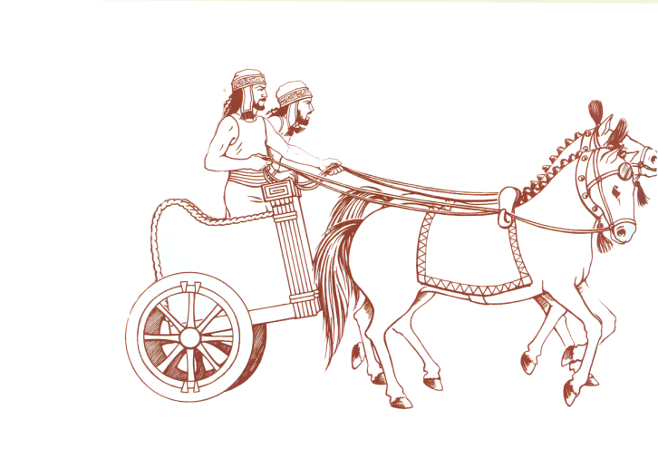
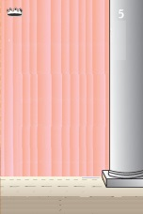
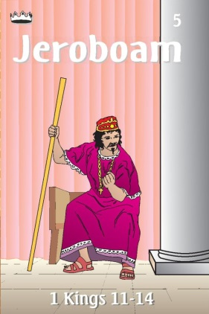
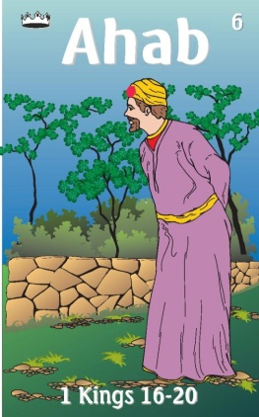
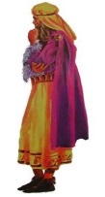
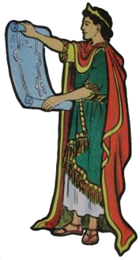
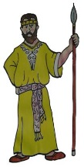
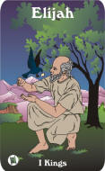
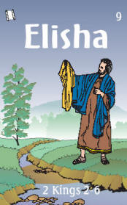
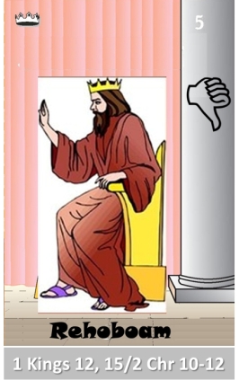
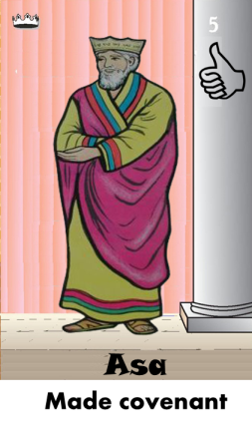
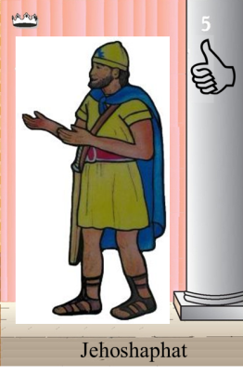
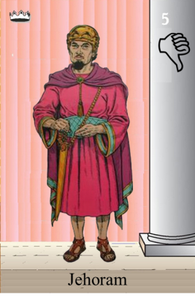
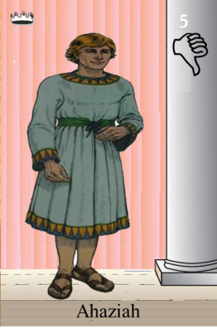
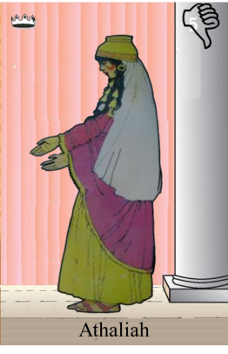
Ahaziah
Jehoram
Killed by Jehu
Baasha
Jehu
Ahijah
Man of God
Rocks for
Mizpah & Geba
Early Kings
Omri Kings
Jehu Kings
Brings in Syria
Obadiah - 830
Killed by Jehu
Shemaiah
Azariah
Hanani the Seer

Slide 11
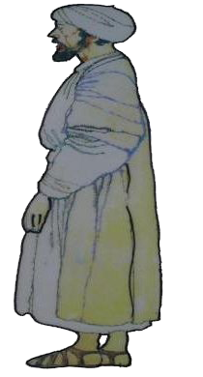
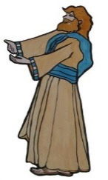
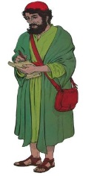
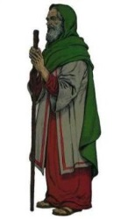
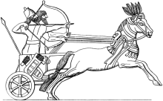
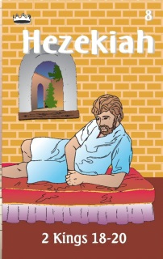
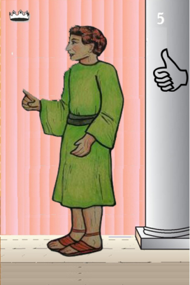
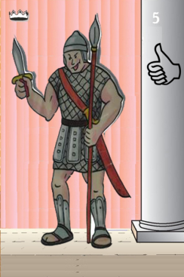
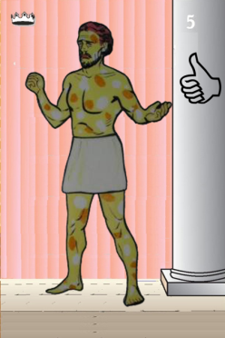
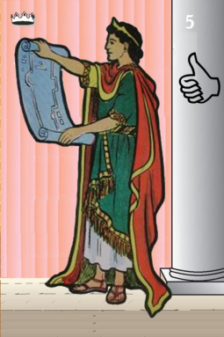
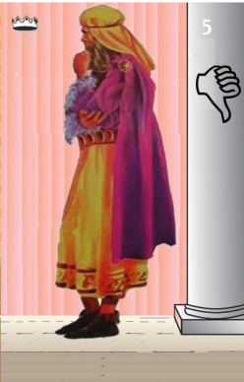
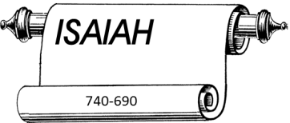
Jehu
841-814
Jehoahaz
Jehoash
Elisha &
the Arrows
Jeroboam II
Zechariah
Tiglath-pileser III
(745–727 b.c.)
793-753
Jehu Kings
Confusing
Brings in Assyria
Joash
Amaziah
Uzziah
Jotham
Ahaz
Jehoiada Made covenant

Slide 12
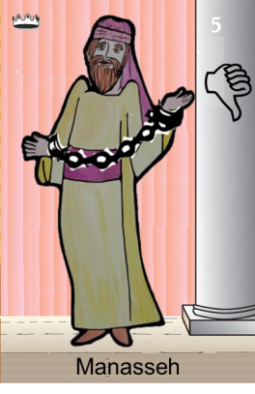
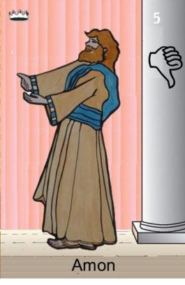
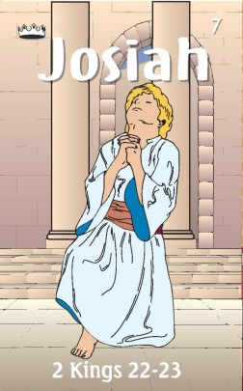
Confusing
Judah Alone
Tiglath-pileser III
(745–727 b.c.)
Shallum 752
Menahem 752-742
Pekahiah 742-740
Pekah(752) 740-732
Hoshea 732-722
697-642
640-609
Made covenant
Uzziah
Jotham
Ahaz

Slide 13
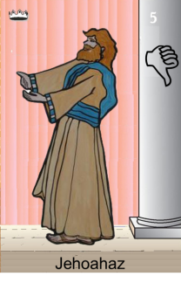
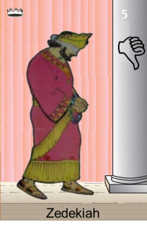
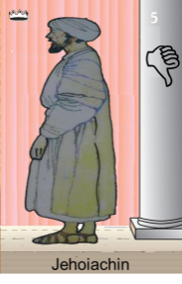
Confusing
Judah Alone
Tiglath-pileser III
(745–727 b.c.)
697-642
640-609
Shallum 752
Menahem 752-742
Pekahiah 742-740
Pekah(752) 740-732
Hoshea 732-722
Made covenant
609
609-597
Egypt
597-586
Babylon
Uzziah
Jotham
Ahaz
597
Babylon

Slide 14
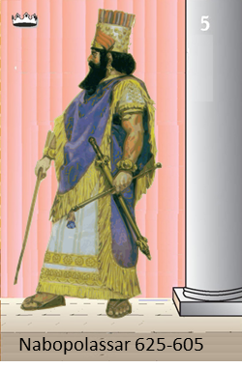
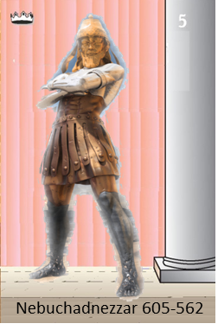
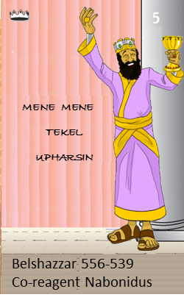
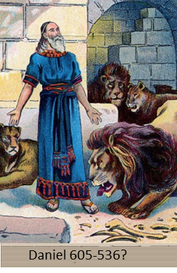
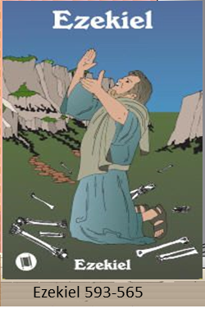
Judah Alone
605-538 BC
Return From Exile
640-609
Babylonian Captivity
538-425?
Daniel
605 BC
597 BC
586 BC

Slide 15
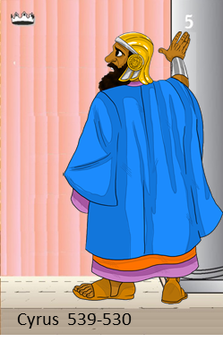
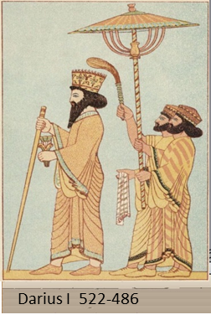
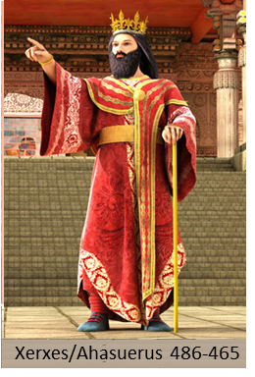
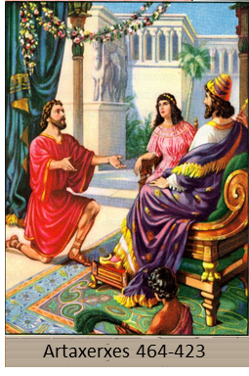
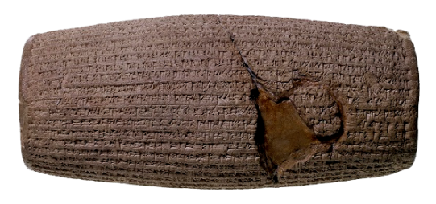
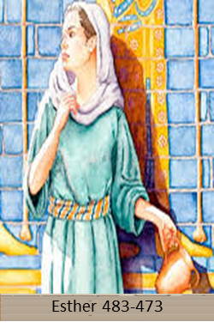
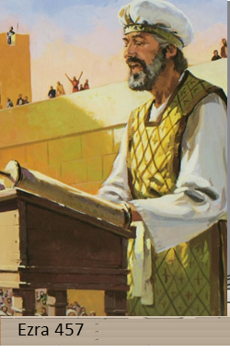
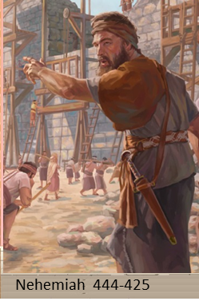
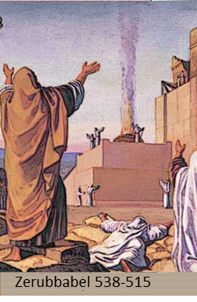
538-425? BC
Return From Exile
640-609
Cyrus Cylinder
Freeing People
537 Rebuild Altar
516 Rebuild Temple

Slide 16
Three Returns
rebuilt

Slide 17
Cyrus (559-530 BC)
Cyrus Cylinder
Darius I (522-486 BC)
Artaxerxes I
(465-424 BC)
Ezra 7 & Nehemiah
Cambyses
(530-522 BC)
rebuilt
Xerxes II
(424-423 BC)
Xerxes I
(also Ahasuerus)
486-465 BC
Ezra 4:6
Darius II (423-404 BC) – Last Persian king mentioned (Neh. 12:22)
Notes:
VI. Persian kings during the period of the books of Ezra and Nehemiah
1. Cyrus (559-530 BC) – Founder of the Persian Empire. In 539 BC Babylon fell to him without a struggle. His policy included returning people and their gods back to their homelands, thus fulfilling Isaiah 44:28, 45:1ff. The “Cyrus Cylinder”, a record of some of the Persian policies reads as follows:
“I returned to these sacred cities…, the sanctuaries of which have been in ruins for a long time, the images which (used) to live therein and established for them permanent sanctuaries. I (also) gathered all their (former) inhabitants and returned (to them) their habitations…
May all the gods whom I have resettled in their sacred cities ask daily Bel and Nebo for a long life for me…, to Marduk, my lord, may they say this: “Cyrus, the king who worships you, and Cambyses, his son…”
2. Cambyses (530-522 BC)
3. Darius I (522-486 BC) – The first several years of his reign, he spent putting down revolts. This was 520, when Haggai and Zechariah began prophesying, and in which year the work on the temple was resumed (see Ezra 5 and 6). The Persian empire reached the height of its power during the reign of Darius.
4. Xerxes I (also called Ahasuerus 486-465 BC) – He is mentioned in passing in Ezra 4:6. He was the king of Persia during the time of Esther.
5. Artaxerxes I (465-424 BC) – Persian king whose reign encompasses Ezra 7 to the end of the book and the entire book of Nehemiah. In the early years of his reign, there was a revolt in Egypt, so Ezra’s trip to nearby Judah in 458 BC could have been politically useful to him. Several years later (449 BC) his own governor of Syria revolted. The king’s sensitivity to unrest in the region can be seen in his response to accusations that the Jews might also try to revolt (Ezra 4:7ff). He recognized a man he could trust, however, in Nehemiah and appointed him governor of Judah in 445.
6. Xerxes II (424-423 BC)
7. Darius II (423-404 BC) – Last Persian king mentioned by Nehemiah (Neh. 12:22)
Darius II (423-404 BC) – Last Persian king mentioned by Nehemiah (Neh. 12:22)

Slide 18
Return to Lord = Visions of Better Time
You rob God & Priest corrupted
Rebuild Temple
Malachi
538-515 BC
Haggai
Zechariah
457 BC
444-425 BC
REBUILD TEMPLE
REBUILD WORSHIP
LAW
REBUID WALLS

Slide 19
Dates/Books of Return from Exile

Slide 21
Haggai 1:3-6(ESV) ³Then the word of the Lord came by the hand of Haggai the prophet, ⁴“Is it a time for you yourselves to dwell in your paneled houses, while this house lies in ruins? ⁵Now, therefore, thus says the Lord of hosts: Consider your ways. ⁶You have sown much, and harvested little. You eat, but you never have enough; you drink, but you never have your fill. You clothe yourselves, but no one is warm. And he who earns wages does so to put them into a bag with holes.

Slide 23
Zechariah 1:1-6(ESV) ¹In the eighth month, in the second year of Darius, the word of the Lord came to the prophet Zechariah, the son of Berechiah, son of Iddo, saying, ²“The Lord was very angry with your fathers. ³Therefore say to them,
Thus declares the Lord of hosts: Return to me, says the Lord of hosts, and I will return to you, says the Lord of hosts.
⁴Do not be like your fathers, to whom the former prophets cried out,
‘Thus says the Lord of hosts, Return from your evil ways and from your evil deeds.
’ But they did not hear or pay attention to me, declares the Lord. ⁵Your fathers, where are they?
And the prophets, do they live forever? ⁶But my words and my statutes, which I commanded my servants the prophets, did they not overtake your fathers? So they repented and said, As the Lord of hosts purposed to deal with us for our ways and deeds, so has he dealt with us.”
You have holes in your pockets.
Rebuild the Temple
You robbed God, Stop!
Return to me
Messiah is coming
Haggai
Zechariah
Malachi

Slide 24
Zechariah
I Call to Repentance 1:1-6
II Nine Visions 1:7-6:15
III Question about Fasts 7:1-8:23
IV Two Oracles/Predictions of the Future 9:1-14:21
A. Coming & Rejection of Messiah 9:1-11:17
B. Reign of Messiah 12:1-14:21

Slide 25
Zechariah’s Flow

Slide 26
Men of Bethel have a question
Zechariah 7:1-3(ESV) ¹In the fourth year of King Darius, the word of the Lord came to Zechariah on the fourth day of the ninth month, which is Chislev. ²Now the people of Bethel had sent Sharezer and Regem-melech and their men to entreat the favor of the Lord, ³saying to the priests of the house of the Lord of hosts and the prophets,
“Should I weep and abstain in the fifth month, as I have done for so many years?”
Lord has a question
Zechariah 7:4-5 the Lord asks a question ⁴Then the word of the Lord of hosts came to me: ⁵“Say to all the people of the land and the priests, When you fasted and mourned in the fifth month and in the seventh, for these seventy years, was it for me that you fasted?

Slide 27
2Kg 25 Siege of Jerusalem starts 10th month
^{8:19}“Thus says the Lord of hosts: The fast of the fourth month and the fast of the fifth and the fast of the seventh and the fast of the tenth
Early Rain, when they sowed their seed,
4”
5”
2”
6”
1”
5”
7th Month – Fast Day of Atonement
2”
0”
Latter Rain fell about April, served to fill the ears, and render them plump and perfect.
Jer 41 Gedaliah Killed -7th mon
0”
0”
2Kgs 25 5th month
Temple/city burns-Fast
0”
0”
2Kgs 25 4th month
Jerusalem falls-Fast

Slide 28
Feast Not Fasting
Zechariah 8:18-23(ESV) ¹⁸And the word of the Lord of hosts came to me, saying, ¹⁹“Thus says the Lord of hosts: The fast of the fourth month and the fast of the fifth and the fast of the seventh and the fast of the tenth shall be to the house of Judah seasons of joy and gladness and cheerful feasts. Therefore love truth and peace. ²⁰“Thus says the Lord of hosts: Peoples shall yet come, even the inhabitants of many cities. ²¹The inhabitants of one city shall go to another, saying, ‘Let us go at once to entreat the favor of the Lord and to seek the Lord of hosts; I myself am going.’ ²²Many peoples and strong nations shall come to seek the Lord of hosts in Jerusalem and to entreat the favor of the Lord. ²³Thus says the Lord of hosts: In those days ten men from the nations of every tongue shall take hold of the robe of a Jew, saying, ‘Let us go with you, for we have heard that God is with you.’”

Slide 29
Ezra 7:6 (ESV) ⁶ this Ezra went up from Babylonia. He was a scribe skilled in the Law of Moses that the LORD, the God of Israel, had given, and the king granted him all that he asked, for the hand of the LORD his God was on him.
Ezra 7:9-10 (ESV) ⁹ For on the first day of the first month he began to go up from Babylonia, and on the first day of the fifth month he came to Jerusalem, for the good hand of his God was on him.
¹⁰ For Ezra had set his heart to study the Law of the LORD, and to do it and to teach his statutes and rules in Israel.

Slide 30
Ezra’s – Concern on Marriages
Ezra 9:2-6(ESV) ²For they have taken some of their daughters to be wives for themselves and for their sons, so that the holy race has mixed itself with the peoples of the lands. And in this faithlessness the hand of the officials and chief men has been foremost.” ³As soon as I heard this, I tore my garment and my cloak and pulled hair from my head and beard and sat appalled. ⁴Then all who trembled at the words of the God of Israel, because of the faithlessness of the returned exiles, gathered around me while I sat appalled until the evening sacrifice. ⁵And at the evening sacrifice I rose from my fasting, with my garment and my cloak torn, and fell upon my knees and spread out my hands to the Lord my God, ⁶saying: “O my God, I am ashamed and blush to lift my face to you, my God, for our iniquities have risen higher than our heads, and our guilt has mounted up to the heavens.

Slide 31
Ezra Prays
We have has great guilt from days of our fathers
You thus given us into hands of other kings
Brought sword, plunder, & utter shame
Favored us and brought remnant back to land to give us a secure home in your holy place
We are slaves
You have not forsaken us
Given Persians place in World order to love your people
Made it so Persians give money to repair ruins and protect us
But we have forsaken your commandments
People formerly in this land are impure and an abomination
Therefore do not give your sons or daughters for marriage to them
Does this so you may be strong, eat good and live an inheritance to your children forever
Because we did not obey you punished less than we deserved & given us a remnant
Shall we again break your commandments again and intermarry with people who practice abominations
Would you not again consume us and leave no remnant
Lord is just, we are guilty & none can stand before you

Slide 32
People Listen
Ezra 10:9(ESV) ⁹Then all the men of Judah and Benjamin assembled at Jerusalem within the three days. It was the ninth month, on the twentieth day of the month. And all the people sat in the open square before the house of God, trembling because of this matter and because of the heavy rain.
Ezra 10:16-17(ESV) ¹⁶Then the returned exiles did so. Ezra the priest selected men,£ heads of fathers’ houses, according to their fathers’ houses, each of them designated by name. On the first day of the tenth month they sat down to examine the matter; ¹⁷and by the first day of the first month they had come to the end of all the men who had married foreign women.

Slide 33
Ezra Reads the Law
Nehemiah 8:2-3(ESV) ²So Ezra the priest brought the Law before the assembly, both men and women and all who could understand what they heard, on the first day of the seventh month. ³And he read from it facing the square before the Water Gate from early morning until midday, in the presence of the men and the women and those who could understand. And the ears of all the people were attentive to the Book of the Law.

Slide 34
Nehemiah – A Leader of Action
Then I said to them, “You see the distress that we are in, how Jerusalem lies waste, and its gates are burned with fire. Come and let us build the wall of Jerusalem, that we may no longer be a reproach.” Nehemiah 2:17 | So we built the wall, and the entire wall was joined together up to half its height, for the people had a mind to work. Nehemiah 4:6 | And it happened, when all our enemies heard of it, and all the nations around us saw these things, that they were very disheartened in their own eyes; for they perceived that this work was done by our God. Nehemiah 6:15-16
And all the people gathered as one man into the square before the Water Gate. And they told Ezra the scribe to bring the Book of the Law of Moses that the LORD had commanded Israel. Nehemiah 8:1 They read from the book, from the Law of God, clearly, and they gave the sense, so that the people understood the reading. Nehemiah 8:8 | ³⁸ “Because of all this we make a firm covenant in writing; on the sealed document are the names of our princes, our Levites, and our priests. Nehemiah 9:38 Now the leaders of the people lived in Jerusalem. And the rest of the people cast lots to bring one out of ten to live in Jerusalem the holy city, while nine out of ten remained in the other towns. Nehemiah 11:1 | ¹⁴ Remember me, O my God, concerning this, and do not wipe out my good deeds that I have done for the house of my God and for his service. Nehemiah 13:14

Slide 35
Nehemiah 2
3 Then Eliashib the high priest rose up with his brothers the priests, and they built the Sheep Gate. They consecrated it and set its doors. They consecrated it as far as the Tower of the Hundred, as far as the Tower of Hananel.
² And next to him the men of Jericho built.
And next to them Zaccur the son of Imri built.
³ The sons of Hassenaah built the Fish Gate. They laid its beams and set its doors, its bolts, and its bars

Slide 36
Nehemiah 4 Opposition to the Work
Now when Sanballat heard that we were building the wall, he was angry and greatly enraged, and he jeered at the Jews. ² And he said in the presence of his brothers and of the army of Samaria,
“What are these feeble Jews doing?
Will they restore it for themselves?
Will they sacrifice?
Will they finish up in a day?
Will they revive the stones out of the heaps of rubbish, and burned ones at that?”
³ Tobiah the Ammonite was beside him, and he said,
“Yes, what they are building—if a fox goes up on it he will break down their stone wall!”

Slide 37
Nehemiah-Rebuilding the Wall
Nehemiah 4:6 So we built the wall, and the entire wall was joined together up to half its height, for the people had a mind to work.
Nehemiah 6:15-16 ¹⁵So the wall was finished on the twenty-fifth day of Elul, in fifty-two days. ¹⁶And it happened, when all our enemies heard of it, and all the nations around us saw these things, that they were very disheartened in their own eyes; for they perceived that this work was done by our God.

Slide 38
Covenant to Follow the Law
2 Chronicles 15:12-14(ESV) ¹²And they entered into a covenant to seek the Lord, the God of their fathers,
with all their heart and with all their soul, ¹³but that whoever would not seek the Lord, the God of Israel, should be put to death, whether young or old, man or woman. ¹⁴They swore an oath to the Lord with a loud voice and with shouting and with trumpets and with horns.
Asa
911-870
Joash
835-796
2 Kings 11:17(ESV) ¹⁷And Jehoiada made a covenant between the Lord and the king and people, that they should be the Lord’s people, and also between the king and the people.
Josiah
640-609
2 Kings 23:3(ESV) ³And the king stood by the pillar and made a covenant before the Lord, to walk after the Lord and to keep his commandments and his testimonies and his statutes with all his heart and all his soul, to perform the words of this covenant that were written in this book. And all the people joined in the covenant.
Nehemiah
444-425
Nehemiah 9:38 (ESV) ³⁸ “Because of all this we make a firm covenant in writing; on the sealed document are the names of our princes, our Levites, and our priests. Obligations of Covenant - Nehemiah 10:28-39

Slide 39
Malachi
Malachi is best known as the last book of the Old Testament. Following this book over 400 years of silence prevailed until the angel appeared to Zacharias (Luke 1:11) during his temple duties.
Despite the brevity of his account Malachi wrote much which prepares the hearts of the people for the coming Messiah. He spoke of the forerunner of the Christ (4:5-6). But primarily he rebuked the nation for its indifference to both the letter and the spirit of the law.
The people were no longer worshipping God properly nor were their treatment of one another acceptable to God. Malachi writes the imagined responses of the people to the chastisement of Jehovah and through this method shows the hypocrisy of the nation.

Slide 41
Malachi
Malachi 3:8-9
“Will a man rob God? Yet you have robbed Me!
But you say, ‘In what way have we robbed You?’
In tithes and offerings.
You are cursed with a curse, For you have robbed Me,
Even this whole nation.
Malachi 4:5 Behold, I will send you Elijah the prophet Before the coming of the great and dreadful day of the Lord.

Slide 42
Lesson 25
When Did This History Occur?
Nehemiah and Malachi
When
Where
Who
What
Why

Slide 43
Prophetic Waves
Assyrian Threat
Syrian Threat
Babylonian Threat
Romans
Moses
Exodus
Persian
Written
Israel Falls
Abraham
Judah Falls
Judges
Kingdom Divides
Captivity
& Return
United Kingdom
Oral
Daniel
roars
Greeks
2100
1400
1100
1000
900
800
700
600
500
400
100
0
~30
100
605
597
586
538
458
444
722
Christ
Exile
Return

