Slide 1
Lesson 9
Manasseh, Josiah, Jeremiah, Habakkuk and Zephaniah

Slide 2
Kings of United & Divided Kingdom
United
Kingdom
Divided Kingdom
Judah Alone
Early Kings – Israel
Dynasty 1&2
Omri
Dynasty 3
Jehu
Dynasty 4
Confusing
Dynasties
Hezekiah
Hezekiah
(728-686)
Manasseh
Amon
1
Jereboam
Nadab
3
Omri
Ahab
(874-853)
Ahaziah
Jehoram
4
Jehu
(841-814)
Jehoahaz
Jehoash
Jereboam II
(793-753)
Zechariah
Shallum
Menahem
Pekaiah
Pekah
Hosea
(732-722)
5
Saul
(1050-1010)
David
(1010-970)
Solomon
(970-930)
2
Baasha
Elah
Josiah &
Sons
Zimri ~ 885
Tibni
Josiah
(640-609)
Jehoahaz
Jehoiakim
Jehoiachin
Zedekiah
(597-586)
Early Kings – Judah
Dynasty 1&2
Omri
Dynasty 3
Jehu
Dynasty 4
Confusing
Dynasties
Rehoboam
Abijam
Asa
(930-870)
Jehosphat
(873-848)
Jehoram
Ahaziah
Athaliah
Joash
Amaziah
Azariah/Uzziah
(790-739)
Jotham
Ahaz
Hezekiah
Judah Return
Zerubbabel (538-515)
Ezra (458-456)
Nehemiah (444-432)

Slide 4
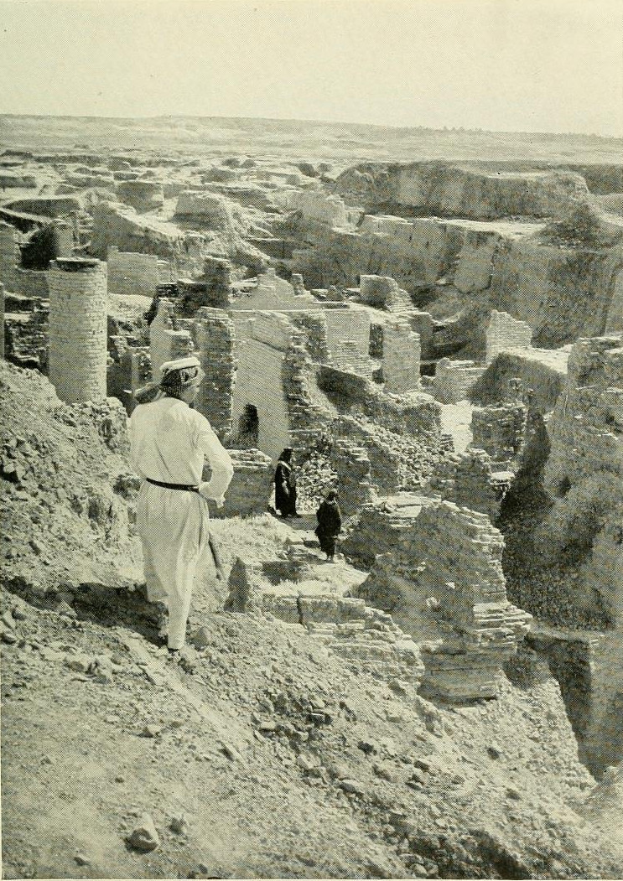
Return from Captivity
Can this be rebuilt?
Why did Jehovah let this happen?
What about a king?
What about the temple?
What do I do to keep this from happening again?

Slide 5
The Role of the Prophets
They are Spokesmen for God, serving as “forthtellers,” speaking what God put in their mouth.
They are Preachers of the Covenant, relating their message to God’s previous promises to the nation of Israel. These covenants were made with or through Abraham, Moses, and David
They are historians, or Interpreters of the Israelites’ History. With out their interpretation God’s people would not know why an event was occurring.

Slide 6
God’s Test for a Prophet
Deuteronomy 18:18-22(ESV) ¹⁸I will raise up for them a prophet like you from among their brothers.
And I will put my words in his mouth, and he shall speak to them
all that I command him.
¹⁹And whoever will not listen to my words that he shall speak in my name, I myself will require it of him.
²⁰But the prophet who presumes to speak a word in my name that I have not commanded him to speak, or who speaks in the name of other gods, that same prophet shall die.’
²¹And if you say in your heart, ‘How may we know the word that the Lord has not spoken?’—
²² when a prophet speaks in the name of the Lord, if the word does not come to pass or come true, that is a word that the Lord has not spoken; the prophet has spoken it presumptuously. You need not be afraid of him.

Slide 7
Ahijah
Jehu
Man of God
Micaiah
Man of God
Syria
Shemaiah
Azariah
Hanani
Assyria
Babylon/Persia

Slide 8
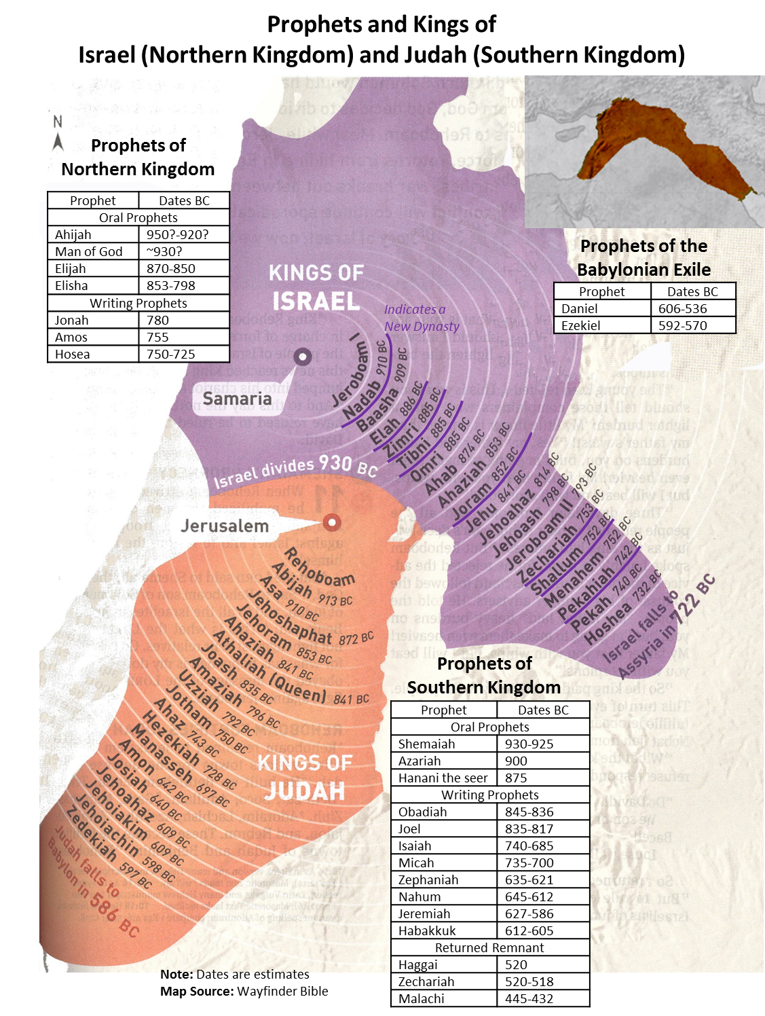

Slide 9
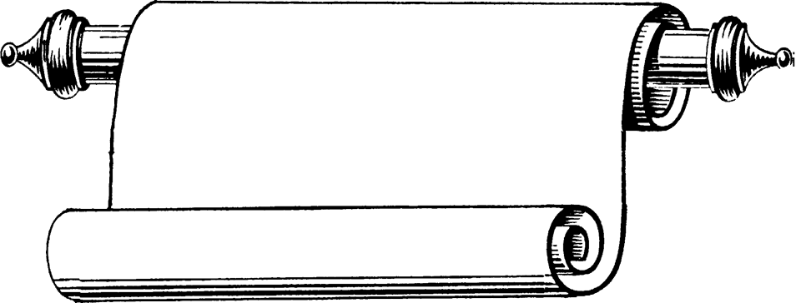
Edomites invaded Judah just as Judah was being ransacked - prophesies Edom's downfall
The
Judges
OBADIAH
845 Edom
JOEL
Judah see severe locust plague as a coming
Day of the LORD
830
Told to preach in Nineveh resulted in his being swallowed by a fish & city repenting
Kings & Prophets
JONAH
780 Nineveh
Israel, repent of injustice and idolatry or else go into exile
AMOS
Divided Kingdom
Israel & Judah
755
HOSEA
His life with adulterous wife like God & Israel
750-725
MICAH
Judah, repent of injustice and idolatry or else go into exile
735-700
ISAIAH
Isaiah 1-6 Reason for God’s Actions &
Isaiah’s Call
Isaiah 7-35 Immediate threat & Judgments
Isaiah 36-39 Historical account of siege
Isaiah 40-66 Cyrus, Future Threats & Hopes
740-690

Slide 10
Kings & Prophets
NAHUM
Divided Kingdom
Judah Alone
& Fall of Judah
The prophet predicts the fall of Nineveh
630-612 Nineveh
ZEPHANIAH
Prophet emphasizes the need for the people of Judah to turn away from idolatry
630-625
HABAKKUK
"Why do the wicked and cruel Babylonians go unpunished?" Prophet finds his answer in God's goodness and wisdom
612-606
Jer 1-20 Sermons & prophecies during Josiah
Jer 21-39 Prophecies of Specific Events
Jer 40-45 Sermons after fall of Israel
Jer 46-51 God’s Judgment on Foreign Nations
Jer 52 Fall of Jerusalem
JEREMIAH
627-586
LAMENTATIONS
Jeremiah cries from the depths of his heart over the destruction of Jerusalem
586

Slide 11
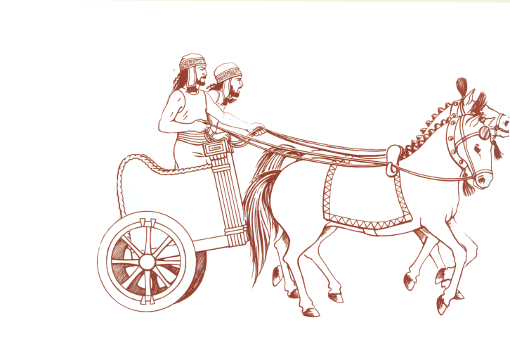
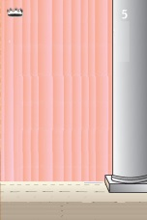
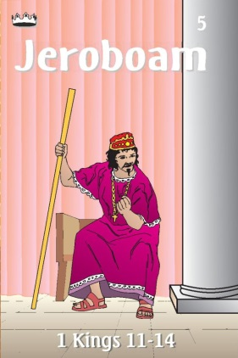
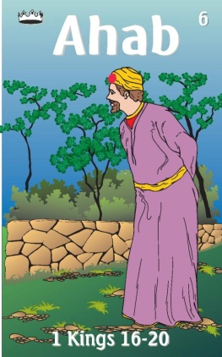
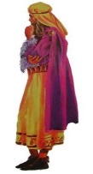
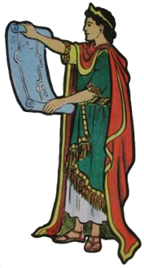
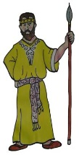
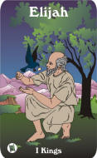
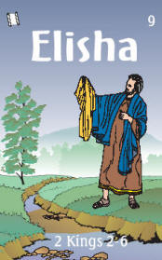
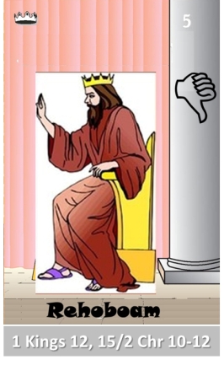
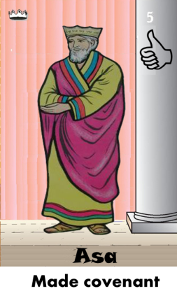
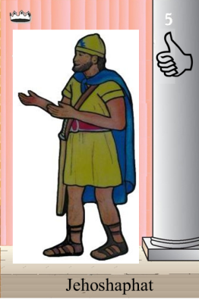
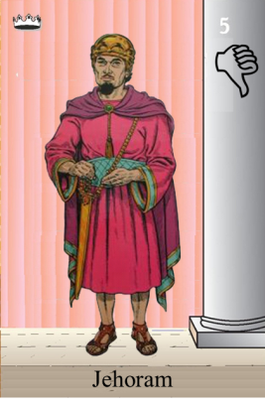
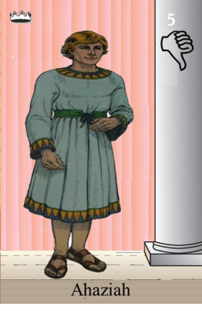
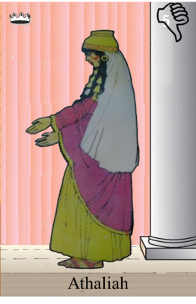
Ahaziah
Jehoram
Killed by Jehu
Baasha
Jehu
Ahijah
Man of God
Rocks for
Mizpah & Geba
Early Kings
Omri Kings
Jehu Kings
Brings in Syria
Obadiah - 830
Killed by Jehu
Shemaiah
Azariah
Hanani the Seer

Slide 12
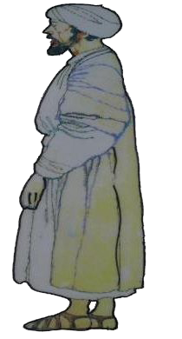
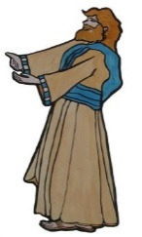
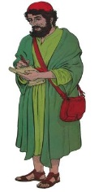
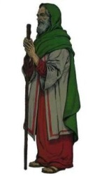
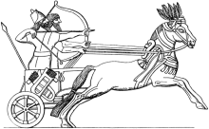
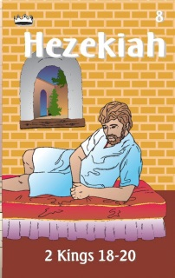
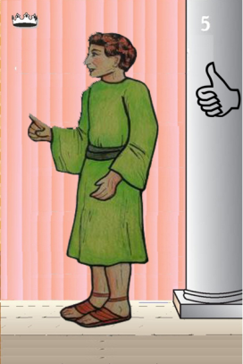
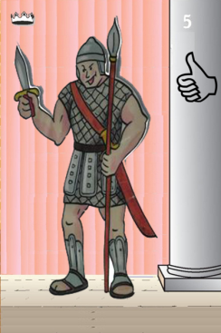
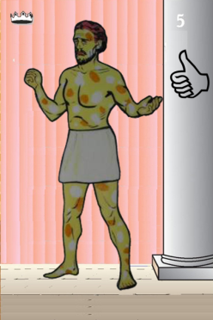
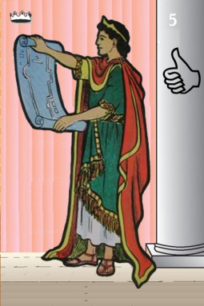
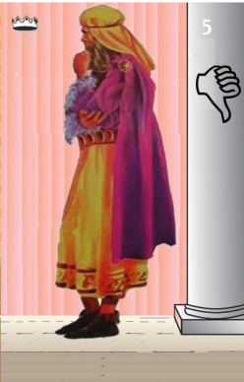
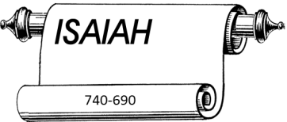
Jehu
841-814
Jehoahaz
Jehoash
Elisha &
the Arrows
Jeroboam II
Zechariah
Tiglath-pileser III
(745–727 b.c.)
793-753
Jehu Kings
Confusing
Brings in Assyria
Joash
Amaziah
Uzziah
Jotham
Ahaz
Jehoiada Made covenant

Slide 13
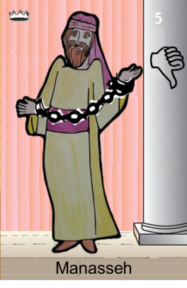
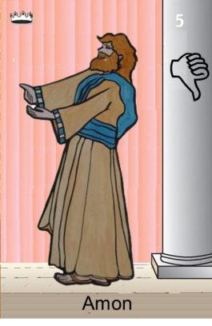
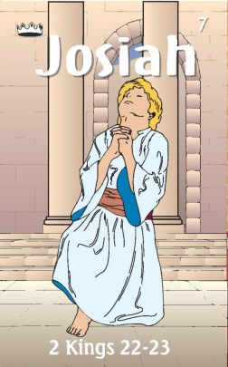
Confusing
Judah Alone
Tiglath-pileser III
(745–727 b.c.)
Shallum 752
Menahem 752-742
Pekahiah 742-740
Pekah(752) 740-732
Hoshea 732-722
697-642
640-609
Made covenant
They were stoned — As Zechariah, the son of Jehoiada, 2 Chronicles 24:21. they were sawn asunder — As, according to the tradition of the Jews, Isaiah was by Manasseh
Uzziah
Jotham
Ahaz

Slide 14
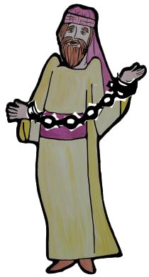
#14 Manasseh Card
Kings of Assyria
Sennacherib
704–681
Esarhaddon
680–669
Ashurbanipal
668–627
did what was evil in the sight of the Lord, according to the abominations of the nations whom the Lord drove out before the people of Israel.
697-642
Longest ruler 55 yrs
built altars in the house of the Lord
shed very much innocent blood
king of Assyria captured Manasseh
entreated favor of Lord & humbled himself greatly
Prophets
Manasseh
Isaiah (J)
Judah Alone
Notes:
Tiglath-pileser III—744–727 B.C.
Sargon II—721–705 B.C.
Sennacherib—704–681
Esarhaddon—680–669 B.C.
Ashurbanipal—668–627 B.C

Slide 15
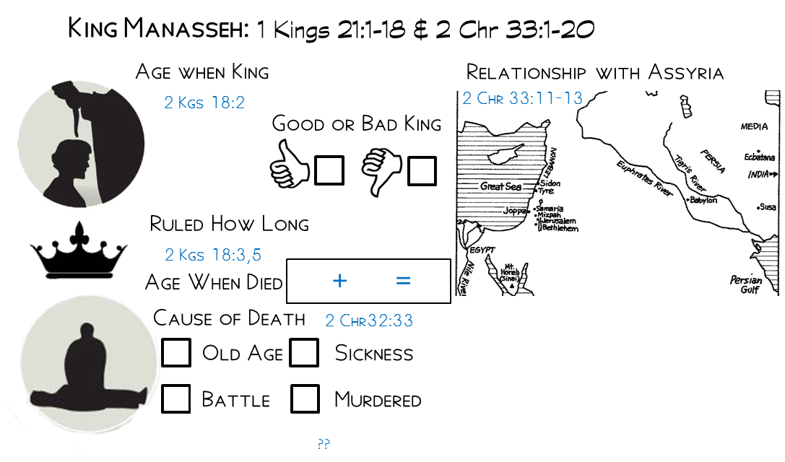
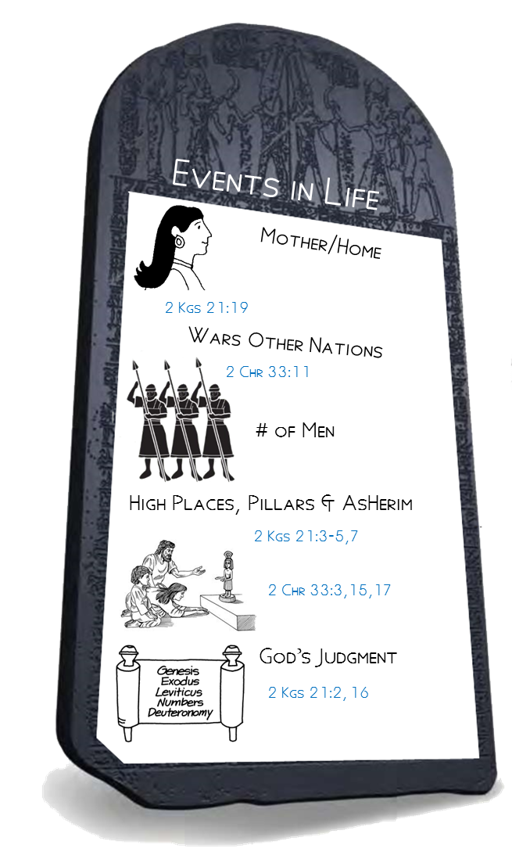
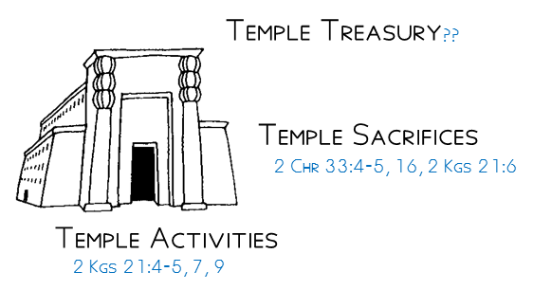
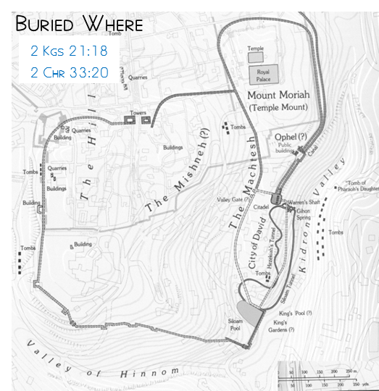
12
Commanders of Assyria took him captive with hooks and chains into Babylon
55
67
Hephzibah
Slept with his fathers
Manasseh taken captive by Assyria
Buried in garden of his house (garden of Uzza)
Rebuilt the high places; after his repentence high places remained but people worshipped only to God
Altars to Baals and made Asherahs; Worshipped all the host of heaven; Burned his sons as an offering.
Altars for all the host of heaven; Carved image of Asherah in the House of Lord;
Evil in the sight of the Lord, according to abominations of the nations driven out by Israel

Slide 16
Manasseh’s Reign according to the despicable practices II Kgs 21
³For he rebuilt the high places…
…he erected altars for Baal and made an Asherah, as Ahab king of Israel had done
…worshiped all the host of heaven and served them.
⁴And he built altars in the house of the Lord
⁵And he built altars for all the host of heaven in the two courts of the house of the Lord.
⁶And he burned his son as an offering
and used fortune-telling and omens
and dealt with mediums and with wizards.
He did much evil in the sight of the Lord, provoking him to anger
¹⁶Moreover, Manasseh shed very much innocent blood, till he had filled Jerusalem from one end to another,

Slide 17
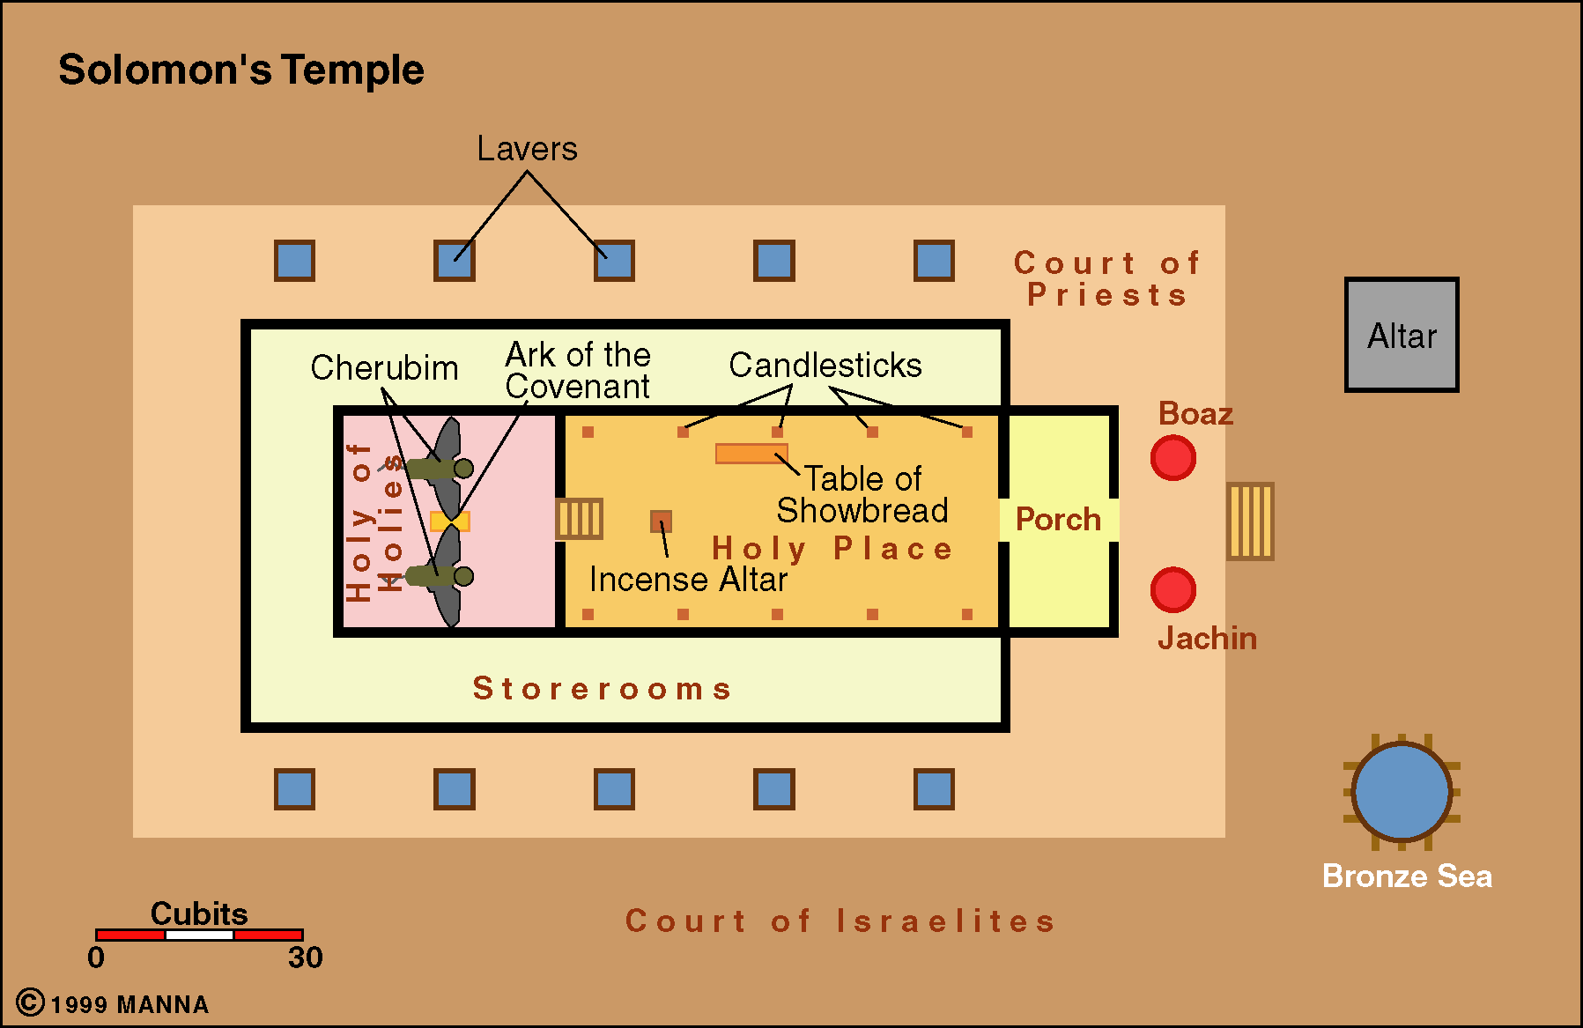
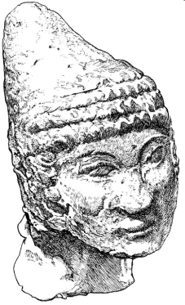
II Kings 21
⁷ He even set a carved image of Asherah that he had made, in the house of which the Lord had said to David and to Solomon his son, “In this house and in Jerusalem, which I have chosen out of all the tribes of Israel, I will put My name forever;
⁴ He also built altars in the house of the Lord…
⁵And he built altars for all the host of heaven in the two courts of the house of the Lord.
X
X

Slide 18
Jehovah Takes Action
1. Sends Messengers – II Kgs 21:10
¹⁰And the Lord said by his servants the prophets,
2. Message – II Kgs 21:11-12
¹¹“Because Manasseh king of Judah has committed these abominations and has done things more evil than all that the Amorites did, who were before him, and has made Judah also to sin with his idols,
¹²therefore thus says the Lord, the God of Israel: Behold, I am bringing upon Jerusalem and Judah such disaster that the ears of everyone who hears of it will tingle.

Slide 19
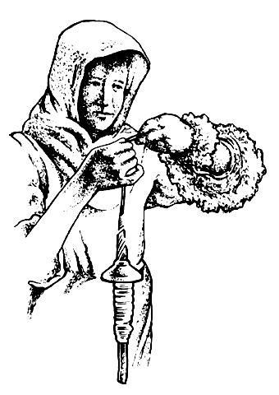
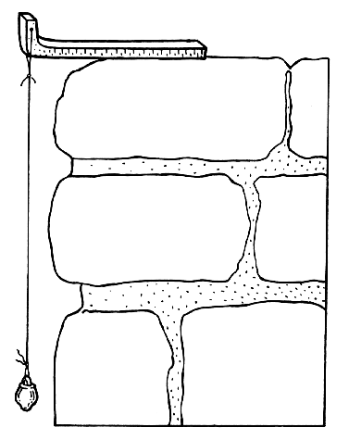
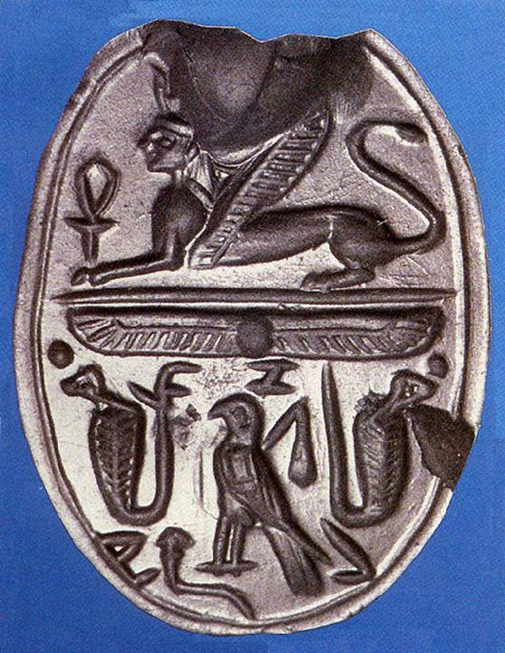
Jehovah Takes Action
3. Measuring Scale & Judgment on Jerusalem – II Kgs 21:13
¹³And I will stretch over Jerusalem the measuring line of Samaria, and the plumb line of the house of Ahab, and I will wipe Jerusalem as one wipes a dish, wiping it and turning it upside down.
Seal of Jezebel

Slide 20
Jehovah Takes Action
4. Change in Relationship with Judah – II Kgs 21:14
¹⁴And I will forsake the remnant of my heritage and give them into the hand of their enemies, and they shall become a prey and a spoil to all their enemies,
5. Resposne of Manasseh & People – II Chr 33:10
¹⁰The Lord spoke to Manasseh and to his people, but they paid no attention.

Slide 21
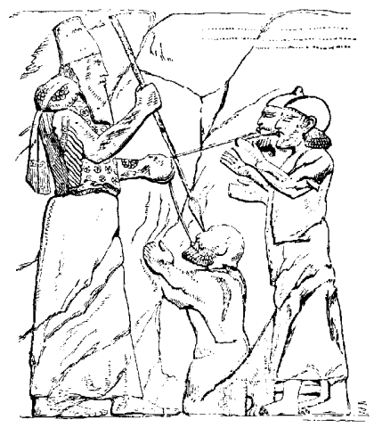
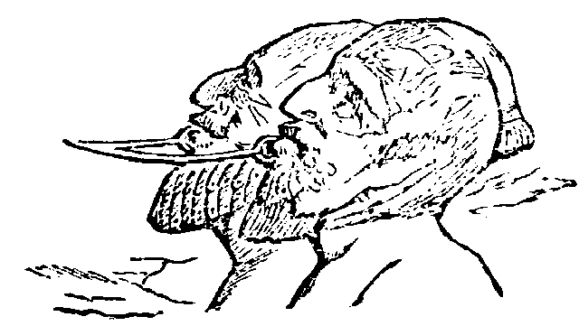
Assyrian King Blinding & Hooking
2 Chr 33:10 - 11 ¹⁰The Lord spoke to Manasseh and to his people, but they paid no attention. ¹¹Therefore the Lord brought upon them the commanders of the army of the king of Assyria, who captured Manasseh with hooks and bound him with chains of bronze and brought him to Babylon.

Slide 22
Manasseh Learns His Lesson II Chr 33
¹²And when he was in distress, he entreated the favor of the Lord his God and humbled himself greatly before the God of his fathers. ¹³He prayed to him, and God was moved by his entreaty and heard his plea and brought him again to Jerusalem into his kingdom. Then Manasseh knew that the Lord was God

Slide 23
Manasseh Changes II Chr 33
¹⁵And he took away the foreign gods and the idol from the house of the Lord, and all the altars that he had built on the mountain of the house of the Lord and in Jerusalem, and he threw them outside of the city.
¹⁶He also restored the altar of the Lord and offered on it sacrifices of peace offerings and of thanksgiving, and he commanded Judah to serve the Lord, the God of Israel.
¹⁷Nevertheless, the people still sacrificed at the high places, but only to the Lord their God.

Slide 24
Time Line – Judah Alone
Josiah born
730 BC
710 BC
690 BC
670 BC
650 BC
630 BC
610 BC
590 BC
570 BC
648 BC Manasseh
taken
prisoner?
~Josiah born
627 BC Jeremiah begins his prophecies
722 BC Fall of Samaria
622 BC Book of the Law found
Josiah begins reforms
588 BC Nebuchadnezzar begins final siege
715 BC Hezekiah Life extended 15 yrs
586 BC Jerusalem Falls-Exile
697 BC Manasseh becomes king
640 BC Josiah
becomes king
597 BC Nebuchadnezzar besieges Jerusalem & takes Jehoiachin captive
701 BC Sennacherib invades Judah
(14th yrs after Hezekiah’s
life extended?)
642 BC Amon
becomes king
605 BC Nebuchadnezzar invades Judah
& takes captives (Daniel)
728 BC Hezekiah king (3rd yr Hoshea)
609 BC Pharaoh Neco kills Josiah in battle
& puts Jehoakim on throne
730 BC
710 BC
690 BC
670 BC
650 BC
630 BC
610 BC
590 BC
570 BC

Slide 25
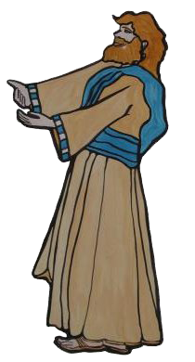
#15 Amon Card
Kings of Assyria
Ashurbanipal
668–627
did what was evil in the sight of the Lord, like Manasseh. He sacrificed to all the images that Manasseh had made, he did not humble himself before the Lord
642-640
Prophets
servants conspired against him and put him to death in his house.
Amon
Judah Alone

Slide 26
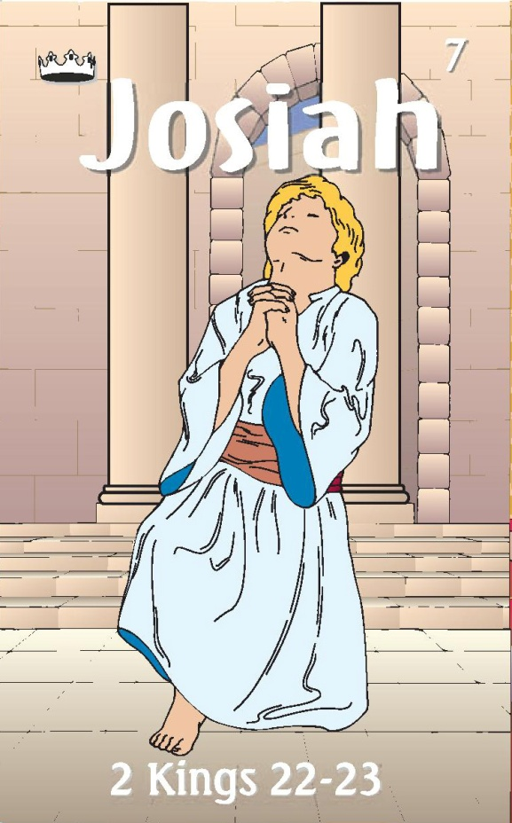
#16 Josiah Card
Kings of Assyria
Ashurbanipal
668–627
Assur-etil-ilani
626-607
640-609
Prophets
Jeremiah (J)
Zephaniah (J)
Made covenant
JOSIAH & SONS

Slide 27
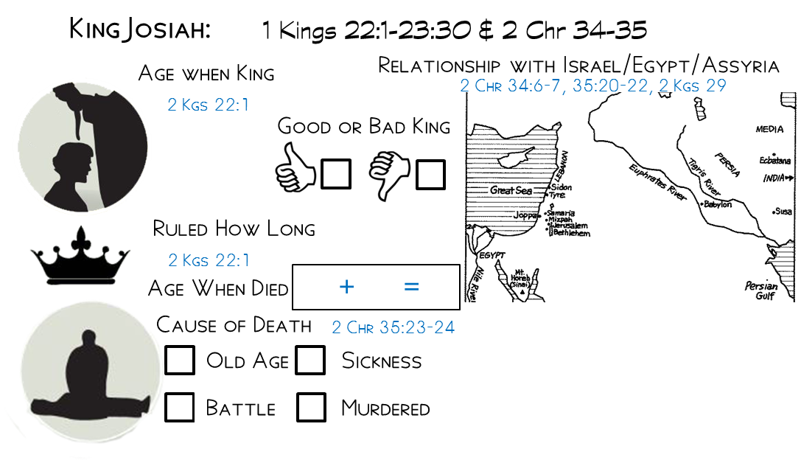
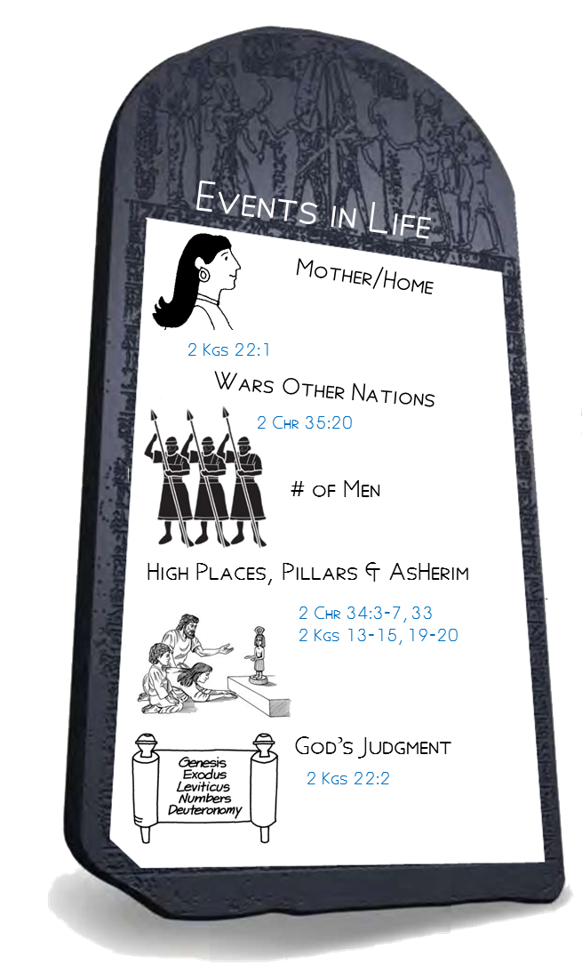
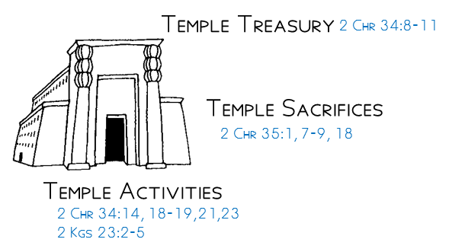
Tried to help Babylon against Assyria by trying to stop Egypt
8
31
39
Killed by archers of Neco
Jedidah the daughter of Adaiah of Bozkath
Buried in his own tomb/tomb of his fathers
30:26
Money collected from people used to repair Temple
Egypt
Many animals/Passover
No Passover like it since days of Samuel
Removed High places, destroyed altar at Bethel
Made all serve the Lord
Removed Baal, etc from Temple
Made Covanant
Found Book of the Law
Tore clothes when heard what Law siad
Inquired of the Lord
he did what was right in the eyes of the Lord and walked in all the way of David his father, and he did not turn aside to the right or to the left

Slide 29
Comparing Offerings
22,000
120000
700/7000
3800/37600
2670/20200

Slide 30
Josiah’s Early Reform – II Chr 34:3,8
What did he begin at age 16?
2 Chronicles 34 ³For in the eighth year of his reign, while he was yet a boy, he began to seek the God of David his father,
What did he begin at age 20?
2 Chronicles 34 ³ …and in the twelfth year he began to purge Judah and Jerusalem of the high places, the Asherim, and the carved and the metal images.
What did he begin at age 26?
2 Chronicles 34 ⁸Now in the eighteenth year of his reign, when he had cleansed the land and the house, he sent Shaphan (etc) …to repair the house of the Lord his God.

Slide 31
Josiah’s breaks altars in Israel
Naphtali
Dan
Jericho
2 Chronicles 34
⁶And in the cities of Manasseh, Ephraim, and Simeon, and as far as Naphtali, in their ruins all around,
⁷he broke down the altars and beat the Asherim and the images into powder and cut down all the incense altars throughout all the land of Israel. Then he returned to Jerusalem.
Manasseh
Ephraim
Geba
Jerusalem
Judah
Simeon
Beersheba

Slide 32
Josiah Hears the Law – II Chr 34:19 & 21
How did Josiah react when the Law was read to him
2 Chronicles 34
¹⁹And when the king heard the words of the Law, he tore his clothes.
²¹“Go, inquire of the Lord for me and for those who are left in Israel and in Judah, concerning the words of the book that has been found.
For great is the wrath of the Lord that is poured out on us, because our fathers have not kept the word of the Lord, to do according to all that is written in this book.”

Slide 33
Josiah’s Reaction

Slide 34
Death of Josiah
2 Kings 23:29 - 30 (NKJV) ²⁹In his days Pharaoh Necho king of Egypt went to the aid of the king of Assyria, to the River Euphrates; and King Josiah went against him. And Pharaoh Necho killed him at Megiddo when he confronted him. ³⁰Then his servants moved his body in a chariot from Megiddo, brought him to Jerusalem, and buried him in his own tomb. And the people of the land took Jehoahaz the son of Josiah, anointed him, and made him king in his father’s place.

Slide 35
2 Chronicles 35:20 - 23 ²⁰After all this, when Josiah had prepared the temple, Necho king of Egypt came up to fight at Carchemish by the Euphrates; and Josiah went out against him.

Slide 36
Kings of Judah Before Fall of Israel Basic Info
King
Good /Bad King
Age
Years of Rule
Buried Where
Cause of Death
Rehoboam
Did Evil
17
Natural
41
City of David
Abijah
Not Loyal
3
City of David
Natural
Asa
41
Own tomb City of David
Diseased Feet
Did Right
Jehoshaphat
City of David
Natural
Doing right
35
25
Jehoram
Ways of
Israel
No Fire
No Kings Tomb
Lord – intestines came out
32
8
Ahaziah
Ways of
Ahab
Killed by Jehu
22
1
City of David
Athaliah (usurper)
Doing
Wickedly
Killed by Captains of 100
7

Slide 37
Kings of Judah Before Fall of Israel Basic Info
King
Good /Bad King
Age
Years of Rule
Buried Where
Cause of Death
Joash
Did right
instructed
7
40
City of David
No King’s Tomb
Killed by Servants
Amaziah
Did right
Not Loyal
Killed by Servants
25
29
City of David
With Fathers
Uzziah
Did right
Eyes of Lord
Died a Leper
16
52
Burial Field
Jotham
Did right
Eyes of Lord
Natural
25
16
City of David
With Fathers
Ahaz
Did not do right
Eyes of Lord
20
16
Not in tombs of the kings
Natural
Hezekiah
Did right-David
None like him
Natural
25
29
Upper Part
Of Tomb
Manasseh
Did not do right
Worse than Nations
Natural
12
55
Garden of his House

Slide 38
Kings of Judah Before Fall of Israel Basic Info
King
Good /Bad King
Age
Years of Rule
Buried Where
Cause of Death
Manasseh
Did not do right
Worse than Nations
Natural
12
55
Garden of his House
Amon
Did evil as his father did
Killed by Servants
22
2
Garden of his House
Josiah
Did right-
walked like David
Killed in Battle
8
31
Own Tomb
Jehoahaz
Jehoiakim
Jehoiachim
Zedekiah

Slide 39
Outline for Zephaniah
Outline
A Sad Day Coming (1:1–3:8)
Judah and Jerusalem judged (1:1–2:3)
Enemy nations judged (2:4-15)
Judah and Jerusalem judged (3:1-8)
A Glad Day Coming (3:9-20)
The expression “the day of the Lord” is found more times in Zephaniah than in any other Bible book.

Slide 40
Zephaniah Message – Zeph 1:2-3
What news did Zephaniah bring the people?
Zephaniah 1
² “I will utterly sweep away everything from the face of the earth,” declares the Lord.
³ “I will sweep away man and beast;
I will sweep away the birds of the heavens and the fish of the sea, and the rubble with the wicked.
I will cut off mankind from the face of the earth,” declares the Lord.

Slide 41
Zephaniah Message – Zeph 1:2-3
Who was the judgment directed against?
Zephaniah 1
⁴ “I will stretch out my hand against Judah and against all the inhabitants of Jerusalem;
and I will cut off from this place the remnant of Baal
and the name of the idolatrous priests along with the priests,
⁵ those who bow down on the roofs to the host of the heavens,
those who bow down and swear to the Lord and yet swear by Milcom,
⁶ those who have turned back from following the Lord, who do not seek the Lord or inquire of him.”
Milcom a god of the Ammonites (compare NIV “Molech”) that is mentioned in Jeremiah 49:1-6

Slide 42
Zephaniah Message – Zeph 3:6-7
Example of God’s Judgment on Nations
Zephaniah 3 ⁶ “I have cut off nations; their battlements are in ruins;
I have laid waste their streets so that no one walks in them; their cities have been made desolate, without a man, without an inhabitant.
How did God hope Judah would respond to this example?
Zephaniah 3
⁷ I said, ‘Surely you will fear me; you will accept correction. Then your dwelling would not be cut off according to all that I have appointed against you.”
How did Judah react?
Zephaniah 3
⁷ … But all the more they were eager to make all their deeds corrupt.

Slide 43
Zephaniah Message – Zeph 2:1-3
What glimmer of hope is offered?
Zephaniah 2
³ Seek the Lord, all you humble of the land, who do his just commands;
seek righteousness; seek humility; perhaps you may be hidden on the day of the anger of the Lord.

Slide 45
Habakkuk’s Complaint
Habakkuk 1:1-4(ESV) ¹The oracle that Habakkuk the prophet saw.
² O Lord, how long shall I cry for help,
and you will not hear?
Or cry to you “Violence!”
and you will not save? ³ Why do you make me see iniquity,
and why do you idly look at wrong?
Destruction and violence are before me;
strife and contention arise. ⁴ So the law is paralyzed,
and justice never goes forth.
For the wicked surround the righteous;
so justice goes forth perverted.

Slide 46
Lord’s Answer
Habakkuk 1:1-4(ESV) ¹The oracle that Habakkuk the prophet saw.
² O Lord, how long shall I cry for help,
and you will not hear?
Or cry to you “Violence!”
and you will not save? ³ Why do you make me see iniquity,
and why do you idly look at wrong?
Destruction and violence are before me;
strife and contention arise. ⁴ So the law is paralyzed,
and justice never goes forth.
For the wicked surround the righteous;
so justice goes forth perverted.
Habakkuk 1:5-9(ESV) ⁵ “Look among the nations, and see;
wonder and be astounded.
For I am doing a work in your days
that you would not believe if told. ⁶ For behold, I am raising up the Chaldeans,
that bitter and hasty nation,
who march through the breadth of the earth,
to seize dwellings not their own. ⁷ They are dreaded and fearsome;
their justice and dignity go forth from themselves.
⁸ Their horses are swifter than leopards,
more fierce than the evening wolves;
their horsemen press proudly on.
Their horsemen come from afar;
they fly like an eagle swift to devour. ⁹ They all come for violence,
all their faces forward.
They gather captives like sand.

Slide 47
Habakkuk’s 2nd Complaint
Habakkuk 1:12-17(ESV) ¹² Are you not from everlasting,
O Lord my God, my Holy One?
We shall not die.
O Lord, you have ordained them as a
judgment, and you,
O Rock, have established them for reproof. ¹³ You who are of purer eyes than to see evil
and cannot look at wrong,
why do you idly look at traitors
and are silent when the wicked swallows up
the man more righteous than he? ¹⁴ You make mankind like the fish of the sea,
like crawling things that have no ruler. ¹⁵ He brings all of them up with a hook;
he drags them out with his net;
he gathers them in his dragnet;
so he rejoices and is glad. ¹⁶ Therefore he sacrifices to his net
and makes offerings to his dragnet;
for by them he lives in luxury,
and his food is rich. ¹⁷ Is he then to keep on emptying his net
and mercilessly killing nations forever?
Habakkuk 2:1(ESV) ¹ I will take my stand at my watchpost
and station myself on the tower,
and look out to see what he will say to me,
and what I will answer concerning my
complaint.

Slide 48
Lord’s Answer
Habakkuk 1:12-17(ESV) ¹² Are you not from everlasting,
O Lord my God, my Holy One?
We shall not die.
O Lord, you have ordained them as a
judgment, and you,
O Rock, have established them for reproof. ¹³ You who are of purer eyes than to see evil
and cannot look at wrong,
why do you idly look at traitors
and are silent when the wicked swallows up
the man more righteous than he? ¹⁴ You make mankind like the fish of the sea,
like crawling things that have no ruler. ¹⁵ He brings all of them up with a hook;
he drags them out with his net;
he gathers them in his dragnet;
so he rejoices and is glad. ¹⁶ Therefore he sacrifices to his net
and makes offerings to his dragnet;
for by them he lives in luxury,
and his food is rich. ¹⁷ Is he then to keep on emptying his net
and mercilessly killing nations forever?
Habakkuk 2:1(ESV) ¹ I will take my stand at my watchpost
and station myself on the tower,
and look out to see what he will say to me,
and what I will answer concerning my
complaint.
Habakkuk 2:2-4(ESV) ² And the Lord answered me:
“Write the vision;
make it plain on tablets,
so he may run who reads it. ³ For still the vision awaits its appointed time;
it hastens to the end—it will not lie.
If it seems slow, wait for it;
it will surely come; it will not delay. ⁴ “Behold, his soul is puffed up;
it is not upright within him,
but the righteous shall live by his faith.

Slide 49
Woes
Dishonesty (2:6)
Covetousness (2:9)
Bloody Building of Enterprises (2:12)
Debauchery (2:15)
Idolatry (2:18-20)
God’s Woes for Babylonians
Habakkuk 2:12(ESV) ¹² “Woe to him who builds a town with blood
and founds a city on iniquity!
Habakkuk 2:19-20(ESV) ¹⁸ “What profit is an idol
when its maker has shaped it,
a metal image, a teacher of lies?
For its maker trusts in his own creation
when he makes speechless idols!
¹⁹ Woe to him who says to a wooden thing, Awake;
to a silent stone, Arise!
Can this teach?
Behold, it is overlaid with gold and silver,
and there is no breath at all in it. ²⁰ But the Lord is in his holy temple;
let all the earth keep silence before him.”

Slide 50
Habakkuk’s Prayer
Habakkuk 3:17-18(ESV) ¹⁷ Though the fig tree should not blossom,
nor fruit be on the vines,
the produce of the olive fail
and the fields yield no food,
the flock be cut off from the fold
and there be no herd in the stalls, ¹⁸ yet I will rejoice in the Lord;
I will take joy in the God of my salvation.

