Slide 1
2 Samuel
“you save the humble, But your eyes are on the haughty” (22:28)

Slide 2
Schedule
Date | Teacher | Text
10/28 | Dave | Intro: 1 Samuel Recap
10/31 | Dave | House of David v. House of Saul (1-4)
11/4 | Dave | The New King (5-6)
11/7 | Dave | The Promise (7)
11/11 | Dave | David’s Administration (8-10)
11/14 | Dave | David & Bathsheba (11-12)
11/18 | Dave | Amnon & Tamar (13-14)
Date | Teacher | Title
11/21 | No Class | TBD
11/25 | Dave | Abaslom’s Treason (15-17)
11/28 | Dave | Absalom’s Fall (18-20)
12/2 | Dave | Atonement & the Song of Praise (21-22)
12/5 | Dave | Last Words/Mighty Men/Census (23-24)
12/9 | TBD | David’s Death (1 Kings 1-2)
12/12 | TBD | Review

Slide 3
1 Samuel 1 (NKJV)
⁵ But to Hannah he would give a double portion, for he loved Hannah, although the Lord had closed her womb.
⁶ And her rival also provoked her severely, to make her miserable, because the Lord had closed her womb.
⁷ So it was, year by year, when she went up to the house of the Lord, that she provoked her; therefore she wept and did not eat.

Slide 4
The LORD Does Whatever Is Good To Him (cf. 1 Samuel 3:18)
What God did
Closed the womb of Hannah (1:5-6)
Did not remove the sons of Eli immediately (2:12-36)
Promised to punish the very old Eli (2:27 – 3:18)
Did not immediately identify himself to Samuel (3:2-10)
Gave the child Samuel a hard message (3:11-18)
Allowed Israel to be defeated and the ark taken (4:1-11)

Slide 5
1 Samuel 16:7 (NKJV)
But the Lord said to Samuel:
“Do not look at his appearance
or his physical stature,
because I have refused him.
For the LORD does not see as man sees;
For man looks at the outward appearance,
But the LORD looks at the heart.”

Slide 6
1“My heart rejoices in the Lord; My horn is exalted in the Lord.
I smile at my enemies, Because I rejoice in Your salvation.
2 No one is holy like the Lord,
For there is none besides You, Nor is there any rock like our God.
3 Talk no more so very proudly; Let no arrogance come from your mouth,
For the Lord is the God of knowledge; And by Him actions are weighed.
4 The bows of the mighty men are broken, and those who stumbled are girded with strength.
5 Those who were full have hired themselves out for bread, and the hungry have ceased to hunger.
Even the barren has borne seven, and she who has many children has become feeble.
6 The Lord kills and makes alive; He brings down to the grave and brings up.
7 The Lord makes poor and makes rich; He brings low and lifts up.
8 He raises the poor from the dust and lifts the beggar from the ash heap,
To set them among princes and make them inherit the throne of glory.
For the pillars of the earth are the Lord’s, and He has set the world upon them.
9 He will guard the feet of His saints, but the wicked shall be silent in darkness.
For by strength no man shall prevail.
10 The adversaries of the Lord shall be broken in pieces;
From heaven He will thunder against them. The Lord will judge the ends of the earth.
He will give strength to His king, and exalt the horn of His anointed.”

Slide 7
1“My heart rejoices in the Lord; My horn is exalted in the Lord.
I smile at my enemies, Because I rejoice in Your salvation.
2 No one is holy like the Lord,
For there is none besides You, Nor is there any rock like our God.
3 Talk no more so very proudly; Let no arrogance come from your mouth,
For the Lord is the God of knowledge; And by Him actions are weighed.
4 The bows of the mighty men are broken, and those who stumbled are girded with strength.
5 Those who were full have hired themselves out for bread, and the hungry have ceased to hunger.
Even the barren has borne seven, and she who has many children has become feeble.
6 The Lord kills and makes alive; He brings down to the grave and brings up.
7 The Lord makes poor and makes rich; He brings low and lifts up.
8 He raises the poor from the dust and lifts the beggar from the ash heap,
To set them among princes and make them inherit the throne of glory.
For the pillars of the earth are the Lord’s, and He has set the world upon them.
9 He will guard the feet of His saints, but the wicked shall be silent in darkness.
For by strength no man shall prevail.
10 The adversaries of the Lord shall be broken in pieces;
From heaven He will thunder against them. The Lord will judge the ends of the earth.
He will give strength to His king, and exalt the horn of His anointed.”

Slide 8
1“My heart rejoices in the Lord; My horn is exalted in the Lord.
I smile at my enemies, Because I rejoice in Your salvation.
2 No one is holy like the Lord,
For there is none besides You, Nor is there any rock like our God.
3 Talk no more so very proudly; Let no arrogance come from your mouth,
For the Lord is the God of knowledge; And by Him actions are weighed.
4 The bows of the mighty men are broken, and those who stumbled are girded with strength.
5 Those who were full have hired themselves out for bread, and the hungry have ceased to hunger.
Even the barren has borne seven, and she who has many children has become feeble.
6 The Lord kills and makes alive; He brings down to the grave and brings up.
7 The Lord makes poor and makes rich; He brings low and lifts up.
8 He raises the poor from the dust and lifts the beggar from the ash heap,
To set them among princes and make them inherit the throne of glory.
For the pillars of the earth are the Lord’s, and He has set the world upon them.
9 He will guard the feet of His saints, but the wicked shall be silent in darkness.
For by strength no man shall prevail.
10 The adversaries of the Lord shall be broken in pieces;
From heaven He will thunder against them. The Lord will judge the ends of the earth.
He will give strength to His king, and exalt the horn of His anointed.”
Why would Hannah say this?

Slide 9
1“My heart rejoices in the Lord; My horn is exalted in the Lord.
I smile at my enemies, Because I rejoice in Your salvation.
2 No one is holy like the Lord,
For there is none besides You, Nor is there any rock like our God.
3 Talk no more so very proudly; Let no arrogance come from your mouth,
For the Lord is the God of knowledge; And by Him actions are weighed.
4 The bows of the mighty men are broken, and those who stumbled are girded with strength.
5 Those who were full have hired themselves out for bread, and the hungry have ceased to hunger.
Even the barren has borne seven, and she who has many children has become feeble.
6 The Lord kills and makes alive; He brings down to the grave and brings up.
7 The Lord makes poor and makes rich; He brings low and lifts up.
8 He raises the poor from the dust and lifts the beggar from the ash heap,
To set them among princes and make them inherit the throne of glory.
For the pillars of the earth are the Lord’s, and He has set the world upon them.
9 He will guard the feet of His saints, but the wicked shall be silent in darkness.
For by strength no man shall prevail.
10 The adversaries of the Lord shall be broken in pieces;
From heaven He will thunder against them. The Lord will judge the ends of the earth.
He will give strength to His king, and exalt the horn of His anointed.”
We see this throughout 1 Samuel

Slide 10
1“My heart rejoices in the Lord; My horn is exalted in the Lord.
I smile at my enemies, Because I rejoice in Your salvation.
2 No one is holy like the Lord,
For there is none besides You, Nor is there any rock like our God.
3 Talk no more so very proudly; Let no arrogance come from your mouth,
For the Lord is the God of knowledge; And by Him actions are weighed.
4 The bows of the mighty men are broken, and those who stumbled are girded with strength.
5 Those who were full have hired themselves out for bread, and the hungry have ceased to hunger.
Even the barren has borne seven, and she who has many children has become feeble.
6 The Lord kills and makes alive; He brings down to the grave and brings up.
7 The Lord makes poor and makes rich; He brings low and lifts up.
8 He raises the poor from the dust and lifts the beggar from the ash heap,
To set them among princes and make them inherit the throne of glory.
For the pillars of the earth are the Lord’s, and He has set the world upon them.
9 He will guard the feet of His saints, but the wicked shall be silent in darkness.
For by strength no man shall prevail.
10 The adversaries of the Lord shall be broken in pieces;
From heaven He will thunder against them. The Lord will judge the ends of the earth.
He will give strength to His king, and exalt the horn of His anointed.”

Slide 11
1“My heart rejoices in the Lord; My horn is exalted in the Lord.
I smile at my enemies, Because I rejoice in Your salvation.
2 No one is holy like the Lord,
For there is none besides You, Nor is there any rock like our God.
3 Talk no more so very proudly; Let no arrogance come from your mouth,
For the Lord is the God of knowledge; And by Him actions are weighed.
4 The bows of the mighty men are broken, and those who stumbled are girded with strength.
5 Those who were full have hired themselves out for bread, and the hungry have ceased to hunger.
Even the barren has borne seven, and she who has many children has become feeble.
6 The Lord kills and makes alive; He brings down to the grave and brings up.
7 The Lord makes poor and makes rich; He brings low and lifts up.
8 He raises the poor from the dust and lifts the beggar from the ash heap,
To set them among princes and make them inherit the throne of glory.
For the pillars of the earth are the Lord’s, and He has set the world upon them.
9 He will guard the feet of His saints, but the wicked shall be silent in darkness.
For by strength no man shall prevail.
10 The adversaries of the Lord shall be broken in pieces;
From heaven He will thunder against them. The Lord will judge the ends of the earth.
He will give strength to His king, and exalt the horn of His anointed.”

Slide 12
“He will give strength to His king, and exalt the horn of His anointed.”
BUT THERE WAS NO KING At this time.
What did hannah mean?

Slide 13
The Bookends of 1-2 Samuel Comparing Hannah’s Prayer with David’s Song
Hannah’s Prayer (1 Samuel 2:1-10) | David’s Song (2 Samuel 22:1-51)
“My horn is exalted in the LORD. I smile at my enemies, because I rejoice in Your salvation.” (v.1) | “My shield and the horn of my salvation … so shall I be saved from my enemies.” (v. 3-4)
“No one is holy like the LORD, for there is none besides You, nor is there any rock like our God.” (v.2) | “The Lord is my rock…” (v.2) “For who is God, except the LORD? And who is a rock, except our God?” (v. 32) Also see v.47.
The LORD can reverse the normal course of things to accomplish His purpose, V.4-8 | “by You I can run against a troop…I can leap over a wall … my arms can bend a bow of bronze…”; “You have kept me as the head of nations.” (vv.30,35,44)
“He will guard the feet of His saints …” (chasyid, v.9) | “With the merciful you will show Yourself merciful…” (chasyid, v.26)
“…but the wicked shall be silent in darkness.” (v.9) | See judgment in vv.10-12. “For You are my lamp, O LORD; The LORD shall enlighten my darkness.” (v.29)
“From heaven He will thunder against them” (adversaries, v.10) | “The LORD thundered from heaven…” (against adversaries, v.14)
“He will give strength to His king, And exalt the horn of His anointed.” (v.10) | “He is the tower of salvation to His king, and shows mercy to His anointed” (v.51)

Slide 14
The LORD Does Whatever Is Good To Him (cf. 1 Samuel 3:18)
What God did | “God wouldn’t do that…” | What we learn
Closed the womb of Hannah (1:5-6) | “Talk no more so very proudly; Let no arrogance come from your mouth, for the LORD is the God of knowledge, and by Him actions are weighed.” (2:3) Knowledge Power Holiness/Goodness | God hears prayers of faithful; He raises needed leaders
Did not remove the sons of Eli immediately (2:12-36) |  | God wants His people to clearly see right and wrong
Promised to punish the very old Eli (2:27 – 3:18) |  | God says that faith without works is dead (James 2:17)
Did not immediately identify himself to Samuel (3:2-10) |  | God gives time to learn and understand
Gave the child Samuel a hard message (3:11-18) |  | God trains his servants by setting a high expectation
Allowed Israel to be defeated and the ark taken (4:1-11) |  | God will suffer “shame” if it wakes people up to who He is

Slide 15
8:1-5
WHAT Has HAPPENED? What is god’s response?

Slide 16
God Anoints Saul (Chapters 9-10)
Good looks, good family (9:1-2; 10:24)
Thinks that payment or a gift is necessary to get a “seer’s” (prophet’s) help (9:6-10)
Doesn’t seem to know or recognize Samuel, despite living only five miles away (9:6-10,18)
Humble? (9:21; see also 15:17)
Hesitant to assume responsibility even after God confirms his anointing (10:16, 21-22)

Slide 17
10:24 (KEY VERSE)
“And Samuel said to All the people, ‘Do you see him whom the lord has chosen, that there is no one like him among all the people?’ So all the people shouted and said, ‘Long live the king!”

Slide 18
Did Saul obey God? 1 Samuel 15:4-9
Yes?
No?
He gathered together over 200,000 men to fight, V.4.
He attacked the Amelekites from Havilah all the way to Shur, so you would need a lot of men; it was a very large attack, V.7
Of those people that he attacked, he utterly destroyed all the people with the edge of the sword, V.8
He kept the king Agag alive, V.8
He kept the best of the sheep, the oxen, the fatlings, the lambs, all the good animals alive, V.9
We will find evidence later in the book of 1 Samuel (e.g., ch. 30) that Saul stopped and did not destroy all of the Amelekites.
“Now the word of the LORD came to Samuel, saying, ‘I greatly regret that I have set up Saul as king, for he has turned back from following me, and has not performed my commandments…” (v.10-11)

Slide 19
1 Samuel 15:22-23 (NKJV)
“Has the LORD as great delight in burnt offerings and sacrifices, as in obeying the voice of the LORD?
Behold, to obey is better than sacrifice, and to heed than the fat of rams.
For rebellion is as the sin of witchcraft, and stubbornness is as iniquity and idolatry.
Because you have rejected the word of the LORD, He also has rejected you from being king.”

Slide 20
David
Chapters 16-31

Slide 21
1 Samuel 19
Jonathan and David (V.1-7)
Michel and David (V.8-17)
Samuel and David (V.18-24)
¹¹ Kill them not, lest my people forget; make them totter by your power and bring them down, O Lord, our shield!
¹² For the sin of their mouths, the words of their lips, let them be trapped in their pride. For the cursing and lies that they utter,
¹³ consume them in wrath; consume them till they are no more, that they may know that God rules over Jacob to the ends of the earth. Selah (Psalm 59, ESV)

Slide 22
Who has God’s help? Chapter 23
David
Saul
Inquires of the LORD (twice!) about whether to attack the Philistines. The LORD says to go. (v.1-6)
Inquires whether the men of Keilah would give him up to Saul. The LORD says they would. David leaves. (v.9-13)
Jonathan finds David and encourages him. (v.15-18)
David has gone out ahead (v.25)
Says, ‘God has delivered him (David) into my hand…” (v.7-8)
God did not deliver David into his hand; Saul cannot find David (v.14-15)
The Ziphites offer to deliver David to him. Saul says, ‘Blessed are you of the LORD…’ (v.19-24)
A messenger comes to direct him elsewhere, right as Saul was about to capture David (v.26-29)

Slide 23
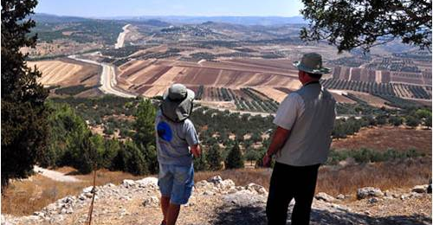
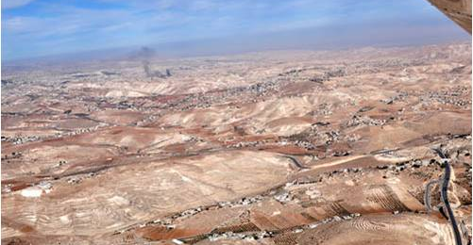
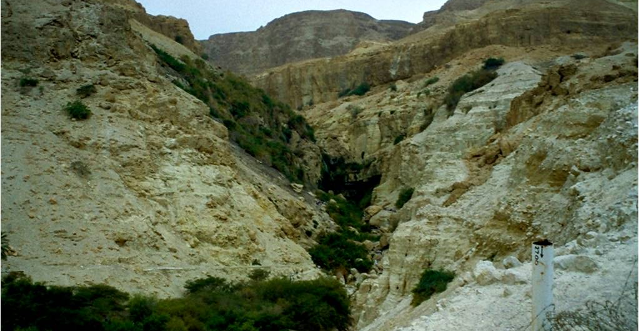
On The Run
Cave of Adullam
Ziph, Maon, etc.
En Gedi
22:1
23:14,24-25
23:29

Slide 24
Chapters 24-26 David and Saul have ‘Jonah’ moments
Chapter 24
Chapter 25
Chapter 26
Saul seeks revenge.
David shows mercy.
Saul turns back.
David seeks revenge.
Abigail sparks mercy.
David turns back.
Saul’s heart continues to seek revenge.
David’s heart continues to show mercy.

Slide 25
Further Comparisons
David
Saul
26: When David is shown grace, he returns it on others.
27: While David is discouraged and deceitful, he still drives out the Lord’s enemies with fervor.
27: David finds himself in the midst of a challenging threat.
25: David found help in a woman under God’s blessing.
29-30: God helps David, who is undeserving. God then grants David another opportunity to seek his word and brings David victory against his enemies.
26: When Saul is shown grace, he does not appreciate it.
28: Saul does not seem interested in battling for the Lord’s cause, and he is saddled with fear.
28: Saul finds himself in the midst of a challenging threat.
28: Saul found hopelessness in a woman under the LORD’s curse.
28: God does not help Saul.
31: Saul perishes without the LORD’s help.

Slide 26
1 Samuel 16:7 (NKJV)
But the Lord said to Samuel:
“Do not look at his appearance
or his physical stature,
because I have refused him.
For the LORD does not see as man sees;
For man looks at the outward appearance,
But the LORD looks at the heart.”

Slide 27
2 Samuel
“you save the humble, But your eyes are on the haughty” (22:28)

