Slide 1
2 Samuel
“you save the humble, But your eyes are on the haughty” (22:28)

Slide 2
Schedule
Date | Teacher | Text
10/28 | Dave | Intro: 1 Samuel Recap
10/31 | Dave | House of David v. House of Saul (1-4)
11/4 | Dave | The New King (5-6)
11/7 | Dave | The Promise (7)
11/11 | Dave | David’s Administration (8-10)
11/14 | Dave | David & Bathsheba (11-12)
11/18 | Dave | Amnon & Tamar (13-14)
Date | Teacher | Title
11/21 | No Class | TBD
11/25 | Dave | Abaslom’s Treason (15-17)
11/28 | Dave | Absalom’s Fall (18-20)
12/2 | Dave | Atonement & the Song of Praise (21-22)
12/5 | Dave | Last Words/Mighty Men/Census (23-24)
12/9 | TBD | David’s Death (1 Kings 1-2)
12/12 | TBD | Review

Slide 3
David’s Desire (7:1-7)
What Did David Think?
“I dwell in a house of cedar, but the ark of God dwells in tent curtains.”
What Did Nathan Think?
“Go, do all that is in your heart, for the LORD is with you.”
What Did God Think?
“You shall not build a house for me to dwell in.” (cf. 1 Chr. 17:4)

Slide 4
God’s Covenant with David (7:12-16)
¹² “When your days are fulfilled and you rest with your fathers, I will set up your seed after you, who will come from your body, and I will establish his kingdom.
¹³ He shall build a house for My name, and I will establish the throne of his kingdom forever.
¹⁴ I will be his Father, and he shall be My son. If he commits iniquity, I will chasten him with the rod of men and with the blows of the sons of men.
¹⁵ But My mercy shall not depart from him, as I took it from Saul, whom I removed from before you.
¹⁶ And your house and your kingdom shall be established forever before you. Your throne shall be established forever.” ’ ”
God would set up an offspring of David (“from your body”) to reign in David’s place.
God would establish the throne of his kingdom (and David’s kingdom) forever.
The offspring would build a house for God’s name.
If the offspring sinned, he would be chastened by God, but the promise would endure.
David’s house (family), kingdom (extent of rule), throne (authority) would be established forever.

Slide 5
God’s Covenant with David (7:12-16)
Solomon
The Messiah: Jesus
Identified by God as the son of David who would ‘build a house for My name’ (1 Chr. 22:6-10)
Solomon sinned, and the kingdom was torn from him (1 Kings 11:11-13)
Psalmists understood the nature of the word ‘forever’ (Ps. 89:3-4, 19-37; Ps. 132:11-12)
It would seem that sin (and death) were abiding challenges to this promise of rest.
Jer. 23:5-6, “’I will raise to David a Branch of righteousness…”
As sure as evening and morning, Jer. 33:21ff.
And yet, this would be something different than expected! (22:29-30)
Isa. 9:6-7, “Unto us a Child is born”
Amos 9:8-12, “I will raise up the tabernacle of David, which has fallen down..” (see Acts 15:15-17)
Luke 1:30-33; Matt. 22:41ff; Acts 2

Slide 6
David’s Prayer of Thanks
2 samuel 7:18-29

Slide 7
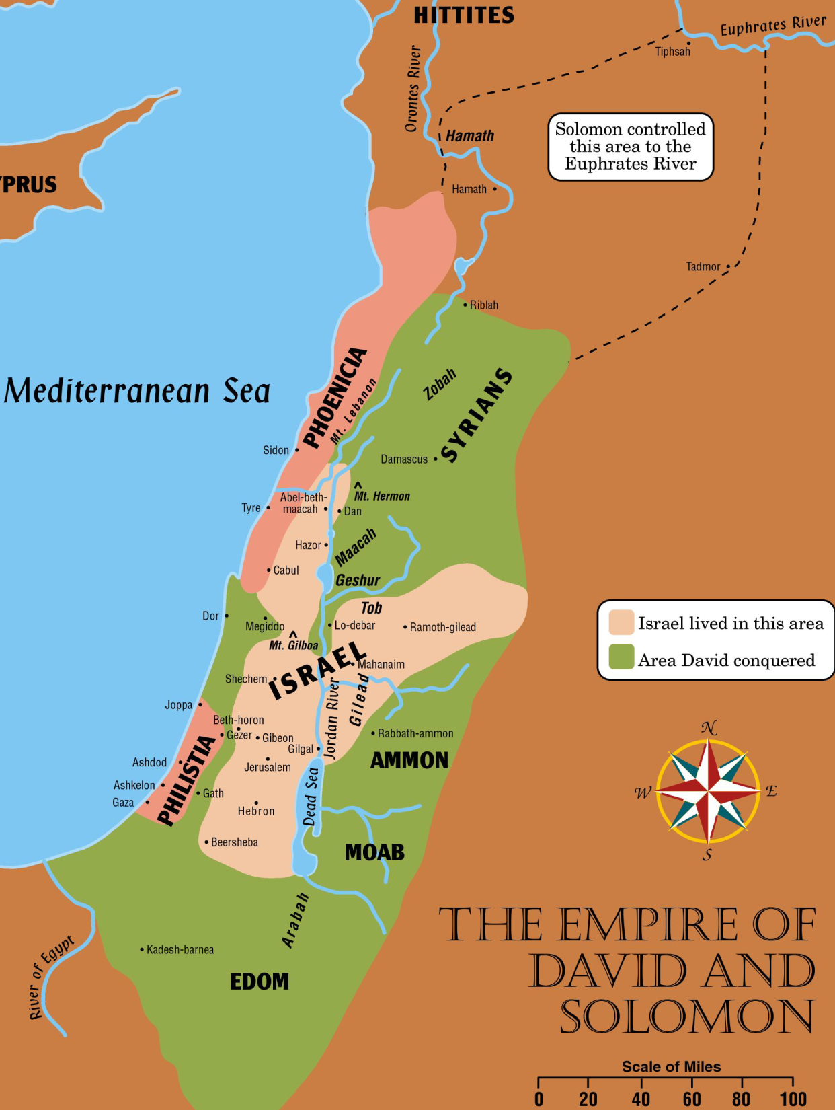
2 Samuel 8
Functions to present evidence that God could and would fulfill His promise.

Slide 8
Deuteronomy 17:14-20 (NKJV)
¹⁴ “When you come to the land which the Lord your God is giving you, and possess it and dwell in it, and say, ‘I will set a king over me like all the nations that are around me,’
¹⁵ you shall surely set a king over you whom the Lord your God chooses; one from among your brethren you shall set as king over you; you may not set a foreigner over you, who is not your brother.
¹⁶ But he shall not multiply horses for himself, nor cause the people to return to Egypt to multiply horses, for the Lord has said to you, ‘You shall not return that way again.’
¹⁷ Neither shall he multiply wives for himself, lest his heart turn away; nor shall he greatly multiply silver and gold for himself.
¹⁸ “Also it shall be, when he sits on the throne of his kingdom, that he shall write for himself a copy of this law in a book, from the one before the priests, the Levites.
¹⁹ And it shall be with him, and he shall read it all the days of his life, that he may learn to fear the Lord his God and be careful to observe all the words of this law and these statutes,
²⁰ that his heart may not be lifted above his brethren, that he may not turn aside from the commandment to the right hand or to the left, and that he may prolong his days in his kingdom, he and his children in the midst of Israel.

Slide 9
Deuteronomy 17:14-20 (NKJV)
¹⁴ “When you come to the land which the Lord your God is giving you, and possess it and dwell in it, and say, ‘I will set a king over me like all the nations that are around me,’
¹⁵ you shall surely set a king over you whom the Lord your God chooses; one from among your brethren you shall set as king over you; you may not set a foreigner over you, who is not your brother.
¹⁶ But he shall not multiply horses for himself, nor cause the people to return to Egypt to multiply horses, for the Lord has said to you, ‘You shall not return that way again.’
¹⁷ Neither shall he multiply wives for himself, lest his heart turn away; nor shall he greatly multiply silver and gold for himself.
¹⁸ “Also it shall be, when he sits on the throne of his kingdom, that he shall write for himself a copy of this law in a book, from the one before the priests, the Levites.
¹⁹ And it shall be with him, and he shall read it all the days of his life, that he may learn to fear the Lord his God and be careful to observe all the words of this law and these statutes,
²⁰ that his heart may not be lifted above his brethren, that he may not turn aside from the commandment to the right hand or to the left, and that he may prolong his days in his kingdom, he and his children in the midst of Israel.

Slide 10
Deuteronomy 17:14-20 (NKJV)
¹⁴ “When you come to the land which the Lord your God is giving you, and possess it and dwell in it, and say, ‘I will set a king over me like all the nations that are around me,’
¹⁵ you shall surely set a king over you whom the Lord your God chooses; one from among your brethren you shall set as king over you; you may not set a foreigner over you, who is not your brother.
¹⁶ But he shall not multiply horses for himself, nor cause the people to return to Egypt to multiply horses, for the Lord has said to you, ‘You shall not return that way again.’
¹⁷ Neither shall he multiply wives for himself, lest his heart turn away; nor shall he greatly multiply silver and gold for himself.
¹⁸ “Also it shall be, when he sits on the throne of his kingdom, that he shall write for himself a copy of this law in a book, from the one before the priests, the Levites.
¹⁹ And it shall be with him, and he shall read it all the days of his life, that he may learn to fear the Lord his God and be careful to observe all the words of this law and these statutes,
²⁰ that his heart may not be lifted above his brethren, that he may not turn aside from the commandment to the right hand or to the left, and that he may prolong his days in his kingdom, he and his children in the midst of Israel.

Slide 11
2 Samuel 8
Functions to present evidence that God could and would fulfill His promise.
“Through God we will do valiantly, for it is He who shall tread down our enemies.” (Ps. 60:12)
“the LORD preserved David wherever he went.” (2 Sam. 8:6,14)
“So David reigned over all Israel; and David administered judgment and justice to all his people.” (8:15)
“Righteousness and justice are the foundation of Your throne…” (Ps. 89:14)
“Of the increase of His government and peace there will be no end, upon the throne of David and over His kingdom, to order it and establish it with judgment and justice from that time forward, even forever. The zeal of the LORD of hosts will perform this.” (Isaiah 9:7)

Slide 12
Relationships in 2 Samuel 1-4
Saul
Jesse
Abner
Rechab and Baanah
Jonathan
Ishbosheth
David
Zeruiah
(Sister, 1 Chr. 2:16)
Joab
Abishai
Mephibosheth
Asahel

Slide 13
Kindness/Mercy/Lovingkindness
Hesed, 1 samuel 7:15, 9:1, 9:3, 9:7, 10:2

Slide 14
Mephibosheth 2 Samuel 9
“And you shall not only show me the kindness of the LORD while I still live, that I may not die; but you shall not cut off your kindness from my house forever, no, not when the LORD has cut off every one of the enemies of David from the face of the earth.” (1 Sam. 7:15, cf.17,42)
“Is there not still someone of the house of Saul, to whom I may show the kindness of God?” (2 Sam. 9:3,cf.1,7)
V.7 is the center
Protection (kindness),
Provision (restoration),
Position (table)
Unearned, undeserved
Timeline: likely at least 15-20 years since the covenant with Jonathan.
Psalm 89:14b

Slide 15
2 Samuel 10
Contrasts with 2 Samuel 9 – the offering of kindness within covenant and outside of covenant, and responses
Shows David’s willingness to commit significant resources to addressing justice.
Compare Psalm 2 – what happens when kings of the earth set themselves against the LORD’s anointed?
What do you make of Joab’s statement in V.11-12?
This conflict is the context for David’s sin in chapter 11 (cf. 11:1, 12:26-31)

