Slide 1

God at the Center
Introduction & Numbers 1-4

Slide 2

Introduction to Numbers
Relevancy for Christians Today
  “¹¹Now these things happened to them as an example, but they were written down for our instruction, on whom the end of the ages has come. ¹²Therefore let anyone who thinks that he stands take heed lest he fall.” (1 Cor. 10:11-12)
  Numbers Strongly Parallels Our Lives as Christians
Name
  Hebrew: “In the Wilderness”
  Greek: “Arithmoi” (Arithmetic / Numbers)
A Few Things to Note…
  Diversity of Genre
    Census / Travelogue
    Narrative / Law
  Largely Faithless Period (Hebrews 11:29-30 Skips Over Numbers)
  God’s Wrath & Kindness (cf. Romans 11:22)

Slide 4
Introduction to Numbers
Census for War (Numbers 1)
Arrangement of Camp (Numbers 2)
Duties & Census of Levites (Numbers 3-4)

Slide 5
Census of the Soldiers (1:1-54)
Opening (1:1)
  “The Lord Spoke to Moses…” (Over 150x in Numbers)
  Contrast Leviticus 1:1 & Numbers 1:1
Instructions for Numbering (1:2-19)
  Implications of Numbering (vs. 2-3)
    God is King of the Nation (cf. 2 Samuel 24)
    There is a Battle to Fight (cf. Ephesians 6:10-20; Revelation 7:1-8)
    The Promises to be “Innumerable” Haven’t Yet Happened
  Tribal Leaders Assisted in the Census (vs. 4-19)
    Tribal Leaders Appear Again (2:1-34; 7:1-88; 10:14-28)
    Nahshon of Judah in Jesus’ Lineage (Vs. 7; Ruth 4:20-22)
The Numbering (1:20-46)
  Judah Is the Largest; Manasseh the Smallest (vs. 27, 35)
  Totals – 603,550 (cf. Exodus 38:26)
  Only Joshua & Caleb Make It (Numbers 26:65)
Exemption of Levites (1:47-54; Elaborated in Numbers 3-4)
  Each Has a Different Role (cf. 1 Corinthians 12:12-26)

Slide 6
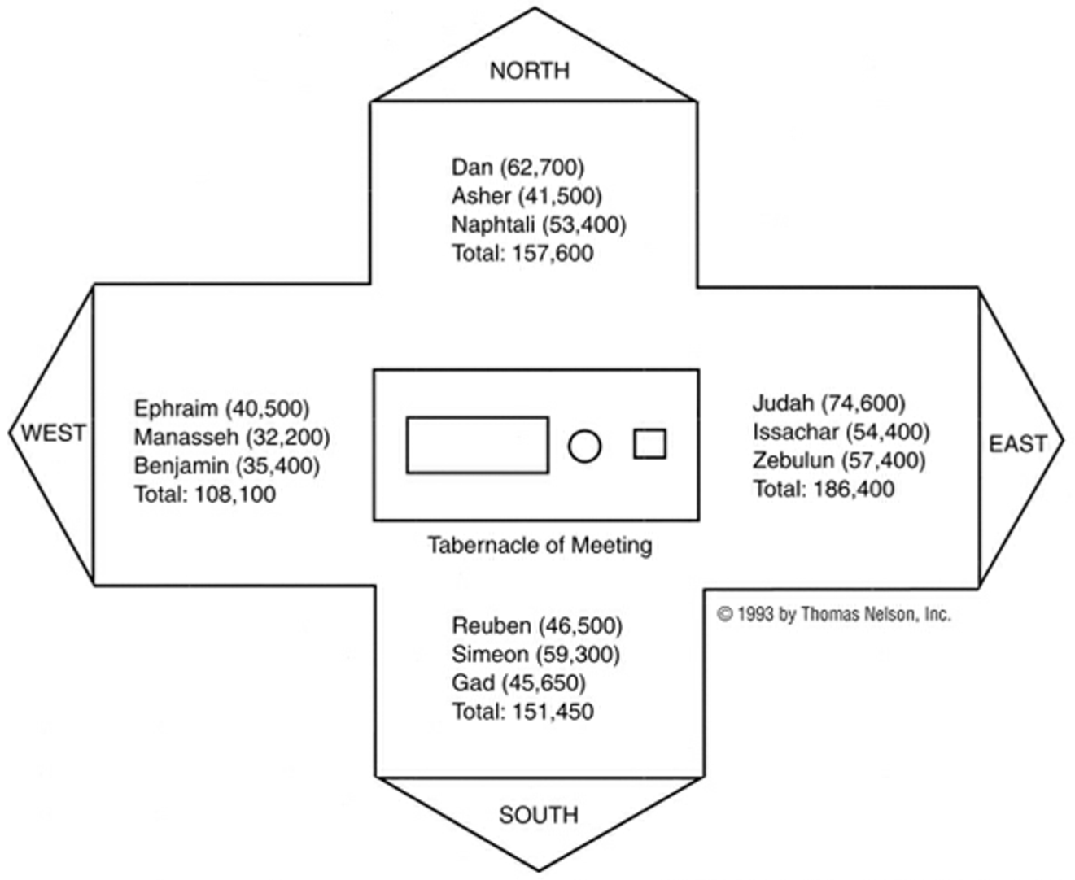
North Side (2:25-31)
Sons of Concubines
Guarded by Merari
East Side (2:3-9)
Children of Leah
Guarded by Priests
Judah Exalted to First
Entrance to Tabernacle
West Side (2:18-24)
Sons of Rachel
Joseph’s Children
Guarded by Gershon
South Side (2:10-16)
Reuben/Simeon Leah’s Demoted Children
Gad From Concubine
Guarded by Kohath

Slide 7
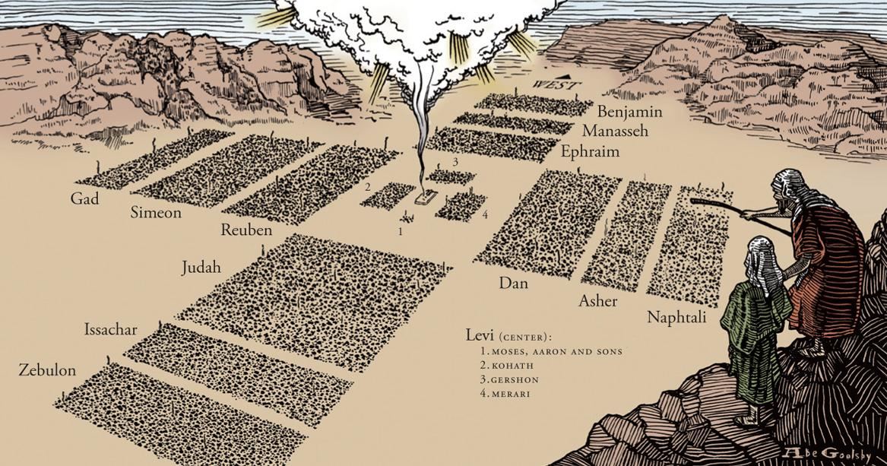

Slide 8
Arrangement of Camp (Numbers 2)
How They Camp (vs. 2)
  By His Own Standard/Banner (According to Jewish Tradition…)
    East – Lion
    South – Man
    West – Calf/Ox
    North – Eagle
  Facing the Tabernacle
    God is the Focal Point of the Camp
    Purpose of Tabernacle Was for God to Dwell With Them (Exodus 25:8)
Levites & Travelling (vs. 17)
  Travels On Either Side of Tabernacle
  Creates “Buffer” For Tabernacle Material
Concluding Remarks (vs. 31-34)
  Repeats Census Numbers/Levites Role
  They Obeyed God – Contrast to Later Chapters

Slide 9
Levites & Priests (Numbers 3-4)
The Priests (3:1-4)
  Nadab & Abihu
    Died For Offering Strange Fire (Leviticus 10)
    Serve as Example for Rest of Levites/Priests
  Eleazar & Ithamar
    All Priests Come Through These Men (Nadab & Abihu Had No Children)
The Roles of the Levites
  Guard/Protect Tabernacle (1:51-53; 3:7-8; 3:38)
    Functioned Like Security Guards for Tabernacle
    ”Guard” Commanded of Adam for the Garden (Genesis 2:15; cf. 3:24)
    We Should Approach God with Reverence
  Serve the Priests (4:47)
    Assisted in Cleaning/Carrying Tabernacle

Slide 10
Levites & Priests (Numbers 3-4)
Specific Clan Duties
  Kohath – Carried the Holy Things (3:27-32; 4:1-20)
  Gershon – Carried the Fabrics (3:25-26; 4:21-28)
  Merari – Carried the Poles, Frames, etc… (3:36-37; 4:29-33)
  A Way to Remember
    KoHath – Holy Things
    Gershon – Girly Things
    Merari – Manly Things
Selection of Levites (3:11-13; 40-51)
  God Chose Levites Over Firstborn (cf. Exodus 13:11-15; 32:26-29)
  All Firstborn Had to be Redeemed
    Firstborn of Israel – 22,273 (3:43)
    Levites – 22,000 (3:39)
    273 Firstborn Had to be Redeemed (1,365 Shekels)

Slide 11
Seeing Jesus in Numbers 1-4
Levites Served Beginning at Age 30 (Numbers 4:3, 35, 47)
  “Jesus, when he began his ministry, was about thirty years of age…” (Luke 3:23)
Jesus ”Tabernacled” With Us
  “And the Word became flesh and dwelt among us, and we have seen his glory, glory as of the only Son from the Father, full of grace and truth.”
  (John 1:14)
Jesus Has an Army That Fights With Sword of the Spirit
  “And I heard the number of the sealed, 144,000, sealed from every tribe of the sons of Israel…” (Revelation 7:4)

