Slide 1
Psalm1 Class Lesson 1
Topic: Erik Borlaug's Zoom Meeting (Psalms) Time: Apr 3, 2020 07:30 PM Eastern Time (US and Canada) Every week on Fri, until May 8, 2020, 6 occurrence(s) Apr 3, 2020 07:30 PM - Psalm 1 Apr 10, 2020 07:30 PM - Psalm 11 Apr 17, 2020 07:30 PM - Psalm 49 Apr 24, 2020 07:30 PM - Psalm 84 May 1, 2020 07:30 PM - Psalm 91 May 8, 2020 07:30 PM - Psalm 142
Join Zoom Meeting https://us04web.zoom.us/j/730383771
Meeting ID: 730 383 771

Slide 2
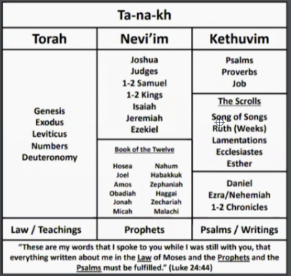
Parts of Hebrew Bible
There is no material for the class. I would ask for this friday if you read Psalm 1 and consider the following questions..
(1) What is Biblical meditation? How does it differ from other forms of meditation?
(2) What are the benefits/promises of meditation?
(3) How can we grow in our ability to meditate?

