Slide 1
an example & instruction
in
right thinking
Paul’s letter
to the Philippians

Slide 2
a.) the story behind the letter
b.) ch. 1 perspective in suffering
c.) ch. 2a humility & unselfishness
d.) ch. 3b direction of focus
e.) ch. 4 joy, peace & contentment
Paul’s letter
to the Philippians

Slide 3
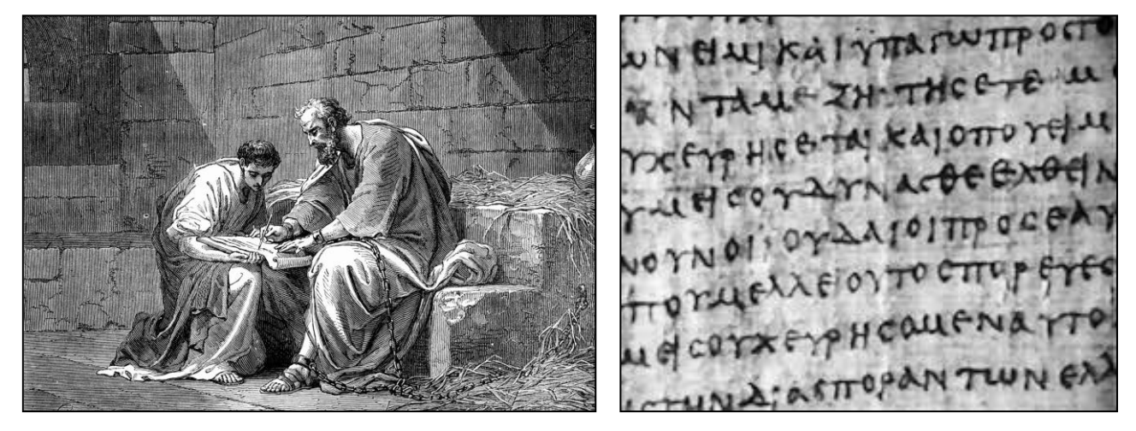
a.) the story behind the letter
Paul’s letter
to the Philippians
Image courtesy of: ManuscriptBibleStudy.com

Slide 4
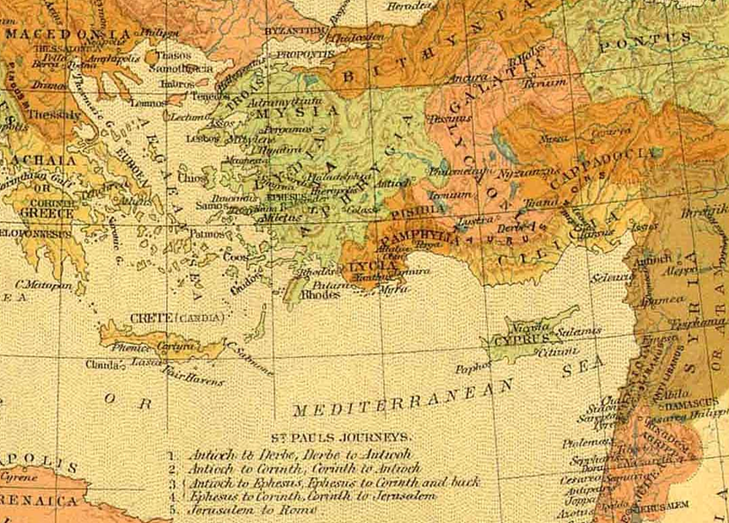
Paul’s journeys
$$
PHILIPPI Lydia & Jailor ACTS 16:11ff
THESSALONICA
Luke
Paul
Silas
Timothy
2nd missionary
journey
Acts 15:36-18:22
Notes:
And keep in mind also the Pharisaic view that eternal life was in the Law of Moses.
In Jn. 5 Jesus spoke of them searching those scriptures and
“THINKING that in THEM you have eternal life.”
But like a bright light shining under a bed, Law doesn’t remove dirt, law shows where the dirt is.
As Jesus continued in John 5.45:
I don’t need to accuse you, the one that accuses you IS MOSES, on whom YOU SET YOUR HOPE.
As for the Gentiles, recall Pharisees among the disciples demanding Torah compliance for the Gentiles:
Ac.15.5:
“It is necessary to circumcise them, and to charge them to keep the law of Moses.“
In contrast to the Phar. View, which P knew well, Paul declared trust in Christ.

Slide 5
Paul’s journeys
ATTACKED ACCUSED ARRESTED
3rd missionary
journey
Acts 18:23-21:16
Plot: 40 men vow to kill him
Tr. to Caesarea / 2 yrs. in prison
Appeals to go to Rome
Notes:
And keep in mind also the Pharisaic view that eternal life was in the Law of Moses.
In Jn. 5 Jesus spoke of them searching those scriptures and
“THINKING that in THEM you have eternal life.”
But like a bright light shining under a bed, Law doesn’t remove dirt, law shows where the dirt is.
As Jesus continued in John 5.45:
I don’t need to accuse you, the one that accuses you IS MOSES, on whom YOU SET YOUR HOPE.
As for the Gentiles, recall Pharisees among the disciples demanding Torah compliance for the Gentiles:
Ac.15.5:
“It is necessary to circumcise them, and to charge them to keep the law of Moses.“
In contrast to the Phar. View, which P knew well, Paul declared trust in Christ.

Slide 6
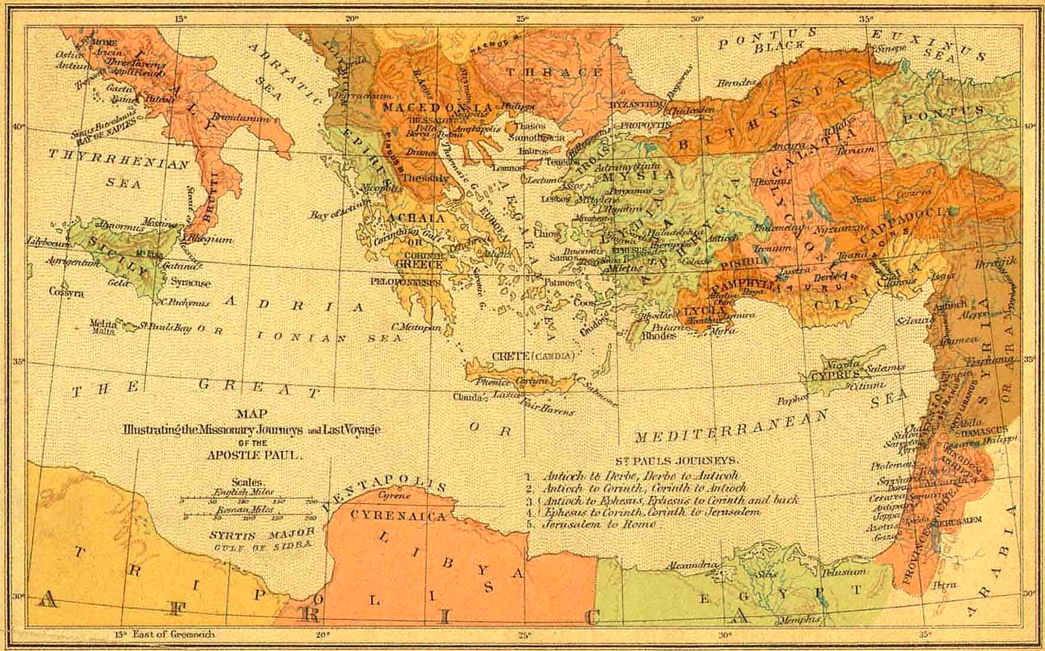
3minutebiblestudy.com
journey to Rome
As a prisoner
Acts 27-28:16

Slide 7
Philippians
Epaphroditus & the gift
Epaphroditus
Paul’s letter
To the
Philippians

Slide 8
Paul’s letter
to the Philippians
Image courtesy of: ManuscriptBibleStudy.com

Slide 9
Paul & financial fellowship
Php. 1:5 4:15-18
Notes:
And keep in mind also the Pharisaic view that eternal life was in the Law of Moses.
In Jn. 5 Jesus spoke of them searching those scriptures and
“THINKING that in THEM you have eternal life.”
But like a bright light shining under a bed, Law doesn’t remove dirt, law shows where the dirt is.
As Jesus continued in John 5.45:
I don’t need to accuse you, the one that accuses you IS MOSES, on whom YOU SET YOUR HOPE.
As for the Gentiles, recall Pharisees among the disciples demanding Torah compliance for the Gentiles:
Ac.15.5:
“It is necessary to circumcise them, and to charge them to keep the law of Moses.“
In contrast to the Phar. View, which P knew well, Paul declared trust in Christ.

Slide 10
Php. 1:12
“I want you to know…”

Slide 11
word spreading
motivating others
prisoner
lost are hearing of Christ
envy & animosity
to be
with
Christ
might be executed

Slide 12
a.) positive over negative
b.) eternal over temporary (cf. 2 Cor. 4)
c.) joy over self pity
d.) win/win over lose/lose
lessons
from ch. 1

Slide 13
key words:
JOY (7x), REJOICE (8x)
tone:
appreciative& optimistic
and yet…

Slide 14
For unto you it is given in the behalf of Christ, not only to believe on him,
but also to suffer for his sake;
Having the same conflict
which ye saw in me,
and now hear to be in me.
Philippians
1:29-30

Slide 15
the Humility of Christ
lessons
from ch. 2 (a.)

Slide 16
a.) be of one mind
b.) don’t be self-seeking
c.) look to the things of others
d.) count other better than self
e.) be humble and servant minded
f.) look to the example of Jesus Christ
lessons
from ch. 2 (a.)

Slide 17
a.) put trust in Christ not in self
b.) forgetting the things that are behind
c.) stretch forward
lessons
from ch. 3 (b.)

Slide 18
a.) rejoice in the Lord
b.) be anxious in nothing
c.) prayer & supplication with thanksgiving
d.) think on these things…
e.) learning to be content
lessons
from ch. 4

Slide 19
God, grant me the serenity to accept the things I cannot change, courage to change the things I can, and wisdom to know the difference

Slide 20
“When upon life’s billows you are tempest tossed...” COUNT YOUR BLESSINGS lyrics by Johnson Oatman Jr.

Slide 21
Paul’s letter
to the Philippians
Image courtesy of: ManuscriptBibleStudy.com

