Slide 1
Leah
Genesis 29

Slide 2
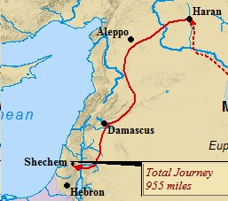

Slide 3
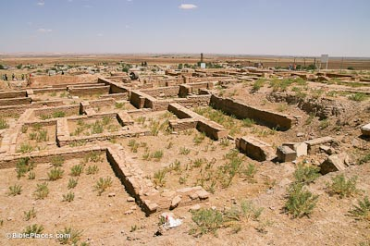
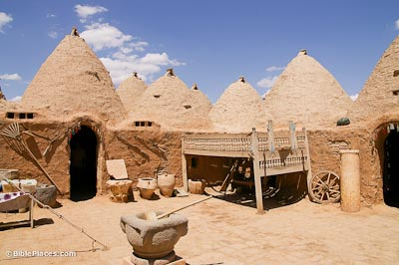
Haran

Slide 4
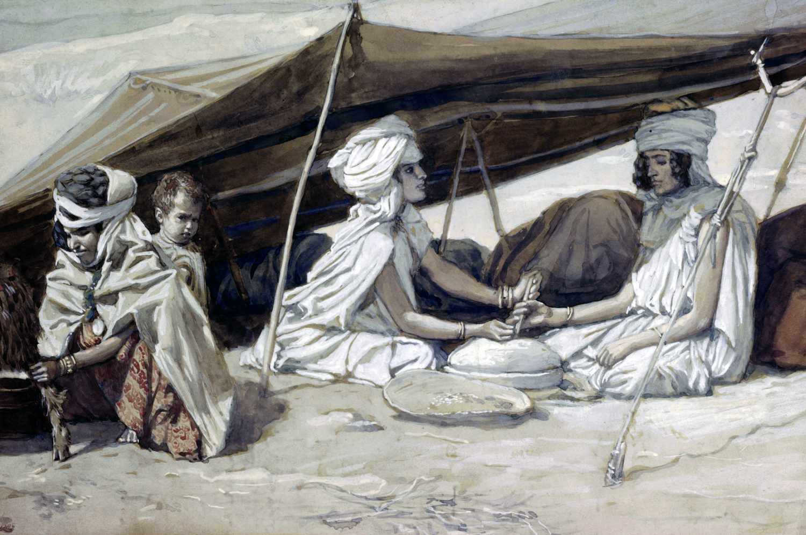
Important figures in Leah’s life
Laban
Rachel
Jacob

Slide 5
Genesis 29:16-18
16 Now Laban had two daughters; the name of the older was Leah, and the name of the younger was Rachel.
17 And Leah’s eyes were weak, but Rachel was beautiful in figure and appearance.
18 Now Jacob loved Rachel, so he said, “I will serve you seven years for your younger daughter Rachel.”

Slide 6
1. Disadvantages
A physical weakness
An unfavorable comparison with her sister.

Slide 7
Genesis 29:25
25 So it came about in the morning that, behold, it was Leah! And he said to Laban, “What is this that you have done to me? Was it not for Rachel that I served with you? Why then have you deceived me?”

Slide 8
Genesis 29:31
31 Now the Lord saw that Leah was unloved, and He opened her womb,
32 Leah conceived and gave birth to a son, and named him Reuben, for she said, “Because the Lord has seen my affliction; surely now my husband will love me.”

Slide 9
Génesis 29:35
35 And she conceived again and gave birth to a son, and said, “This time I will praise the Lord.” Therefore she named him Judah. Then she stopped having children.

Slide 10
Leah
Many disadvantages
She sought the Lord (29:31-35)
Great blessings come “long term” to those who seek God.

Slide 11
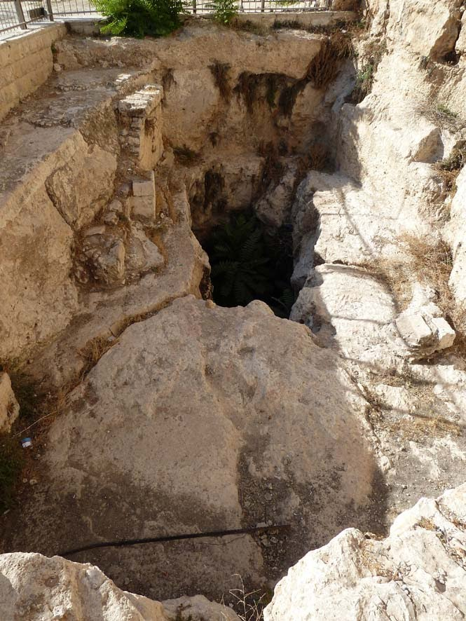
Long Term Blessings
Her children (29:31)
She gradually gained the respect of her husband (31:4,14)
Buried in a place of honor, Cave of Machpelah Hebrón (49:31)

Slide 12
Genesis 49:10 Judah
The scepter will not depart from Judah, Nor the ruler’s staff from between his feet, Until Shiloh comes, And to him shall be the obedience of the peoples.

Slide 13
Aren’t we all like Leah?

