Slide 2
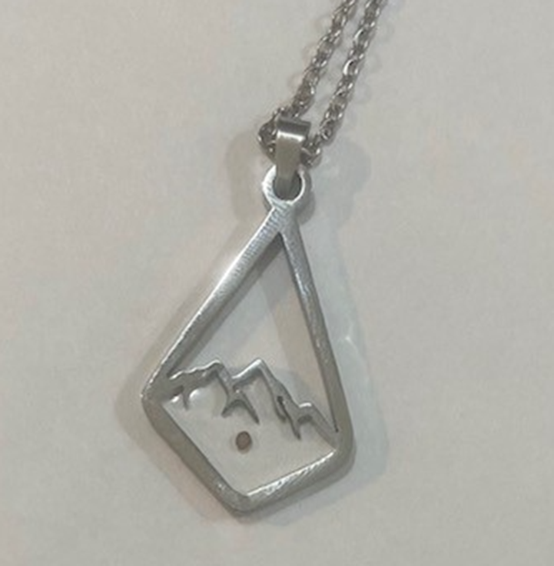
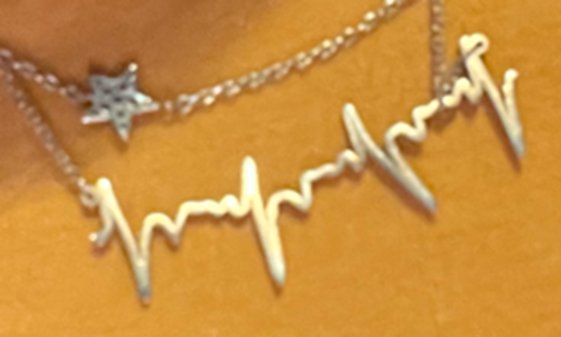
Do Not Despise the Day of Small Things Mustard Seed Faith
Zechariah 4:10
Luke 17:5-6

Slide 3
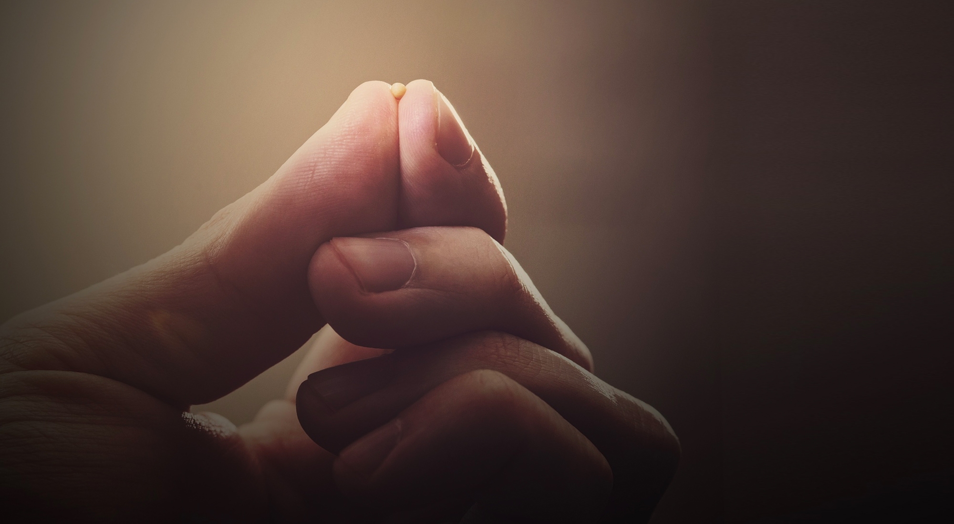
Faith of a Mustard Seed
²⁰ He said to them, “Because of your little faith. For truly, I say to you, if you have faith like a grain of mustard seed, you will say to this mountain, ‘Move from here to there,’ and it will move, and nothing will be impossible for you.” Matthew 17:14-20
⁵ The apostles said to the Lord, “Increase our faith!” ⁶ And the Lord said, “If you had faith like a grain of mustard seed, you could say to this mulberry tree, ‘Be uprooted and planted in the sea,’ and it would obey you. Luke 17:5-6
THE CHALLENGE OF TEMPTATION (Luke 17:1-2)
THE CHALLENGE OF FORGIVENESS (17:3-4)
THE CHALLENGE OF SERVICE (17:7-10)

Slide 4
Faith of a Mustard Seed – Small but Powerful
DO NOT DESPISE THE DAY OF SMALL THINGS
6 Then he said to me, “This is the word of the LORD to Zerubbabel: Not by might, nor by power, but by my Spirit, says the LORD of hosts. 7 Who are you, O great mountain? Before Zerubbabel you shall become a plain. And he shall bring forward the top stone amid shouts of ‘Grace, grace to it!’” Zechariah 4:6-7
"Do not despise the day of small things. Men will rejoice when they see the plumb line in the hand of Zerubbabel" (vs. 10).
Moses' rod that delivered a nation from Egypt (Exodus 4:1-9)
God fed the entire nation of Israel with a small, fine bread. Exodus 16: 14
The jawbone of a donkey that in Samson's hand killed a thousand Philistines
Five smooth pebbles that felled the giant Goliath (1 Samuel 17),
The handful of flour and a jar of oil that sustained a widow through years of famine (2 Kings 4:1-7),
Twelve Ordinary, uneducated men were chosen to change the world.
Their powerful, life giving, life changing message – this valuable treasure - was carried in cheap clay jars.
Five barley loaves and a couple fish that fed a multitude (Matthew 14:13-21),

Slide 5
Faith of a Mustard Seed – Faith is Precious
Small Faith – the Faith the Size of a Mustard Seed – SAVES!
“What shall we do?” Repent and Be Baptized for the Remission of Your Sins and You Shall Received the Gift of the Holy Spirit. (Acts 2:37-38)
But a Mustard Seed Grows!
Now faith is the assurance of things hoped for, the conviction of things not seen. Heb 11:1
“And without faith it is impossible to please God, for whoever would approach him must believe that he exists and that he rewards those who seek him.” Hebrews 11:6
To have Faith means having our whole way of perceiving and responding to life transformed by God.
2 Peter 1:5-11: ⁵ For this very reason, make every effort to add your faith with virtue, and knowledge, ⁶ self-control, steadfastness, godliness, ⁷ brotherly affection, love. ⁸ For if these qualities are yours and are increasing, they keep you from being ineffective or unfruitful in the knowledge of our Lord Jesus Christ. ¹⁰ Therefore, brothers, be all the more diligent to confirm your calling and election, for if you practice these qualities, you will never fall.
THREE THINGS THAT ARE PRECIOUS TO GOD
The Blood of Christ (1 Peter 1:19)
The Promises of God (2 Peter 1:3-4)
The Like Precious Faith (2 Peter 1:1)

Slide 6
Faith of a Mustard Seed – How to Make it Grow?
Small Faith – the Faith the Size of a Mustard Seed – SAVES!
“What shall we do?” Repent and Be Baptized for the Remission of Your Sins and You Shall Received the Gift of the Holy Spirit. (Acts 2:37-38)
But a Mustard Seed Must Grow!
“And without faith it is impossible to please God …” Heb 11:6
CHOOSE FAITH: Joshua 24:15 – choose this day whom you will serve
WALK FAITH: 2 Corinthians 5:7 for we walk by faith, not by sight (Psa 119.105; Jo 8.12; Ro 6.4; Eph2.10)
HEAR FAITH: Jo 5:24– he who hears My words, and believes in Him who sent me, has eternal life.
THINK FAITH: Philippians 2:5 “Let this mind be in you, which was also in Christ Jesus
SEE FAITH: Hebrews 12:2 - “Looking unto Jesus the author and finisher of our faith.”
TALK FAITH: Luke 17:5 – Lord Increase Our Faith (Psalms 105:2)
WORK FAITH: James 2:18 I will show you my faith by my works.

Slide 7
FAITH
Go Pass On Grow

Slide 9
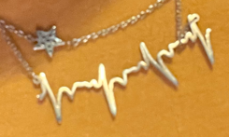

Slide 10
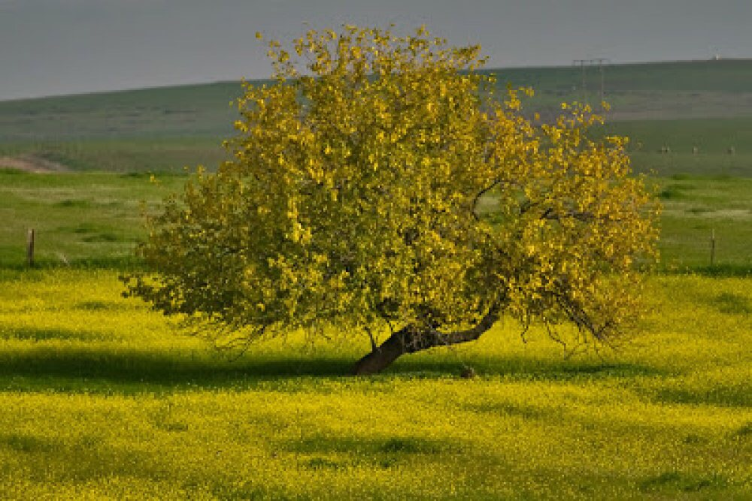

Slide 11
