Slide 1
God´s Holy People
Made in His Image to Be Like Him

Slide 2
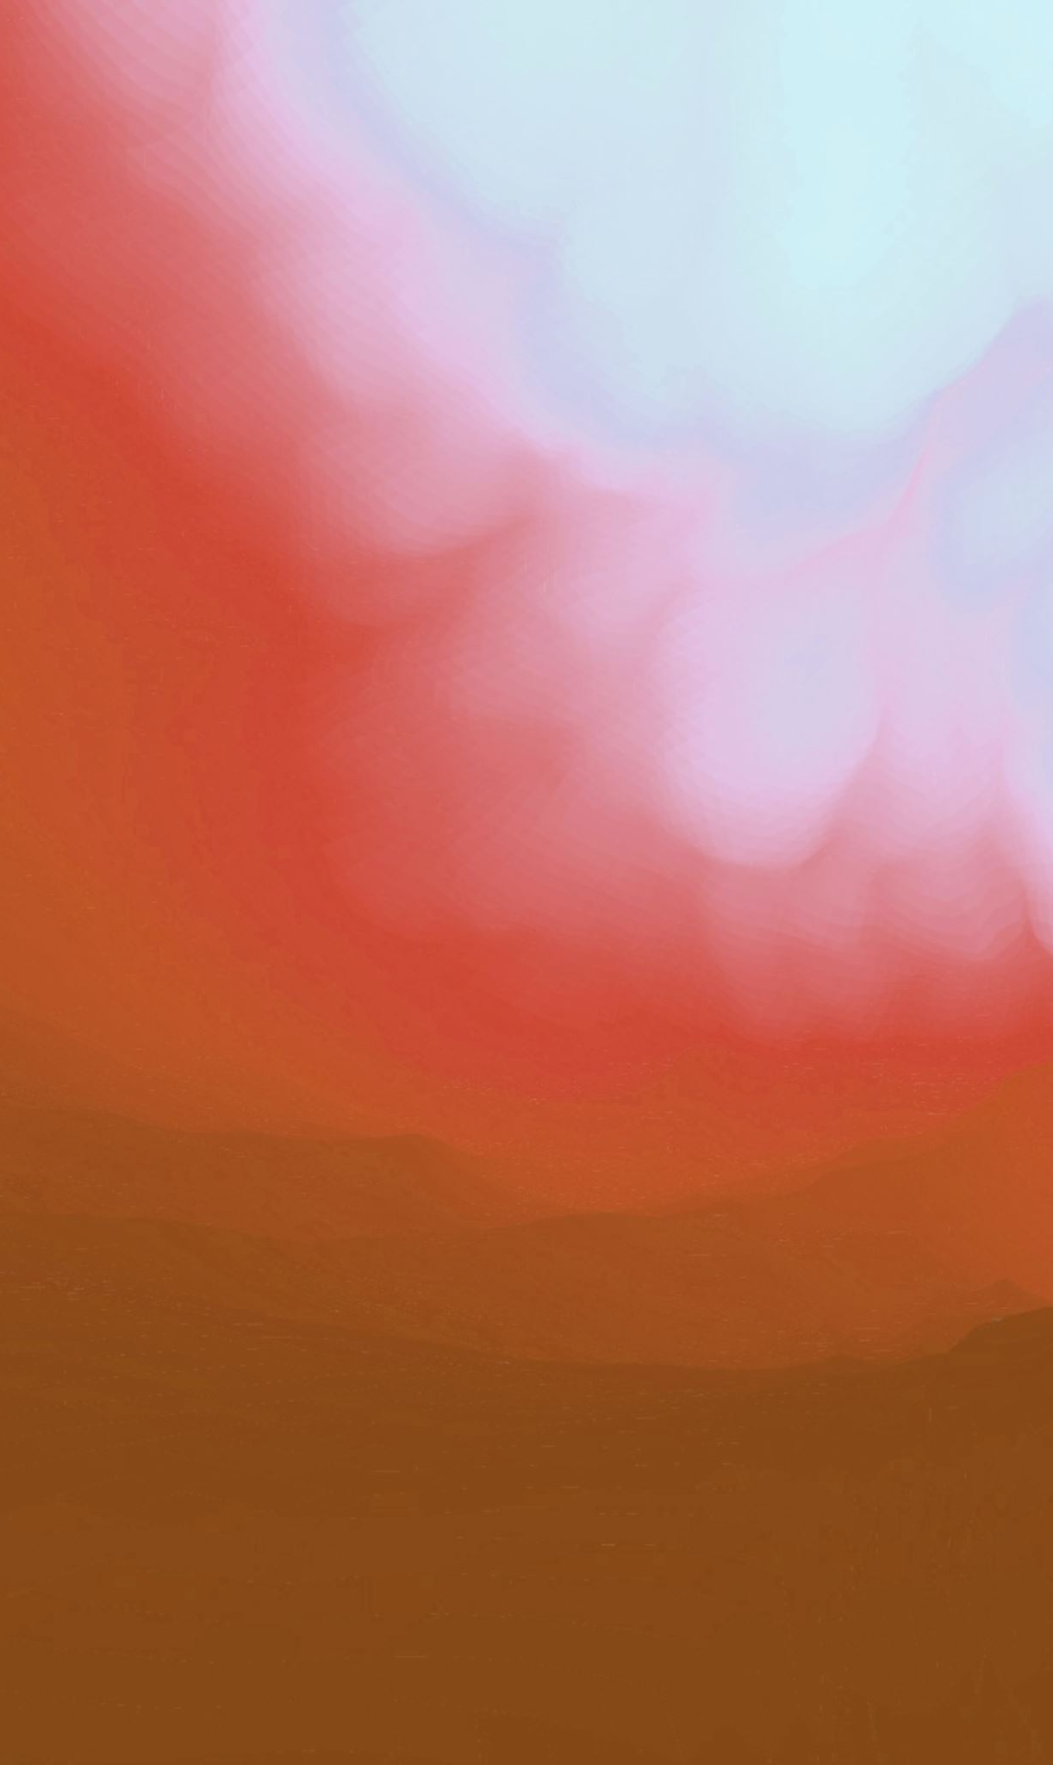
Set apart from the start
God is above all of His creatures (Romans 1:25)
He created humans to be above all other earthly creatures
Special emphasis in Creation (Genesis 1:26; Genesis 2)
Sanctity of human life (Genesis 9:3-6)
The underlying reason: made in His image (Genesis 1:26-27)

Slide 3
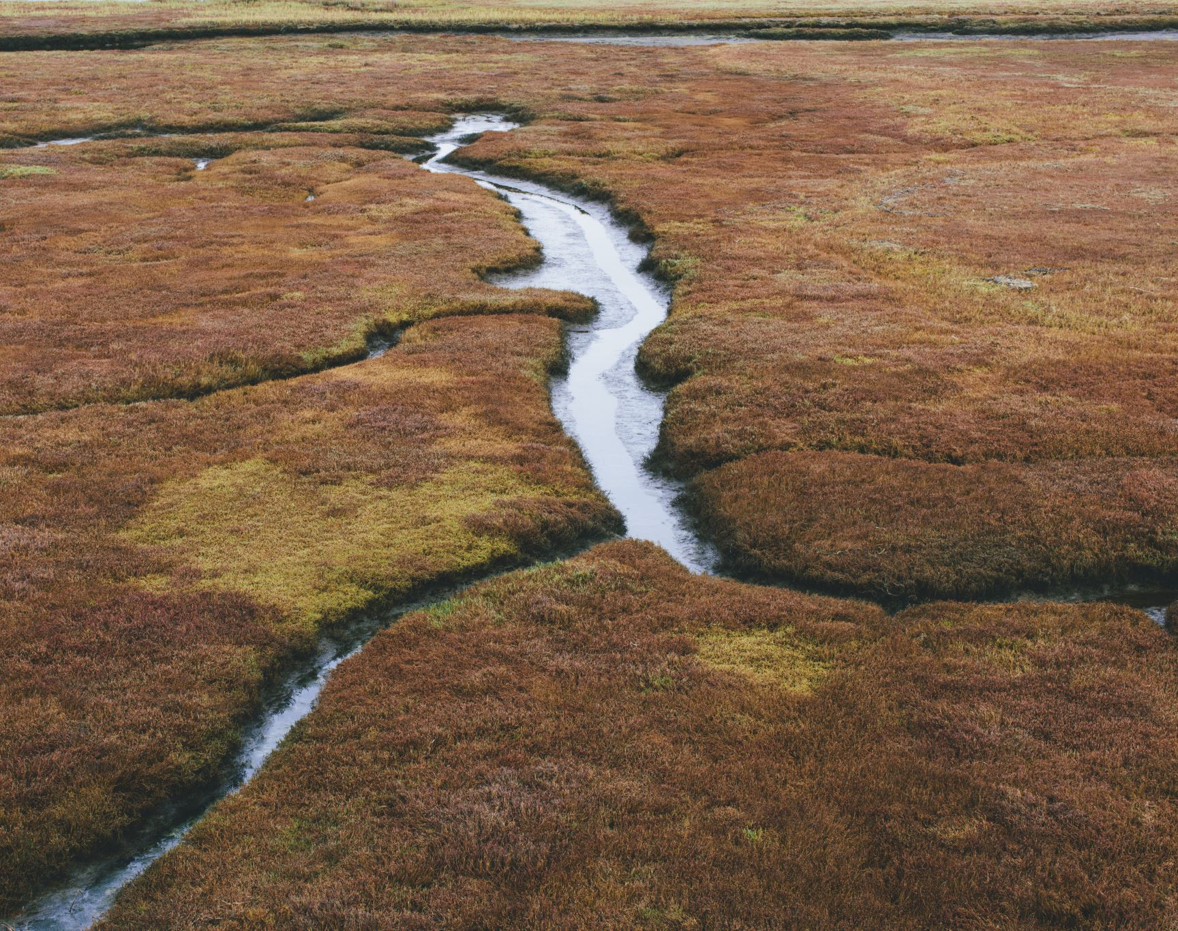
Sad realities
Eden
Cain
Genesis 5
Flood
Babel
Rays of Hope
4:26
5:24
6:8
In just 11 chapters!

Slide 4
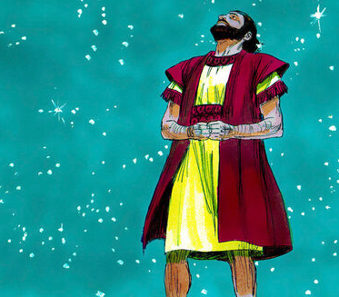
Struggles of the Patriarchs
Abraham: Good, but not perfect
Isaac: Good, but not perfect
Jacob: Far from perfect, slow to convert
Jacob´s sons: Far from perfect
Authorized image use:
Sweet Publishing / FreeBibleimages.org

Slide 5
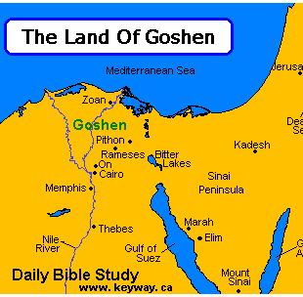
The chosen people in Egypt
A separate people in a separate territory
Complaining and idolatrous

Slide 6
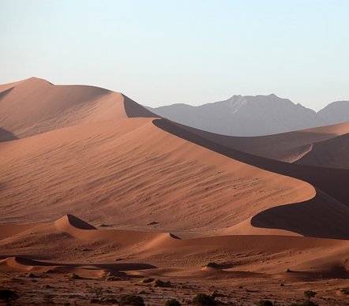
The chosen people in the desert
Special principles for their holiness (Leviticus 11:45)
Complaining and idolatrous

Slide 7
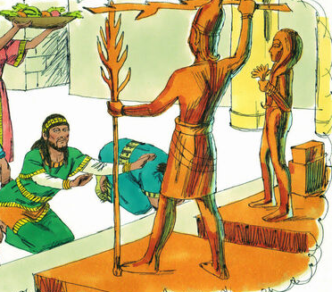
The chosen people in the time of the Judges
Increasingly idolatrous and evil
Authorized image use:
Sweet Publishing / FreeBibleimages.org

Slide 8
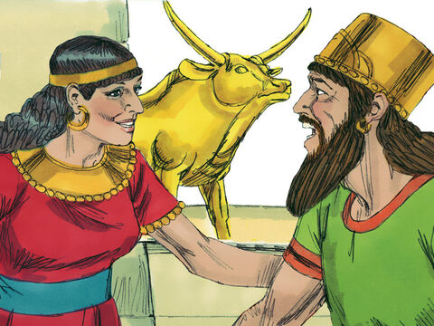
The chosen people in the Kingdom periods
Countless stories of unfaithfulness
Authorized image use:
Sweet Publishing / FreeBibleimages.org

Slide 9
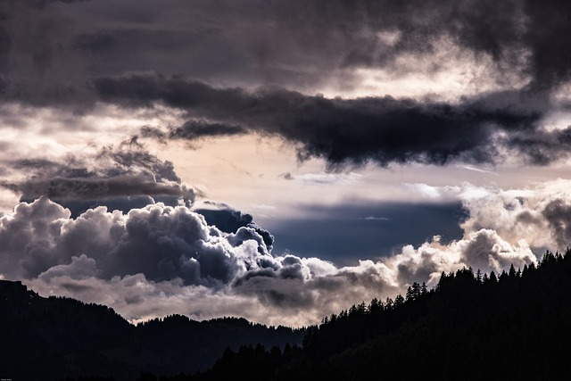
God´s Eviction Notice (Ezekiel 8-11)
Ezekiel visits the temple (8:1-3a)
What he saw in this holy place
Idol of Jealousy (8:5-6)
Elders worshiping detestable things (8:7-13)
Women weeping for Tammuz (8:14-15)
Men worshiping the sun (8:16)
General wickedness in the land (8:17)
There was no room for God, so He moved out (10:4,18,19; 11:23)

Slide 10
Anguish and hope: a word that calls our attention
God´s own heart crushed (Ezekiel 6:4,6,9)
The crushed heart of the “weeping prophet” (Jeremiah 8:21)
The crushing of the sinner´s heart (Psalm 51:17)
God can heal (Psalm 147:1-3)

Slide 11
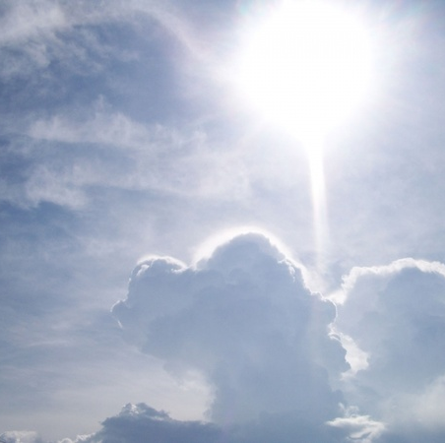
Expectation of healing
Saved from Egypt, not by Egypt: Passover
Exodus 12:13
Isaiah 31:5
God moves back in (Ezekiel 43:1-7)

Slide 12
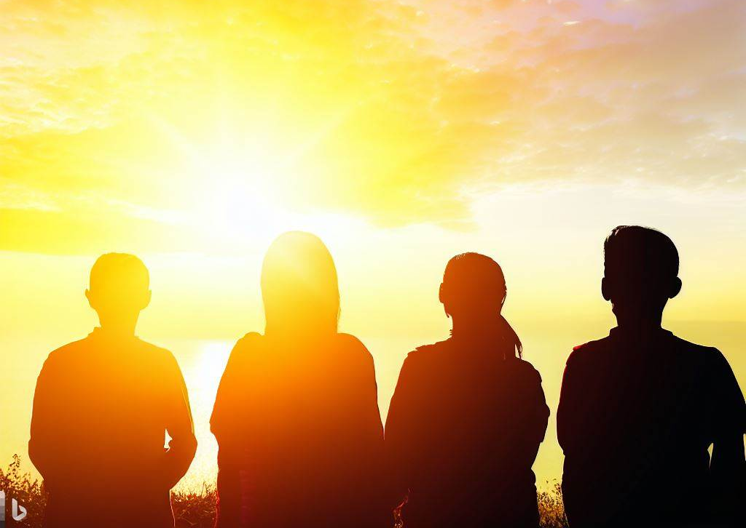
Pointing to Christ
He has separated a holy people (1 Peter 2:9)
Implications in our conduct (1 Peter 1:13-16)
We participate in the purification to be fit for His use (2 Timothy 2:20-22)
He purifies his Bride (Ephesians 5:26-27; reminder of Ezekiel 16)
The Beulah blessing (Revelation 21:2-3; Ezekiel 48:35)

Slide 13
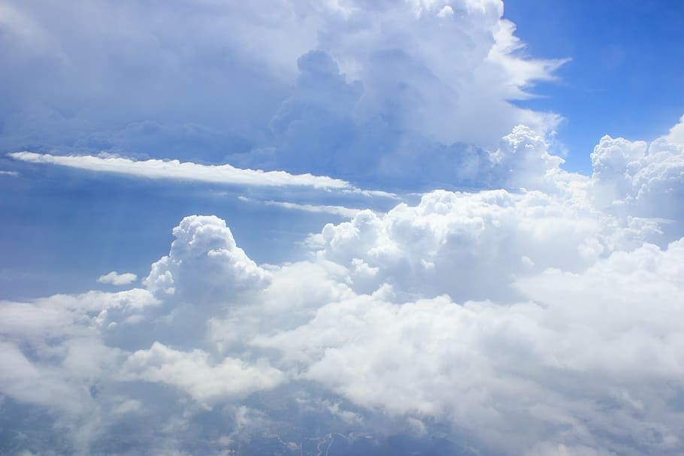
Purified by His blood, we become the heavenly things in the eternal tabernacle (Hebrews 9:23)

