Slide 1
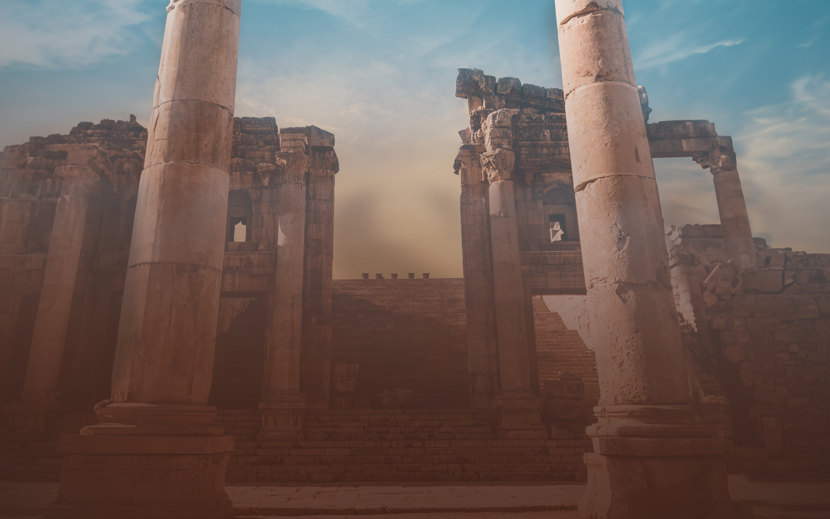
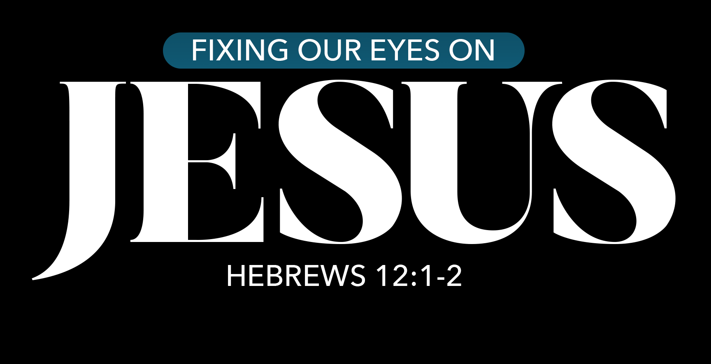

Slide 2
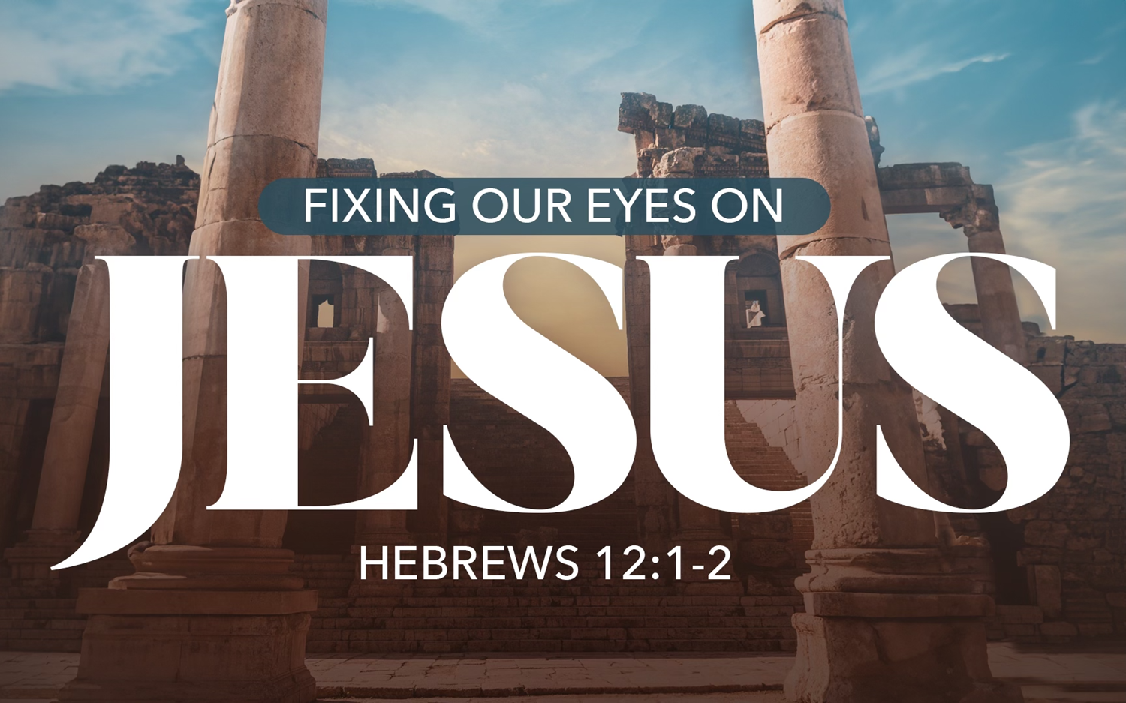
Key Verse
“¹ Therefore, since we have so great a cloud of witnesses surrounding us, let us also lay aside every encumbrance and the sin which so easily entangles us, and let us run with endurance the race that is set before us,
² fixing our eyes on Jesus, the author and perfecter of faith, who for the joy set before Him endured the cross, despising the shame, and has sat down at the right hand of the throne of God.”

Slide 3
Key Verse
“¹ Therefore, since we have so great a cloud of witnesses surrounding us, let us also lay aside every encumbrance and the sin which so easily entangles us, and let us run with endurance the race that is set before us,
² fixing our eyes on Jesus, the author and perfecter of faith, who for the joy set before Him endured the cross, despising the shame, and has sat down at the right hand of the throne of God.”

Slide 4
Key Verse
“¹ Therefore, since we have so great a cloud of witnesses surrounding us, let us also lay aside every encumbrance and the sin which so easily entangles us, and let us run with endurance the race that is set before us,
² fixing our eyes on Jesus, the author and perfecter of faith, who for the joy set before Him endured the cross, despising the shame, and has sat down at the right hand of the throne of God.”
Who he is
What he has done
Why he did it
How we should respond

Slide 5
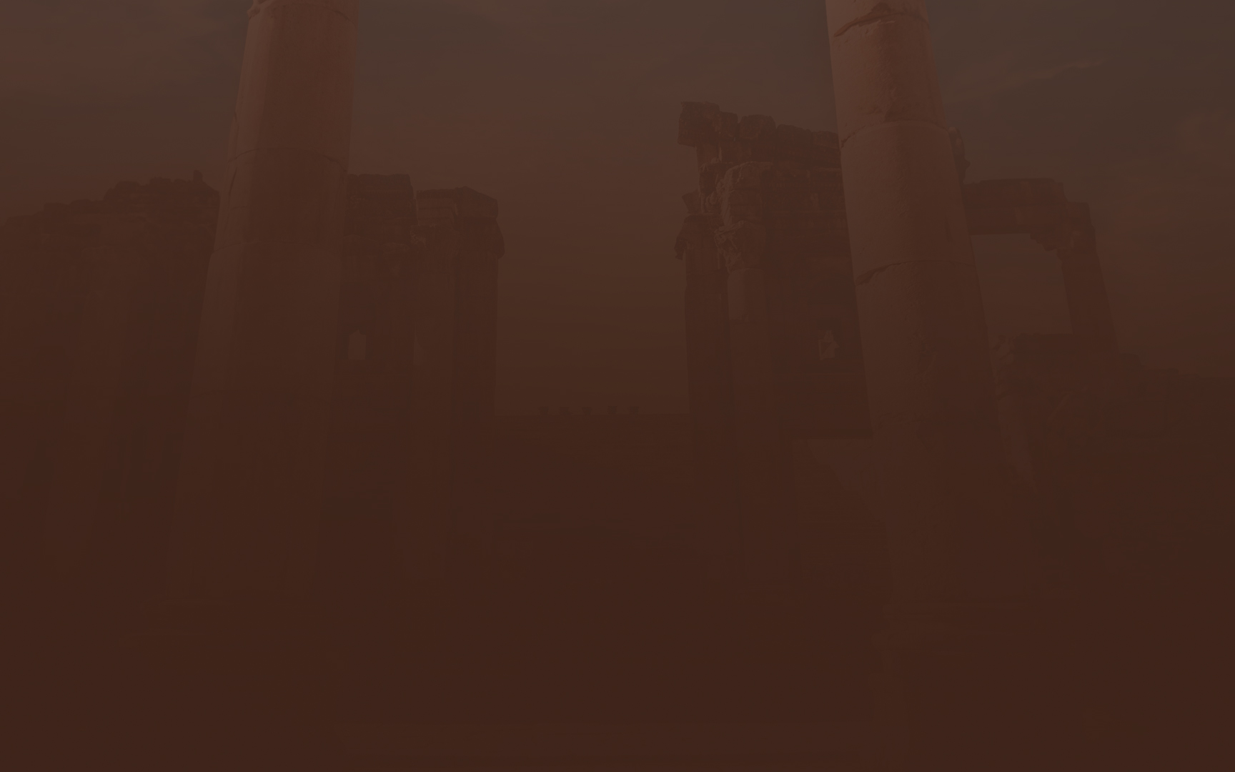
Other Activities with Our Theme
Children’s classes – Gospels
Public Readings – Sunday am and pm
Annual Reading Plan – copies in foyer
End of the Year Studies – topic to be on Christ
Song – “Looking to Thee”
Podcast

Slide 6
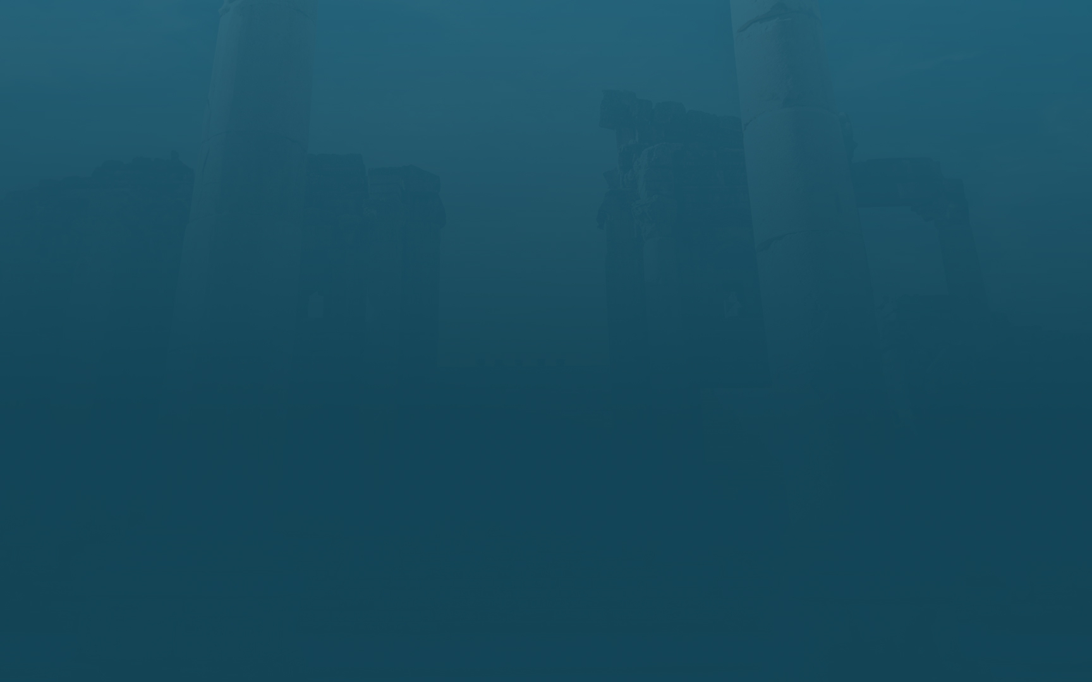

10-15 Minute Podcasts
Related to the Annual Reading
Available on Spotify
Look for an email with a link
QR codes

Slide 8
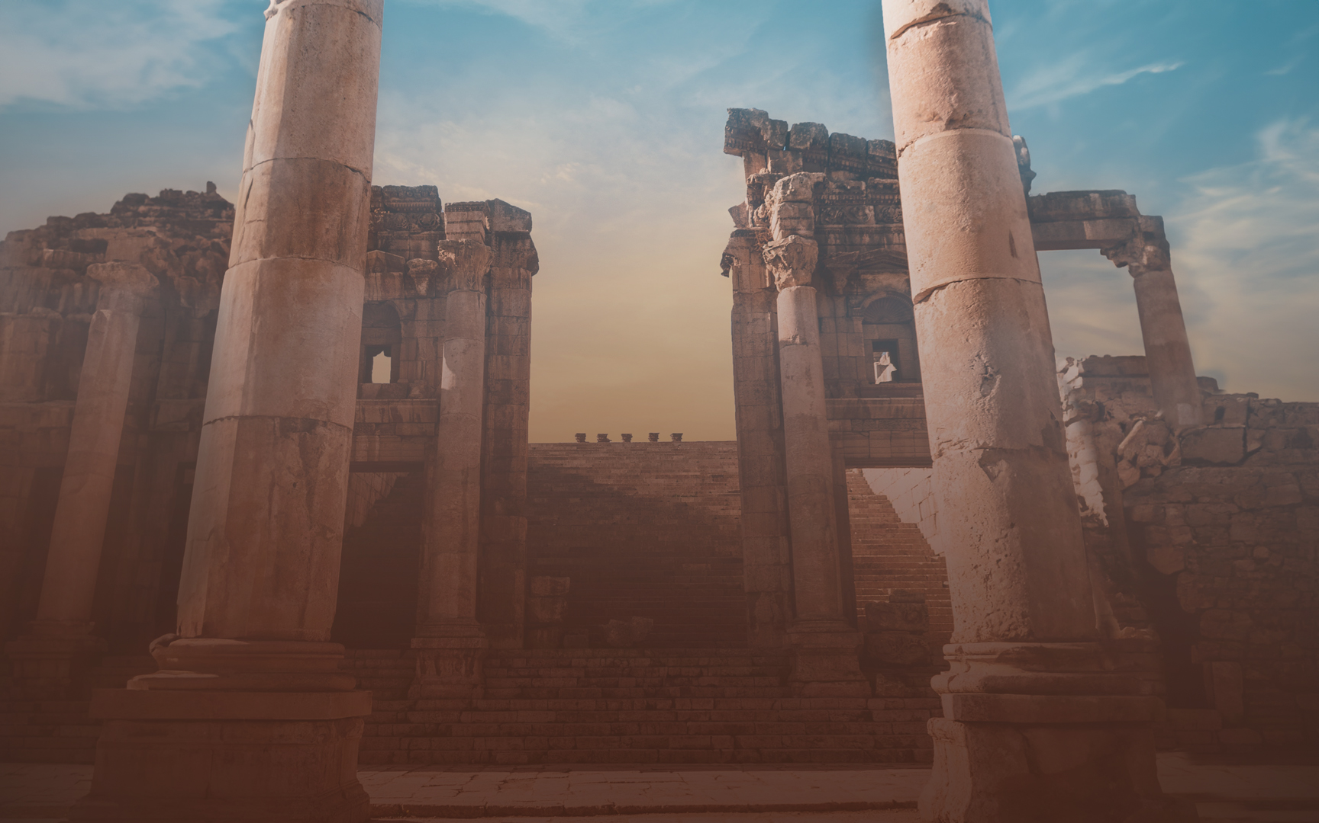
The Context of Our Theme Passage
Hebrews 10:26 – 11:40

Slide 9
Running with Endurance – Hebrews 12:1
“¹ Therefore, since we have so great a cloud of witnesses surrounding us, let us also lay aside every encumbrance and the sin which so easily entangles us, and let us run with endurance the race that is set before us,

Slide 10
Fixing Our Eyes on Jesus
² fixing our eyes on Jesus, the author and perfecter of faith, who for the joy set before Him endured the cross, despising the shame, and has sat down at the right hand of the throne of God.”
Author and perfector of our faith
Endured the cross
Despised the shame
Motivated by the joy set before him
Seated at the right hand of the throne of God
HCSB Source and perfector
ESV Founder and perfector
NIV, NET Pioneer and perfector
NASB Originator and perfector
NKJV, MEV Author and finisher

Slide 11
Go to Christ – Hebrews 13:12-15
¹² So Jesus also suffered outside the gate in order to sanctify the people through his own blood. ¹³ Therefore let us go to him outside the camp and bear the reproach he endured. ¹⁴ For here we have no lasting city, but we seek the city that is to come. ¹⁵ Through him then let us continually offer up a sacrifice of praise to God, that is, the fruit of lips that acknowledge his name.

Slide 12
An Invitation – Hebrews 13:20-21
²⁰ Now may the God of peace who brought again from the dead our Lord Jesus, the great shepherd of the sheep, by the blood of the eternal covenant, ²¹ equip you with everything good that you may do his will, working in us^{[c]} that which is pleasing in his sight, through Jesus Christ, to whom be glory forever and ever. Amen.

Slide 13
