Slide 1
Baskaran, Christians, and Running the Race
October 22, 2023

Slide 2
Baskaran
“...And Jesus said to Simon, ‘Do not be afraid; from now on you will be catching men.’ And when they had brought their boats to land, they left everything and followed Him.” (Luke 5:10b-11)

Slide 3
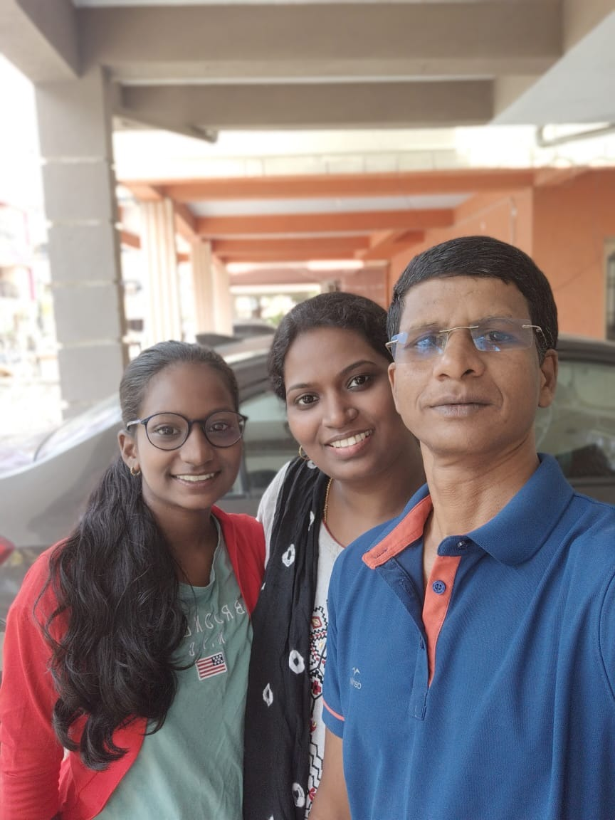
Baskaran’s Bio and Work in Chennai
Became a Christian in 2000
Age: 49, Education: BA in Corporate Secretaryship
Family: Wife and Daughter (13 years old)
Helped three groups since then:
2000-2011: Perambur (Chennai)
2011-2016: Virugambakkam (Chennai)
2016 - Present: Porur (Chennai)
Secular work:
2009-2019: School bus driver
About Porur congregation (assembling since 2016):
45 members

Slide 4
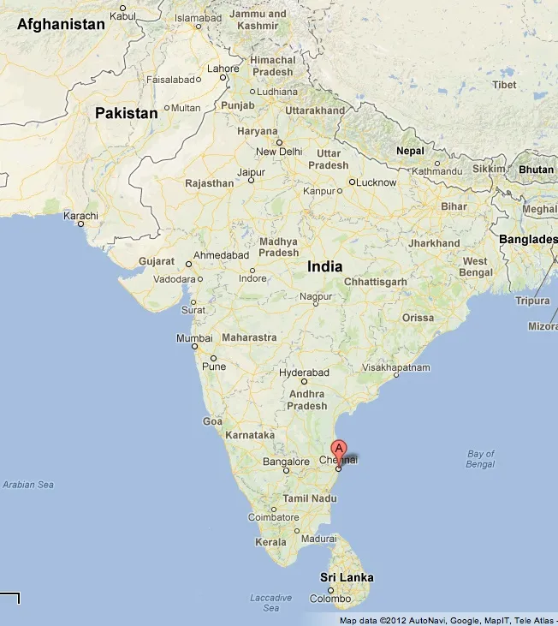
Day | Name(s) | Age(s) | Background | Contacts
Monday | Saravanan | 27 | Denomination | New souls after attending the Bible studies call upon other souls for study. Church members introduce their neighbors and friends.
Tuesday | Elamaran | 47 | Denomination
 | Selva Kumar, Mary Shyla | 49,48 | Denomination
Saturday | Selvaraj, Premalatha, Angel | 40,36,18 | Denomination
 | Madhan, Stella, Mathew | 40,35,15 | Denomination
 | Devanandham, Shyamala, Gayathri, Deepan | 58,55,27,22 | Hinduism
Sunday | Arun, Priya, Amsa | 30,28,60 | Hinduism
 | Sathya | 32 | Denomination
Other Activities
Wednesday PM Bible study | 4th Sunday After Worship: Study/Counseling for Youth
Friday, Sunday: Study at members’ homes | Guiding/Developing Men to Preach and Teach
2nd Sunday After Worship: Study for Women | Thursday: YouTube Recording (Channel: “Bible Simplified”)
3rd Sunday After Worship: Study for Men / Elder Class | Counseling for Family Issues, Addictive Behaviors, etc.

Slide 5
What Is A “Christian”?
“So Barnabas went to Tarsus to look for Saul, and when he had found him, he brought him to Antioch. For a whole year they met with the church and taught a great many people. And in Antioch the disciples were first called Christians.”
(Acts 14:25-26)

Slide 6
What is a Christian? Defining a “disciple”
"If you abide in My word, you are truly my disciples." (John 8:31)
"By this My Father is glorified, that you bear much fruit and so prove to be my disciples.” (John 15:8)
"By this all people will know that you are My disciples, if you have love for one another." (John 13:35)
"If anyone comes to Me and does not hate his own father and mother and wife and children and brothers and sisters, yes, and even his own life, he cannot be my disciple. Whoever does not bear his pwn cross and come after Me cannot be My disciple ... So therefore, any one of you who does not renounce all that he has cannot be My disciple." (Luke 14:26-27,33)
“Go therefore and make disciples of all nations, baptizing them in the name of the Father and of the Son and of the Holy Spirit, teaching them to observe all that I have commanded you.” (Matthew 26:19-20a)

Slide 7
Run The Race With Endurance
“Therefore, since we are surrounded by so great a cloud of witnesses, let us also lay aside every weight, and sin which clings so closely, and let us run with endurance the race that is set before us.”
(Hebrews 12:1)

Slide 8
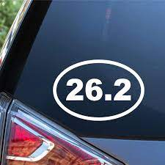
“Run With Endurance The Race”
2 Timothy
2:5, “An athlete is not crowned unless he competes according to the rules.”
4:7, “I have fought the good fight, I have finished the race, I have kept the faith.”
1 Corinthians 9:24, “Do you not know that in a race all the runners run, but only one receives the prize? So run that you may obtain it.”
Hebrews 12:1, “…let us run with endurance the race that is set before us.”

Slide 9
We are called to endure.
“Brother will deliver brother over to death, and the father his child, and children will rise against parents and have them put to death, and you will be hated by all for my name’s sake. But the one who endures to the end will be saved.” (Matt. 10:21-22)
“If we endure, we will also reign with him.” (2 Timothy 2:12)
“Love … endures all things …” (1 Corinthians 13:7)
God has promised to help.
“No temptation has overtaken you that is not common to man. God is faithful, and he will not let you be tempted beyond your ability, but with the temptation he will also provide the way of escape, that you may be able to endure it.” (1 Corinthians 10:13)
“…for He has said, ‘I will never leave you nor forsake you.’ So we can confidently say, ‘The Lord is my helper; I will not fear; what can man do to me?’” (Hebrews 13:5-6)

Slide 10
“Therefore lift your drooping hands and strengthen your weak knees and make straight paths for your feet, so that what is lame may not be put out of joint but rather be healed.”
Hebrews 12:12-13

