Slide 1
Notes:
Indifference 1. having no particular interest or sympathy; unconcerned. 2. neither good nor bad; mediocre.

Slide 2
Subjectivity
1. the quality of being based on or influenced by personal feelings, tastes, or opinions.
2. the quality of existing in someone's mind rather than the external world.

Slide 3
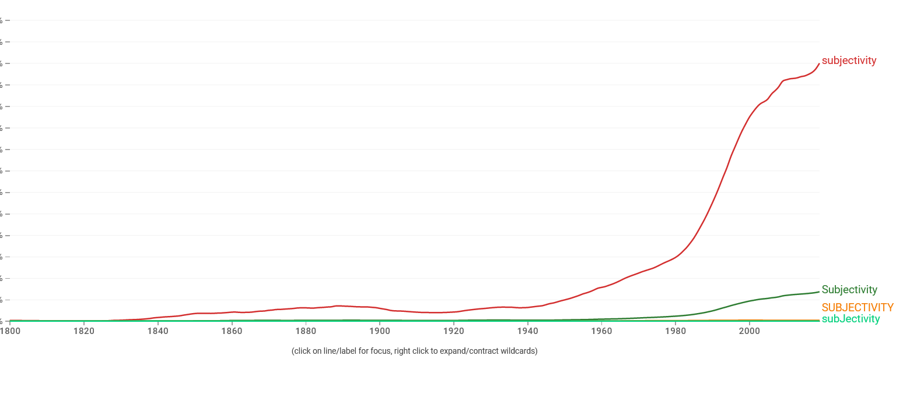

Slide 4
Subjectivity
New
Enlighten
Rebellion
Notes:
New – Something novel , progressive, a way of looking at things
2 Timothy 4:
³ For the time will come when they will not endure sound doctrine, but according to their own desires, because they have itching ears, they will heap up for themselves teachers; ⁴ and they will turn their ears away from the truth, and be turned aside to fables.
Colossians 2:1 For I want you to know what a great conflict I have for you and those in Laodicea, and for as many as have not seen my face in the flesh, 2 that their hearts may be encouraged, being knit together in love, and attaining to all riches of the full assurance of understanding, to the knowledge of the mystery of God, both of the Father and of Christ, 3 in whom are hidden all the treasures of wisdom and knowledge.
4 Now this I say lest anyone should deceive you with persuasive words.
2 Peter 1: 16 For we did not follow cleverly devised stories when we told you about the coming of our Lord Jesus Christ in power, but we were eyewitnesses of his majesty.
Enlighten – smarter, more advance, developed, mature
1 Corinthians 2:1 And I, brethren, when I came to you, did not come with excellence of speech or of wisdom declaring to you the testimony of God. 2 For I determined not to know anything among you except Jesus Christ and Him crucified. 3 I was with you in weakness, in fear, and in much trembling. 4 And my speech and my preaching were not with persuasive words of human wisdom, but in demonstration of the Spirit and of power, 5 that your faith should not be in the wisdom of men but in the power of God.
6 However, we speak wisdom among those who are mature, yet not the wisdom of this age, nor of the rulers of this age, who are coming to nothing. 7 But we speak the wisdom of God in a mystery, the hidden wisdom which God ordained before the ages for our glory, 8 which none of the rulers of this age knew; for had they known, they would not have crucified the Lord of glory.
1 John 4:1 You are of God, little children, and have overcome them, because He who is in you is greater than he who is in the world. 5 They are of the world. Therefore they speak as of the world, and the world hears them. 6 We are of God. He who knows God hears us; he who is not of God does not hear us. By this we know the spirit of truth and the spirit of error.
Rebellion – Just don’t want to follow God, deny Jesus
2 Peter 2: 1 But there were also false prophets among the people, even as there will be false teachers among you, who will secretly bring in destructive heresies, even denying the Lord who bought them, and bring on themselves swift destruction. 2 And many will follow their destructive ways, because of whom the way of truth will be blasphemed. 3 By covetousness they will exploit you with deceptive words; for a long time their judgment has not been idle, and their destruction does not slumber.
4 For if God did not spare the angels who sinned, but cast them down to hell and delivered them into chains of darkness, to be reserved for judgment; 5 and did not spare the ancient world, but saved Noah, one of eight people, a preacher of righteousness, bringing in the flood on the world of the ungodly; 6 and turning the cities of Sodom and Gomorrah into ashes, condemned them to destruction, making them an example to those who afterward would live ungodly; 7 and delivered righteous Lot, who was oppressed by the filthy conduct of the wicked 8 (for that righteous man, dwelling among them, tormented his righteous soul from day to day by seeing and hearing their lawless deeds)— 9 then the Lord knows how to deliver the godly out of temptations and to reserve the unjust under punishment for the day of judgment, 10 and especially those who walk according to the flesh in the lust of uncleanness and despise authority. They are presumptuous, self-willed. They are not afraid to speak evil of dignitaries, 11 whereas angels, who are greater in power and might, do not bring a reviling accusation against them before the Lord.

Slide 5
Subjectivity
New ‘Religion’
1. the belief in and worship of a superhuman power or powers, especially a God or gods.
2. a pursuit or interest to which someone ascribes supreme importance.
New
Enlighten
Rebellion
Notes:
Religion
1. the belief in and worship of a superhuman power or powers, especially a God or gods.
2. a pursuit or interest to which someone ascribes supreme importance.
Environmentalism
Nationalism / Racism

Slide 6
Subjectivity
‘PR’ Campaign
New ‘Religion’
supreme importance
IF right and wrong is determined by what we each individually subjectively think then I need to influence those around me to think the same way I do to ‘normalize’ my behavior.
New
Enlighten
Rebellion
Notes:
Religion
1. the belief in and worship of a superhuman power or powers, especially a God or gods.
2. a pursuit or interest to which someone ascribes supreme importance.
Replacing God
Environmentalism
Nationalism / Racism
Social Justice
PR Campaign
IF right and wrong is determined by what we each individually subjectively think then I need to influence those around me to think the same way I do to ‘normalize’ my behavior.

Slide 7
Subjectivity
‘PR’ Campaign
18 For when they speak great swelling words of emptiness, they allure through the lusts of the flesh, through lewdness, the ones who have actually escaped from those who live in error. 19 While they promise them liberty, they themselves are slaves of corruption; for by whom a person is overcome, by him also he is brought into bondage
New ‘Religion’
supreme importance
New
Enlighten
Rebellion
Notes:
PR Campaign
IF right and wrong is determined by what we each individually subjectively think then I need to influence those around me to think the same way I do to ‘normalize’ my behavior.
Media – Movies / Music / Theater
Parades
Schools
Legislate
Promise: Freedom, Inclusion, diversity of thought, acceptance of all.
2 Peter 2:18 For when they speak great swelling words of emptiness, they allure through the lusts of the flesh, through lewdness, the ones who have actually escaped from those who live in error. 19 While they promise them liberty, they themselves are slaves of corruption; for by whom a person is overcome, by him also he is brought into bondage
Smudge Campaign-

Slide 8
PR / Smudge
Campaign
Subjectivity
Old Fashioned
Antiquated thinking
Backwards
Simple minded
Narrow-minded
Bigoted
Hateful
Dangerous Hate Speech
New ‘Religion’
supreme importance
New
Enlighten
Rebellion
Notes:
Smudge Campaign-
Old Fashioned
Antiquated thinking
Backwards
Narrowminded
Bigoted
Hateful
Dangerous Hate Speech

Slide 9
PR / Smudge
Campaign
Subjectivity
New ‘Religion’
supreme importance
Sin
New
Enlighten
Rebellion
Notes:
Evil-
Recent violence
Gen 3
1 Now the serpent was more cunning than any beast of the field which the Lord God had made. And he said to the woman, “Has God indeed said, ‘You shall not eat of every tree of the garden’?”
2 And the woman said to the serpent, “We may eat the fruit of the trees of the garden; 3 but of the fruit of the tree which is in the midst of the garden, God has said, ‘You shall not eat it, nor shall you touch it, lest you die.’ ”
4 Then the serpent said to the woman, “You will not surely die. 5 For God knows that in the day you eat of it your eyes will be opened, and you will be like God, knowing good and evil.”
6 So when the woman saw that the tree was good for food, that it was pleasant to the eyes, and a tree desirable to make one wise, she took of its fruit and ate. She also gave to her husband with her, and he ate

Slide 10
Notes:
Indifference 1. having no particular interest or sympathy; unconcerned. 2. neither good nor bad; mediocre.

