Slide 1
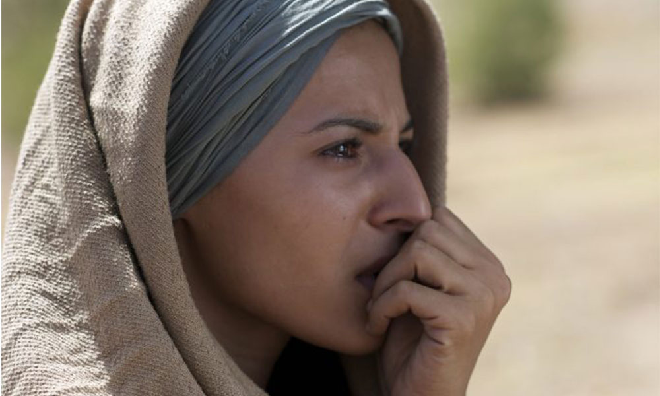
The Faith of Rahab

Slide 2
What we know about Rahab:
She was a Canaanite
She was a harlot
She was a “liar”?
She was an obedient believer
Hebrews 11:30-31; Joshua 2:3-14

Slide 3
Rahab chooses the Lord over…
A pagan culture (Deut 20:18; Gen 15:16)
Unfulfilled expectations
Fake news

Slide 4
Rahab in the New Testament
Heb 11:31
James 2:24-25
Matthew 1:5-6

Slide 5
The Faith of Rahab

