Slide 1
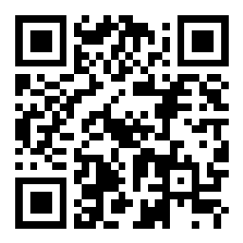
Hebrews
slido.com
#embryhills
Lesson One: Introduction • Christ and the Prophets

Slide 2
Who wrote the book of Hebrews?
ⓘ Start presenting to display the poll results on this slide.

Slide 3
Approximately when was Hebrews written?
ⓘ Start presenting to display the poll results on this slide.

Slide 4
Who were (likely) the first readers of Hebrews?
ⓘ Start presenting to display the poll results on this slide.

Slide 5
What is the primary purpose of the Hebrew letter?
ⓘ Start presenting to display the poll results on this slide.

Slide 6
What persuasive technique best describes the approach of Hebrews?
ⓘ Start presenting to display the poll results on this slide.

Slide 9
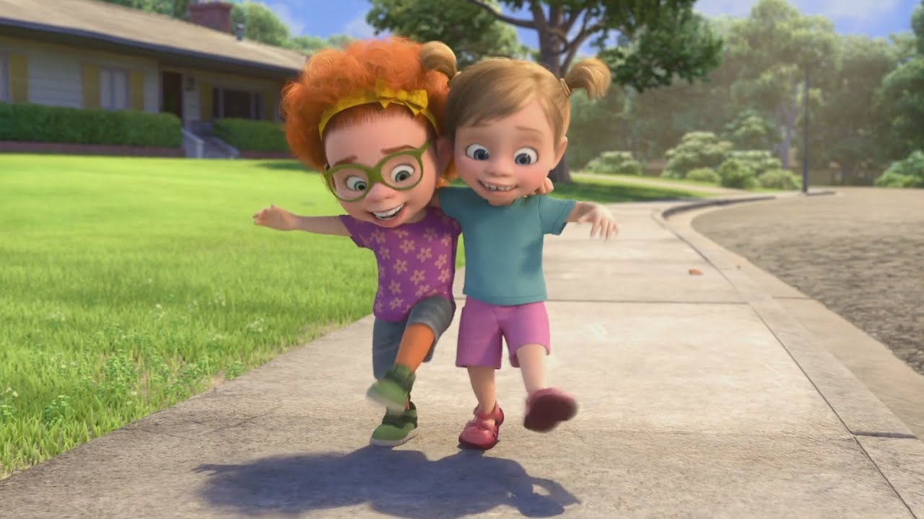
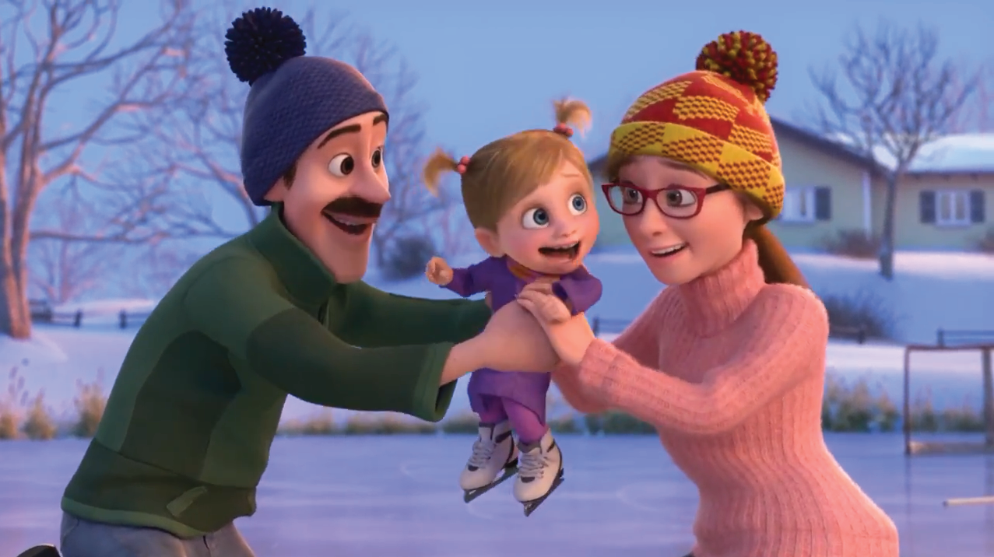
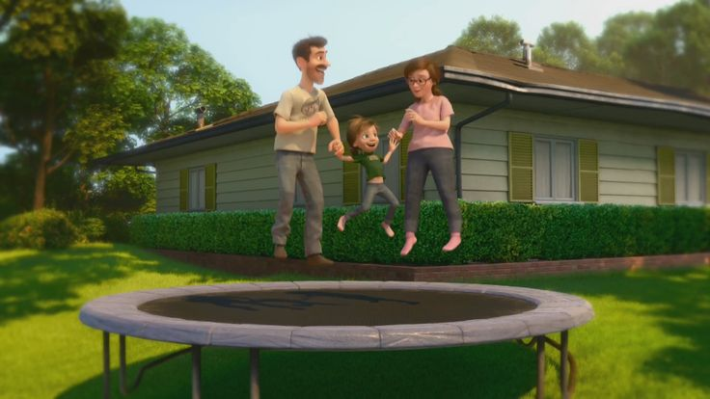
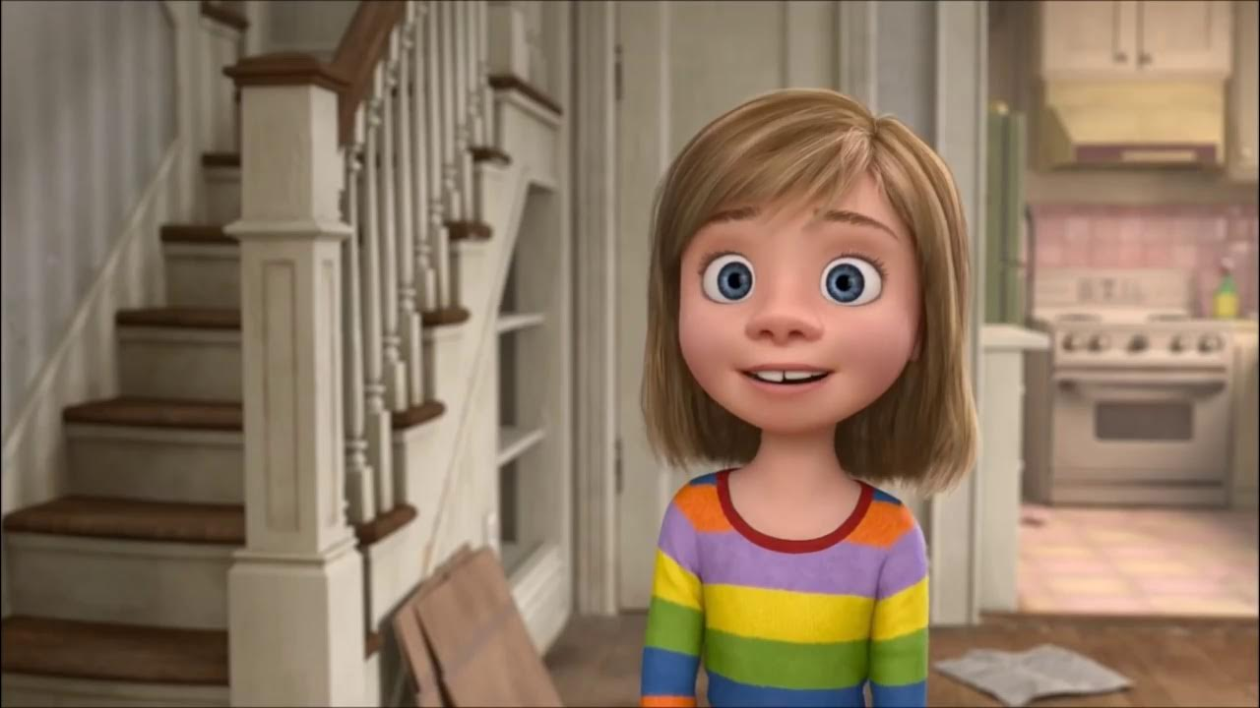
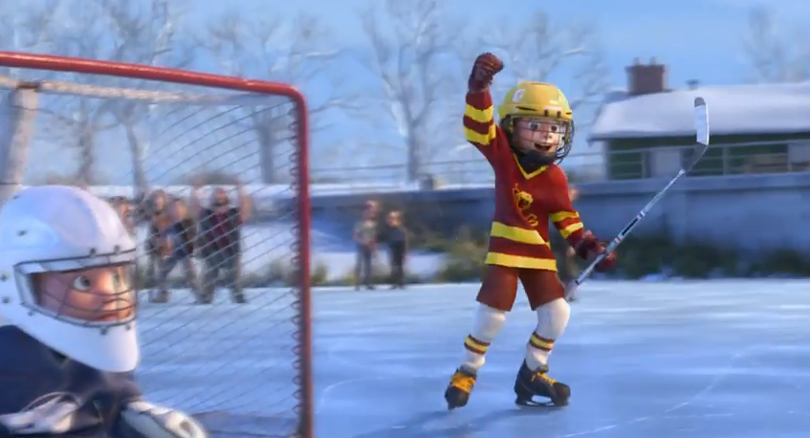
Great Family
Great House
Great Yard
Great Friends
Great Hockey Team
Happy
Life
Riley grew up in Minnesota
Meet 11-year old Riley…

Slide 10
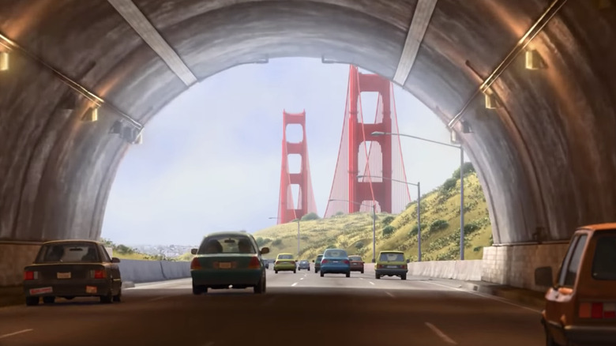
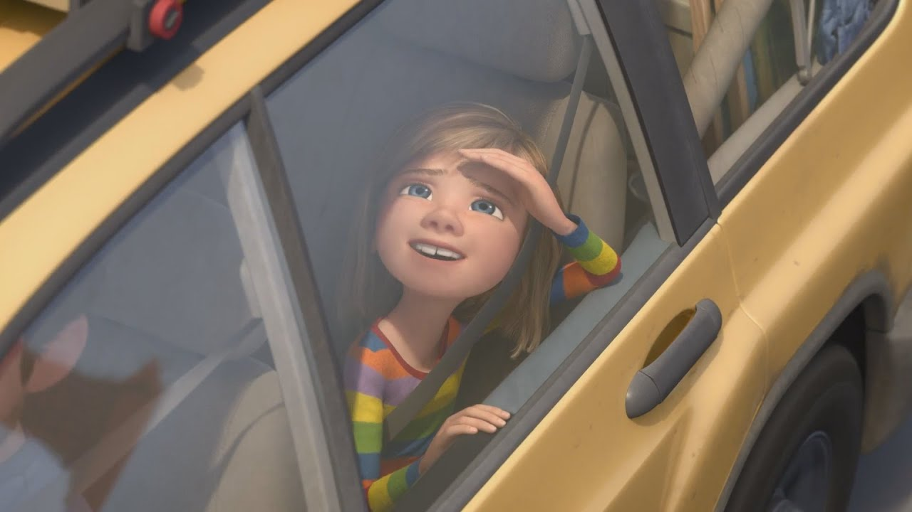
Hopeful
Change
Happy
Life
But then her family moves to San Francisco…
…hoping to improve their lives…

Slide 11
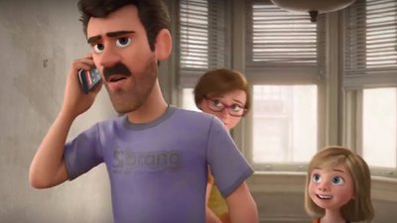
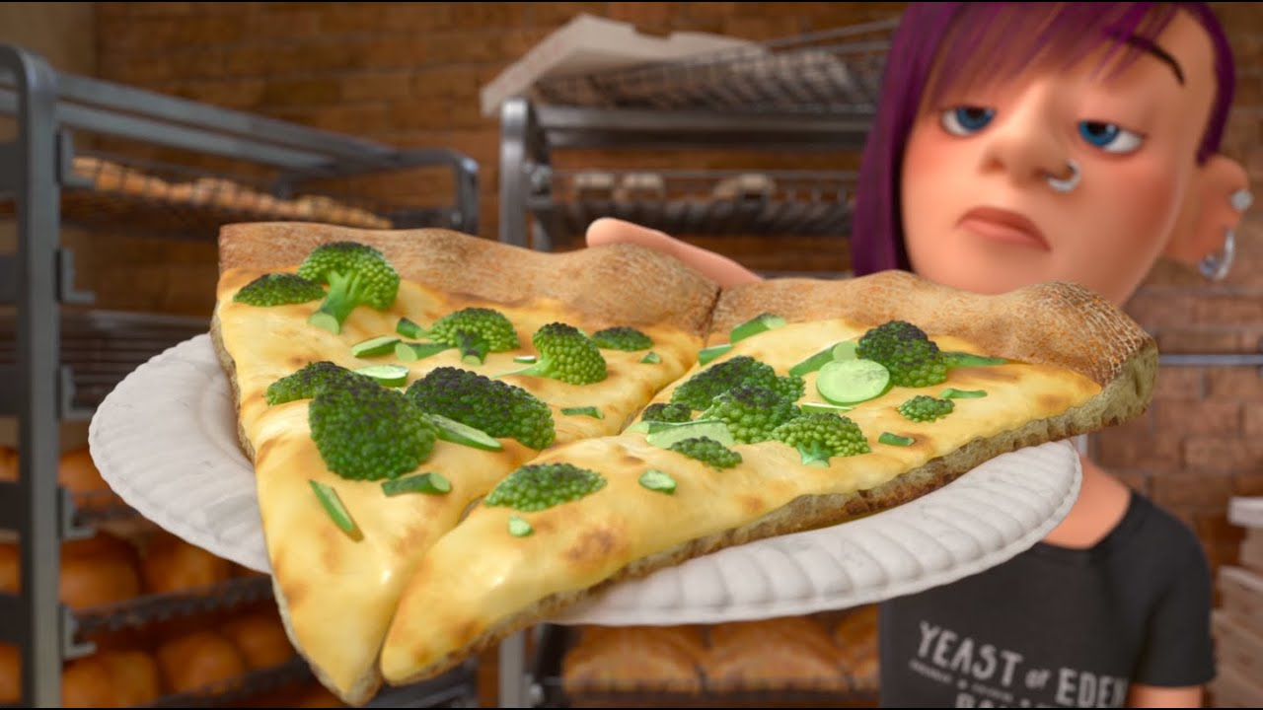
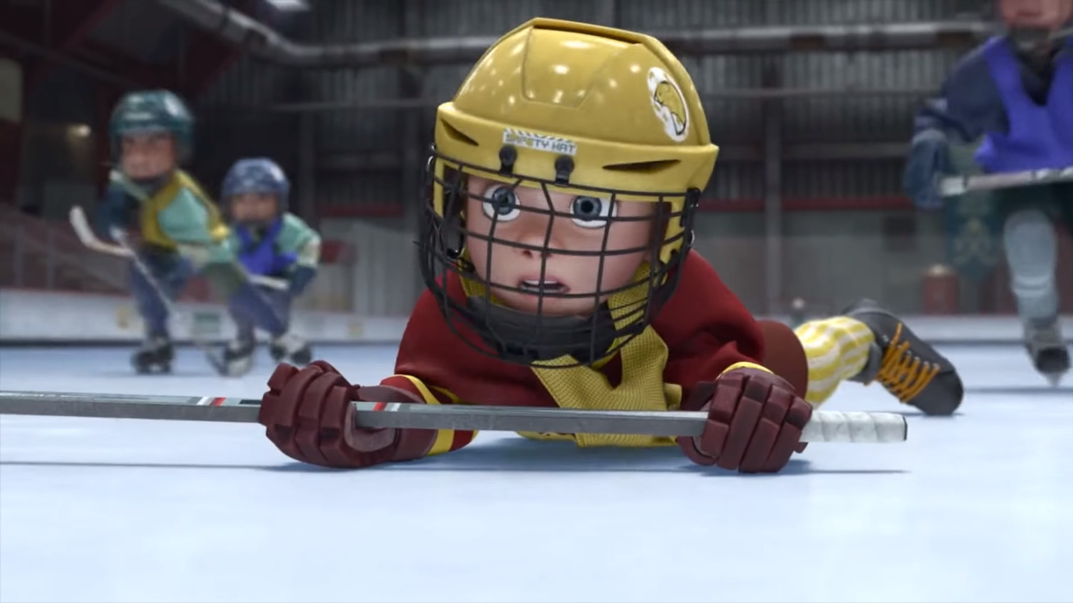
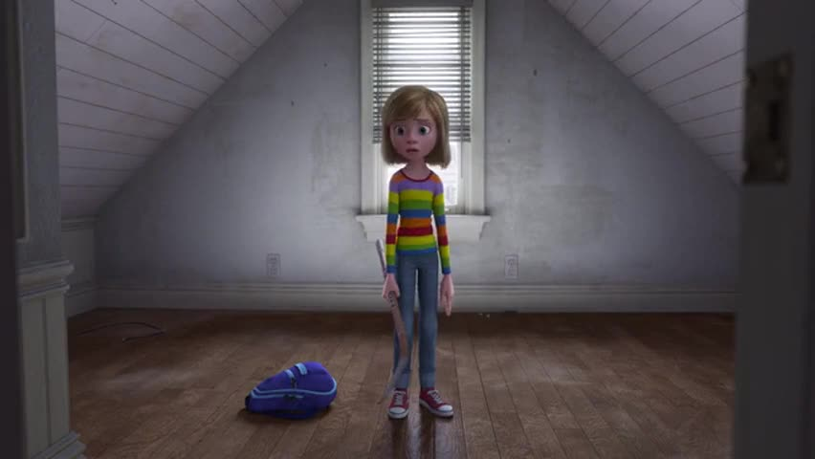
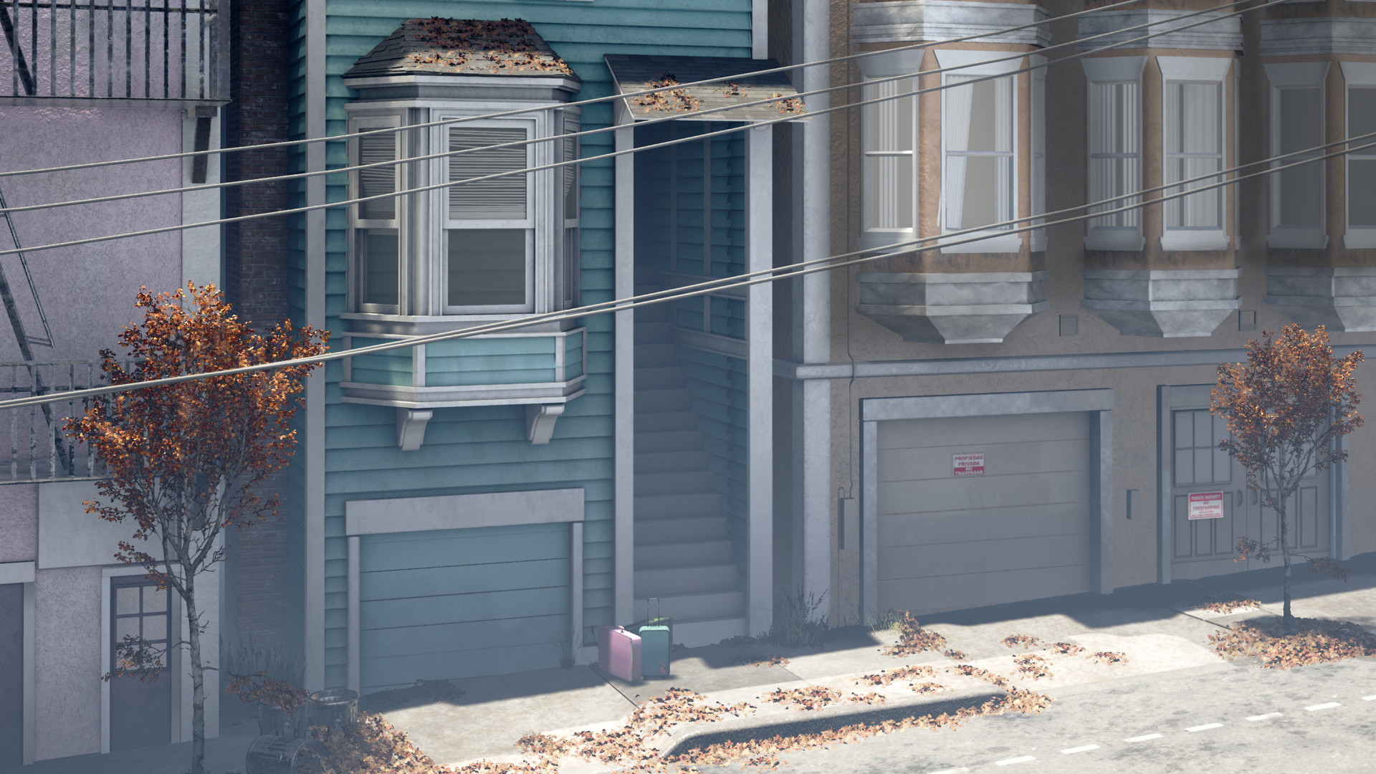
Ugly House
Nasty Room
Stressed
Parents
Broccoli Pizza!
Fails Hockey Tryouts
Hard
Struggles
Hopeful
Change
Happy
Life
…only to face challenges

Slide 12
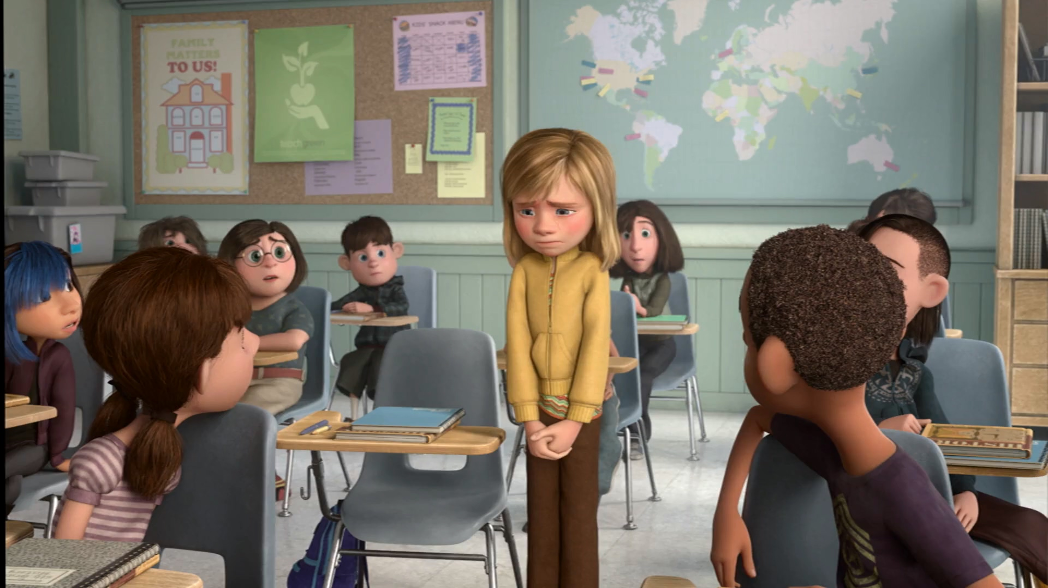
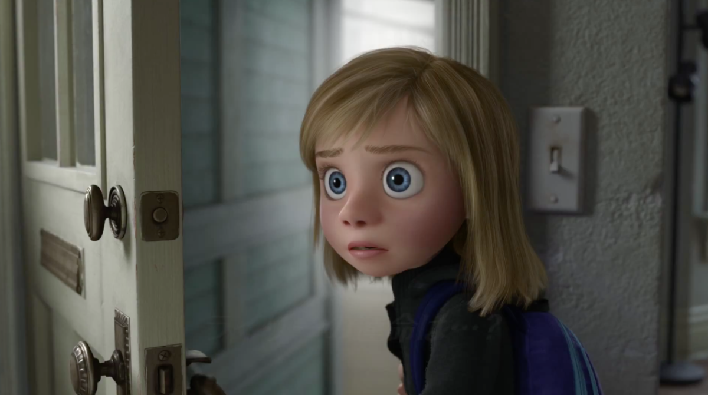
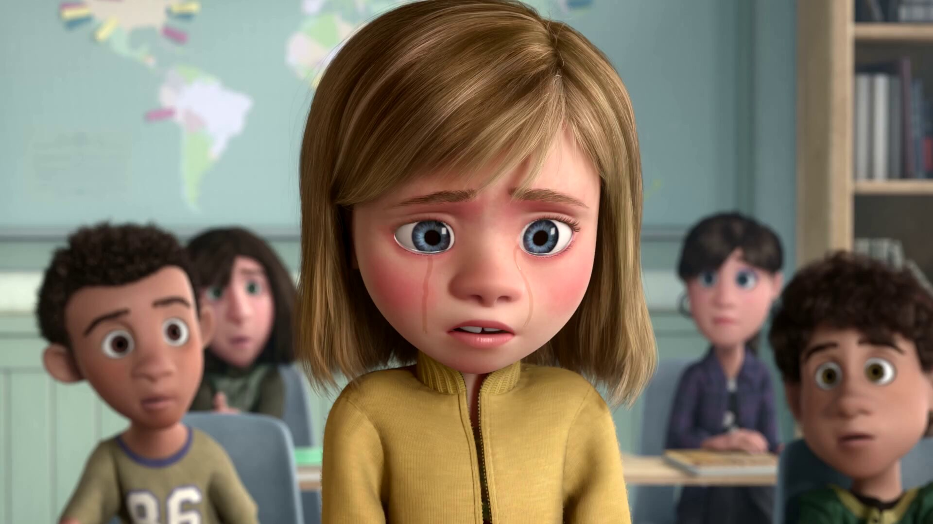
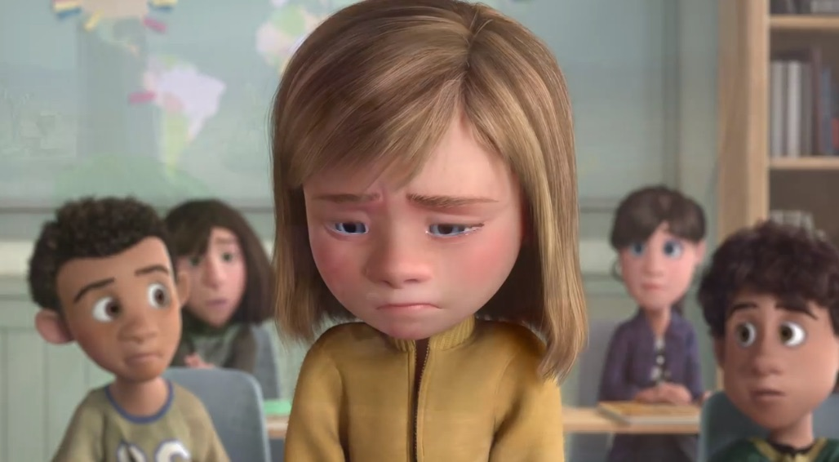
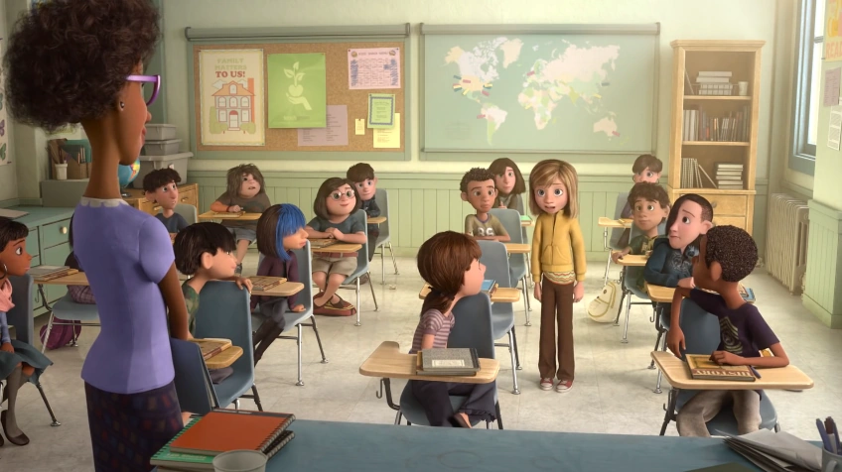
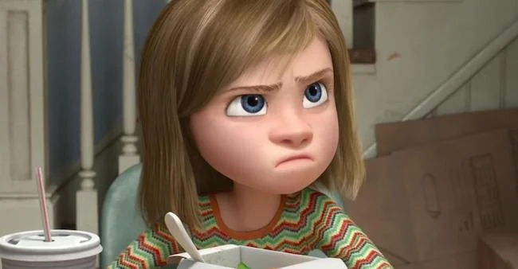
Emotional
Crisis
Hard
Struggles
Hopeful
Change
Happy
Life
Go Back!
…and come up with an idea!
…her other emotions take over…
Unable to feel joy or sadness…
…and her emotions breakdown.
In front of her new class…
…she misses her earlier life…

Slide 13
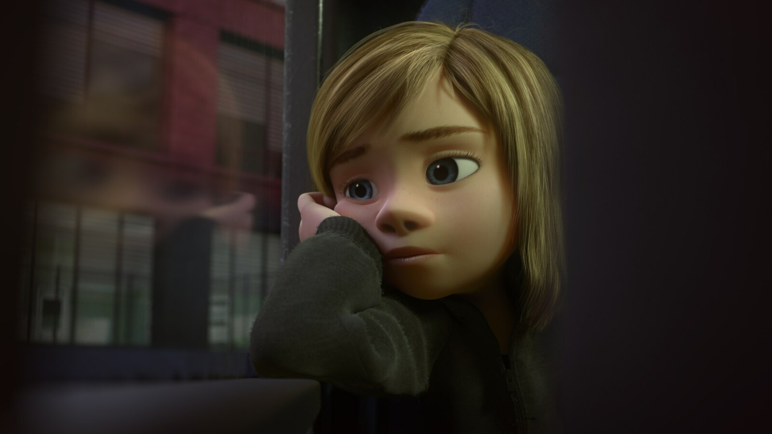
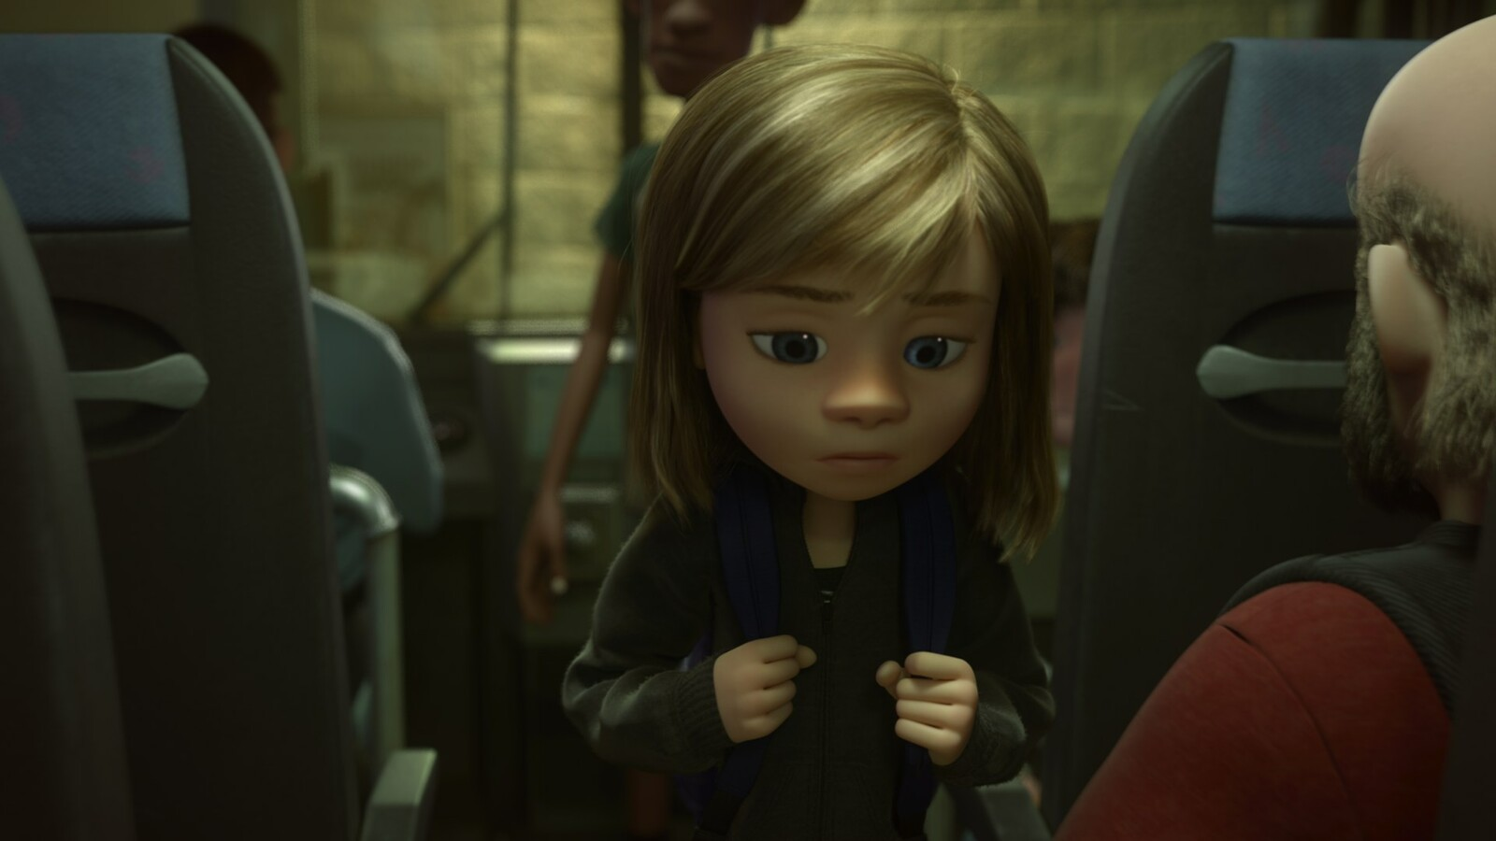
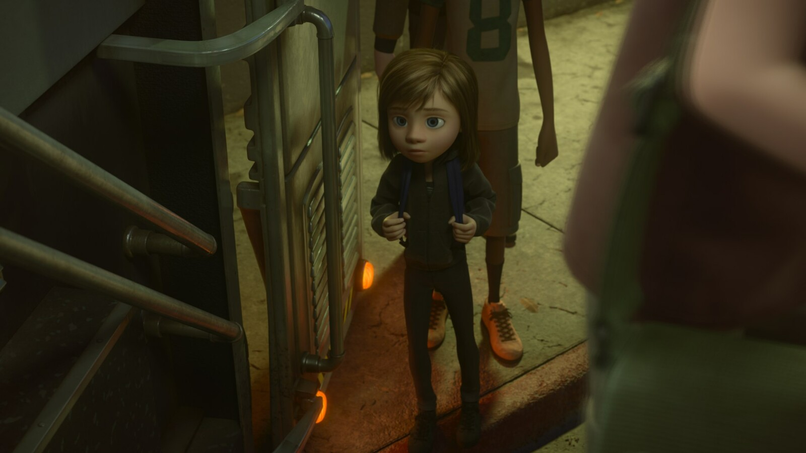
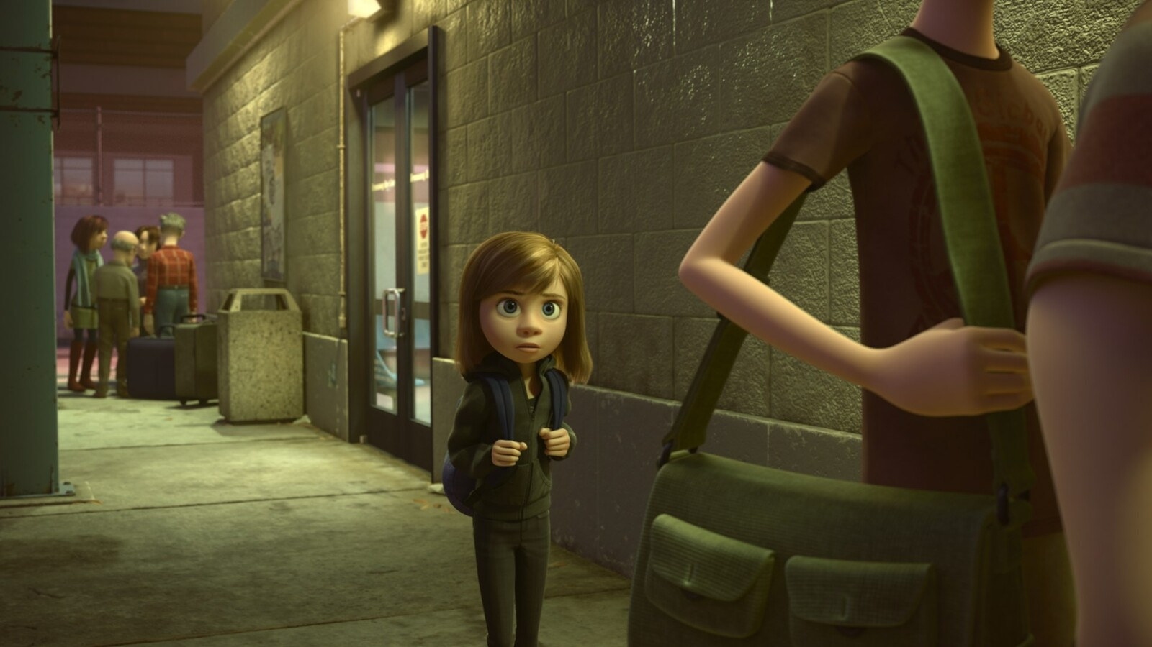
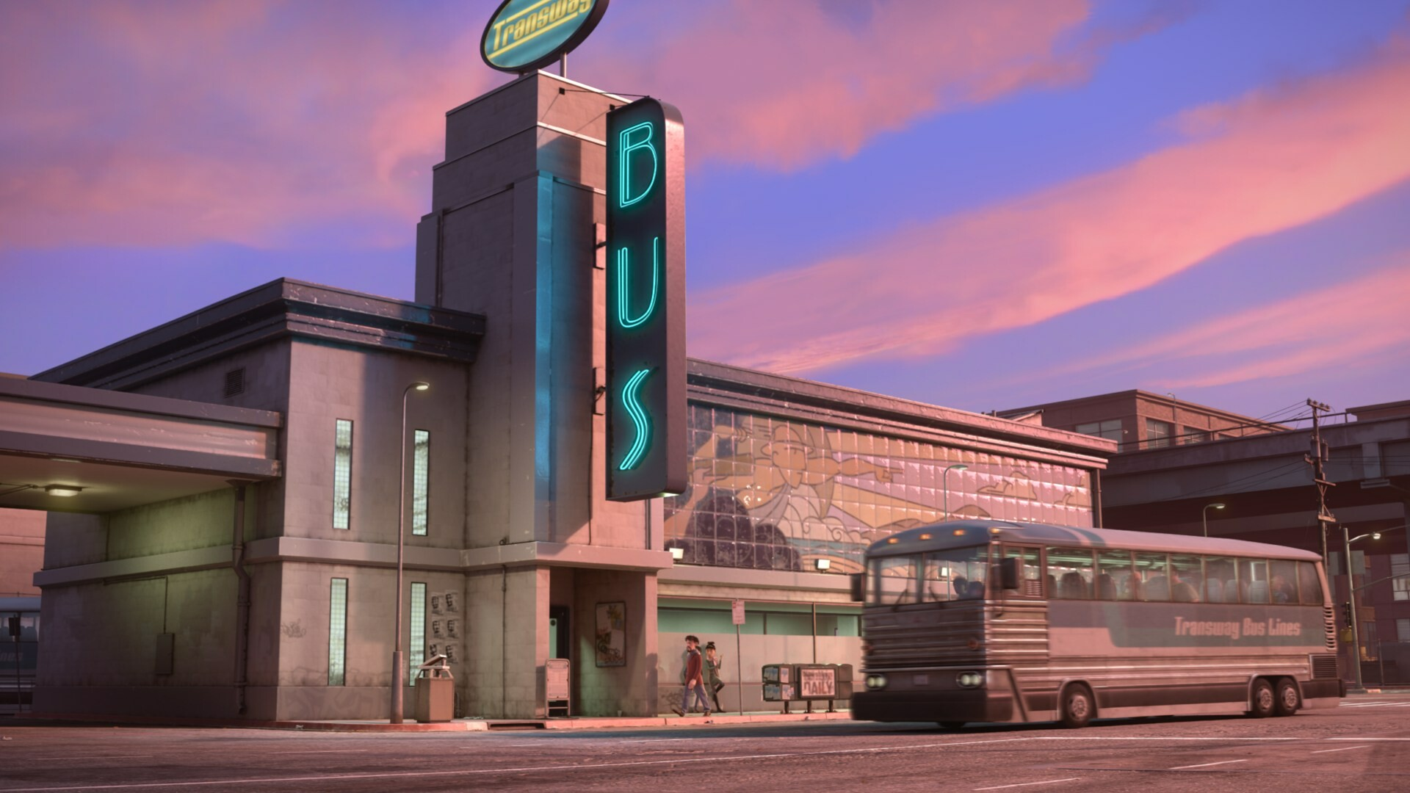
Emotional
Crisis
Hard
Struggles
Hopeful
Change
Happy
Life
Go Back!

Slide 14
10:32-34
DO NOT
Harden your hearts 3:15
Throw away your confidence 10:35
Shrink back 10:39
Grow weary 12:3
Lose heart 12:3
Seizure of Property
Became Christians
Moses, Law, Traditions
Public Ridicule
Remember the former days
Secure Community
Sent to Prison
Joyfully Accepted Suffering
Emotional
Crisis
Temple & Feasts
Hard
Struggles
Hopeful
Change
Happy
Life
Go Back!

Slide 15
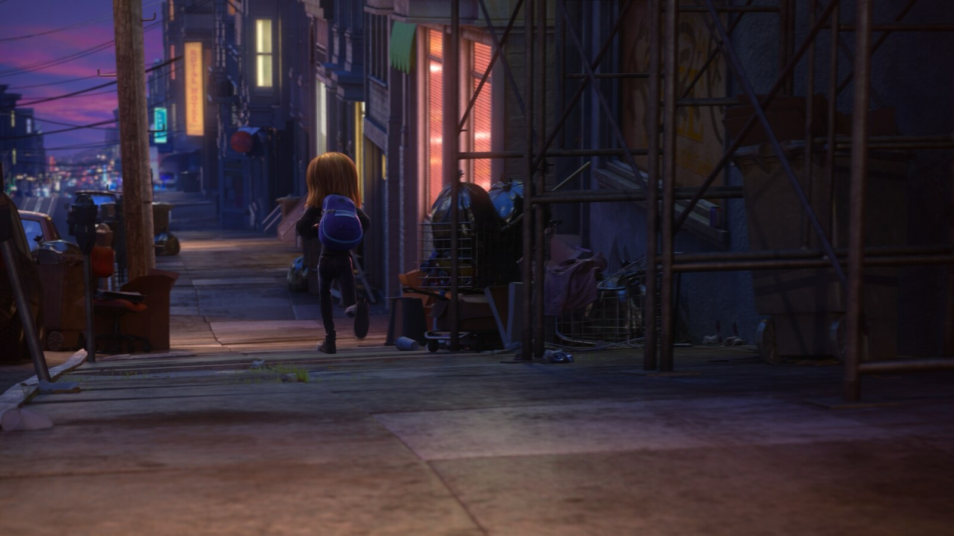
Emotional
Crisis
Hard
Struggles
Hopeful
Change
Happy
Life
Go Back!
Riley feels sadness again…

Slide 16
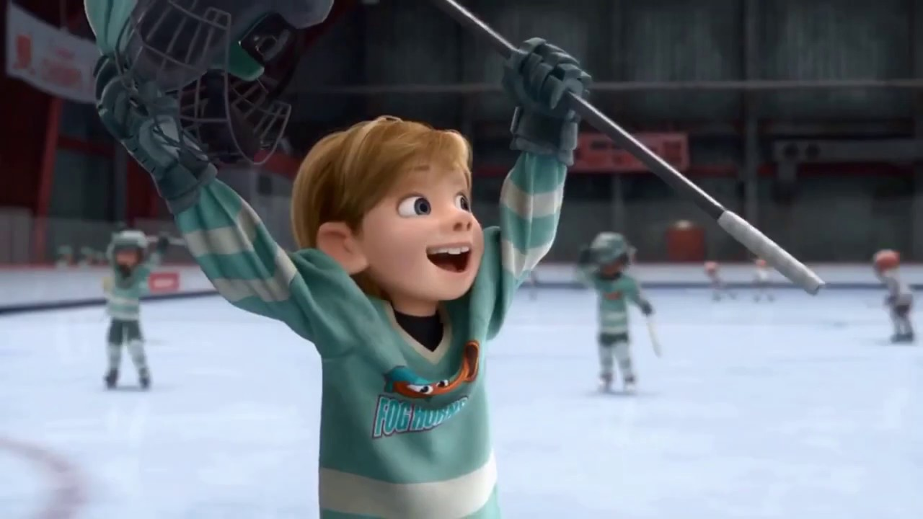
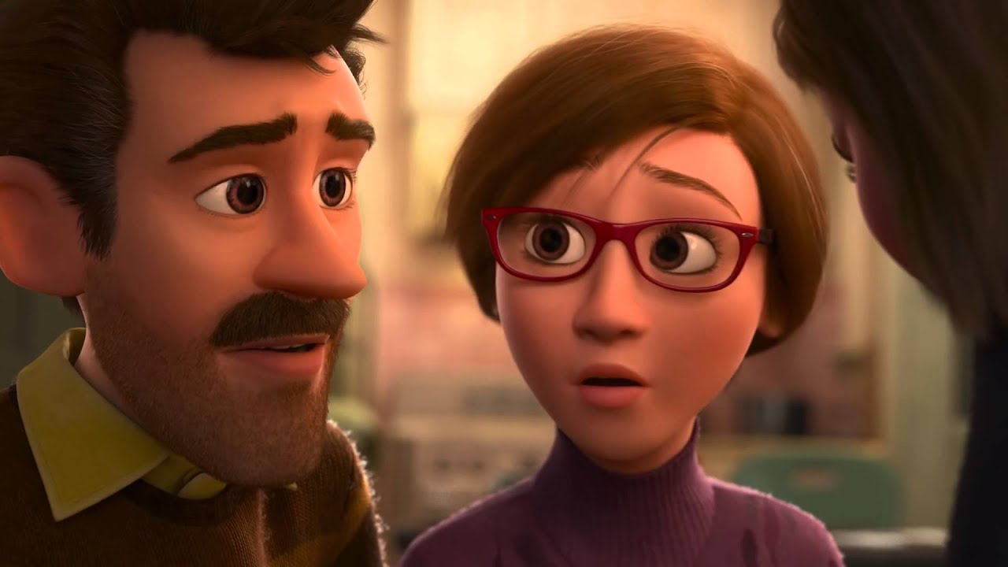
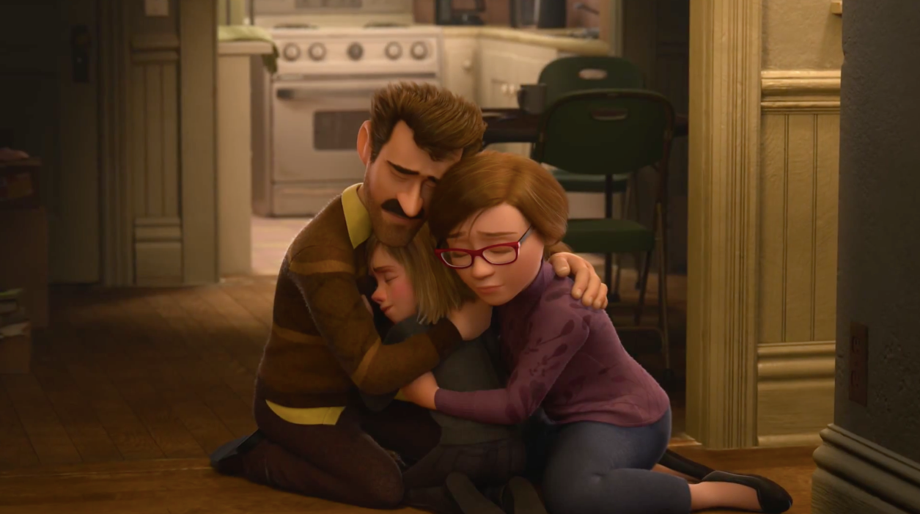
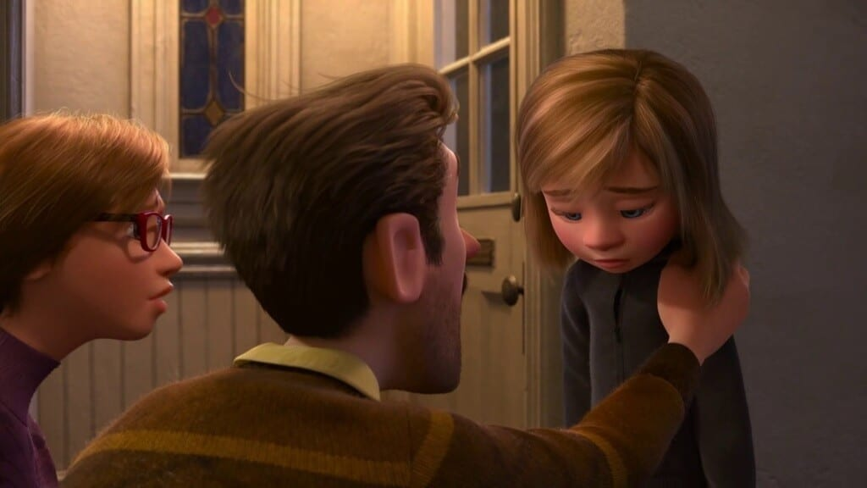
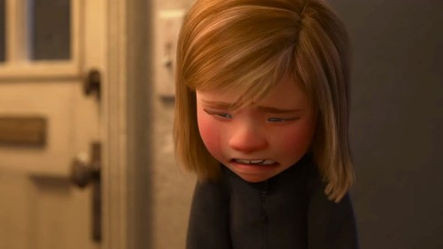
Better
Life
Seek
Help
Emotional
Crisis
Hard
Struggles
Hopeful
Change
Happy
Life
“I miss Minnesota too”
“I miss Minnesota…”

Slide 17
¹⁴ Therefore, since we have a great high priest who has passed through the heavens, Jesus the Son of God, let us hold fast our confession. ¹⁵ For we do not have a high priest who cannot sympathize with our weaknesses, but One who has been tempted in all things as we are, yet without sin. ¹⁶ Therefore let us draw near with confidence to the throne of grace, so that we may receive mercy and find grace to help in time of need.
Better
Life
Seek
Help
Emotional
Crisis
Hard
Struggles
Hopeful
Change
Happy
Life
Harden your hearts
Throw away your confidence
Shrink back
Grow weary
Lose heart
Go Back!
DO NOT

Slide 18
Hebrews

Slide 19
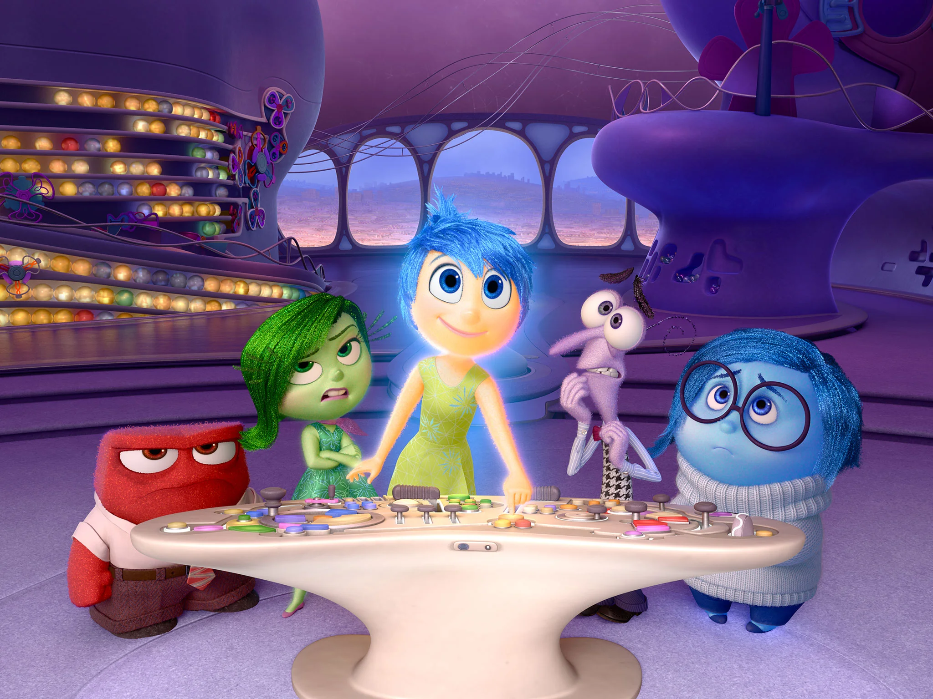

Slide 20
¹⁰ “Therefore I was angry with this generation, And said, ‘They always go astray in their heart, And they did not know My ways’; ¹¹ As I swore in My wrath, ‘They shall not enter My rest.’”
²⁷ but a terrifying expectation of judgment and the fury of a fire which will consume the adversaries.
²⁹ for our God is a consuming fire.

Slide 21
4 Therefore, let us fear if, while a promise remains of entering His rest, any one of you may seem to have come short of it.
³¹ It is a terrifying thing to fall into the hands of the living God.

Slide 22
⁹ But we do see Him who was made for a little while lower than the angels, namely, Jesus
…you have become dull of hearing. ¹² For though by this time you ought to be teachers, you have need again for someone to teach you the elementary principles of the oracles of God…

Slide 23
8 Now the main point in what has been said is this: we have such a high priest, who has taken His seat at the right hand of the throne of the Majesty in the heavens, ² a minister in the sanctuary and in the true tabernacle, which the Lord pitched, not man
¹⁹ Therefore, brethren, since we have confidence to enter the holy place by the blood of Jesus, ²⁰ by a new and living way which He inaugurated for us through the veil…

Slide 24
⁷ In the days of His flesh, He offered up both prayers and supplications with loud crying and tears to the One able to save Him from death…
…you endured a great conflict of sufferings, ³³ partly by being made a public spectacle through reproaches and tribulations, and partly by becoming sharers with those who were so treated.

Slide 25
² fixing our eyes on Jesus, the author and perfecter of faith, who for the joy set before Him endured the cross, despising the shame, and has sat down at the right hand of the throne of God.
³⁴ For you showed sympathy to the prisoners and accepted joyfully the seizure of your property, knowing that you have for yourselves a better possession and a lasting one.
¹¹ All discipline for the moment seems not to be joyful, but sorrowful; yet to those who have been trained by it, afterwards it yields the peaceful fruit of righteousness.

Slide 26
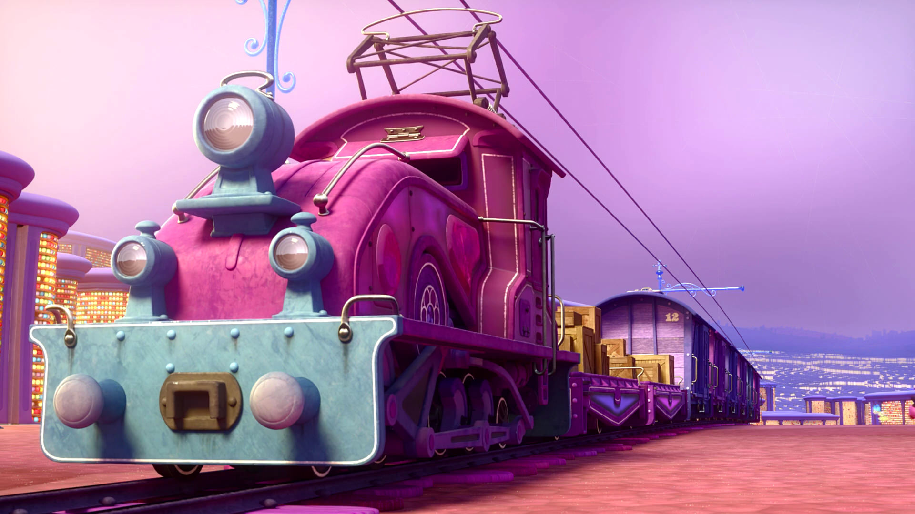
Train of Thought

Slide 27
Train of Thought

Slide 28
TABERNACLE
COVENANT
ORDER & OATH
JESUS IS OUR
7-10:18
GREAT HIGH PRIEST
SACRIFICE
promises
MINISTRY
Train of Thought

Slide 29
Sorrowful
Straighten
Lest we drift
Enduring foR
12:4-11
Discipline
Pay Attention
Joy set before Him
Angels
1:4-2:16
God has spoken
1:1-3
In his son
Strengthen
Pursue Peace
Right Hand
Why Lower?
Right Hand
Righteousness
Prepare
12:12-17
to Endure
Endured Cross
Short of Grace
Purification
Despising Shame
Bitterness
Encourage
Suffering
FIXING OUR
12:2-3
Eyes On Jesus
Esau
Hold Firm
Faithful
Run with Endurance
2:17-18
Merciful
No Evil Hearts
Able to Help
Moses
Joshua
3-4
Be Diligent
MINISTRY
Have Faith
promises
SACRIFICE
COVENANT
TABERNACLE
ORDER & OATH
JESUS IS OUR
7-10:18
GREAT HIGH PRIEST
Miss Rest
God’s Word
THE CLOUD
10:32-12:1
OF witnesses
Shaking
Hold Fast
Throw Away
Need Endurance
Time of Need
4:14-16
Gratitude & Service
Reveremce & Awe
Grace to Help
Sinai
12:18-29
AND Zion
Draw Near
Consuming Fire
Immaturity
Suffering of Christ
Falling Away
Aaron
5:1-10
Melchi
zEdek
Judgment
Draw Near
Vengeance
Hold Fast
SINCE Therefore
10:19-25
LET US
For if we go
10:26-31
on sinning
Stir Up
Faith & Patience
Anchor of Hope
Encourage
Fury of Fire
Terrifying
5:11-6:20
Closing
13
exhortations
Train of Thought

Slide 30
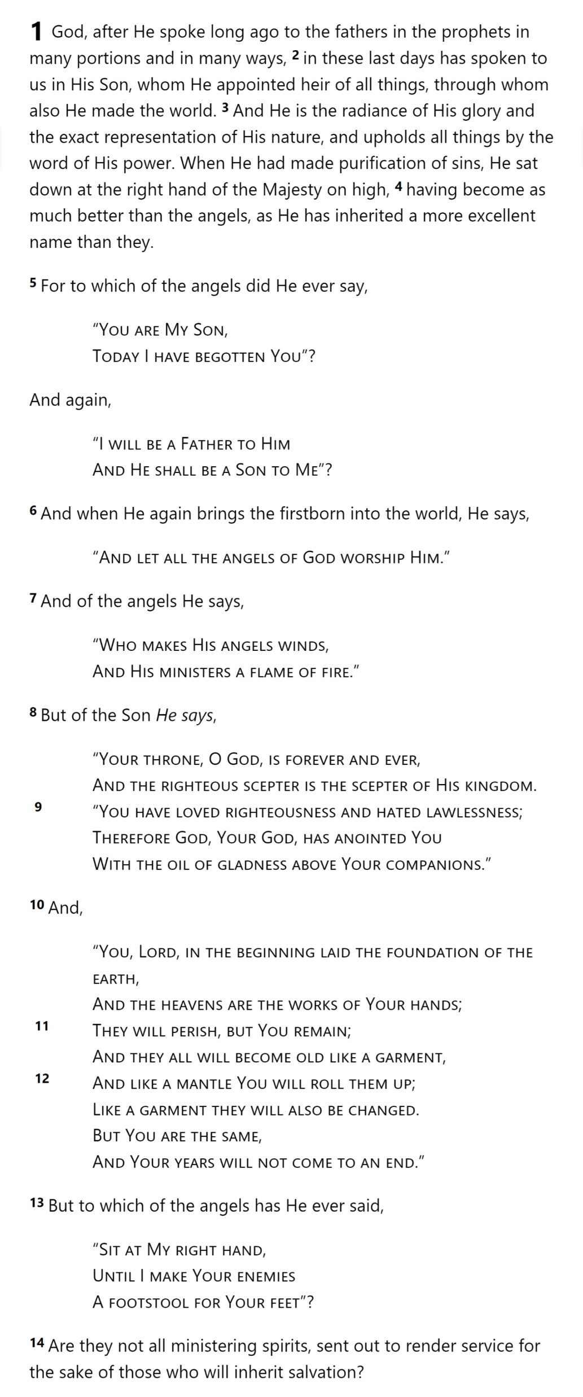
GOD
SON
MAN
Hebrews 1

Slide 31
THE OATH
GOD
SON
ANGELS
God’s
Activity
Son’s
Nature
Son’s
Activity
MAN
Hebrews 1

Slide 32
Hebrews

