Slide 1
Hebrews
Lesson Three: Lower than the Angels

Slide 3
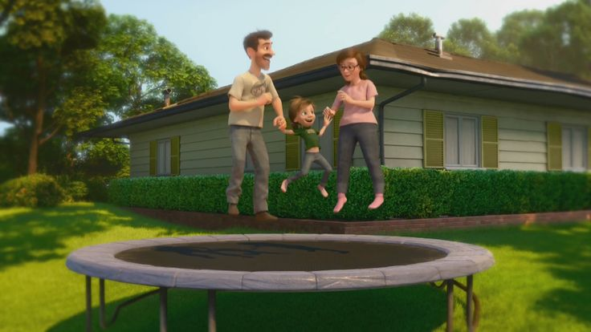
Great Family
Great House
Great Yard
Great Friends
Great Hockey Team
Happy
Life

Slide 4
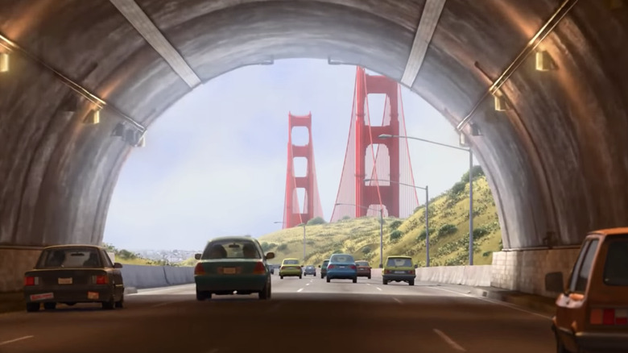
Hopeful
Change
Happy
Life

Slide 5
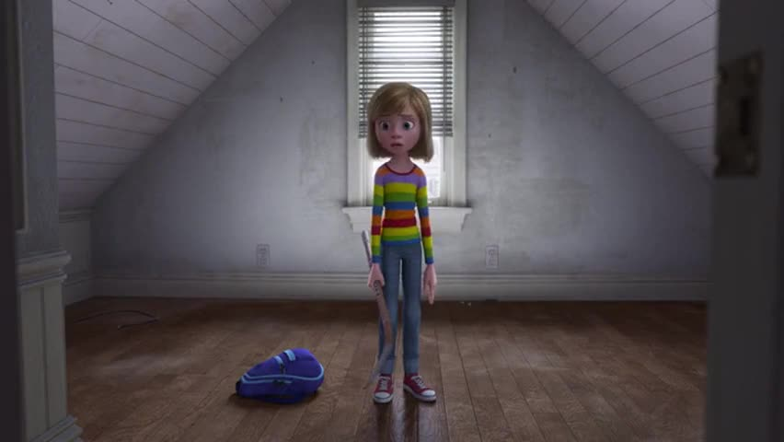
Ugly House
Nasty Room
Stressed
Parents
Broccoli Pizza!
Fails Hockey Tryouts
Hard
Struggles
Hopeful
Change
Happy
Life

Slide 6
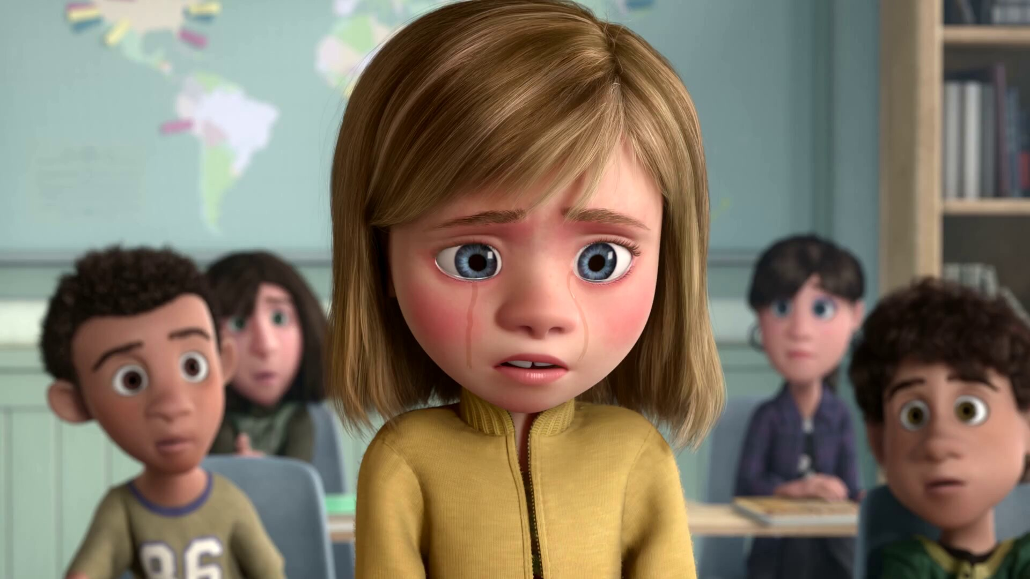
Emotional
Crisis
Hard
Struggles
Hopeful
Change
Happy
Life

Slide 7
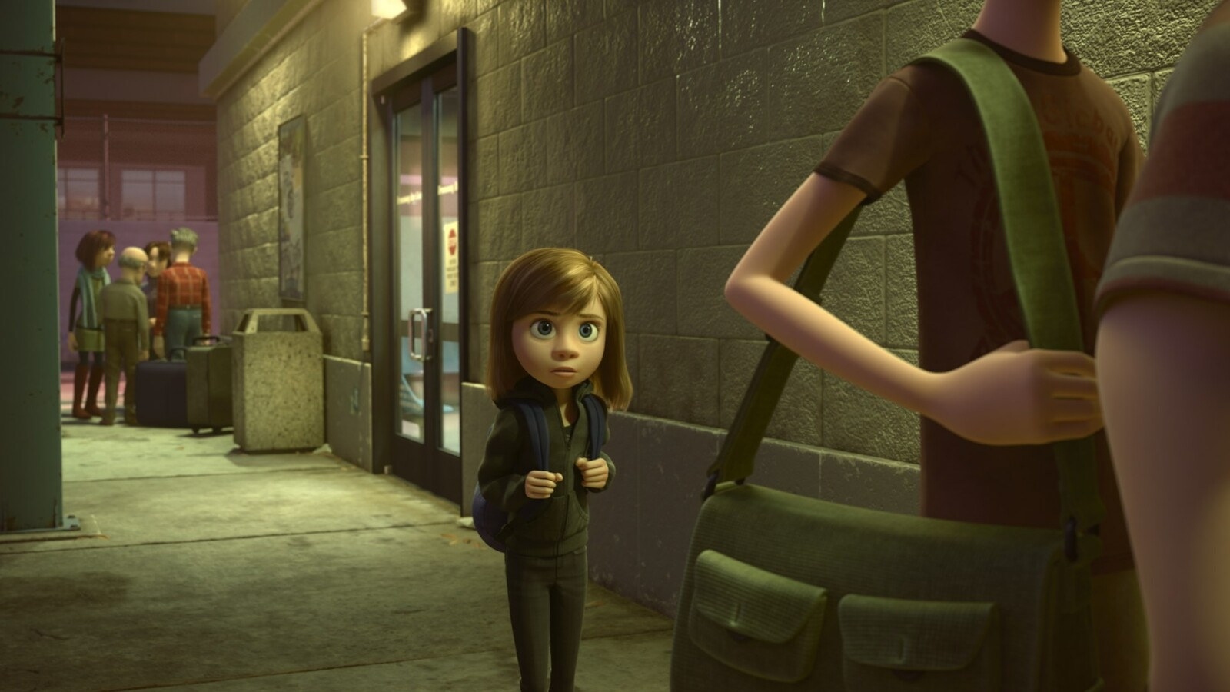
Emotional
Crisis
Hard
Struggles
Hopeful
Change
Happy
Life
Go Back!

Slide 8
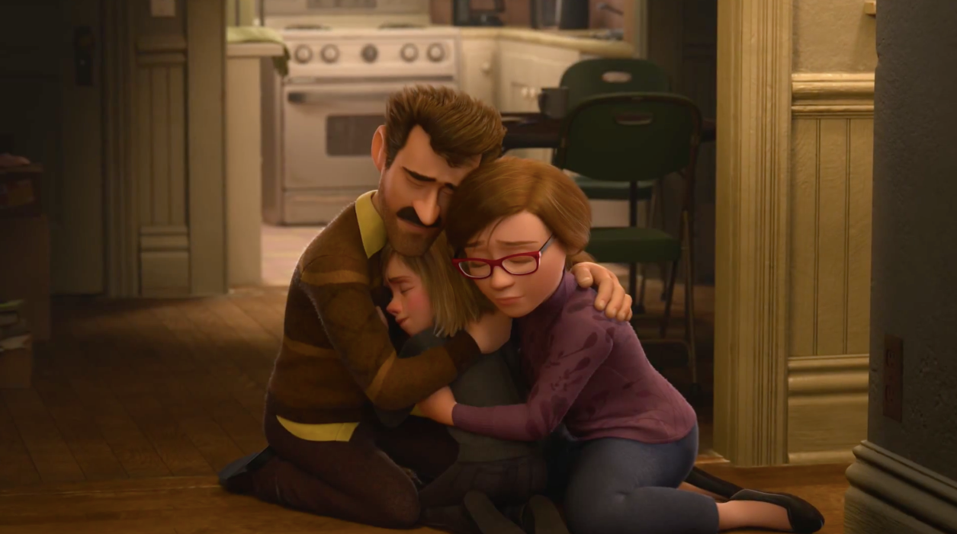
Seek
Help
Emotional
Crisis
Hard
Struggles
Hopeful
Change
Happy
Life
Go Back!

Slide 9
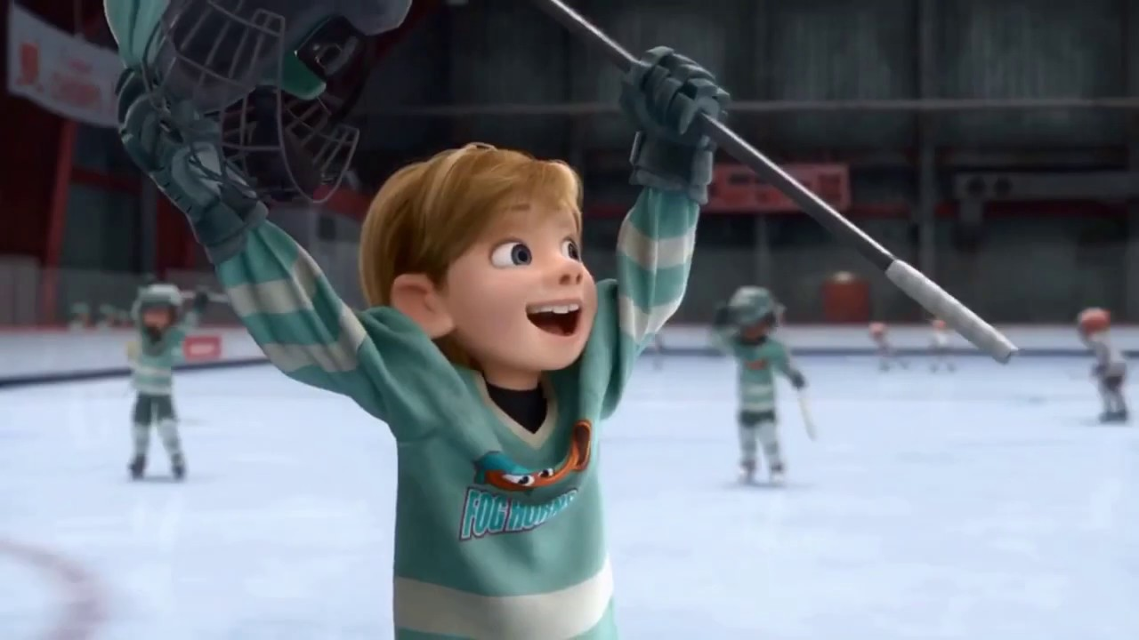
Better
Life
Seek
Help
Emotional
Crisis
Hard
Struggles
Hopeful
Change
Happy
Life
Go Back!

Slide 10
10:32-34
Hebrews
Better
Life
Seizure of Property
Moses, Law, Traditions
Public Ridicule
Became Christians
Secure Community
Sent to Prison
Seek
Help
Emotional
Crisis
Temple & Feasts
Hard
Struggles
Hopeful
Change
Happy
Life
Harden your hearts
Throw away your confidence
Shrink back
Grow weary
Lose heart
Go Back!
DO NOT

Slide 11
JESUS IS OUR
7-10:18
GREAT HIGH PRIEST
Better
Life
Seek
Help
Emotional
Crisis
Hard
Struggles
Hopeful
Change
Happy
Life
Harden your hearts
Throw away your confidence
Shrink back
Grow weary
Lose heart
Go Back!
DO NOT

Slide 12
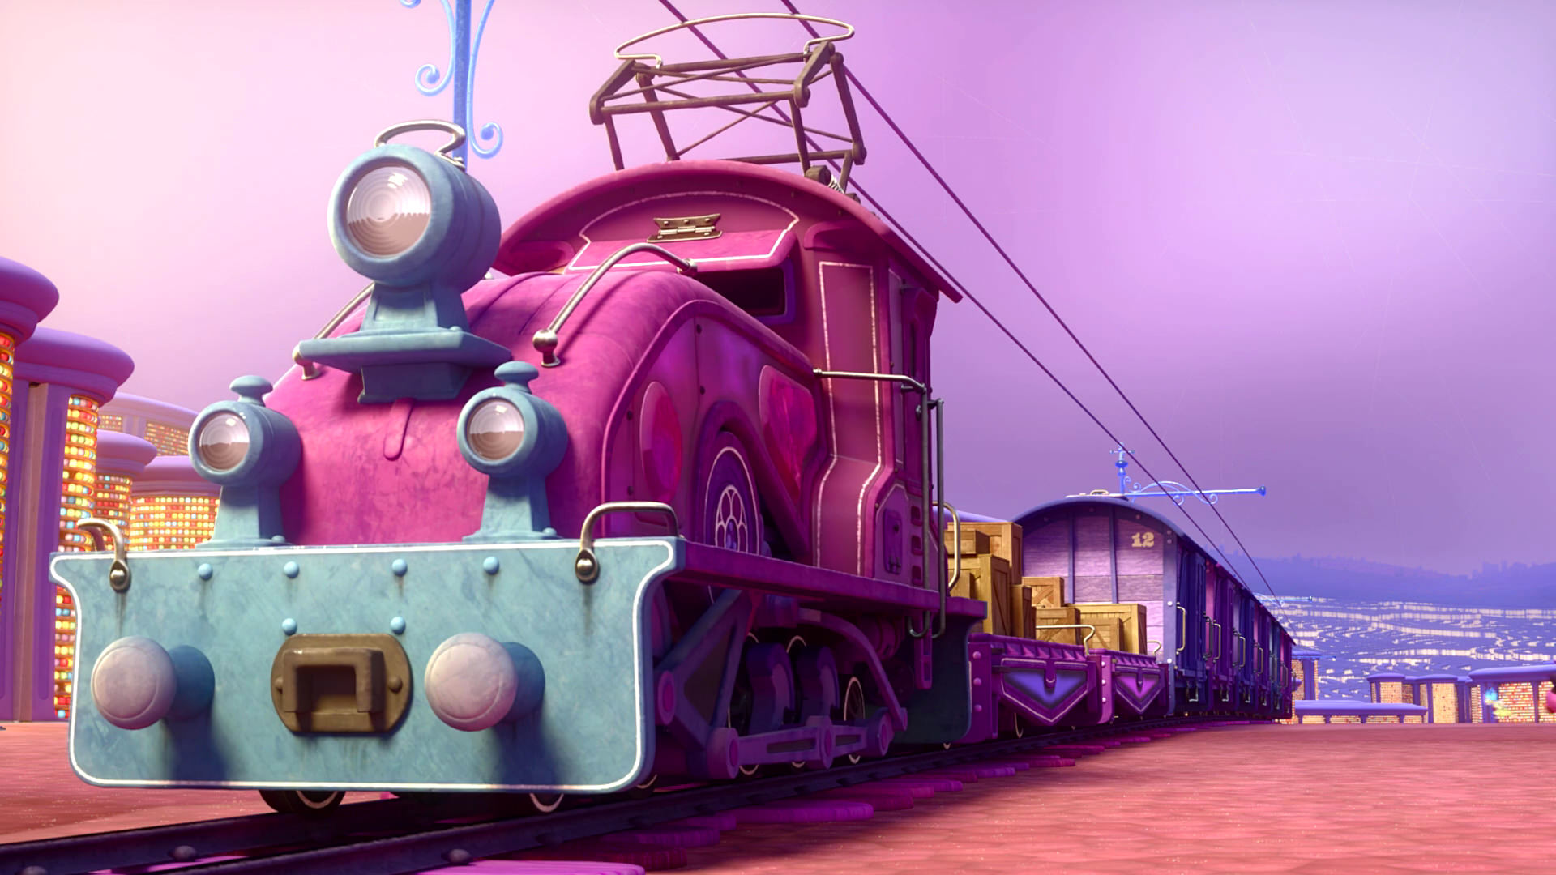
Train of Thought

Slide 13
Train of Thought

Slide 14
TABERNACLE
COVENANT
ORDER & OATH
JESUS IS OUR
7-10:18
GREAT HIGH PRIEST
SACRIFICE
promises
MINISTRY
Train of Thought

Slide 15
Sorrowful
Straighten
Lest we drift
Enduring foR
12:4-11
Discipline
Pay Attention
Joy set before Him
Angels
1:4-2:16
God has spoken
1:1-3
In his son
Strengthen
Pursue Peace
Why Lower?
Right Hand
Righteousness
Prepare
12:12-17
to Endure
Endured Cross
Right Hand
Short of Grace
Purification
Despising Shame
Bitterness
Encourage
Suffering
FIXING OUR
12:2-3
Eyes On Jesus
Esau
Hold Firm
Faithful
Run with Endurance
2:17-18
Merciful
No Evil Hearts
Able to Help
Moses
Joshua
3-4
Be Diligent
MINISTRY
Have Faith
promises
SACRIFICE
COVENANT
TABERNACLE
ORDER & OATH
JESUS IS OUR
7-10:18
GREAT HIGH PRIEST
Miss Rest
God’s Word
THE CLOUD
10:32-12:1
OF witnesses
Shaking
Hold Fast
Throw Away
Need Endurance
Time of Need
4:14-16
Gratitude & Service
Reveremce & Awe
Grace to Help
Sinai
12:18-29
AND Zion
Draw Near
Consuming Fire
Immaturity
Suffering of Christ
Falling Away
Aaron
5:1-10
Melchi
zEdek
Judgment
Draw Near
Vengeance
Hold Fast
SINCE Therefore
10:19-25
LET US
For if we go
10:26-31
on sinning
Stir Up
Faith & Patience
Anchor of Hope
Encourage
Fury of Fire
Terrifying
5:11-6:20
Closing
13
exhortations
Train of Thought

Slide 18
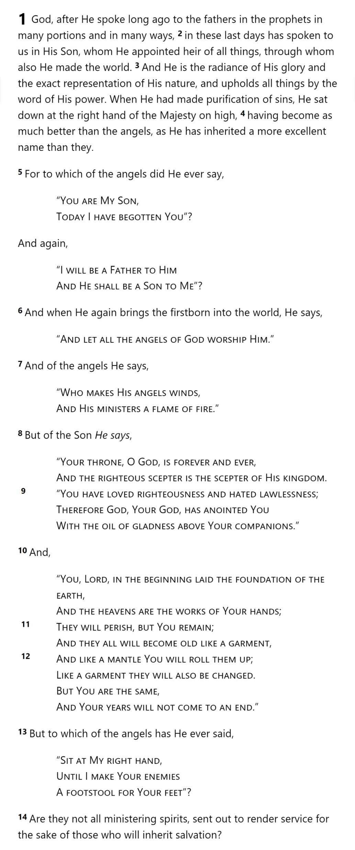
GOD
SON
MAN
Hebrews 1

Slide 19
THE OATH
GOD
SON
ANGELS
God’s
Activity
Son’s
Nature
Son’s
Activity
MAN
Hebrews 1

Slide 20
More Excellent Name
THE OATH
GOD
SON
ANGELS
Psalm 2:7
2 Samuel 7:14
MAN
Hebrews 1
Notes:
Psalm 2: “Coronation” Psalm (envisions an ideal king)
2 Samuel 7: Covenant with David: promise of Solomon as heir

Slide 21
More Excellent Name
THE OATH
GOD
Angels Worship Him
SON
ANGELS
Psalm 97:7
MAN
Hebrews 1
Notes:
Psalm 97: Elohim (angels or gods) Also Deut 32:43 LXX?

Slide 22
More Excellent Name
THE OATH
GOD
Angels Worship Him
SON
Angels are Created
ANGELS
Psalm 104:4 [LXX]
Psalm 45:6-7
MAN
Hebrews 1
Notes:
Psalm 104: “makes the winds His messengers” (LXX switches)
Psalm 45: Royal Wedding Psalm

Slide 23
THE OATH
More Excellent Name
Son is Eternal
GOD
Angels Worship Him
SON
Angels are Created
ANGELS
Psalm 102:25-26
MAN
Hebrews 1

Slide 24
THE OATH
More Excellent Name
Son is Eternal
GOD
Angels Worship Him
Son Rules
SON
Angels are Created
Angels Serve
ANGELS
Psalm 110:1
MAN
Hebrews 1

Slide 25
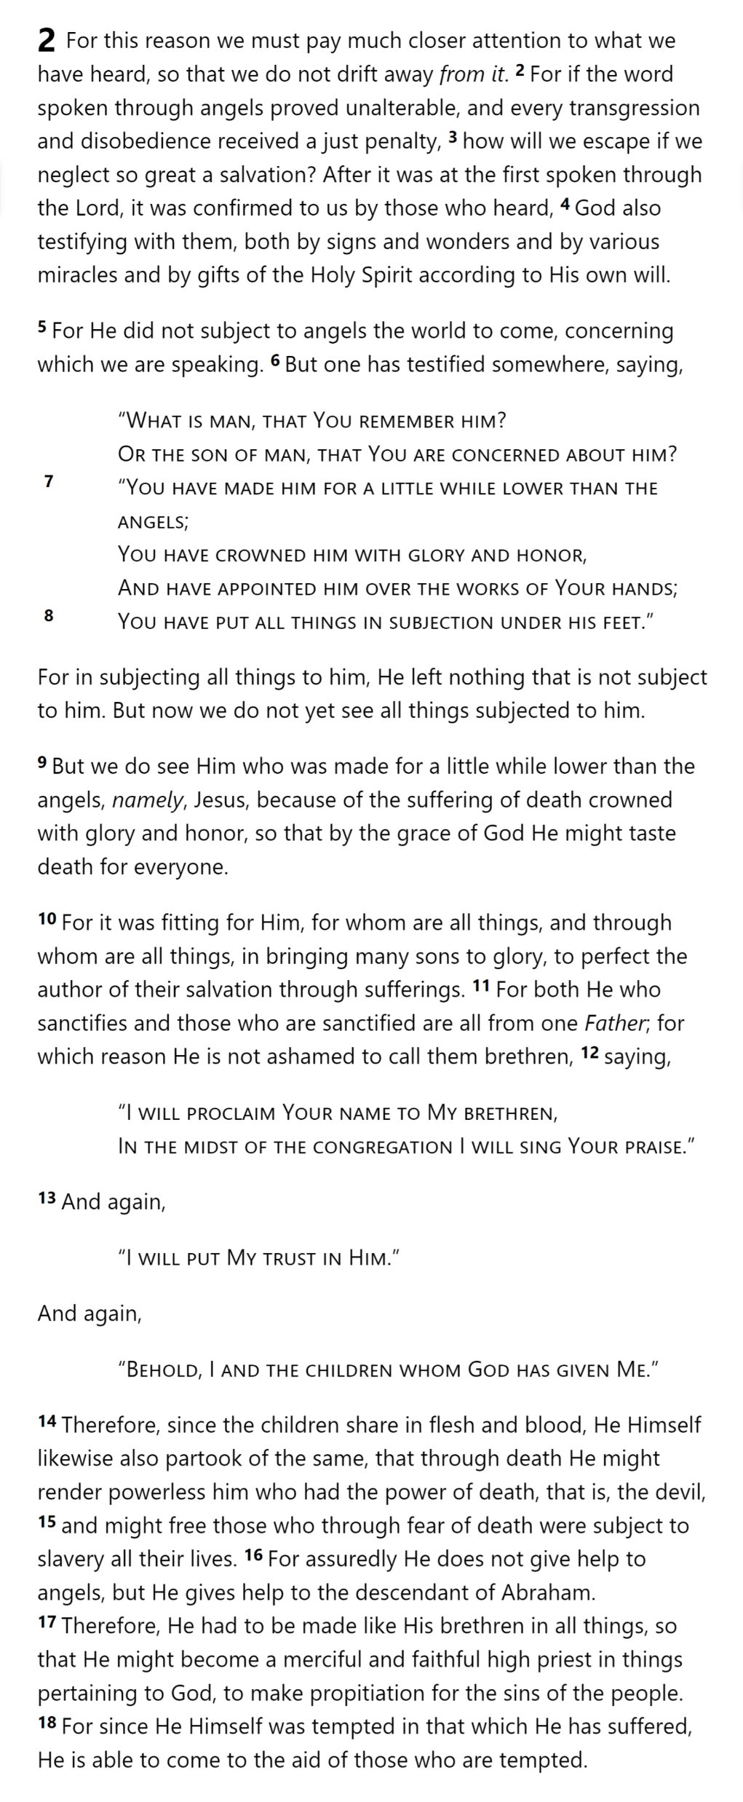
THE OATH
HOLY
SPIRIT
GOD
SON
ANGELS
Angels
Punish
ment
Lesser
DISOBEDIENCE
MAN
SON
PUNISH
MENT
Greater
DISOBEDIENCE
ESCAPE
MAN
MAN
MAN
MAN
Hebrews 2

Slide 26
THE OATH
HOLY
SPIRIT
GOD
SON
ANGELS
MAN
MAN
MAN
MAN
MAN
Hebrews 2

Slide 27
THE OATH
HOLY
SPIRIT
GOD
SON
ANGELS
MAN
MAN
MAN
Hebrews 2
MAN
MAN

Slide 28
THE OATH
HOLY
SPIRIT
GOD
ANGELS
MAN
MAN
SON
MAN
Hebrews 2
MAN
MAN
SON
SON

Slide 29
THE OATH
HOLY
SPIRIT
GOD
ANGELS
SON
SON
MAN
MAN
SON
MAN
Hebrews 2
MAN
MAN

Slide 30
THE OATH
HOLY
SPIRIT
GOD
SON
ANGELS
SON
MAN
MAN
SON
MAN
Hebrews 2
MAN
MAN

Slide 31
THE OATH
HOLY
SPIRIT
GOD
SON
ANGELS
MAN
MAN
MAN
MAN
SON
SON
SON
SON
SON
MAN
SON
Hebrews 2

Slide 32
THE OATH
HOLY
SPIRIT
GOD
SON
SON
SON
SON
SON
ANGELS
MAN
MAN
MAN
MAN
SON
MAN
SON
Hebrews 2

Slide 33
THE OATH
HOLY
SPIRIT
GOD
SON
SON
SON
SON
SON
ANGELS
Psalm 22:22
MAN
MAN
MAN
MAN
Isaiah 8:17-18
SON
MAN
SON
Hebrews 2

Slide 34
THE OATH
HOLY
SPIRIT
GOD
SON
SON
SON
SON
SON
ANGELS
MAN
MAN
MAN
MAN
SON
MAN
SON
Hebrews 2

Slide 35
Hebrews

