Slide 1
Hebrews
Lesson Four: Christ, Moses, and Joshua

Slide 3
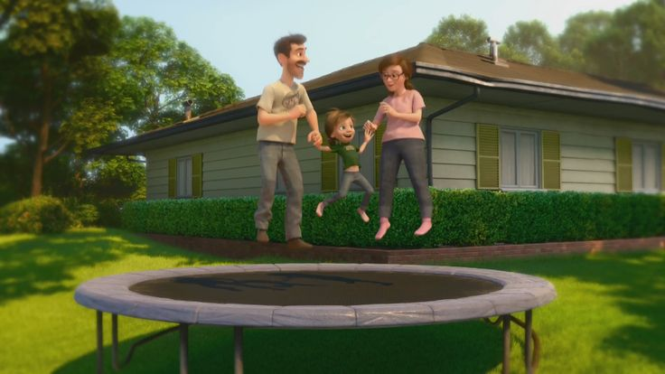
Great Family
Great House
Great Yard
Great Friends
Great Hockey Team
Happy
Life

Slide 4
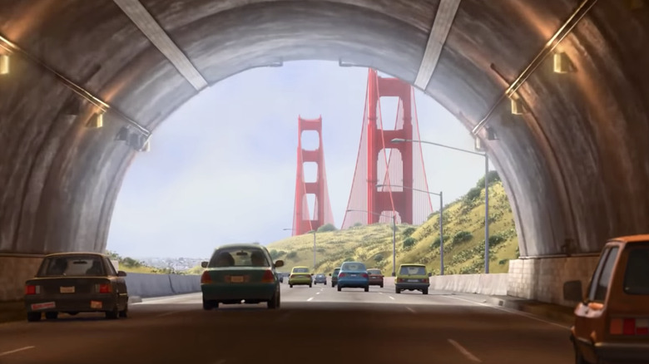
Hopeful
Change
Happy
Life

Slide 5
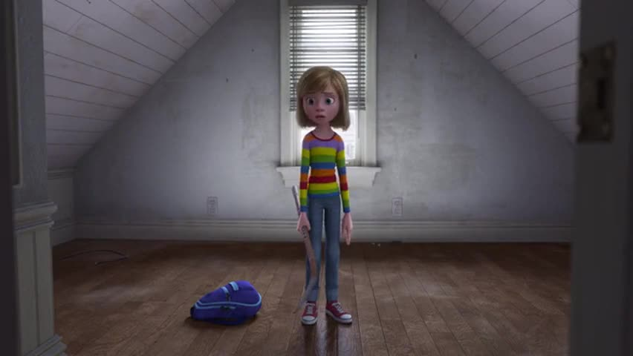
Ugly House
Nasty Room
Stressed
Parents
Broccoli Pizza!
Fails Hockey Tryouts
Hard
Struggles
Hopeful
Change
Happy
Life

Slide 6
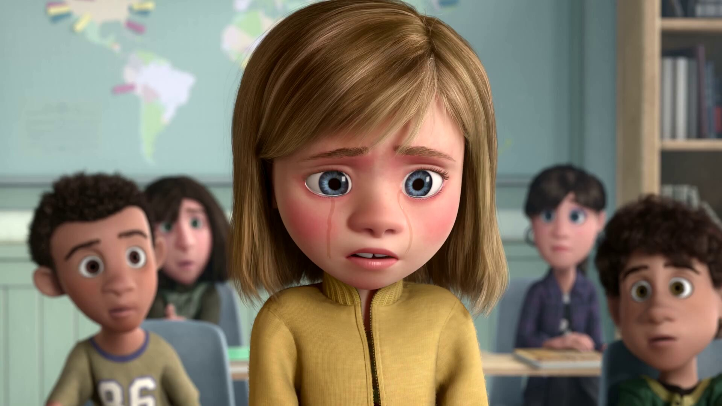
Emotional
Crisis
Hard
Struggles
Hopeful
Change
Happy
Life

Slide 7
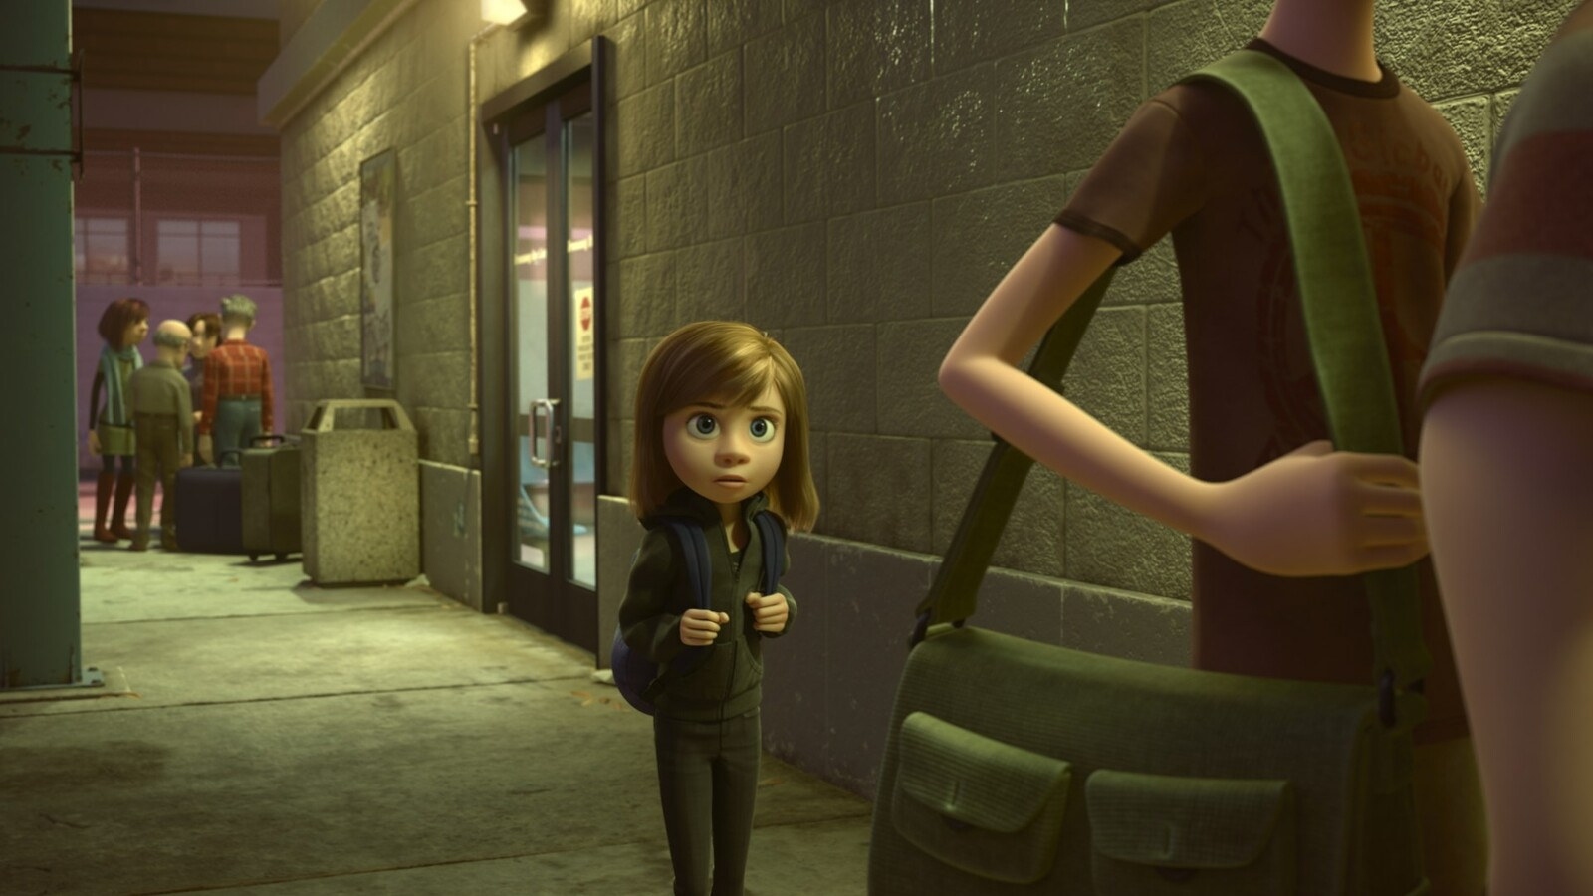
Emotional
Crisis
Hard
Struggles
Hopeful
Change
Happy
Life
Go Back!

Slide 8
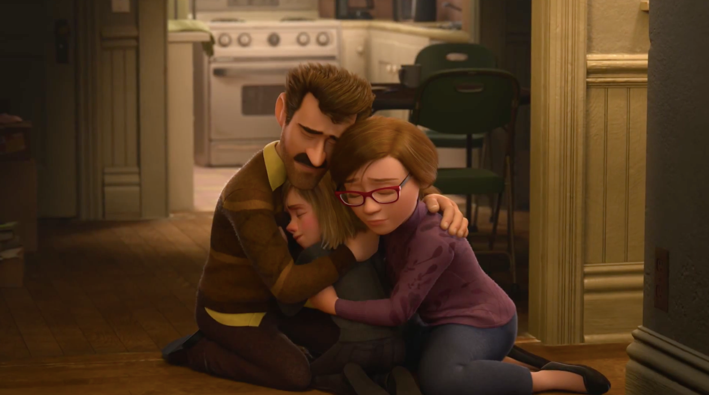
Seek
Help
Emotional
Crisis
Hard
Struggles
Hopeful
Change
Happy
Life
Go Back!

Slide 9
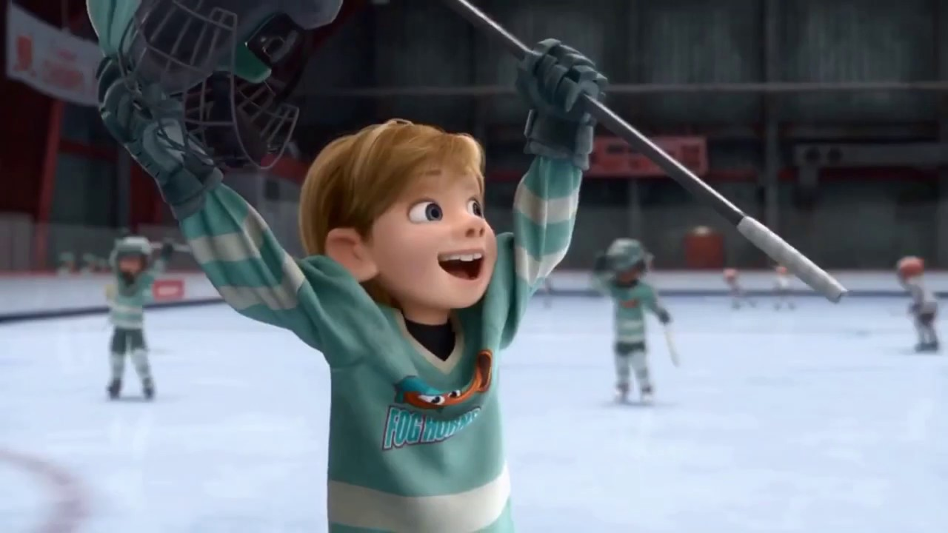
Better
Life
Seek
Help
Emotional
Crisis
Hard
Struggles
Hopeful
Change
Happy
Life
Go Back!

Slide 10
10:32-34
Hebrews
Better
Life
Seizure of Property
Moses, Law, Traditions
Public Ridicule
Became Christians
Secure Community
Sent to Prison
Seek
Help
Emotional
Crisis
Temple & Feasts
Hard
Struggles
Hopeful
Change
Happy
Life
Harden your hearts
Throw away your confidence
Shrink back
Grow weary
Lose heart
Go Back!
DO NOT

Slide 11
JESUS IS OUR
7-10:18
GREAT HIGH PRIEST
Better
Life
Seek
Help
Emotional
Crisis
Hard
Struggles
Hopeful
Change
Happy
Life
Harden your hearts
Throw away your confidence
Shrink back
Grow weary
Lose heart
Go Back!
DO NOT

Slide 12
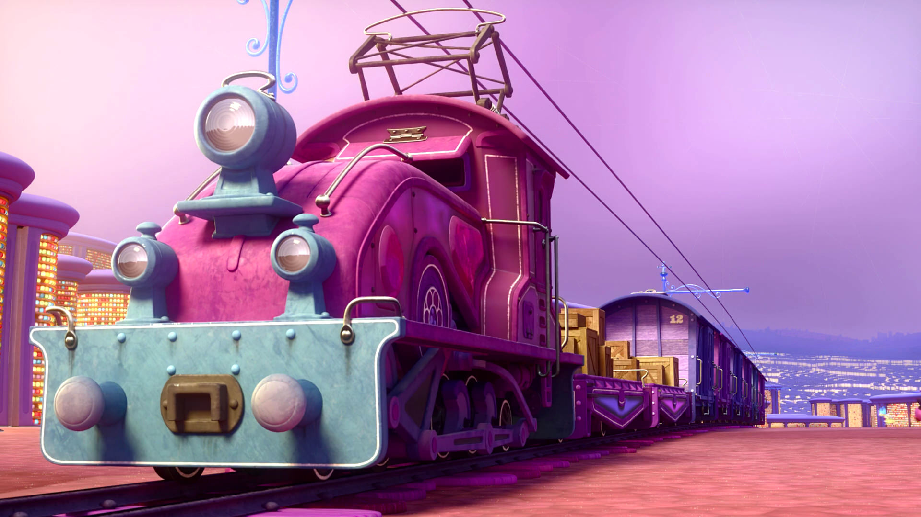
Train of Thought

Slide 13
Train of Thought

Slide 14
TABERNACLE
COVENANT
ORDER & OATH
JESUS IS OUR
7-10:18
GREAT HIGH PRIEST
SACRIFICE
promises
MINISTRY
Train of Thought

Slide 15
Sorrowful
Straighten
Lest we drift
Enduring foR
12:4-11
Discipline
Pay Attention
Joy set before Him
Angels
1:4-2:16
God has spoken
1:1-3
In his son
Strengthen
Pursue Peace
Why Lower?
Right Hand
Righteousness
Prepare
12:12-17
to Endure
Endured Cross
Right Hand
Short of Grace
Purification
Despising Shame
Bitterness
Encourage
Suffering
FIXING OUR
12:2-3
Eyes On Jesus
Esau
Hold Firm
Faithful
Run with Endurance
2:17-18
Merciful
No Evil Hearts
Able to Help
Moses
Joshua
3-4
Be Diligent
MINISTRY
Have Faith
promises
SACRIFICE
COVENANT
TABERNACLE
ORDER & OATH
JESUS IS OUR
7-10:18
GREAT HIGH PRIEST
Miss Rest
God’s Word
THE CLOUD
10:32-12:1
OF witnesses
Shaking
Hold Fast
Throw Away
Need Endurance
Time of Need
4:14-16
Gratitude & Service
Reveremce & Awe
Grace to Help
Sinai
12:18-29
AND Zion
Draw Near
Consuming Fire
Immaturity
Suffering of Christ
Falling Away
Aaron
5:1-10
Melchi
zEdek
Judgment
Draw Near
Vengeance
Hold Fast
SINCE Therefore
10:19-25
LET US
For if we go
10:26-31
on sinning
Stir Up
Faith & Patience
Anchor of Hope
Encourage
Fury of Fire
Terrifying
5:11-6:20
Closing
13
exhortations
Train of Thought

Slide 16
GOD
God has spoken
1:1-3
In his son
SON
Right Hand
Purification
JESUS IS OUR
7-10:18
GREAT HIGH PRIEST
MAN

Slide 17
THE OATH
Angels
1:4-2:16
GOD
God has spoken
1:1-3
In his son
Right Hand
SON
Purification
More Excellent Name
ANGELS
Angels Worship Him
JESUS IS OUR
7-10:18
GREAT HIGH PRIEST
Angels are Created
Son is Eternal
MAN
Son Rules
Angels Serve

Slide 18
THE OATH
HOLY
SPIRIT
GOD
Lest we drift
Pay Attention
Angels
1:4-2:16
SON
God has spoken
1:1-3
In his son
Right Hand
Purification
ANGELS
JESUS IS OUR
7-10:18
GREAT HIGH PRIEST
MAN
MAN
MAN
MAN
MAN

Slide 19
THE OATH
HOLY
SPIRIT
GOD
Lest we drift
Pay Attention
Angels
1:4-2:16
SON
God has spoken
1:1-3
In his son
Why Lower?
Right Hand
Purification
ANGELS
JESUS IS OUR
7-10:18
GREAT HIGH PRIEST
MAN
MAN
MAN
MAN
MAN

Slide 20
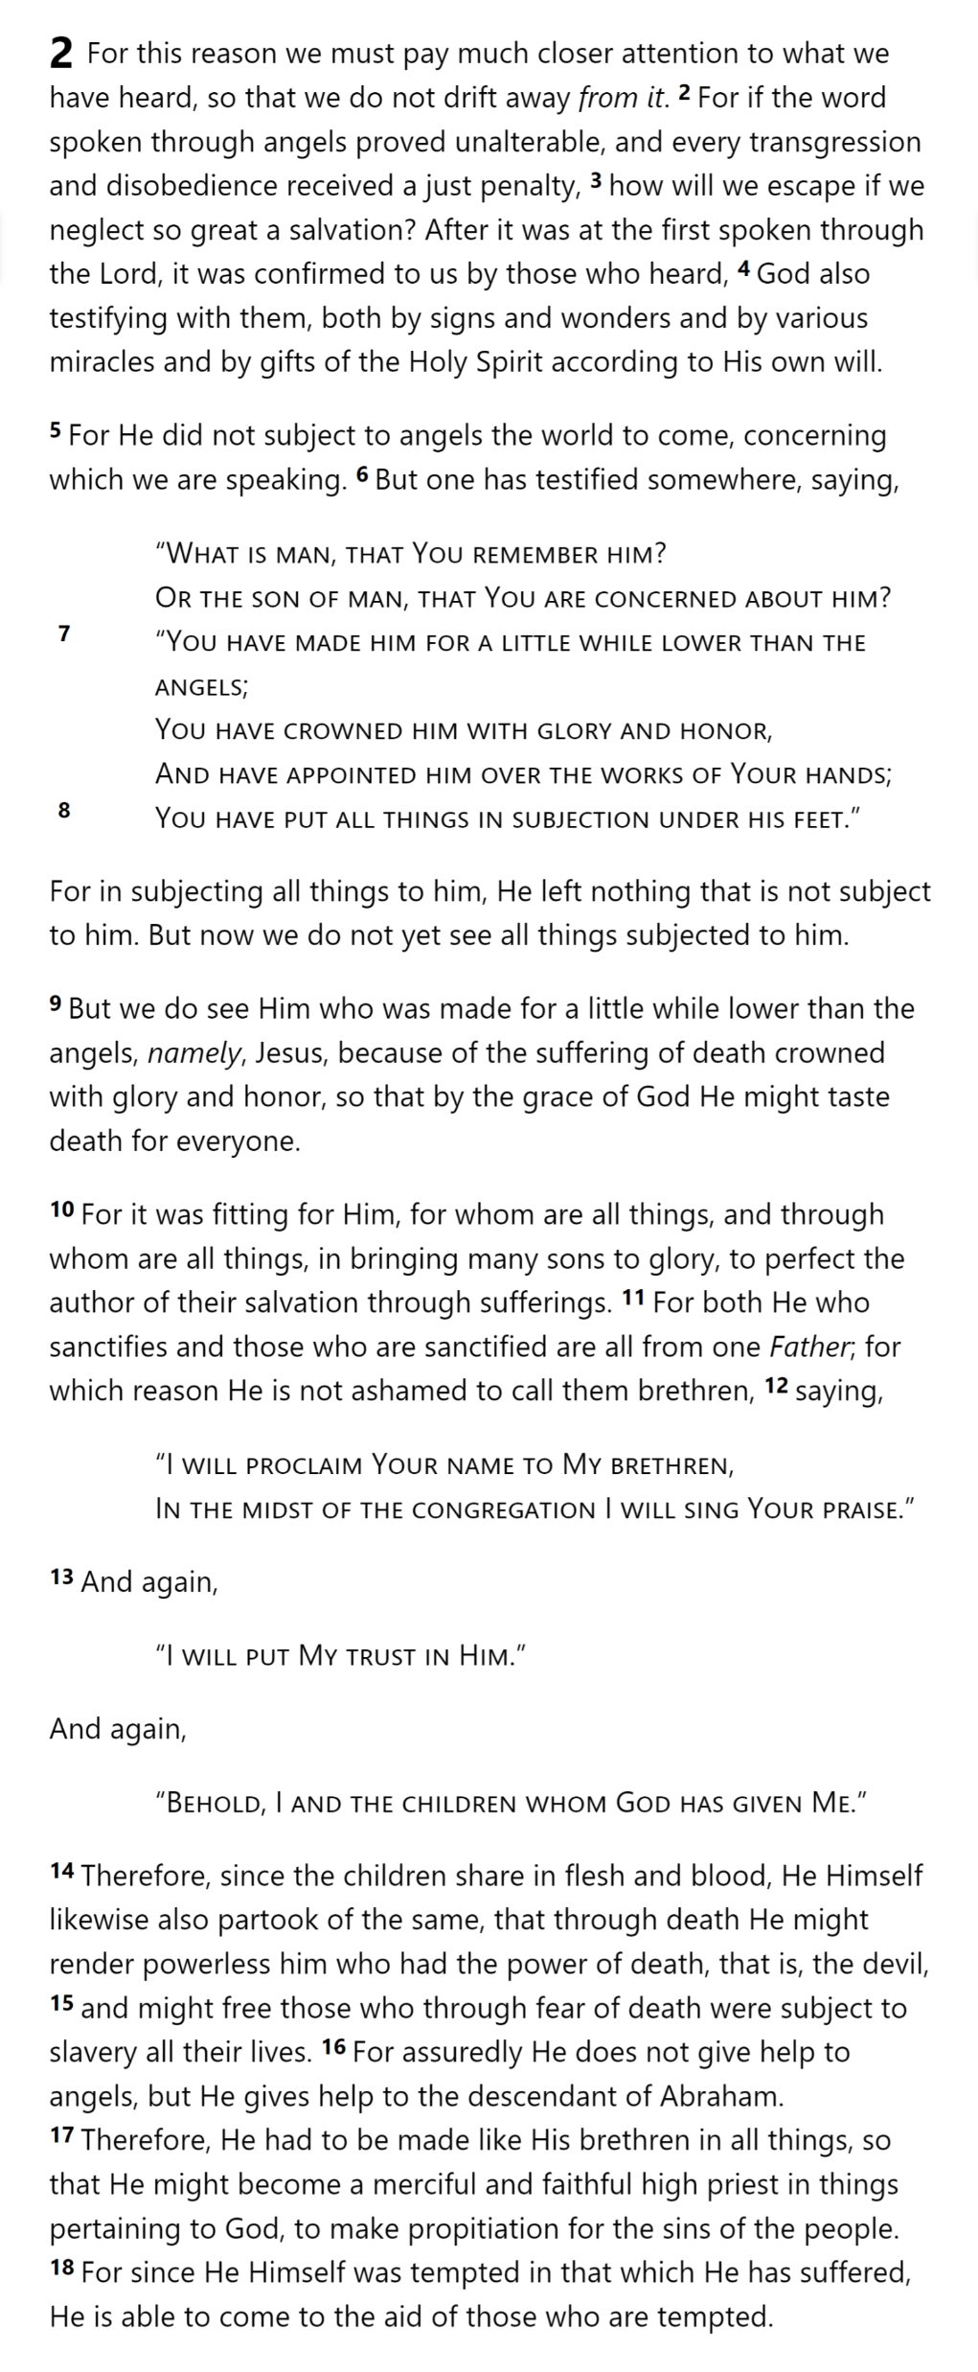
THE OATH
HOLY
SPIRIT
GOD
SON
Why Lower?
ANGELS
MAN
MAN
MAN
MAN
MAN
Hebrews 2

Slide 21
THE OATH
HOLY
SPIRIT
GOD
SON
Why Lower?
ANGELS
MAN
MAN
MAN
Hebrews 2
MAN
MAN

Slide 22
THE OATH
HOLY
SPIRIT
GOD
To achieve the unfulfilled destiny of man to rule over all creation
Why Lower?
ANGELS
MAN
MAN
SON
MAN
Hebrews 2
MAN
MAN
SON
SON

Slide 23
THE OATH
HOLY
SPIRIT
GOD
Why Lower?
ANGELS
SON
SON
MAN
MAN
SON
MAN
Hebrews 2
MAN
MAN

Slide 24
THE OATH
HOLY
SPIRIT
GOD
SON
Why Lower?
ANGELS
SON
MAN
MAN
SON
MAN
Hebrews 2
MAN
MAN

Slide 25
THE OATH
HOLY
SPIRIT
GOD
SON
Why Lower?
ANGELS
MAN
MAN
MAN
MAN
SON
SON
SON
SON
SON
MAN
SON
Hebrews 2

Slide 26
THE OATH
HOLY
SPIRIT
GOD
SON
Why Lower?
To “bring many sons to glory” through His suffering
SON
SON
SON
SON
ANGELS
MAN
MAN
MAN
MAN
SON
MAN
SON
Hebrews 2

Slide 27
Why Lower?
THE OATH
To allow us to become part of God’s family
HOLY
SPIRIT
GOD
SON
SON
SON
SON
SON
ANGELS
Psalm 22:22
MAN
MAN
MAN
MAN
Isaiah 8:17-18
SON
MAN
SON
Hebrews 2

Slide 28
To partake of death to render the devil powerless and to free us from fear of death
THE OATH
Why Lower?
To share in our experience of suffering and temptation
To become our high priest so He could come to our aid in temptation
HOLY
SPIRIT
GOD
SON
SON
SON
SON
SON
MAN
MAN
MAN
MAN
SON
MAN
SON
Hebrews 2

Slide 29
THE OATH
HOLY
SPIRIT
GOD
SON
SON
SON
SON
SON
ANGELS
Lest we drift
Pay Attention
Angels
1:4-2:16
God has spoken
1:1-3
In his son
Why Lower?
Right Hand
MAN
MAN
MAN
MAN
Purification
Suffering
SON
Faithful
2:17-18
Merciful
Able to Help
JESUS IS OUR
7-10:18
GREAT HIGH PRIEST
MAN
SON
Hebrews 2

Slide 30
THE OATH
Lest we drift
Pay Attention
Angels
1:4-2:16
HOLY
SPIRIT
GOD
God has spoken
1:1-3
In his son
Why Lower?
Right Hand
SON
Purification
Suffering
SON
SON
SON
SON
Faithful
ANGELS
2:17-18
Merciful
Moses
Joshua
3-4
Able to Help
JESUS IS OUR
7-10:18
GREAT HIGH PRIEST
MAN
MAN
MAN
MAN
SON
MAN
SON
Hebrews 2

Slide 31
Lest we drift
Pay Attention
Angels
1:4-2:16
God has spoken
1:1-3
In his son
Why Lower?
Right Hand
Purification
Suffering
Faithful
2:17-18
Merciful
Moses
Joshua
3-4
Able to Help
JESUS IS OUR
7-10:18
GREAT HIGH PRIEST
THE OATH
HOLY
SPIRIT
GOD
MOSES
SON
SON
SON
SON
SON
ANGELS
MAN
MAN
MAN
MAN
SON
SLAVES
IN
EGYPT
MAN
MAN
MAN
SON
MAN
MAN

Slide 32
Left High Position to Suffer
THE OATH
HOLY
SPIRIT
GOD
SON
Identified with his Brethren
SON
SON
SON
SON
ANGELS
MAN
MAN
MAN
MAN
SON
SLAVES
IN
EGYPT
MAN
MOSES
MAN
MAN
SON
MAN
MAN

Slide 33
Left High Position to Suffer
THE OATH
HOLY
SPIRIT
GOD
PROMISED LAND
SON
Identified with his Brethren
SON
SON
SON
SON
ANGELS
Freed them from slavery…
MAN
MAN
MAN
MAN
MAN
MAN
MAN
MAN
…via the death of the firstborn
PASSOVER
SON
Led the saved to a better life…
MAN
…but through a difficult path
MOSES
MAN
SON

Slide 34
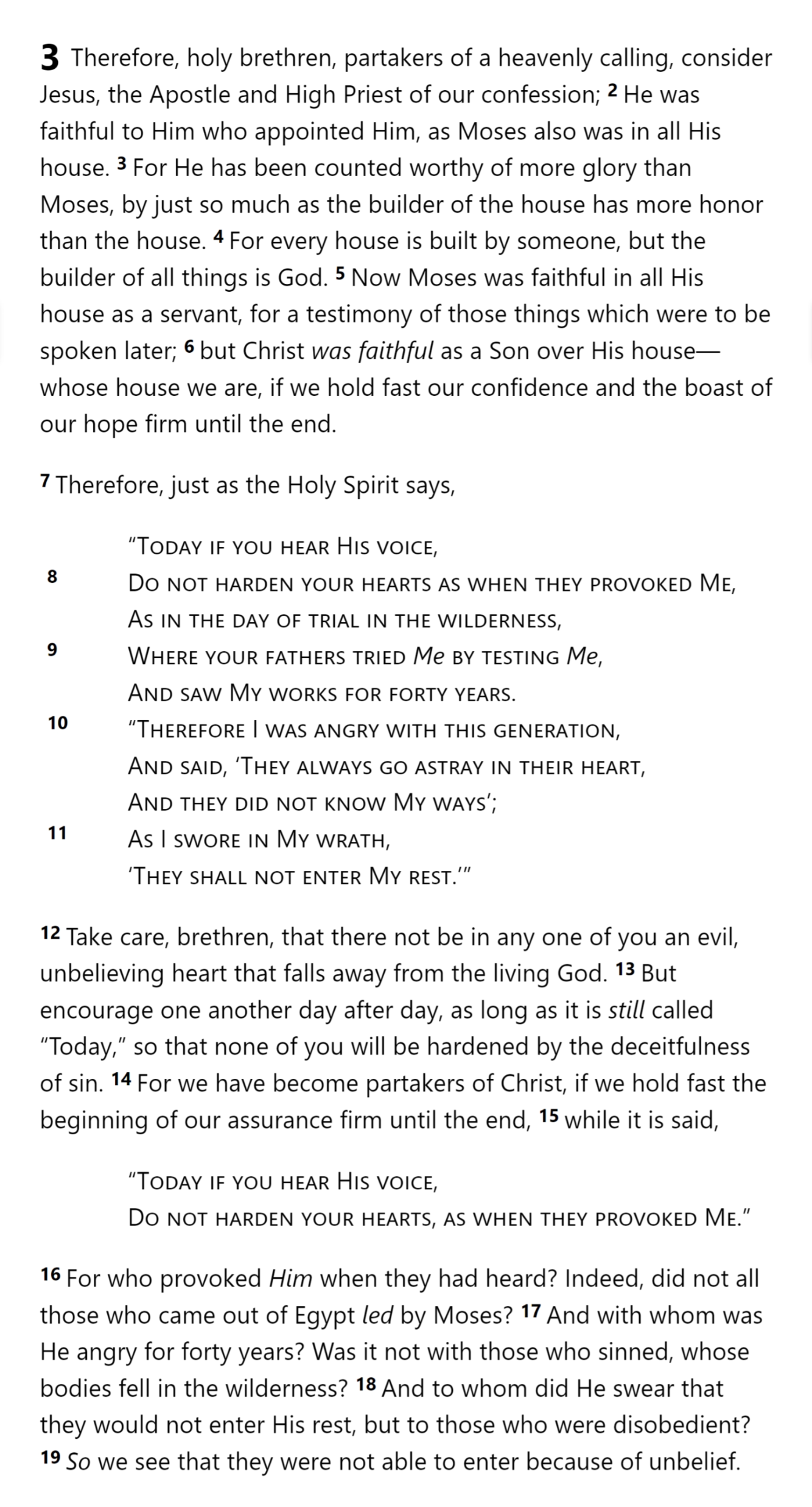
Jesus & Moses:
Both Faithful
Jesus: More
Glory & Honor
3:14 For we have become partakers of Christ, if we hold fast the beginning of our assurance firm until the end,
¹⁵ The Lord your God will raise up for you a prophet like me from among you, from your countrymen, you shall listen to him … ¹⁷ The Lord said to me, “… I will put My words in his mouth, and he shall speak to them all that I command him.”
Deuteronomy 18:15-18
Moses (3:1-4:13)
Aaron (4:14-7:28)
Jesus: Builder of the House => God
Moses: A Servant
Jesus: A Son
Moses: Testified of things to be spoken
Hebrews 3

Slide 35
Left High Position to Suffer
THE OATH
HOLY
SPIRIT
GOD
PROMISED LAND
SON
Identified with his Brethren
SON
SON
SON
SON
ANGELS
Freed them from slavery…
MAN
MAN
MAN
MAN
MAN
MAN
MAN
MAN
…via the death of the firstborn
PASSOVER
SON
Led the saved to a better life…
MAN
…but through a difficult path
MOSES
MAN
SON

Slide 36
Left High Position to Suffer
THE OATH
HOLY
SPIRIT
GOD
“Would that we had died in the land of Egypt! Or would that we had died in this wilderness! ³ Why is the Lord bringing us into this land, to fall by the sword? Our wives and our little ones will become plunder…”
PROMISED LAND
“Would it not be better for us to return to Egypt?” ⁴ So they said to one another, “Let us appoint a leader and return to Egypt.”
SON
Identified with his Brethren
SON
SON
SON
SON
ANGELS
Freed them from slavery…
MAN
MAN
MAN
MAN
MAN
MAN
MAN
MAN
…via the death of the firstborn
Emotional
Crisis
Hard
Struggles
Hopeful
Change
PASSOVER
SON
Led the saved to a better life…
Happy
Life
Go Back!
MAN
…but through a difficult path
MOSES
MAN
SON

Slide 37
Psalm 95:7b-11
“as at Meribah, as in the day of Massah”
What was the core problem with the Israelites?
Hebrews 3

Slide 38
The Hebrews were at risk of the same “heart problem” …
And so is every believer of any time
We must be diligent and help each other
A good beginning is not enough; we must stick with it to the end, no matter what comes
Hebrews 3

Slide 39
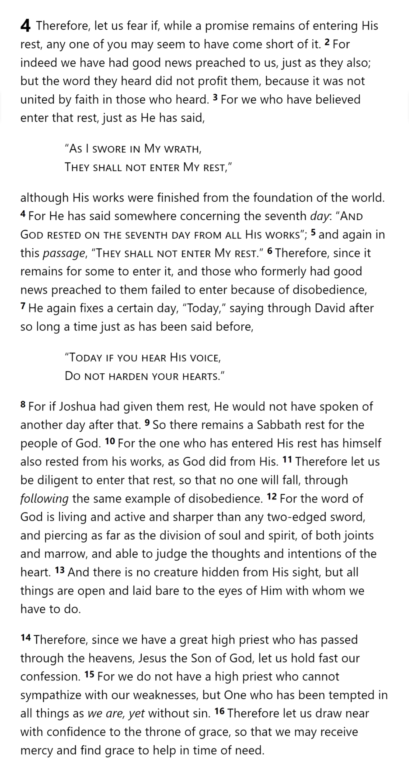
Hebrews 3

Slide 40
Hebrews 3

Slide 41
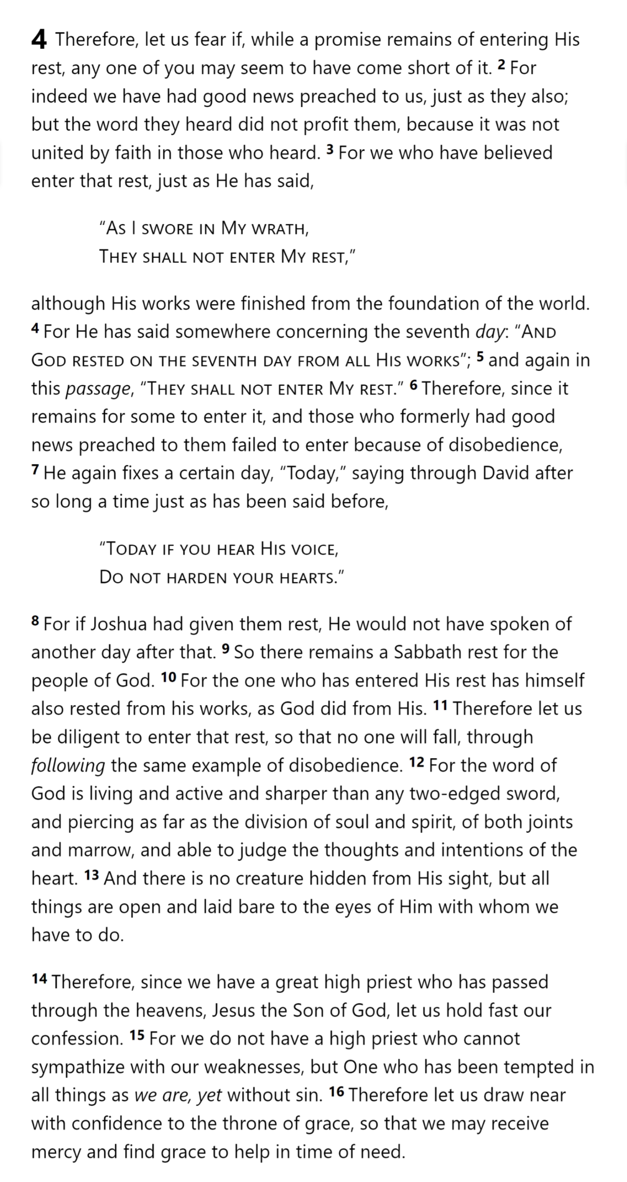
Hebrews 4

Slide 42
Creation
Wanderings
David
Psalm 95
“Today”
Rest
Remains
“Today”
GOD’S
REST
Hebrews 3

Slide 43
Hebrews 4

Slide 44
1 God … ² in these last days has spoken to us in His Son
4:2 For indeed we have had good news preached to us, just as they also; but the word they heard did not profit them, because it was not united by faith in those who heard.
¹² For the word of God is living and active and sharper than any two-edged sword, and piercing as far as the division of soul and spirit, of both joints and marrow, and able to judge the thoughts and intentions of the heart. ¹³ And there is no creature hidden from His sight, but all things are open and laid bare to the eyes of Him with whom we have to do.
2 For this reason we must pay much closer attention to what we have heard, so that we do not drift away from it … After it was at the first spoken through the Lord, it was confirmed to us by those who heard …
3:5 Moses … [testified] of those things which were to be spoken later
⁶ … those who formerly had good news preached to them failed to enter because of disobedience,
3:7 “Today if you hear His voice, ⁸ Do not harden your hearts

Slide 45
Hebrews

