Slide 1
Hebrews
Lesson Five: Christ and Aaron

Slide 3
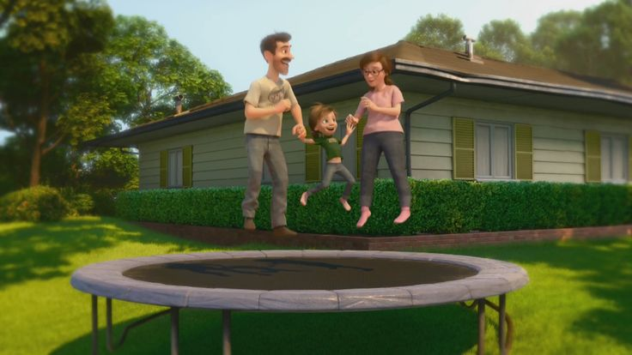
Great Family
Great House
Great Yard
Great Friends
Great Hockey Team
Happy
Life

Slide 4
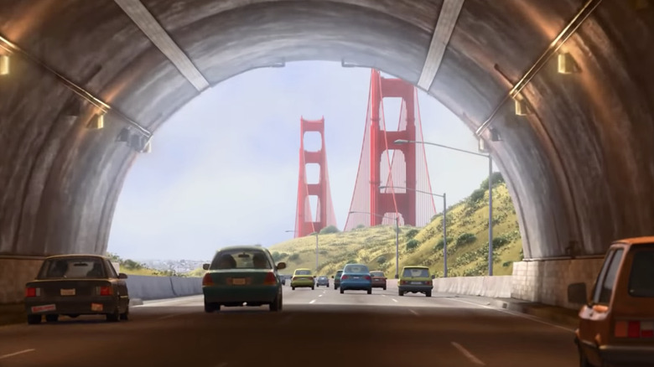
Hopeful
Change
Happy
Life

Slide 5
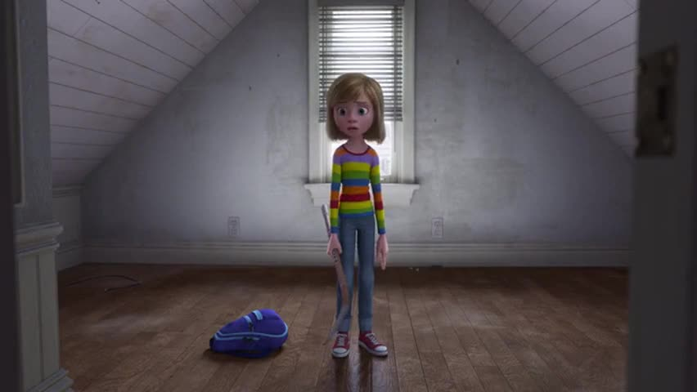
Ugly House
Nasty Room
Stressed
Parents
Broccoli Pizza!
Fails Hockey Tryouts
Hard
Struggles
Hopeful
Change
Happy
Life

Slide 6
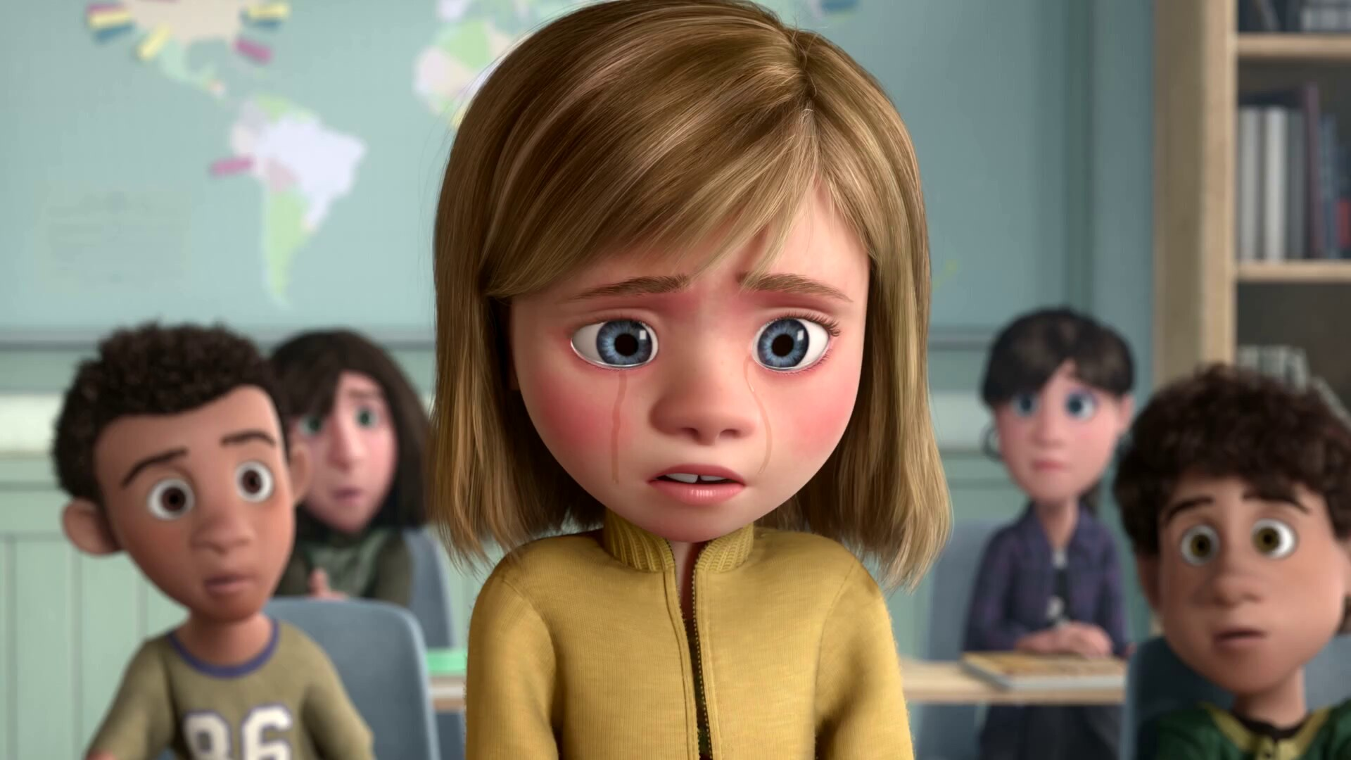
Emotional
Crisis
Hard
Struggles
Hopeful
Change
Happy
Life

Slide 7
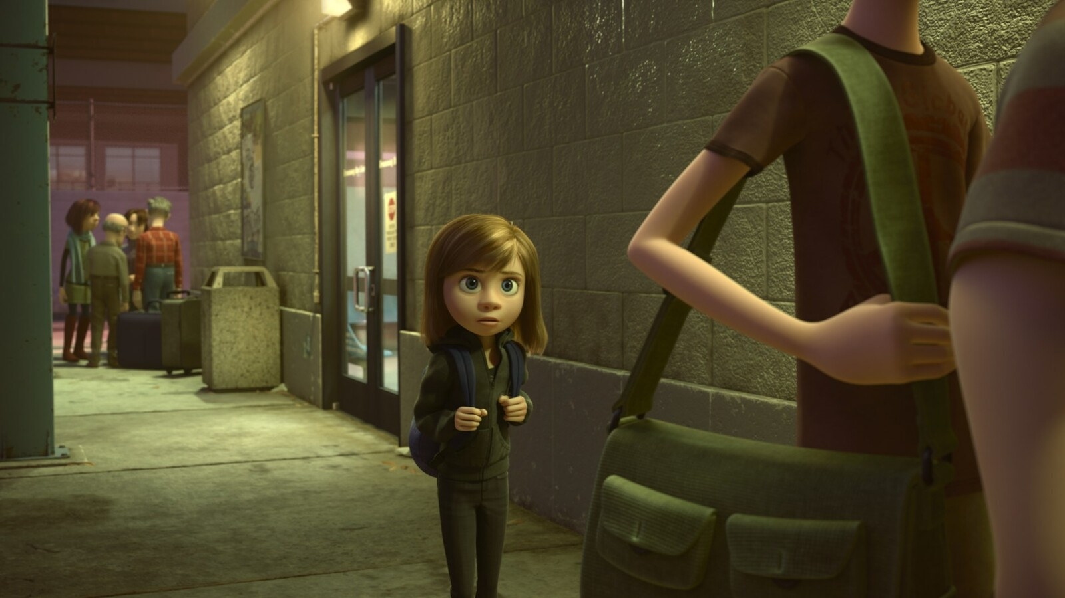
Emotional
Crisis
Hard
Struggles
Hopeful
Change
Happy
Life
Go Back!

Slide 8
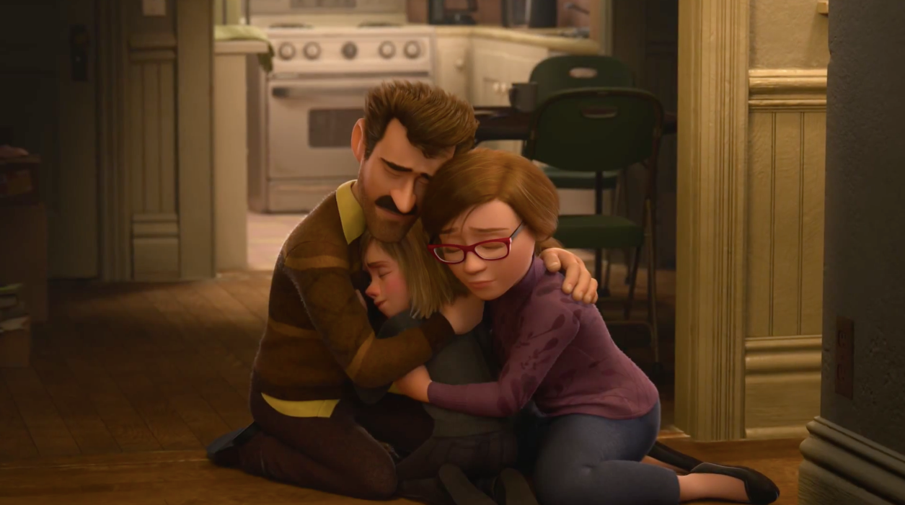
Seek
Help
Emotional
Crisis
Hard
Struggles
Hopeful
Change
Happy
Life
Go Back!

Slide 9
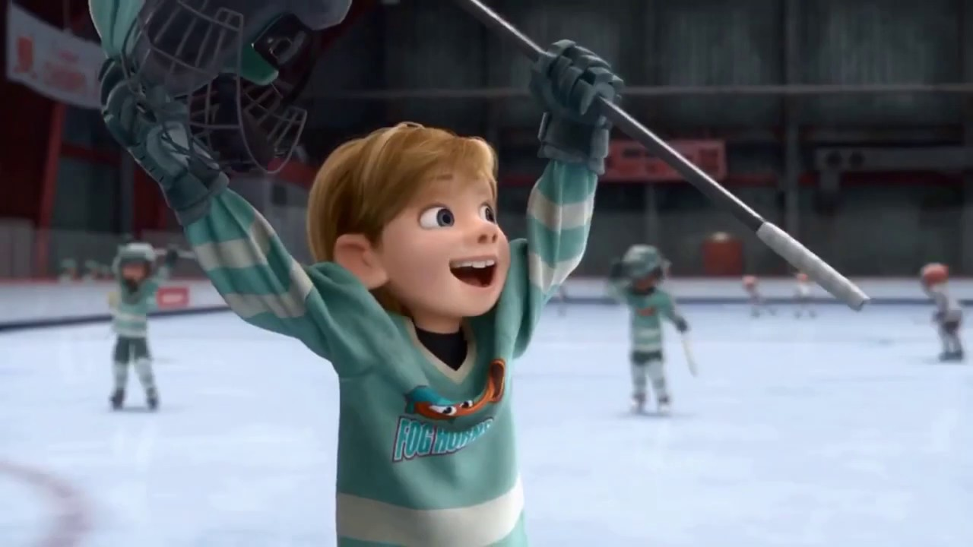
Better
Life
Seek
Help
Emotional
Crisis
Hard
Struggles
Hopeful
Change
Happy
Life
Go Back!

Slide 10
10:32-34
Hebrews
Better
Life
Seizure of Property
Moses, Law, Traditions
Public Ridicule
Became Christians
Secure Community
Sent to Prison
Seek
Help
Emotional
Crisis
Temple & Feasts
Hard
Struggles
Hopeful
Change
Happy
Life
Harden your hearts
Throw away your confidence
Shrink back
Grow weary
Lose heart
Go Back!
DO NOT

Slide 11
JESUS IS OUR
7-10:18
GREAT HIGH PRIEST
Better
Life
Seek
Help
Emotional
Crisis
Hard
Struggles
Hopeful
Change
Happy
Life
Harden your hearts
Throw away your confidence
Shrink back
Grow weary
Lose heart
Go Back!
DO NOT

Slide 12
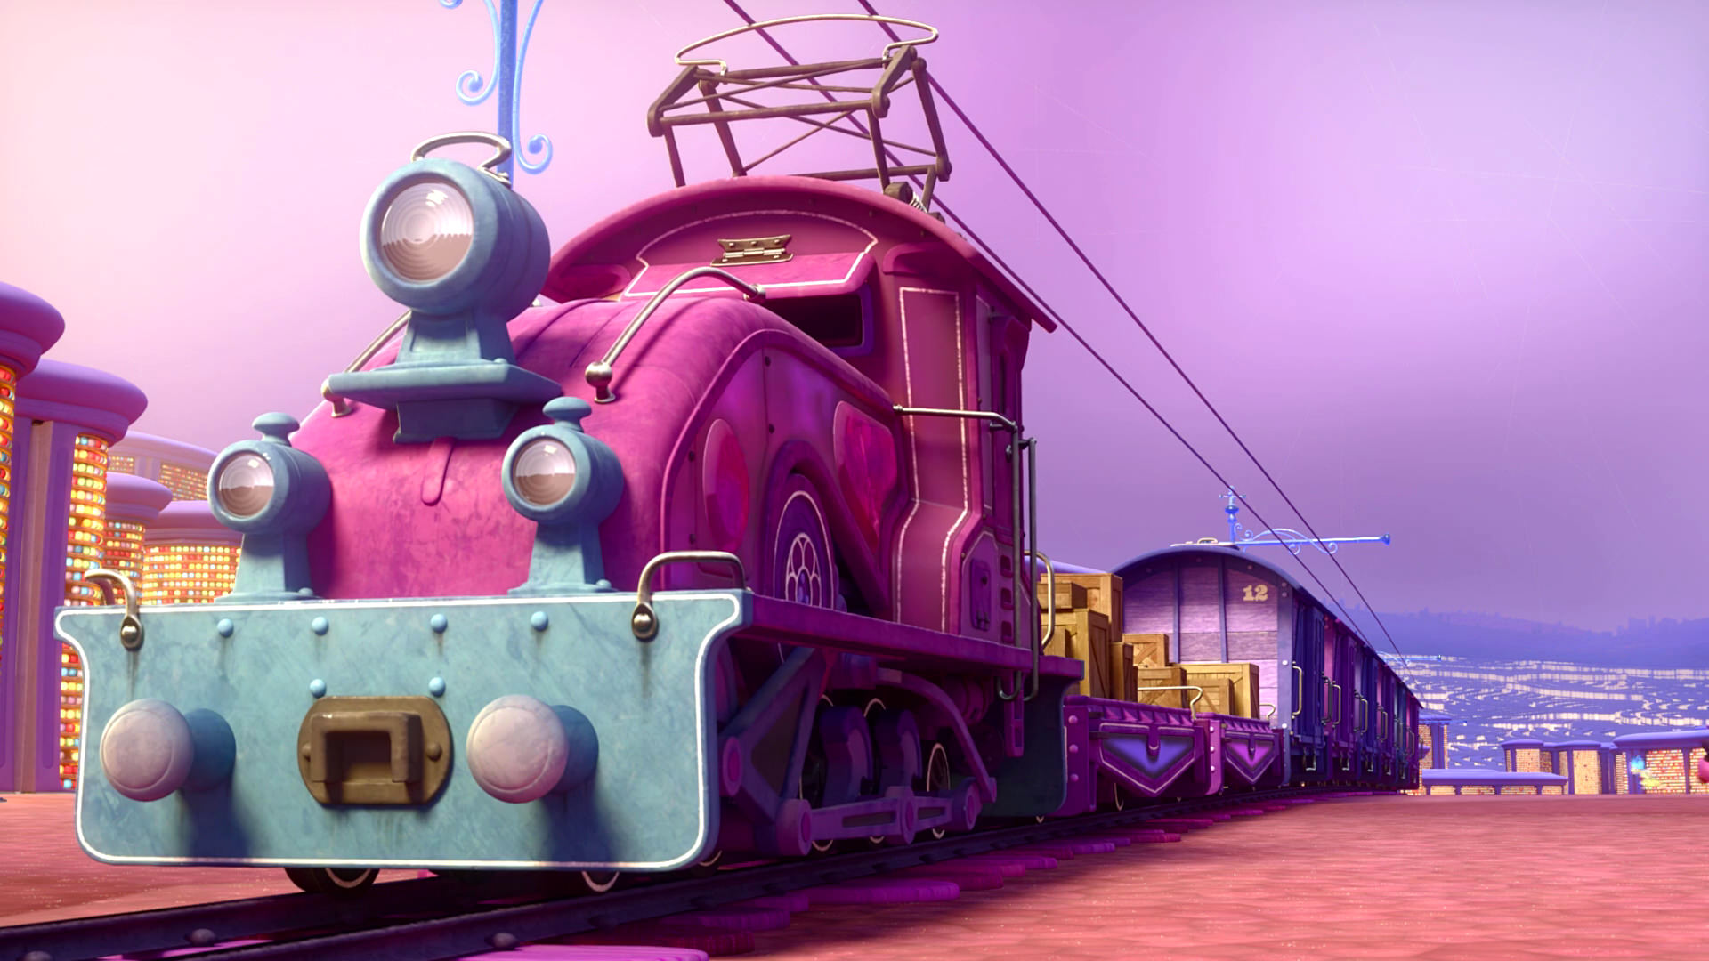
Train of Thought

Slide 13
Train of Thought

Slide 14
TABERNACLE
COVENANT
ORDER & OATH
JESUS IS OUR
7-10:18
GREAT HIGH PRIEST
SACRIFICE
promises
MINISTRY
Train of Thought

Slide 15
Sorrowful
Straighten
Lest we drift
Enduring foR
12:4-11
Discipline
Pay Attention
Joy set before Him
Angels
1:4-2:16
God has spoken
1:1-3
In his son
Strengthen
Pursue Peace
Why Lower?
Right Hand
Righteousness
Prepare
12:12-17
to Endure
Endured Cross
Right Hand
Short of Grace
Purification
Despising Shame
Bitterness
Encourage
Suffering
FIXING OUR
12:2-3
Eyes On Jesus
Esau
Hold Firm
Faithful
Run with Endurance
2:17-18
Merciful
No Evil Hearts
Able to Help
Moses
Joshua
3-4
Be Diligent
MINISTRY
Have Faith
promises
SACRIFICE
COVENANT
TABERNACLE
ORDER & OATH
JESUS IS OUR
7-10:18
GREAT HIGH PRIEST
Miss Rest
God’s Word
THE CLOUD
10:32-12:1
OF witnesses
Shaking
Hold Fast
Throw Away
Need Endurance
Time of Need
4:14-16
Gratitude & Service
Reveremce & Awe
Grace to Help
Sinai
12:18-29
AND Zion
Draw Near
Consuming Fire
Immaturity
Suffering of Christ
Falling Away
Aaron
5:1-10
Melchi
zEdek
Judgment
Draw Near
Vengeance
Hold Fast
SINCE Therefore
10:19-25
LET US
For if we go
10:26-31
on sinning
Stir Up
Faith & Patience
Anchor of Hope
Encourage
Fury of Fire
Terrifying
5:11-6:20
Closing
13
exhortations
Train of Thought

Slide 16
Sorrowful
Straighten
Lest we drift
Enduring foR
12:4-11
Discipline
Pay Attention
Joy set before Him
Angels
1:4-2:16
God has spoken
1:1-3
In his son
Strengthen
Pursue Peace
Why Lower?
Right Hand
Righteousness
Prepare
12:12-17
to Endure
Endured Cross
Right Hand
Short of Grace
Purification
Despising Shame
Bitterness
Encourage
Suffering
FIXING OUR
12:2-3
Eyes On Jesus
Esau
Hold Firm
Faithful
Run with Endurance
2:17-18
Merciful
No Evil Hearts
Able to Help
Moses
Joshua
3-4
Be Diligent
MINISTRY
Have Faith
promises
SACRIFICE
COVENANT
TABERNACLE
ORDER & OATH
JESUS IS OUR
7-10:18
GREAT HIGH PRIEST
Miss Rest
God’s Word
THE CLOUD
10:32-12:1
OF witnesses
Shaking
Hold Fast
Throw Away
Need Endurance
Time of Need
4:14-16
Gratitude & Service
Reveremce & Awe
Grace to Help
Sinai
12:18-29
AND Zion
Draw Near
Consuming Fire
Immaturity
Suffering of Christ
Falling Away
Aaron
5:1-10
Melchi
zEdek
Judgment
Draw Near
Vengeance
Hold Fast
SINCE Therefore
10:19-25
LET US
For if we go
10:26-31
on sinning
Stir Up
Faith & Patience
Anchor of Hope
Encourage
Fury of Fire
Terrifying
5:11-6:20
Closing
13
exhortations
Train of Thought

Slide 17
GOD
God has spoken
1:1-3
In his son
SON
Right Hand
Purification
JESUS IS OUR
7-10:18
GREAT HIGH PRIEST
MAN

Slide 18
THE OATH
GOD
Angels
1:4-2:16
SON
God has spoken
1:1-3
In his son
Right Hand
Purification
ANGELS
JESUS IS OUR
7-10:18
GREAT HIGH PRIEST
MAN

Slide 19
THE OATH
HOLY
SPIRIT
GOD
Lest we drift
Pay Attention
Angels
1:4-2:16
SON
God has spoken
1:1-3
In his son
Right Hand
Purification
ANGELS
JESUS IS OUR
7-10:18
GREAT HIGH PRIEST
MAN
MAN
MAN
MAN
MAN

Slide 20
THE OATH
HOLY
SPIRIT
GOD
Lest we drift
Pay Attention
Angels
1:4-2:16
SON
God has spoken
1:1-3
In his son
Why Lower?
Right Hand
Purification
JESUS IS OUR
7-10:18
GREAT HIGH PRIEST
MAN
MAN
MAN
MAN
MAN

Slide 21
THE OATH
HOLY
SPIRIT
GOD
SON
Why Lower?
MAN
MAN
MAN
MAN
MAN
Hebrews 2

Slide 22
THE OATH
To achieve the unfulfilled destiny of man to rule over all creation
HOLY
SPIRIT
GOD
Why Lower?
MAN
MAN
SON
MAN
Hebrews 2
MAN
MAN
SON
SON

Slide 23
To achieve the unfulfilled destiny of man to rule over all creation
HOLY
SPIRIT
GOD
Why Lower?
SON
SON
MAN
MAN
SON
MAN
Hebrews 2
MAN
MAN

Slide 24
THE OATH
To achieve the unfulfilled destiny of man to rule over all creation
HOLY
SPIRIT
GOD
SON
Why Lower?
SON
MAN
MAN
SON
MAN
Hebrews 2
MAN
MAN

Slide 25
THE OATH
To achieve the unfulfilled destiny of man to rule over all creation
HOLY
SPIRIT
GOD
SON
Why Lower?
MAN
MAN
MAN
MAN
SON
SON
SON
SON
SON
MAN
SON
Hebrews 2

Slide 26
THE OATH
To achieve the unfulfilled destiny of man to rule over all creation
HOLY
SPIRIT
GOD
SON
Why Lower?
To “bring many sons to glory” through His suffering
SON
SON
SON
SON
To allow us to become part of God’s family
To partake of death to render the devil powerless and to free us from fear of death
MAN
MAN
MAN
MAN
To share in our experience of suffering and temptation
SON
To become our high priest so He could come to our aid in temptation
MAN
SON
Hebrews 2

Slide 27
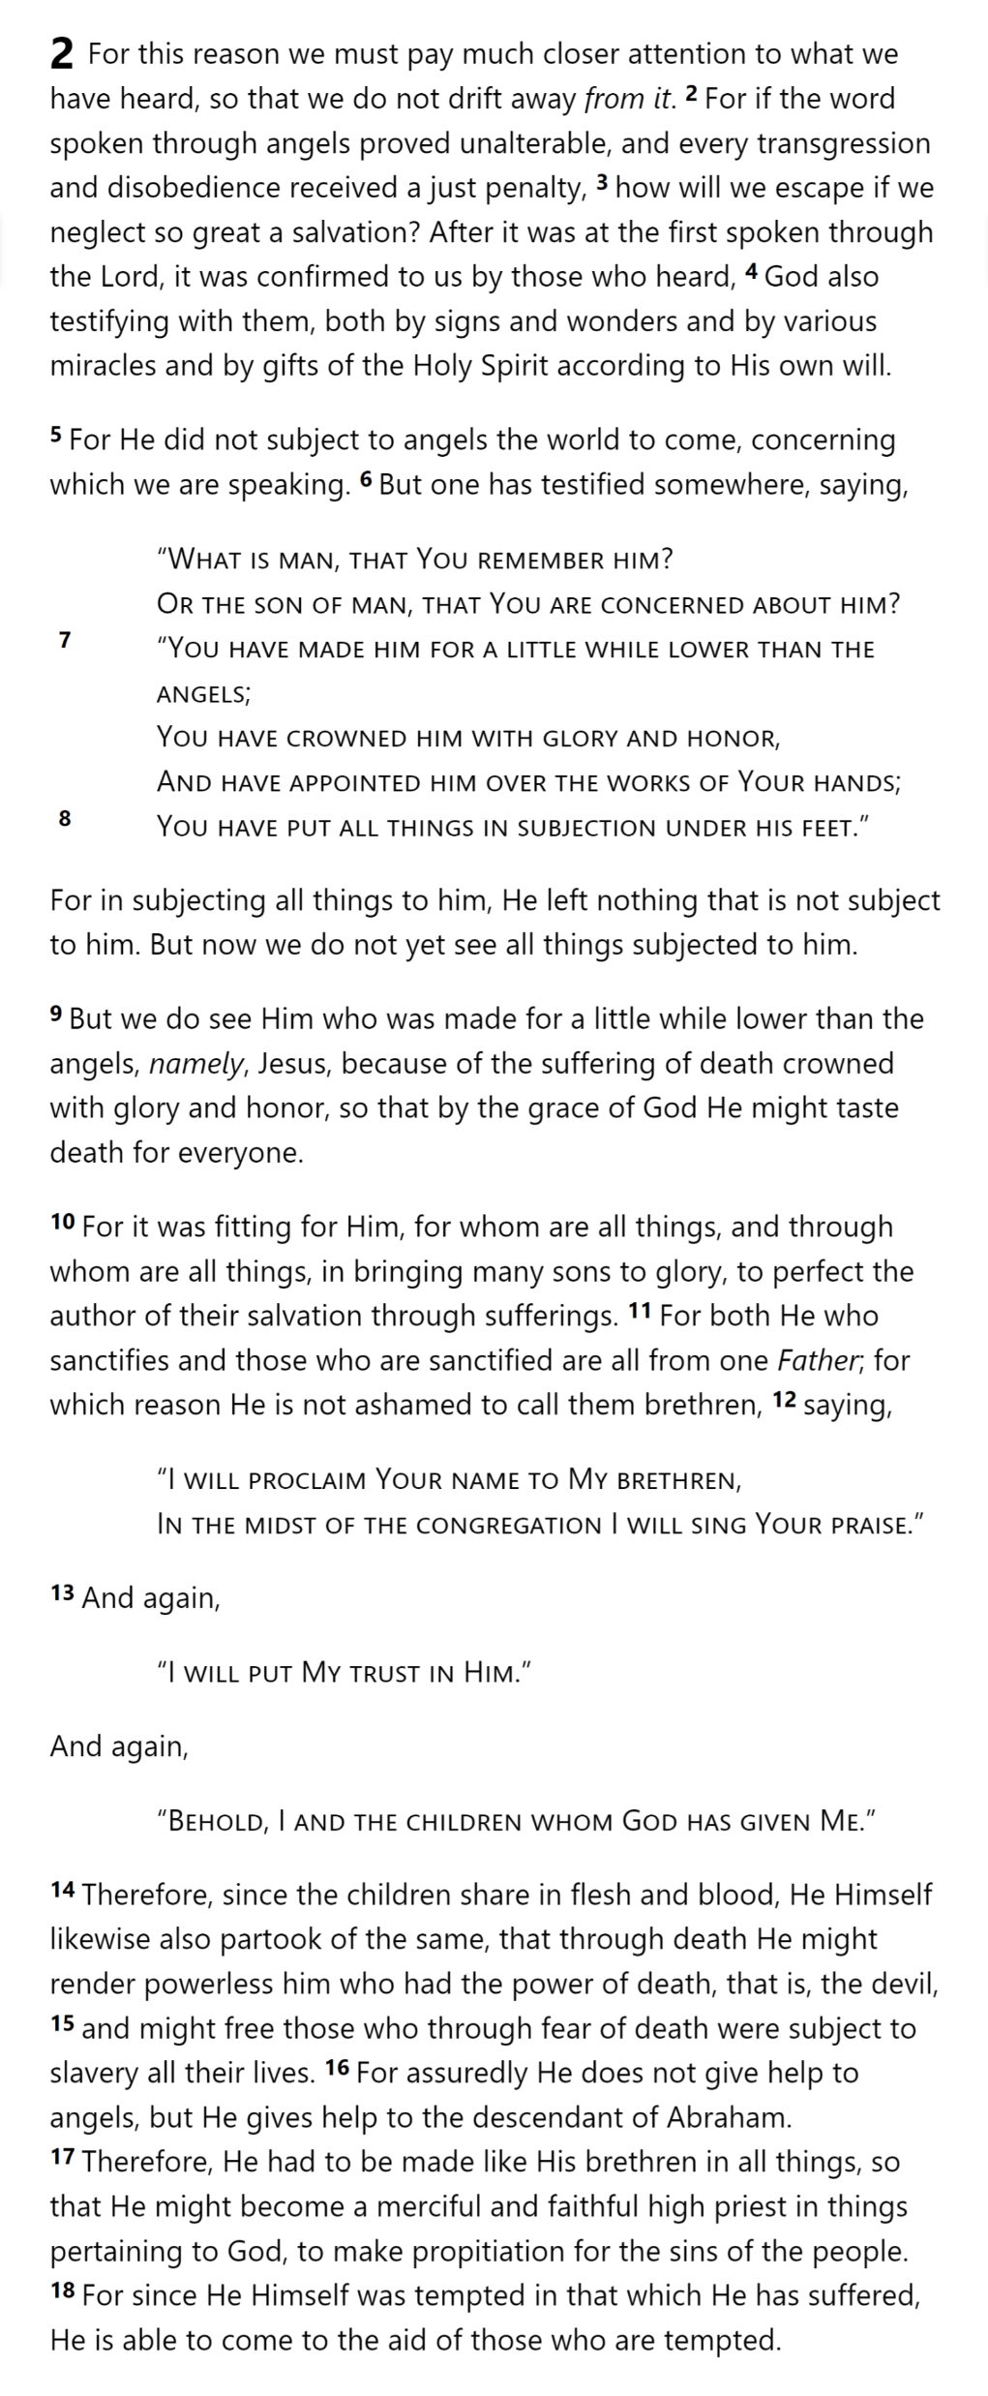
THE OATH
HOLY
SPIRIT
GOD
SON
SON
SON
SON
SON
ANGELS
Lest we drift
Pay Attention
Angels
1:4-2:16
God has spoken
1:1-3
In his son
Why Lower?
Right Hand
MAN
MAN
MAN
MAN
Purification
Suffering
SON
Faithful
2:17-18
Merciful
Able to Help
JESUS IS OUR
7-10:18
GREAT HIGH PRIEST
MAN
SON
Hebrews 2

Slide 28
Left High Position to Suffer
THE OATH
Lest we drift
Pay Attention
Angels
1:4-2:16
HOLY
SPIRIT
GOD
God has spoken
1:1-3
In his son
PROMISED LAND
Why Lower?
Right Hand
SON
Identified with his Brethren
Purification
Suffering
SON
SON
SON
SON
Faithful
ANGELS
2:17-18
Freed them from slavery…
Merciful
Moses
Joshua
3-4
Able to Help
JESUS IS OUR
7-10:18
GREAT HIGH PRIEST
MAN
MAN
MAN
MAN
MAN
MAN
MAN
MAN
…via the death of the firstborn
PASSOVER
SON
Led the saved to a better life…
MAN
…but through a difficult path
MOSES
MAN
SON
Hebrews 2

Slide 29
Pay Attention
Angels
1:4-2:16
God has spoken
1:1-3
In his son
Why Lower?
Right Hand
Purification
Suffering
Faithful
2:17-18
Merciful
Moses
Joshua
3-4
Able to Help
JESUS IS OUR
7-10:18
GREAT HIGH PRIEST
Left High Position to Suffer
THE OATH
HOLY
SPIRIT
GOD
PROMISED LAND
SON
Identified with his Brethren
SON
SON
SON
SON
ANGELS
Freed them from slavery…
MAN
MAN
MAN
MAN
MAN
MAN
MAN
MAN
…via the death of the firstborn
PASSOVER
SON
Led the saved to a better life…
MAN
…but through a difficult path
MOSES
MAN
SON

Slide 30
Left High Position to Suffer
THE OATH
HOLY
SPIRIT
GOD
“Would that we had died in the land of Egypt! Or would that we had died in this wilderness! ³ Why is the Lord bringing us into this land, to fall by the sword? Our wives and our little ones will become plunder…”
PROMISED LAND
“Would it not be better for us to return to Egypt?” ⁴ So they said to one another, “Let us appoint a leader and return to Egypt.”
SON
Identified with his Brethren
SON
SON
SON
SON
ANGELS
Freed them from slavery…
MAN
MAN
MAN
MAN
MAN
MAN
MAN
MAN
…via the death of the firstborn
Emotional
Crisis
Hard
Struggles
Hopeful
Change
PASSOVER
SON
Led the saved to a better life…
Happy
Life
Go Back!
MAN
…but through a difficult path
MOSES
MAN
SON

Slide 31
Lest we drift
Pay Attention
Angels
1:4-2:16
God has spoken
1:1-3
In his son
Why Lower?
Right Hand
Purification
Suffering
Faithful
2:17-18
Merciful
Moses
Joshua
3-4
Able to Help
JESUS IS OUR
7-10:18
GREAT HIGH PRIEST
THE OATH
HOLY
SPIRIT
GOD
Take care, brethren, that there not be in any one of you an evil, unbelieving heart that falls away from the living God.
PROMISED LAND
SON
SON
SON
SON
SON
ANGELS
MAN
MAN
MAN
MAN
MAN
MAN
MAN
MAN
Emotional
Crisis
Hard
Struggles
Hopeful
Change
SON
PASSOVER
Happy
Life
Go Back!
MAN
MAN
MOSES
SON

Slide 32
THE OATH
Lest we drift
Pay Attention
Angels
1:4-2:16
HOLY
SPIRIT
GOD
God has spoken
1:1-3
In his son
Why Lower?
Right Hand
SON
Purification
Suffering
SON
SON
SON
SON
Encourage
ANGELS
Faithful
2:17-18
Hold Firm
Merciful
No Evil Hearts
Able to Help
Moses
Joshua
3-4
Be Diligent
JESUS IS OUR
7-10:18
GREAT HIGH PRIEST
MAN
MAN
MAN
MAN
Miss Rest
God’s Word
SON
MAN
SON
Hebrews 2
Emotional
Crisis
Hard
Struggles
Hopeful
Change
Happy
Life
Go Back!

Slide 33
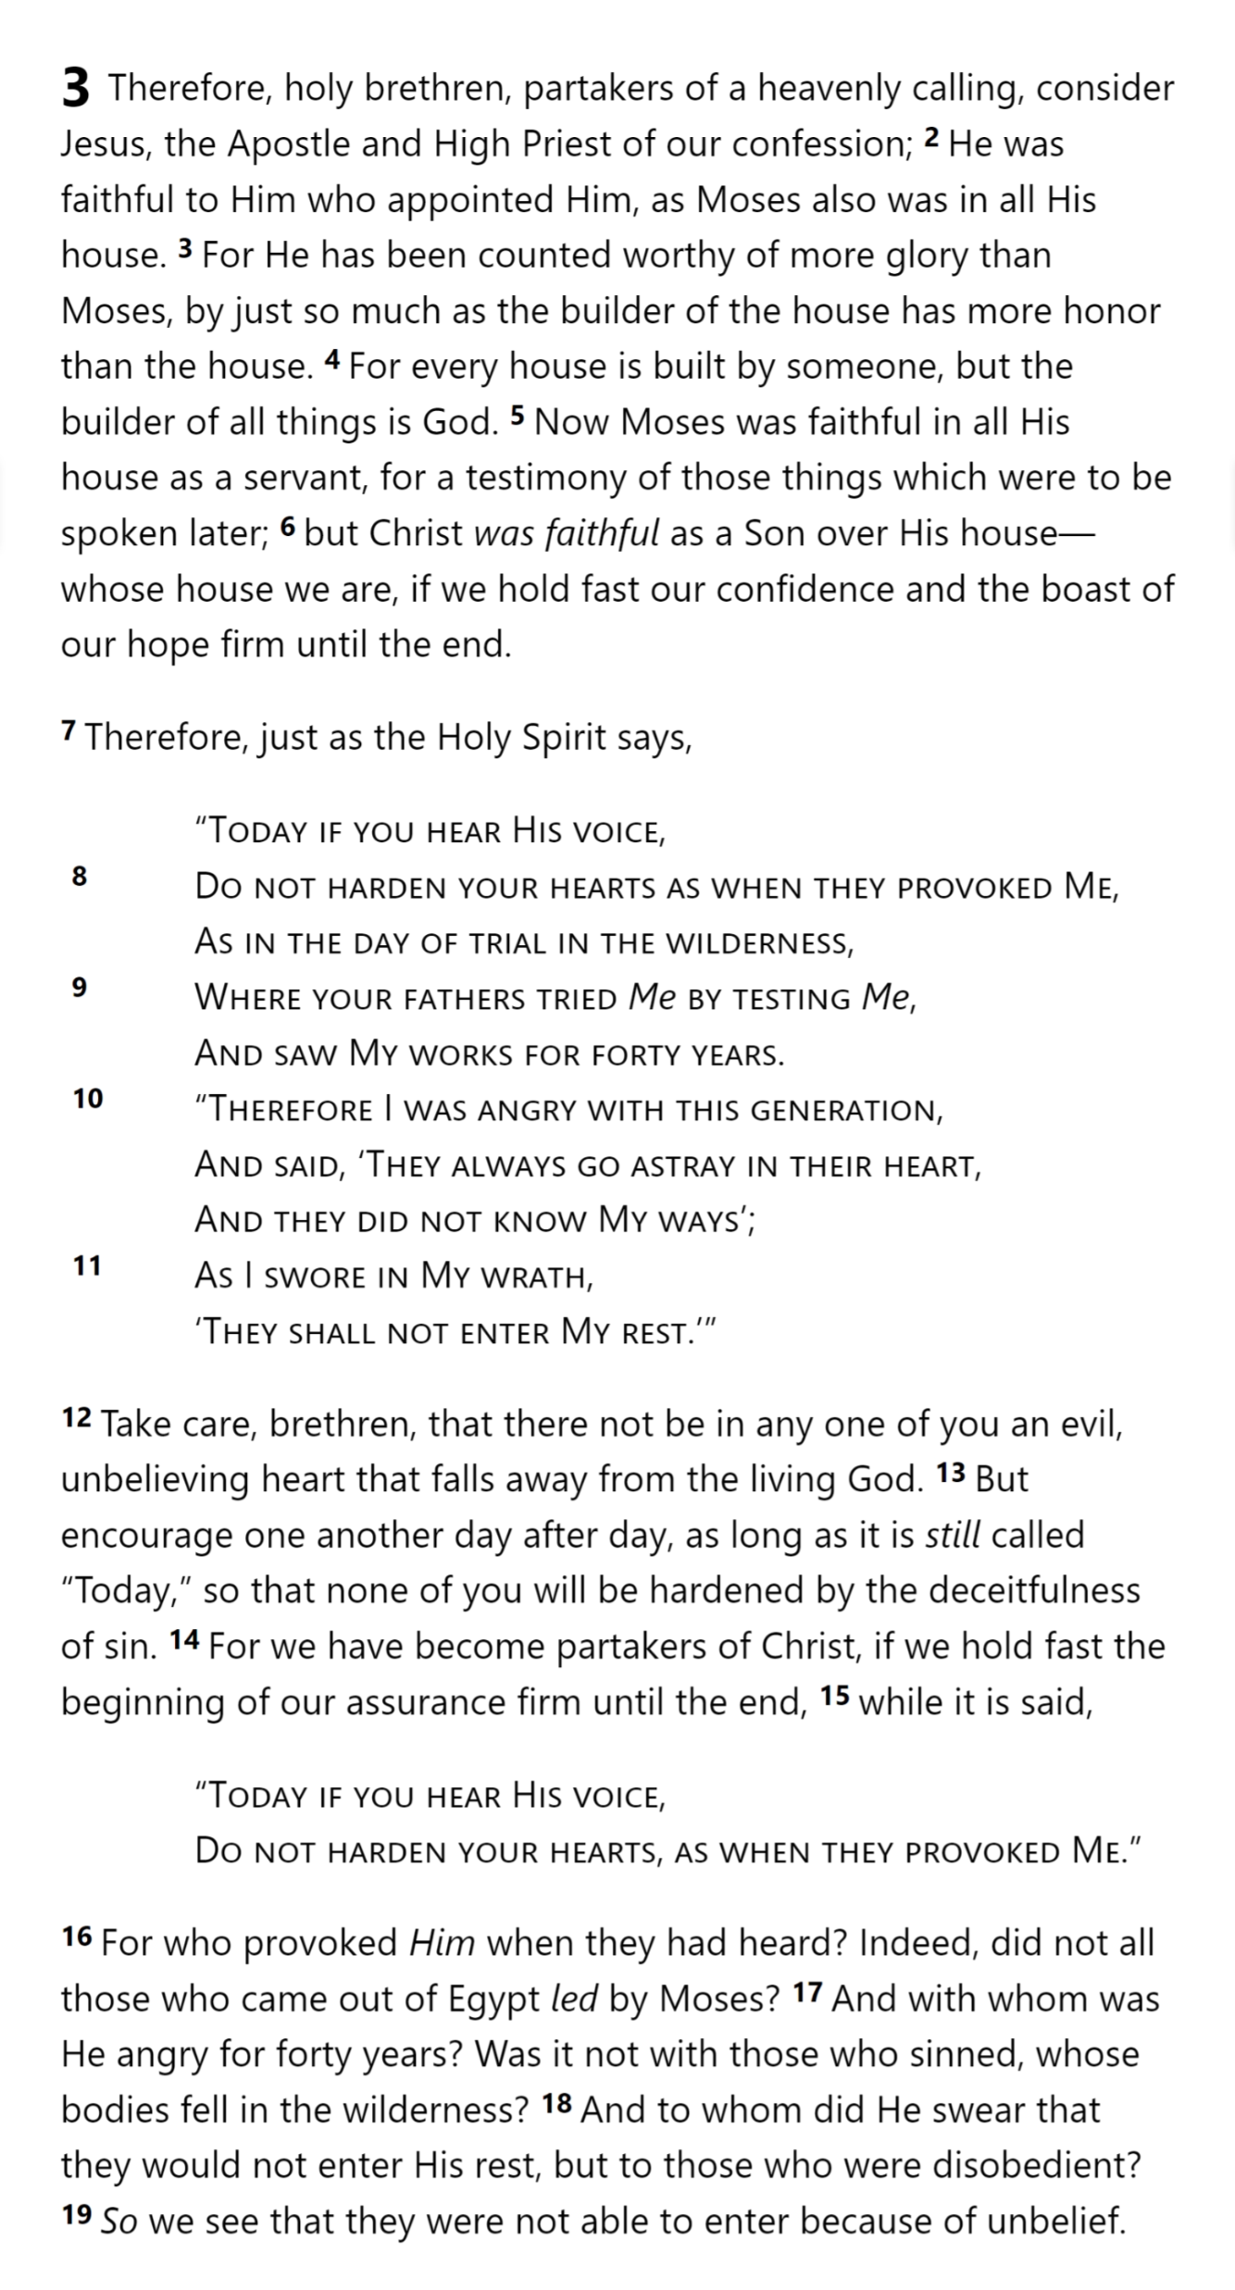
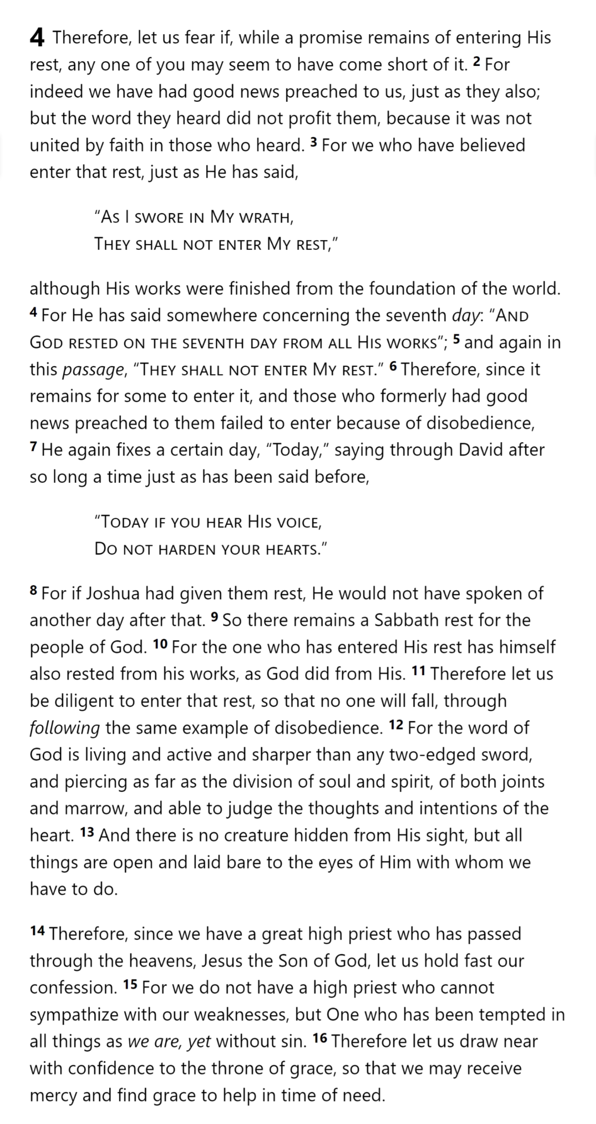
Creation
Wanderings
David
Psalm 95
“Today”
Rest
Remains
“Today”
GOD’S
REST
Hebrews 3

Slide 34
Hebrews 4

Slide 35
1 God … ² in these last days has spoken to us in His Son
4:2 For indeed we have had good news preached to us, just as they also; but the word they heard did not profit them, because it was not united by faith in those who heard.
¹² For the word of God is living and active and sharper than any two-edged sword, and piercing as far as the division of soul and spirit, of both joints and marrow, and able to judge the thoughts and intentions of the heart. ¹³ And there is no creature hidden from His sight, but all things are open and laid bare to the eyes of Him with whom we have to do.
2 For this reason we must pay much closer attention to what we have heard, so that we do not drift away from it … After it was at the first spoken through the Lord, it was confirmed to us by those who heard …
3:5 Moses … [testified] of those things which were to be spoken later
⁶ … those who formerly had good news preached to them failed to enter because of disobedience,
3:7 “Today if you hear His voice, ⁸ Do not harden your hearts

Slide 36
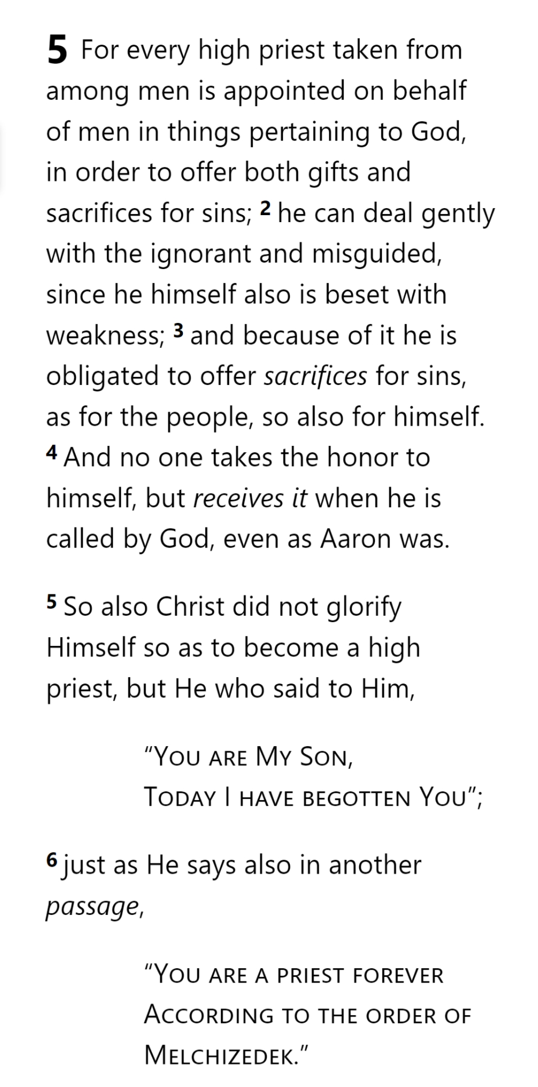
Lest we drift
Pay Attention
Angels
1:4-2:16
God has spoken
1:1-3
In his son
Why Lower?
Right Hand
Purification
Encourage
Suffering
Hold Firm
Faithful
2:17-18
Merciful
No Evil Hearts
Able to Help
Moses
Joshua
3-4
Be Diligent
MINISTRY
promises
SACRIFICE
COVENANT
TABERNACLE
ORDER & OATH
JESUS IS OUR
7-10:18
GREAT HIGH PRIEST
Miss Rest
God’s Word
Hold Fast
Time of Need
4:14-16
Grace to Help
Draw Near

Slide 37
Lest we drift
Pay Attention
Angels
1:4-2:16
God has spoken
1:1-3
In his son
Why Lower?
Right Hand
Purification
Encourage
Suffering
Hold Firm
Faithful
2:17-18
Merciful
No Evil Hearts
Able to Help
Moses
Joshua
3-4
Be Diligent
MINISTRY
promises
SACRIFICE
COVENANT
TABERNACLE
ORDER & OATH
JESUS IS OUR
7-10:18
GREAT HIGH PRIEST
Miss Rest
God’s Word
Hold Fast
Time of Need
4:14-16
Grace to Help
Draw Near
Aaron
5:1-10

Slide 38
Lest we drift
From Among Men
Pay Attention
Angels
1:4-2:16
God has spoken
1:1-3
In his son
Why Lower?
Right Hand
Purification
He must be a member of the group he represents (he must be a man).
Encourage
Suffering
Hold Firm
Faithful
C
2:17-18
Merciful
No Evil Hearts
Able to Help
Moses
Joshua
3-4
Be Diligent
MINISTRY
promises
SACRIFICE
COVENANT
TABERNACLE
ORDER & OATH
JESUS IS OUR
7-10:18
GREAT HIGH PRIEST
Miss Rest
God’s Word
Hold Fast
Time of Need
4:14-16
Grace to Help
Draw Near
Aaron
5:1-10

Slide 39
From Among Men
Representative
His role is to be the “interface” between men and their God.
A

Slide 40
From Among Men
Representative
Offer Sacrifices
Offering sacrifices to God is his main job.
F

Slide 41
From Among Men
Representative
Offer Sacrifices
Compassionate
His understanding of man’s plight enables him to treat men kindly when they make mistakes.
E

Slide 42
From Among Men
Representative
Offer Sacrifices
Compassionate
Knows Weakness
He must know from experience the problems that men face.
D

Slide 43
From Among Men
Representative
He offers the sacrifices to deal with the sin of the people he represents.
G
Offer Sacrifices
Compassionate
Knows Weakness
Atones for Men

Slide 44
From Among Men
Representative
Offer Sacrifices
He himself must appear before God without sin.
H
Compassionate
Knows Weakness
Atones for Men
Without Sin

Slide 45
From Among Men
Representative
Offer Sacrifices
Compassionate
He must be appointed by God, not himself.
B
Knows Weakness
Atones for Men
Without Sin
Appointed by God

Slide 46
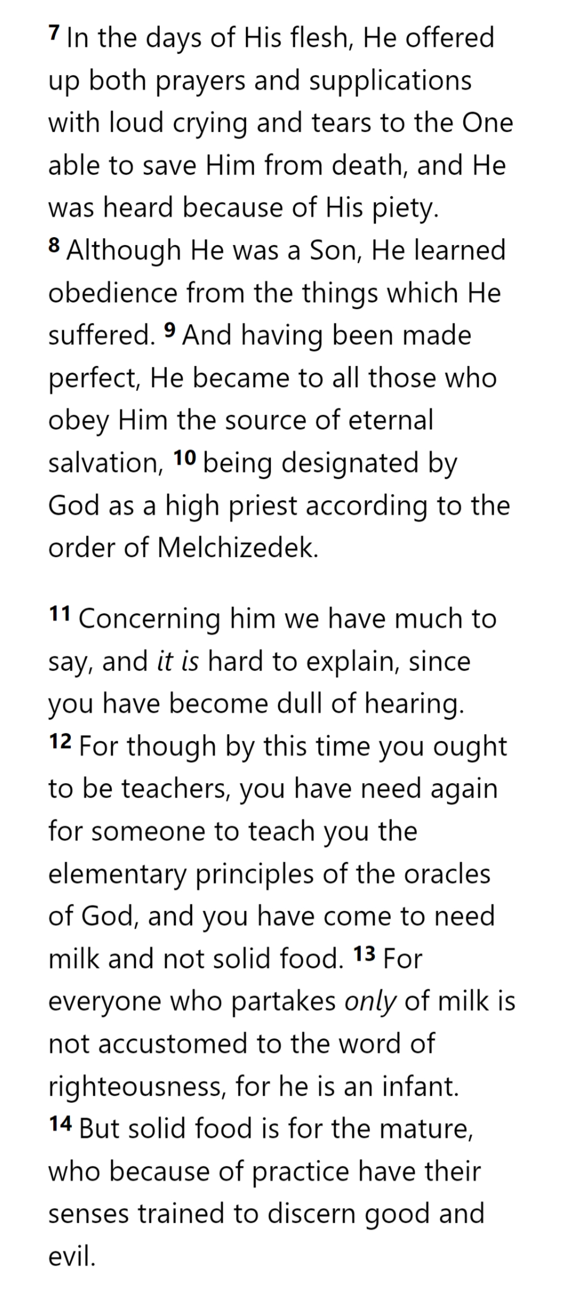
From Among Men
Representative
Offer Sacrifices
Compassionate
Knows Weakness
Atones for Men
Without Sin
Appointed by God

Slide 47
From Among Men
Representative
Offer Sacrifices
Compassionate
Knows Weakness
Atones for Men
Without Sin
Appointed by God

Slide 49
Hebrews

Slide 50
Lest we drift
Pay Attention
Angels
1:4-2:16
God has spoken
1:1-3
In his son
Why Lower?
Right Hand
Purification
Encourage
Suffering
Hold Firm
Faithful
2:17-18
Merciful
No Evil Hearts
Able to Help
Moses
Joshua
3-4
Be Diligent
MINISTRY
promises
SACRIFICE
COVENANT
TABERNACLE
ORDER & OATH
JESUS IS OUR
7-10:18
GREAT HIGH PRIEST
Miss Rest
God’s Word
Hold Fast
Time of Need
4:14-16
Grace to Help
Draw Near
Immaturity
Suffering of Christ
Aaron
5:1-10
Melchi
zEdek
5:11-6:20

