Slide 1
There’s a battle raging.
Ephesians 6:11 Put on the full armor of God, so that you will be able to stand firm against the schemes of the devil. 12 For our struggle is not against flesh and blood, but against the rulers, against the powers, against the world forces of this darkness, against the spiritual forces of wickedness in the heavenly places.
God believes you can win this battle.

Slide 2
A few things about the enemy
He has sinned from the beginning (1st John 3:8.)
We don’t know when he was created, but he is a created being who was created good and with freewill.
2nd Peter 2:4, Jude 6, and 1st Timothy 3:6 give mention of angels who rebelled against God.
Not satisfied with the position given to them and being conceited they fell into condemnation.
He is not equal forces with God (Job 1.)
He is the father of lies (John 8.)
He is a lion seeking to devour anyone (1st Peter 5:8.)

Slide 3
The lion seeking to devour
Ephesians 6:11 Put on the full armor of God, so that you will be able to stand firm against the schemes of the devil. 12 For our struggle is not against flesh and blood, but against the rulers, against the powers, against the world forces of this darkness, against the spiritual forces of wickedness in the heavenly places.
1st Peter 2:11 Beloved, I urge you as aliens and strangers to abstain from fleshly lusts which wage war against the soul.
James 4:1 Is not the source your pleasures that wage war in your members?

Slide 4
Shadows of Satan: The Betrayer
How the betrayer from the beginning influences God’s people to betray God

Slide 5
Acts 1:13 When they had entered the city, they went up to the upper room where they were staying; that is, Peter and John and James and Andrew, Philip and Thomas, Bartholomew and Matthew, James the son of Alphaeus, and Simon the Zealot, and Judas the son of James. 14 These all with one mind were continually devoting themselves to prayer, along with the women, and Mary the mother of Jesus, and with His brothers. 15 At this time Peter stood up in the midst of the brethren (a gathering of about one hundred and twenty persons was there together), and said, 16 “Brethren, the Scripture had to be fulfilled, which the Holy Spirit foretold by the mouth of David concerning Judas, who became a guide to those who arrested Jesus. 17 For he was counted among us and received his share in this ministry.”

Slide 6
Judas was one of the twelve
Luke 6:12 It was at this time that He went off to the mountain to pray, and He spent the whole night in prayer to God. 13 And when day came, He called His disciples to Him and chose twelve of them, whom He also named as apostles: 14 Simon, whom He also named Peter, and Andrew his brother; and James and John; and Philip and Bartholomew; 15 and Matthew and Thomas; James the son of Alphaeus, and Simon who was called the Zealot; 16 Judas the son of James, and Judas Iscariot, who became a traitor.
He wasn’t a traitor in the beginning, he became that.

Slide 7
Judas was one of the twelve
Luke 6:24 But woe to you who are rich, for you are receiving your comfort in full…
Matthew 6:24 “No one can serve two masters; for either he will hate the one and love the other, or he will be devoted to one and despise the other. You cannot serve God and wealth.
Luke 6:49 But the one who has heard and has not acted accordingly, is like a man who built a house on the ground without any foundation; and the torrent burst against it and immediately it collapsed, and the ruin of that house was great.”
He wasn’t a traitor in the beginning, he became that.
He would’ve heard Jesus’ sermons and warnings.

Slide 8
Judas was one of the twelve
Luke 11:39 “Now you Pharisees clean the outside of the cup and of the platter; but inside of you, you are full of robbery and wickedness.”
Luke 11:42“But woe to you Pharisees! For you pay tithe of mint and rue and every kind of garden herb, and yet disregard justice and the love of God; but these are the things you should have done without neglecting the others.
Luke 12:1 He began saying to His disciples first of all, “Beware of the leaven of the Pharisees, which is hypocrisy. 2 “But there is nothing covered up that will not be revealed, and hidden that will not be known.
He wasn’t a traitor in the beginning, he became that.
He would’ve heard Jesus’ sermons and warnings.

Slide 9
Judas was one of the twelve
Luke 9:1 And He called the twelve together, and gave them power and authority over all the demons and to heal diseases. 2 And He sent them out to proclaim the kingdom of God and to perform healing. 3 And He said to them, “Take nothing for your journey, neither a staff, nor a bag, nor bread, nor money; and do not even have two tunics apiece. 4 “Whatever house you enter, stay there until you leave that city. 5 “And as for those who do not receive you, as you go out from that city, shake the dust off your feet as a testimony against them.” 6 Departing, they began going throughout the villages, preaching the gospel and healing everywhere.
He wasn’t a traitor in the beginning, he became that.
He would’ve heard Jesus’ sermons and warnings.
He would’ve been a part of the good that the apostles did.

Slide 10
Acts 1:13 When they had entered the city, they went up to the upper room where they were staying; that is, Peter and John and James and Andrew, Philip and Thomas, Bartholomew and Matthew, James the son of Alphaeus, and Simon the Zealot, and Judas the son of James. 14 These all with one mind were continually devoting themselves to prayer, along with the women, and Mary the mother of Jesus, and with His brothers. 15 At this time Peter stood up in the midst of the brethren (a gathering of about one hundred and twenty persons was there together), and said, 16 “Brethren, the Scripture had to be fulfilled, which the Holy Spirit foretold by the mouth of David concerning Judas, who became a guide to those who arrested Jesus. 17 For he was counted among us and received his share in this ministry.”

Slide 11
From apostle to betrayer
Ignored the warnings that Jesus gave Him.
Proximity and public deeds don’t replace true devotion.
Hypocrisy can be hidden from people, but never from God.
Secret sin will embolden you to assume that there’s no consequences.
Sin causes you to think shortsightedly about your actions.

Slide 12
Betrayers don’t just betray God, they betray themselves
Matthew 27:1-6
The price received for betraying Jesus wasn’t worth anything in the long run.
The people that Judas betrayed Jesus with, ultimately betrayed him.
Instead of riches and esteem, Judas was remembered as a traitor whose end was in Jerusalem.
Matthew 26:14-16

Slide 13
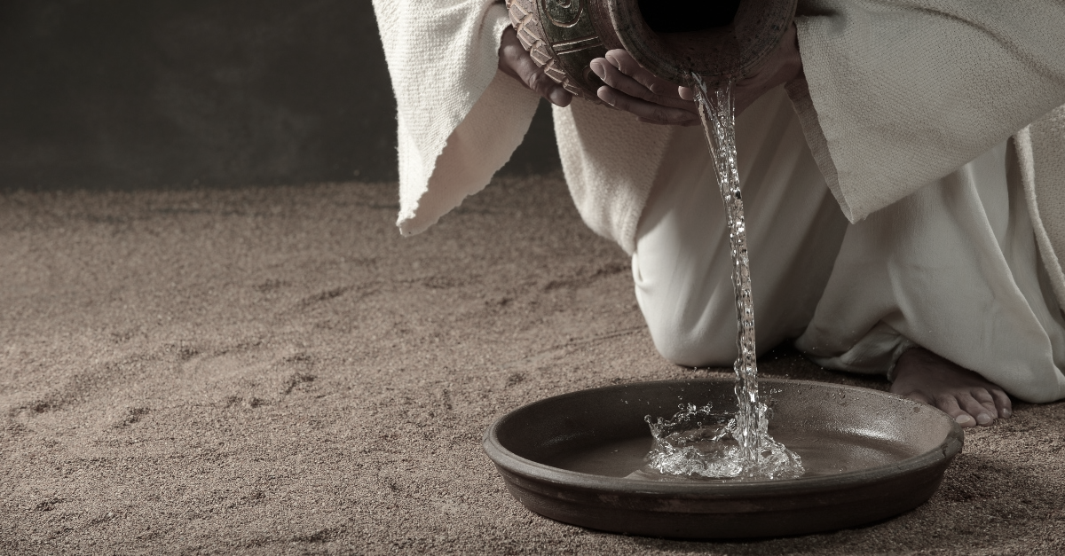
God never betrays His covenant to us
John 13:1 Now before the Feast of the Passover, Jesus knowing that His hour had come that He would depart out of this world to the Father, having loved His own who were in the world, He loved them to the end. 2 During supper, the devil having already put into the heart of Judas Iscariot, the son of Simon, to betray Him, 3 Jesus, knowing that the Father had given all things into His hands, and that He had come forth from God and was going back to God, 4 *got up from supper, and *laid aside His garments; and taking a towel, He girded Himself. 5 Then He *poured water into the basin, and began to wash the disciples’ feet and to wipe them with the towel with which He was girded.

