Slide 1
Hebrews
Lesson Nine: Covenant & Sacrifice

Slide 2
10:32-34
Hebrews
Better
Life
Seizure of Property
Moses, Law, Traditions
Public Ridicule
Became Christians
Secure Community
Sent to Prison
Seek
Help
Emotional
Crisis
Temple & Feasts
Hard
Struggles
Hopeful
Change
Happy
Life
Harden your hearts
Throw away your confidence
Shrink back
Grow weary
Lose heart
Go Back!
DO NOT

Slide 3
JESUS IS OUR
7-10:18
GREAT HIGH PRIEST
Better
Life
Seek
Help
Emotional
Crisis
Hard
Struggles
Hopeful
Change
Happy
Life
Harden your hearts
Throw away your confidence
Shrink back
Grow weary
Lose heart
Go Back!
DO NOT

Slide 4
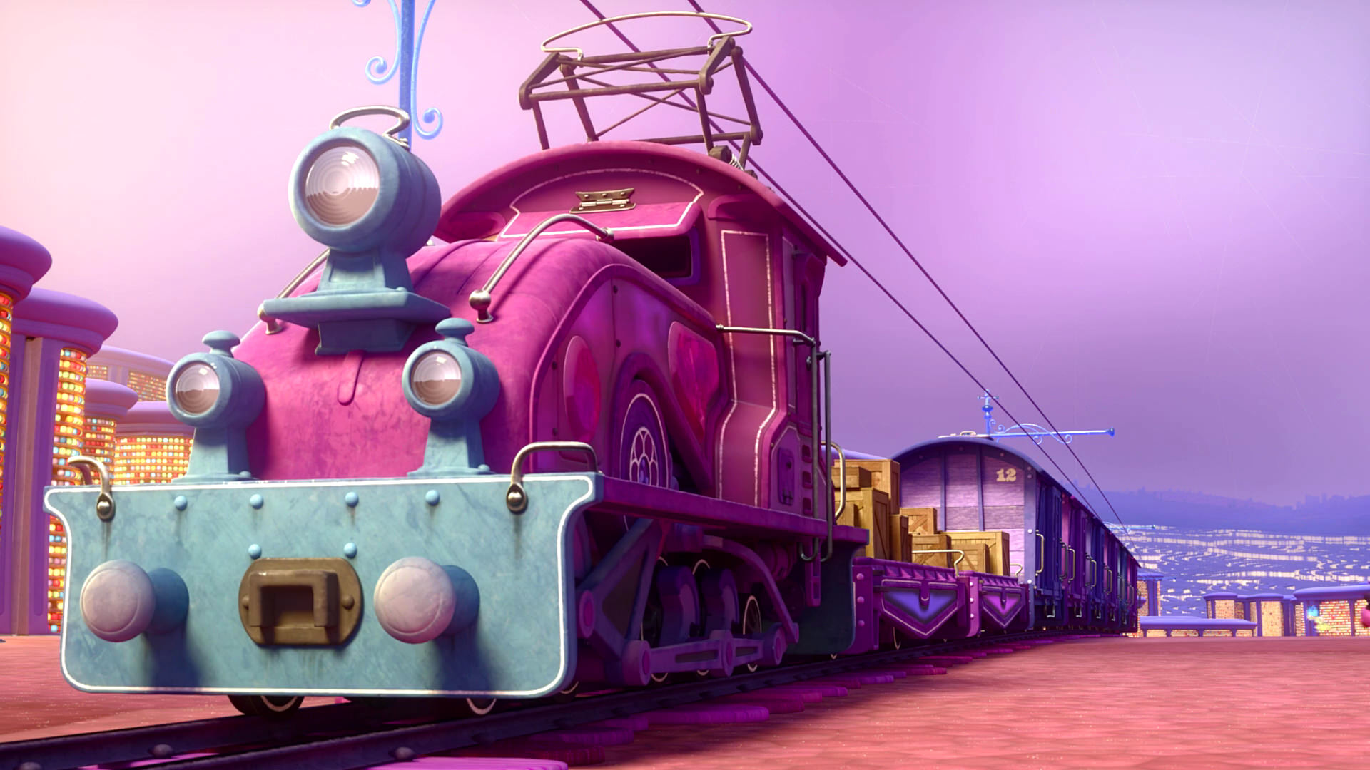
Train of Thought

Slide 5
Train of Thought

Slide 6
Sorrowful
Straighten
Lest we drift
Enduring foR
12:4-11
Discipline
Pay Attention
Joy set before Him
Angels
1:4-2:16
God has spoken
1:1-3
In his son
Strengthen
Pursue Peace
Why Lower?
Right Hand
Righteousness
Prepare
12:12-17
to Endure
Endured Cross
Right Hand
Short of Grace
Purification
Despising Shame
Bitterness
Encourage
Suffering
FIXING OUR
12:2-3
Eyes On Jesus
Esau
Hold Firm
Faithful
Run with Endurance
2:17-18
Merciful
No Evil Hearts
Able to Help
Moses
Joshua
3-4
Be Diligent
MINISTRY
Have Faith
promises
SACRIFICE
COVENANT
TABERNACLE
ORDER & OATH
JESUS IS OUR
7-10:18
GREAT HIGH PRIEST
Miss Rest
God’s Word
THE CLOUD
10:32-12:1
OF witnesses
Shaking
Hold Fast
Throw Away
Need Endurance
Time of Need
4:14-16
Gratitude & Service
Reveremce & Awe
Grace to Help
Sinai
12:18-29
AND Zion
Draw Near
Consuming Fire
Immaturity
Suffering of Christ
Falling Away
Aaron
5:1-10
Melchi
zEdek
Judgment
Draw Near
Vengeance
Hold Fast
SINCE Therefore
10:19-25
LET US
For if we go
10:26-31
on sinning
Stir Up
Faith & Patience
Anchor of Hope
Encourage
Fury of Fire
Terrifying
5:11-6:20
Closing
13
exhortations
Train of Thought

Slide 7
TABERNACLE
COVENANT
ORDER & OATH
JESUS IS OUR
7-10:18
GREAT HIGH PRIEST
SACRIFICE
promises
MINISTRY
Train of Thought

Slide 8
THE OATH
HOLY
SPIRIT
GOD
The exalted Son of God
SON
MAN
MAN
MAN
MAN
MAN

Slide 9
THE OATH
HOLY
SPIRIT
GOD
Became lower than the angels … partook of flesh and blood
MAN
MAN
SON
MAN
MAN
MAN
SON
SON

Slide 10
HOLY
SPIRIT
GOD
Tasted of death for everyone
SON
SON
MAN
MAN
SON
MAN
MAN
MAN

Slide 11
THE OATH
HOLY
SPIRIT
GOD
Perfected to be the author of our salvation
SON
SON
MAN
MAN
SON
MAN
MAN
MAN

Slide 12
THE OATH
HOLY
SPIRIT
GOD
SON
Freed us from slavery
MAN
MAN
MAN
MAN
SON
SON
SON
SON
SON
MAN
SON

Slide 13
THE OATH
HOLY
SPIRIT
GOD
And become our merciful and faithful high priest
SON
To bring many sons to glory
SON
SON
SON
SON
MAN
MAN
MAN
MAN
SON
MAN
SON

Slide 14
HEBREWS 5
GOD
GOD
THE OATH
HOLY
SPIRIT
GOD
MELCHIZEDEK
PRIEST
AARON
SON
SON
SON
SON
SON
TITHE
BLESSING
TABERNACLE
“You are My Son, Today I have begotten You.”
Psalm 2:7
ABRAHAM
LEVI
LEVI
LEVI
LEVI
MAN
MAN
MAN
MAN
ISAAC
BULL
SON
LAND
NATION
SEED
COVENANT
MAN
MAN
MAN
SON
MAN
MAN
MAN

Slide 15
HEBREWS 5
GOD
GOD
THE OATH
HOLY
SPIRIT
GOD
MELCHIZEDEK
PRIEST
AARON
SON
The Lord has sworn and will not change His mind, “You are a priest forever According to the order of Melchizedek.”
Psalm 110:4
SON
SON
SON
SON
TITHE
BLESSING
TABERNACLE
ABRAHAM
LEVI
LEVI
LEVI
LEVI
MAN
MAN
MAN
MAN
ISAAC
BULL
SON
LAND
NATION
SEED
COVENANT
MAN
MAN
MAN
SON
MAN
MAN
MAN

Slide 16
HEBREWS 7
GOD
GOD
THE OATH
HOLY
SPIRIT
GOD
MELCHIZEDEK
PRIEST
The Greatness of Melchizedek
AARON
SON
King of Peace (Salem)
King of Righteousness
Priest of God Most High
Gave Abraham a blessing
Received tithe from Abraham …
... and even Levi! (in his loins)
Was not a relative of Abraham
Superior even to the one with the promises from God
“made like the Son of God, he remains a priest perpetually”
SON
SON
SON
SON
TITHE
BLESSING
TABERNACLE
ABRAHAM
LEVI
LEVI
LEVI
LEVI
MAN
MAN
MAN
MAN
ISAAC
BULL
SON
LAND
NATION
SEED
COVENANT
MAN
MAN
MAN
SON
MAN
MAN
MAN

Slide 17
HEBREWS 7
GOD
GOD
THE OATH
HOLY
SPIRIT
GOD
MELCHIZEDEK
PRIEST
AARON
The Eternal Priesthood
SON
SON
SON
SON
SON
TITHE
¹¹Now if perfection was through the Levitical priesthood … what further need was there for another priest to arise according to the order of Melchizedek, and not be designated according to the order of Aaron?
BLESSING
The Lord has sworn and will not change His mind, “You are a priest forever According to the order of Melchizedek.”
Psalm 110:4
TABERNACLE
ABRAHAM
LEVI
LEVI
LEVI
LEVI
MAN
MAN
MAN
MAN
ISAAC
BULL
SON
LAND
NATION
SEED
COVENANT
MAN
MAN
MAN
SON
MAN
MAN
MAN

Slide 18
HEBREWS 7
GOD
GOD
THE OATH
HOLY
SPIRIT
GOD
MELCHIZEDEK
PRIEST
AARON
The Eternal Priesthood
SON
Physical Requirement
Power of an Indestructible Life
SON
SON
SON
SON
TITHE
BLESSING
TABERNACLE
Many Priests who keep dying
One Who holds His priesthood permanently
ABRAHAM
LEVI
LEVI
LEVI
LEVI
MAN
MAN
MAN
MAN
Repeated sacrifices for people & priests
Sacrificed Himself Once for All
ISAAC
BULL
SON
LAND
NATION
SEED
Without an Oath
With an Oath
COVENANT
MAN
MAN
MAN
Weak Men
Perfect Son
SON
MAN
MAN
MAN

Slide 19
HEBREWS 7
GOD
GOD
THE OATH
HOLY
SPIRIT
GOD
MELCHIZEDEK
PRIEST
AARON
The Eternal Priesthood
SON
For when the priesthood is changed, of necessity there takes place a change of law also.
SON
SON
SON
SON
TITHE
BLESSING
TABERNACLE
ABRAHAM
LEVI
LEVI
LEVI
LEVI
MAN
MAN
MAN
MAN
ISAAC
BULL
SON
LAND
NATION
SEED
COVENANT
COVENANT
MAN
MAN
MAN
SON
MAN
MAN
MAN

Slide 20
HEBREWS 7
GOD
GOD
THE OATH
HOLY
SPIRIT
GOD
MELCHIZEDEK
PRIEST
AARON
The Eternal Priesthood
SON
For when the priesthood is changed, of necessity there takes place a change of law also.
SON
SON
SON
SON
TITHE
BLESSING
TABERNACLE
ABRAHAM
LEVI
LEVI
LEVI
LEVI
MAN
MAN
MAN
MAN
Weakness
Uselessness
Makes Nothing Perfect
Better Hope
Better Covenant
ISAAC
BULL
SON
LAND
NATION
SEED
COVENANT
COVENANT
MAN
MAN
MAN
SON
MAN
MAN
MAN

Slide 21
HEBREWS 7
GOD
GOD
THE OATH
HOLY
SPIRIT
GOD
MELCHIZEDEK
PRIEST
AARON
The Eternal Priesthood
SON
For it was fitting for us to have such a high priest, holy, innocent, undefiled, separated from sinners and exalted above the heavens…
Hebrews 7:26
SON
SON
SON
SON
TITHE
BLESSING
TABERNACLE
ABRAHAM
LEVI
LEVI
LEVI
LEVI
MAN
MAN
MAN
MAN
ISAAC
BULL
SON
LAND
NATION
SEED
COVENANT
COVENANT
MAN
MAN
MAN
SON
MAN
MAN
MAN

Slide 22
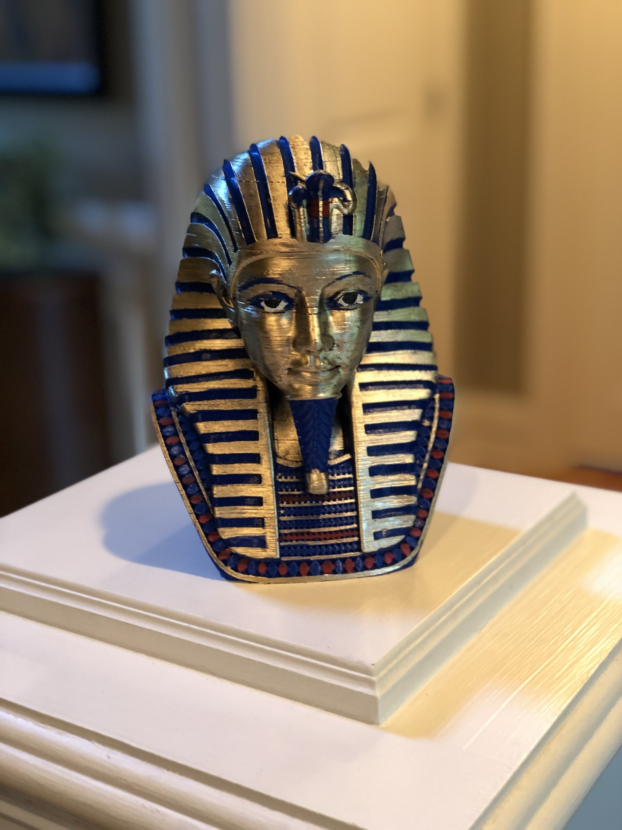
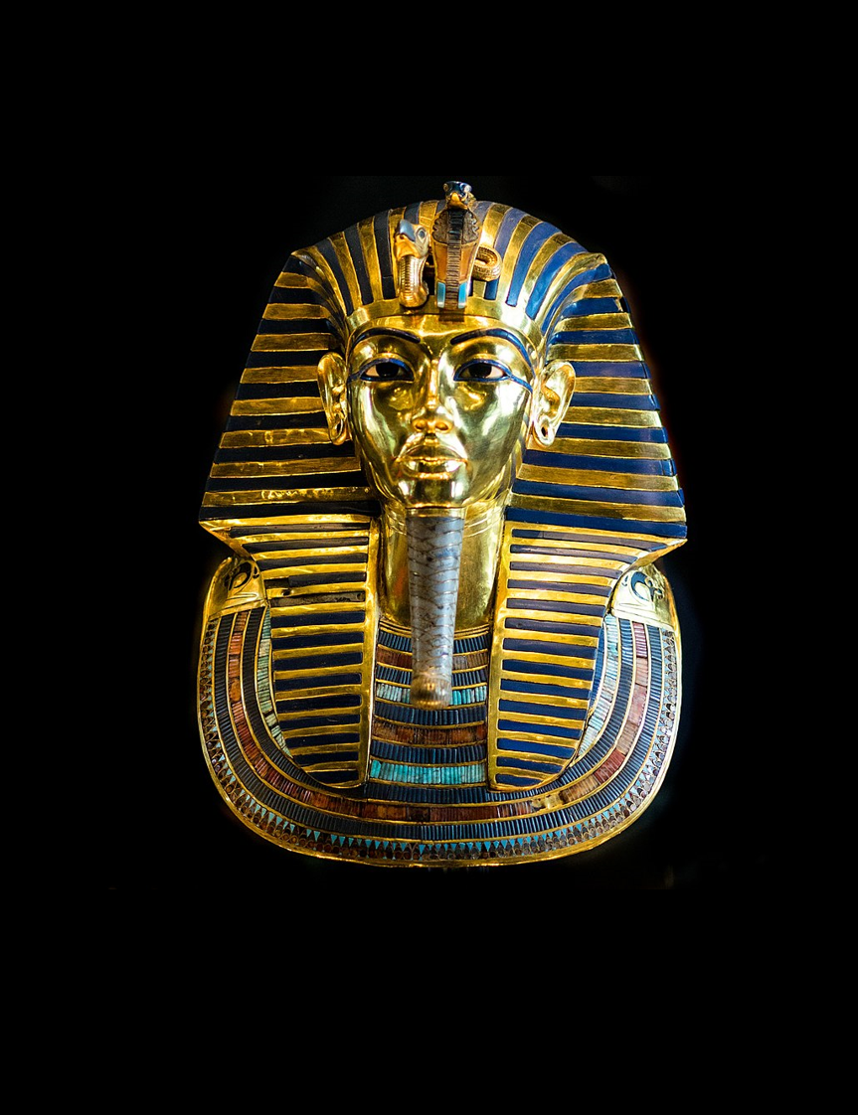
HEBREWS 8
GOD
GOD
THE OATH
HOLY
SPIRIT
GOD
MELCHIZEDEK
PRIEST
AARON
SON
SON
SON
SON
SON
TITHE
BLESSING
TABERNACLE
ABRAHAM
LEVI
LEVI
LEVI
LEVI
MAN
MAN
MAN
MAN
ISAAC
BULL
Earthly
Heavenly
SON
Shadow
True
LAND
NATION
SEED
COVENANT
Man Pitched
Lord pitched
COVENANT
MAN
MAN
MAN
SON
MAN
Copy
Pattern
MAN
MAN

Slide 23
HEBREWS 8
GOD
THE OATH
HOLY
SPIRIT
GOD
Jeremiah 31
AARON
SON
⁷ For if that first covenant had been faultless, there would have been no occasion sought for a second.
⁶But now He has obtained a more excellent ministry, by as much as He is also the mediator of a better covenant, which has been enacted on better promises.
Not like the covenant which I made with their fathers
SON
SON
SON
SON
⁸ For finding fault with them, He says,
“Behold, days are coming, says the Lord, When I will effect a new covenant…
TABERNACLE
(Stone)
Hearts & Minds
LEVI
LEVI
LEVI
MAN
MAN
MAN
MAN
(Broken)
God & People
¹³ When He said, “A new covenant,” He has made the first obsolete. But whatever is becoming obsolete and growing old is ready to disappear.
(Ignorance)
All will know Me
BULL
SON
(No Forgiveness)
Forgiveness of Sin
COVENANT
COVENANT
MAN
MAN
MAN
SON
MAN
MAN
MAN

Slide 24
HEBREWS 9
GOD
THE OATH
HOLY
SPIRIT
GOD
¹¹ But when Christ appeared as a high priest of the good things to come…
SON
AARON
SON
SON
SON
SON
Outer Tabernacle
True Tabernacle
TABERNACLE
Blood of Animals
His Own Blood
LEVI
LEVI
LEVI
MAN
MAN
MAN
MAN
⁸ The Holy Spirit is signifying this, that the way into the holy place has not yet been disclosed while the outer tabernacle is still standing, ⁹ which is a symbol for the present time.
Continually Enter
Once For All
BULL
Cleanse Flesh
Cleanse Conscience
SON
Until time of reformation
Eternal Redemption
COVENANT
COVENANT
MAN
MAN
MAN
¹⁴ …to serve the living God?
SON
MAN
MAN
MAN

Slide 25
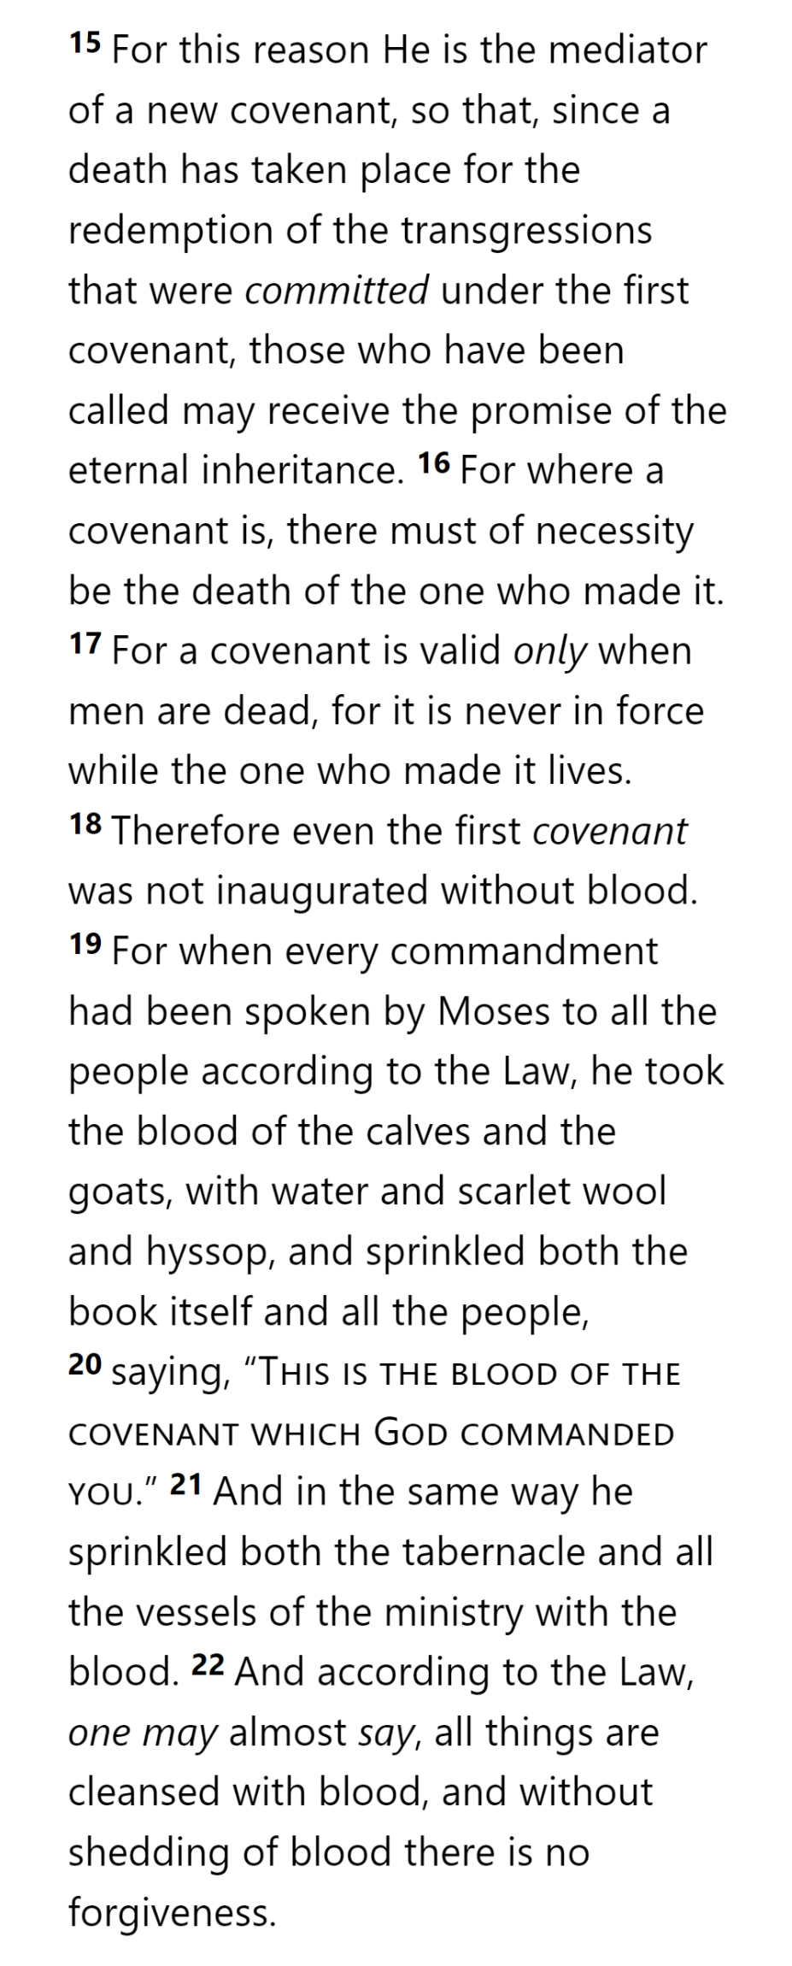
HEBREWS 9
GOD
THE OATH
HOLY
SPIRIT
GOD
AARON
SON
SON
SON
SON
SON
TABERNACLE
LEVI
LEVI
LEVI
MAN
MAN
MAN
MAN
BULL
SON
COVENANT
COVENANT
MAN
MAN
MAN
SON
MAN
MAN
MAN
Hebrews 9

Slide 26
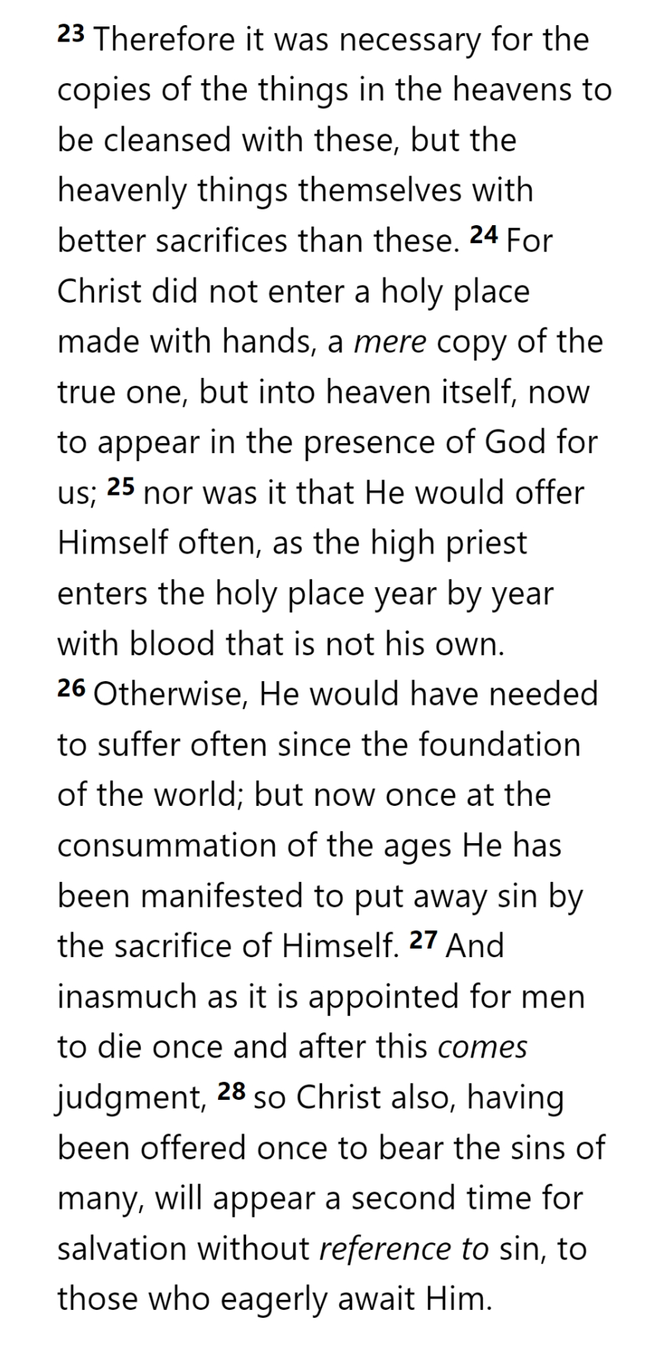
GOD
THE OATH
HOLY
SPIRIT
GOD
AARON
²⁷ And when He had taken a cup and given thanks, He gave it to them, saying, “Drink from it, all of you; ²⁸ for this is My blood of the covenant, which is poured out for many for forgiveness of sins.
SON
SON
SON
SON
SON
TABERNACLE
LEVI
LEVI
LEVI
MAN
MAN
MAN
MAN
BULL
SON
COVENANT
COVENANT
MAN
MAN
MAN
SON
MAN
MAN
MAN
Hebrews 9

Slide 27
GOD
THE OATH
HOLY
SPIRIT
GOD
AARON
SON
SON
SON
SON
SON
TABERNACLE
LEVI
LEVI
LEVI
MAN
MAN
MAN
MAN
BULL
SON
COVENANT
COVENANT
MAN
MAN
MAN
SON
MAN
MAN
MAN
Hebrews 9

Slide 28
GOD
THE OATH
HOLY
SPIRIT
GOD
AARON
SON
SON
SON
SON
SON
TABERNACLE
LEVI
LEVI
LEVI
MAN
MAN
MAN
MAN
BULL
SON
COVENANT
COVENANT
MAN
MAN
MAN
SON
MAN
MAN
MAN
Hebrews 9

Slide 29
GOD
THE OATH
HOLY
SPIRIT
GOD
AARON
SON
SON
SON
SON
SON
TABERNACLE
LEVI
LEVI
LEVI
MAN
MAN
MAN
MAN
BULL
SON
COVENANT
COVENANT
MAN
MAN
MAN
SON
MAN
MAN
MAN
Hebrews 9

Slide 30
GOD
THE OATH
HOLY
SPIRIT
GOD
AARON
SON
SON
SON
SON
SON
TABERNACLE
LEVI
LEVI
LEVI
MAN
MAN
MAN
MAN
BULL
SON
COVENANT
COVENANT
MAN
MAN
MAN
SON
MAN
MAN
MAN
Hebrews 9

Slide 31
GOD
THE OATH
HOLY
SPIRIT
GOD
AARON
SON
SON
SON
SON
SON
TABERNACLE
LEVI
LEVI
LEVI
MAN
MAN
MAN
MAN
BULL
SON
COVENANT
COVENANT
MAN
MAN
MAN
SON
MAN
MAN
MAN
Hebrews 10

Slide 32
GOD
THE OATH
HOLY
SPIRIT
GOD
AARON
SON
SON
SON
SON
SON
TABERNACLE
LEVI
LEVI
LEVI
MAN
MAN
MAN
MAN
BULL
SON
COVENANT
COVENANT
MAN
MAN
MAN
SON
MAN
MAN
MAN
Hebrews 10

Slide 33
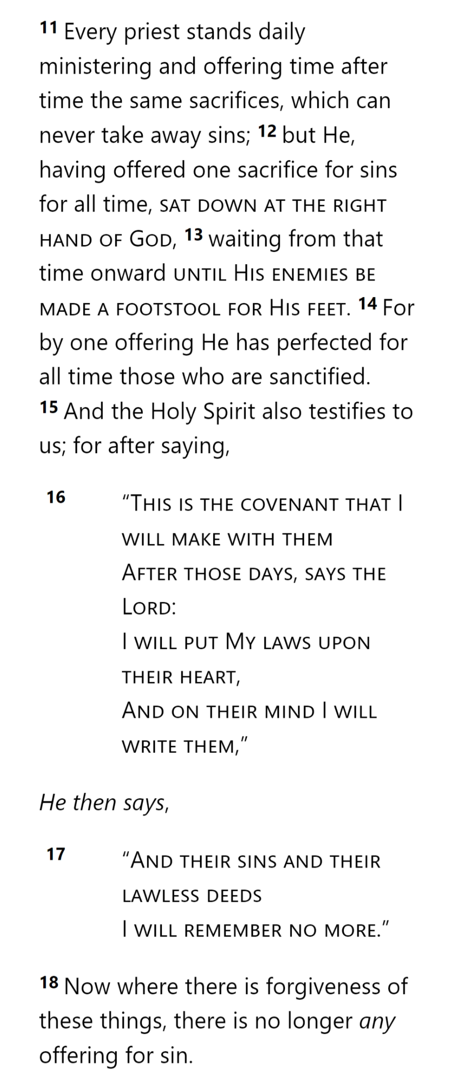
GOD
THE OATH
HOLY
SPIRIT
GOD
¹⁷ “Do not think that I came to abolish the Law or the Prophets; I did not come to abolish but to fulfill. ¹⁸ For truly I say to you, until heaven and earth pass away, not the smallest letter or stroke shall pass from the Law until all is accomplished.
AARON
SON
SON
SON
SON
SON
TABERNACLE
LEVI
LEVI
LEVI
MAN
MAN
MAN
MAN
BULL
SON
COVENANT
COVENANT
MAN
MAN
MAN
SON
MAN
MAN
MAN
Hebrews 10

Slide 34
GOD
THE OATH
HOLY
SPIRIT
GOD
AARON
SON
SON
SON
SON
SON
TABERNACLE
LEVI
LEVI
LEVI
MAN
MAN
MAN
MAN
BULL
SON
COVENANT
COVENANT
MAN
MAN
MAN
SON
MAN
MAN
MAN
Hebrews 10

Slide 35
GOD
THE OATH
HOLY
SPIRIT
GOD
AARON
SON
SON
SON
SON
SON
TABERNACLE
LEVI
LEVI
LEVI
MAN
MAN
MAN
MAN
BULL
SON
COVENANT
COVENANT
MAN
MAN
MAN
SON
MAN
MAN
MAN
Hebrews 10

Slide 36
GOD
THE OATH
HOLY
SPIRIT
GOD
AARON
SON
SON
SON
SON
SON
TABERNACLE
LEVI
LEVI
LEVI
MAN
MAN
MAN
MAN
BULL
SON
COVENANT
Jeremiah 31
COVENANT
MAN
MAN
MAN
SON
MAN
MAN
MAN
Hebrews 10

Slide 37
GOD
THE OATH
HOLY
SPIRIT
GOD
AARON
SON
SON
SON
SON
SON
TABERNACLE
LEVI
LEVI
LEVI
MAN
MAN
MAN
MAN
BULL
SON
COVENANT
COVENANT
MAN
MAN
MAN
SON
MAN
MAN
MAN
Hebrews 10

Slide 38
Hebrews

