Slide 2
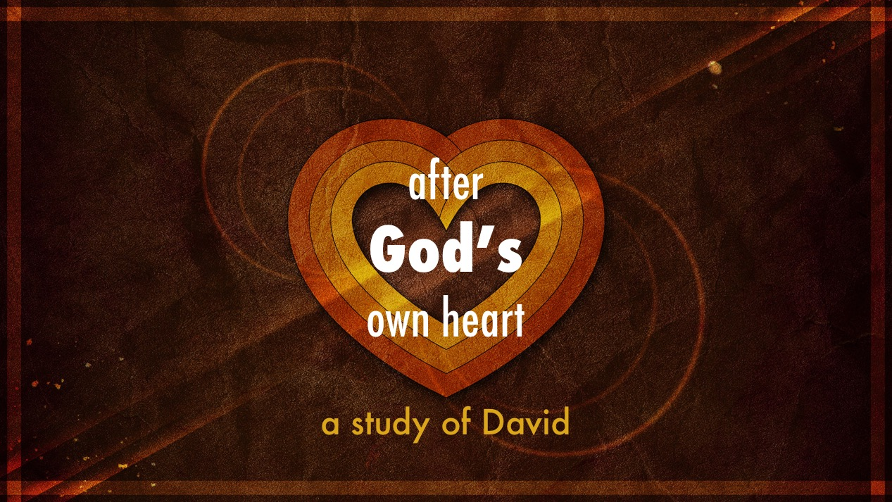

Slide 3
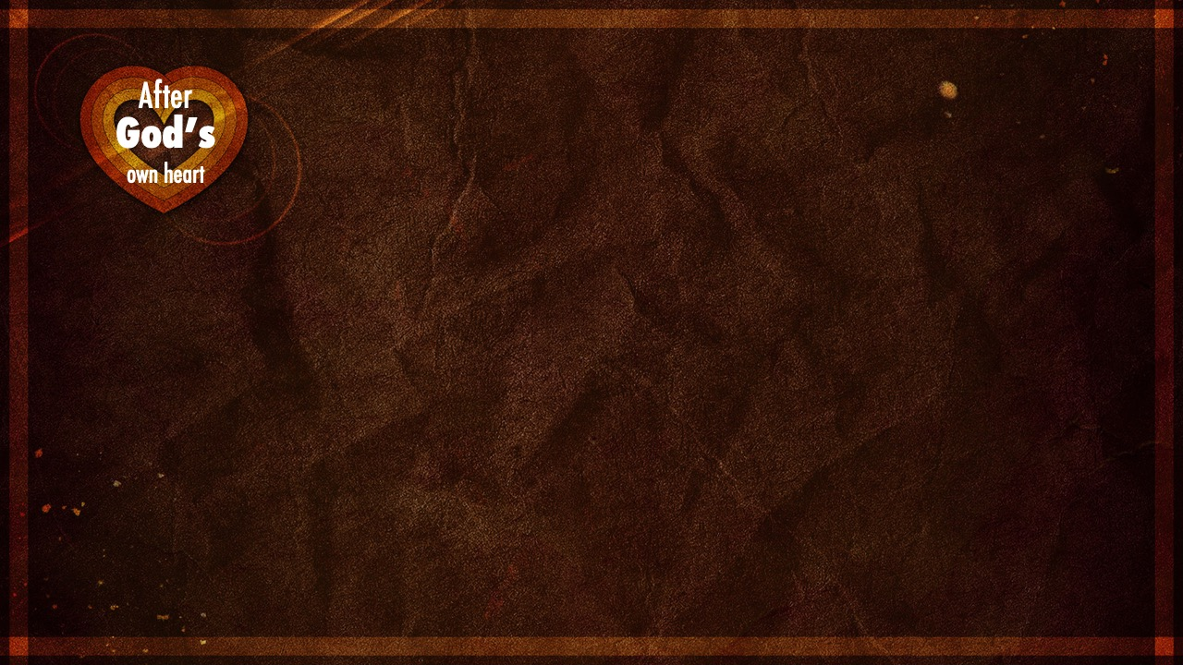
Absalom: A Look At
How We Rebel

Slide 6
Absalom: A Look At
How We Rebel
We fail to see others as brothers (13.20)
We become frustrated with God (13.21-22)
We choose to do our own will (13.24-29)
We rebel outright (chapters 15-16)

Slide 7
David: A Picture Of
God’s Love For Sinners

Slide 9
David: A Picture Of
God’s Love For Sinners
His heart longs for us even though we have banished ourselves (2Samuel 13.39)
Only He can bring the banished back…
and He will! (2Samuel 14.14)
Even though we are in open rebellion, He would deal gently with us (2Samuel 18.5)

Slide 10
David: A Picture Of
God’s Love For Sinners
He hopes for our return
(2Samuel 18.24; Luke 15.20)
He would die for our sake
(2Samuel 18.33; Romans 5.6-8)

