Slide 2
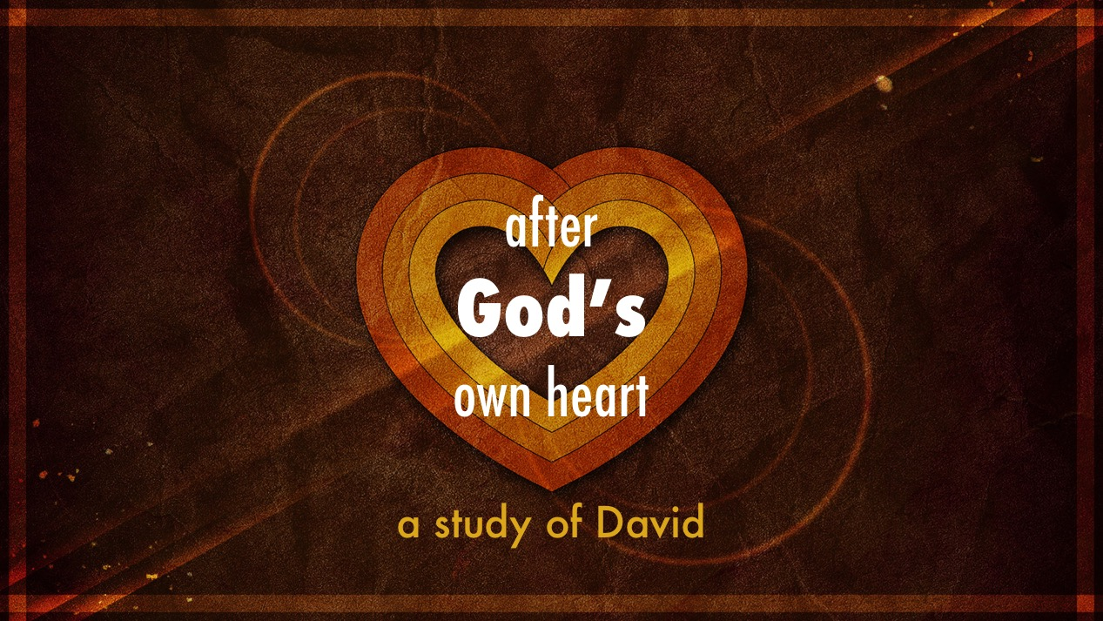

Slide 3

How David Fell…
David set himself up to fall (11.1)

Slide 5
How David Fell…
David set himself up to fall (11.1)
David allowed his lust to conceive (11.2-4)
David’s sin became more precious to him than anything else (11.5-27)
David retained a sense of justice, but he was blind to his own flaws (12.1-6)

Slide 6
David Made Correction…
By understanding that every sin is against God (12.7-15)
By believing in God’s mercy
(12.15-23; Psalm 32.1-7)
By committing himself to real change
(Psalm 32.8-11; Psalm 51)

