Slide 1
Warm up - MATCH
“Those that can swim, jump overboard first”
“In a short time would you persuade me to be a Christian?”
“I came upon them with the soldiers and rescued him, having learned that he was a Roman citizen.”
“Go away for the present. When I get an opportunity I will summon you.”
“Paul, you are out of your mind; your great learning is driving you out of your mind.”
Claudius Lysias
Felix
Festus
Agrippa
Julius

Slide 2
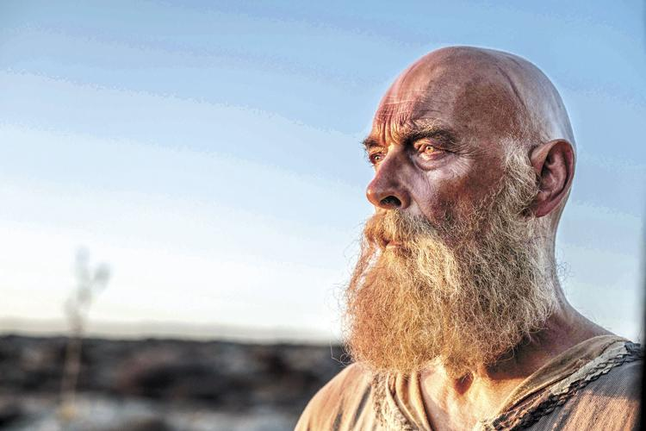
Life and epistles of Paul, “The very least of all the saints”
James Faulkner
in Paul the Apostle, 2018
Embry Hills
Feb – Apr 2024
Journey to Rome; Prison Epistles

Slide 3
Course calendar
L | Date | Subject | Texts | Dates
1 | 25-Feb-24 | Background, youth and persecution | Acts 7-8 | 0 – 33
2 | 28-Feb-24 | Conversion until Antioch | Acts 9-11,22,26; Gal. 1-2 | 33 – 46
3 | 3-Mar-24 | 1st preaching tour; controversy over Gentile converts | Acts 13:1 – 15:35; Gal. 4-6 | 47 – 49
4 | 6-Mar-24 | 1st preaching tour; controversy over Gentile converts | Acts 13:1 – 15:35; Gal. 4-6 | 47 – 49
5 | 10-Mar-24 | 2nd preaching tour; epistles from 2nd tour | Acts 15:36 – 18:22; 1&2 Thess. | 50 – 54
6 | 13-Mar-24 | 2nd preaching tour; epistles from 2nd tour | Acts 15:36 – 18:22; 1&2 Thess. | 50 – 54
7 | 17-Mar-24 | 3rd preaching tour; epistles from 3rd tour | Acts 18:23 – 20:38; Romans, 1&2 Cor. | 54 – 58
 | 20-Mar-24 | (No class)
8 | 24-Mar-24 | 3rd preaching tour; epistles from 3rd tour | Acts 18:23 – 20:38; Romans, 1&2 Cor. | 54 – 58
9 | 27-Mar-24 | Imprisonment in Caesarea | Acts 21-26 | 58 – 59
10 | 31-Mar-24 | Journey to Rome; prison epistles | Acts 27-28; Eph., Phi., Col., Phlm. | 60 – 61
11 | 3-Apr-24 | Journey to Rome; prison epistles | Acts 27-28; Eph., Phi., Col., Phlm. | 60 – 61
12 | 7-Apr-24 | Life after Acts; preacher epistles | 1&2 Timothy, Titus | 62 – 68
13 | 10-Apr-24 | Overflow and review

Slide 4
Blue Letter Bible
Conybeare & Howson
Stalker
S. Hall
BEE
51
52
53
57
54
54
54
57
57
58
59
59
61
63
63-66
67
49
51
52
51
53
53
53
54
56
57
57
59
60
62
63
66
51
52
53
57
54 spri
54 su
54 fall
57
57
58
59
60
61
62
63
63-66
68
50
51
51
51
53
54
54
57
57
58
59
61-62
62
62-67
63
67-69
68
50
51
52
?
53
53
54
55
56
57
57
57
59
60
61-62
63
63-67
63
67-68
68
2nd journey starts
1 Thessalonians. At Corinth
2 Thessalonians. At Corinth
Galatians?
Leave Corinth
Jerusalem at Pentecost (?)
Starts 3rd journey
1 Corinthians. At Ephesus
2 Corinthians. At Macedonia
Romans. At Corinth
Lands at Caesarea and goes to Jerusalem
Felix
Festus
Arrives in Rome. Imprisoned. Philmn, Col, Eph, Phi. At Rome
Released from Roman imprisonment
Further missionary work (Macedonia, Asia, Spain?)
1 Timothy, from Macedonia. Titus, from Ephesus. 2nd imprisonment and martyrdom under Nero
2 Timothy, from Rome

Slide 5
APPROX. TIMELINE – PAUL’S LIFE
Tarsus, Gamaliel, zealous, persecutor
Damascus/Arabia (3 years),
Visit to Jerusalem,
Syria/Cilicia,
Antioch (1 year)
1st preach. trip
2nd preach. trip
3rd preach. trip
Prison in Caes.
Prison in Rome
30
40
50
60
70 AD
Cross
Romans
Galatians?
1st visit to Jerusalem
2nd visit to Jerusalem
1 & 2 Corinthians
Eph, Php, Col, Phm
Stephen
Peter visits Antioch
Jerus. conference
1 & 2 Thessalonians

Slide 6
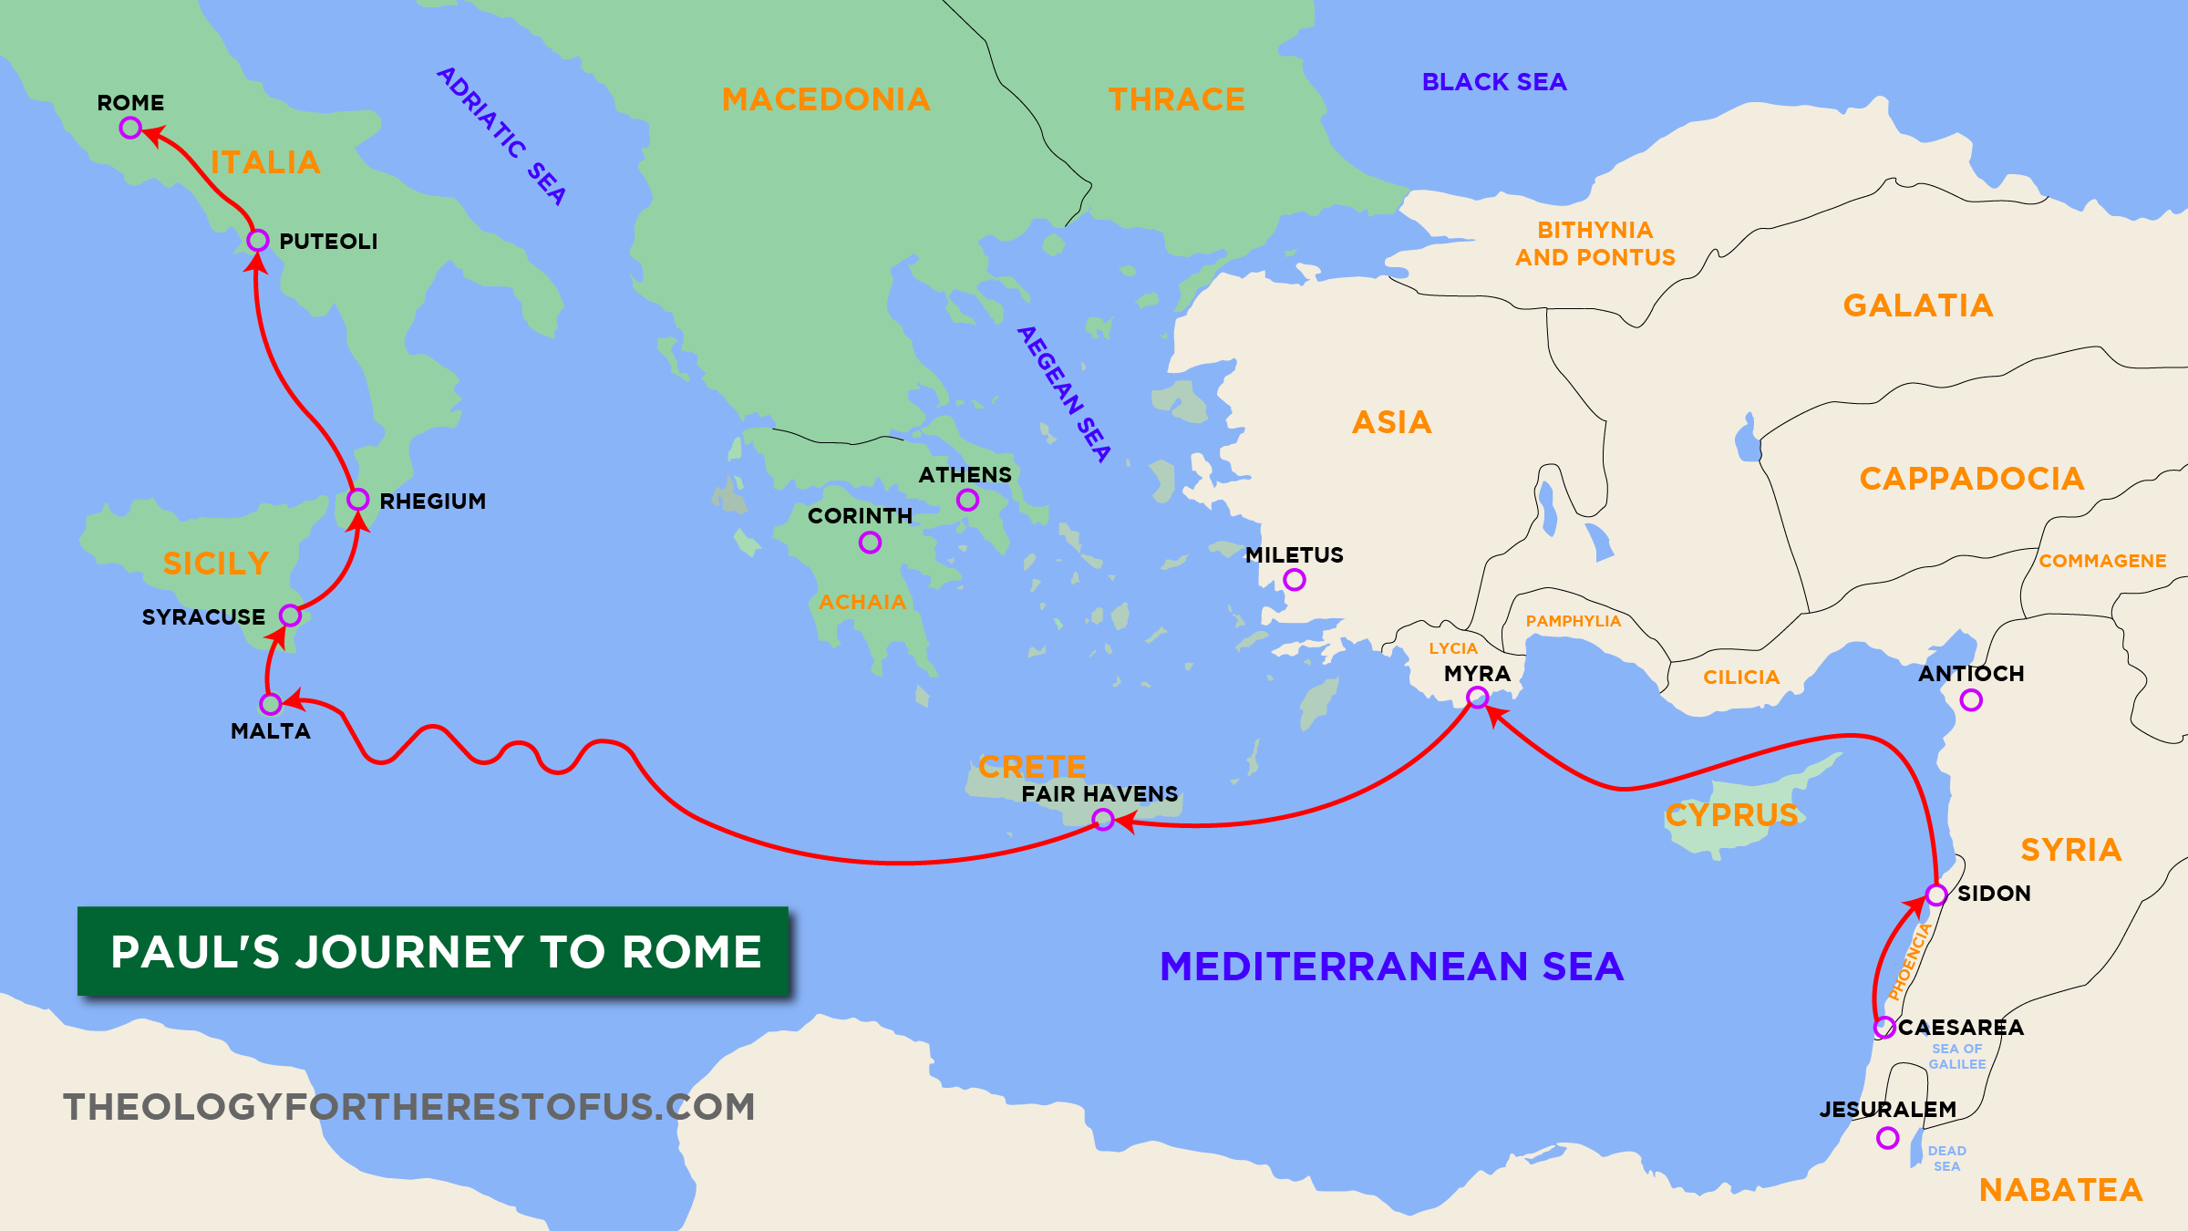

Slide 7
Who is it? – Col 1:24; Phi. 3:10
Three years of ministry
Fulfilled the task God gave him, declared God’s word, humbly served
Innocent, 20:26
Plots of Jews, Acts 20:19
Movement to Jerusalem
On a mission of mercy and generosity
Knowing that there will be persecution and arrest, 20:22-23
In Caesarea, well-meaning disciples, hearing the warning, attempt to stop him from going, 21:12
Determined to do the will of God, Acts 20:24; 21:14
Preparing disciples for departure
Intimate time with the brethren before suffering
Controversy in the temple, 21:27
Arrest – laid hands on him, 21:27
Jewish mob crying for his demise.
Delivered to the Gentiles (Acts 21:11 with Luke 9:44), false charges having to do with temple, 24:13
Trials – multiple, before both Jews, Gentiles (Roman governor) and King Herod
The High priest and council is involved; the HP is prejudiced from beginning
Striking him before any conviction, in violation of the law
Serious but unprovable accusations, 25:7
Gentiles delay tactics (24:22), passing him on because they recognize that he is innocent
But in the end they punish him because they wish to do the Jews a favor, 24:27; 25:9
Do we have the same mindset towards suffering?

Slide 8
OBEYABLE ACTS - PAUL
Evangelistic goals: Monday: hand card for church to all clients
Mentoring goals: Tuesday: Take each child for a walk and discuss a proverb
Teaching goals: Wednesday: Prepare for teaching this class
Prayer goals: Thursday: Skip lunch and use the time to pray for those on bulletin
Brotherly love goals: Friday: Call someone on bulletin while driving
Holiness goals: Saturday: Fast from “me time”
Knowledge goals: Sunday: Take detailed notes on all three sermons/classes

Slide 9
GROUP DISCUSSION
Tell us a little about yourself
Tell the story of what happened with Paul from your perspective
Did you make any religious changes as a result of this experience? Why or why not?
CLAUDIUS LYSIAS
Acts 22:22 – 23:31
FESTUS
Acts 25:1 – 26:32
JULIUS
Acts 27:1 – 28:16
FELIX
Acts 23:32 – 24:27
AGRIPPA
Acts 25:13 – 26:32
ANANIAS THE HIGH PRIEST
Shows up in 23, 24, maybe 25?

Slide 10
“You must testify also in rome” – Acts 23:11
ACTS 21
Arrival in Jerusalem
Paul – temple purification rite and pays expenses for 4 men under vow. PURPOSE: To prove that he does not teach Jews to forsake Moses and that he himself lives in observance of the law (20-25)
Jews from Asia seize him for, ironically, teaching “against the people and the law and this place” (28; cf. 6:13)
Mob – about to be killed (23:27) – tribune (Claudius Lysias) confused – allows to address crowd from steps
Acts 22
Defense – I am one of you. Here’s why I changed. Jesus’ order to go to Gentiles
Revelation of Roman citizenship

Slide 11
“You must testify also in rome” – Acts 23:11
Acts 23
Investigative trial before Council. Paul allowed 1 sentence defense. Barely makes it out
Jesus – encouraging promise
Plot by 40 Jews – Lysias sends him to Caesarea with heavy escort and letter to Felix (governor)
ACTS 24
High priest and elders – demonstrating importance
Roman prosecutor (Tertullus): plague, stirs up riots throughout world (17:6), ringleader of sect, tried to profane temple
Paul – Jerusalem to bring alms, temple to worship, no disputing or stirring crowds, cannot prove accusations (witnesses?). But I am a Christian, but only so because I believe what they claim to believe (same God, Scripture, and hope). Also has been previous trial.
Felix – has heard about Christianity. Delay tactic. Kindness. Private interview. Fear at message. Hoping for bribe. Hears him often. “The present” turns to 2 years. Leaves Paul in prison as favor to Jews.

Slide 12
“You must testify also in rome” – Acts 23:11
Acts 25
Two years have not abated Jewish intent to kill. Recognize it is unjust – will not achieve ends in legitimate trial.
Festus, new governor, knows truth (25), confused (20), yet wants to do Jews favor. Paul knows what will happen if he has to go to Jerusalem. Appeals to Caesar.
Matter of curiosity to visiting Agrippa (22)
ACTS 26
Agrippa knows Jews – v. 3 – and believes prophets 26:27
Resurrection flabbergasts Festus, though Paul’s learning evident. But v. 8.
Agrippa practically on trial. Evasive.
Innocence evident – 31-32. Agrippa’s implied condemnation of Festus.

Slide 13
Warm UP
How are Paul’s letters ordered in the NT?
a. Alphabetical
b. Chronological
c. Place of writing
d. Size
e. Audience
f. Something else

Slide 14
Life and epistles of Paul, “The very least of all the saints”
James Faulkner
in Paul the Apostle, 2018
Embry Hills
Feb – Apr 2024
Journey to Rome; Prison Epistles

Slide 15
Course calendar
L | Date | Subject | Texts | Dates
1 | 25-Feb-24 | Background, youth and persecution | Acts 7-8 | 0 – 33
2 | 28-Feb-24 | Conversion until Antioch | Acts 9-11,22,26; Gal. 1-2 | 33 – 46
3 | 3-Mar-24 | 1st preaching tour; controversy over Gentile converts | Acts 13:1 – 15:35; Gal. 4-6 | 47 – 49
4 | 6-Mar-24 | 1st preaching tour; controversy over Gentile converts | Acts 13:1 – 15:35; Gal. 4-6 | 47 – 49
5 | 10-Mar-24 | 2nd preaching tour; epistles from 2nd tour | Acts 15:36 – 18:22; 1&2 Thess. | 50 – 54
6 | 13-Mar-24 | 2nd preaching tour; epistles from 2nd tour | Acts 15:36 – 18:22; 1&2 Thess. | 50 – 54
7 | 17-Mar-24 | 3rd preaching tour; epistles from 3rd tour | Acts 18:23 – 20:38; Romans, 1&2 Cor. | 54 – 58
 | 20-Mar-24 | (No class)
8 | 24-Mar-24 | 3rd preaching tour; epistles from 3rd tour | Acts 18:23 – 20:38; Romans, 1&2 Cor. | 54 – 58
9 | 27-Mar-24 | Imprisonment in Caesarea | Acts 21-26 | 58 – 59
10 | 31-Mar-24 | Journey to Rome; prison epistles | Acts 27-28; Eph., Phi., Col., Phlm. | 60 – 61
11 | 3-Apr-24 | Journey to Rome; prison epistles | Acts 27-28; Eph., Phi., Col., Phlm. | 60 – 61
12 | 7-Apr-24 | Life after Acts; preacher epistles | 1&2 Timothy, Titus | 62 – 68
13 | 10-Apr-24 | Overflow and review

Slide 16
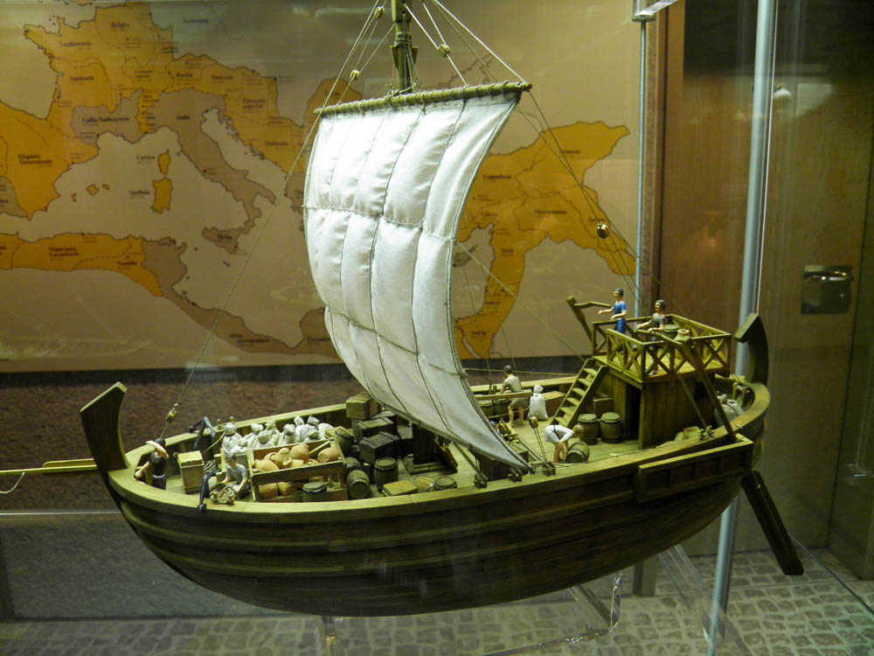
“You must testify also in rome” – Acts 23:11
ACTS 27-28
Paul’s advice ignored. Bad storm.

Slide 17
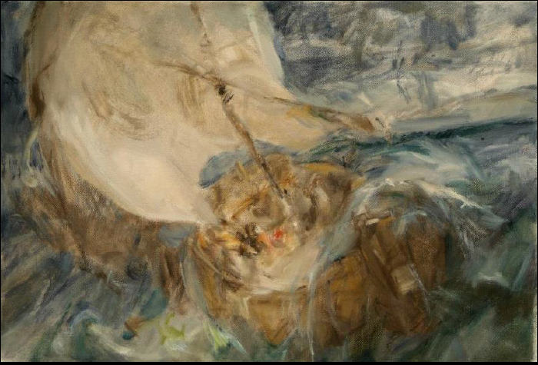
Acts 27:18 Since we were violently storm-tossed, they began the next day to jettison the cargo. 19 And on the third day they threw the ship's tackle overboard with their own hands. 20 When neither sun nor stars appeared for many days, and no small tempest lay on us, all hope of our being saved was at last abandoned. 21 Since they had been without food for a long time…29 And fearing that we might run on the rocks…
Psalm 107:23 Some went down to the sea in ships, doing business on the great waters; 24 they saw the deeds of the LORD, his wondrous works in the deep. 25 For he commanded and raised the stormy wind, which lifted up the waves of the sea. 26 They mounted up to heaven; they went down to the depths; their courage melted away in their evil plight; 27 they reeled and staggered like drunken men and were at their wits' end. 28 Then they cried to the LORD in their trouble…
Luk 8:23 ... And a windstorm came down on the lake, and they were filling with water and were in danger. 24 And they went and woke him, saying, “Master, Master, we are perishing!” And he awoke and rebuked the wind and the raging waves, and they ceased, and there was a calm. 25 He said to them, “Where is your faith?” And they were afraid, and they marveled, saying to one another, “Who then is this, that he commands even winds and water, and they obey him?”
…and he delivered them from their distress. 29 He made the storm be still, and the waves of the sea were hushed. 30 Then they were glad that the waters were quiet, and he brought them to their desired haven. 31 Let them thank the LORD for his steadfast love, for his wondrous works to the children of man!

Slide 18
“You must testify also in rome” – Acts 23:11
ACTS 27-28
Paul’s advice ignored. Bad storm.
Paul’s vision.

Slide 19
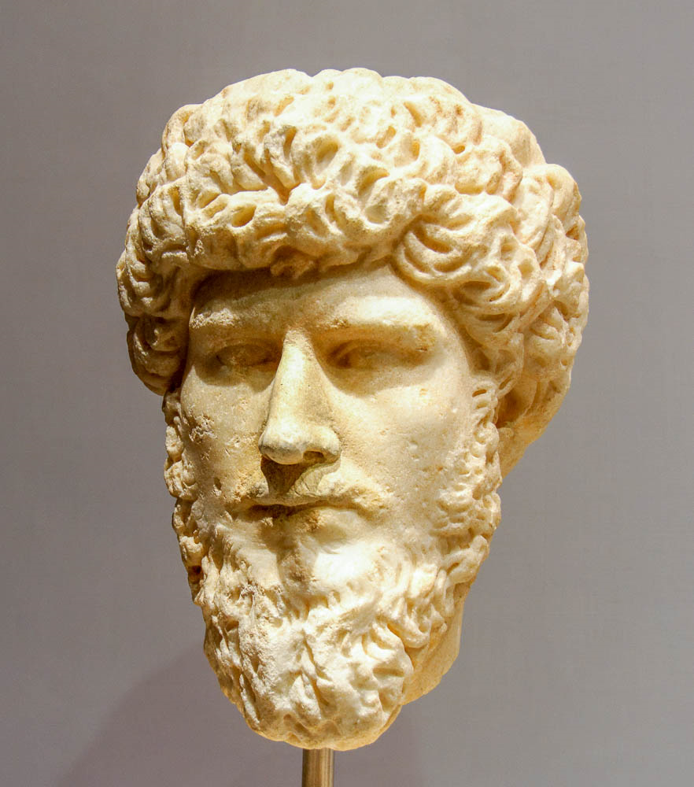
“…for not a hair is to perish from the head of any of you.” Act 27:34

Slide 20
“You must testify also in rome” – Acts 23:11
ACTS 27-28
Paul’s advice ignored. Bad storm.
Paul’s vision.
Shipwreck.
On Malta: miracles.
Brethren on way to Rome. “Thank God and took courage”

Slide 21
ROME
PAUL’S DESIRE
Acts 19:21
Rom. 1:11-15
Rom. 15:22-24
JESUS’ PROMISE
Acts 23:11
Acts 27:24
ARRIVAL
Brethren - Acts 28:14-15
Jews – Acts 28:23-28
Gentiles and all – Acts 28:31; Phi. 1:12ff; 4:22

Slide 22
PRISON EPISTLES

Slide 23
PRISON EPISTLES
Eph 3:1 For this reason I, Paul, a prisoner of Christ Jesus on behalf of you Gentiles …4:1 I therefore, a prisoner for the Lord, urge you to walk in a manner worthy of the calling … 6:18 praying at all times…making supplication for all the saints, 19 and also for me, that words may be given to me in opening my mouth boldly to proclaim the mystery of the gospel, 20 for which I am an ambassador in chains, that I may declare it boldly, as I ought to speak.
Php 1:7 …I hold you in my heart, for you are all partakers with me of grace, both in my imprisonment and in the defense and confirmation of the gospel….1:12 I want you to know, brothers, that what has happened to me has really served to advance the gospel, 13 so that it has become known throughout the whole imperial guard and to all the rest that my imprisonment is for Christ. 14 And most of the brothers, having become confident in the Lord by my imprisonment, are much more bold to speak the word without fear.
Col 4:3 At the same time, pray also for us, that God may open to us a door for the word, to declare the mystery of Christ, on account of which I am in prison— 4 that I may make it clear, which is how I ought to speak…4:18 I, Paul, write this greeting with my own hand. Remember my chains. Grace be with you.
Phm 1:1 Paul, a prisoner for Christ Jesus, and Timothy our brother, To Philemon …1:9 yet for love's sake I prefer to appeal to you—I, Paul, an old man and now a prisoner also for Christ Jesus— 10 I appeal to you for my child, Onesimus, whose father I became in my imprisonment.

Slide 24
HOW WAS PAUL DOING?
Joyful (Phi. 1:4 and a dozen other places in Philippians)
What was Paul missing?
What were the keys to his joy? (4:4-9)
What was Paul doing?
Praying (Eph. 1:16; Col 1:9; Phil. 1:4; Phm. 1:4)
Preaching (Acts 28:31; Phi. 1:13; Phm. 1:10)
Writing
Receiving visitors (Acts 28:30; Tychicus, Onesimus, Epaphroditus, etc.)
Fellowship. Note that he had “fellow prisoners” (Aristarchus, Col 4:10; Epaphras; Ph, 1:23), so he was not alone

Slide 25
EPHESIANS AS A PRISON EPISTLE
The tone is remarkable – he is joyful, “giving thanks always and for everything” (5:20)
“Grace to you and peace” 1:2
“Blessed be the God and Father of our Lord…” 1:3ff
“Having the eyes of your hearts enlightened…” 1:15ff
God’s great might (1:19-20), Christ’s exalted position (1:21-23), our new life and true status (ch. 2)
He interprets his imprisonment in relation to his charge to preach to Gentiles
“A prisoner for Christ Jesus on behalf of you Gentiles” (3:1)… “So I ask you not to lose heart over what I am suffering for you, which is for your glory” (3:13).
When he places himself in the grander scheme of God (and true spiritual realities, cf. 5:12), his sufferings lose their power to dishearten. Asks this same perspective for them (3:14-20)
His imprisonment strengthens the exhortation (4:1)
Practically, helps in urging submission (5:22-6:9), preparation for spiritual warfare and boldness (6:10-20)

Slide 26
Colossians AS A PRISON EPISTLE
How he understands his suffering (1:24-29) (cf. Acts 28:20)
“for your sake…for the sake of [Christ’s] body”
“filling up what is lacking in Christ’s afflictions”
“For this I toil, struggling with all his energy that he powerfully works within me”
How he uses his suffering (2:1ff)
“I want you to know how great a struggle I have for you and for those at Laodicea and for all who have not seen me face to face, that their hearts may be encouraged…to reach all the…understanding and the knowledge of God’s mystery, which is Christ…”
“I say this in order that no one may delude you…”
“See to it that no one takes you captive by philosophy and empty deceit…” (2:8)
“He disarmed the rulers and authorities” (2:15)
“Remember my chains” (4:18)
Prayer: open doors, clear speech (4:2-4)

Slide 27
EpHESIANS AND COLOSSIANS - SIMILARITIES

Slide 28
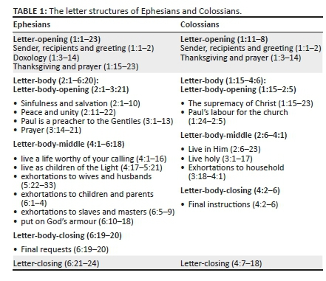
EpHESIANS AND COLOSSIANS - SIMILARITIES

Slide 29
EpHESIANS AND COLOSSIANS - SIMILARITIES

Slide 30
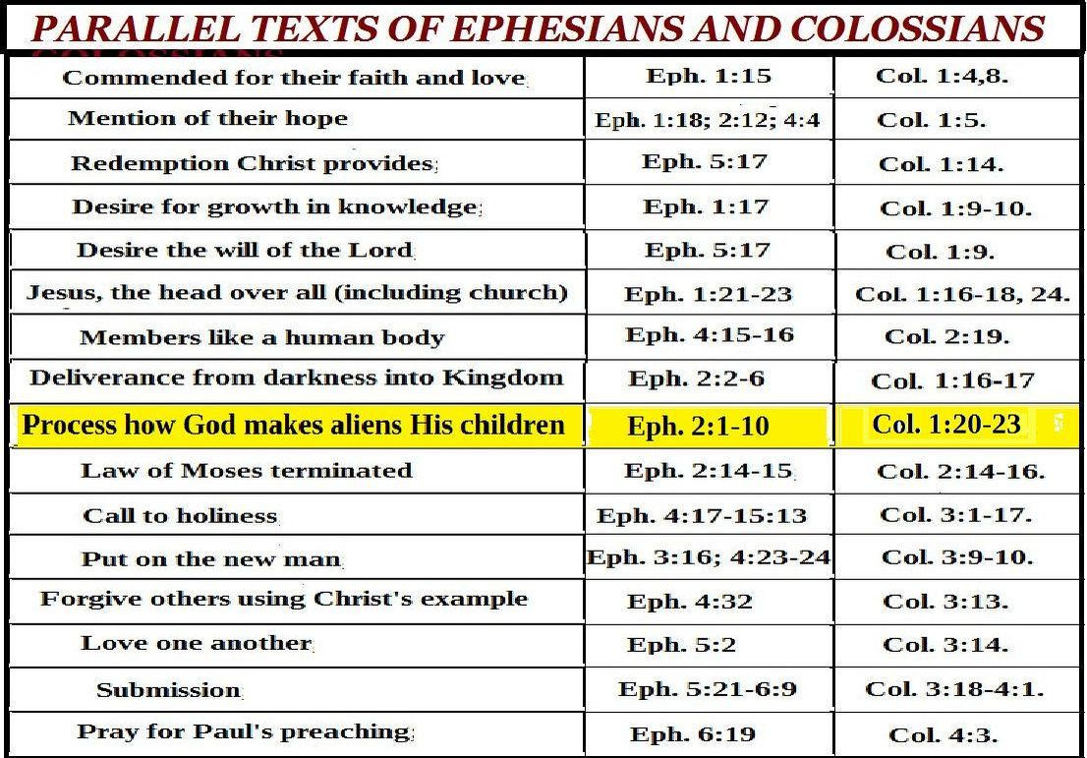
EpHESIANS AND COLOSSIANS - SIMILARITIES

Slide 31
EpHESIANS AND COLOSSIANS - DIFFERENCES

Slide 32
EpHESIANS AND COLOSSIANS - DIFFERENCES
Why? (Col 4:16)
Sources? (Col 4:9, 12 with Philemon 10, 23)

Slide 33
EpHESIANS AND COLOSSIANS - DIFFERENCES

Slide 34
Philemon
3 outstanding debts
Onesimus / owed Philemon what he stole, his life; needed to return for punishment
Paul / owed Philemon the value of each day’s lost work; charge it my account
Philemon / owed Paul his new life in Christ (19); needed to welcome Onesimus as a brother; even better: free him, return him to me (?)
Mat 6:12 – key to daily decisions

Slide 36
Have this mind among yourselves
Jesus
// Paul
// Timothy
// Epaphroditus
// Others
// Phillippians
// Us

Slide 37
 | Christ as… | Focus | Explanation
Ephesians | Head | Unity of Christ | Christ breaks down barriers between believers
Philippians | Example | Attitude of Christ | Christ models how to handle difficulty with humility
Colossians | God | Deity of Christ | Christ is superior to human philosophies
Philemon | Reconciler | Forgiveness of Christ | Christ reconciles believers to God and one another

Slide 38
PAUL / verses to remember
Verse that says where Paul’s story begins
The great lesson of Paul’s life
First description of Paul/ contrast with verse of how Paul viewed himself
Jesus’ summary of how Paul spent his youth
Summary of Paul’s message to Jews
Summary of Paul’s message to Gentiles
Acts 7:51-53; Fil 3:4-6
Acts 26:14
Acts 17:22-31
1 Tim. 1:16
Gal 1:15
Acts 13:13-41

Slide 39
Warm up
4 examples of humility in Phi. 2
4 descriptions of our “walk” in the Lord in Eph. 4-5
4 false doctrines Paul had to combat in Col. 2
3 debts in Philemon
4+ exhortations to Timothy as an evangelist in 1 Tim. 4
3+ metaphors for evangelists in 2 Tim. 2
5 groups of people addressed in Titus 2

Slide 40
Long term project

