Slide 1
Acts 13:1-3 (NASB95) 1 Now there were at Antioch, in the church that was there, prophets and teachers: Barnabas, and Simeon who was called Niger, and Lucius of Cyrene, and Manaen who had been brought up with Herod the tetrarch, and Saul. 2 While they were ministering to the Lord and fasting, the Holy Spirit said, “Set apart for Me Barnabas and Saul for the work to which I have called them.” 3 Then, when they had fasted and prayed and laid their hands on them, they sent them away.

Slide 2
Acts 14:21-24 (NASB95) 21 After they had preached the gospel to that city and had made many disciples, they returned to Lystra and to Iconium and to Antioch, 22 strengthening the souls of the disciples, encouraging them to continue in the faith, and saying, “Through many tribulations we must enter the kingdom of God.” 23 When they had appointed elders for them in every church, having prayed with fasting, they commended them to the Lord in whom they had believed. 24 They passed through Pisidia and came into Pamphylia.

Slide 3
Acts 14:25-28 (NASB95) 25 When they had spoken the word in Perga, they went down to Attalia. 26 From there they sailed to Antioch, from which they had been commended to the grace of God for the work that they had accomplished. 27 When they had arrived and gathered the church together, they began to report all things that God had done with them and how He had opened a door of faith to the Gentiles. 28 And they spent a long time with the disciples.

Slide 4
Romans 15:28-30 (NASB95) …I will go on by way of you to Spain. 29 I know that when I come to you, I will come in the fullness of the blessing of Christ. 30 Now I urge you, brethren, by our Lord Jesus Christ and by the love of the Spirit, to strive together with me in your prayers to God for me.

Slide 5
Encouragement from the saints in Spain

Slide 6
Spain and God
Though not huge in size, Spain is home to over 47 million people.
For comparison it contains about the same land area as GA, AL, TN, and NC but those states have a combined population of ~ 34 million people.

Slide 7
Spain and God
Though the country is predominantly “Catholic,” that’s more by culture than it is by belief. Even 2/3 of the self-professing Catholics practice an “a la carte brand of Catholicism.”
The lack of without any actual biblical answers to questions/concerns has created an irreverence of God and the spiritual realm.
The native Spaniards are increasingly irreligious, but with the high number of Latin Americans moving to Spain, it’s creating evangelistic opportunities.
We visited with 5 different churches and met another via Zoom.
Overall, the saints in Spain mention about 10 churches in the country most having between 10 and 30 members.
Most of the churches do not have a full-time evangelist (one did) and none of the churches that we visited had elders.
Most of the churches are young churches (less than 10 years old), but strongly desire to biblically serve God.

Slide 8
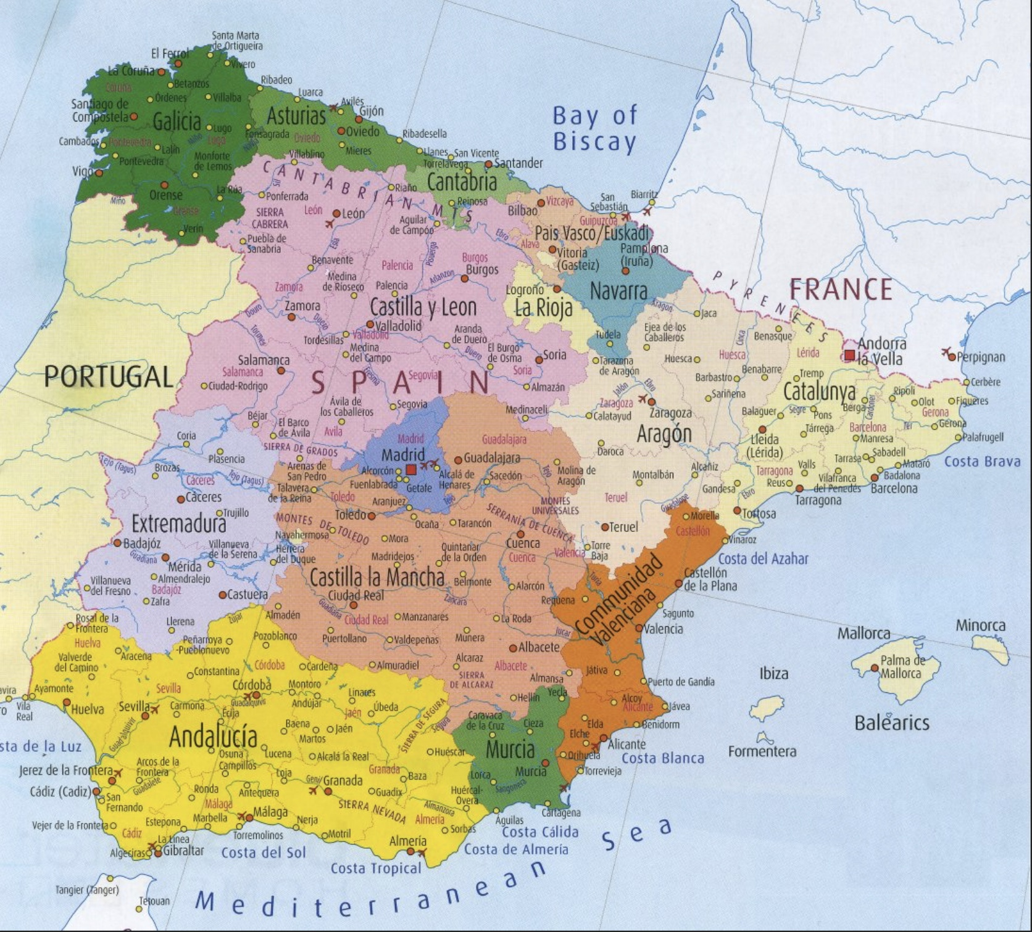

Slide 9
The church that meets in Valencia
1 Peter 2:11 Beloved, I urge you as aliens and strangers to abstain from fleshly lusts which wage war against the soul. 12 Keep your behavior excellent among the Gentiles, so that in the thing in which they slander you as evildoers, they may because of your good deeds, as they observe them, glorify God in the day of visitation.

Slide 10
The church that meets in Barcelona
Philippians 1:15 Some, to be sure, are preaching Christ even from envy and strife, but some also from good will; 16 the latter do it out of love, knowing that I am appointed for the defense of the gospel; 17 the former proclaim Christ out of selfish ambition rather than from pure motives, thinking to cause me distress in my imprisonment. 18 What then? Only that in every way, whether in pretense or in truth, Christ is proclaimed; and in this I rejoice.

Slide 11
The church that meets in Badalona
1 Corinthians 12:12 For even as the body is one and yet has many members, and all the members of the body, though they are many, are one body, so also is Christ. 13 For by one Spirit we were all baptized into one body, whether Jews or Greeks, whether slaves or free, and we were all made to drink of one Spirit. 14 For the body is not one member, but many.

Slide 12
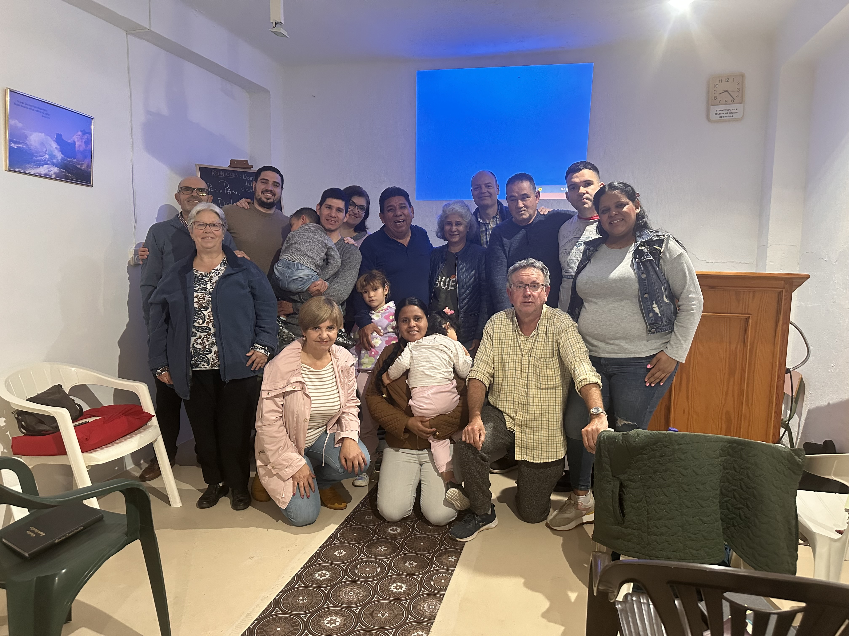
The church that meets in Dos Hermanas/Sevilla
Ephesians 4:14 As a result, we are no longer to be children, tossed here and there by waves and carried about by every wind of doctrine, by the trickery of men, by craftiness in deceitful scheming; 15 but speaking the truth in love, we are to grow up in all aspects into Him who is the head, even Christ,.

Slide 13
The church that meets in Madrid
1 Peter 2:4 And coming to Him as to a living stone which has been rejected by men, but is choice and precious in the sight of God, 5 you also, as living stones, are being built up as a spiritual house for a holy priesthood, to offer up spiritual sacrifices acceptable to God through Jesus Christ.

Slide 14
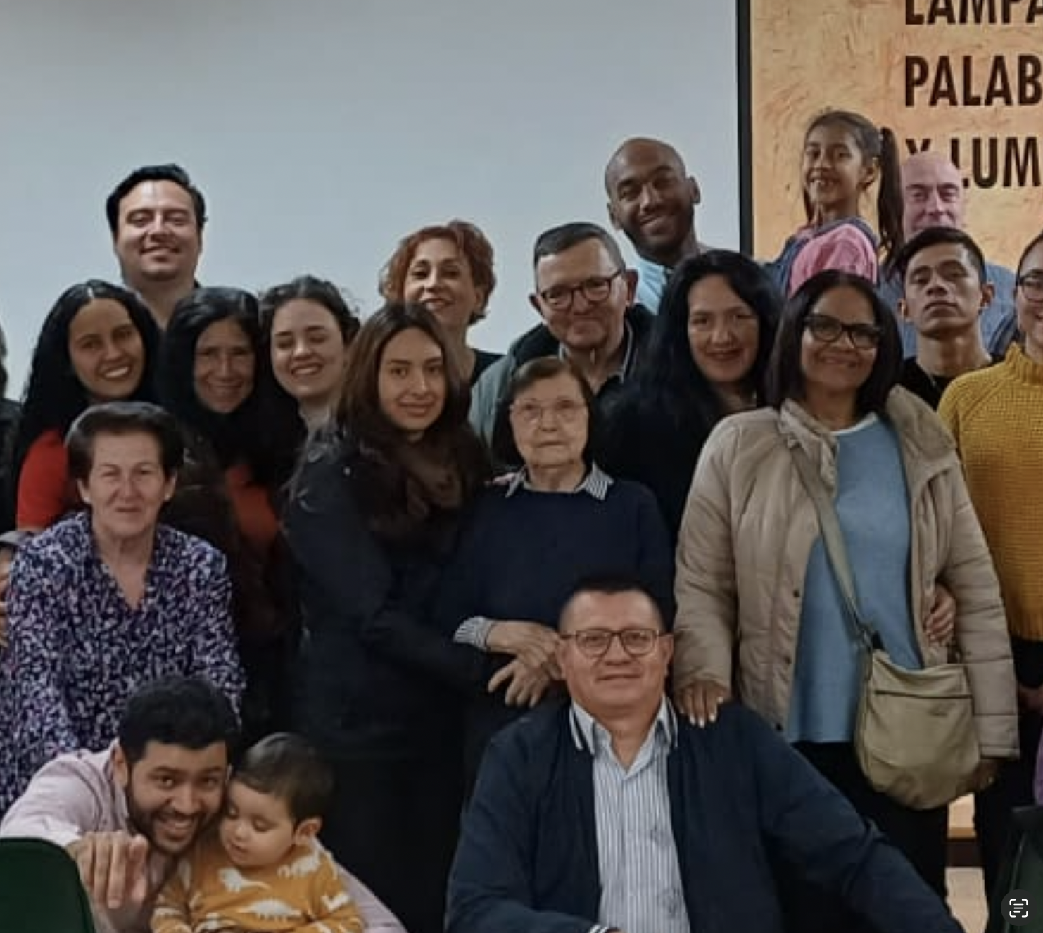
“Here we have no city”

Slide 15
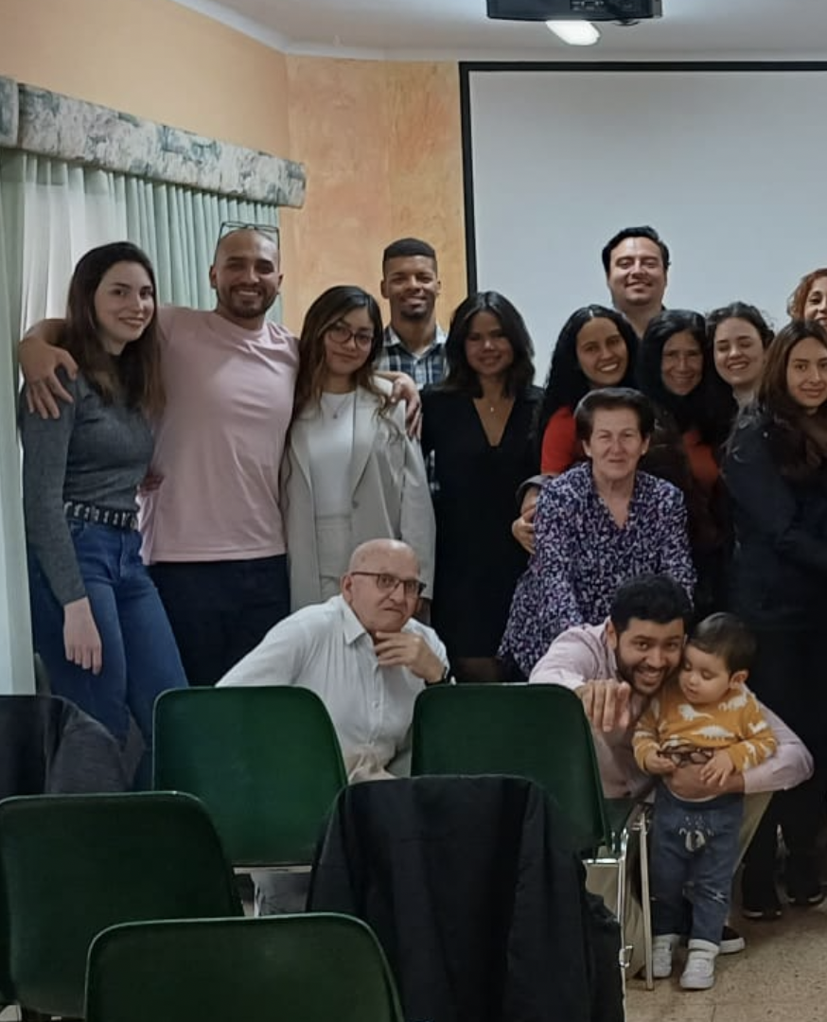
“Proclaiming His excellencies”

Slide 16
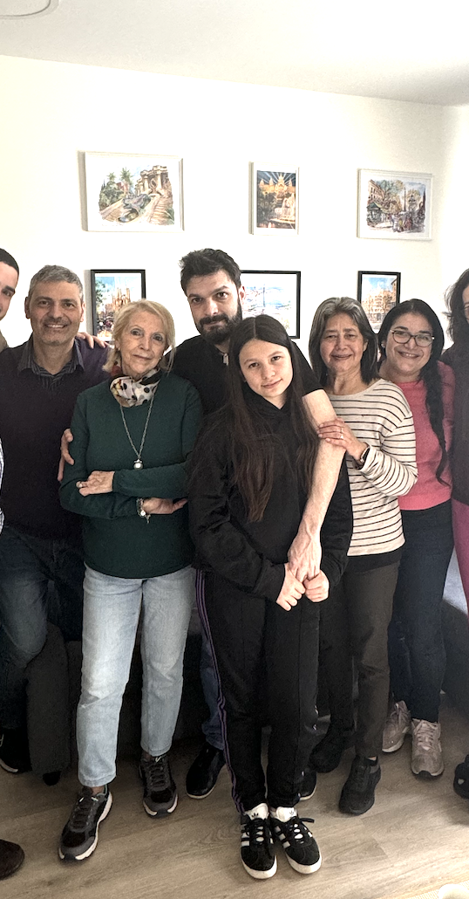
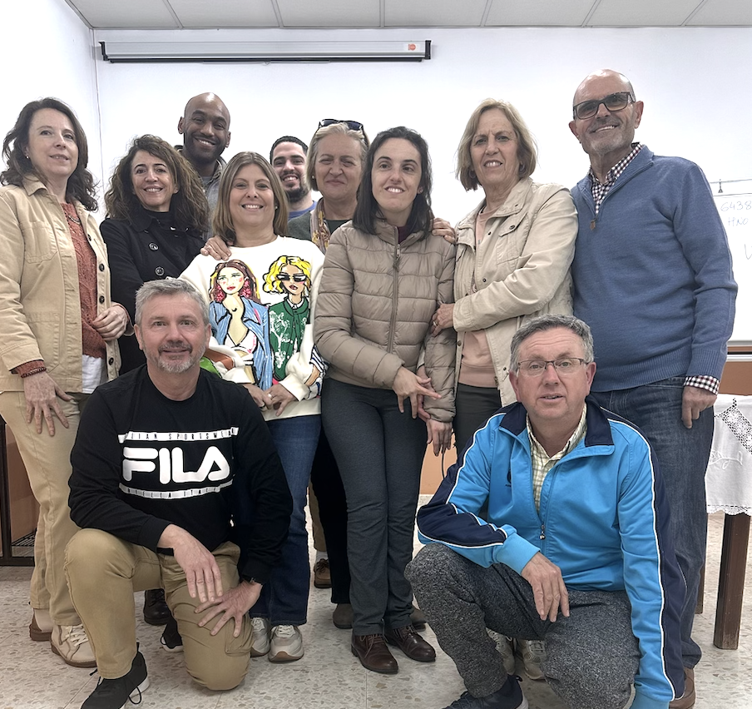
“Cling to what is good”

Slide 17
How you’ve helped with the work in Spain
Prayed for them
Allowed for me to go
You’ve given an example
You’ve taught them

Slide 18
Romans 10:14 How then will they call on Him in whom they have not believed? How will they believe in Him whom they have not heard? And how will they hear without a preacher? 15 How will they preach unless they are sent? Just as it is written, “How beautiful are the feet of those who bring good news of good things!”

Slide 19
1 Peter 2:21 For you were called to this, because Christ also suffered for you, leaving you an example, so that you should follow in His steps. 22 He did not commit sin, and no deceit was found in His mouth; 23 when He was reviled, He did not revile in return; when He was suffering, He did not threaten but entrusted Himself to the One who judges justly.
Who are you on your worst days?

